Slide 1
Window Installation:
Pan Flashing and Air-Sealing to Prevent Water Intrusion
Educational Overview
Revised August 31, 2018

Slide 3
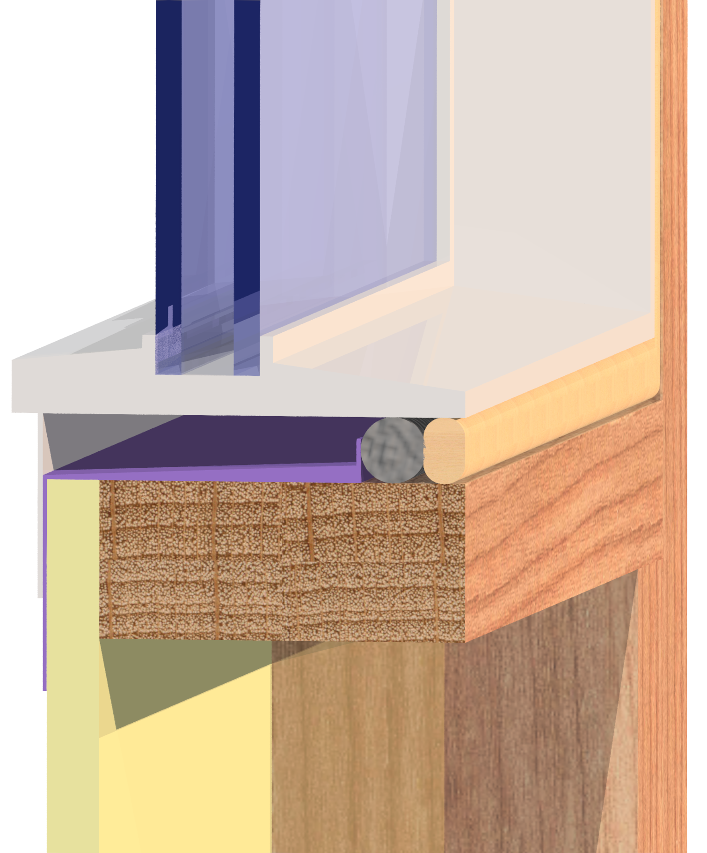
Introduction
This presentation addresses two practices with proven ability to improve water penetration resistance of fenestration product installation (windows and doors) :
  Sill pans and flashing for rough opening drainage
  Air-sealing of the interior side of the rough opening gap

Slide 4
Introduction
These practices are important for all window types, installations, and water-resistive barrier (WRB) materials and methods.
Why?
  Windows leak!
  Also, prevention of bulk water intrusion (wetting potential) is more important and effective than reliance on uncertain drying potential of a wall assembly (which can only delay, not prevent, eventual water damage or mold growth).
Window water leakage will cause damage to wood framing regardless of differences in drying potential

Slide 5
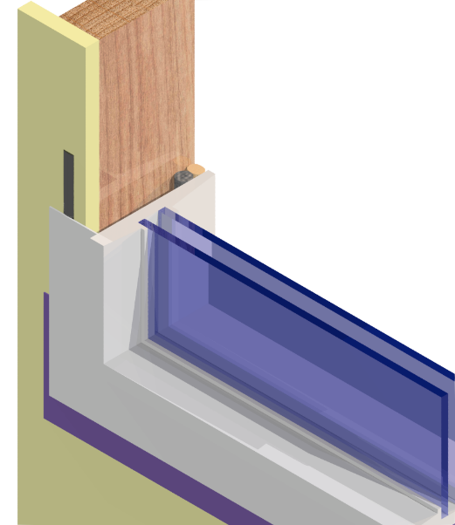

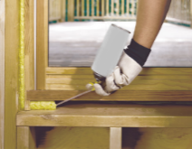
Basic Requirements
Window installation details for any wall assembly must address multiple objectives to perform well:
Clearances and shimming
to support the weight of the fenestration unit, ensure window operation, and allow for expansion and contraction
Air-sealing
of the rough-opening gap between the fenestration frame and wall frame
Structural support and anchorage
for the window to resist wind loads
Prevention of water intrusion
at the window-wall interface by proper flashing and integration with the WRB

Slide 6
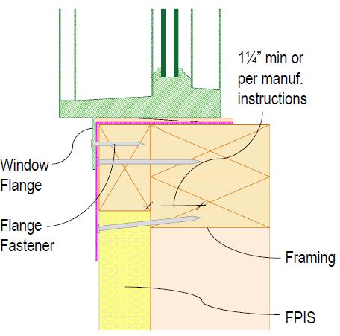
Basic Requirements
Alternative installations, special conditions, or those conditions not addressed in window manufacturer installation instructions must rely on approved details as permitted in Section 104.11 of the IRC or IBC to achieve the above intent.

Slide 7
Importance of Sill Pans
Sill pans are not required by code, but are important for multiple reasons:
  Fenestration ratings and standards do not account for all water leakage paths
  Inadvertent water intrusion may occur even with careful installation practices
  Severe weather events may exceed the fenestration rating requirements
  Durability of the fenestration unit and exterior wall coverings may degrade over time
  Water that does inadvertently penetrate a fenestration product or interface tends to collect underneath the window sill.
Wind and Rain
Sill pans help rain water drain to the exterior

Slide 8


Importance of Air Sealing
Air sealing of window installations is required by the energy code, and also improves resistance to wind-driven rain water intrusion
  By air-sealing the interior side of the rough opening gap, the wind pressure across the exterior window-wall interface is reduced (i.e., pressure equalized)
  This helps prevent wind pressure-driven water intrusion and improves the ability for any water collected in a properly installed sill pan to drain outward.
ΔP
Flange
Sealant
Backer rod

Slide 9
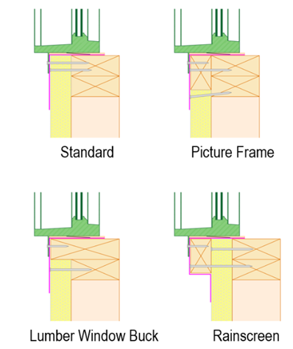
Applicability to Installation Variations
Several common methods of window detailing are shown at right and described in the Window Installation Guides
Regardless of method, effective drainage at the sill is a critical part of window performance

Slide 10
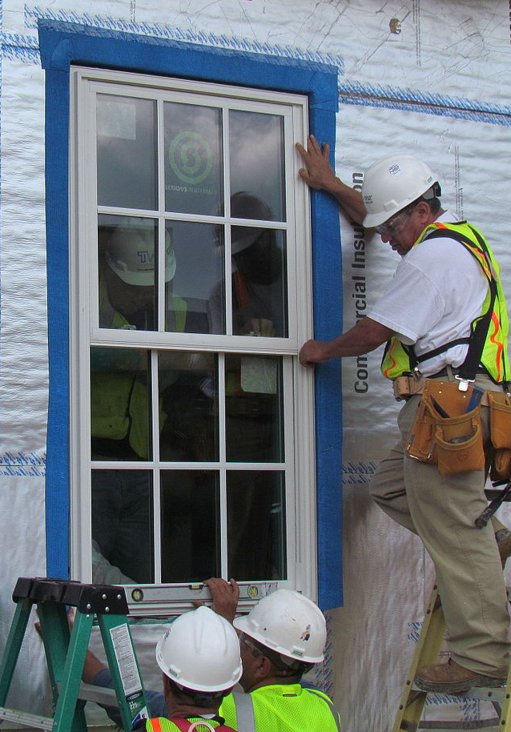
Water leakage study
An extensive study of installed windows from 113 laboratory and 127 field tests was conducted and relevant codes, standards, and window product types also assessed.

Slide 11
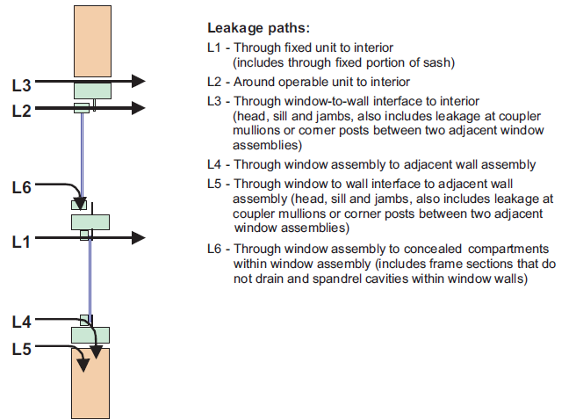
Water leakage study
Research identified 6 possible water leakage paths through windows and interfaces
Paths L4 and L5 were considered to be “high risk” in relation to consequences of damage to susceptible and concealed wall materials

Slide 12
Water leakage study
Far fewer failures observed in lab testing than field testing
For lab tests, leakage paths L3 and L5 through interfaces are excluded and path L4 through the window unit is not always checked (same for window qualification and rating standards such as AAMA A440 referenced by US and Canadian building codes)

Slide 13
Water leakage study
About 20% of field-tested window installations leaked through the window-wall interface
More than 50% of window units field tested experienced water intrusion through one or more leakage paths through the window unit itself (about 15% of the cases included leakage directly through the window sill frame).

Slide 14
Water leakage study
The study found that window standards, testing, and practices do not adequately address:
  installed performance,
  durability of water resistance,
  climate/exposure conditions in relation to specification and test criteria,
  guidance for many common construction materials & methods in current use, and
  on-going quality control in fabrication/manufacture and field installation (for example there appears to be no requirement in window manufacturing or standards for periodic water resistance testing during production).
CONCLUSION: Providing a subsill drainage path was considered more effective than attempting to achieve better quality in window manufacturing and installation

Slide 15
Water leakage study
Based on the prior findings, over 25 variations of wall-window interface details were tested to determine the most effective methods for managing rainwater infiltration
Head
Jambs
Sill

Slide 16
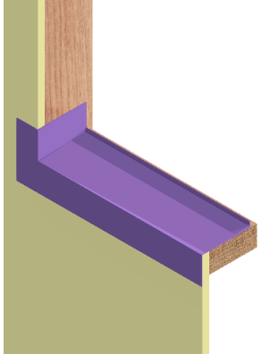
Installation Details & Components
Sill flashing membrane wrapping up the jambs and over the sheathing WRB or membrane WRB at the sill
Proper lapping of flashing layers and the WRB
Small (1/16”-1/8”) drainage gap behind the window flange
Backer rod
Insulation/sealant to the interior side of the sill leaving the drainage path unobstructed.
2
5
4
1
3

Slide 17
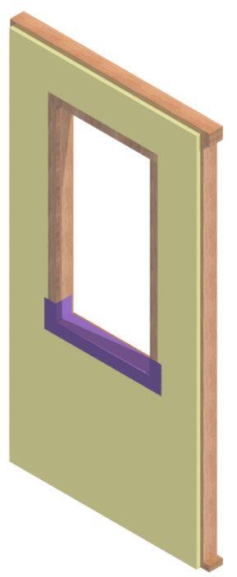
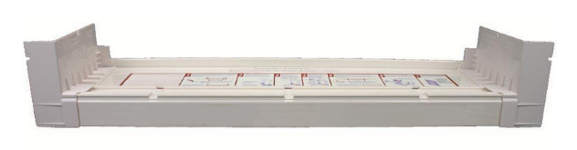
Recommendations
Pan flashing (sill drainage) should be provided in all except “no exposure” conditions (e.g., not exposed to wind-driven rain)
The sloped sill pan, while preferred, may only be necessary in moderate to high exposures

Slide 18
Suggested Resources
Window Installation - ContinuousInsulation.org
“Water Penetration Resistance of Windows – Study of Manufacturing, Building Design, Installation, and Maintenance Factors”, RDH Building Engineering Limited, Vancouver, BC, Canada (study sponsored by Canada Mortgage and Housing Corporation, Homeowner Protection Office, and British Columbia Housing Management Commission) (http://rdh.com/wp-content/uploads/2014/07/Water-Penetration-Resistance-of-Windows-Study.pdf), December 31, 2002.
“Results of Assessing the Effectiveness of Wall-Window Interface Details to Manage Rainwater”, 11th Canadian Conference on Building Science and Technology, 2007 (http://www.nbec.net/documents/RESULTSONASSESSINGTHEEFFECTIVENESSOFWALL-WINDOWINTERFACEDETAILSTOMANAGERAINWATER-M.A.LACASSE.pdf)

Slide 19
Suggested Resources
“Window Sill Details for Effective Drainage of Water”, 2011 (http://www.nrc-cnrc.gc.ca/ctu-sc/ctu_sc_n76)
“Window Installation Details for Effective Sealing Practice”, 2013 (http://www.nrc-cnrc.gc.ca/ctu-sc/ctu_sc_n80)
“Water Penetration Resistance of Windows – Study of Manufacturing, Building Design, Installation and Maintenance Factors”, CMHC-SCHL Canada, Research Highlight Technical Series 03-124, November 2003 (https://www.cmhc-schl.gc.ca/odpub/pdf/63367.pdf)
“Water Penetration Resistance of Windows – Study of Codes, Standards, Testing and Certification”, CHMC-SCHL Canada, Research Highlights Technical Series 03-125 (https://www.cmhc-schl.gc.ca/publications/en/rh-pr/tech/03-125-e.htm)

