Slide 1
Thermal Bridging in Building Thermal Envelope Assemblies:
Repetitive Metal Penetrations
Educational Overview
Revised August 31, 2018

Slide 3
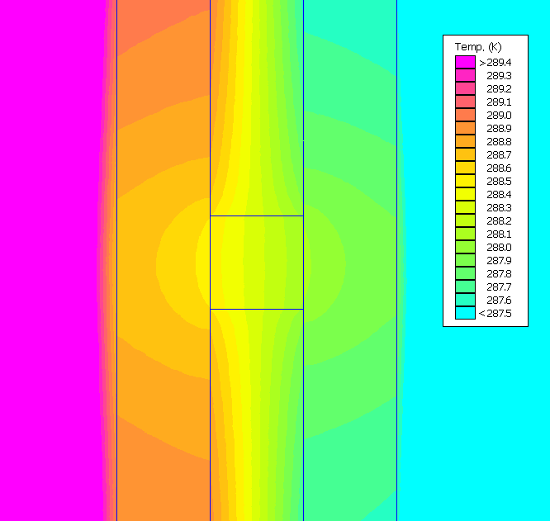
Introduction
Thermal bridging is caused by highly conductive elements that penetrate thermal insulation and/or misaligned planes of thermal insulation.
These paths allow heat flow to bypass the insulating layer, and reduce the effectiveness of the insulation and the overall building thermal envelope.
Thermal bridging can significantly impact :
  Whole building energy use
  Condensation risk
  Occupant comfort

Slide 4
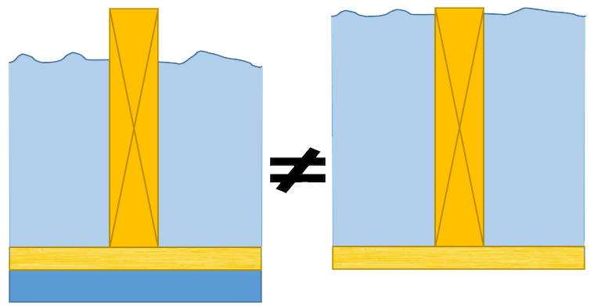
Introduction
However, simply adding more insulation to a building envelope to offset the impact of thermal bridges can lead to inefficient or impractical solutions.
  Detailing and location of insulation are crucial to minimizing heat flow and eliminating thermal bridges
Thus, it is important to consider practical ways to account for and mitigate (minimize) thermal bridging effects.

Slide 5
Overview
This presentation covers:
  Overview of various types of thermal bridges and their impacts
    “Big” thermal bridges and resources to mitigate them
  Repetitive metal penetrations for cladding and component attachments
    While generally “small” (e.g. metal fasteners, connectors, ties), their cumulative effect can be large

Slide 6
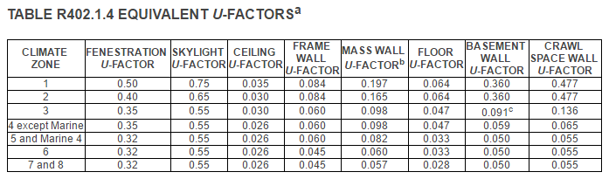
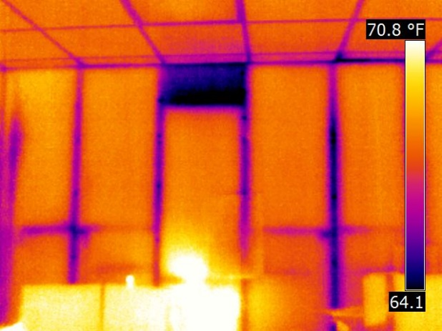

Three Categories of Thermal Bridges & Code Compliance Implications
Thermal bridging within assemblies (e.g., repetitive framing members) are generally accounted for in testing or calculation of nominal U-factors for an envelope assembly for energy code compliance purposes.
Metal wall framing

Slide 7
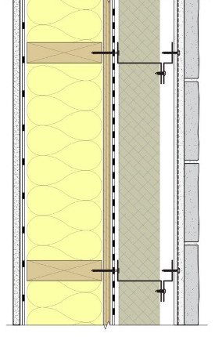
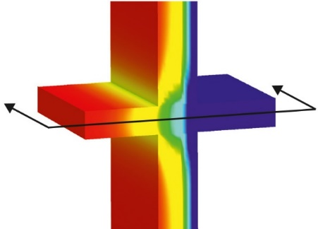

Three Categories of Thermal Bridges & Code Compliance Implications
Thermal bridging that occurs at the interface of assemblies or envelope components is generally not accounted for and is often ignored for code compliance.
  These are known as “linear thermal bridges”
  The impact on thermal performance of a building can be very large
Concrete slab penetrating wall
Metal Z-girts that extend through insulation layer

Slide 8
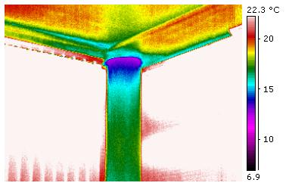

Three Categories of Thermal Bridges & Code Compliance Implications
Thermal bridging that occurs at “points” within an assembly (e.g., many small cladding connections, a beam or pipe penetration, etc) may or may not be fully accounted for in testing or calculation of U-factors.
  These are known as “point thermal bridges”
  The thermal performance impacts are often non-negligible.
Steel column going through roof

Slide 9
Important Factors
The magnitude of impact of thermal bridging depends on a number of factors:
  The type of structural material (wood, steel, concrete, masonry)
  The details used to interface or interconnect assemblies or make component attachments to the structure.
  The location of insulation materials on or within the assembly
  The thermal characteristics of elements penetrating insulation layers and the continuity of the heat flow path

Slide 10
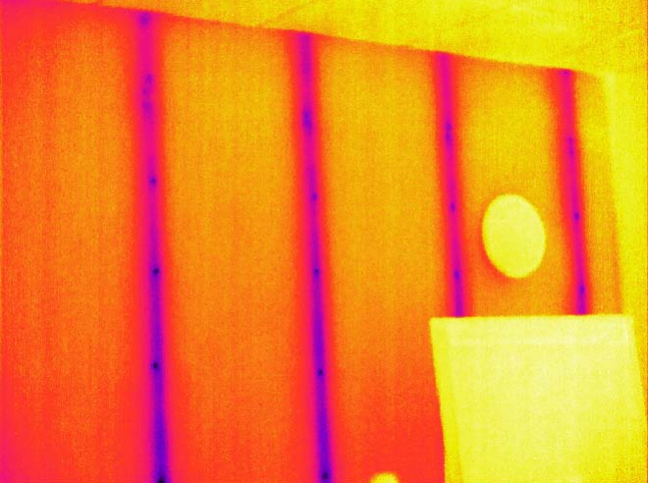
Important Factors
The impact of thermal bridges is often disproportionate to the actual area of the thermal bridge itself relative to the overall assembly area.
  A “small” thermal bridge does not necessarily mean it has a “small” impact (particularly in a cumulative sense for multiple thermal bridges)

Slide 11
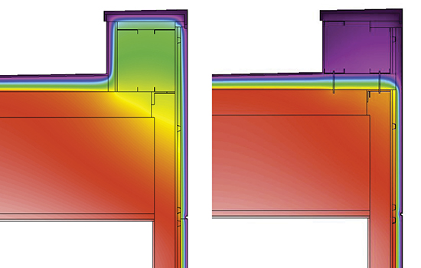
Impacts of the “Big” Thermal Bridges
“Big” thermal bridges may include:
  Uninsulated floor slab edges or projecting balconies
  Window perimeter interfaces with walls
  Steel shelf angles continuous penetrating exterior insulation
  Parapet-wall-roof intersections
  Interior-to-exterior wall intersections
Source: payette.com

Slide 12
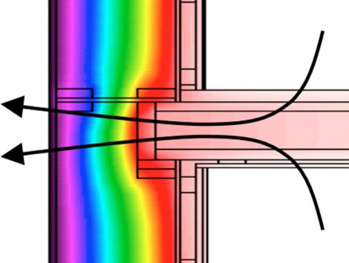
Impacts of the “Big” Thermal Bridges
These “big” thermal bridges can in total contribute 20-70% of actual heat flow through building envelopes!
  Yet, they are often ignored in practice and are not addressed in current US energy codes and standards

Slide 13
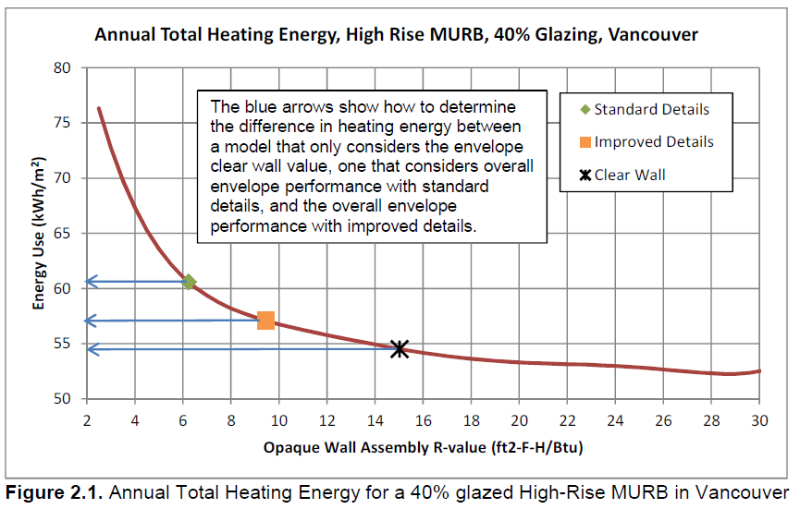
Thermal Bridge Mitigation vs. Increasing Insulation
Increasing insulation levels can face diminishing returns, particularly where thermal bridging is ignored.
  Improved detailing can save energy without increasing the amount of insulation.
Good practice must consider appropriate means to reduce thermal bridging AND use appropriate insulation for optimal efficiency and code compliance.
Source: Building Envelope Thermal Bridging Guide
https://www.bchydro.com/powersmart/business/programs/new-construction.html#thermal

Slide 14
Example of a “Big” Thermal Bridge
Locating insulation only within or to the interior side of exterior bearing walls in multi-story construction results in a thermal bridge (floor slab penetration) at each story level.
This thermal bridge extends around the entire building and is worsened when there are cantilevered balconies by projections of the floor slab.

Slide 15
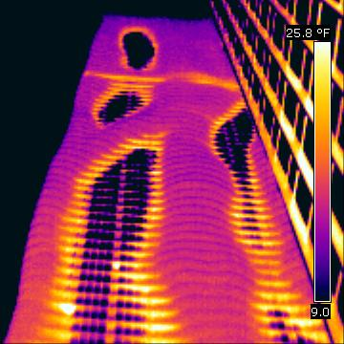
Example of a “Big” Thermal Bridge
Increasing insulation thickness on the interior side of such construction will do little to improve performance of the envelope.
However, placing at least some amount of the insulation continuously on the exterior side of the walls will serve to mitigate the slab edge thermal bridging .
Aqua Tower floor slab thermal bridges
Source: Wikipedia.org

Slide 16
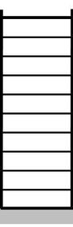
Interior Insulation on Mass Buildings is NOT Continuous
A slab edge thermal bridge can cause a 71% increase in the assembly U-factor (0.120 Btu/hr-ft²-F)
  The slab edge linear thermal bridge contributes 0.050 Btu/hr-ft²-F.
  For a mass wall in a mixed climate, the nominal U-factor for the assembly is approximately 0.070 Btu/hr-ft²-F
Placing continuous insulation on the exterior (and extending across the slab edge) can reduce or eliminate this impact.
Insulation on Interior Side Slab Edge Thermal Bridges
Continuous insulation on Exterior Side
All Slab Edges Insulated

Slide 17
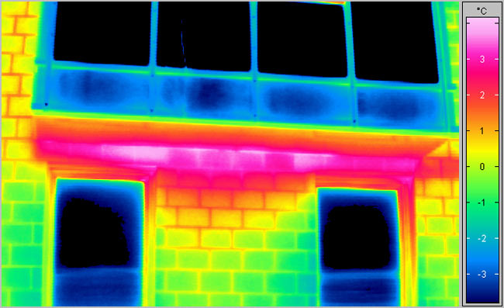
Resources to Mitigate “Big” Thermal Bridges
International codes have already initiated provisions to require consideration of thermal bridging
U.S. model energy codes and standards, such as ASHRAE 90.1, are planning to similarly address thermal bridging in the near future.
For additional information, detailing examples, and design guidance, refer to:
  Building Envelope Thermal Bridging Guide
  Thermal Bridging Solutions: Minimizing Structural Steel’s Impact
Example of a Linear Thermal Bridge (uninsulated exposed slab edge)

Slide 18
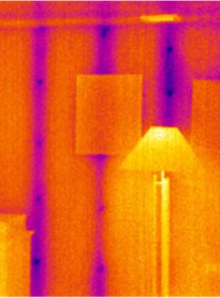
PART 2: Repetitive Metal Penetrations (point thermal bridges)
Solutions for point thermal bridging caused by repetitive metal penetrations have seen less progress
  Examples include fasteners and connectors used for cladding, gypsum board, and exterior sheathing attachments to the structure.
Repetitive metal penetrations may increase nominal U-factors (based on no fasteners) and heat flow through assemblies by as little as 1% or as much as 44% in typical wood, steel, or concrete/masonry assemblies.
  The variation depends on structural material type, fastening schedule, insulation placement, and other factors
Point thermal bridges in gypsum
Source: ecohome.net

Slide 19
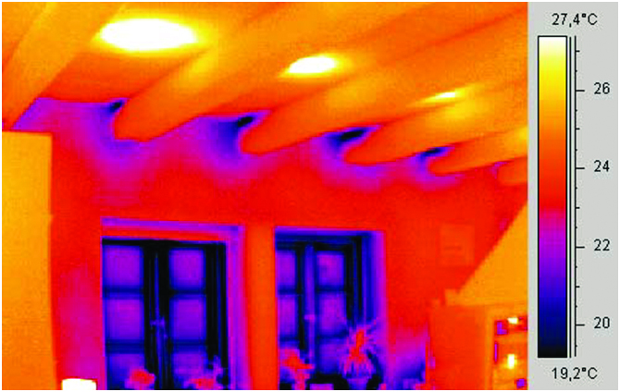
PART 2: Repetitive Metal Penetrations (point thermal bridges)
For other less frequent but larger point thermal bridges, (beams, columns, pipes, etc) refer to design guides:
  Building Envelope Thermal Bridging Guide
  Thermal Bridging Solutions: Minimizing Structural Steel’s Impact
Beam thermal bridges
Source: coolingindia.in

Slide 20
Repetitive Metal Penetrations (point thermal bridges)
In the image at right, the linear thermal bridges caused by framing members are accounted for in assembly U-factors, however, point thermal bridges caused by fasteners are not

Slide 21
Repetitive Metal Penetrations (point thermal bridges)
Point thermal bridges should be appropriately quantified in order to account for their impact on nominal assembly U-factors
  In some cases, sheathing and/or drywall fasteners may be accounted for in nominal assembly U-factors
  In most cases, cladding fasteners or brick ties and other similar connections are not.
  For mass concrete/masonry walls the impact of metal clips are nominally accounted for in Appendix A of ASHRAE 90.1
The important thing is to verify what is actually included in nominal U-factors for assemblies

Slide 22
ABTG Research Report
The following research report is the basis for the remainder of this presentation:
  Repetitive Metal Penetrations in Building Thermal Envelope Assemblies, ABTG RR No. 1510-03
  http://www.appliedbuildingtech.com/rr/1510-03
The research report includes:
  Extensive literature review and data assessment
  Cataloguing of data regarding point thermal bridges caused by fasteners, ties, and similar elements
  Data for assemblies with and without exterior continuous insulation.
  Data for wood, steel, and concrete/masonry assemblies

Slide 23
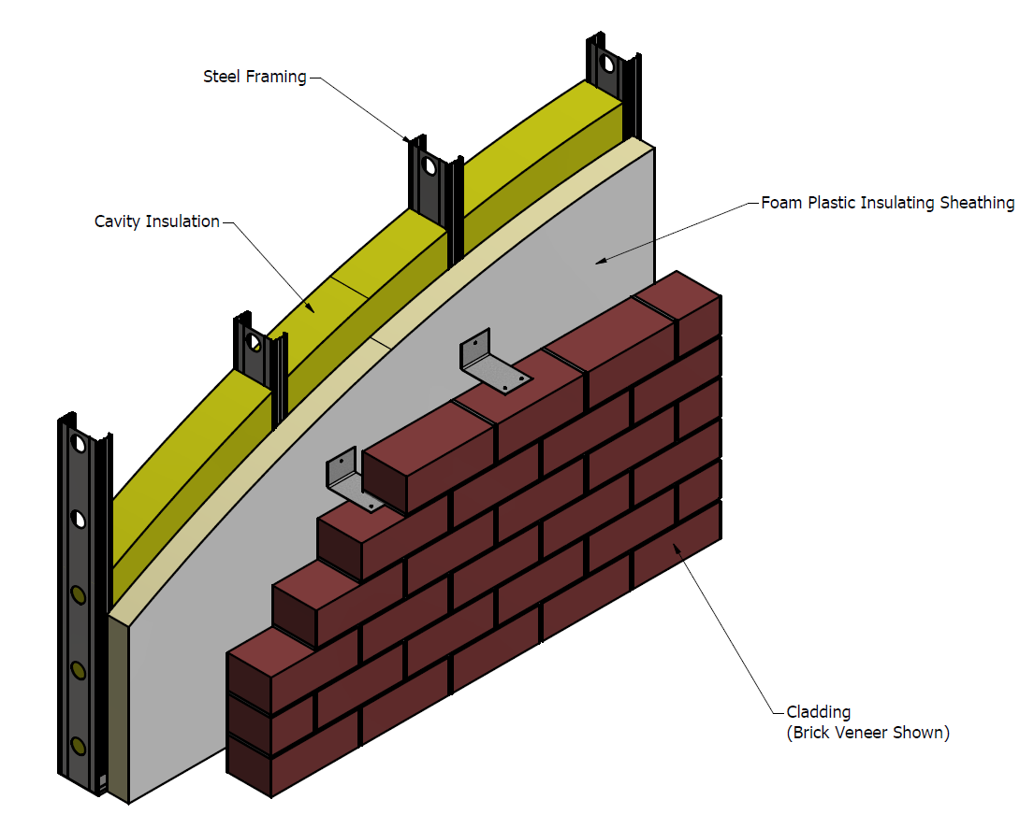
Scope of ABTG Research Report
The point thermal bridges assessed are associated with the following conditions:
  Above-deck roof insulation fastened to a metal or wood roof deck.
  Sheathing or cladding fastened through exterior continuous insulation and brick ties for anchored masonry veneer attachments.
  Non-insulating sheathing materials (e.g., wood structural panels or gypsum board) penetrated by metal fasteners for sheathing attachment.

Slide 24
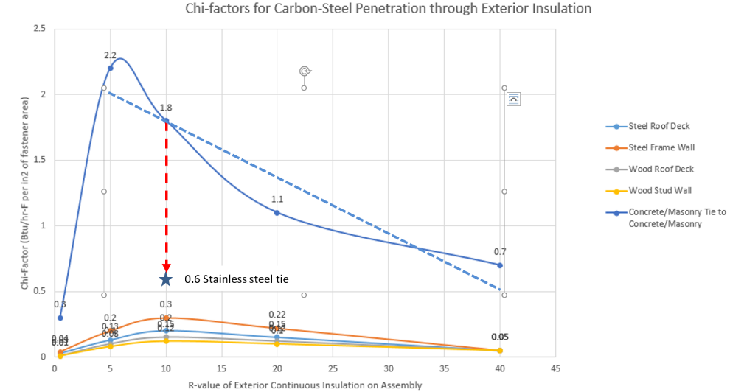
Major Findings
Impacts of thermal bridging vary widely due to differences in detailing, insulation placement, and materials used.
Reported Chi-factors (point thermal transmittance values – similar to U-factor) follow predictable trends (see graph).
Charted data only roughly characterizes reported Chi-factors due to variations in methods of analysis, detailing differences, etc.
For similar metal penetration conditions, impact is different for wood, steel, and concrete/masonry substrates.
Chi-factor magnitude depends on fastener material (i.e., carbon steel vs. stainless steel).

Slide 25
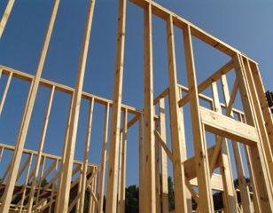
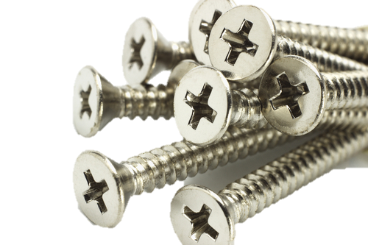
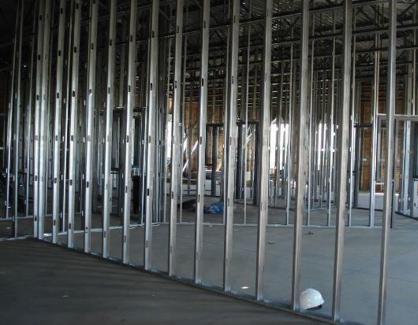
Major Findings
Stainless steel fasteners appear to have a much greater beneficial effect (reduced Chi-factor) for concrete/masonry and steel substrates than for wood.
Why?
  Stainless steel has a 3x lower thermal conductivity than carbon steel.
  Wood framing disrupts the heat flow path better than steel or concrete/masonry.
  Thus, the impact of reducing the thermal conductivity of the fastener material is less significant (but not always negligible).

Slide 26
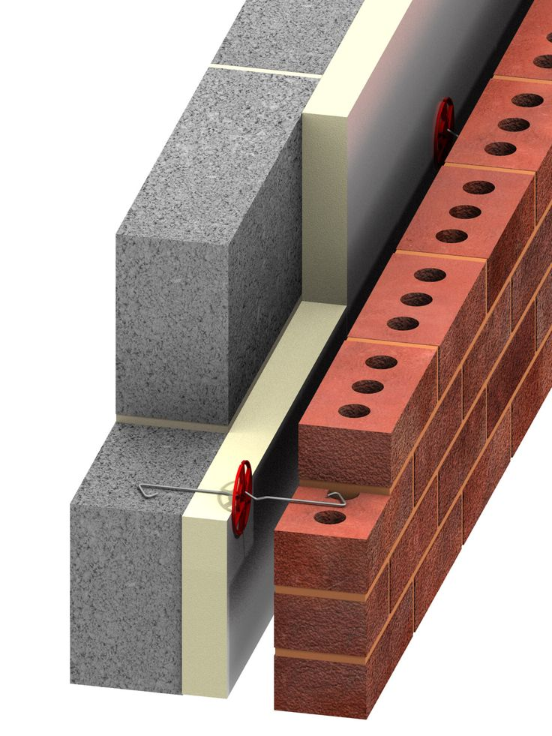
Major Findings
Connection details or devices that disrupt the thermal pathway have a significant impact (35-40% reduction in Chi-factor)
  Example: Brick tie with hinge/joint between the veneer and substrate.
Fastening roof membranes/insulation to wood instead of steel roof decking reduced the fastener Chi-factor approx. 40%.

Slide 27
Major Findings
Metal penetration point thermal bridging occurs on walls with or without exterior continuous insulation (ci).
  Chi-factors for fasteners that penetrate ci, however, are generally larger (see leftmost portion of chart shown previously)
  Both conditions need to be considered to ensure equitable treatment of thermal impacts for different methods of insulating various assembly types.

Slide 28
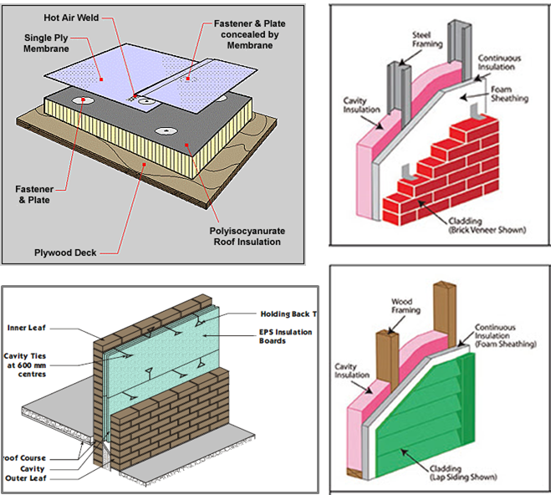
Findings for Specific Assemblies
Assemblies representative of the 2018 IECC and ASHRAE 90.1 (clockwise from top left)
  Mechanically attached above-deck CI roof system
  Steel frame wall assembly
  Wood frame wall assembly
  Mass wall assembly with a CI layer sandwiched between mass layers

Slide 29
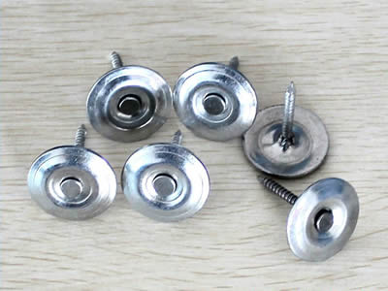
Mechanically fastened above-deck roof insulation and membrane
The impact of mechanical fastening on the U-factor is about 2-3% increase for carbon steel fasteners with metal cap washers (less for stainless steel)
  This assumes a typical fastening schedule for mechanically attached insulation layers and roof membrane.

Slide 30
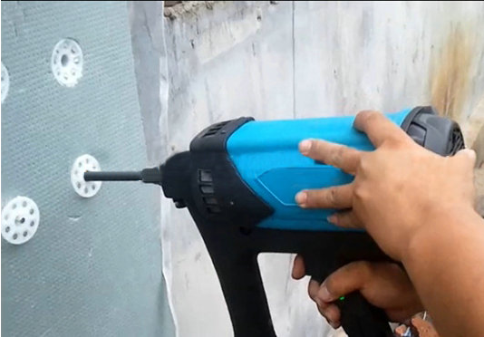
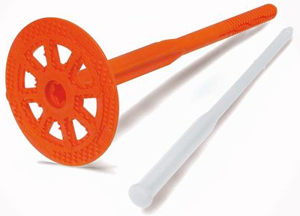
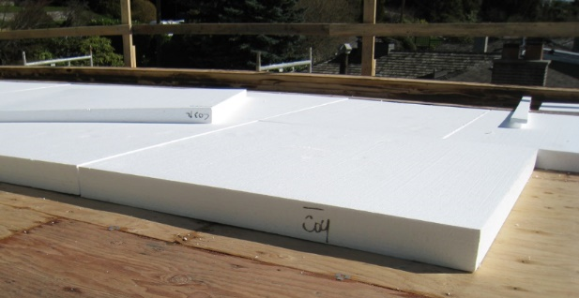
Mechanically fastened above-deck roof insulation and membrane
SOLUTIONS:
  Use of recessed plastic insulation fasteners to fasten above-deck roof insulation may reduce thermal bridging impact by as much as 30%.
  Attachment to a wood roof deck instead of metal deck would have a similar magnitude of benefit in mitigating thermal bridging through fasteners.
  The above mitigating actions should not be considered as cumulative.
Above deck roof insulation installation
Source: greenbuildingadvisor.com

Slide 31
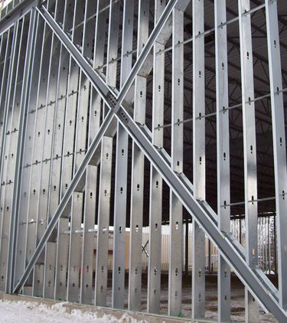
Cold-formed Steel Frame Walls
The impact on the U-factor varies with the amount of CI because fasteners are point thermal bridges, while steel studs are linear thermal bridges accounted for in the cavity insulation correction factor.
Chi-factors are greater for steel frame than wood frame walls because metal creates a more significant and continuous thermal bridge (framing and fastener)
For typical cladding and sheathing fastening with CI ranging from R-3.8ci to R-17.5ci, the assembly overall U-factor is increased by 7-18%,
  If the cladding fastening does not penetrate ci, the impact is only 2%

Slide 32
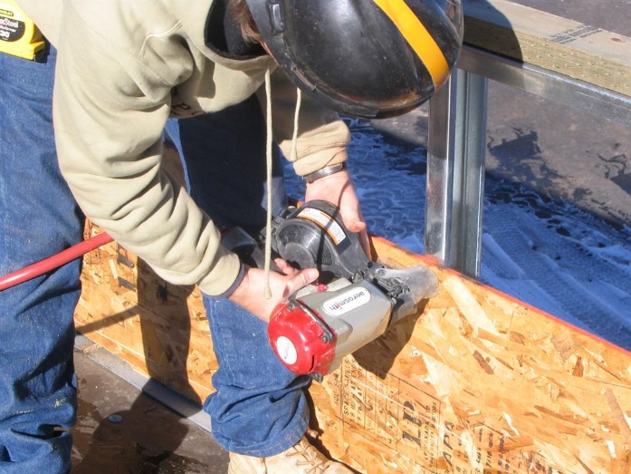
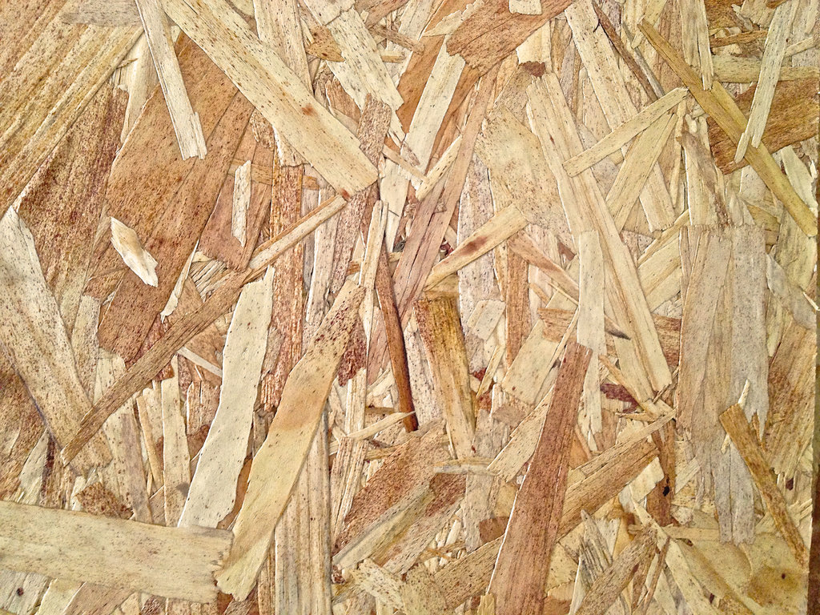

Cold-formed Steel Frame Walls
SOLUTIONS:
  Significant reduction in chi-factor achieved through use of stainless steel fasteners.
  Use of wood or other low-conductivity material as a fastener base (rather than placing fasteners directly into the highly conductive steel framing members) could reduce the fastener Chi-factor by up to 40%.

Slide 33
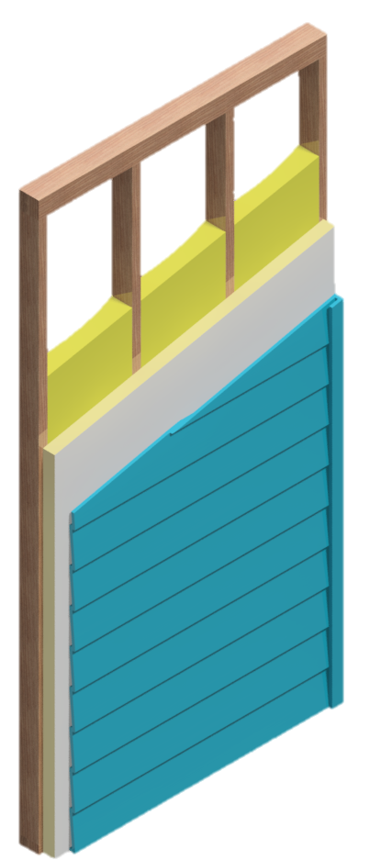
Wood Frame Wall Assemblies
Assemblies with exterior CI ranging from R-3.8 to R-15.6 experience an increase in nominal U-factor of about 3-7%, less than half the impact experienced for similar steel frame wall assemblies.
Assemblies without exterior CI experience an increase in nominal U-factor of about 1%.
Although this impact is small in magnitude, it is significant considering that an assembly with exterior CI of R-5 experiences a 3% increase in overall U-factor.
Ignoring a 1% difference and accounting for a 3% difference can create inequities for assemblies that are on the competitive edge of energy code compliance

Slide 34
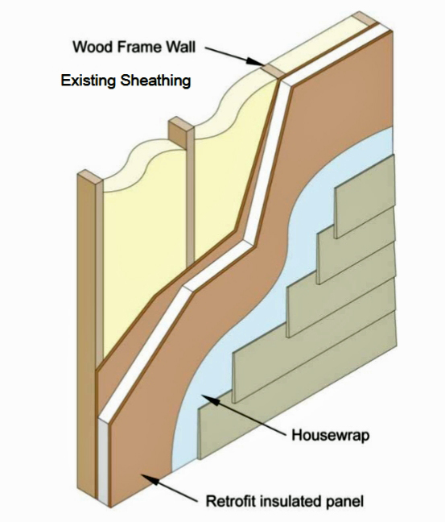
Wood Frame Wall Assemblies
SOLUTIONS:
  While impacts are small for wood framing, minimizing connection points through ci can provide a small thermal performance improvement.
  Placing ci over heavily fastened shear wall panels will help to mitigate the additional heat flow through the structural shear panel fastenings.
Insulation over wood sheathing
Source: greenbuildingadvisor.com

Slide 35
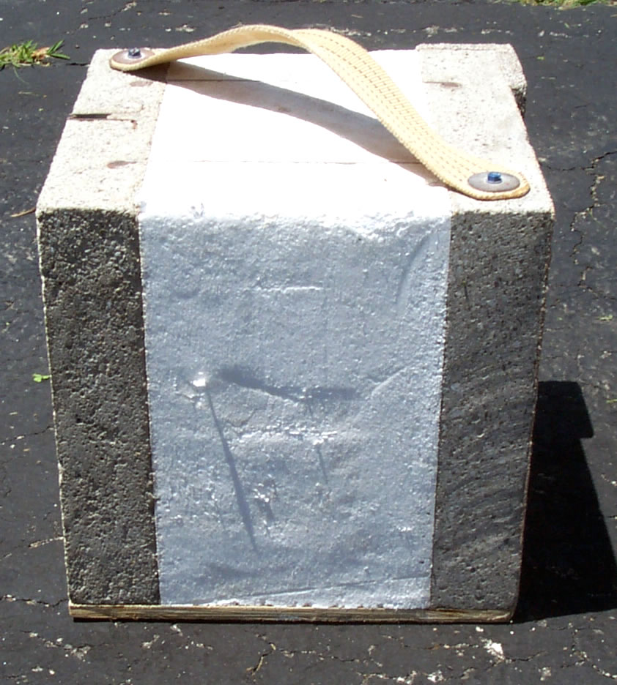
Mass Wall (concrete/masonry) Assemblies
Mass wall assembly with a CI layer between mass layers (e.g., brick cavity wall, concrete sandwich panels, etc.):
  For mass walls with exterior CI ranging from R-5.7 to R-25, the relative increase in U-factor ranges from 28% to 44% when carbon steel metal ties are used.
Insulated concrete wall assembly
Source: solarcrete.com

Slide 36
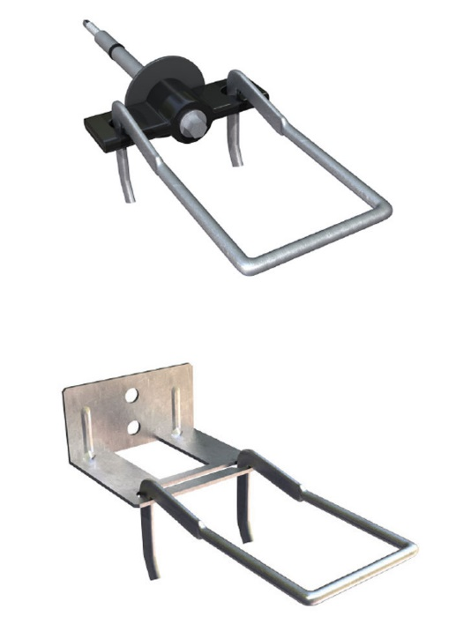
Mass Wall (concrete/masonry) Assemblies
SOLUTIONS:
  The use of stainless steel ties (or other less conductive tie designs) may provide significant thermal bridging mitigation benefits, and in this scenario would reduce the U-factor impact to a lesser increase of 9-15%
  Minimizing the number of ties
  Using ties that are thermally broken or of low thermal conductivity material (e.g., carbon fiber, etc.)
  Placing most of the insulation toward the exterior side of mass walls increases thermal mass benefits and minimizes the “big” thermal bridges addressed earlier.
Thermally optimized screw tie (top)
Double eye and pintle plate tie. (bottom)
Source: masonrysystemsguide.com

Slide 37
Conclusions - Linear Thermal Bridges.
Multiple methods of mitigating the “big” thermal bridges are available to the designer, for example:
  Use of exterior continuous insulation
  Use of offset steel shelf angles at slab edges to allow exterior insulation to pass behind with only point thermal bridges to support the shelf angle.
  Many other solutions for a variety of details

Slide 38
Conclusions - Point Thermal Bridges
Multiple methods of mitigating point thermal bridging (e.g., repetitive metal penetrations) are available to the designer, for example:
  Stainless steel instead of carbon steel connectors
  Plastic washers instead of steel washers
  Use of wood or other less-thermally-conductive substrates/structure
  Specialty fasteners or connectors or detailing that create a thermal break
These methods may vary in relative effectiveness depending on various factors

Slide 39
Suggested Resources
Prevent Thermal Bridging - ContinuousInsulation.org

