Slide 1
Termite Protection: Building Code Provisions & Recommended Improvements
Educational Overview
Revised August 31, 2018

Slide 3
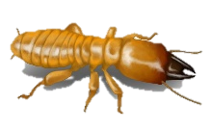
Introduction
Termites cause serious damage in the United States – around $2.5 billion yearly, or about one-third of the damage toll of wind events including hurricanes and tornadoes.
Based on a 3% infestation rate, the repair cost of a termite infestation averages about $700 per housing unit.
≈$700

Slide 4
Introduction
Home insurance typically does not protect against termite damage.
While various types of “warranties” are offered by termite treatment companies, they may vary widely in content, value, and requirements.
Thus, especially in termite-prone regions, it is a good idea for homeowners to think about the termite resistance of their homes.

Slide 5
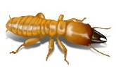
Introduction
How does foam sheathing on home foundations or above-grade walls perform with respect to termite protection?
So far, there has been insufficient scientific data to properly compare termite resistance in houses with foam sheathing with houses using other building materials.

Slide 6
Introduction
Concerns have been brought up based on a variety of anecdotal observations:
Foam sheathing in foundation wall creates a “hidden pathway” (not visible to termite inspectors)
Foam sheathing products may somehow attract termites
However, good science can alleviate these concerns and lead to better termite protection practices in all construction.

Slide 7
Introduction
Fact:
Foam plastics are not a food source for termites.
Therefore, foam sheathing itself does not attract termites, although they are able to burrow through it to find food sources

Slide 8
Introduction
Fact:
Hidden pathways for termite access exist in nearly all types of construction.
Despite this, current building codes do not require termite shields or any other methods of disrupting hidden pathways

Slide 9
Introduction
Because building codes do not require termite shields, chemical soil treatment may be the only line of defense.
Periodic re-treatment is necessary to maintain protection, however because re-treatment is not required by code, it often only occurs after termites have caused obvious damage.

Slide 10
Introduction
This Educational Program will summarize the available information on termite protection and suggest key general improvements to building code provisions, especially in the ‘very heavy’ termite risk zone
Termite Infestation Probability Map
[IRC Figure R301.2]
(emphasis added)

Slide 11
Building Code Provisions – IRC 2018
The 2018 IRC includes provisions for termite protection, but there are some points of weakness in the code.

Slide 12
Building Code Provisions – IRC 2018
One area to note is that the IRC permits, but does not require, the use of multiple methods of termite protection in conjunction.
In practice, this means that termite shields are seldom used in new home construction, because most newly constructed homes receive chemical treatment.
However, in high termite hazard zones, using multiple methods may be appropriate as a minimum practice.

Slide 13
Building Code Provisions – IRC 2018
Another area to note is that Section R318.4 does not require protection of foam plastics, it just limits the location of their use and requires that they be located at least 6” above grade.
The intent is to prevent the creation of a “hidden pathway” for termite infestation, but because hidden pathways exist in nearly all types of construction, these provisions do not adequately address the concern.

Slide 14
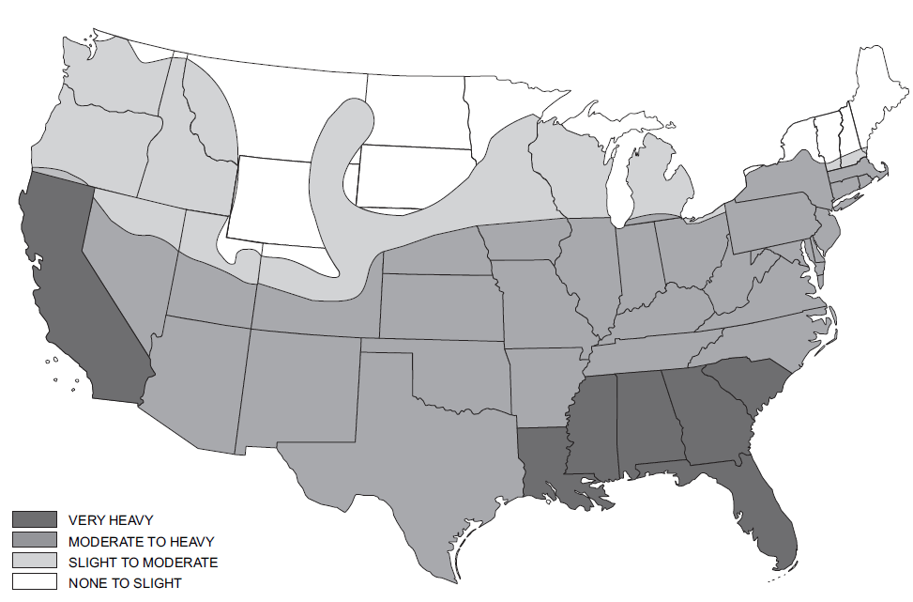
Building Code Provisions – IRC 2018
A third point is that the code gives responsibility to the local jurisdiction to determine the need for termite protection – yet lacks definitive guidelines for assessing risk objectively.
The IRC map may serve as a guide, however termite ecology depends on site characteristics in addition to general climate trends.

Slide 15
Building Code Provisions – 1958 FHA
Despite being decades old, the 1958 FHA Minimum Property Standard (MPS) was actually much more systematic and thorough in addressing the issue of termites.
The MPS covers:
The use of termiticides and termite shields
Moisture protection of wood structural materials
Semi-annual termite inspection requirements
Specific instructions for determining the need for termite protection

Slide 16
Building Code Provisions – 1958 FHA
Unlike the IRC, the MPS:
Included detailed illustrations for application of termite shields and integration with use of foundation insulation
Was based on sound science, namely a 1950’s National Academy of Sciences (NAS) study which included the expertise of a broad variety of experts, the results of which remain relevant today
Although the NAS study did not recommend combinations of measures in even the most severe termite hazard regions, there was some apparent dissention on this matter among the NAS study participants.

Slide 17
Termite Hazard and Protective Measures
The MPS provisions required termite protections as follows:
Region 1 (“very heavy”) – in all types of foundation construction.
Region 2 (“moderate-heavy”) – same as Region 1 “except in local areas of this region (i.e., the arid Southwest) where termites are known not to be a problem…”
In other words, Region 2 was considered hazardous like Region 1 unless local data suggested otherwise.
This concept has reversed in many recent model codes – where termite protection is unnecessary, unless deemed necessary by local jurisdiction.

Slide 18
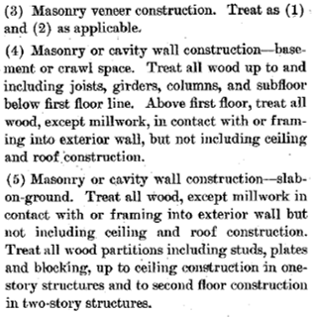
Termite Hazard and Protective Measures
Modern building codes also appear to have relaxed requirements
For example, the MPS required the lower story of the building or through the first floor framing to use treated lumber.
The 2018 IRC doesn’t specify to what extent treated wood must be used in the structure for termite protection purposes.
Thus, one could simply use a treated sill plate as required by decay resistance provisions

Slide 19
Termite Hazard and Protective Measures
The map follows broad ecological trends, showing lower termite hazard as climates become cooler and dryer.
However, local variation is significant.

Slide 20
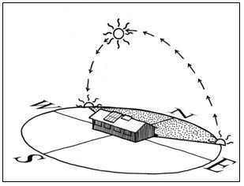
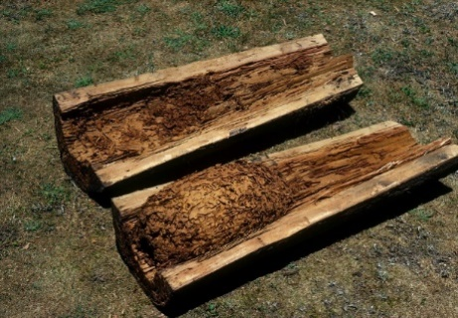
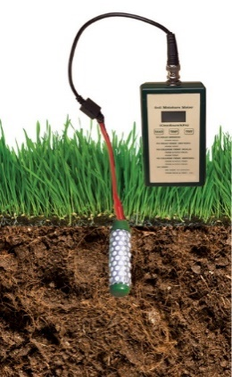
Termite Hazard and Protective Measures
Research done in Colorado, a state spanning three termite hazard zones, has shown that termite hazard is dependent on local or site microclimatic conditions, including:
Availability of food sources
Soil moisture conditions (e.g., low lying verses higher well-drained soil)
Solar exposure (e.g., north vs. south facing slope).

Slide 21
Termite Hazard and Protective Measures
Recent research conducted by Cookson and Trajstman shows:
Relying on visual inspection (with or without foam sheathing) was only 33% effective
Chemical treatment was 96% effective
These findings suggest that foam sheathing has little impact on the ability of termites to escape visual detection, and that both protective chemical soil treatment and protective physical barriers such as termite shields are called for.
Current codes in the U.S. require, at most, only one protection measure in any region, or none at all if determined by the local jurisdiction, which appears inconsistent with the research.

Slide 22
Ubiquity of Hidden Pathways for Termite Access
The following slides describe several types of assemblies with hidden pathways that are currently allowed by the model codes.
Conventional block foundations
Termites gain access to food sources (wood) via cracks in mortar joints and voids in block interiors or cores.
This foundation type demonstrates that hidden pathways exist with block foundations.
Durability by Design

Slide 23
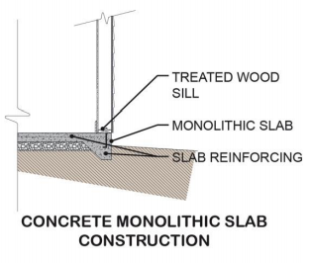
Ubiquity of Hidden Pathways for Termite Access
Conventional monolithic concrete slab on grade and independent stem wall with a slab on grade foundation
When concrete develops cracks, termites enter to seek food sources within the building.
Independent stem wall and slab foundation have an intentional “crack” or construction joint between the slab and stem wall that is frequently concealed under finishes, providing a hidden pathway for termite access.
Durability by Design

Slide 24
Ubiquity of Hidden Pathways for Termite Access
Permanent wood foundations
Hidden pathways are created by plastic water-proofing films required in these foundations.
Additionally, these foundations often include exterior “skirt boards” (usually treated plywood) extending from just below grade to the bottom of above grade walls to protect the plastic film.

Slide 25
Ubiquity of Hidden Pathways for Termite Access
Brick veneer extending below grade
Creates a hidden pathway behind the brick veneer for termite access.
Adhered veneers backed by a drainage mat material can also create a hidden pathway.
Flashing materials at weeps could serve as a termite shield if properly specified and installed.
Durability by Design

Slide 26
Ubiquity of Hidden Pathways for Termite Access
The FHA’s required “Subterranean Termite Soil Treatment Builder’s Guarantee” (Form NPCA-99a) includes the statement at right.
This statement misrepresents termite infestation risk factors in two ways:
First, one might believe that foam sheathing has a greater effect on infestation risk simply by being mentioned first.
Second, the list fails to recognize the ubiquity of hidden pathways in all foundations.
“Factors which may lead to infestation from wood destroying insects include: (bullets and emphasis added)
Foam insulation at the foundation
Earth-wood contact
Faulty grade
Firewood against structure
Insufficient ventilation
Moisture
Wood debris in crawlspace
Wood mulch
Tree branches touching structures
Landscape timbers
Wood rot
Should these or other such conditions exist, corrective measures should be taken by the owner in order to reduce the chances of infestations by wood destroying insects, and the need for treatment.”

Slide 27
Ubiquity of Hidden Pathways for Termite Access
In some cases, concern over foam has led to refusals to warrant homes with foam insulation on the exterior of foundations as though hidden pathways don’t exist otherwise
This can be particularly troubling at the point of sale of a home for which the NPCA-99a form is intended to apply for VA or FHA financed home construction.
In Situ Architecture

Slide 28
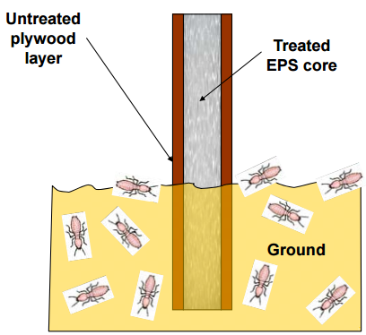
Termites, Carpenter Ants and Foam Plastic Materials
Field test data shows only minor damage in both treated foam vs. untreated foam in field studies done in a “very heavy” termite probability condition.
Conversely, untreated wood becomes severely damaged and consumed in a short time period.
LANXESS

Slide 29
Termites, Carpenter Ants and Foam Plastic Materials
To keep buildings safe, regardless of the construction materials used, it is important to make conditions unfavorable to termites and carpenter ants.
First, the following protective measures are useful:
Termite shields
Chemical soil treatment around and underneath foundations, along with periodic inspection and retreatment
Treated wood and foam plastic (in severe conditions)
Heron Cay Executive Home

Slide 30
Termites, Carpenter Ants and Foam Plastic Materials
Second, keeping assemblies dry not only prevents decay, but also repels termites and ants.
Weatherproofing measures are important, including:
Flashing
Water-resistive barrier,
Siding installation,
Roof overhangs, Grading and surface drainage,
Guttering and downspout discharge away from the foundation
Water vapor diffusion control measures, such as proper use of vapor retarders and/or exterior insulation, are also important.
ORNL

Slide 31
Conclusions & Recommendations
Keep the current termite infestation probability map
The map is still relevant and need not be updated
Because termite hazard can vary significantly at specific sites within a region, providing default regional guidance is important
Local jurisdictions can still relax requirements given substantiating data and experience

Slide 32
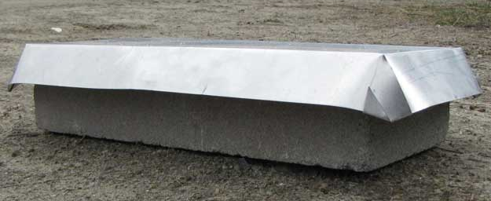
Conclusions & Recommendations
In ‘very heavy’ or ‘moderate-to-heavy’ regions, use multiple methods of termite protection
For example, initial chemical soil treatment plus use of termite shields.
Even if chemical soil treatment is not maintained, termite shields will deter access and assist in early detection.
Universal use of termite shields in high risk regions would also help resolve concerns with hidden pathways in a manner that is product-neutral and consistent

Slide 33
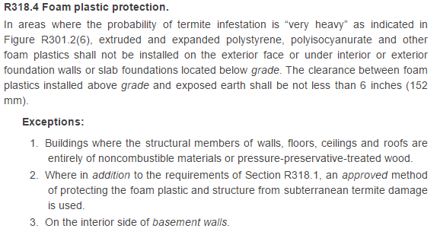
Conclusions & Recommendations
Maintain existing requirements in U.S. model codes regarding an approved method of protecting foam plastics in ‘very heavy’ termite regions on foundation walls and below slabs on grade.
It is recommended that the method in Section R318.4 of the 2018 IRC become the primary method, not an exception, and that it continue to be used in combination with one or more of methods in Section R318.1.

Slide 34
Conclusions & Recommendations
It is strongly recommended that the reference to foam plastic insulation as an implied risk for termite infestation be removed from FHA Form No. NPCA-99a
Instead, the form should indicate various types of hidden pathways that can increase the potential for undetected termite infestation and provide guidance on how to protect against termite infestation

Slide 35
Suggested Resources
Residential Foundations - ContinuousInsulation.org

