Slide 1
If Walls Could Talk...
Jay Crandell, Applied Building Technology Group (ABTG)/ARES Consulting
Amy Schmidt, DuPont
Presented at the 2020 RESNET Building Performance Conference
Notes:
Introductions

Slide 3
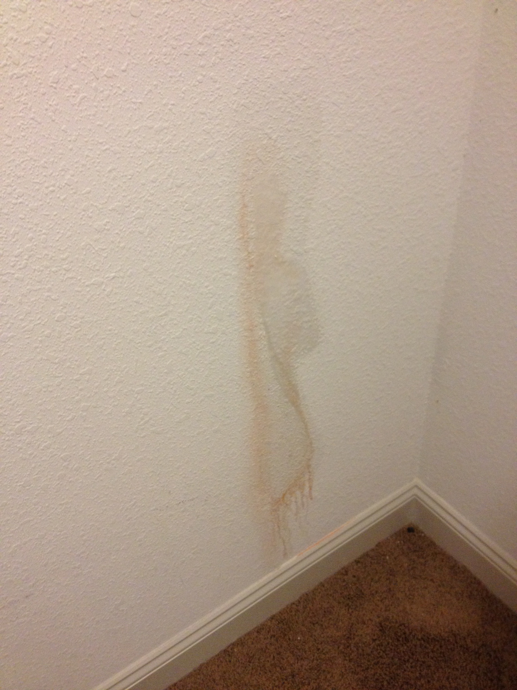
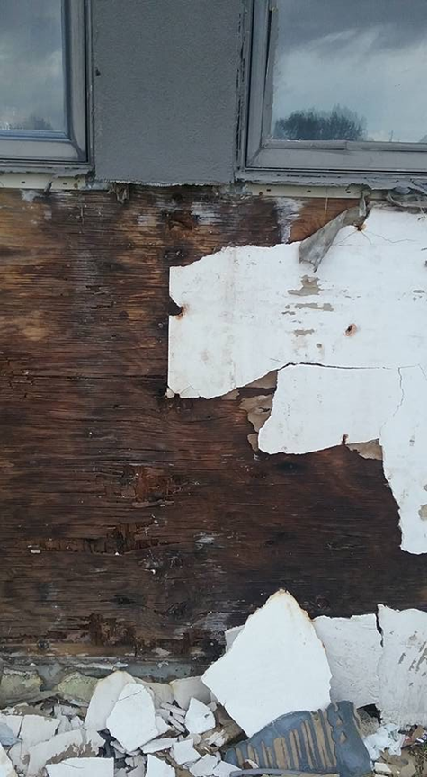
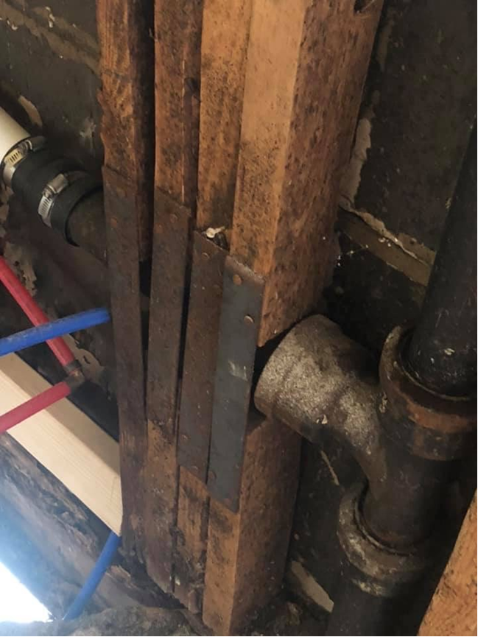
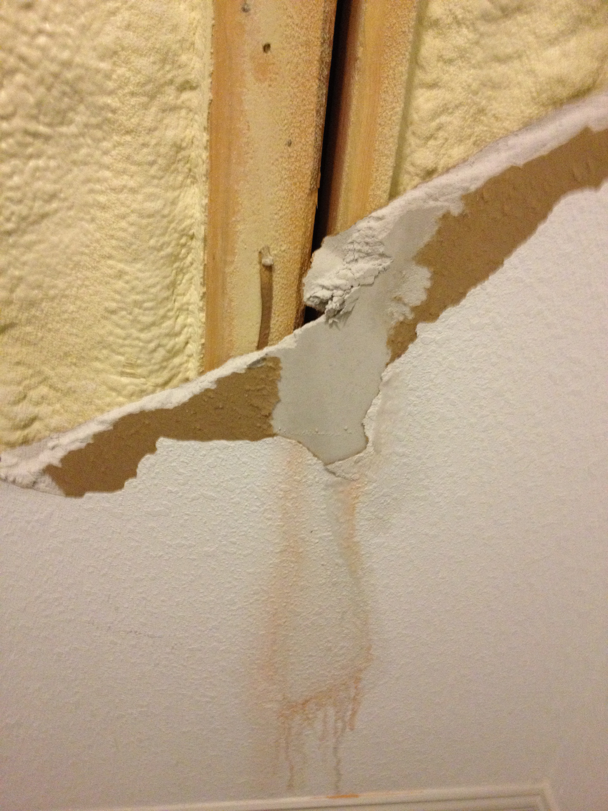
Notes:
Amy

Slide 4
If Walls Could Talk, What Might We Learn?
There is building science baked into the code that provides correct guidance for the construction of opaque walls. Unfortunately . . .
Sometimes important “ingredients” or inter-related provisions are ignored or misapplied.
The code includes exceptions and trade-offs (i.e., allowing substitute ingredients) that can lead to unintended consequences
We will identify problematic provisions and provide examples of the unintended consequences
We will identify 2021 IECC solutions to some of the problematic exceptions in the current code
We will provide recommendations for avoiding the other unintended consequences
Notes:
Amy

Slide 5
The “Recipe” and “Main Ingredients” of a Wall
Structure, Safety and Durability ~1/3 Cup
These are the foundational ingredients
Thermal and moisture control ingredients must be correctly added to maximize value and protect the structure and occupants
Recipe varies by climate/hazard condition
Thermal Performance ~1/3 Cup
Continuous Insulation
Cavity Insulation & Framing Factor (thermal bridging)
Amount of each insulation component
Moisture Control ~1/3 Cup
Water-resistive barrier (WRB)
Air barrier (AB) – also important for thermal performance
Vapor retarders (VR)
Proportion of Cavity and Ci insulation matters
Notes:
Amy

Slide 6
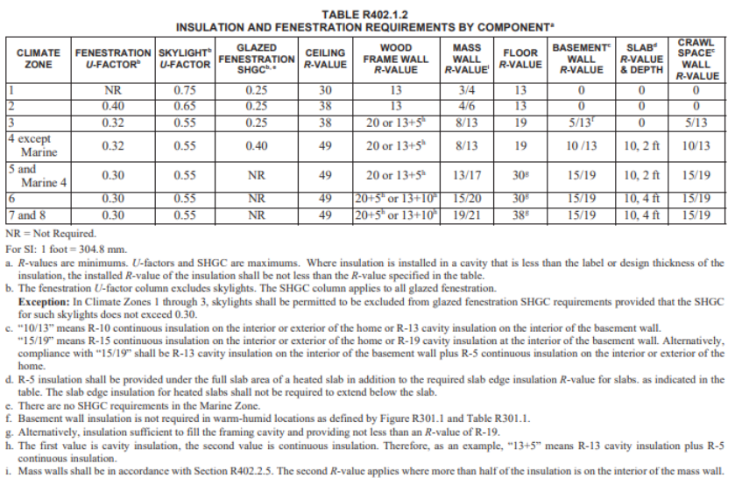
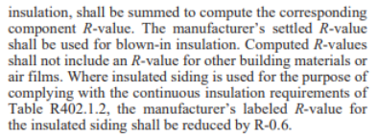
Potential for Incorrect R-value Compliance
The Issues:
The performance characteristics of continuous insulation and cavity insulation are not well understood
The definitions of cavity insulation and continuous insulation are not well understood
The “+” is misinterpreted
Users want an easy button for a cavity only solution
Example: R20+5≠R25
Notes:
Amy

Slide 7
DEFINITIONS: Cavity and Continuous Insulation (2021 IECC)
CONTINUOUS INSULATION (ci): Insulating material that is continuous across all structural members without thermal bridges other than fasteners and service openings. It is installed on the interior or exterior, or is integral to any opaque surface, of the building envelope.
CAVITY INSULATION: Insulating material located between framing members.
Notes:
Amy

Slide 8
R-value computation clarified in 2021 IECC
2021 IECC revised as follows (CE60-19 Part II):
Notes:
Amy

Slide 9
R-value “+” and “/” symbols clarified in 2021 IECC (RE28-19)
The “+” was always a symbol meaning “AND”, not addition. Thus, “&” is now used for insulation strategies requiring cavity and continuous insulation.
The “/” was always as symbol meaning “OR”, not division.
The “ci” designation added to clarify cavity vs. continuous insulation components
Notes:
Amy

Slide 10
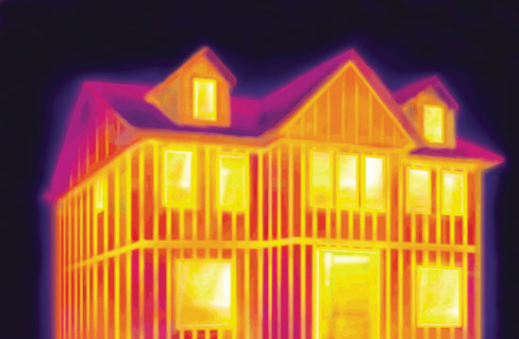
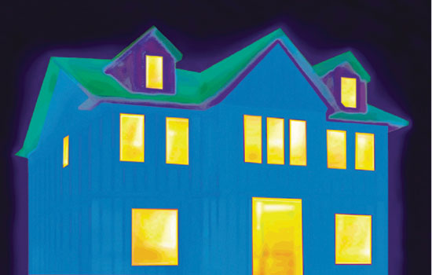
Why is this important?...(example)
Wall Construction & Insulation Strategy: | 2x6@16”oc Wood Frame Wall
 | “R25” (cavity only) | “R20+5” (cavity & ci)
Total Nominal R-value of Insulation: | R25 | R25
U-factor | 0.0573 | 0.0464
Effective R-value | 17.5 | 21.6
They do not perform the same because simple R-value summation does not include the framing factor impact to cavity insulation. Must do proper energy code math (parallel path analysis).
Refer to wall calculator for thermal and moisture check: https://www.continuousinsulation.org/wood-wall-calculator
R20+5 ≠ R25
Notes:
Amy

Slide 11
Weakening Footnote
The Issue:
Footnote g, allows R19 in lieu of R30 or R38
There is no requirement to make up the energy losses through improved performance in other areas of the envelope
Results in 39% reduction of the R30 requirement and 50% reduction of the R38 requirement
Notes:
Amy

Slide 12
There’s a better way…
2021 IECC deletes footnote ‘g’ allowing minimum R19 floor insulation (RE52-19)
The provision is obsolete as new construction materials and methods rarely, if ever, use 2x6 or 2x8 floor construction (IRC joist tables limit span to 10’ to 12’ for 2x6 and 2x8 No. 1 grade lumber at 16”oc).
Where needed for existing construction, IECC Chapter 5, Section R503.1.1 allows for simply filling a floor, wall, or ceiling cavity with insulation when the cavity is exposed during an alteration.
For new construction, the U-factor and Total UA alternative (e.g., REScheck) provide a means for compliance without reducing the floor or overall building envelope performance.
Notes:
Jay

Slide 13
Examples of a better way…
Consider a rare case where a 2x6 floor is used for an average 2-story home in Climate Zone 5, or
A small 2-story addition to an existing home to match existing floor depth and crawlspace depth or basement clearance.
NOTE: In the two solutions, the addition of R-10ci to the underside of floor or R-5ci to the exterior of the wall is sized in proportion to cavity insulation to provide improved water vapor performance in addition to thermal performance. Use of ci with sealed/taped joints also helps control inward vapor movement from crawlspace. Use of ci on wall and floor also improves comfort.
U-factor Solution for Floor (U=0.033):
Use R21 cavity insulation in 2x6 floor with R-10ci (i.e., R21+R10)
Total UA Solution for Envelope*:
Use R19 in 2x6 floor (in lieu of R30)
Use R19+5ci wall (in lieu of R20)
All other R-values and window U-factors unchanged and total UA of envelope remains the same.
Same UA method can trade-up walls for less ceiling insulation to avoid energy-heel trusses where architecturally infeasible
* Uses DOE baseline 2-story 2500 sqft home
Notes:
Jay

Slide 14
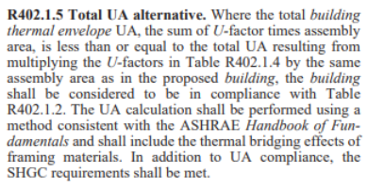
Potentially Problematic Trade-offs in most Compliance Options
The “Prescriptive Option” of the IECC allows the you to choose either R-values, U-factors, or a Total UA to comply with the insulation requirements.
Notes:
Amy

Slide 15
Potentially Problematic Trade-offs in most Compliance Options
Component R-values and assembly U-factors have some self limiting trade-off characteristics.
However, when utilizing the Total UA Alternative there is no limit on how much any given insulated assembly can be traded-off for another.
Notes:
Amy

Slide 16
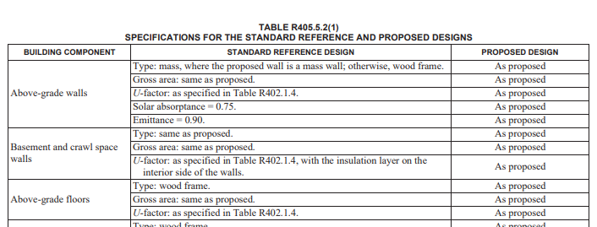
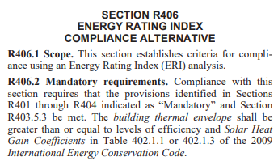
Potentially Problematic Trade-offs in most Compliance Options
The Performance and ERI Compliance options are based on the assembly U-factor requirements.
Performance option – no trade-off limit
ERI without renewable energy - 2009 IECC backstop
ERI with renewable energy - 2015 IECC backstop
Notes:
Amy

Slide 17
WARNING #1: Avoid “Trade-off” Tunnel Vision
All compliance paths and envelope “trade-offs” can have unintended consequences if the following factors are not considered in full view:
It matters what “ingredients” are used (e.g., R-value, permeance, etc. of insulation and building material layers)
It matters in what order these ingredients are arranged in a wall
The ingredients and recipe for combining them change with climate
Don’t use renewable energy to “trade-off” envelope energy efficiency (conservation) thereby negating the primary value of renewable resources to reduce the use of non-renewable fuels, GHG emissions, and pollutants
The problem with the energy code compliance paths is that they only look at thermal performance and, taken alone, this can set a trap for unintended consequences.
Notes:
Jay

Slide 18
WARNING #2: With flexibility comes responsibility
Vast Number of Options: 4 VR x 3 AB x 3 ci x 2 cavity x 3 WRB x 3 structural sheathing x 2 cladding = 1,296 options to configure a wall!
This calculation of the number of wall assembly options is just for basic material types/categories/arrangements, not including specific material variations within category or changes in R-values of ci or cavity insulation.
At least half of these combinations are wrong for any given climate
Some are marginal depending on climate and indoor moisture loads
Conversely, some combinations are good for all climates
Some examples of unintended consequences follow…
Notes:
Jay

Slide 19
Unintended Consequences: Examples (All Energy Code Compliance Paths)
Climate Zone 7 Example
Energy code says OK to use R20+5ci wall
Current building code simply says to use a Class I or II vapor retarder – no other “ingredients” or “recipe” conditions are mentioned.
REALITY CHECK: This wall is OK in Climate Zone 6, but NOT Climate Zone 7 from a vapor control standpoint!
Why? The insulation ratio (?) is not quite enough for Climate Zone 7 (but is adequate for Climate Zone 6 or lower)
Huh?
Notes:
Jay

Slide 20
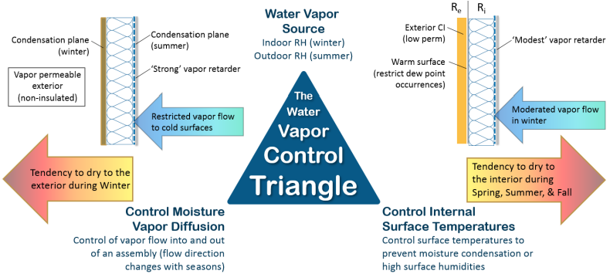
WAIT A MINUTE! What is Insulation Ratio? – the “secret” to the recipe
These two wall parameters are important for two different wall strategies:
Notes:
Jay

Slide 21
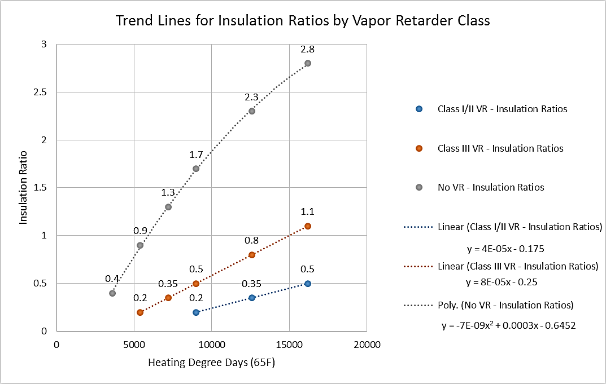
Insulation Ratio (basis of 2021 IRC)
Source: http://www.appliedbuildingtech.com/rr/1410-03
Notes:
Jay

Slide 22
Insulation Ratio (basis of 2021 IRC)
Source: http://www.appliedbuildingtech.com/rr/1701-01
Notes:
Jay

Slide 23
Permeance Ratio (not included in 2021 IRC)
NOTE: For use with cavity insulation only walls, or walls that have continuous insulation but inadequate insulation ratio.
Source: http://www.appliedbuildingtech.com/rr/1701-01
Notes:
Jay

Slide 24
Updated 2021 IRC and IBC Vapor Retarder Provisions
Based on IRC proposal RB223-19 (nearly identical for IBC)
First, vapor retarder classes are broadly defined…
Notes:
Jay

Slide 25
Updated 2021 IRC and IBC Vapor Retarder Provisions
Second, their application by climate zone is tabulated with footnotes addressing cases where ci is used or may be necessary to help control moisture
Footnote ‘b’ prevents double vapor barrier unless designed – generally meaning use of a Class I smart vapor retarder (see footnote ‘a’)
Footnote ‘c’ and Table R702.7(3) provide requirements when foam sheathing (‘ci’) is used.
Notes:
Jay

Slide 26
Updated 2021 IRC and IBC Vapor Retarder Provisions
Next, where the wall has a Class II VR and foam sheathing ci…
This is the “insulation ratio” in prescriptive form (same format as used in the existing Class III VR table shown in next slide)
As noted in footnote ‘c’ the Class II VR must have a permeance of > 1 perm under “wet cup” ASTM E96 test (e.g., is a smart vapor retarder). Generically, this means a Kraft paper facer on fiberglass batts (or similar).
Notes:
Jay

Slide 27
Updated 2021 IRC and IBC Vapor Retarder Provisions
Finally, where a Class III VR is used…
Note that in the colder climates, exterior ‘ci’ must be used (is the only option) to protect the wall from moisture accumulation when a fairly “vapor open” Class III VR is used.
Also, note that as the climate gets colder a higher exterior sheathing permeance is required if not using ‘ci’ to protect the wall from moisture accumulation (same should apply with use of a Class II VR, but not currently in the code).
Notes:
Jay

Slide 28
Wall Calculator – Easy Button to IECC and IRC Coordinated Compliance
Implements R-value and U-factor checks per IECC and also a moisture control check per IRC (including insulation and permeance ratio checks)
https://www.continuousinsulation.org
Notes:
Jay

Slide 29
Unintended Consequences: Examples (All Energy Code Compliance Paths)
Now, let’s return to the Climate Zone 7 example with some knowledge as to how to make a good wall recipe using good ingredients…
BETTER SOLUTIONS: A few examples derived from applying IECC and IRC requirements (or more simply using the “wall calculator”):
2x6 wall, R20+7.5ci with Class II(Kraft/”smart”) VR gives IR = 7.5/20 = 0.38 > 0.35 min. OK (wall dries to the inside & prevents diffusion wetting) – Meets IRC and more stringent than R20+5ci for IECC compliance
2x4 wall, R13+10ci with a Class III (e.g., Latex paint) VR gives IR = 0.77 > 0.7 min. OK (wall dries even faster to inside & similarly prevents diffusion wetting in winter) – Meets IECC R-value and IRC.
Any wall, R0+20ci with Class III or no interior VR gives IR=20/1 = 20! (extreme inward drying potential & maximum prevention of diffusion wetting); meets IECC wall U-factor for CZ 7 and better than IRC moisture control.
Notes:
Jay

Slide 30
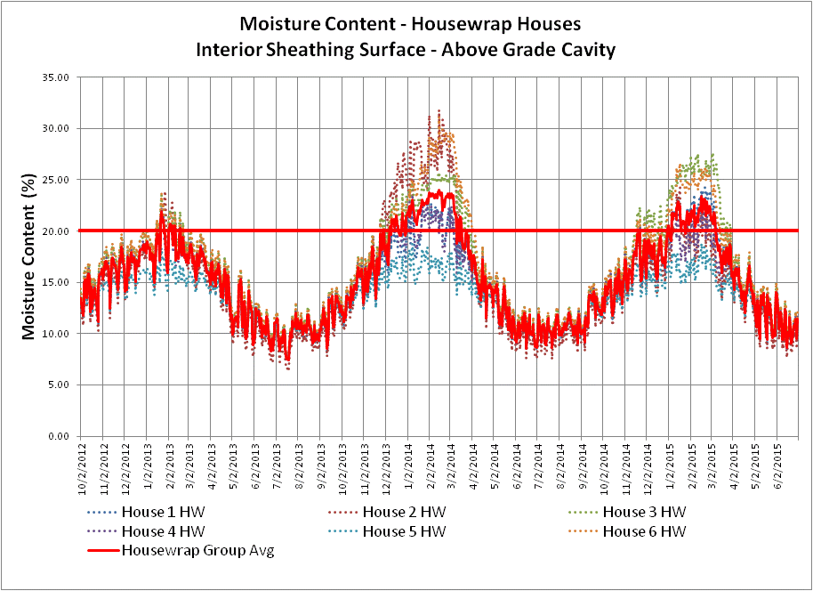
Unintended Consequences: Examples (All Energy Code Compliance Paths)
Climate Zone 5 Example
IECC currently allows use of R20 cavity only insulation in CZ5
IRC simply says to use a Class I or II vapor retarder – no other “ingredients” or “recipe” conditions are mentioned.
Don’t recommend using a Class II (Kraft paper) vapor retarder to avoid high (>20% to 30% saturated) moisture cycling in OSB:
OSB MC - Actual data from 6 occupied homes with R20 walls
Notes:
Jay

Slide 31
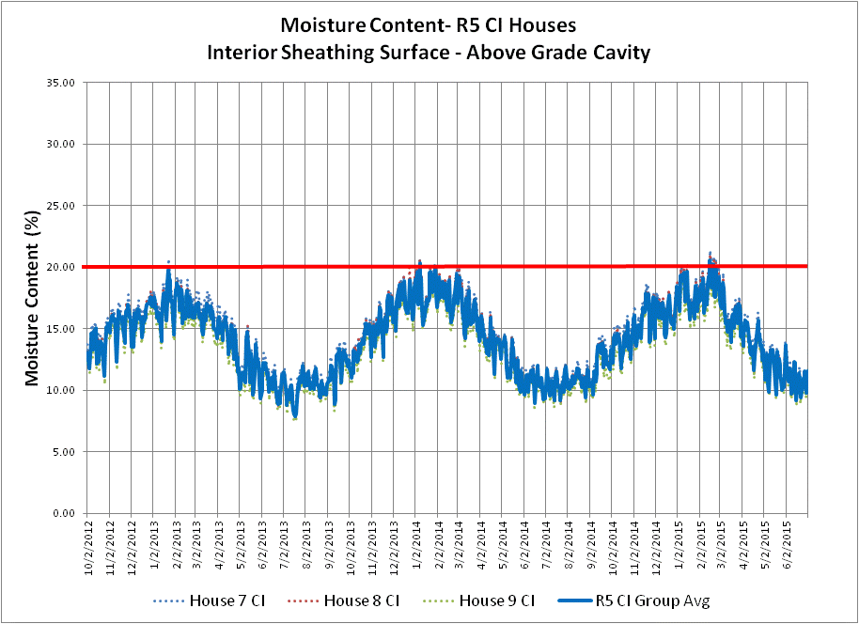
Unintended Consequences: Examples (All Energy Code Compliance Paths)
BETTER SOLUTIONS: Derived from applying IECC and IRC requirements (or more simply using the “wall calculator”):
For an R20 2x6 wall (air permeable cavity insulation only) in CZ 5, a Class I VR is needed to provide an acceptable permeance ratio for this wall and the Class I VR should also be “smart” to avoid condensation on the VR in the summer AC/cooling season.
Or, by adding R5ci to the exterior (R20+5ci), a Class II (Kraft) VR can be used resulting in a much dryer (<20% MC) and more stable environment for the OSB:
Actual data from 6 occupied homes with R20+5 walls
Notes:
Jay

Slide 32
Unintended Consequences: State & Local Modifications (examples)
R13+1ci (replacing R13+5ci) in CZ 4
This is not thermally equivalent to an R20 or R13+5 wall as currently required by the IECC.
This wall may also experience moisture problems if minimum R-3ci is not used with a Class II (Kraft) VR to achieve an adequate insulation ratio and drying to interior.
R21 replacing R20+5ci or R13+10ci in CZs 6 & 7
Using R21 cavity insulation is far from being thermally equivalent to R20+5ci or R13+10ci
If used, a Class I “smart” VR should be used with carefully sealed interior AB to prevent exterior sheathing from cycling through high moisture every year and avoid condensation on VR in summer (AC cooling).
SOLUTION: Follow the latest codes 2021 IECC and IRC – weakening thermal performance can inadvertently result in lessened durability.
Notes:
Jay

Slide 33
2021 IECC Updates to R-value Path (Section R402)
CLIMATE ZONE | WOOD FRAME WALL R-VALUE
1 | 13 or 0+10ci^{h}
2 | 13 or 0+10ci^{h}
3 | 20 or 13+5ci^{h} or 0+15ci^{h}
4 except Marine | 30 or 20+5ci^{h} or 13+10ci^{h} or 0+20ci^{h}
5 and Marine 4 | 30 or 20+5ci^{h} or 13+10ci^{h} or 0+20ci^{h}
6 | 30 or 20+5ci^{h} or 13+10ci^{h} or 0+20ci^{h}
7 and 8 | 30 or 20+5ci^{h} or 13+10ci^{h} or 0+20ci^{h}
2021 IECC Wall R-value requirements improved over earlier editions.
These provide more options to help make good choices informed also by improvements to 2021 IRC R702.7 vapor control provisions.
Covers all options (cavity only, cavity + continuous, continuous only) with thermally equivalent solutions
When coordinated with 2021 IRC:
Adding R20+5 to CZ 4 and 5 will improve moisture performance with use of Class II (Kraft) VR
Having an R30 cavity equivalent in CZ 5-8 will raise importance of using Class I “smart” VR (although not required by 2021 IRC); or using at least part-fill with low-perm ccSPF complying with earlier insulation ratios and a Class II (Kraft) VR for improved inward drying.
Notes:
Jay

Slide 34
2021 Updates to ERI Path (Section R406)
Current ERI path has a 2009 IECC envelope backstop without solar
This backstop only prevents excessive trading-off of envelope thermal performance; it does not prevent trade-offs that could create moisture control problems.
The 2021 IECC …
Changes the ERI backstop to 1.15UA multiplier (RE150-19), this still allows some CZs to be traded-off in ways that could create moisture problems as per the current backstop.
Changes the backstop with renewable energy to 2018 IECC envelope R-values (RE182-19) combined with a 5% of total building energy use limit on crediting renewable energy production to the ERI score (RE184-19).
Also, ERI scores (targets) are reduced by about 5 points (RE192-19) for better energy conservation performance and this will help mitigate unintended consequences of envelope trade-offs.
Notes:
Amy

Slide 35
2021 Updates to Performance Path (Section R405)
The current performance path has no backstop…
Envelope insulation could theoretically be traded down to pre-energy code levels (e.g., prior to 1970s)
2021 IECC continues to prevent this by prohibiting HVAC equipment efficiency (through use of an outdated Federal baseline efficiency standard) from being used to enable severe trade-offs of envelope performance.
The 2021 IECC will include a 2009 IECC R-value backstop (RE151-19) but this will not necessary prevent envelope trade-offs that might cause moisture problems – must follow 2021 IRC vapor retarder requirements.
Notes:
Amy

Slide 36
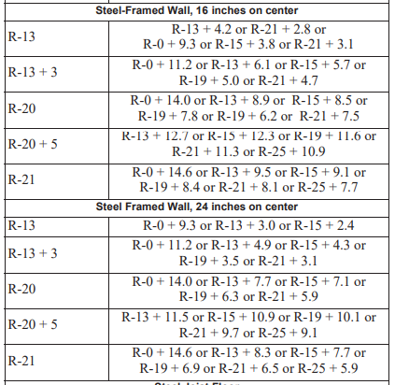
Potentially Problematic Steel Frame Compliance
Failure to update this table has left users wanting for appropriate equivalent prescriptive solutions
Values highlighted in blue are not found in Table R402.1.2 so they are not relevant
Some values in Table R402.1.2 are not found in this Steel framed equivalence table.
R13+5
R13+10
Notes:
Amy

Slide 37
2021 IECC Responds…
The following steel frame wall equivalent R-values have been added to the 2021 IECC Table R402.2.6 (RE51-19):
Wood Frame Wall R-value Required (Table R402.1.2) | Steel Frame Wall R-value Equivalent (cavity + ci)
 | 16”oc Studs | 24”oc studs
R13+5ci | R-0+15 or R-13+9 or R-15+8.5 or R-19+8 or R-21+7 | R-0+15 or R-13+7.5 or R-15+7 or R-19+6 or R-21+6
R13+10ci | R0+20 or R-13+15 or R-15+14 or R-19+13 or R-21+13 | R-0+20 or R-13+13 or R-15+12 or R-19+11 or R-21+11
NOTE: While R13+10ci and R20+5ci are thermally equivalent walls for wood framing, they each require different solutions for steel framing due to difference in 4” and 6” steel stud impact on cavity insulation effective R-value (40-50% of cavity insulation rated R-value). This is why equivalent steel frame walls always require continuous insulation, even when compared to a wood stud wall with cavity insulation only.
Notes:
Jay

Slide 38
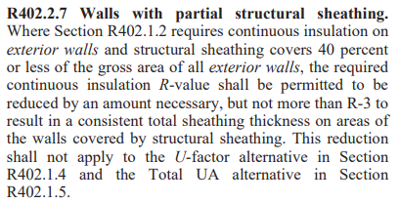
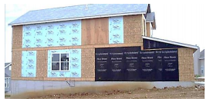
Potentially Problematic Insulation trade-off on Walls with Partial Sheathing
This language was intended to address intermittent structural sheathing challenges
Unfortunately it has created more problems by not addressing it correctly
There is not requirement to make up for energy losses due to this loophole
Notes:
Amy

Slide 39
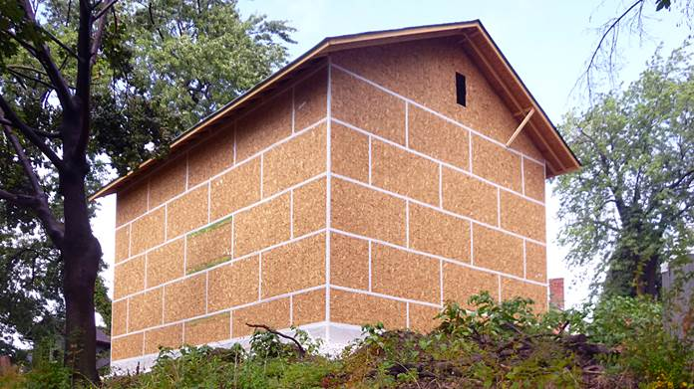
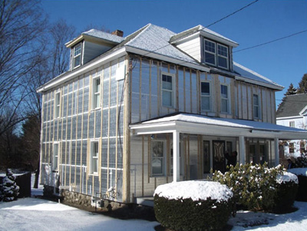
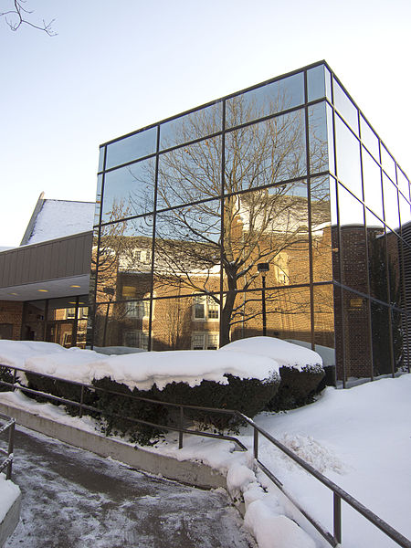
But, again, there’s a better way…
This provision is obsolete. With newer bracing provisions in IRC, most homes are fully or continuously structurally sheathed.
CI can be applied uniformly as “over-sheathing” and is now common practice.
Using thinner Ci over corner brace panels can result in --- you got it -- inadequate insulation ratio and unintended moisture consequences (in the braced portion of the wall where its perhaps most important)!
Sources:
http://www.greenbuildingadvisor.com/blogs/dept/musings/osb-airtight
http://buildingscience.com/documents/digests/bsd-139-deep-energy-retrofit...
Baby It’s Cold Outside – Nazareth College, Rochester, NY (Wikimedia commons)
Notes:
Jay

Slide 40
CONCLUSIONS
What are walls telling us?
With the right ingredients and recipe, advancements in the energy code can actually serve to improve energy performance and durability.
Conversely, misinformed use of weakening trade-offs or even some of the existing prescriptive R-value solutions can result in unintended consequences (even though technically “code compliant”).
The IECC and latest water vapor control provisions of the 2021 IRC and IBC need to be used in tandem to ensure a good recipe “mix”.
All other factors equal, increasing the insulation ratio (adding more ci) will improve moisture and thermal performance; reducing ci will have the opposite effect (don’t go below the 2021 IRC code minimums for a given climate)
Notes:
Jay

Slide 41
CONCLUSIONS
Trading off ci can lead to moisture control problems when not meeting the required insulation ratio because of the absence of “permeance ratio” limits in the code (except when using a Class III VR).
Southern/Warm climates – using ci to block inward vapor drives (also applies to reservoir claddings – see new 2021 IRC stucco provisions); insulation ratio is not a concern in warm climates.
IECC residential above grade walls will include a “perfect wall” option for all climates using ci only (i.e., optimal from a moisture control standpoint for all climate zones)

Slide 42
Thank you!
Jay Crandell
jcrandell@aresconsulting.biz
Amy Schmidt
Amy.j.Schmidt@dupont.com

