Slide 1

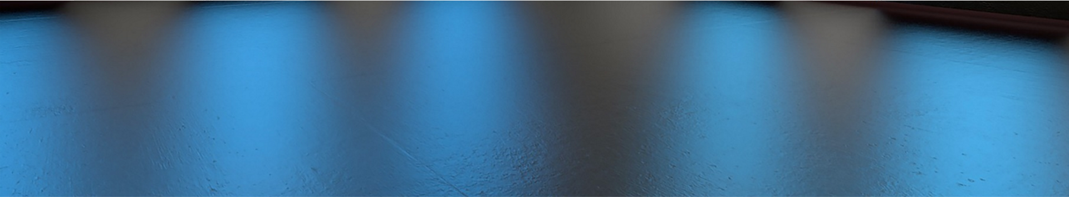

Applying Recent Building and Energy Code Advancements:
Durable and Energy-Efficient Building Enclosures
Jay H. Crandell, P.E.
ARES Consulting / ABTG

Slide 3
Outline
Energy Code Advancements
Coordinated Building Code Advancements
Example Applications
Conclusions & Questions
FOCUS: Above-grade exterior walls

Slide 4

Energy Code Advancements
Major advancement of building energy code occurred in 2012 (~30% increase in energy efficiency, reduction in energy use).
Since 2012, there have been few advances in the 2015 and 2018 IECC.
In 2021 IECC, significant additional energy efficiency improvements are expected.

Slide 5
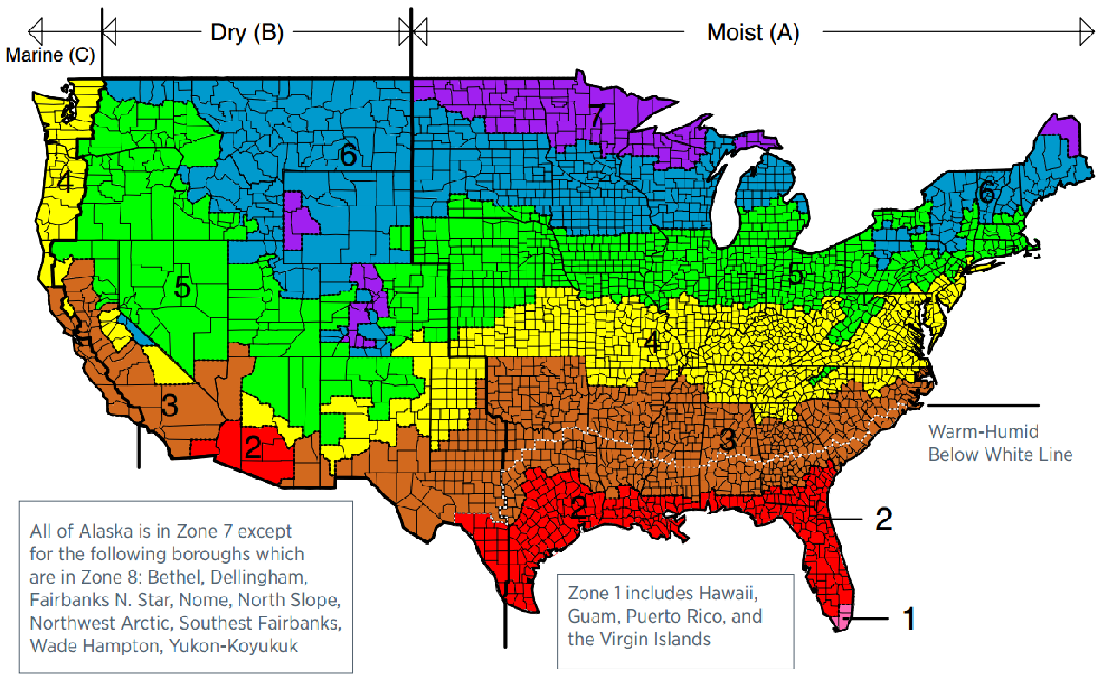
Climate Zone Map
2021 code will use an updated map

Slide 6
2018 IECC-R / IRC Ch11 Wall R-value Options
(one- and two-family dwellings incl. townhouses)
Climate Zone | Wood Frame Wall R-value (16”oc)ª
1 | 13+0ci or 0+10ci
2 | 13+0ci or 0+10ci
3 | 20+0ci, 13+5ci, or 0+15ci
4 except Marine | 20+0ci, 13+5ci, or 0+15ci
5 and Marine 4 | 20+0ci, 13+5ci, or 0+15ci
6 | 30+0ci, 20+5ci, 13+10ci, or 0+20ci
7 and 8 | 30+0ci, 20+5ci, 13+10ci, or 0+20ci
Example 1 (later)
Equivalent R-value options are added as expected in 2021 code.
Not shown are expected improvements in CZ 4 & 5 to equal CZ 6, 7, & 8

Slide 7
2018 IECC-C Above-grade Wall R-value Options
(commercial and Group R MF residential buildings)
Climate Zone | Occupancy & Use | Construction Type
 |  | Mass | Metal Bldg | Metal Frame | Wood Frame & Other
1 | Group R | R-5.7ci | R-13+R-6.5ci | R-13+R-5ci | R-13+R-3.8ci or R-20
 | All Other | R-5.7ci | R-13+R-6.5ci | R-13+R-5ci | R-13+R-3.8ci or R-20
2 | Group R | R-7.6ci | R-13+R-13ci | R-13+R-7.5ci | R-13+R-3.8ci or R-20
 | All Other | R-5.7ci | R-13+R-6.5ci | R-13+R-5ci | R-13+R-3.8ci or R-20
3 | Group R | R-9.5ci | R-13+R-13ci | R-13+R-7.5ci | R-13+R-3.8ci or R-20
 | All Other | R-7.6ci | R-13+R-13ci | R-13+R-7.5ci | R-13+R-3.8ci or R-20
4 except Marine | Group R | R-11.4ci | R-13+R-13ci | R-13+R-7.5ci | R-13+R-3.8ci or R-20
 | All Other | R-9.5ci | R-13+R-13ci | R-13+R-7.5ci | R-13+R-3.8ci or R-20
5 and Marine 4 | Group R | R-13.3ci | R-13+R-13ci | R-13+R-7.5ci | R-13+R-7.5ci R-20+R-3.8ci
 | All Other | R-11.4ci | R-13+R-13ci | R-13+R-7.5ci | R-13+R-3.8ci or R-20
6 | Group R | R-15.2ci | R-13+R-13ci | R-13+R-7.5ci | R-13+R-7.5ci R-20+R-3.8ci
 | All Other | R-13.3ci | R-13+R-13ci | R-13+R-7.5ci | R-13+R-7.5ci R-20+R-3.8ci
7 | Group R | R-15.2ci | R-13+R-19.5ci | R-13+R15.6ci | R-13+R-7.5ci R-20+R-3.8ci
 | All Other | R-15.2ci | R-13+R-13ci | R-13+R-7.5ci | R-13+R-7.5ci R-20+R-3.8ci
8 | Group R | R-25ci | R-13+R-19.5ci | R-13+R-17.5ci | R-13+R-15.6ci R-20+R10ci
 | All Other | R-25ci | R-13+R-13ci | R-13+R-7.5ci | R-13+R-15.6ci R-20+R10ci
Example 3 (later)
Example 2 (later)
Some R-values expected to increase in 2021 IECC where less stringent than ASHRAE 90.1

Slide 8
R-value Trade-offs
There are several ways that alternative R-values can be determined for code compliance:
  Use of U-factors for equivalent assemblies but different amounts and locations of insulation and building materials
  Use of total UA trade-off, e.g., strengthening one assembly to weaken another (e.g., use REScheck or COMcheck)
  Use of building performance methods (e.g., ERI path or building simulation path)
Any of the approaches give flexibility to have more or less insulation or a different arrangement of the insulation for good or bad…
CAUTION! – UNINTENDED CONSEQUENCE #1: This flexibility for energy code compliance can result in assemblies that perform differently (better or worse) from a moisture control and durability perspective.

Slide 9
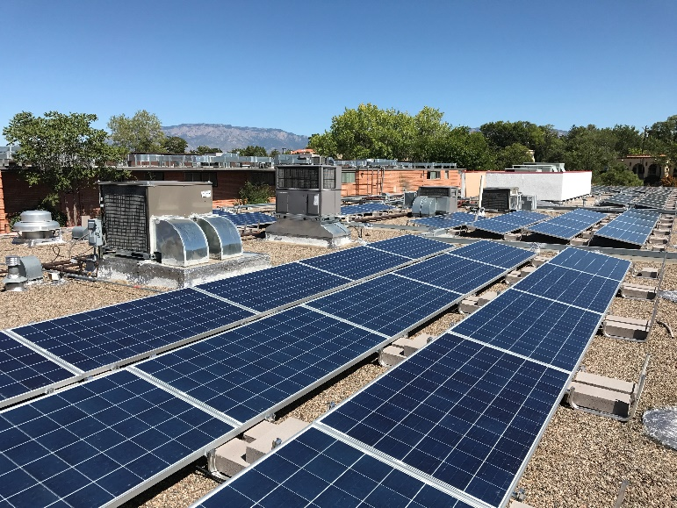
R-value Trade-offs
CAUTION! – UNINTENDED CONSEQUENCE #2: Value of “clean” renewable energy (e.g., solar PV) can be traded-off for reduced energy efficiency (i.e., trade-off envelope R-value).
WHY?
  Doing this causes more net energy use by the building (with renewables used only to offset the increase in energy use from a weaker building envelope)
  This works against energy conservation and wastes renewable energy resources and technology to allow a “weaker” building envelope.
  Consequently, the use of renewable (“clean”) energy would do little or nothing to reduce the use of non-renewable (fossil) energy sources and GHG emissions.
SOLUTION: Sustainable Energy Strategy = Conservation + Renewables
Newer energy codes are becoming more intelligent in preventing bad “trade deals” by instituting renewable trade-off limits and/or envelope R-value backstops in the performance compliance paths (e.g., ERI or simulation).
Source: Everguardsolar.com, 2/27/2020

Slide 10
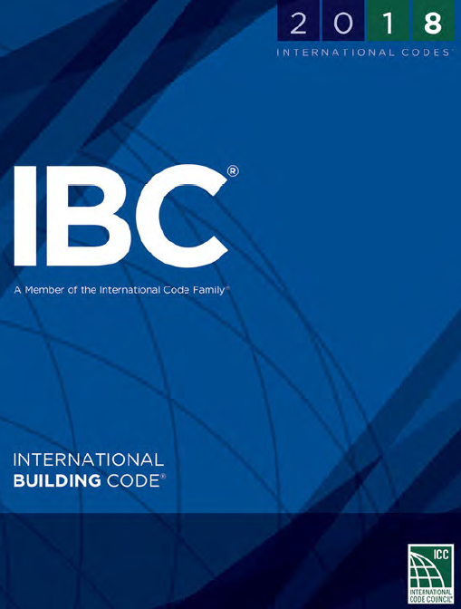
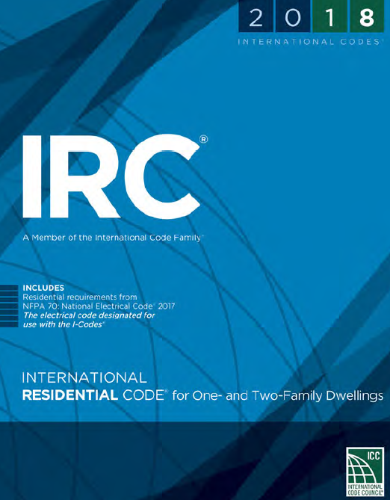
Coordinated Building Code Advancements
Energy code advancements and flexibility to make “trade-offs” requires coordinating advancements in the building code’s moisture control provisions.
Why?
  To help avoid unintended consequences…
  Insulation materials, amounts, and their location on a building assembly can affect moisture control, for good or bad
  Building materials and their properties and locations within an envelope assembly also affect moisture control and durability, for good or bad.
  Healthy and durable buildings require materials to be protected against the effects of moisture (i.e., mold, corrosion, rot, shrink/swell, degradation due to moisture cycling, etc.)
Codes have been largely silent or incomplete on many of the key factors that govern how an assembly will perform as a system in controlling moisture.
This is changing in the 2021 editions of the IRC and IBC…

Slide 11
Coordinated Building Code Advancements
  Water-resistive barriers and flashing
  Air-barriers
  Reservoir Claddings
  System-based vapor retarder provisions

Slide 12
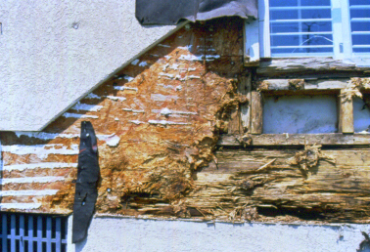
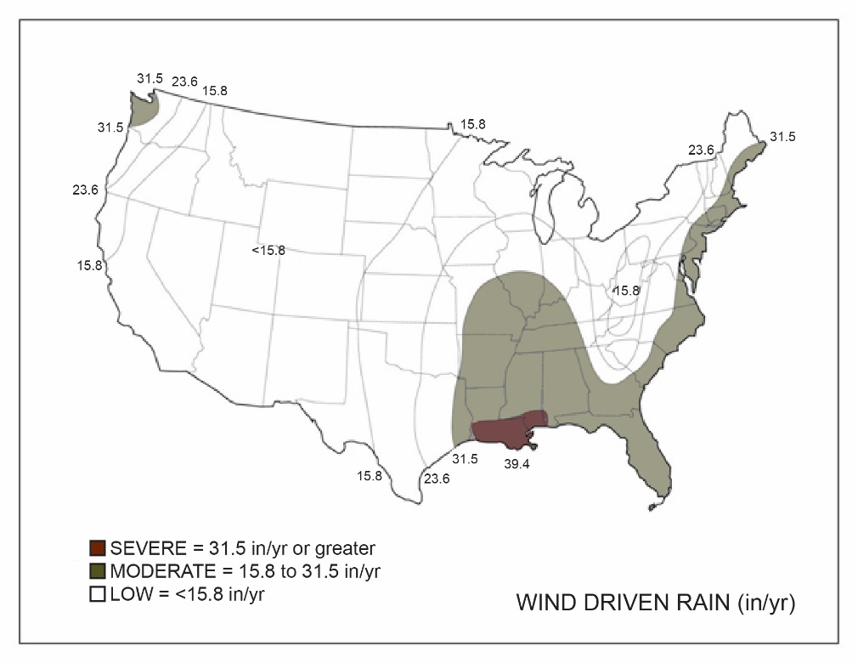
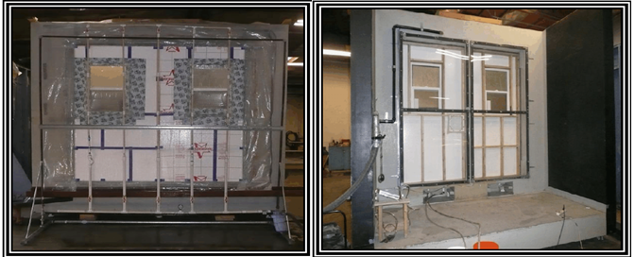
Water-Resistive Barriers & Flashing
Wind-driven rain is the water-intrusion hazard, especially for walls
The code currently does not factor variations in WDR hazard into WRB, fenestration, and flashing requirements or assembly tests (e.g., ASTM E331)

Slide 13
Water-Resistive Barriers & Flashing
2021 IBC and IRC will expand guidance on selection of and criteria for water-resistive barriers (2021 IRC shown, IBC same except No15 felt installation instructions not included):
  R703.2 Water-resistive barrier. Not fewer than one layer of water-resistive barrier shall be applied over studs or sheathing with flashing as indicated in Section R703.4, in such a manner as to provide a continuous water-resistive barrier behind the exterior wall veneer. Water-resistive barrier materials shall comply with one of the following:
  No. 15 felt complying with ASTM D226, Type 1
  ASTM E2556, Type I or II
  ASTM E331 in accordance with Section R703.1.1, or
  Other approved materials in accordance with the manufacturer’s installation instructions.
  No.15 asphalt felt and water-resistive barriers complying with ASTM E2556 shall be applied horizontally, with the upper layer lapped over the lower layer not less than 2 inches (51 mm), and where joints occur, shall be lapped not less than 6 inches (152 mm).
Be sure to follow manufacturer’s instructions (especially for “other approved materials” such as sheathing type WRBs, fluid-applied, adhered, etc.)!

Slide 14
Water-Resistive Barriers & Flashing
2021 IRC (re-organization of flashing for fenestration):
  R703.4.1 Flashing installation at exterior window and door openings. Flashing at exterior window and door openings shall extend to the surface of the exterior wall finish or to the water-resistive barrier complying with Section 703.2 for subsequent drainage. Mechanically attached flexible flashings shall comply with AAMA 712. Flashing at exterior window and door openings shall be installed in accordance with one or more of the following:
  The fenestration manufacturer’s installation and flashing instructions, or for applications not addressed in the fenestration manufacturer’s instructions, in accordance with the flashing manufacturer’s instructions. Where flashing instructions or details are not provided, pan flashing shall be installed at the sill of exterior window and door openings. Pan flashing shall be sealed or sloped in such a manner as to direct water to the surface of the exterior wall finish or to the water resistive barrier for subsequent drainage. Openings using pan flashing shall incorporate flashing or protection at the head and sides.
  In accordance with the flashing design or method of a registered design professional.
  In accordance with other approved methods.

Slide 15
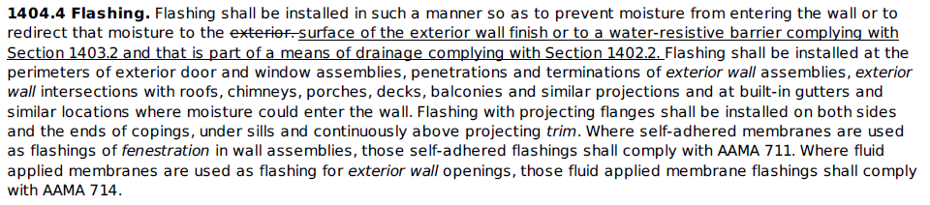
Water-Resistive Barriers & Flashing
2021 IBC (clarification that flashing to WRB is permissible):

Slide 16
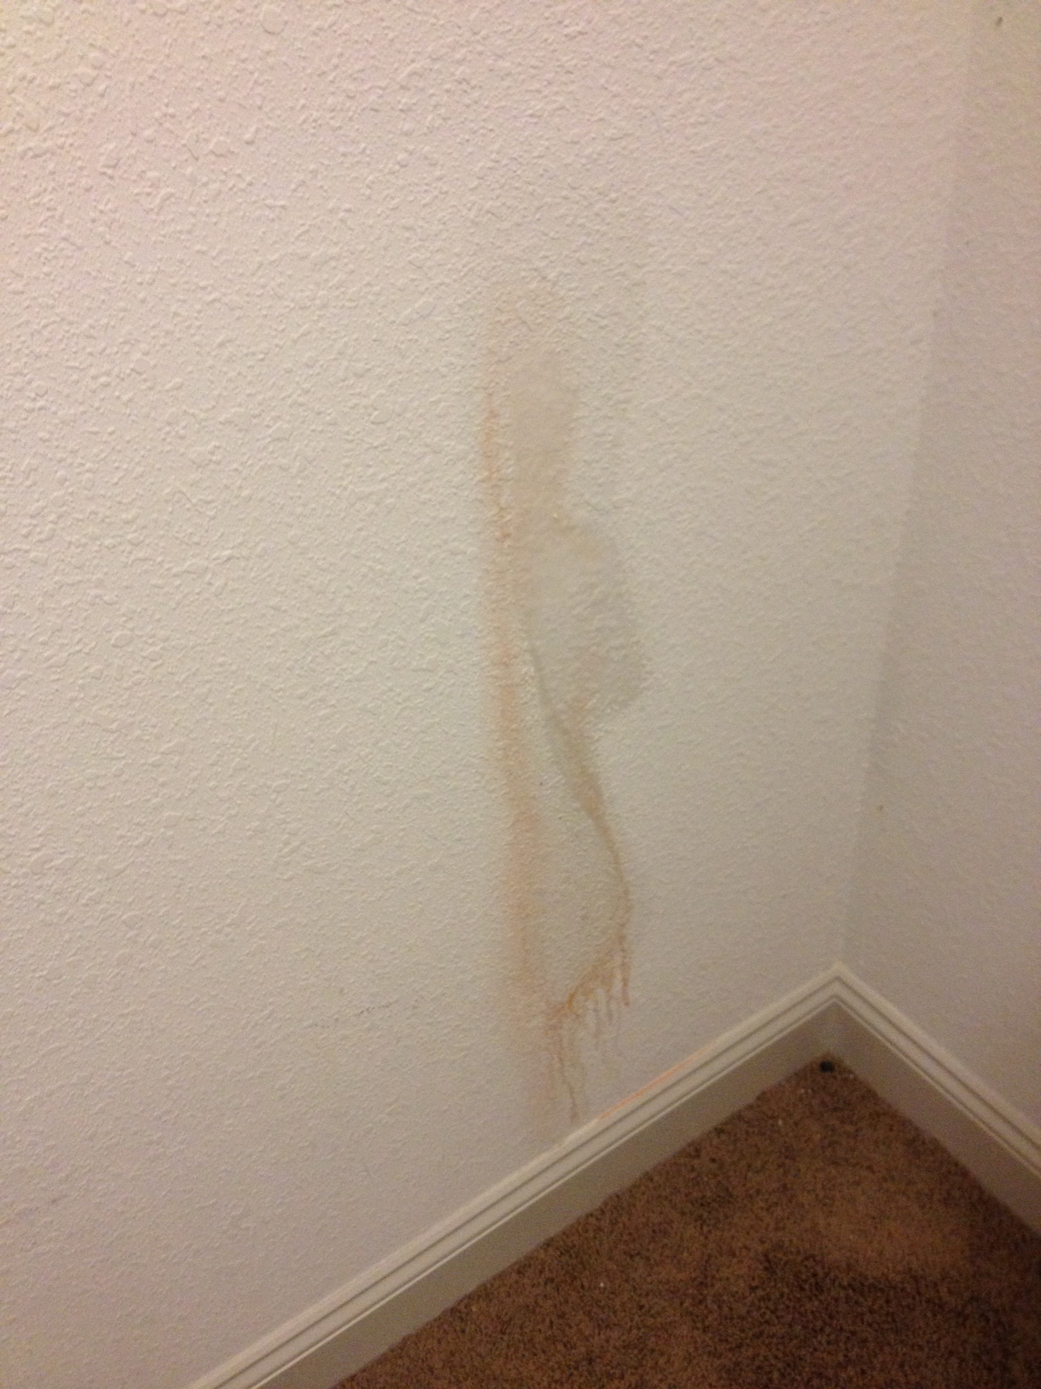
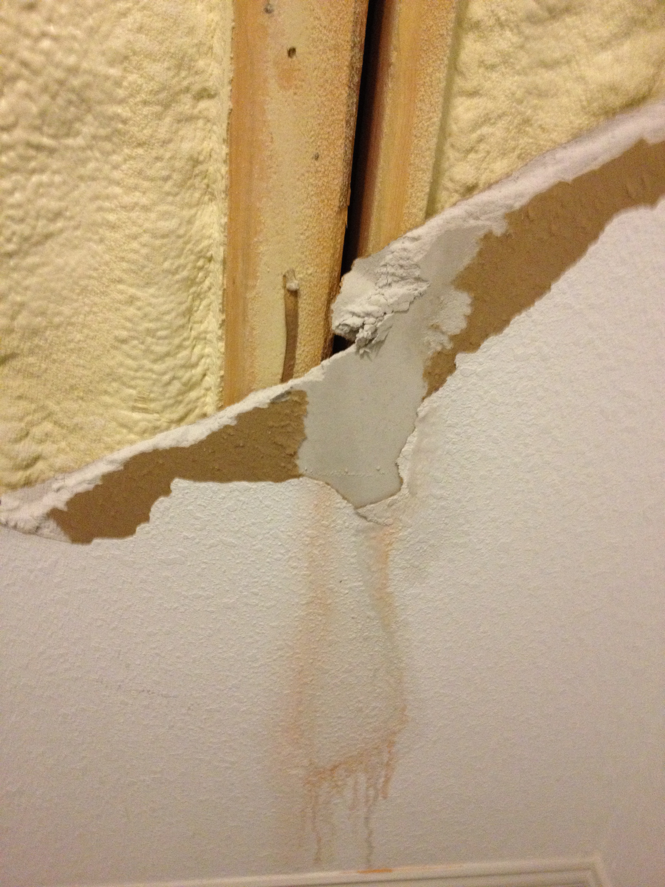
Air Barriers
Air leakage can introduce moist air into assemblies increasing the likelihood of at least localized moisture problems
  Similar to flashing defects resulting in a localized rain water leaks that typically cause localized moisture problems
Air leakage, under the right circumstances, can help an assembly dry out, but this is unreliable, cuts both ways.
It is better to prevent wetting by controlling water and air leaks.

Slide 17
Air Barriers
Air barrier system installation requirements and whole building air leakage testing requirements are found in the energy code.
  Blower door tests are only required for one- and two-family homes, but 2021 IECC is expected to require it for some commercial buildings
There is no mention of air barriers in the building code from a moisture control perspective.

Slide 18
Air Barriers
One proposal attempted to make the link between air-barriers and moisture control, but was not approved for the 2021 I-codes:
  702.7.4 Installation. Vapor retarders shall be installed in accordance with the manufacturer’s instructions or an approved design. The vapor retarder shall be installed as an air barrier or in conjunction with an air barrier.
Vapor retarders work on the principle of controlling vapor diffusion; if they are “flanked” by air movement through the assembly the vapor retarder is bypassed or at least rendered less effective.

Slide 19
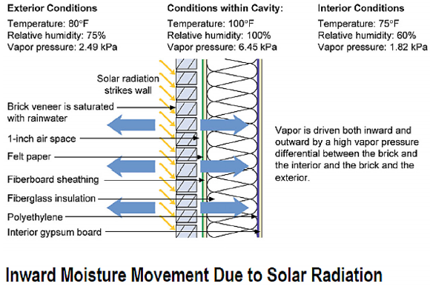
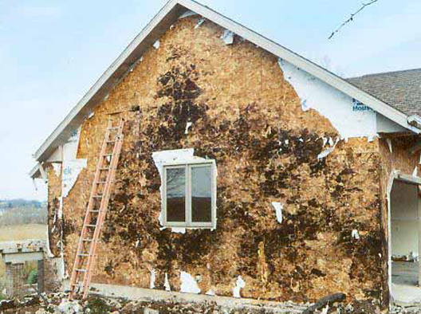
Reservoir Claddings
Reservoir claddings include PC stucco and adhered veneers
Inward vapor drives during summer, especially when solar-driven after rainfall and with AC’d buildings, can result in significant wetting of:
  exterior sheathing
  interior finish materials
  Interior vapor retarder
If combined with inadequate outward vapor control in the winter (in colder climates), then the wall never has opportunity to dry
http://www.greenbuildingadvisor.com/blogs/dept/musings/all-about-wall-rot

Slide 20
Reservoir Claddings
The 2021 IBC and IRC significantly upgrade and clarify stucco WRB and drainage requirements to protect against inward vapor movement:
  2510.6 Water-resistive barriers. Water-resistive barriers shall be installed as required in Section 1403.2 and, where applied over wood-based sheathing, shall comply with Section 2510.6.1 or Section 2510.6.2.

Slide 21
Reservoir Claddings
For “dry” climate regions, the traditional practice of two layers of 10-min Grade D paper or one layer of 60-min Grade D paper is still permitted and further clarified:
  2510.6.1 Dry climates. One of the following shall apply for dry (B) climate zones:
  The water-resistive barrier shall be two layers of 10-minute Grade D paper or have a water resistance equal to or greater than two layers of water-resistive barrier complying with ASTM E2556, Type I. The individual layers shall be installed independently such that each layer provides a separate continuous plane and any flashing, installed in accordance with Section 1404.4 and intended to drain to the water-resistive barrier, is directed between the layers.
  The water-resistive barrier shall be 60-minute Grade D paper or have a water resistance equal to or greater than one layer of water-resistive barrier complying with ASTM E2556, Type II. The water-resistive barrier shall be separated from the stucco by a layer of foam plastic insulating sheathing or other non-water absorbing layer.

Slide 22
Reservoir Claddings
In “moist” or “marine” climate regions, a drainage gap or minimum drainage efficiency is a required enhancement:
  2510.6.2 Moist or marine climates. In moist (A) or marine (C) climate zones, water-resistive barrier shall comply with of one of the following:
  In addition to complying with Item 1 or 2 of Section 2510.6.1, a minimum 3/16 inch (4.8 mm) space shall be added to the exterior side of the water-resistive barrier.
  In addition to complying with Item 2 of Section 2510.6.1, a space with a minimum drainage efficiency of 90% as measured in accordance with ASTM E2273 or Annex A2 of ASTM E2925 is added to the exterior side of the water-resistive barrier.

Slide 23
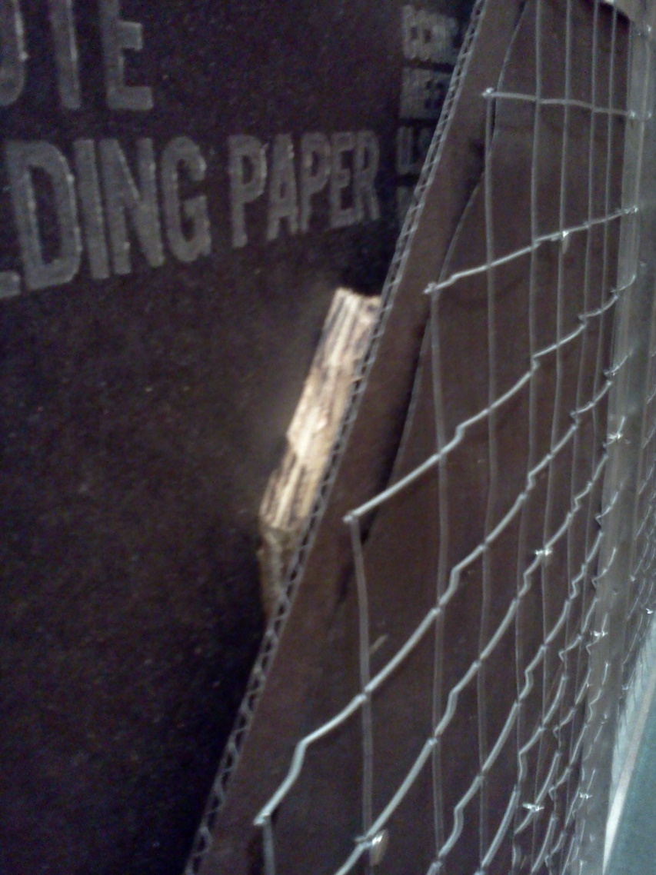
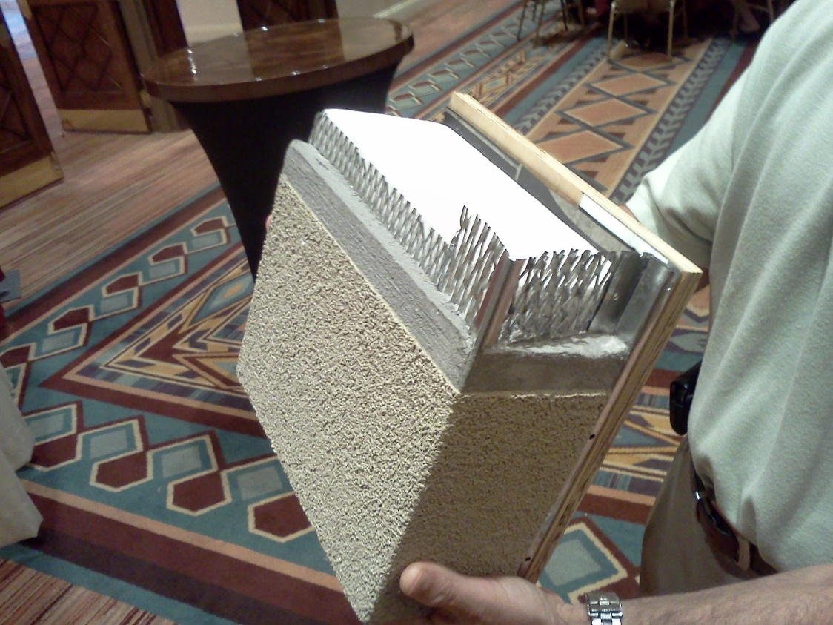
Reservoir Claddings
Example Applications

Slide 24
Water Vapor Retarders
Water vapor diffusion is the movement of water vapor through the layers of an assembly due to vapor pressure differentials caused by indoor air temperature and humidity and outdoor air temperature and humidity.
  It’s direction changes seasonally (winter vs. summer)
  It’s affect on an assembly depends on the vapor permeance of all material layers
  It’s affect depends on the temperatures within the assembly
The old “rules of thumb” that only address a designated interior vapor retarder layer are incomplete and unreliable.
SOLUTION: Codes must be updated to give more complete guidance.
WHY? It affects the whole assembly area, not just localized. It controls or balances both wetting and drying effects in all seasons.

Slide 25
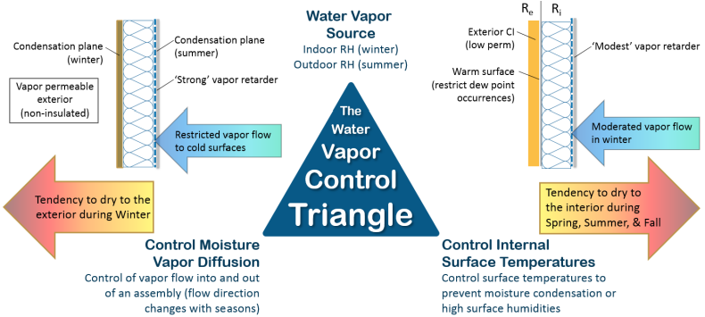
Vapor Control Principles
Two approaches to control water vapor:
  Permeance Controlled Design (permeance ratio)
  Temperature Controlled Design (insulation ratio, IR = Re/Ri)

Slide 26
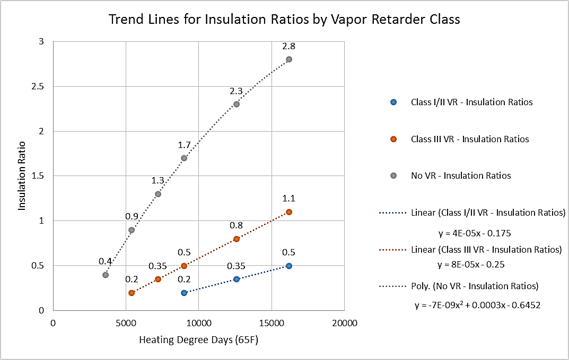
Insulation Ratio
(basis of 2021 IBC and IRC)
Source: http://www.appliedbuildingtech.com/rr/1410-03

Slide 27
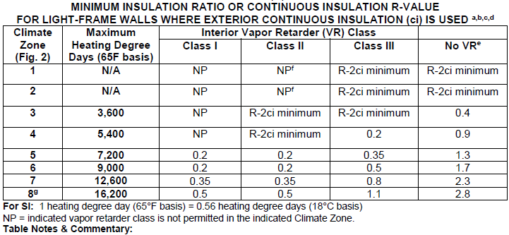
Insulation Ratio
(basis of 2021 IRC)
Source: http://www.appliedbuildingtech.com/rr/1701-01

Slide 28
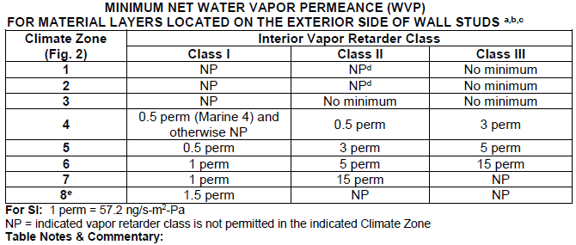
Permeance Ratio
(not included in 2021 IRC)
NOTE: For use with cavity insulation only walls, or walls that have continuous insulation but inadequate insulation ratio.
Source: http://www.appliedbuildingtech.com/rr/1701-01

Slide 29
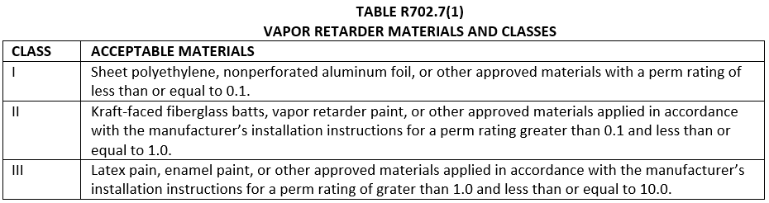
Updated 2021 IRC and IBC Vapor Retarder Provisions
Based on IRC proposal RB223-19 (nearly identical for IBC)
First, vapor retarder classes are broadly defined…

Slide 30
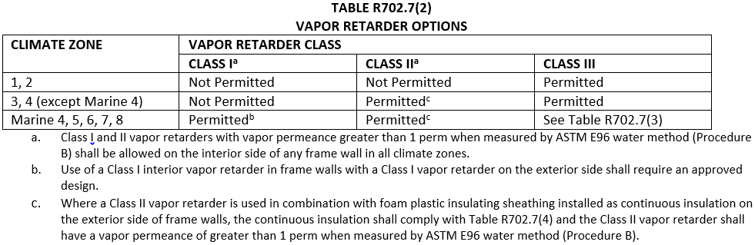
Updated 2021 IRC and IBC Vapor Retarder Provisions
Second, their application by climate zone is tabulated with footnotes addressing cases where ci is used or may be necessary to help control moisture
Footnote ‘b’ prevents double vapor barrier unless designed – generally meaning use of a Class I smart vapor retarder (see footnote ‘a’)
Footnote ‘c’ and Table R702.7(3) provide requirements when foam sheathing (‘ci’) is used.

Slide 31
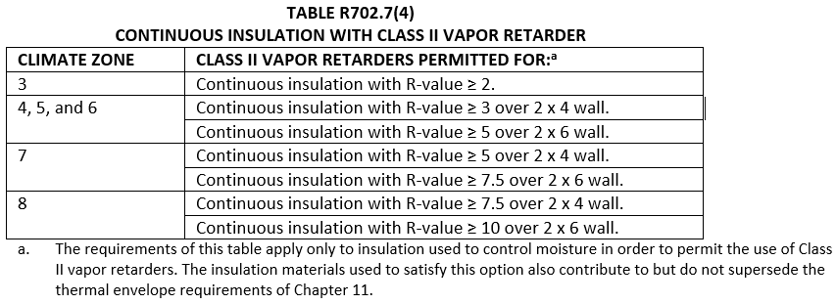
Updated 2021 IRC and IBC Vapor Retarder Provisions
Next, where the wall has a Class II VR and foam sheathing ci…
This is the “insulation ratio” in prescriptive form (same format as used in the existing Class III VR table shown in next slide)
As noted in footnote ‘c’ the Class II VR must have a permeance of > 1 perm under “wet cup” ASTM E96 test (e.g., is a smart vapor retarder). Generically, this means a Kraft paper facer on fiberglass batts (or similar).

Slide 32
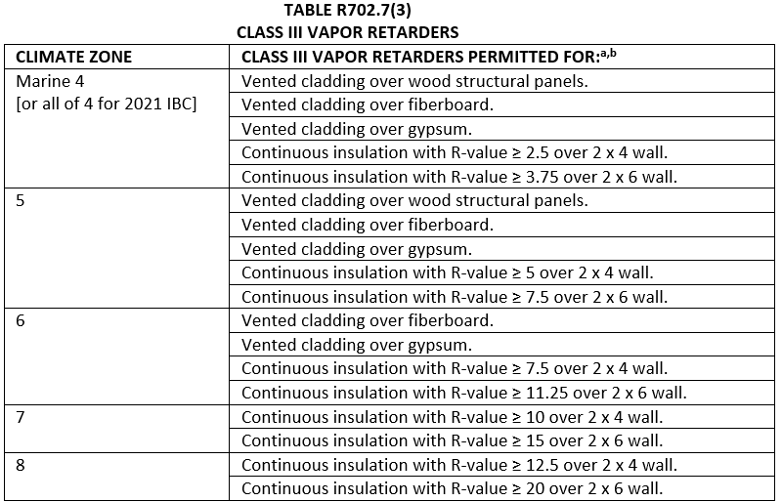
Updated 2021 IRC and IBC Vapor Retarder Provisions
Finally, where a Class III VR is used…
As with the Class II VR table, the colder the climate the more ci R-value required (greater insulation ratio) – this is the temperature controlled design approach. In CZ 7 & 8, this is the only solution.
Also, as the climate gets colder a higher exterior sheathing permeance is required if not using ‘ci’ to protect the wall from moisture accumulation (same should apply with use of a Class II VR, but is not currently in the code) – this is the permeance controlled design, but only for Class III VR applications.

Slide 33
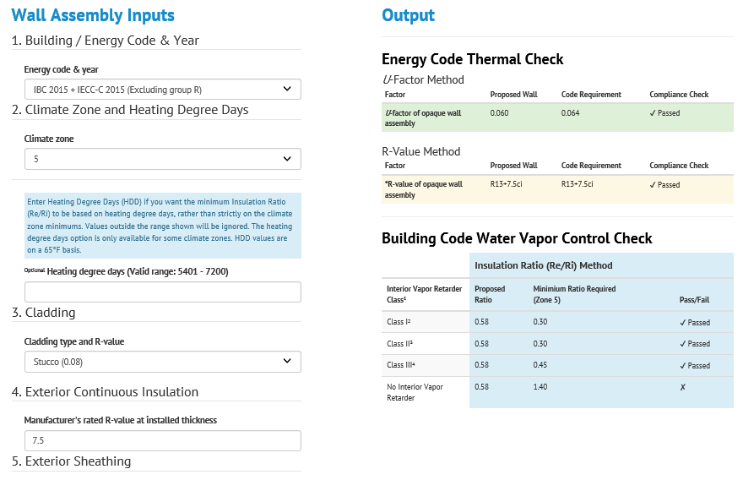
Wall Calculator – Easy Button to IECC and IBC/IRC Coordinated Compliance
Implements R-value and U-factor checks per IECC and also a moisture control check (including insulation and permeance ratio checks)
https://www.continuousinsulation.org

Slide 34
Design Examples
Example 1 – Residential (One- and Two-Family Dwelling)
Given: In Climate Zone 6, the energy code requires one of the following prescriptive R-value solutions for wood-frame walls:
  30+0ci, 20+5ci, 13+10ci, or 0+20ci
Find: For each R-value option, what vapor retarder options are appropriate in accordance with the building code?

Slide 35
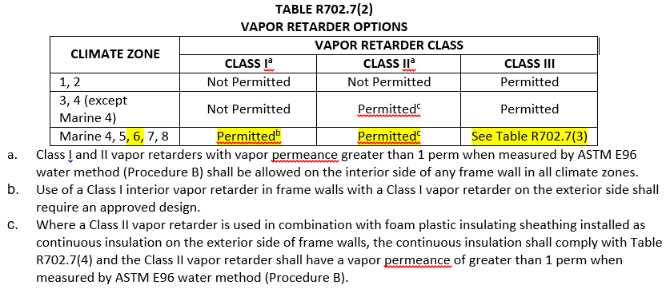
Design Examples
In Climate Zone 6 any of the following vapor retarder options are permitted:

Slide 36
Design Examples
30+0ci Wall Assembly (cavity insulation only – permeance based design)
  Class I vapor retarder is permitted in CZ 6
    Provides great protection against moisture accumulation in exterior sheathing in winter
    Can cause moisture accumulation in summer for AC’d buildings
    Best solution is a “smart” Class I vapor retarder
  Class II vapor retarder is permitted in CZ 6
    Can result in high moisture content in exterior sheathing in winter
    While allowed by code, several studies have shown high moisture content cycling of exterior sheathing (>20% and even near saturation depending on indoor RH levels)
  Class III vapor retarder is permitted in CZ 6
    Must be used with vented cladding and high perm exterior sheathing (e.g., fiberboard or gypsum sheathing)
    Wood structural panels not allowed
    While allowed by code, will result in substantial moisture flow-through which, for cold materials like exterior sheathing or siding in winter, moisture levels will rise (this wall has no temperature control with absence of exterior ci)
  Alternative: Use ccSPF in cavity for at least partial fill to meet insulation ratio required and it also would serve as a Class II vapor retarder.

Slide 37
Design Examples
20+5ci Wall Assembly
  Class II vapor retarder -- permitted in accordance with footnote ‘c’ which requires compliance with continuous insulation ratios.
    RI = 5/20 = 0.25 which is greater than 0.2 (good for CZ 6 or lower, but not CZ 7 or 8).
    2021 code prescriptively requires min. R5ci for 2x6 wall (max R25 vapor permeable cavity insulation) which has IR = 0.2 (OK).
    Also requires that the Class II vapor retarder be “smart” (e.g., Kraft paper)

Slide 38
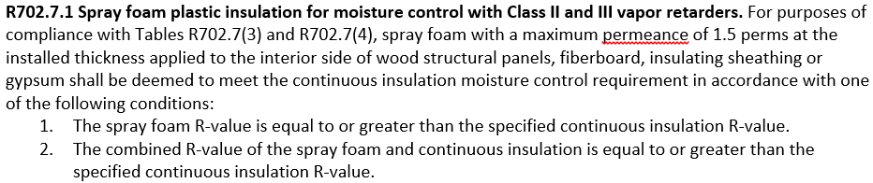
Design Examples
20+5ci Wall Assembly
  Class III vapor retarder -- Minimum R-11.25ci required on 2x6 wall per code. Thus, R20+5ci wall does not work if the R20 cavity insulation is all vapor permeable.
  Alternative:
    Use minimum R-6.25 ccSPF in cavity with R-15 cavity insulation and R-5ci on exterior.
    R-(15+6.25) + 5ci wall ➔ R21 + 5ci wall which meets energy code and allows use of Class III VR.
    The R-6.25 ccSPF and R-5ci can be added together only for the purpose of meeting this table and can’t be added together for energy code compliance.
    ccSPF in cavity must be installed to thickness required for minimum 1.5 perms.

Slide 39
Design Examples
Example 2 – Commercial Building (Group R Residential)
Given: In Climate Zone 5 for a Group R building, the energy code provides the following prescriptive wood-frame wall insulation options:
  R-13+R-7.5ci
  R-20+R-3.8ci
Find: For each of the assembly insulation conditions above, what vapor retarder options are appropriate in accordance with the building code?

Slide 40
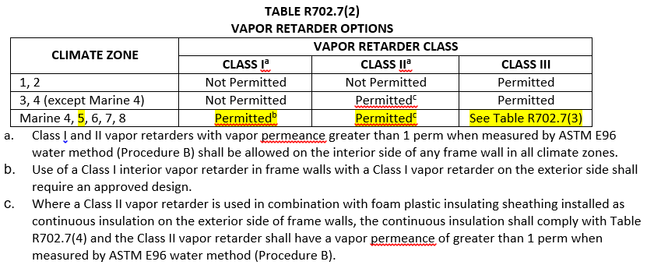
Design Examples
In Climate Zone 5 any of the following vapor retarders are permitted:

Slide 41
Design Examples
R-13+R-7.5ci
  Complies with Class II “smart” (Kraft) vapor retarder
  Complies with use of Class III vapor retarder
R-20+R-3.8ci
  Does not comply with min. ci R-value for 2x6 wall in CZ 5 with Class II VR
  Does not comply with min. ci R-value for 2x6 wall in CZ 5 with Class III vapor retarder
  Alternate: Increase ci R-value or use ccSPF in cavity for partial fill to meet ci R-value, but ccSPF must be thick enough to meet minimum 1.5 perm

Slide 42
Design Examples
Example 3 – Commercial Building (“All Other” – non-Residential)
Given: In Climate Zone 2 for a non-residential metal-frame building, the energy code provides the following prescriptive wall insulation options:
  R-13+R-5ci
Find: For each of the assembly insulation conditions above, what vapor retarder options are appropriate in accordance with the building code

Slide 43
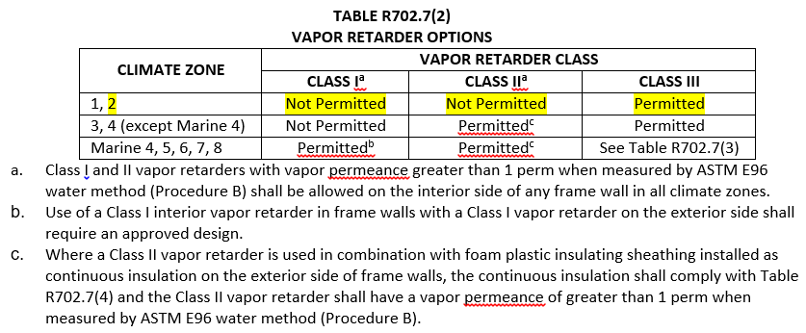
Design Examples
In Climate Zone 2:
  Only Class III VR is permitted
  There is no minimum limit on ci R-value
  Footnote ‘a’ would allow use of Class I or II “smart” vapor retarder
Solution: use Class III VR in CZ 2 with R-13 + R-5ci assembly for maximum drying to interior in warm climate.
Use of lower-perm ci will also help minimize inward vapor drives which are more persistent in warm climates.

Slide 44
Conclusions
Energy Code Advancements
  Significant advancements have been made and are continuing
  These require improved and coordinated building code moisture control requirements as per 2021 IBC and IRC
Coordinated Building Code Advancements
  Significant expansion and improvement of water vapor retarder provisions
  Still some work needed (e.g., guidance permeance controlled assemblies)
  Major improvement for reservoir claddings
Example Applications
  Demonstrate coordinated energy code and building code provisions
  Allows flexibility to optimize energy code and building code compliance

