Slide 1
Engineering Analysis of NFPA 285 Tested Assemblies

Slide 3
Introduction
Foam plastics used in buildings of Types I-IV construction require an assessment of their ability to resist vertical and lateral flame spread
IBC Section 2603.5.5:
“The exterior wall assembly shall be tested in accordance with and comply with the acceptance criteria of NFPA 285”

Slide 4
Introduction
Does this mean that every possible wall assembly configuration needs to be tested to NFPA 285 to be compliant with the code?

Slide 5
Introduction
What about extension of tested assemblies through engineering analysis?
Is actual testing required, or is engineering analysis permitted?
Let’s look at the building code requirements

Slide 6
Code Requirements
First, there are exceptions to the requirement
Code compliance of fire-rated wall assemblies
IBC Section 2603.5.5:

Slide 7
Code Requirements - Exception #1
One-story buildings complying with IBC Section 2603.4.1.4
Flame spread index of 25 or less
Smoke-developed index of 450 or less
Foam Plastic Insulating Sheathing (FPIS) not more than 4" thick
Equipped with an automatic fire sprinkler system
FPIS covered with 0.032“-thick aluminum or 0.0160" corrosion-resistant steel

Slide 8
Code Requirements - Exception #2
FPIS covered by minimum 1" masonry or concrete AND
No airspace between FPIS and masonry/concrete OR
Flame spread index less than 25 and airspace a maximum of 1"

Slide 9
Code Requirements
So other than the exceptions, do all other wall assemblies need to be tested?

Slide 10
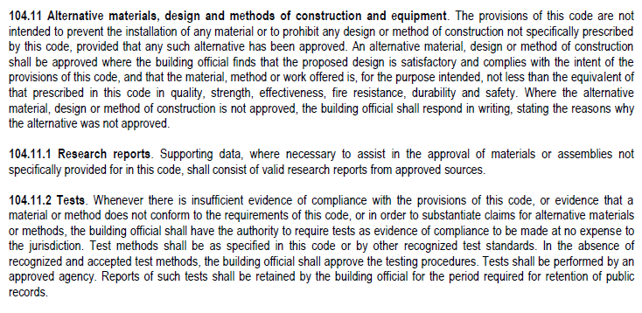
Code Requirements
Alternative materials code provisions (IBC 2015):

Slide 11
Code Requirements
“Shall be tested” – what does this mean?
Any exterior wall assembly needs to be tested to, and comply with, NFPA 285
Is testing of each individual assembly required as stated, or does Section 104.11 apply?
Analysis may be permitted, if the requirements of Section 104.11 are met

Slide 12
Code Requirements – 2015 IBC Combustible Components That Can Trigger NFPA 285 Testing
Combustible air and Water Resistive Barriers (WRB) – 1403.5
2015 IBC includes two new exceptions for limited combustible WRBs
Foam plastic insulation – 2603.5.5
Combustible claddings
In buildings over 40' tall:
EIFS – 1408.2
MCM – 1407.10
FRP – 2612.5
HPL – 1409.10

Slide 13
NFPA 285 Testing
When is NFPA 285 testing of an actual wall assembly required?
Generally, when “noncombustible” walls contain “combustible” materials
Mid and High rise buildings
Applications where assembly fire performance is critical for evacuation and life safety

Slide 14
What is NFPA 285 Testing?
NFPA 285 is a two-story test of a wall assembly testing flame propagation in the following areas:
Over the face of the wall covering
Vertical flame propagation within the combustible core or components
Over the interior surface from one floor to the next
Lateral flame propagation to adjacent compartments

Slide 15
What is NFPA 285 Test Setup?
Fixed gas burner in the center of the first-story test room
The test room contains a window opening with a portable gas burner placed in it

Slide 16
NFPA 285 Test Procedure
Minutes 0-5:
The room burner is ignited and must achieve a first-story room temperature of 1151°F
Minutes 5-30:
The window burner is ignited at minute 5
Both continue to burn for the 25-minute period
Together, they must achieve an average first-story room temperature of 1648°F

Slide 17
NFPA 285 Pass Criteria
For the interior:
No flame propagation into the second-floor room
No thermocouple within 1" of the interior wall surface at the second-story test room can exceed 500°F

Slide 18
NFPA 285 Pass Criteria
For the exterior:
Flames shall not reach 10' above the top of the window opening and shall not reach 5' laterally from the window’s centerline
Thermocouples inside the wall assembly shall not exceed 1000°F during the test

Slide 19
NFPA 285 Pass Criteria
For the internal assembly (i.e., inside assembly)
Assemblies with:
Wall coverings > ¼" thick; or wall coverings ≤ ¼" thick without an air space
Cannot have combustible components that exceed 750°F at thermocouples near the assembly perimeter at the second-story test room
Wall coverings ≤ ¼" with an air space
Temperatures in the air cavity must not exceed 1000°F
Temperatures in the insulation must not exceed 750°F at thermocouples near the assembly perimeter at the second-story test room

Slide 20
Alternative Material Approval Criteria
IBC 104.11 provides the following instructions:
Design is satisfactory
Complies with the intent of the code
Not less than that prescribed in the code in:
quality
strength
effectiveness
fire resistance
durability
safety
Research report from an approved source
Testing from an approved agency

Slide 21
Independent Evaluation by an Approved Source
DrJ Engineering, ICC-ES, IAPMO, ATI/Intertek and NTA are all examples of approved sources that can provide evaluation of alternatives for code compliance

Slide 22
Alternative Material Approval Criteria
One example is ICC-ES AC12 – Acceptance Criteria for Foam Plastic Insulation
AC12 Section 6.6:
Provides specific allowance of engineering analysis to extend NFPA 285 test results

Slide 23
Engineering Analysis Example
Assembly 1 contains Product X and passes NFPA 285 testing
Product X also undergoes cone calorimeter flammability testing to establish the baseline fuel load of the product
Product Z then undergoes cone calorimeter flammability testing
If the results are the same or better than Product X, then Product Z is an acceptable alternative to Product X

Slide 24
Engineering Analysis Example
By passing the same cone calorimeter flammability test as Product X, Product Z is proven equivalent to Product X
Thus, Product Z can be substituted into Assembly 1 with the expectation that it would also pass NFPA 285

Slide 25
Engineering Analysis Reasoning
Only complete assemblies are tested for compliance with NFPA 285
Therefore, the specific products used in the assemblies are the only products deemed to pass testing criteria

Slide 26
Engineering Analysis Reasoning
The language regarding approval of alternative materials is very clear:
Alternative materials “shall be approved” if they are found to comply with Section 104.11, meet the intent of the code and are proven to be at least equivalent to material tested in the original assembly

Slide 27
Engineering Analysis Reasoning
If a material that was not tested in the original assembly is brought into question as being a suitable replacement, the following language dictates the appropriate steps
IBC Section 104.11.2:

Slide 28
Conclusion
2012 IBC Commentary explains:
The focus of the requirement in IBC Section 2603.5.5 for exterior wall assemblies is flammability rather than fire resistance
If material tests prove products are equivalent or better, assembly tests can maintain validity even after alternative material substitution

Slide 29
Conclusion
For assemblies using foam plastic insulation, either option shall be permitted by the building code official:
Testing to NFPA 285, or
Analysis of the substitution of a different product in a tested assembly in accordance with Section 104.11

Slide 30
Conclusion
Compliance report for a substituted foam plastic insulation product should:
Be written by an independent source:
Approved by the building official with the proper qualifications for the analysis of the engineering principles of materials and methods
Reference specific NFPA 285 pass test results
Include small-scale testing, if appropriate
Specify all assembly components and constructions

Slide 31
Conclusion
Compliance report should also:
Substitute only one specific component in a tested assembly in the same location with the same installation requirements (e.g., air gap, attachment method).
Include opening and flashing details, where required
Address all of the applicable concerns listed in 2015 IBC Section 104.11

