Slide 1
STOP WARDROBE MALFUNCTIONS
Don’t Eat Your Sweater:
Continuous Insulation for Code-Compliant & High Performance Walls
Jay Crandell, PE

Slide 3
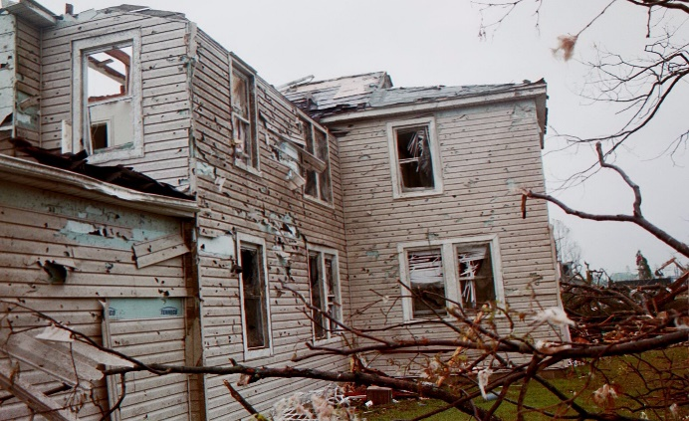
Introduction
Welcome
What’s my story?
  Joe has been addressing keeping the “sweater” and the wall dry
  My presentation is about keeping the sweater on and functional – no wardrobe malfunctions!
    Basically all the other things for code compliance and good practice.
    Nobody wants a disaster….
Notes:
3

Slide 4

Outline
Building Code Compliance
  Continuous Insulation
  Installation and details
  Water resistive barrier
  Siding and Furring Connections
  Window connections/support
  Wall Bracing
  Fire Requirements
Energy Code Compliance
Additional Resources

Slide 5
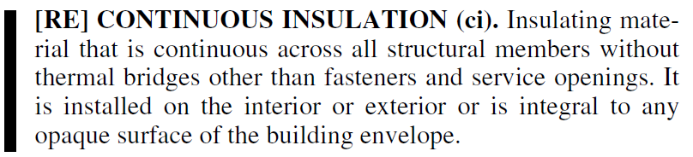
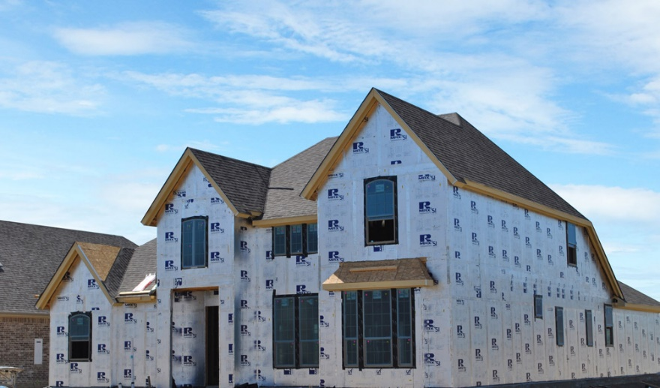
What is continuous insulation?
Definition (2015 IRC)

Slide 6
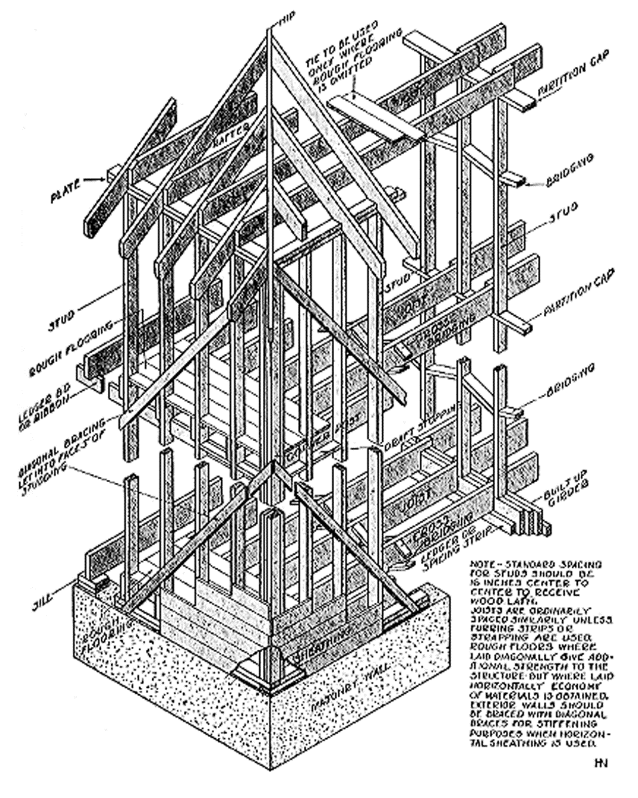
CI History
In early 1900’s, solid wood board sheathing was considered as insulation (HEW, 1931) (~1.2 R/in)
Cellulosic Fiber Insulating Board (‘Fiberboard’) in use since the early 1900’s (~2.5 R/in)

Slide 7
CI History
Continuous insulation is not a new concept. Foam plastic insulating sheathing has been successfully used in this application for more than 50 years.
  Foam sheathing has been used as continuous insulation for low-slope roofs since the 1940’s
  Wall applications of continuous insulation saw increased use after the 1970’s oil crisis

Slide 8
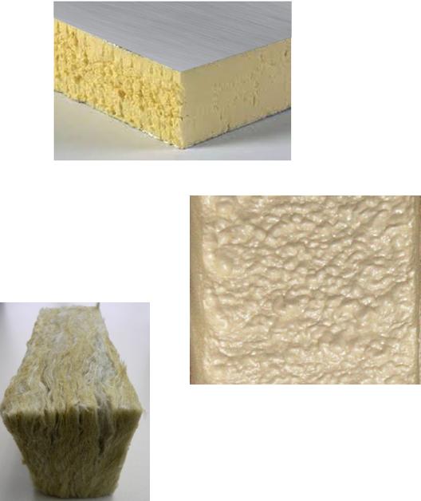
CI Material Types
Foam Plastic Insulating Sheathing
  Foam sheathing, rigid board insulation, etc.
Other types:
  SPF (closed cell polyurethane)
    When used continuously
  Mineral fiber
  Fiberboard
  Insulated siding
  Insulated wraps

Slide 9
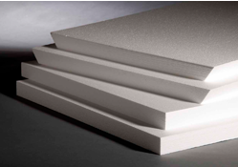
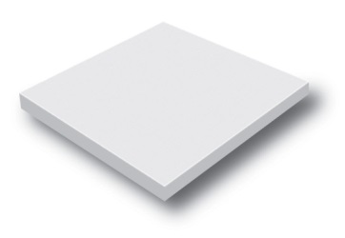
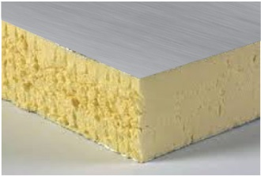
Foam Plastic Insulating Sheathing (FPIS)
Expanded Polystyrene (EPS), ASTM C578
Extruded Polystyrene (XPS), ASTM C578
Polyisocyanurate (Polyiso), ASTM C1289

Slide 10
Possible Code-Compliant Uses of Foam Sheathing
Continuous Thermal Insulation (CI)
Water Resistive Barrier (WRB)
Air Barrier (AB)
Water Vapor Control
Wall Bracing (structural composite panels)

Slide 11
R-value per Inch
Consult with FPIS manufacturer for specific values.
Values shown are representative minimum values.
Notes:
11

Slide 12
Water Resistance

Slide 13
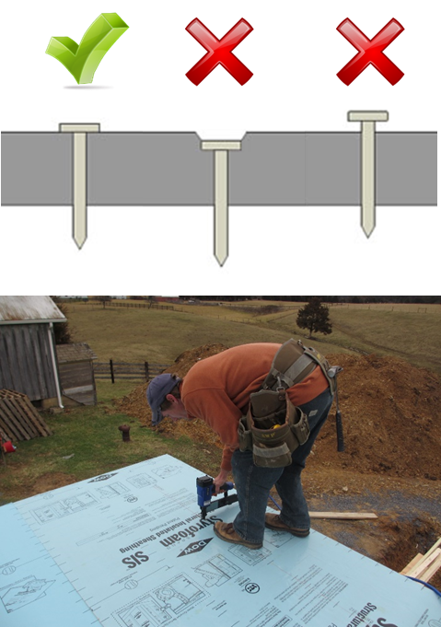
Installation of Foam Boards/Panels
#1 - Follow manufacturer’s installation instructions
Cut with power/hand saws, utility knife, etc.
Drive nails flush and snug
Cap washers are preferred
Some specialty products may require or allow use of nail or staple guns

Slide 14
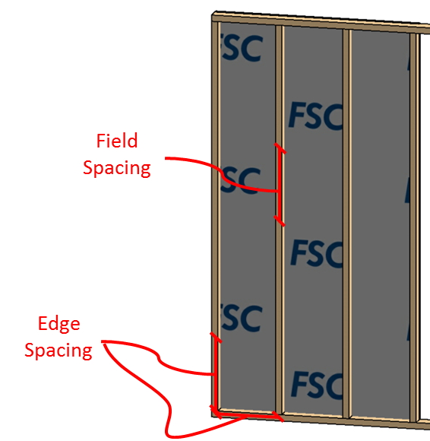
Typical Fastening Pattern
Fasteners along studs and plates at
  Edges of panel
  Field of panel
Typical: 12” oc (edges and field along studs)
  Some may specify 16” oc in field

Slide 15
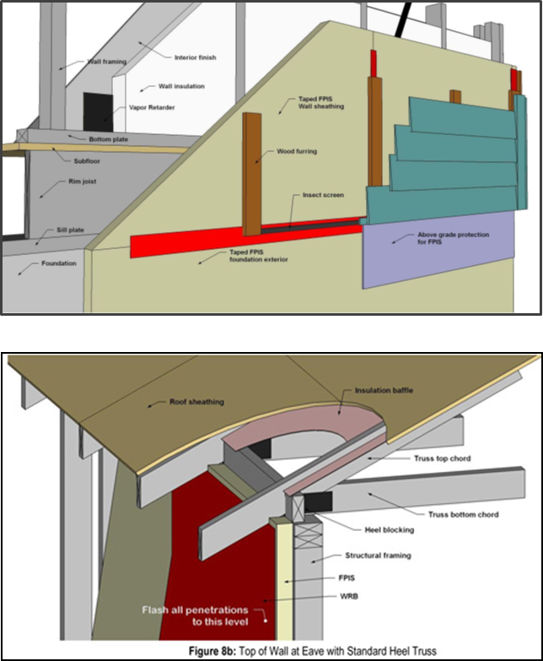
Construction Details – Plan Ahead!
Framing, Sheathing, WRB, Siding Details
  Many sources are available for accepted details and code compliance
  Some resources/ examples follow
Notes:
15

Slide 16
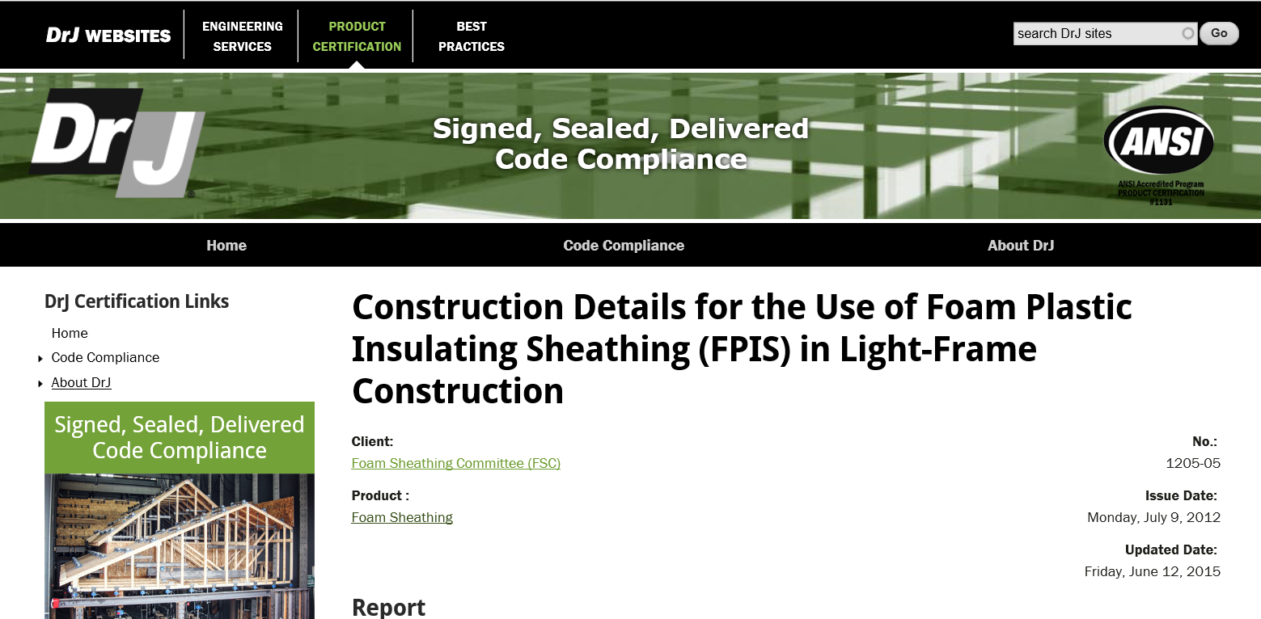
TER 1205-05 Construction Details www.drjcertification.org

Slide 17
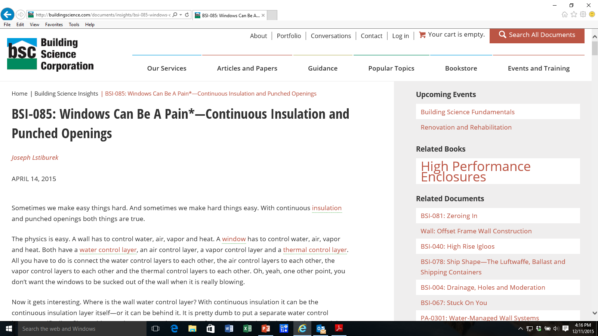
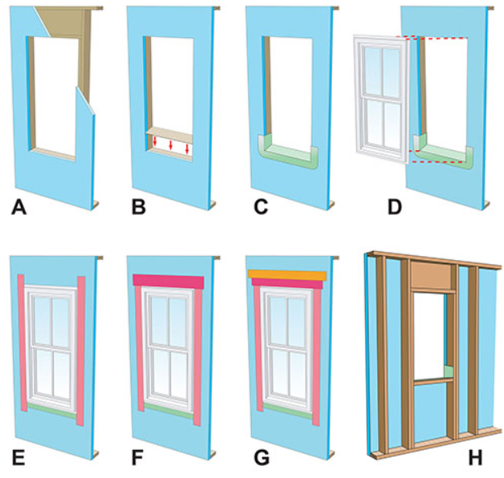
Building Science Corporation www.buildingscience.com

Slide 18
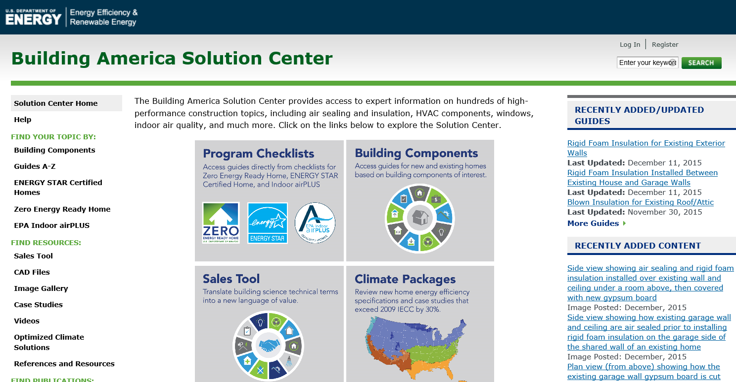
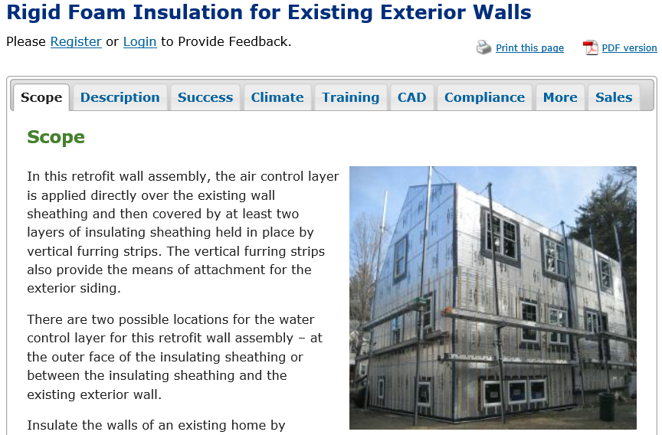
DOE Building America Solution Center basc.pnnl.gov

Slide 19
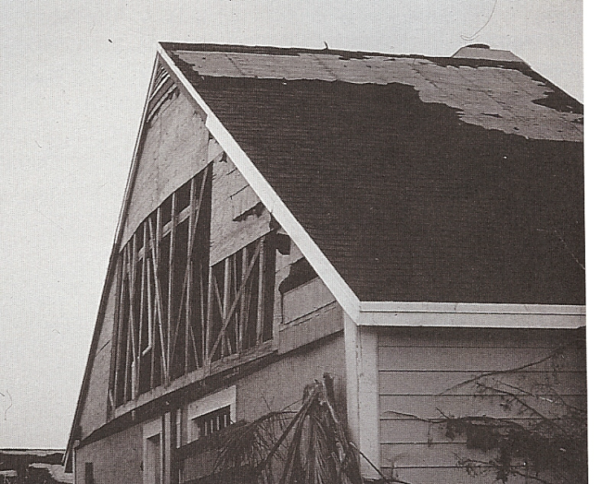
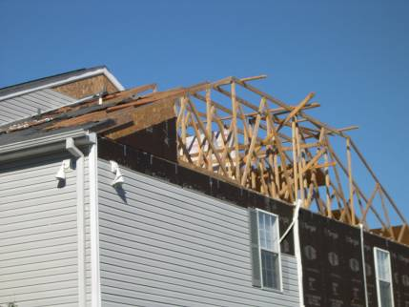
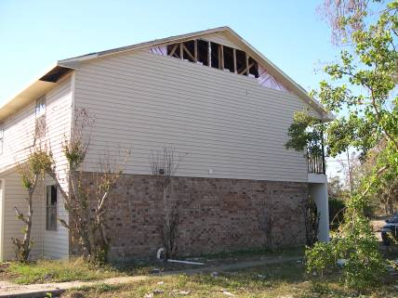
Wind Pressure Requirements
All exterior sheathing materials (and claddings) must meet wind pressure requirements of the code
Wood structural panels
Fiber board
Foam sheathing
Notes:
19

Slide 20
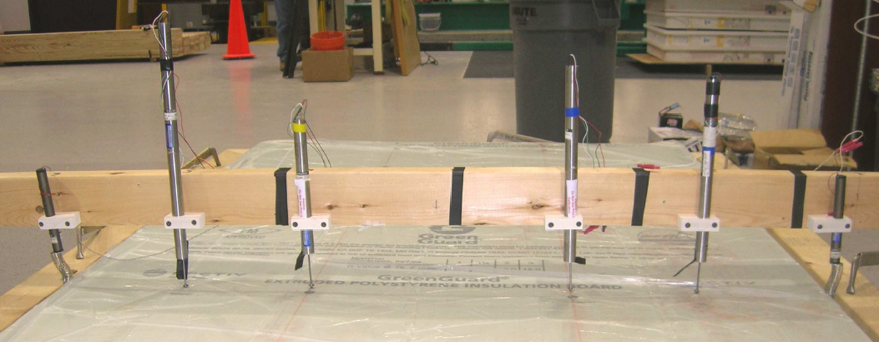
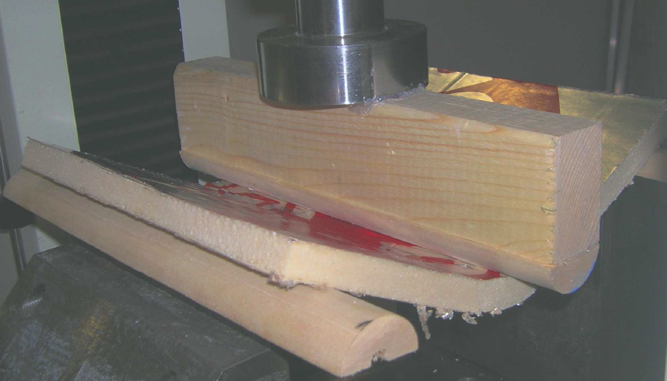
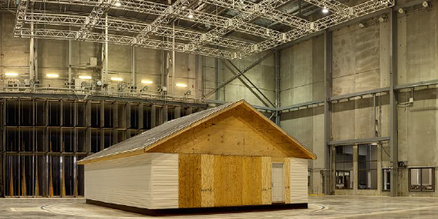
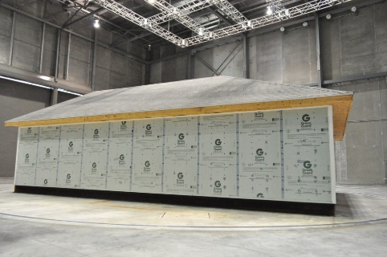
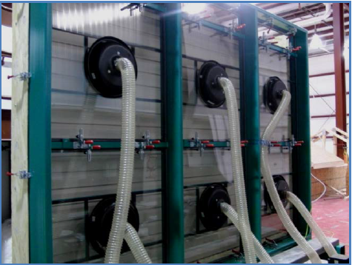
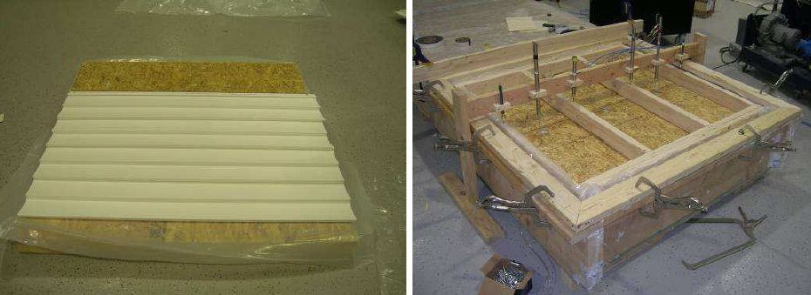
Wind Resistance of FPIS & Vinyl Siding Over FPIS
State-of-art testing program
Worked with FSC/ACC, IBHS, NAHB, VSI, DOE, HIRL, and AWC
Resulted in ANSI/FS 100 Standard

Slide 21

Code Compliance (wind pressure)
ANSI/SBCA/FS 100–2012
sbcindustry.com/fs100.php
  Foam sheathing wind resistance rating standard
  Referenced in 2015 IRC Section R316.8
  Exception: Foam sheathing does not need to be rated if used over structural sheathing !!!
Cladding/furring provides permanent attachment for wind resistance
  Foam sheathing attachment is for temporary construction
  Can use specialty fastener/washers for permanent wind resistance
Notes:
21

Slide 22
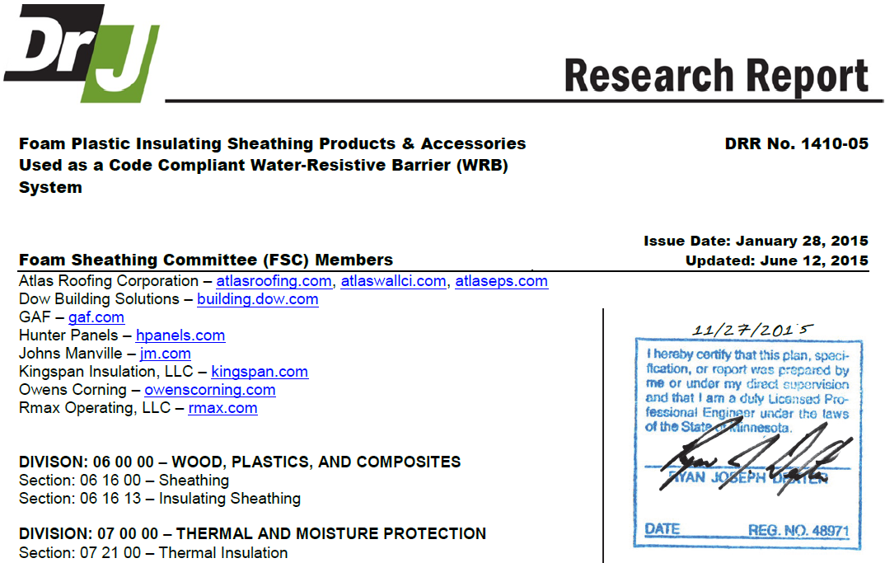

Water Resistive Barrier Application
Use tested and approved foam sheathing WRB products and accessories (e.g., joint tapes and flashings)!
Follow manufacturer’s installation instructions
http://www.drjcertification.org/products/foam-sheathing

Slide 23
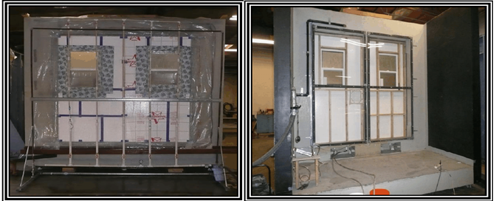
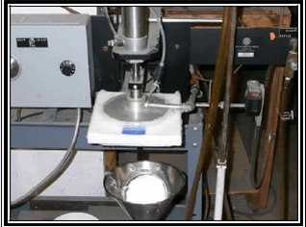
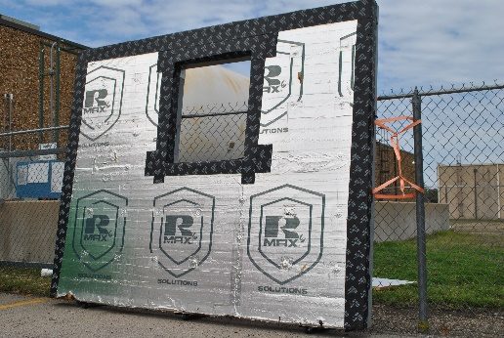
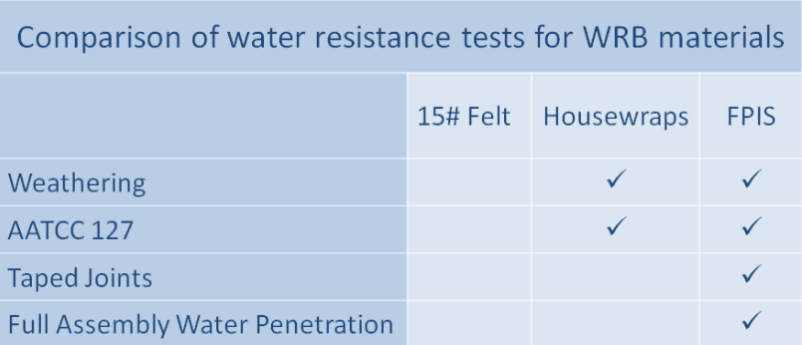
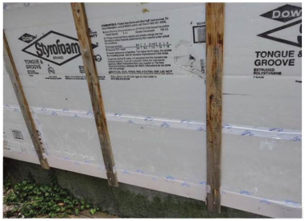
WRB Code Compliance & Performance
ABTG Research Report No. 1504-03 www.appliedbuildingtech.com/rr/1504-03
Water head test after accelerated aging of tape joint
ASTM E331, 2hrs @ 6.24psf with 5gph/ft² spray
Foam WRB & Flashing Tape (3-yr exposure)
Tape joints in-service performance (~15 years after install)
No. 15 Felt = 5-7min @ 2.86psf (code benchmark)

Slide 24
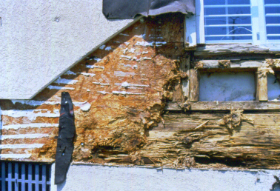
Lesson from EIFS apply to all walls: USE A WRB AND PROPER FLASHING!
Problems identified:
  No drainage of cladding
  No water resistive barrier layer
  Face sealing (rely on caulk?)
  Leaky window units and no pan
  Roof/wall flashing missing or wrong
  Use of interior poly (“double” and “reversed” vapor retarder) in mixed/warm/humid/rainy climates
Problems fixed in IRC
  WRB drainage layer & flashing required behind all claddings, including EIFS (now also drainable)
A very serious wardrobe malfunction
Notes:
24

Slide 25
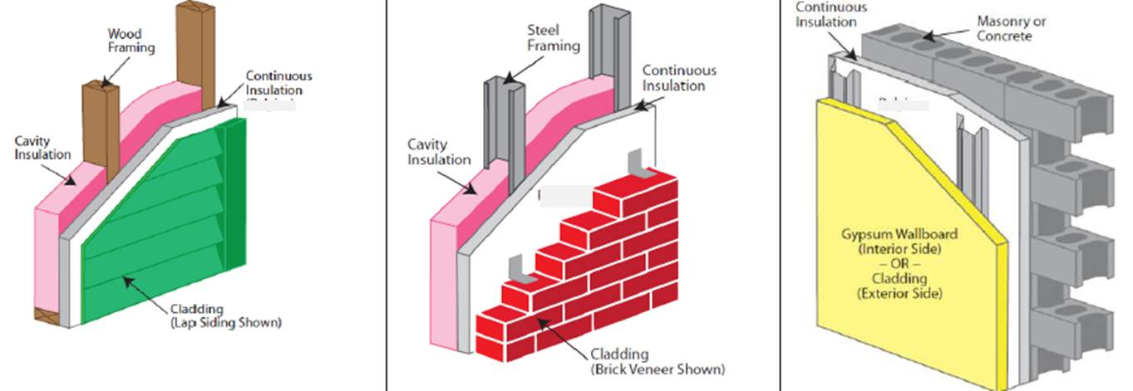
Siding and Furring Connections
Must fasten through foam sheathing!
Place wood or steel furring members over CI to avoid heat loss (thermal bridging) and condensation risk
  Steel furring significantly greater thermal bridge than wood
  Stainless steel has 1/3rd the thermal transmissivity of carbon steel fasteners and connectors

Slide 26
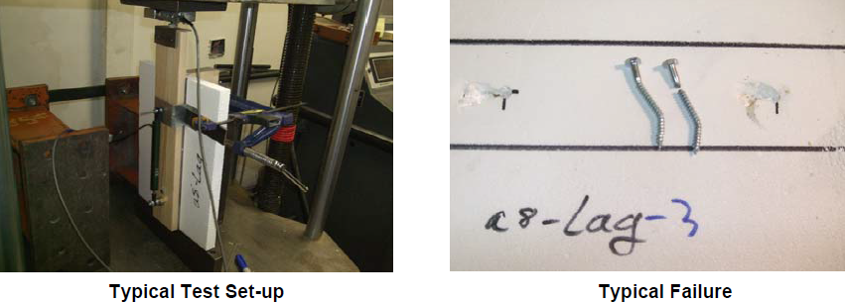
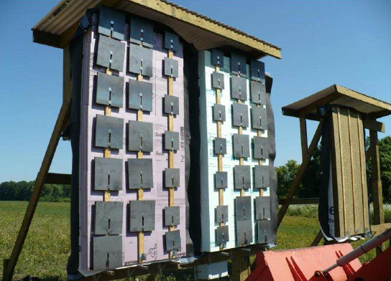
Cladding Attachment through FPIS
Collaborative research
  FSC, NYSERDA, SFA, BSC for DOE/BA, Newport Partners, ARES/ABTG, etc.
Extensive testing effort
  siding and furring connections
  FPIS (up to 4” thick)
  Wood and steel framing
  Commodity nails, screws, & lags
Developed design method consistent with NDS and AISI standards
Solutions added to 2015 IRC
  Proprietary fastener innovations
  Used in various cladding and fastener manufacturer installation instructions

Slide 27
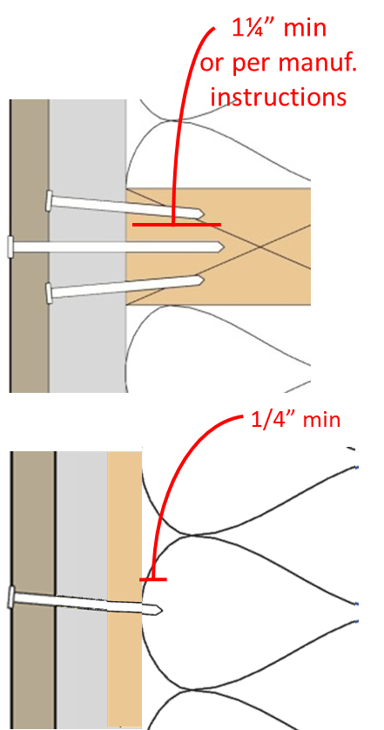
Cladding & Furring Attachment
2015 IRC code requirements:
  R703.15 (wood framing)
  R703.16 (steel framing)
  R703.17 (concrete/masonry)
Siding fastener embedment must be maintained
  Use longer fasteners as needed
  Can use WSP nail base for limited (lightweight) siding applications
Also refer to siding manufacturer’s installation requirements
Minimum 15 psi foam material
Notes:
Soil is a compressible material and we build whole buildings on it. 15 psi foam has a bearing capacity of 2,160 psf and with a safety factor of 3 gives an allowable bearing value of 720 psf. Higher compressive strength foams should be used if bearing foundation loads, but for wall applications 15 psi foam is more than sufficient compressive strength and is the minimum basis in the code.
27

Slide 28
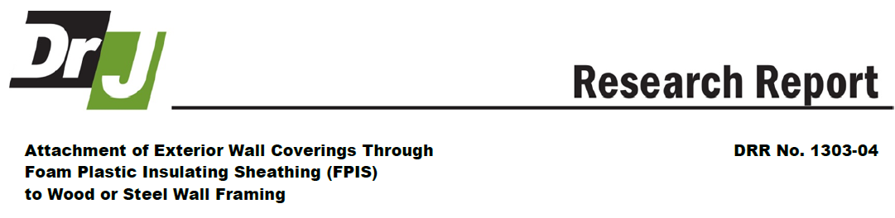
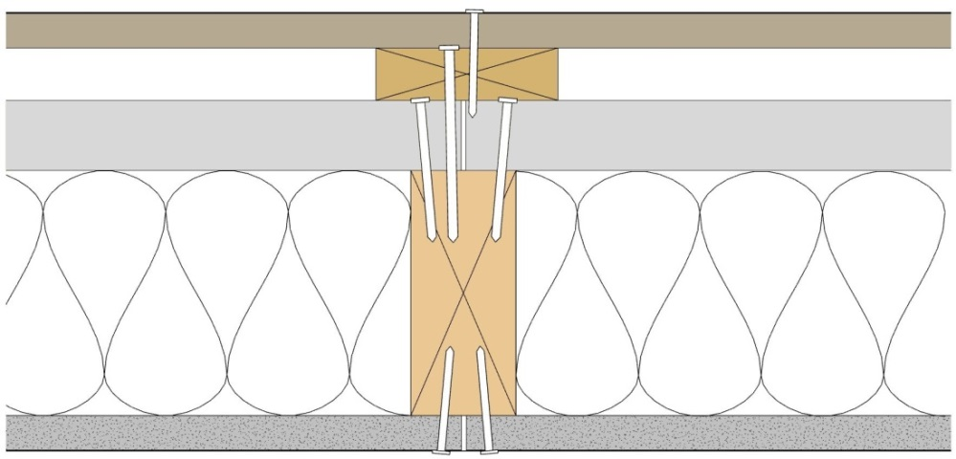
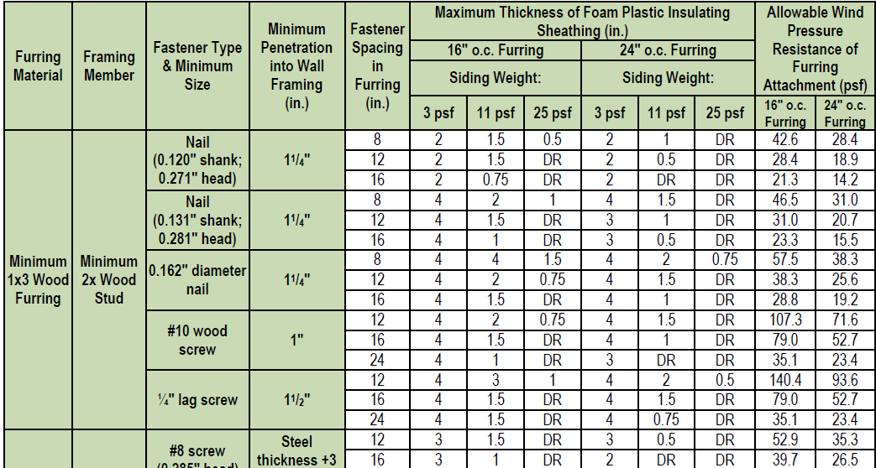
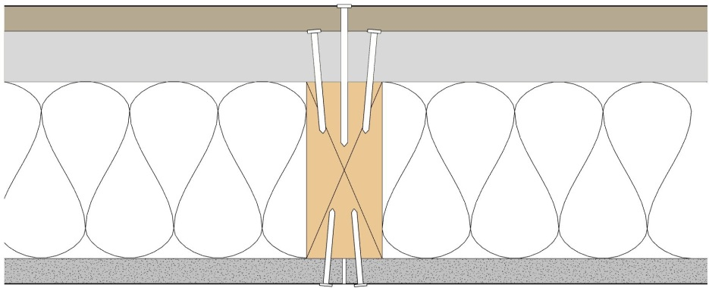
Exterior Wall Covering Attachment over FPIS www.drjcertification.org/products/foam-sheathing
(a)
(e)
(b)
(c)
(d)
(a)
(e)
(c)
(d)

Slide 29
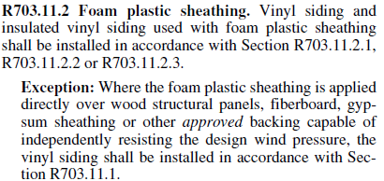
Vinyl Siding Over Foam Sheathing
(wind pressure ratings)
OK, we’ve addressed the “sagging covering” wardrobe malfunction. Now, what if the wind blows?
IRC 2009/2012/2015:
Exceptions are important! – use standard siding wind rating and installation if FPIS is installed over other panels capable of resisting the wind load (oversheathing)
Notes:
29

Slide 30
What if the exception doesn’t apply?
If in 115 mph wind zone (non-hurricane) and exposure B (typical wooded/suburban)…
  Use min. ½” XPS or polyiso, or min. 1” EPS
  Use 1-1/4” fastener penetration in to framing
No problem, follow vinyl siding manufacturer’s installation instructions
No need to adjust siding wind pressure rating

Slide 31
What if that doesn’t apply?
It gets a bit more complicated
Vinyl siding standard wind pressure ratings will need to be modified to determine appropriate siding for the application
  Multiply siding wind pressure rating by 0.39 if wall has interior gypsum board finish
  Multiply siding wind pressure rating by 0.27 if wall is not finished on the interior (e.g., gable end wall)
This only applies to vinyl siding because its wind rating relies on pressure equalization

Slide 32
Vinyl Siding Wind Rating Adjustment
Example:
  130 mph, exposure B (moderate hurricane area)
  Code wind pressure required = 24 psf (neg. pressure)
  Siding wind pressure std. rating = 65 psf
    This is a moderately high rated product (premium)
  Adjustment = 0.39 x 65 psf = 25 psf
  25 psf > 24 psf OK
Results in a more rigid and higher performing (higher safety factor) vinyl siding installation
More resilient protection of WRB during major wind event
  Unintended “exposure” wardrobe malfunction avoided

Slide 33
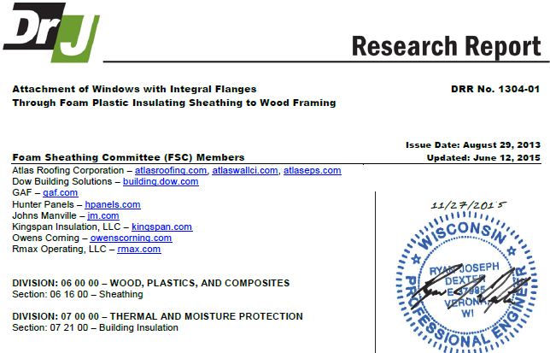
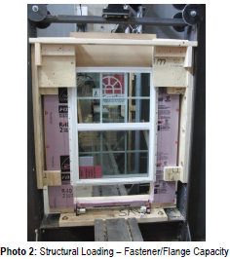
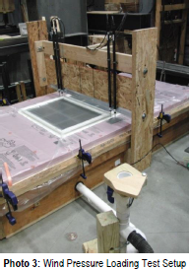
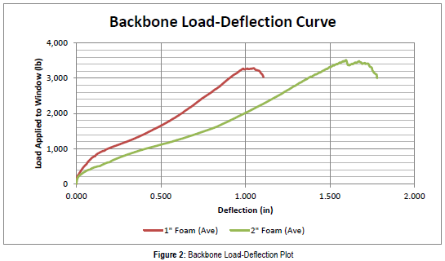
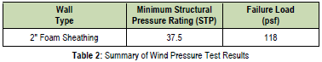
Window Install and Flanges over FPIS
Attachment of flanges directly through foam up to 2” thick have been tested.
  Support of gravity loads
  Wind resistance
http://www.drjcertification.org/products/foam-sheathing

Slide 34
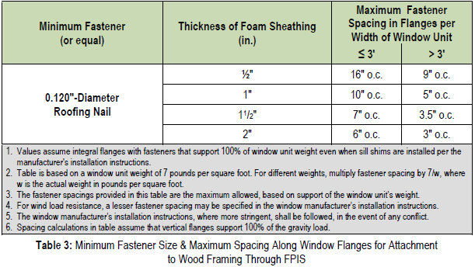
Installation Guidance (flange fasteners)
Follow window manufacturer instructions (shims, anchors, etc.) and verify adequate flange fastening
  Typical flange fastening generally OK for up to 2” thick foam sheathing and typical 3’ windows

Slide 35
Installation Guidance (typical practice)
Common field practice (rule-of-thumb):
  Directly attach flange over foam to framing if foam sheathing thickness is 2” thick or less
  Use a window “buck” to support window if foam sheathing is greater than 2” thick
  Some prefer 1-1/2” thick as the trigger – use what you’re comfortable working with for your project!

Slide 36
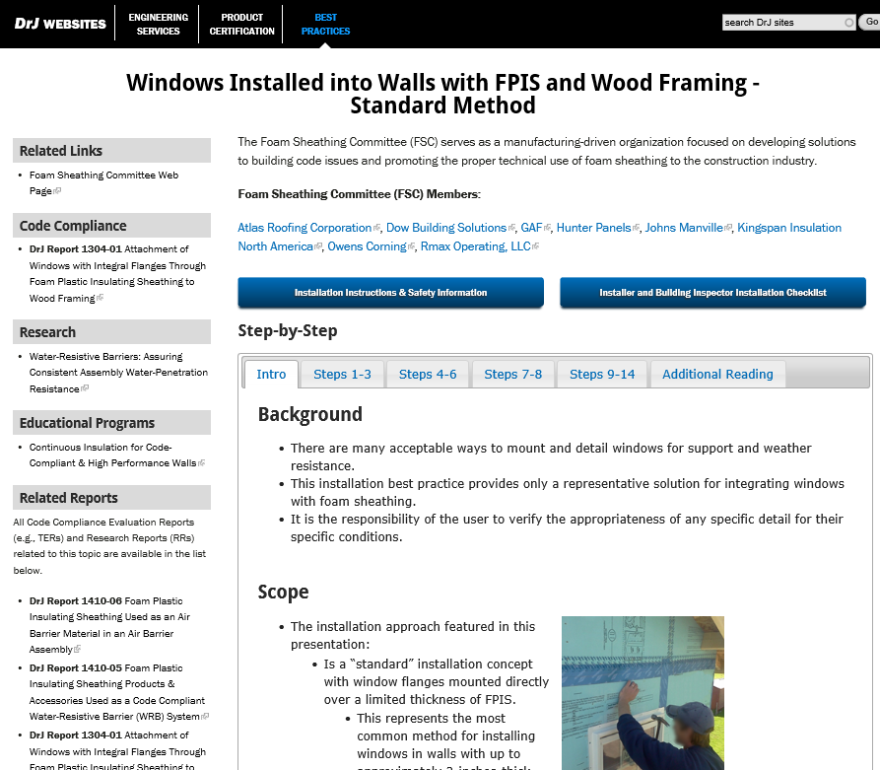
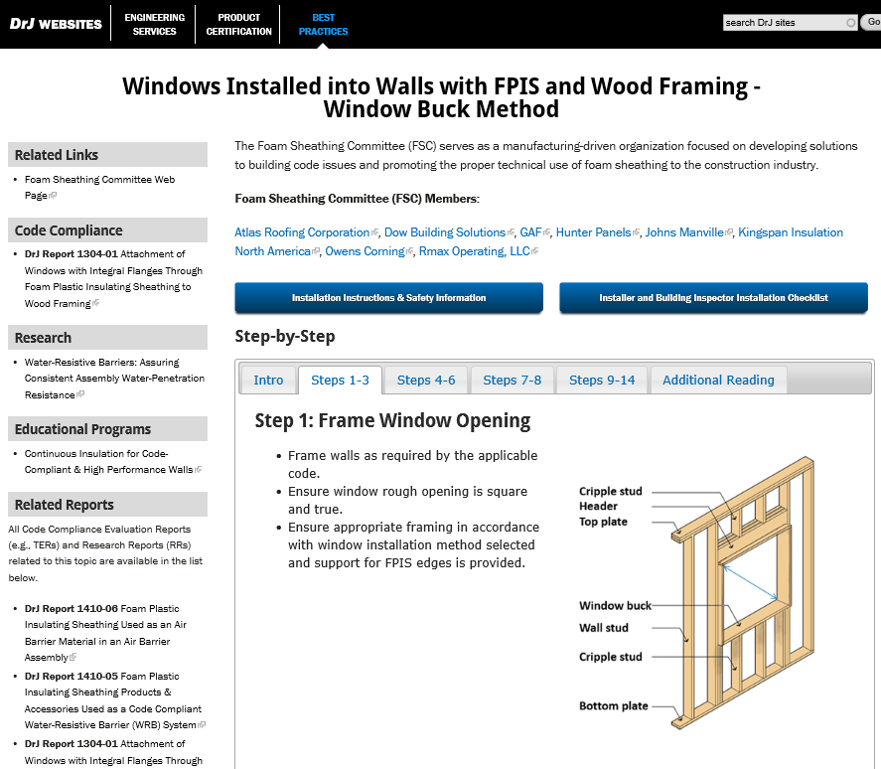
Window Installation Guides
(Standard & Window Buck Installation Methods)
http://www.appliedbuildingtech.com/fsc

Slide 37
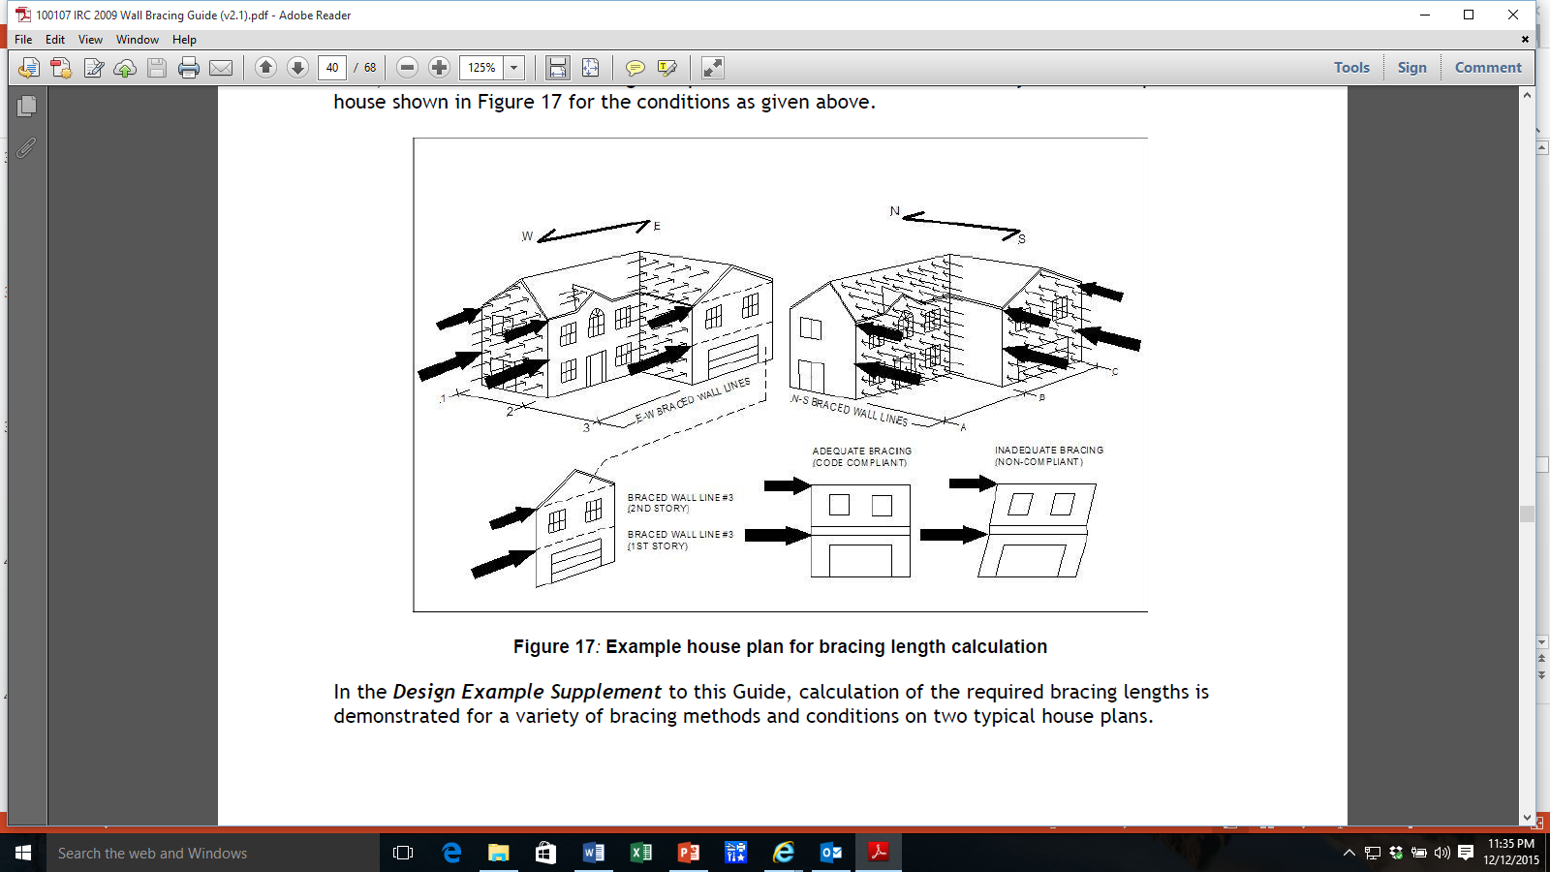

Wall Bracing (IRC Section R602.10)
Many building design factors impact wall bracing and sheathing/insulation decisions.
APA/ICC, FSC, and others offer Wall Bracing Guides to help with this section of code
All bracing methods have limitations, advantages, and disadvantages
http://www.appliedbuildingtech.com/fsc
Notes:
37

Slide 38

Wall bracing – integration with FPIS
Code-compliant bracing methods include:
  Use of foam over continuous structural sheathing (e.g., OSB, plywood, structural fiberboard, etc.) – larger homes/lots of windows
  Use of foam between and/or over intermittent braced wall panels (e.g. WSP, let-in brace, etc.) – smaller/affordable homes

Slide 39

Different views of the world of walls?
Sources:
http://www.greenbuildingadvisor.com/blogs/dept/musings/osb-airtight
http://buildingscience.com/documents/digests/bsd-139-deep-energy-retrofit...
Baby It’s Cold Outside – Nazareth College, Rochester, NY (Wikimedia commons)
Minimum bracing requirements rule the wall area!
But, everybody seems to want the product continuous…
  Continuous structural sheathing
  Continuous insulation
  What next?...Continuous windows?
Balance is achieved in smart, code-compliant designs.

Slide 40

Fire Requirements - IRC
Fire safety requirements for foam sheathing
  IRC Section R316
    R316.3 – Surface burning characteristics
      ASTM E84 or UL 723 - Standard Test Method for Surface Burning Characteristics of Building Materials
      FS ≤ 75 (oak = 100) and SDI ≤ 450
    R316.4 – Thermal barrier
      ½” gypsum or other approved material on interior (typical)
      Some exceptions per approval
    R316.6 – Special approval
      NFPA 286, FM 4880, UL 1040, UL 1715, or other fire tests related to end use configurations

Slide 41
Fire Resources for FPIS
DRR No. 1202-04 Type I-IV Construction
DRR No. 1202-03 Type V Construction
DRR No. 1202-01 NFPA 285 Tested Assemblies
  www.appliedbuildingtech.com/fsc
Add gypsum sheathing for exterior fire rating where needed (e.g., narrow building separation)

Slide 42

Energy Code Compliance
US Climate Zone Map

Slide 43

R-value Compliance Path (prescriptive)
Notes:
43

Slide 44
Other Compliance Paths
U-factors (simple to derive alternate R-values)
  R11+11ci = R13+10ci = R15+8.5ci = R20+5ci = R30
  2x4…2x4…2x4…2x6…2x8 (wall thickness increases as cavity insulation amount increases)
Total envelope UA = UwAw + UrAr + etc.
  Trade away insulation in one place, put more in another
Performance Path (more flexibility)
Energy Rating Index (HERS)
All are tools to help to fine-tune designs
  Limits? – moisture control, comfort, ghosting, etc.

Slide 45
Three Wall Insulation Approaches
Cavity insulation only
Cavity insulation + continuous insulation (ci)
Continuous insulation (ci) only

Slide 46



CI Helps Stop Thermal Bridging

Slide 47


How the sweater works
R-13 cavity insulation
CONCLUSION:
Uh Oh, baby ate sweater…
½” rigid foam CI added
CONCLUSION:
Warm baby, happy baby…
Source: Dryvit/DOW
http://continuingeducation.construction.com/article.php?L=38&C=1147&P=3

Slide 48
U-factor Comparison (sweater vs. no sweater)
R25 ≠ R20 + 5ci
The R20+5ci wall is 15% more efficient than the R-25 wall.
This demonstrates a benefit to wearing and not eating your sweater.
Notes:
Calculation is based on ASHRAE Handbook of Fundamentals, parallel path method, used as the basis for R-value solutions in the IECC.

Slide 49

Coordinate with Building Code Vapor Retarder Requirements
This check is important…
Notes:
Not coordinating energy code decisions with water vapor control control can result in some non-obvious (but should be obvious) potential issues. For example, the energy code allows foam sheathing to be reduced in thickness (R-value) over intermittent wood brace panels for practical reasons (maintain a uniform wall thickness); However, if you reduce the foam sheathing R-value for this reason or for reason of U-factor trade-off, you can run into problems with water vapor control if you do not also verify compliance with the water vapor retarder provisions of the building code. The same is true of walls without continuous insulation. For example, if you increase cavity insulation and it is vapor permeable insulation you better also increase the vapor resistance on the interior (and/or open the exterior up more) and also be more careful with interior air-sealing of the assembly. In short, there is no free lunch. Every system for insulation must be coordinated appropriate with water vapor control provisions.

Slide 50
Air Leakage Control (Air Barriers)
Continuous air-barrier (AB) is required by the IECC & IRC Chapter 11-Energy
The code does not specify air barrier location
  Can be located on the interior, inside, or to the exterior side of walls
EPA Energy Star* requires AB on both sides of walls in cold climates (best practice and highly recommended)
Important to energy conservation and moisture control
Refer to:
  Air Leakage Guide, US DOE, Building Technologies Program

Slide 51
Air Barrier Materials & Methods
Many materials and methods of AB installation are available
  Foam Sheathing w/taped joints
    DRR 1410-06, FPIS Used as an Air Barrier Material in an Air Barrier Assembly.
  Other materials/methods include:
    Sealed drywall installation
    Wraps with sealed/taped joints
    Adhered membranes
    Spray-applied coatings
    Exterior sheathing with sealed joints
    Closed-cell spray foam

Slide 52

Going beyond minimum code with CI
Zero Energy
WRB
AB
WVC
Building Science Corporation
NIST Net Zero Energy Research Home
Notes:
As shown in this photo, FPIS is not just a minimum code insulation solution. It can reach far beyond minimum code requirements to provide exceptional energy savings while providing protection to the building system as a water-resistive barrier, air-barrier, and vapor control layer.
Thus, it is frequently use to gain approval in above-code energy efficiency and green construction programs, such as Energy* and LEED.

Slide 53

A Final Helpful Resource
Durability by Design
– A Professional’s Guide to Durable Home Design
(2nd Edition)
U.S. HUD, Office of Policy Development & Research (www.huduser.gov)

Slide 54
THANK YOU!
Questions?
  Back to Joe…
Contact Info:
Jay Crandell, P.E.
ARES Consulting
www.aresconsulting.biz
Notes:
Thank your for taking part in this presentation!
54

