Slide 1
Water, Wind, Windows, & Walls with Continuous Insulation
IIBEC • March 2022

Slide 3
OUTLINE
Background
Evolving Codes
Fenestration Installation and Performance
Thermal Bridging Impacts of Fenestration Installation
Wind-driven Rain Research
Conclusion & Questions

Slide 4
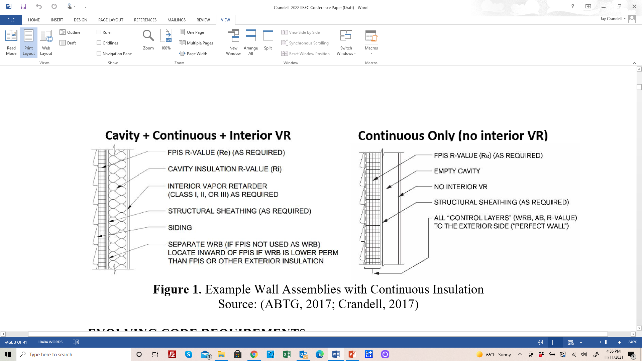
BACKGROUND
Continuous Insulation (ci):
  Insulation that is uncompressed
  …and continuous across
  all structural members
  …without thermal
  bridges*
  …*other than fasteners
  and service openings.
(based on IECC and ASHRAE 90.1 definition)

Slide 5
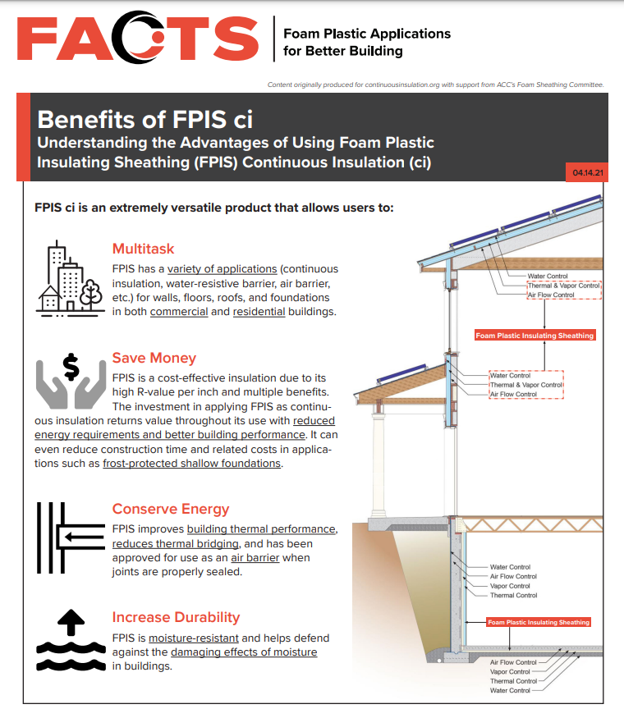
BACKGROUND
Foam plastic insulating sheathing (FPIS) is one type of ci; others include wood fiberboard and mineral fiber.
FPIS has applications for all parts of the building envelope (foundations, walls, floors, and roofs).
FPIS can be multi-functional including ci, water-resistive barrier (WRB), air barrier (AB), vapor control (inward and outward), and even structural.
Prior IIBEC and RCI papers addressed many of these topics.
For additional information refer to: https://www.continuousinsulation.org/resources/benefits-fpis-ci

Slide 6


EVOLVING CODES
2018 & 2021 IECC prescriptive R-values
2024 IBC water vapor retarders
2024 IBC water-resistive barriers
2024 IBC fenestration flashing

Slide 7
Code-referenced Standards for FPIS
ASTM C578
  Expanded polystyrene (EPS)
  Extruded polystyrene (XPS)
ASTM C1289
  Polyisocyanurate (Polyiso, PIC, PIR, etc.)
ANSI/ABTG FS100
  Applies to all types of FPIS where applied over open stud cavities (wind pressure rating is required in this special case)
Fire Properties & Requirements
    IBC Chapter 26 & 14
    See manufacturer data, code compliance reports, and material labels

Slide 8
IECC Prescriptive R-values & U-factors
(light frame commercial buildings)
Climate Zone | Building Use | Metal Framed |  | Wood Framed
 |  | 2018 IECC | 2021 IECC | 2018 IECC | 2021 IECC
0 and 1 | All other | R13+5ci (U-0.077) | R13+5ci (U-0.077) | R13+3.8ci or R20 (U-0.064) | R13+3.8ci or R20 (U-0.064)
 | Group R
2 | All other
 | Group R | R13+7.5ci (U-0.064) | R13+7.5ci (U-0.064)
3 | All other
 | Group R
4 Except Marine | All other
 | Group R
5 and Marine 4 | All other |  | R13+10ci (U-0.055) |  | R13+7.5ci or R20+3.8ci (U-0.051)
 | Group R |  |  | R13+7.5ci or R20+3.8ci (U-0.051)
6 | All other |  | R13+12.5ci (U-0.049)
 | Group R
7 | All other
 | Group R | R13+15.6ci (U-0.052) | R13+15.6ci (U-0.042)
8 | All other | R13+7.5ci (U-0.064) | R18+18.8ci (U-0.037) | R13+15.6ci or R20+10ci (U-0.036) | R13+18.8ci (U-0.032)
 | Group R | R13+17.5ci (U-0.045)
Metal Framed
(Cold-formed Steel)
2021 > 2018 for CZ 5-8 & Marine 4
Wood Framed
2021 > 2018 for CZ 5 & Marine 4
(only for “all other”)
Table based on IECC-Commercial Provisions,
Tables C402.1.3 and C402.1.4.

Slide 9
IECC Prescriptive R-values & U-factors
(one- and two-family dwellings & apartments ≤ 3 stories)
Climate Zone | Wood Frame Walls
 | 2018 IECC | 2021 IECC
0, 1 and 2 | R13 (U-0.084) | R13 or R0+10ci (U-0.084)
3 | R20 or R13+5ci ( U-0.060) | R20 or R13+5ci or R0+15ci (U-0.060)
4 except Marine |  | R30 or R20+5ci or R13+10ci or R20ci (U-0.045)
5 and Marine 4
6 | R20+5ci or R13+10ci (U-0.045)
7 and 8
Wood frame walls
2021 > 2018 for CZ 4 and 5
All climates have multiple equivalent R-value solutions:
  Cavity insulation only
  Cavity + Continuous Insulation
  Continuous Insulation Only

Slide 10
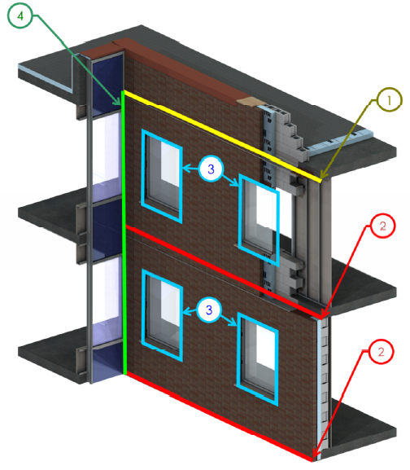
2021 IECC-C Above-Grade Wall Definition
WALL, ABOVE-GRADE. A wall associated with the building thermal envelope that is more than 15 percent above grade and is on the exterior of the building or any wall that is associated with the building thermal envelope that is not on the exterior of the building. This includes, but is not limited to, between-floor spandrels, peripheral edges of floors, roof knee walls, dormer walls, gable end walls, walls enclosing a mansard roof and skylight shafts.
Source: BC Hydro BETB Guide / Morrison Hershfield LTD

Slide 11
2021 IECC-C Above-Grade Wall Definition
Clarifies thermal bridges must be considered in determining wall overall U-factor and compliance, usually with one of the following approaches:
  Use of ci and appropriate detailing is often the most efficient way to mitigate thermal bridges
  Simply adding more insulation to compensate (without mitigating thermal bridges) is another approach, but generally less efficient use of insulation.
Future code development intends to provide explicit thermal bridging provisions to more fully implement the above two approaches
  ASHRAE 90.1 has required consideration of “uninsulated assemblies” (including thermal bridges) in the performance path
  Prescriptive path of IECC and 90.1 has generally assumed no thermal bridges other than those addressed within assemblies (e.g., studs, etc.)
For additional information on thermal bridging, refer to: https://www.continuousinsulation.org/applications/prevent-thermal-bridging

Slide 12
IBC/IRC Improved Water Vapor Control
See Appendix A in paper (2024 IBC provisions)
  Formatting clean-ups
  IRC/IBC consistency
  Complete resolution of errata to 2021 IBC
  Addition of “Responsive Vapor Retarder” definition
  Expand ci vapor control options to better coordinate with energy code insulation options
    First, some background may be helpful…

Slide 13
5 Building Science Concepts for Moisture Control
Successful moisture control requires an integrated approach to 5 key building science concepts:
  Control Rain Water Intrusion (e.g., continuous water-resistive barrier)
  Control Air Leakage (e.g., continuous air barrier)
  Control Indoor Relative Humidity (e.g., building ventilation & de-humidification)
  Control Initial Construction Moisture (e.g., prevent enclosure of wet materials)
  Control Water Vapor (e.g., optimized balance of wetting and drying through strategic use of insulation and vapor retarders)
All are important, all vary in significance, all have
inter-dependencies…

Slide 14
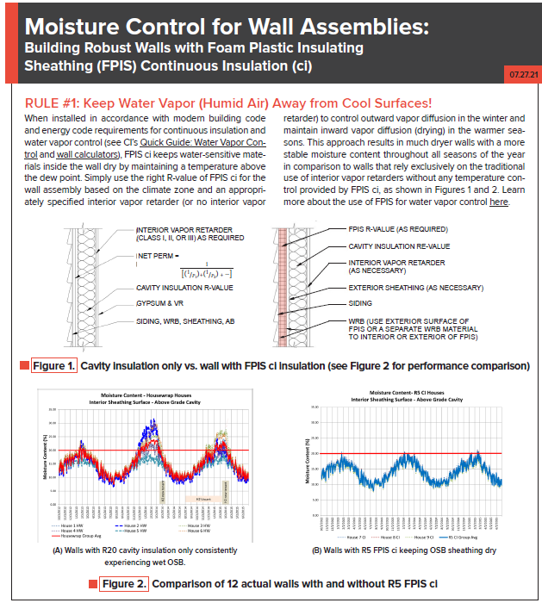
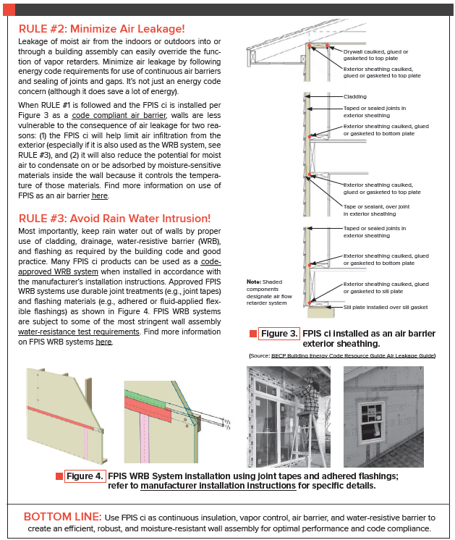
3 Rules for Moisture Control
RULE #1 – Keep water (humid air) away from cool surfaces!
BSC 3, 4, & 5
RULE #2 – Minimize air leakage!
BSC 2
RULE #3 – Avoid rain water intrusion!
BSC 1
https://www.continuousinsulation.org/resources/facts-ci

Slide 15
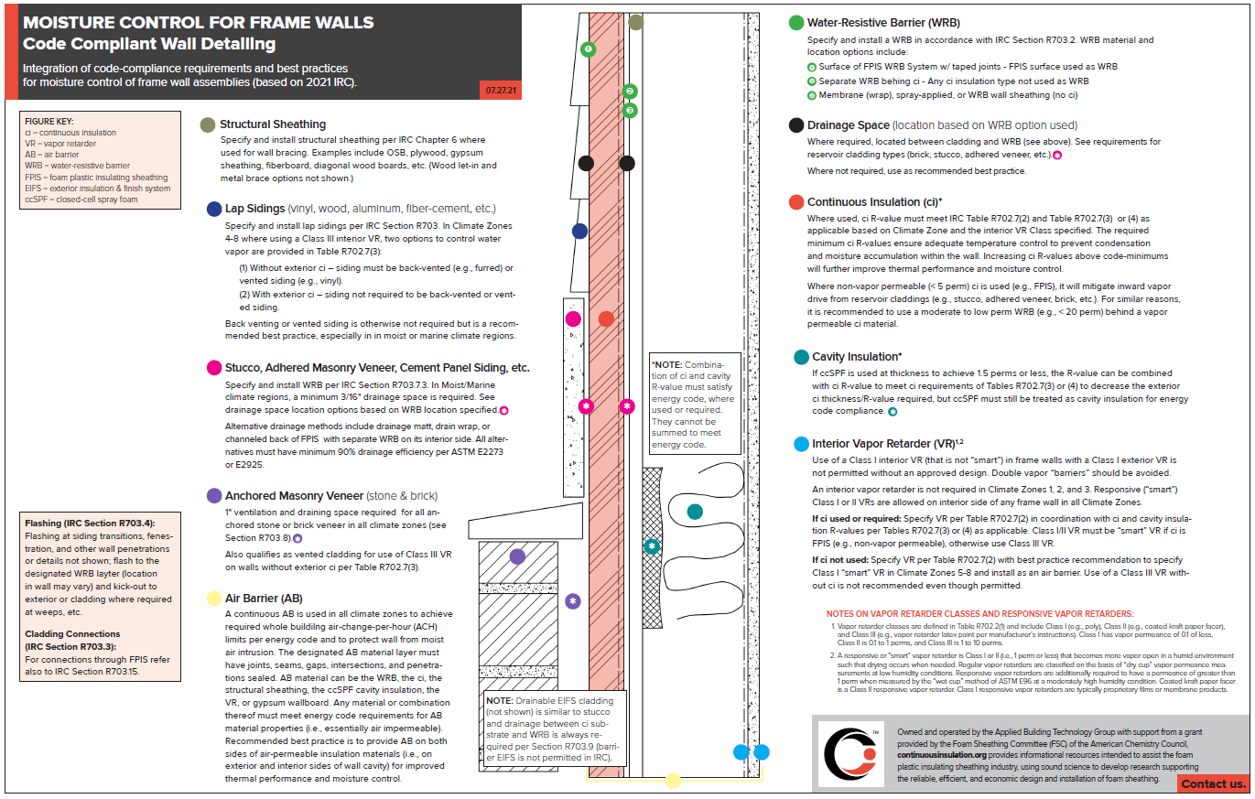
Summary Graphic for Integrated, Code-Compliant
Moisture Control (“Cheat Sheet”)
https://www.continuousinsulation.org/applications/water-vapor-control

Slide 16
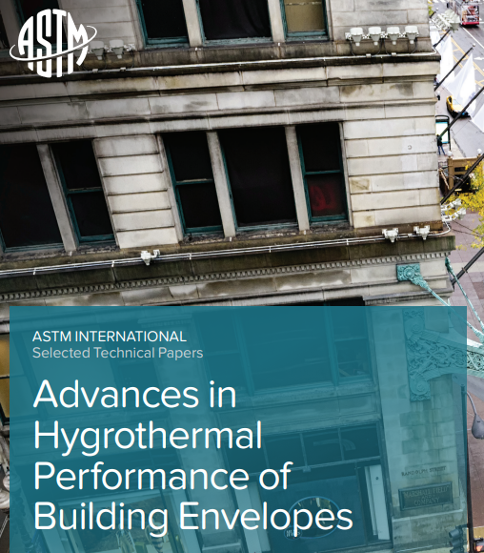
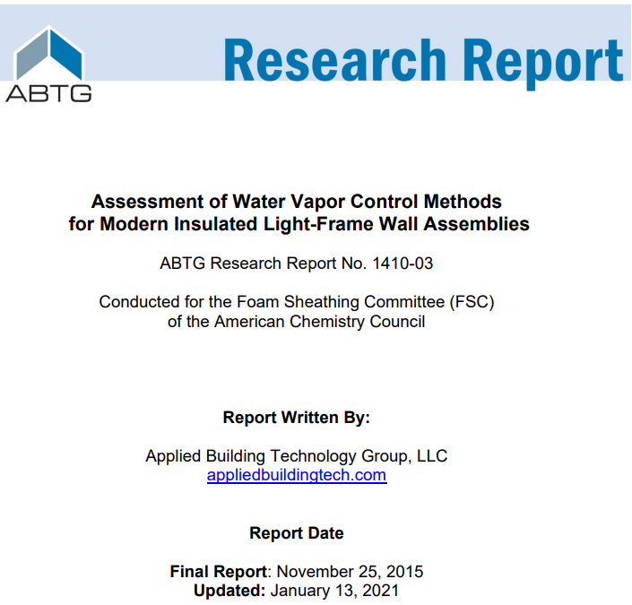
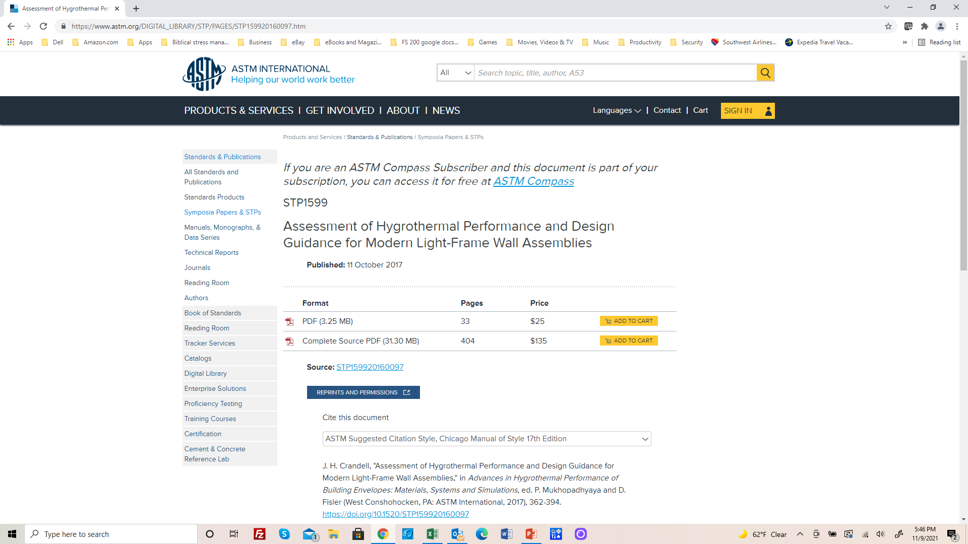
Research Leading to 2021/2024 IRC & IBC Provisions
https://www.appliedbuildingtech.com/rr/1410-03
https://www.astm.org/DIGITAL_LIBRARY/STP/PAGES/STP159920160097.htm

Slide 17
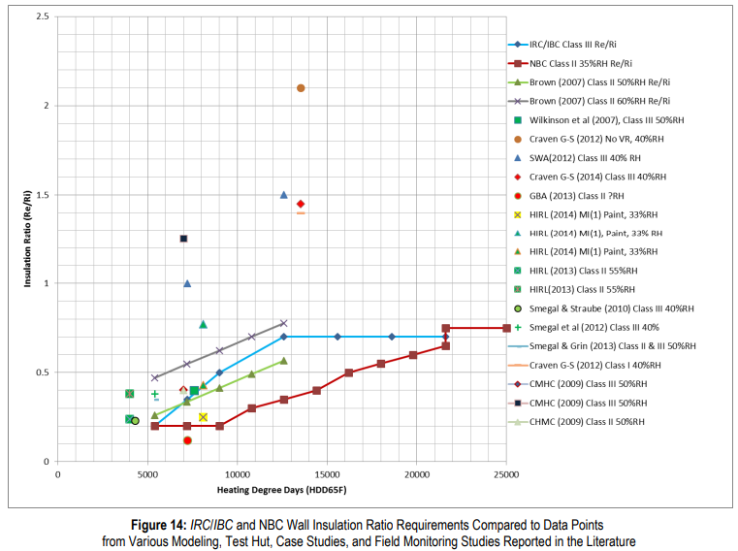

Research Findings
Surveyed multiple field, test hut, and modeling studies
Compared to U.S. and Canadian Code and Practices
Confirmed where practices were working well
Conducted analysis where refinements needed
Peer reviewed
Combined best of U.S. and Canadian
practices to result in 2021 IBC/IRC
Assumed worst-case low permeance conditions for ci and/or exterior material layers to ensure robust prescriptive provisions
Unanimous approval at code hearings including major stakeholders

Slide 18
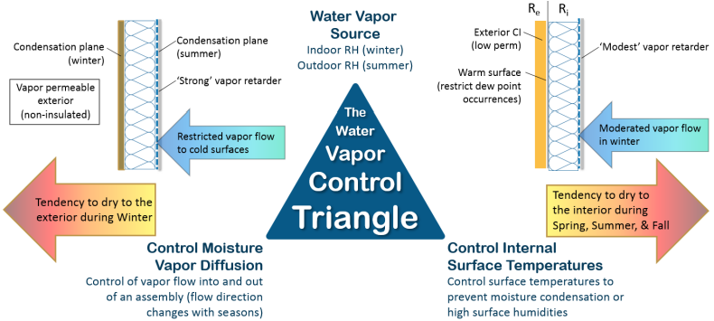
Vapor Control Principles
Two approaches to control water vapor:
  Permeance Controlled Design (permeance ratio)
  Temperature Controlled Design (insulation ratio, IR = Re/Ri)

Slide 19
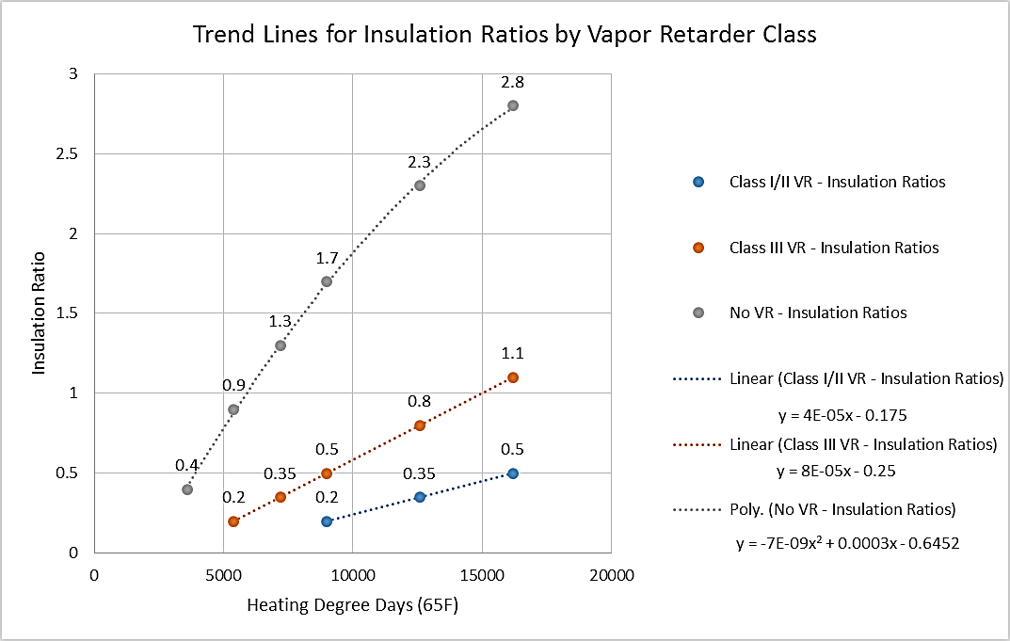
Insulation Ratio (Graphic Format)
(Temperature-controlled Design)
Source: http://www.appliedbuildingtech.com/rr/1410-03

Slide 20
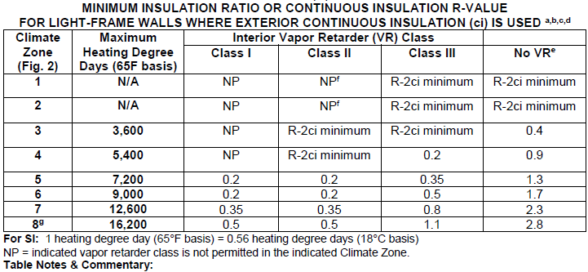
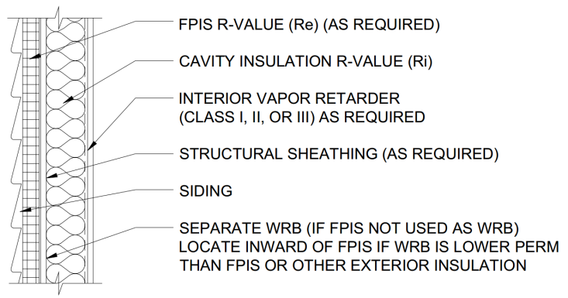
Insulation Ratio (Tabulated Format)
(basis of 2021/2024 IBC and IRC for walls with continuous insulation)
Source: http://www.appliedbuildingtech.com/rr/1701-01

Slide 21
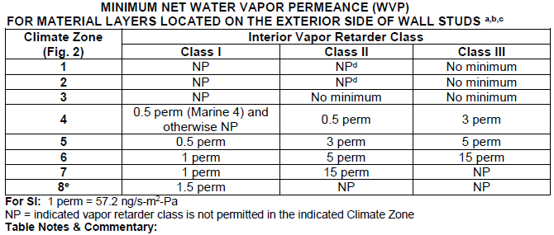
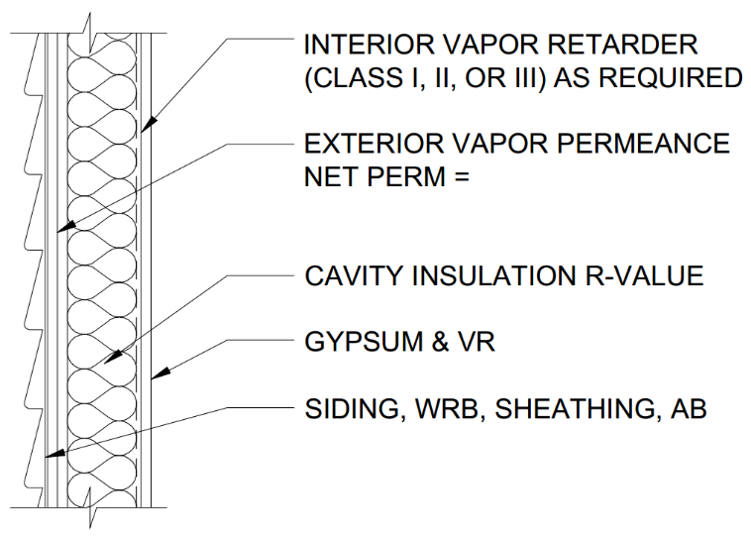
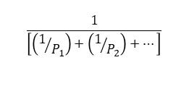
Permeance Ratio
(not included in 2021 or 2024 IBC and IRC)
$$\frac{1}{\left[\left(1/{P_{1}}\right)+\left(1/{P_{2}}\right)+…\right]}$$
NOTE: For use with cavity insulation only walls, or walls that have continuous insulation but inadequate insulation ratio.
Source: http://www.appliedbuildingtech.com/rr/1701-01

Slide 22
2024 IBC Section 1404.3 Provisions
New definition added:
  RESPONSIVE VAPOR RETARDER. A vapor retarder material complying with a vapor retarder class of Class I or Class II but which also has a vapor permeance of 1 perms or greater in accordance with ASTM E96, water method (Procedure B).
RVR’s allowed on interior side of assembly in any climate
Required when using a Class I or II interior VR with FPIS ci on the exterior
  Examples: Class II RVR = coated Kraft paper; Class I RVR = proprietary “smart” vapor retarder (not poly)

Slide 23
2024 IBC Section 1404.3 Provisions
1404.3 Vapor retarders. Vapor retarder materials shall be classified in accordance with Table 1404.3(1). A vapor retarder shall be provided on the interior side of frame walls in accordance with Table 1404.3(2) and Tables 1404.3(3) or 1404.3(4) as applicable, or an approved design using accepted engineering practice for hygrothermal analysis. Vapor retarders shall be installed in accordance with 1404.3.3. The appropriate climate zone shall be selected in accordance with Chapter 3 of the International Energy Conservation Code.
Exceptions:
Basement walls.
Below-grade portion of any wall.
Construction where accumulation, condensation, or freezing of moisture will not damage the materials.
A vapor retarder shall not be required in Climate Zones 1, 2, and 3.
In Climate Zones 4 through 8, a vapor retarder on the interior side of frame walls shall not be required where the assembly complies with Table 1404.3(5).

Slide 24
2024 IBC Section 1404.3 Provisions
1404.3.1 Spray foam plastic insulation for moisture control with Class II or III vapor retarders. For purposes of compliance with Tables 1404.3(3) and 1403.3(4), spray foam with a maximum permeance of 1.5 perms at the installed thickness applied to the interior side of wood structural panels, fiberboard, insulating sheathing or gypsum shall be deemed to meet the continuous insulation moisture control requirement in accordance with one of the following conditions:
The spray foam R-value meets or exceeds the specified continuous insulation R-value.
The combined R-value of the spray foam and continuous insulation is equal to or greater than the specified continuous insulation R-value.

Slide 25
2024 IBC Section 1404.3 Provisions
1404.3.2 Vapor retarder installation. Vapor retarders shall be installed in accordance with the manufacturer’s instructions or an approved design. Where a vapor retarder also functions as a component of a continuous air barrier, the vapor retarder shall be installed as an air barrier in accordance with the International Energy Conservation Code.

Slide 26
2024 IBC Section 1404.3 Provisions
NOTE: These classes are based purely on “dry cup” vapor permeance by definition. Responsive vapor retarders add a requirement that the “wet cup” vapor permeance be greater than 1 perm. For example, while Kraft-faced FG is a Class II VR with “dry cup” permeance of about 0.6 perms, it is also a Class II RVR because it has a “wet cup” permeance of about 2 perms (proprietary RVR’s even greater x10).

Slide 27
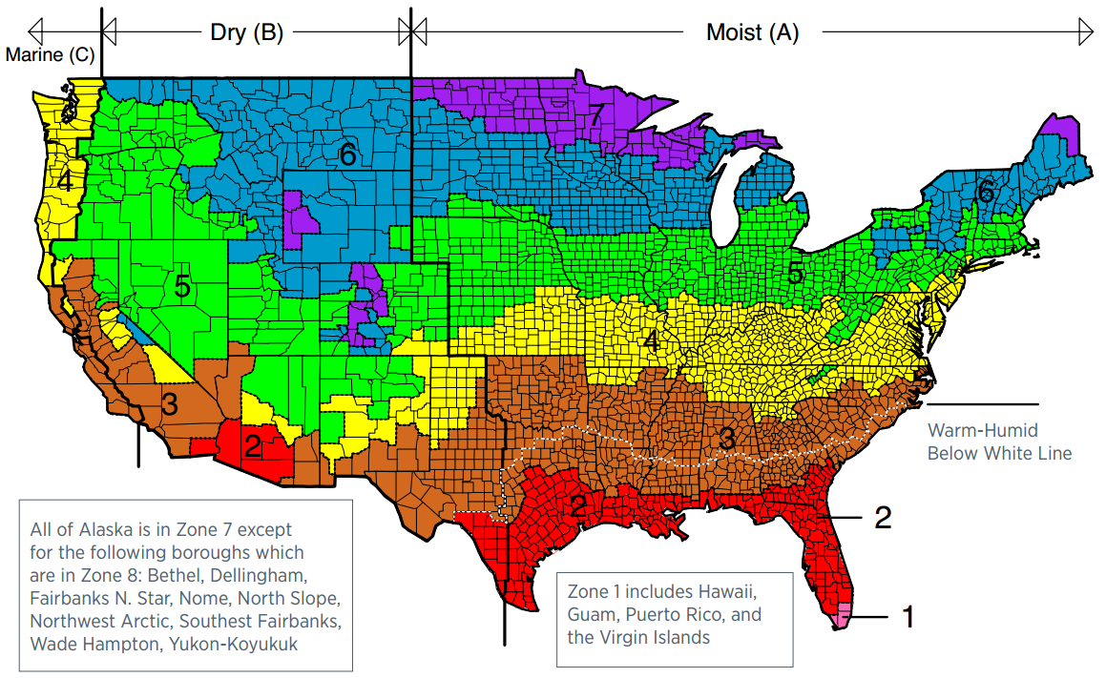
2024 IBC Section 1404.3 Provisions

Slide 28
2024 IBC Section 1404.3 Provisions
a. | Vented cladding shall include vinyl lap siding, polypropylene, or horizontal aluminum siding, brick veneer with airspace as specified in this code, rainscreen systems, and other approved vented claddings.
b. | The requirements in this table apply only to insulation used to control moisture in order to permit the use of Class III vapor retarders. The insulation materials used to satisfy this option also contribute to but do not supersede the thermal envelope requirements of the International Energy Conservation Code.

Slide 29
2024 IBC Section 1404.3 Provisions

Slide 30
2024 IBC Section 1404.3 Provisions

Slide 31
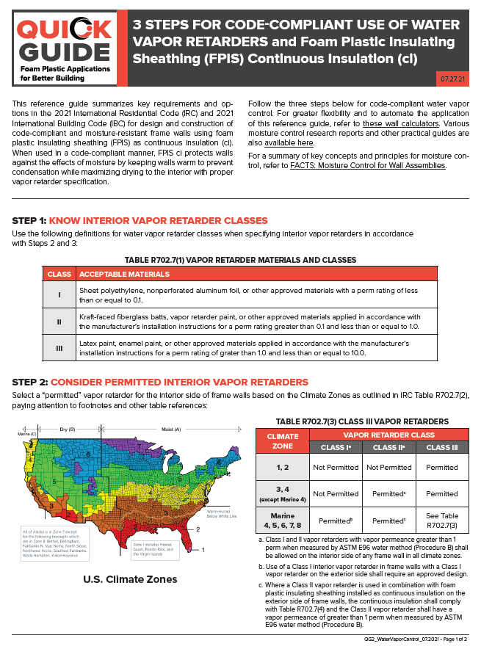
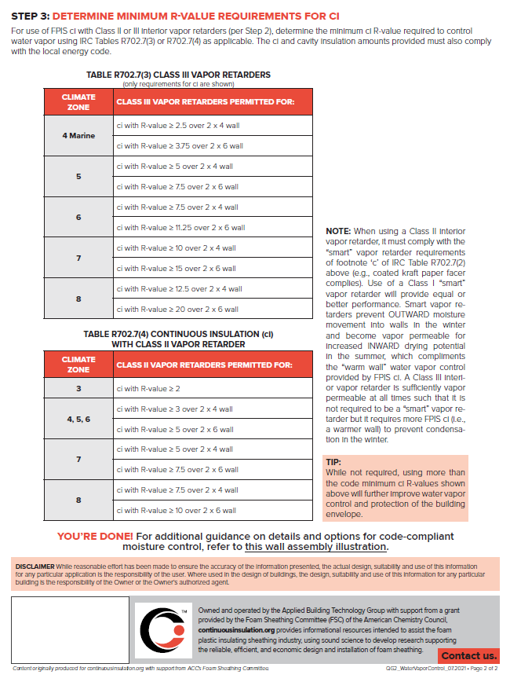
Simplified Code-Compliance Guide
https://www.continuousinsulation.org/resources/quick-guides

Slide 32
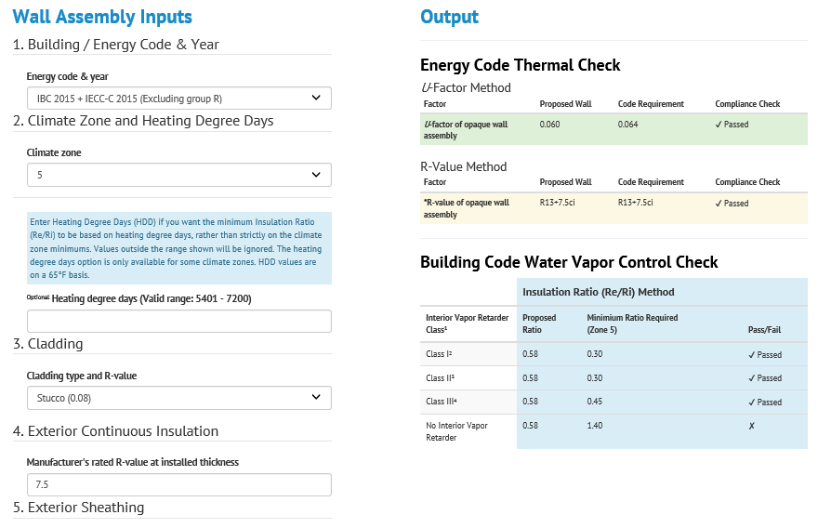
Wall Calculator
“Easy Button” to IECC/90.1 and IBC/IRC Coordinated Compliance
Implements R-value and
U-factor checks per IECC & 90.1 and also a moisture control check (including insulation and permeance ratio checks)
Flexible, More Solutions than Code, More Precise
Wood and steel framing
https://www.continuousinsulation.org

Slide 33
2024 IBC Section 1403.2 – Water-resistive Barrier
1403.2 Water-resistive barrier. Not fewer than one layer of water-resistive barrier material shall be attached to the studs or sheathing, with flashing as described in Section 1404.4, in such a manner as to provide a continuous water-resistive barrier behind the exterior wall veneer. The water-resistive barrier material shall be continuous to the top of walls and terminated at penetrations and building appendages in a manner to meet the requirements of the exterior wall envelope as described in Section 1402.2. Water-resistive barriers shall comply with one of the following:
No. 15 felt complying with ASTM D226, Type 1,
ASTM E2556, Type I or II,
Foam plastic insulating sheathing WRB systems complying with Section 1402.2 and installed in accordance with manufacturer’s installation instructions.
ASTM E331 in accordance with Section 1402.2, or
other approved materials installed in accordance with the manufacturer’s installation instructions.

Slide 34
2024 IBC Section 1404.1 – Flashing
New provisions for fenestration flashing:

Slide 35
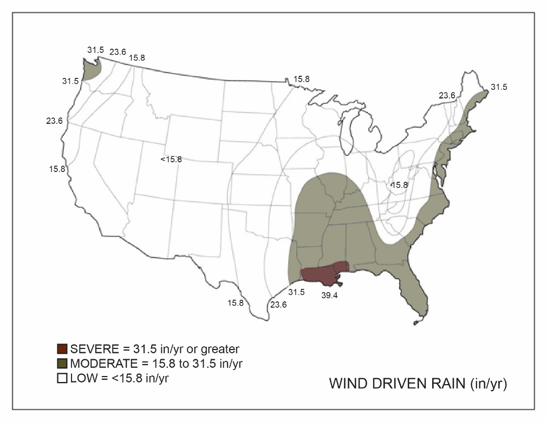
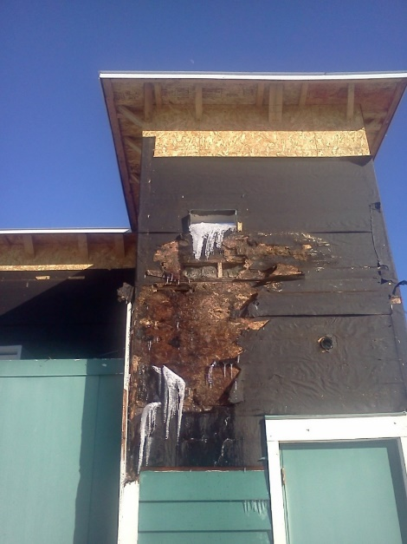
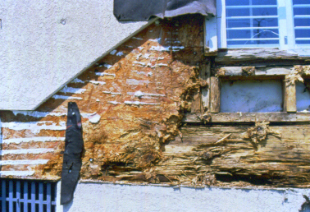
Rain Water Control
Rain water control is often the primary factor associated with observed failure or success of moisture control.
If rain water is not adequately controlled, other building science measures can be rendered ineffective.
Concept is simple:
Keep water out!
Wind driven rain is the primary hazard
(map based on UofGA research)

Slide 36
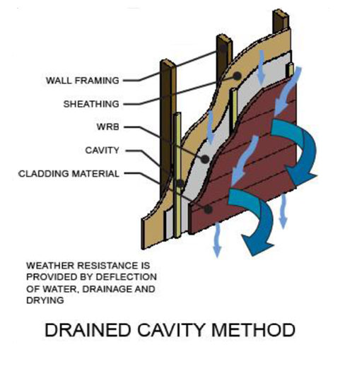

Rain Water Control
Select cladding type, windows & doors,
and installation methods best suited to
the local climate wind-driven rain hazard.
  Durability by Design – 2nd Edition (http://www.huduser.gov/portal/publications/reports/Guide-Durability-by-Design.html )
Variation in cladding material/method performance and variation in wind-driven rain hazard are not differentiated in the code.

Slide 37
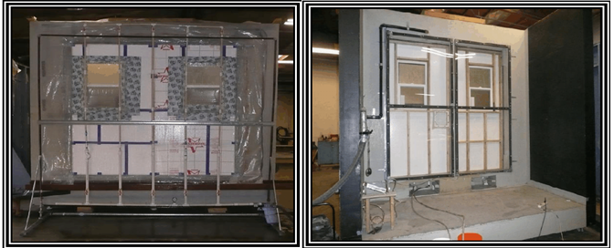
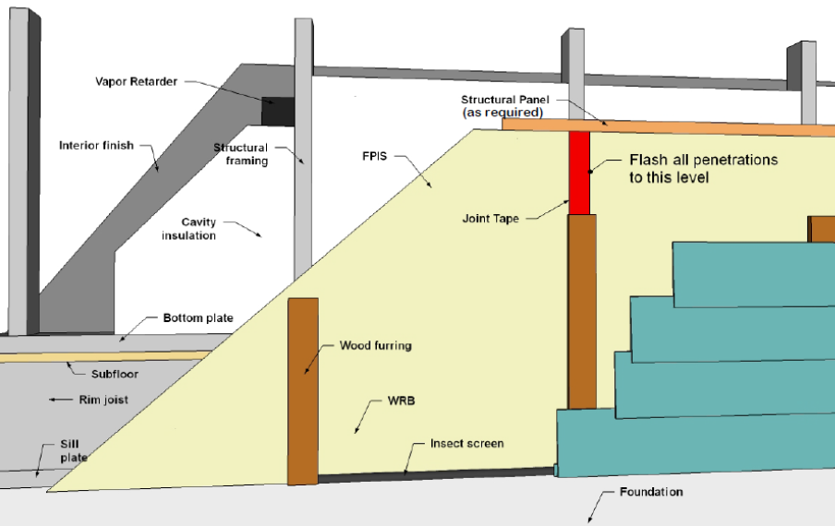
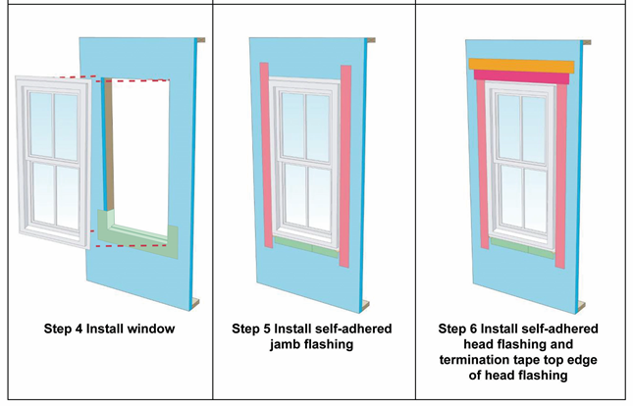
Rain Water Control
Use a code compliant water-resistive barrier (WRB) and flashing details at all penetrations for a continuous drainage plane behind the cladding.
  WHY? All claddings leak!
  WRB is required by code
  But, not all WRBs are equal or subject to equivalent performance criteria
    For additional information on code-compliant ci WRBs, refer to: https://www.continuousinsulation.org/applications/WRB
Window flashing with pan flashing recommended (but not required by code)
  WHY? Many windows/doors leak or will leak.
  Refer to window manufacturer, WRB, and flashing manufacturer instructions
Window flashing addressed more completely next…

Slide 38
FENETRATION INSTALLATION & PERFORMANCE
  FPIS ci Timeline
  Field Installation Experience
  Installed Performance Testing Experience
  Recommended installation instructions

Slide 39
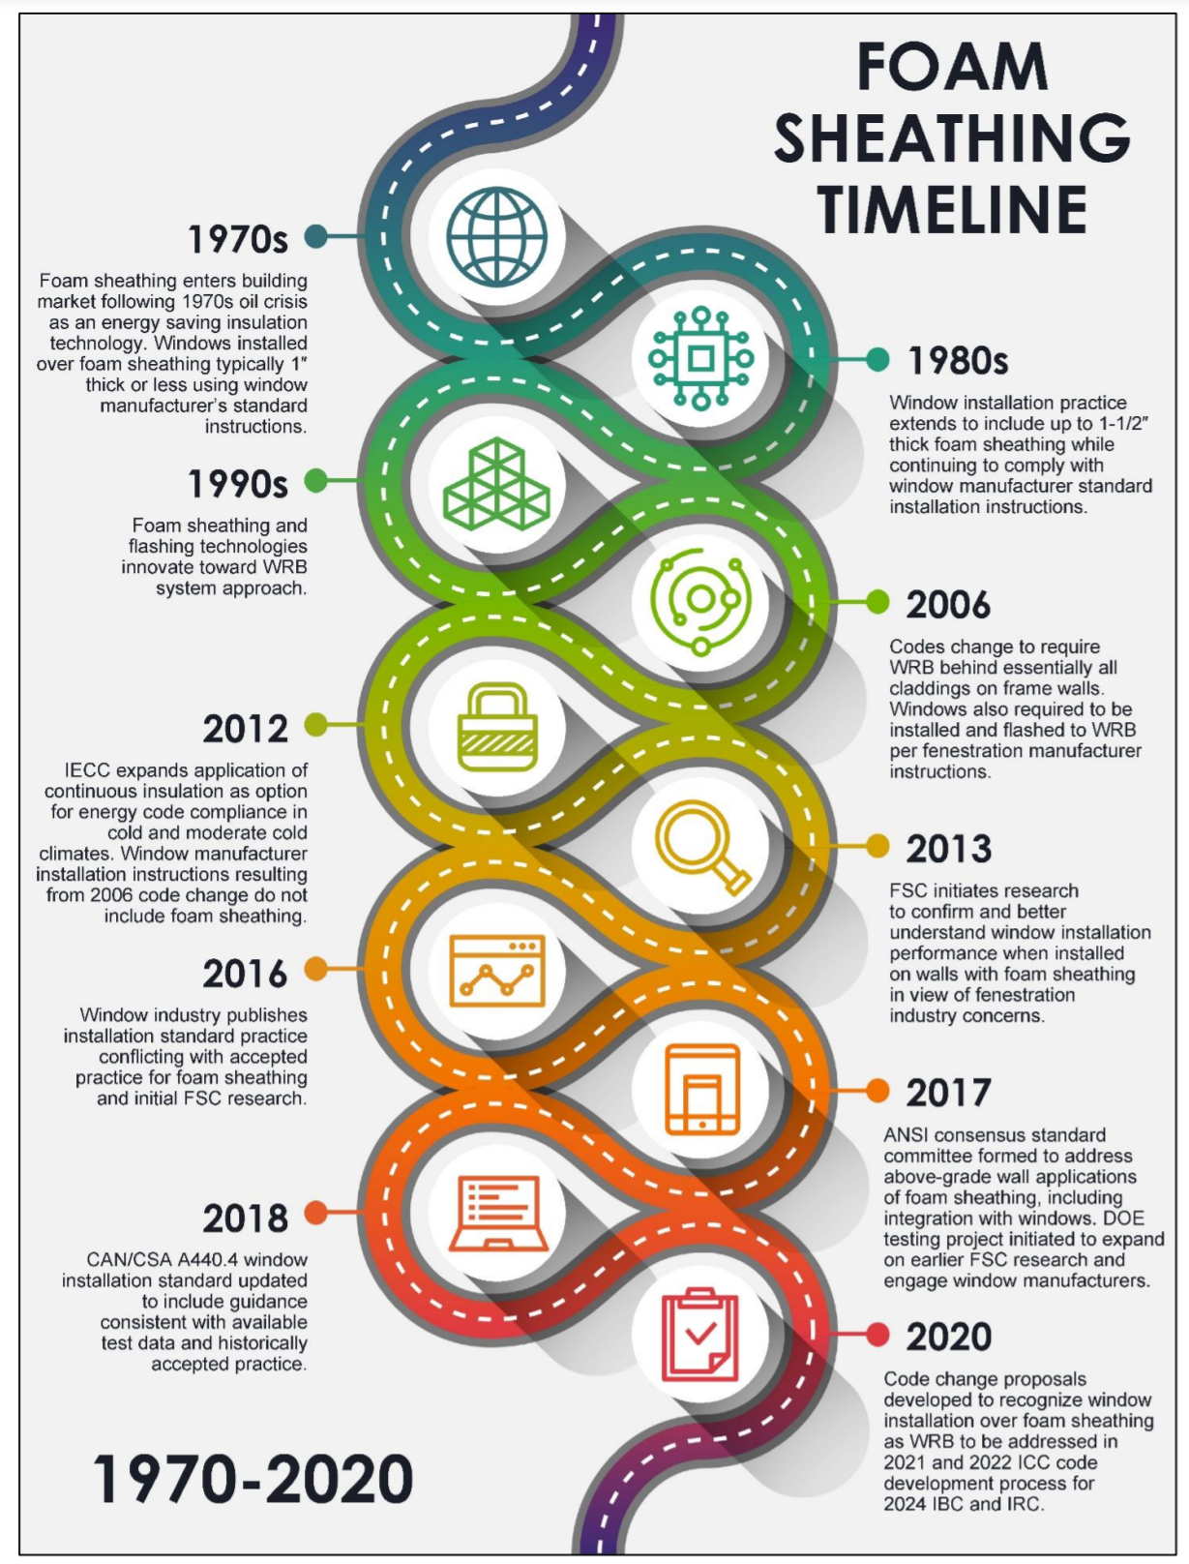
FPIS ci Timeline
1970s – FPIS ci introduced to market as energy conservation technology following 1970s oil crisis
1980s – installation over flanged fenestration progresses from 1” to 1-1/2” (window buck used for thicker foam)
1990s –FPIS ci WRB systems evolve
2006 – IRC & IBC codes change to require WRBs and require use of fenestration manufacturer instructions for flashing
2012 – IECC expands prescriptive R-value use of ci; few window installation instructions address foam sheathing (if any)
2013 – Present – Increased use of FPIS ci, but differing opinions and experience with how to integrate windows with FPIS ci, conflicting requirements, conflicting instructions, conflicting standards, etc.
➔ Research and testing conducted to resolve confusion
➔ Code changes initiated for appropriate requirements

Slide 40
Field Installation Experience
Historically accepted practice (survey actual experience)
Typical builder experienced with FPIS ci:
  “We have been installing vinyl double pane windows over 1-1/2” XPS foam with no OSB for over six years and before that over 1” foam for almost 30 years and have seen no issues with window movement.”
Other sources indicate similar experience
Experience from Canada also imported to U.S.

Slide 41
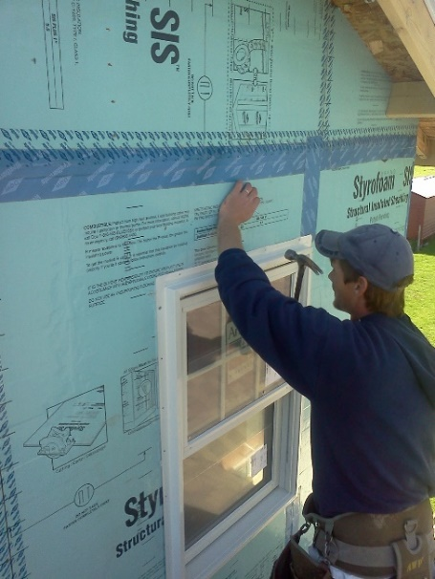
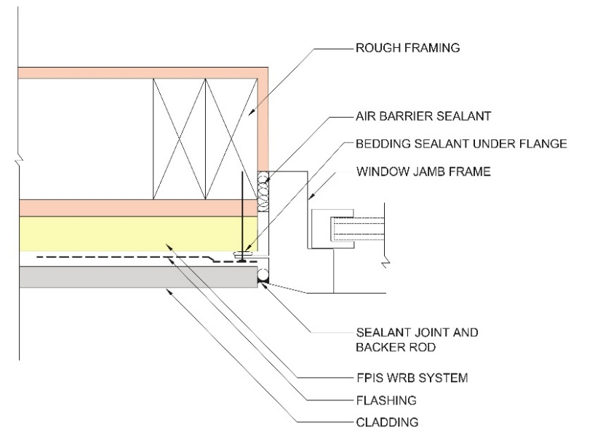
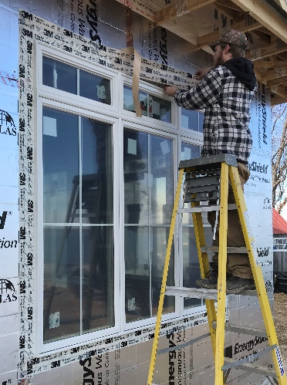
Modern Examples of Historically Accepted Practice
(≤ 1.5” FPIS ci)

Slide 42
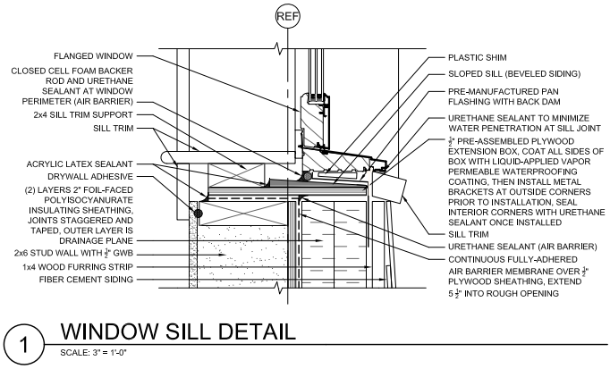
Modern Examples of Historically Accepted Practice
(> 1.5” FPIS ci)
Plywood window buck with 4”-thick FPIS ci
Source: www.nist.gov/system/files/nzertf-architectural-plans3-june2011.pdf

Slide 43
Installed Performance Testing Experience
~150 tests on ~30 wall assembly specimens by independent sources
Four integrally-flanged window types (SH, DH, C, and HS)
Two frame material types (vinyl and wood)
Two installation configurations (single 1-wide, mulled 2-wide)
Range of fenestration unit weights (~30 lbs to ~400 lbs)
Rough opening sizes up to 6-feet
Wall configurations with and without FPIS ci of three material types (XPS, EPS, and PIR), up to 2” thick, and 15 or 25 psi compressive resistance per ASTM C578 or ASTM C1289
FPIS detailed to serve as WRB system and flashed per WRB manufacturer specifications

Slide 44
Installed Performance Testing Experience
Test method generally followed AAMA TIR-504-2020:
  Initial air leakage resistance per ASTM E283
  Initial water resistance per ASTM E331
  Thermal cycling per ASTM E2264 Method A (level 1)
  Repeat air and water resistance testing
  (steps 1 and 2)
  Design pressure (DP) load test per ASTM E330
  Repeat water penetration test (step 2)
  Structural test pressure (STP) = 1.5 x DP
  load test per ASTM E330

Slide 45
Installed Performance Testing Experience
Performance criteria:
  Report air leakage (Steps 1 and 4)
  No water penetration (Steps 1, 4, and 6)
  Design pressure (DP) – no damage that prevents normal operation
  Structural test pressure (STP) – no damage that results in failure to sustain load; any operability impact reported.
Several later tests were focused only on DP and STP testing as allowed by AAMA TIR-504-2020 to address specific questions regarding structural support and anchorage.
Other tests to evaluate special loading conditions also conducted (shear load tests and long term creep/movement tests)

Slide 46
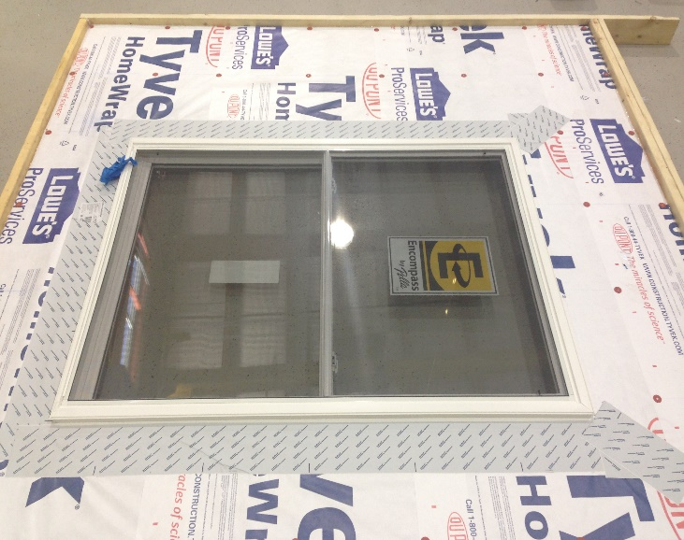
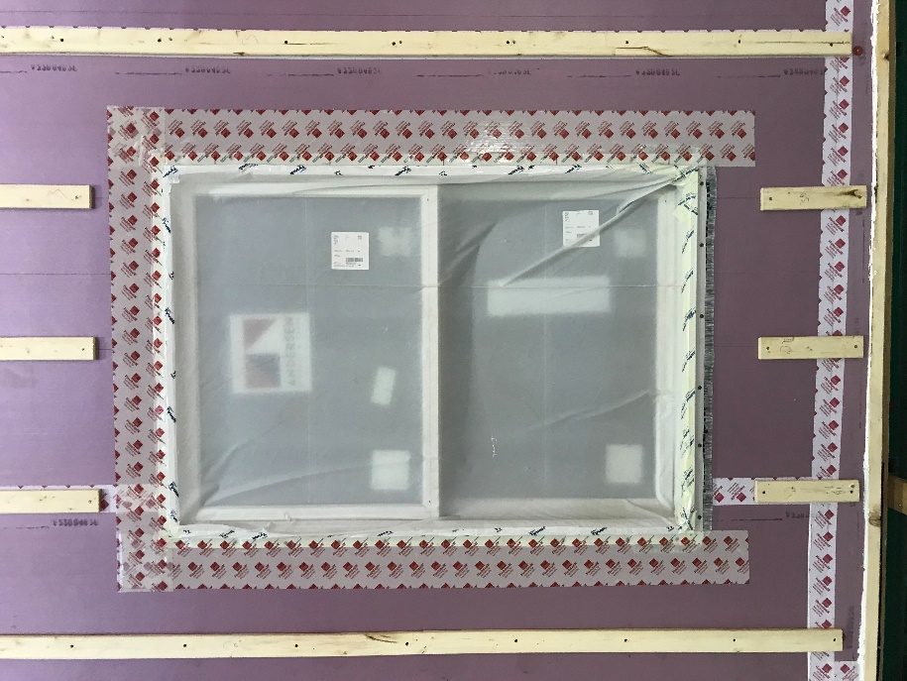
Installed Performance Testing Experience
Water Penetration Resistance Tests
  Tested per ASTM E331 using a 5.4psf pressure differential (just above 15% of the max 35 psf DP rated window unit used in testing).
  Window units “masked” because not re-testing window unit rating itself
  All used joint tapes and adhered flashing specified per the WRB manufacturer’s instructions
  None of the flanges used bedding sealant to the WRB surface (removed redundancy)
  Sill pan flashing used (but without air sealing)
  RESULTS: No water-penetration of assemblies with and without FPIS ci
    As expected, some water movement onto sill pan behind unsealed bottom flange
    Consequence of E331 testing without air sealing rough opening gap and flange providing only 1” lap down from surface of pan flashing

Slide 47
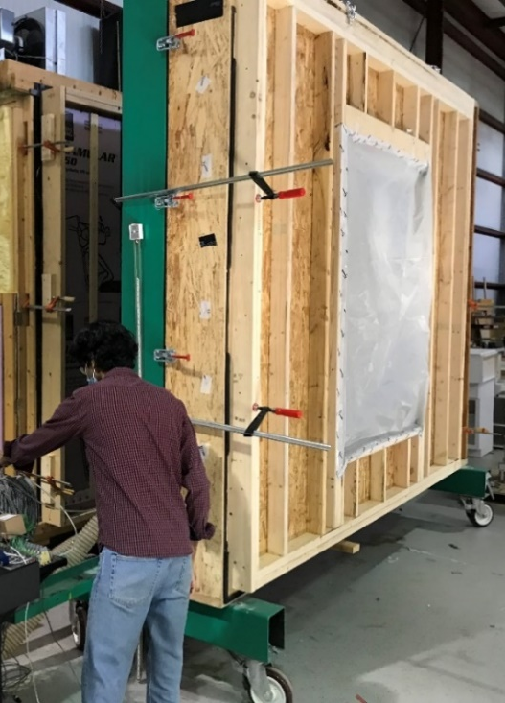
Installed Performance Testing Experience
Uniform Pressure (Wind Load) Resistance
  Tested per ASTM E330 at DP and STP = 1.5 x DP loading
    Most tested to 1.58 x DP (conservatively above STP target)
  Positive pressure then negative pressure tested
  Two specimens ramped to failure (>> STP load)
  Many window installation included weakening variances:
    Flange bedding sealant omitted in all cases
    Some flange fastener groups omitted
    Air sealing of rough opening omitted
    Some shims omitted (e.g., at head of HS window)
  Tests also repeated without weakening variances

Slide 48
Installed Performance Testing Experience
Uniform Pressure (Wind Load) Resistance
  RESULTS: No structural failures related to installation over foam sheathing when adhering to window manufacturer anchorage and support instructions (1” and 2” FPIS thickness, 15psi and 25 psi)
    Some operability impacts observed with missing fastener groups (e.g., sash pin dislodge from brake/balance mechanism discovered after STP test level)
    One structural failure related to missing shims (resulting in premature dislodging of sash from frame)
    One structural failure caused by wood sash cross rail split out at end notch for sash bracket
    As with any window installation with or without FPIS, following manufacturer shimming and flange fastener patterns (i.e., fastener groups) is important
    Casement windows appeared most robust, double hung and horizontal slider appeared most sensitive to installation variances

Slide 49
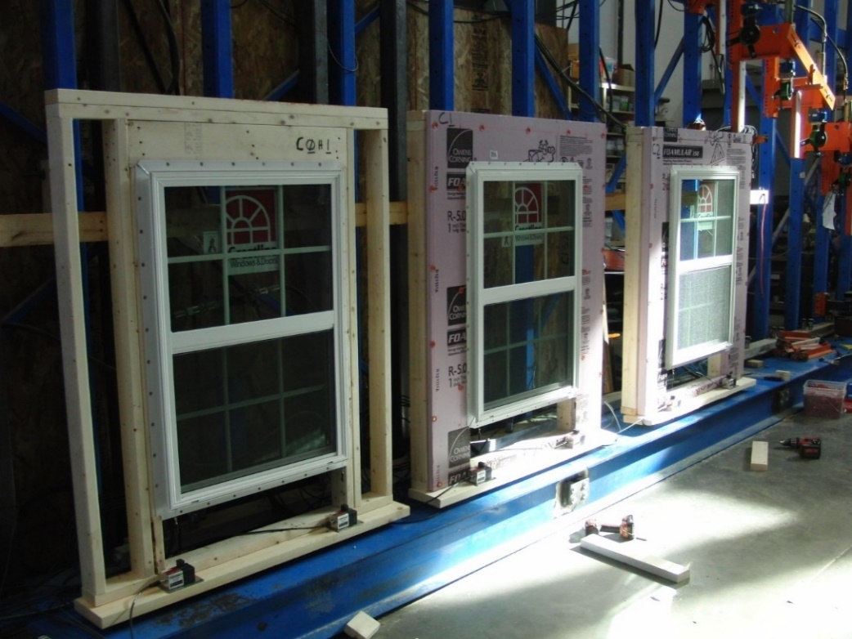
Installed Performance Testing Experience
Sustained Dead Load & Creep Resistance
  Evaluated movement of fenestration under sustained dead load (weight of fenestration unit)
  Monitoring periods of 1 month to 6 months
  Up to 2” thick foam (15 psi minimum)
  Fenestration weights from 27lbs to 384 lbs
  Included same installation weakening variances mentioned previously
  RESULTS: Recorded movement of 0.000” to -0.032” (~1/32nd inch). Periods of upward movement also observed. No relationship to installation conditions discerned. All movement considered negligible or typical due to environmental changes (not creep).

Slide 50
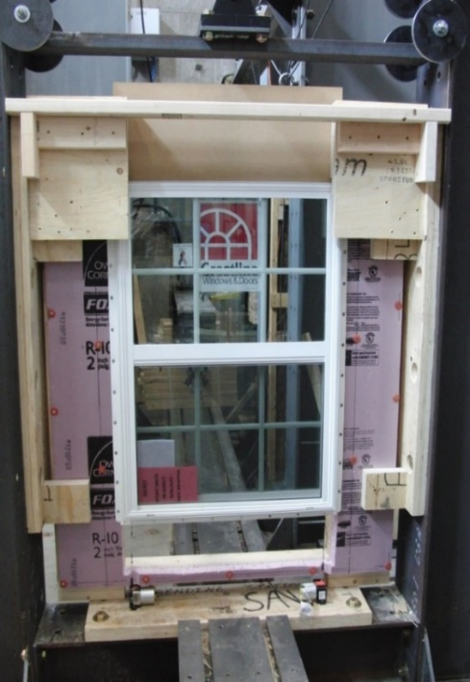
Performance Testing Experience
Flange Fastener Shear Resistance
  Test shear capacity and stiffness of flange fasteners through 1” and 2” thick FPIS (15 psi)
  Windows installed with no shims and no bedding sealant so flange fasteners resist all shear load
  RESULTS: Ultimate shear capacity changed little (~3,300 t0 3,600 lbs); stiffness was affected very predictably; foam sheathing added ductility while providing adequate stiffness for support of fenestration weight.

Slide 51
Performance Testing Experience
Fenestration Size Effect on Installed Performance
  Window size effect on DP rating permitted by code to be evaluated per AAMA 2502, Comparative Analysis Procedure
  Comparative analysis by ASTM E330 testing of SH integral flange vinyl window as installed (positive pressure only):
Size | STP | DP | Safety Factor | Adjusted DP (min 1.5 safety factor) | Installation Notes*
42x66 (gateway) | 37.5 psf | 25 psf | 1.5 | n/a | Wood substrate + shims + ¼” r.o. gap
30x42 | 151 psf | 25 psf | 6.0 | 80 psf | Wood or up to 2” foam (15 psi) substrate, no shims, and 3/8” r.0. gap
30x42 | 118 psf | 25 psf | 4.7
* Fasteners installed in every flange hole for all cases per manufacturer instructions

Slide 52
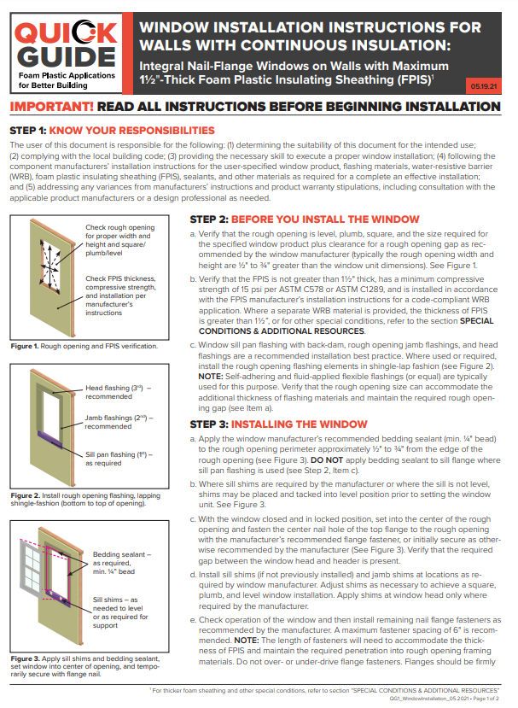
Recommended Installation Instructions
For FPIS of minimum 15 psi compression resistance and maximum 1.5” thickness:
  Use fenestration manufacturer’s shim and fastener schedule
    Adjust fastener length to maintain embedment in framing
  Use WRB or window manufacturer flashing instructions
For FPIS > 1.5” thick:
  Use window buck or similar support method
    Some manufacturer’s offer specialty support brackets
  Otherwise, same as above for remaining installation details
If window manufacturer’s instructions address the specific application with FPIS, use those instructions.
See Appendix B. For additional information, refer to:
https://www.continuousinsulation.org/applications/window-installation

Slide 53
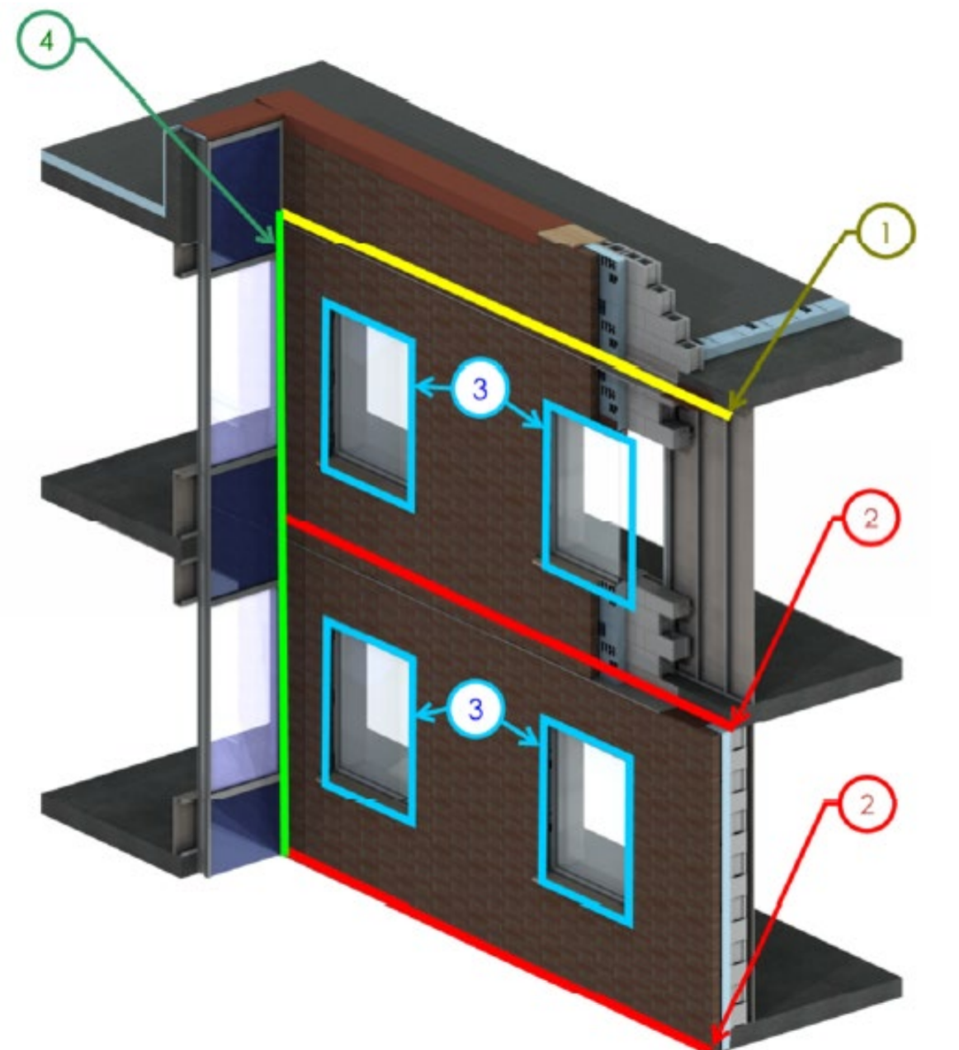
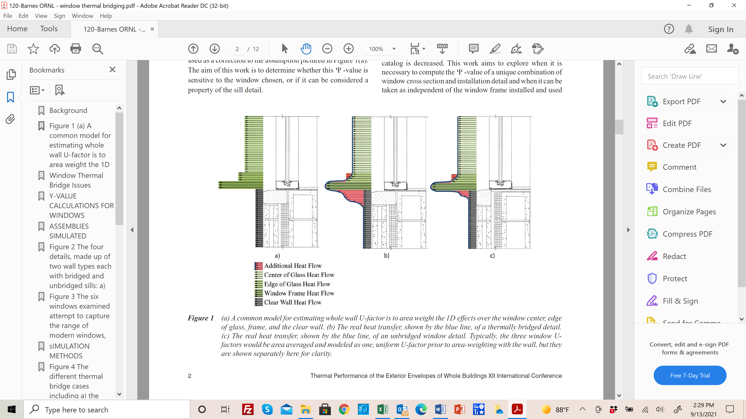
Thermal Bridging Impacts of
Fenestration Installation
Linear thermal bridge around window opening
  Not accounted for in window component U-factor
  Not accounted for in wall clear-field assembly U-factor
Source: Morrison-Hershfield (2020)
Source: Morrison-Hershfield (2020)
Source: Barnes et al. (2013)

Slide 54
Thermal Bridging Impacts of Fenestration Installation
CFS frame office building with 2o% WWR (punched openings) or 33% WWR (ribbon openings) results in 3,200 lnft of linear thermal bridge at window to wall interface
Poor details can reduce overall wall effective R-value by half.
Ignoring thermal bridges can overstate opaque wall performance by as much as 100%
Using efficient thermal bridge mitigation details minimizes the impact.

Slide 55
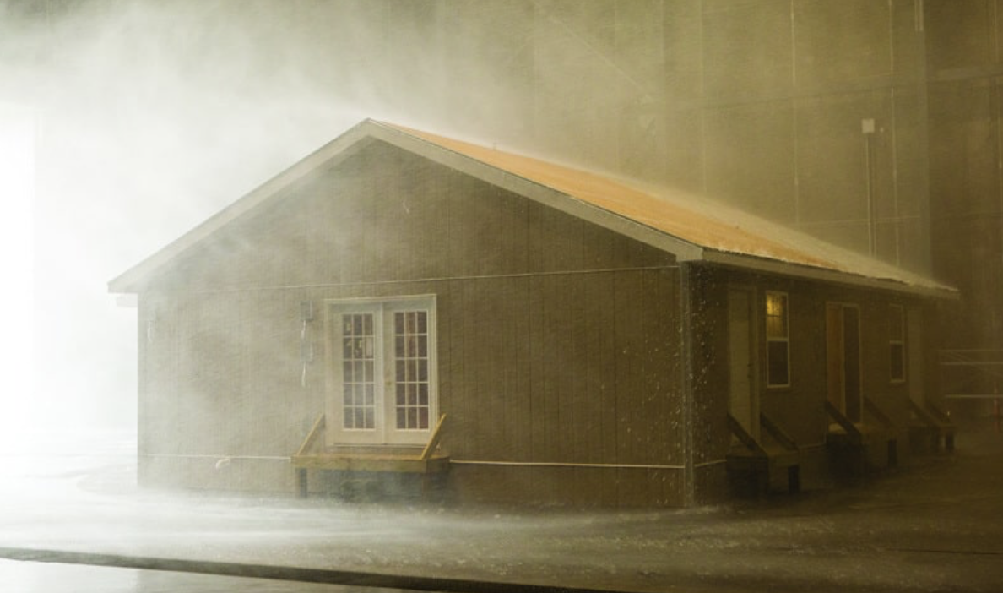
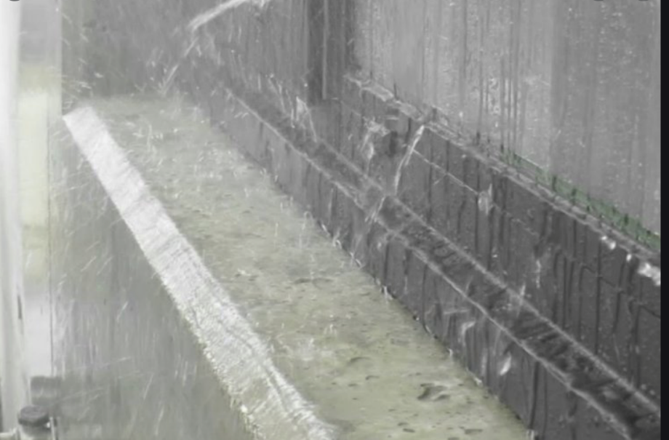
Wind-driven Rain Research
U.S. does not have a wind-driven rain hazard map to establish performance criteria for building enclosures
Wind-driven rain hazard must correlate annual extreme wind speed at a given coincidental rainfall rate considered as a threshold for concern with generating a leak
Wind-driven rain resistance test criteria must then correlate static or cyclic (non-spatially dynamic) test methods like ASTM E331 to observed performance in real wind flow and rain conditions
A wind-driven rain hazard map is the first critical step

Slide 56
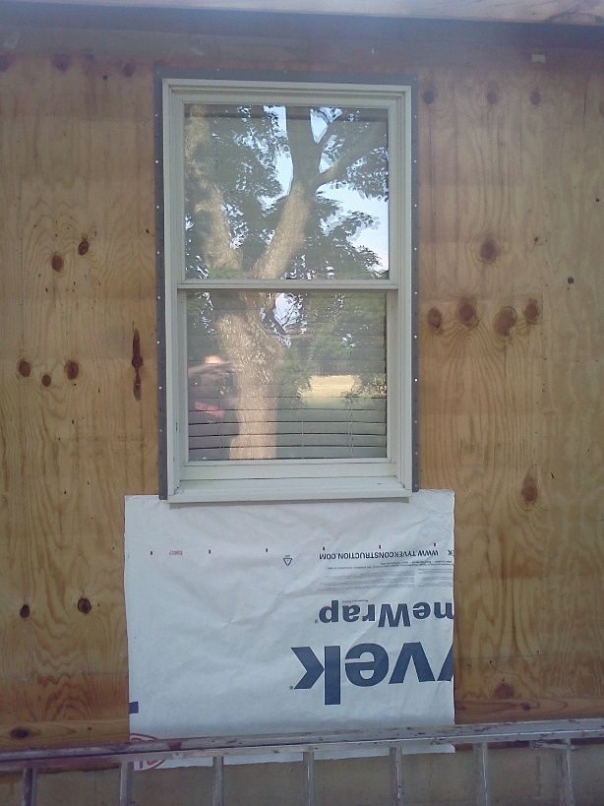

Wind-driven Rain Research
The implications vary by climate based on coincidental wind speed and rainfall rate, frequency/duration, site exposure, and consequences of water leakage or intrusion.
Ultimately, the selected hazard level and performance criteria for design and product evaluation must align with past successful practice, discriminate against unacceptable practice, and consider consequence of different types of leaks.
South Florida vs. Virginia
Extreme Wind-Driven Rain Hazard (Tropical) – Hurricane Andrew, 1992 (~600 yr MRI wind event); Contents Damage in South Florida
Typical Wind-Driven Rain Hazard Exposure (non-tropical, t-storms, etc.); 35-year old building; only minor water staining below window with no WRB, flashing, or bedding sealant

Slide 57
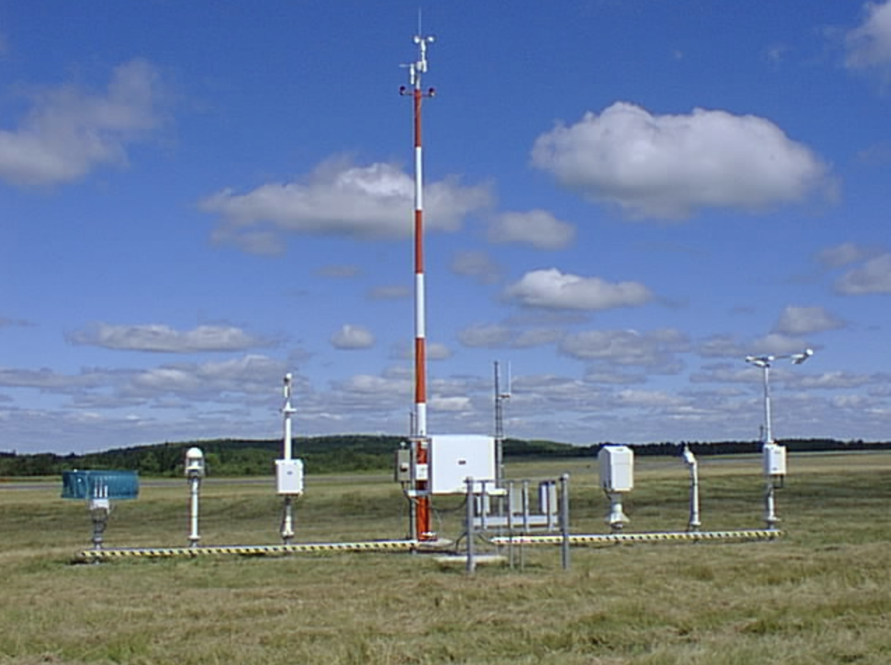
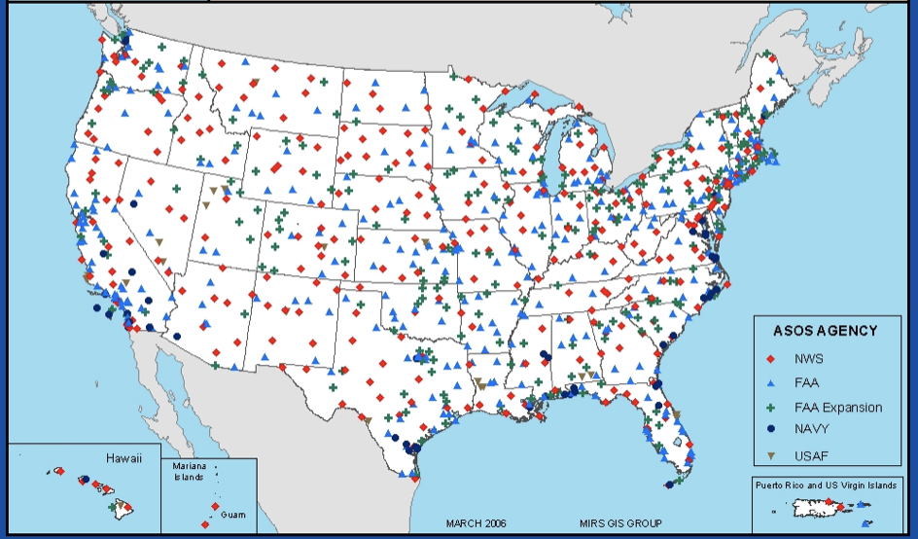
Wind-driven Rain Research
Every 5 minutes
2- minute average wind
Max 5-sec gust
5-minute rainfall accumulation
Every 1-minute
2- minute average wind
max 5-sec wind
1- minute rainfall accumulation
11 MILLION observations/
station for 20 year record!

Slide 58
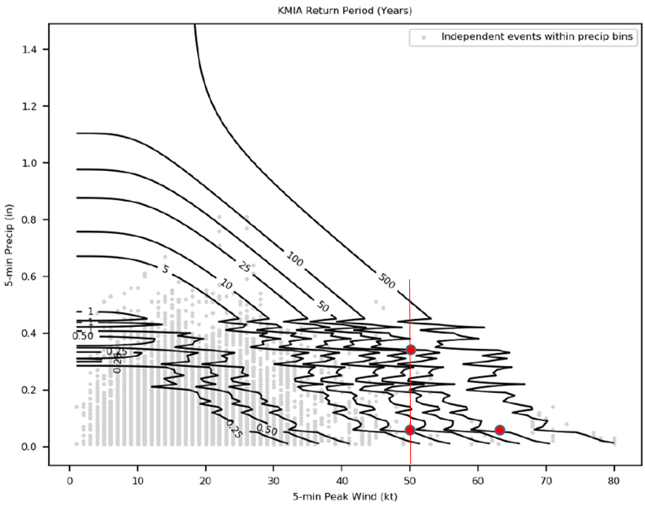
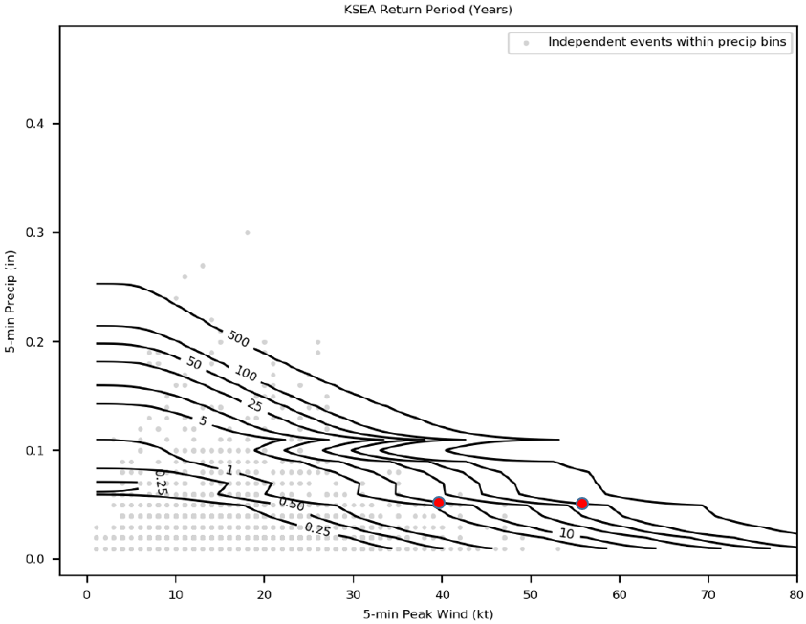
Wind-driven Rain Research
Preliminary Findings (Pilot Study funded by IBHS at Cornell U. / NOAA Northeast Region Climate Data Center):
Miami, FL vs. Seattle, WA

Slide 59
Conclusion
Insulation requirements continue to advance
Building codes continue to improve moisture control
Energy code and building code better coordinated
Fenestration installation practices evaluated & confirmed for use with FPIS ci (with appropriate limitations)
Minimizing thermal bridging at window-wall interface is increasingly important
New wind-driven rain research holds promise to better coordinate risk-consistent enclosure design and product evaluation for variation in U.S. climate hazard.

Slide 60

QUESTIONS?
Jay Crandell
www.aresconsulting.biz
Please submit any questions through the Continuous Insulation website at continuousinsulation.org/contact.

