Slide 1
Moisture Control for Durable &
Energy Efficient Cold-formed Steel Walls
Jay H. Crandell, P.E.
ABTG / ARES Consulting

Slide 3
Outline
Recent Energy Code Advancements
5 building science concepts
Research supporting 2021 code for water vapor control
New 2021 code provisions for water vapor control
Design guides, aids, and on-line calculator tools to coordinate energy/building code compliance
Design example

Slide 4

Energy Code Advancements
Major advancement of building energy code occurred in 2012 (~30% increase in energy efficiency, reduction in energy use).
For 2015 and 2018 IECC there were insignificant changes in envelope provisions.
In 2021 IECC, significant but more selective energy efficiency improvements have occurred.

Slide 5
IECC Prescriptive R-values & U-factors
(Light Frame Commercial Construction)
Climate Zone | Building Use | Metal Framed |  | Wood Framed
 |  | 2018 IECC | 2021 IECC | 2018 IECC | 2021 IECC
0 and 1 | All other | R13+5ci (U-0.077) | R13+5ci (U-0.077) | R13+3.8ci or R20 (U-0.064) | R13+3.8ci or R20 (U-0.064)
 | Group R
2 | All other
 | Group R | R13+7.5ci (U-0.064) | R13+7.5ci (U-0.064)
3 | All other
 | Group R
4 Except Marine | All other
 | Group R
5 and Marine 4 | All other |  | R13+10ci (U-0.055) |  | R13+7.5ci or R20+3.8ci (U-0.051)
 | Group R |  |  | R13+7.5ci or R20+3.8ci (U-0.051)
6 | All other |  | R13+12.5ci (U-0.049)
 | Group R
7 | All other
 | Group R | R13+15.6ci (U-0.052) | R13+15.6ci (U-0.042)
8 | All other | R13+7.5ci (U-0.064) | R18+18.8ci (U-0.037) | R13+15.6ci or R20+10ci (U-0.036) | R13+18.8ci (U-0.032)
 | Group R | R13+17.5ci (U-0.045)
Table based on IECC-Commercial Provisions, Tables C402.1.3 and C402.1.4.

Slide 6
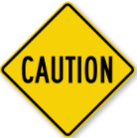
R-value Alternatives
Alternative R-values can be determined by:
  Use of U-factors for equivalent assemblies
    Precalculated U-factors for various R-value assemblies
    (ASHRAE 90.1, Appendix A)
    Cavity correction factor calculation method
    (IECC C402.1.4.2 and ASHRAE 90.1, Appendix A)
    New AISI S250 standard (not currently recognized in codes)
  Use of total UA method (e.g., use REScheck or COMcheck)
  Use of building performance methods (e.g., building modeling/simulation path)
Provides flexibility to have more options for energy
code compliance
  But, are they all really equivalent?
  Can changing insulation amounts or locations on the assembly change the way the assembly handles moisture even if thermal performance remains the same?
– UNINTENDED CONSEQUENCES!
  This flexibility can result in assemblies that perform differently (better or worse) from a moisture control and durability perspective. This may also be the case for some prescribed R-value assemblies in the code (depending on the overall wall assembly design per building code).
  More of an issue for wood framing than steel framing (due to differences in ci R-values prescribed)

Slide 7
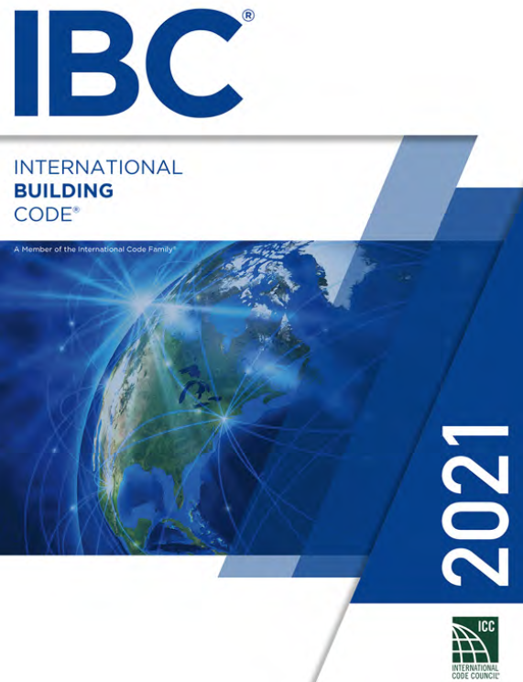
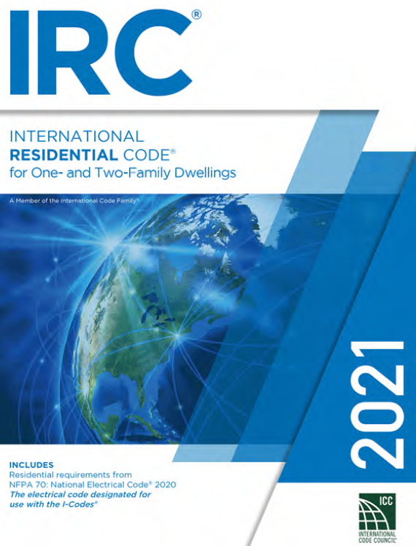
Coordinated Building
Code Advancements
Why?
  To help avoid unintended consequences of complying with
  the energy code.
  Insulation materials, amounts, and their location on a building assembly can affect moisture control, for good or bad
  Building materials and their properties and locations within an envelope assembly also affect moisture control and durability, for good or bad.
  Healthy and durable buildings require materials to be protected against the effects of moisture (i.e., mold, corrosion, rot, shrink/swell, degradation due to moisture cycling, etc.)
Codes have been largely silent or incomplete on many of the key factors that govern how an assembly will perform as a system in controlling moisture.
This has changed in the 2021 editions of the IRC and IBC, but first we need to cover some background...
Note errata for 2021 IBC for 1404.3

Slide 8
Key Building Science Concepts (BSC’s)
Successful moisture control requires an integrated approach to 5 key building science concepts:
  Control Rain Water Intrusion (e.g., continuous water-resistive barrier)
  Control Air Leakage (e.g., continuous air barrier)
  Control Indoor Relative Humidity (e.g., building ventilation & de-humidification)
  Control Initial Construction Moisture (e.g., prevent enclosure of wet materials)
  Control Water Vapor (e.g., optimized balance of wetting and drying through strategic use of insulation and vapor retarders)
All are important, all vary in significance, all have inter-dependencies...

Slide 9
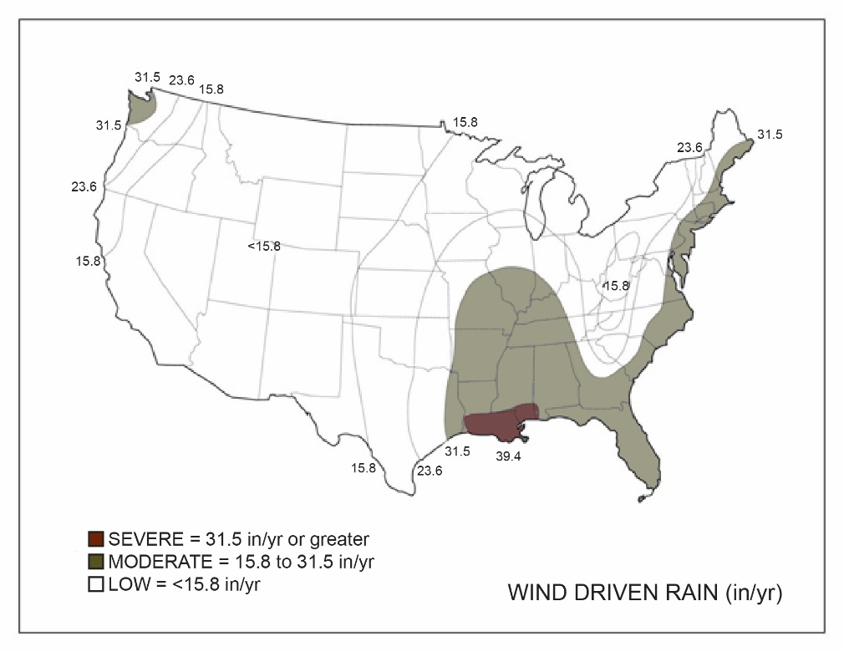
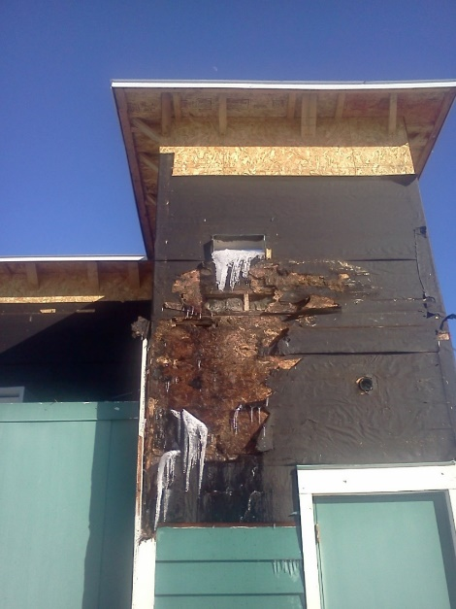
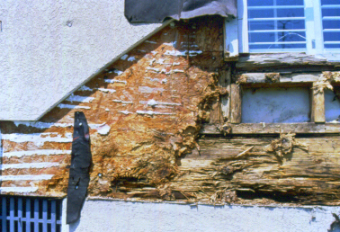
BSC #1 - Rain Water Control
Rain water control is often the primary factor associated with observed failure or success of moisture control.
If rain water is not adequately controlled, other building science measures can be rendered ineffective.
Concept is simple:
Keep water out!
Wind driven rain is the primary hazard
(map based on UofGA research)

Slide 10
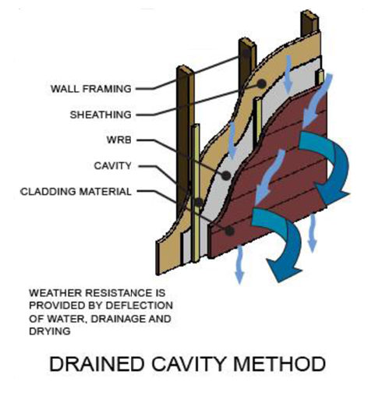

BSC #1 – Rain Water Control
Select cladding type, windows & doors, and installation methods best suited to the local climate wind-driven rain hazard
  Durability by Design – 2nd Edition
Variation in cladding material/method performance and variation in wind-driven rain hazard are not differentiated in
the code.

Slide 11
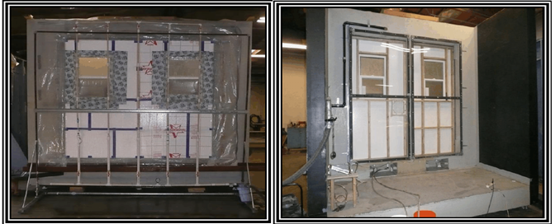
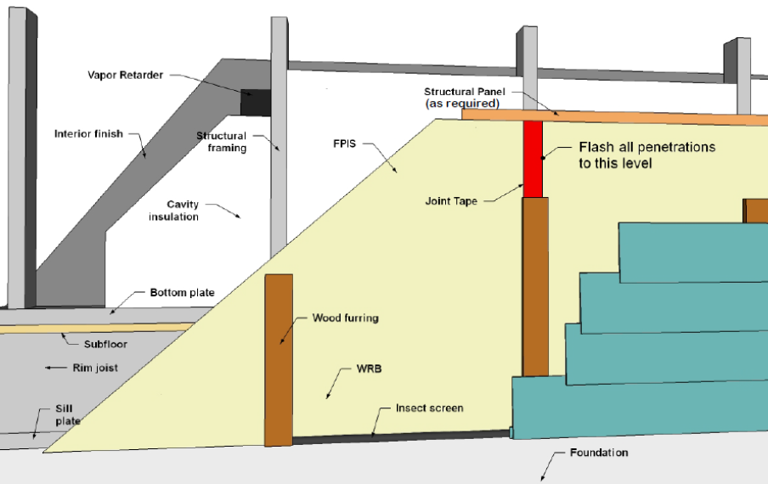
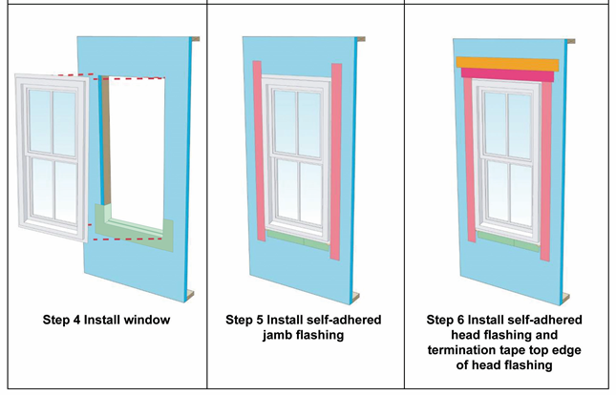
BSC #1 – Rain Water Control
Use a code compliant water-resistive barrier (WRB)
and flashing details at all penetrations for a continuous drainage plane behind the cladding
  WHY? All claddings leak!
  WRB is required by code.
  But, not all WRBs are equal or subject to equivalent performance criteria. For more information, go to continuousinsulation.org/WRB.
Robust window flashing with pan flashing strongly recommended (but not required by code)
  WHY? Many windows/doors leak or will leak.
  Refer to window manufacturer, WRB, and flashing manufacturer instructions. For additional information and installation guides,
  go to continuousinsulation.org/window-installation.
  Standard installation
    Window buck installation
    Rainscreen installation

Slide 12
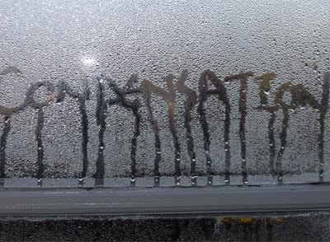
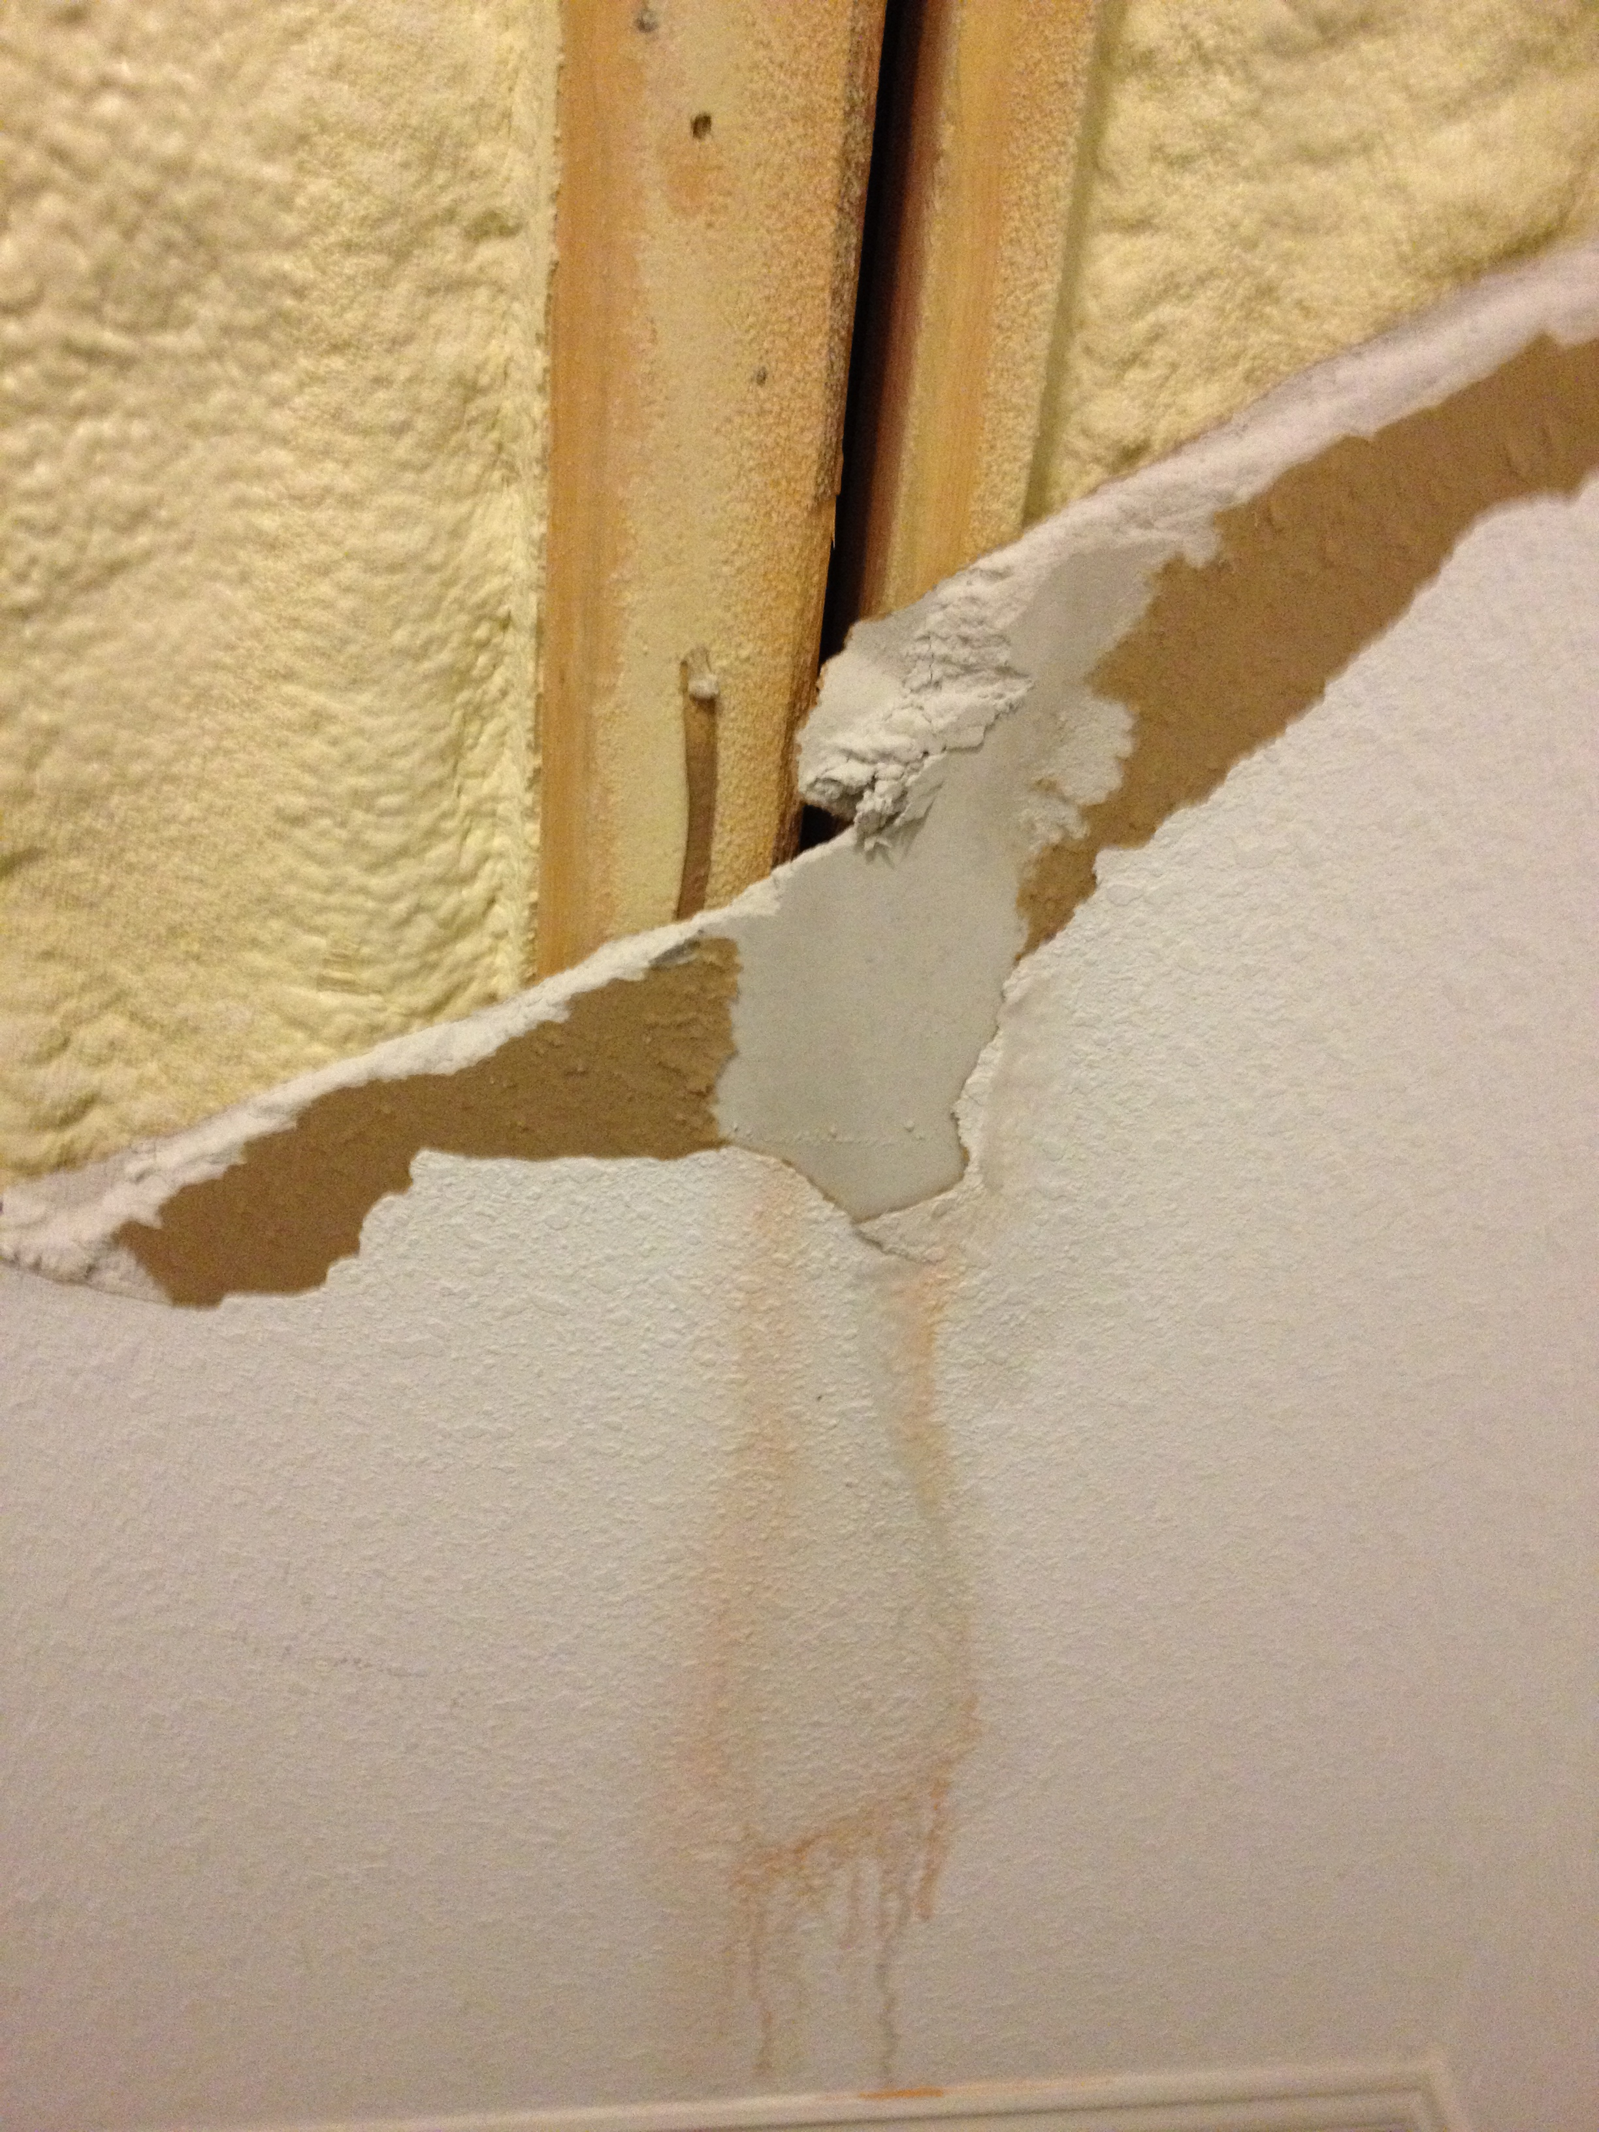
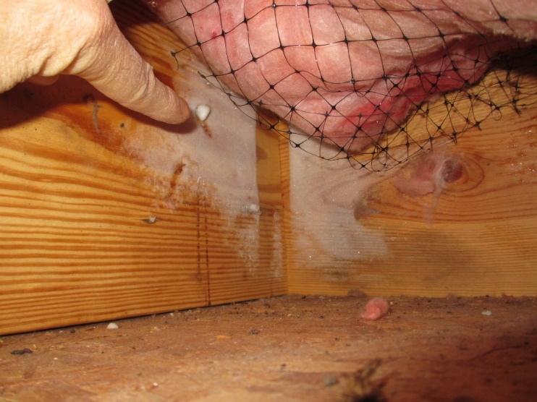
BSC #2 - Air Leakage Control
Lack of air leakage control can allow substantial amounts of moist/humid air into and through assemblies.
  Air can bypass vapor retarders, rendering them much less effective (increase risk of mold, condensation, rot, corrosion, etc.)
  Air can bypass insulation, rendering insulation less effective (increased energy bills, discomfort, etc.)
Air leakage can introduce moist air into assemblies increasing the likelihood of at least localized moisture problems.
  Similar to flashing defects resulting in a localized rain water leaks that typically cause localized moisture problems
Air leakage, under the right circumstances, can help an assembly dry out, but this is unreliable, cuts both ways.
It is better to prevent wetting by controlling water and air leaks and use proper vapor control to promote diffusion drying (while also minimizing seasonal diffusion wetting).

Slide 13
BSC #2 - Air Leakage Control
Air barrier system installation requirements and whole building air leakage testing requirements are found in the energy code.
The IECC does not specify where the continuous air barrier must be located
  Can be located on the interior, inside, or to the exterior side of walls
  EPA Energy Star* requires AB on both sides of assemblies in cold climates (best practice).
For additional guidance refer to continuousinsulation.org/air-barrier.

Slide 14
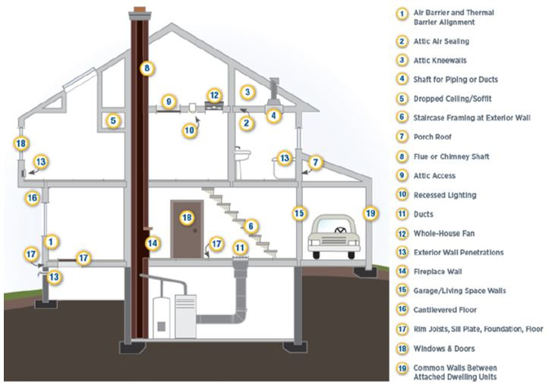
BSC #2 – Air Leakage Control
Many materials and methods of AB installation are available:
  Exterior sheathing with sealed joints
  Sealed drywall installation
  Mechanically attached wraps with sealed joints
  Adhered membranes
  Spray-applied coatings
  Closed-cell spray foam
It’s not just a material; it’s a system!
  As with the WRB and flashing, the AB must be properly sealed at all joints and penetrations and discontinuities.
  Inspection & air-leakage testing are important for quality installations
With proper design and location in an assembly, some air barrier materials may perform multiple roles (e.g., sheathing, insulation, vapor retarder, and air barrier all in one).
Source: U.S. Department of Energy Air Leakage Guide

Slide 15
BSC #3 – Control Indoor Relative Humidity
Excessive indoor relative humidity (RH) can overwhelm any reasonable code-compliant building envelope design
  Acceptable indoor RH levels are not specified by the code in association with vapor retarder and insulation requirements (they are implied)
Building ventilation requirements in the code for indoor air quality purposes can help or harm indoor RH
  Balanced whole building ventilation methods are better than spot ventilation
  Ventilation in winter may cause excessively dry air (may need controlled humidification)
  Ventilation in summer may cause excessively humid air (may need controlled de-humidification)
Proper sizing and specification of AC equipment can help control indoor RH in the summer
  Dehumidification should be considered and used as needed

Slide 16
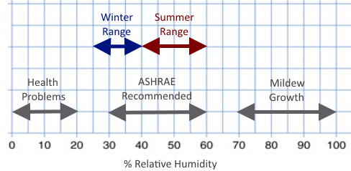
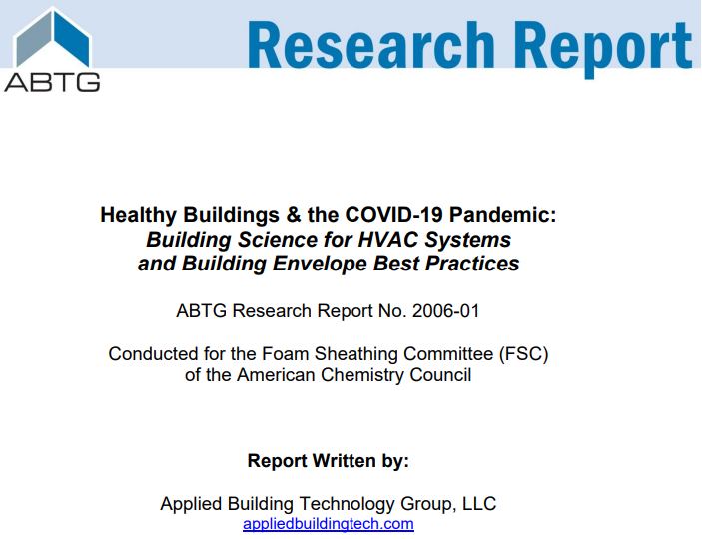
BSC #3 – Control Indoor Relative Humidity
In general, summertime indoor RH should not exceed 60%.
In the winter max recommended RH varies by climate (25% to 40%)
  Lower indoor RH needed in colder climates for water vapor control (unless envelope is designed to tolerate higher RH levels)
  Minimum 40% preferred for respiratory health and minimize disease/viral transmission
Preferred indoor RH levels for building durability and occupant comfort and health can be in conflict
  Must adjust water vapor control strategy accordingly
Special conditions require special solutions
(e.g., pool rooms, saunas, hot tubs, etc.)
For more information go to
continuousinsulation.org/healthy-buildings

Slide 17
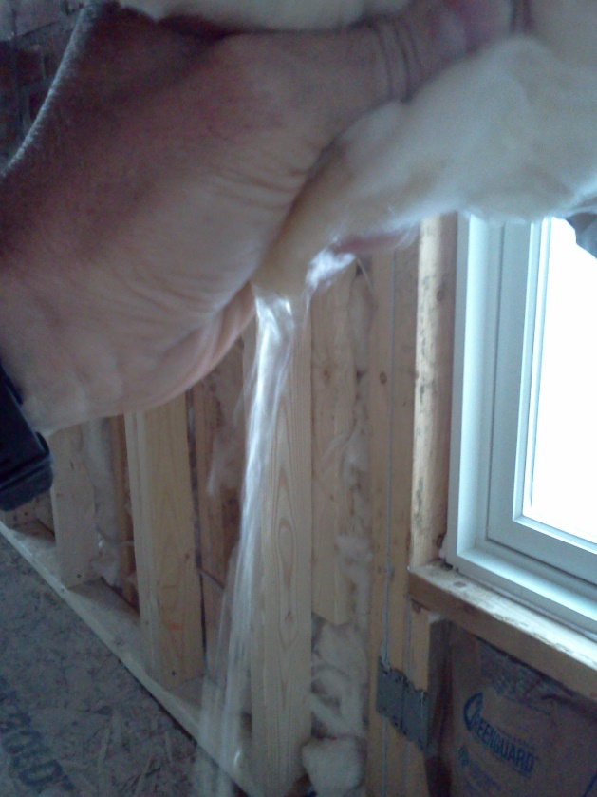
BSC #4 – Control Initial Construction Moisture
Wet framing materials and wet-applied insulation materials can overwhelm the moisture tolerance
of materials.
  This issue mainly affects the initial year of building operation.
  Can result in mold or moisture-related damage to materials such as moisture-sensitive sheathings and interior finishes.
Solutions are simple:
  Don’t use wet materials; and when they are wet, don’t
  close-in the assembly until they are dry.
  Don’t install cavity insulation, vapor retarder, and interior finishes until the wall is dried-in (e.g., water-resistive barrier and all flashings completed).
Storm water expelled from FG batt insulation installed prior to completion of the WRB and flashing

Slide 18
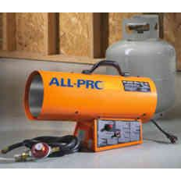
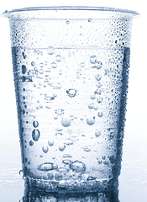

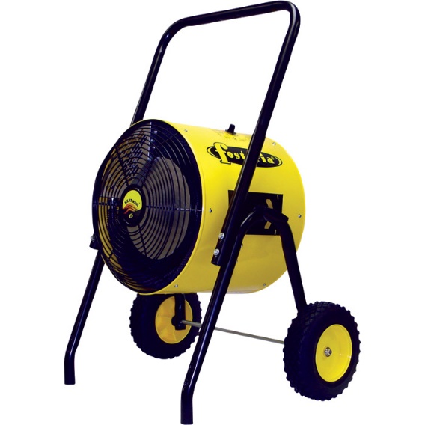
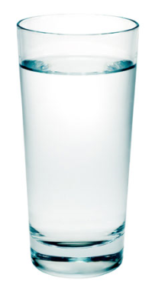
BSC #4 – Control Initial Construction Moisture
TIP: Don’t dry buildings using gas/fuel fired heaters – water vapor is a primary combustion by-product!
  Hot/humid air creates huge vapor drives and can slow drying rather than help it.
  Use hot/dry air instead (electric heaters, dry air ventilation, etc.)

Slide 19

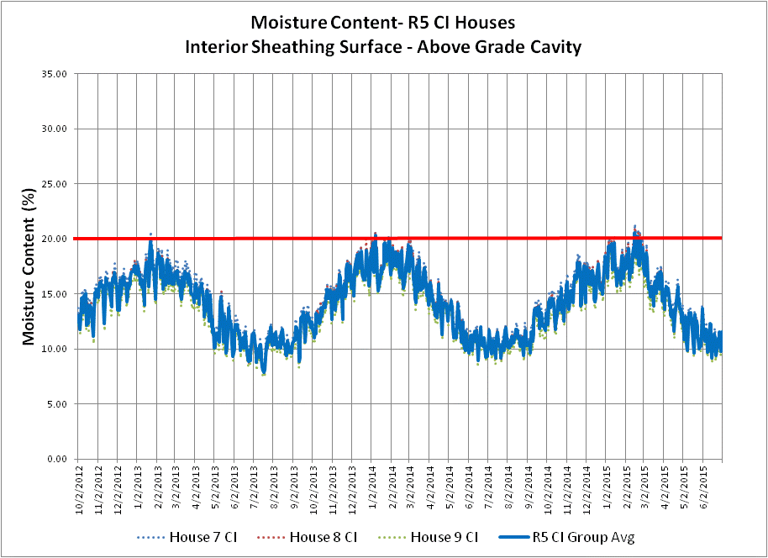
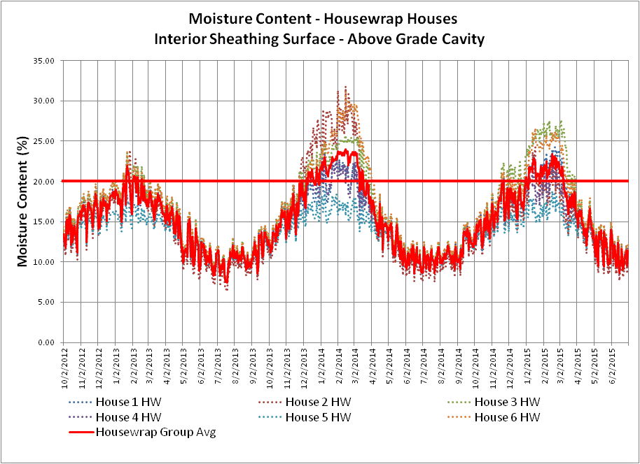
BSC #5 – Control Water Vapor
Water vapor control involves two simple concepts:
  Minimize the risk of the assembly getting wet due to water vapor diffusion (adsorption or condensation).
  Optimize the ability of the assembly to dry in relation to its risk of getting wet.
Two “Code-Compliant” Walls:
Left – moisture cycling below 20% MC
Right – moisture cycling above 20% MC

Slide 20
BSC #5 – Control Water Vapor
While simple in concept, this practice involves consideration
of several factors (not all addressed in code):
  Climate and Indoor RH (boundary conditions)
  Water vapor permeance (WVP) of exterior materials
    Sheathing, WRB, etc.
  WVP of interior materials
    Interior vapor retarders in cold climates, or interior finishes in warm climates
  Location and properties of insulation:
    Cavity insulation R-value and its WVP
    Exterior insulation R-value (continuous insulation) and its WVP

Slide 21
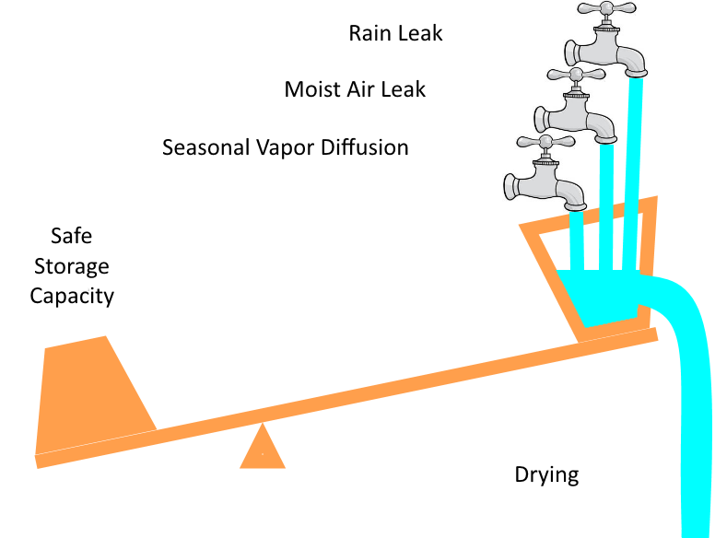
BSC #5 – Control Water Vapor
It is truly a balancing act!
  Risk of rain water wetting
  Risk of air-leakage wetting
  Wetting and drying by water vapor diffusion
R-value and relative WVP of materials and their location within the assembly matters
  Ability of materials to store and tolerate moisture also matters
GOAL: Drying > wetting (in annual, not monthly/seasonal basis) to control risk of mold
or water-sensitive material degradation

Slide 22
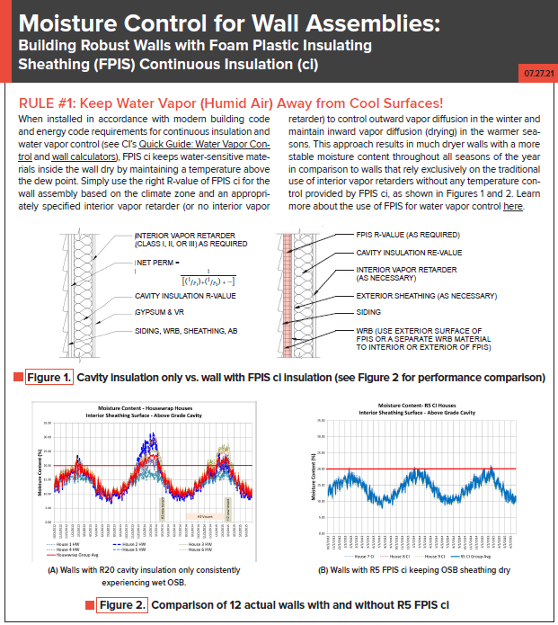
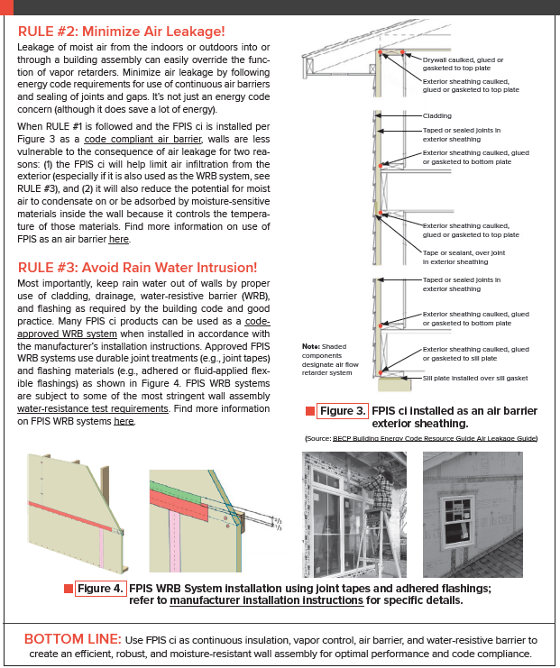
BSC Summary – 3 Rules for Moisture Control
Download resource at continuousinsulation.org/facts

Slide 23
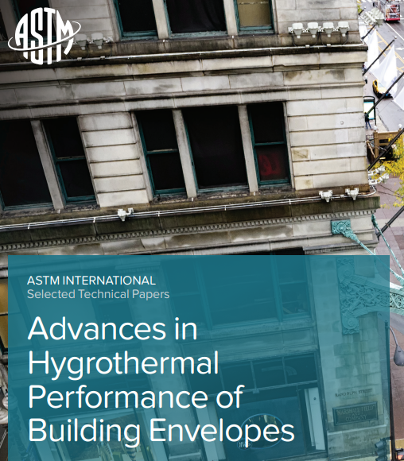
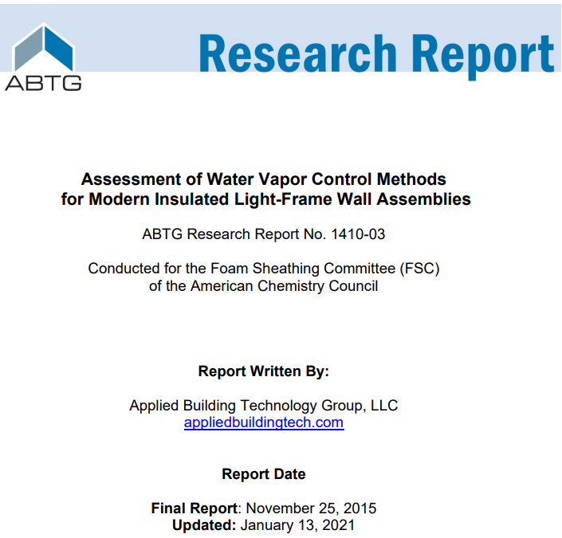
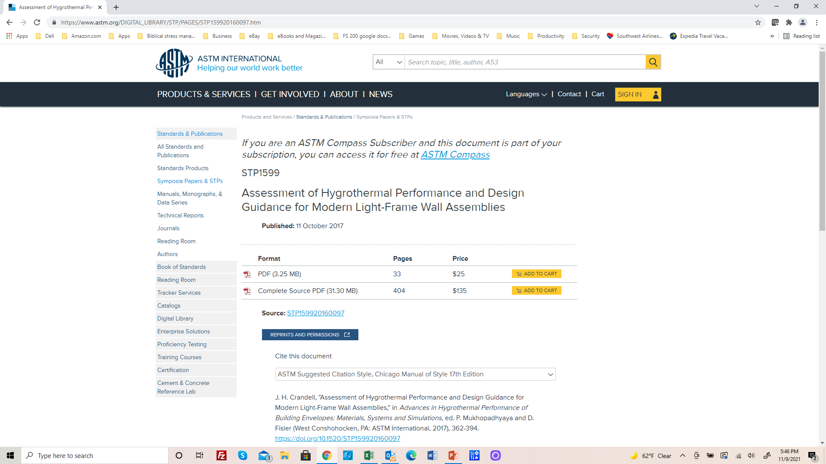
Research Leading to 2021 IRC/IBC Provisions
https://www.appliedbuildingtech.com/rr/1410-03
https://www.astm.org/DIGITAL_LIBRARY/STP/PAGES/STP159920160097.htm

Slide 24
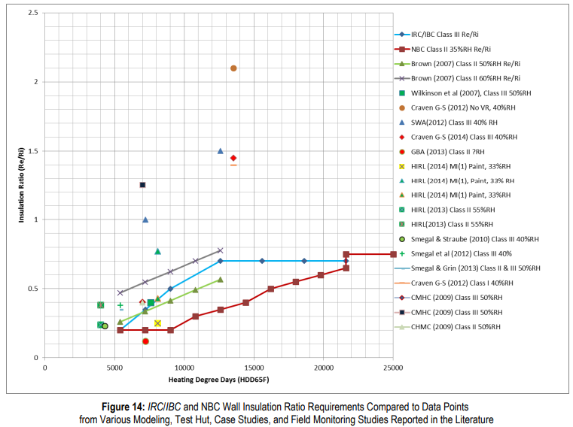

Research Findings
Surveyed multiple field, test hut, and modeling studies
Compared to U.S. and Canadian Code and Practices
Confirmed where practices were working well
Conducted analysis where refinements needed
Peer reviewed
Combined best of U.S. and
Canadian practices to result
in 2021 IBC/IRC
Unanimous approval at code hearings including all major stakeholders

Slide 25
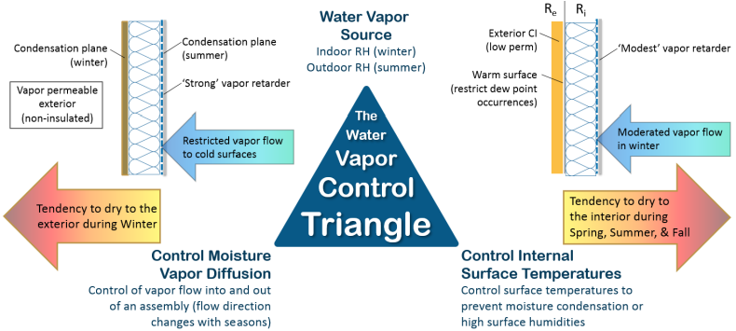
Vapor Control Principles
Two approaches to control water vapor:
  Permeance Controlled Design (permeance ratio)
  Temperature Controlled Design (insulation ratio, IR = Re/Ri)

Slide 26
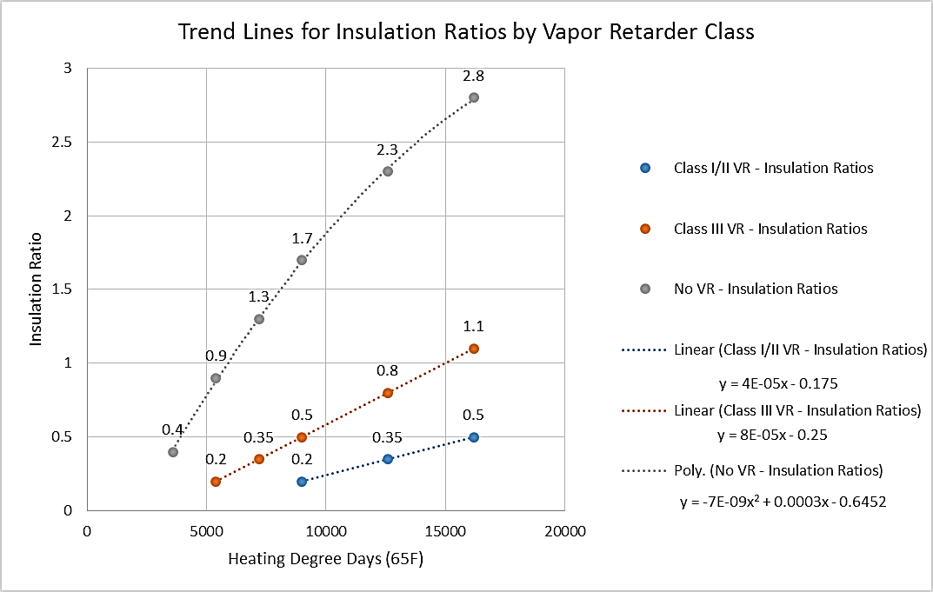
Insulation Ratio (Graphic Format)
(Temperature-controlled Design)
Source: http://www.appliedbuildingtech.com/rr/1410-03

Slide 27
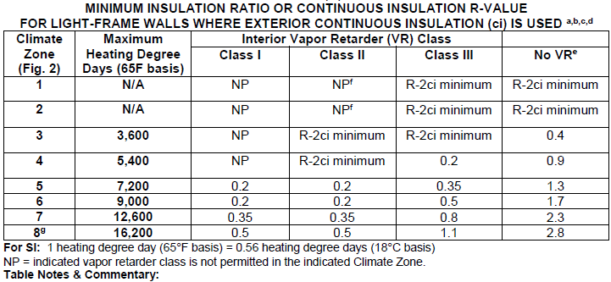
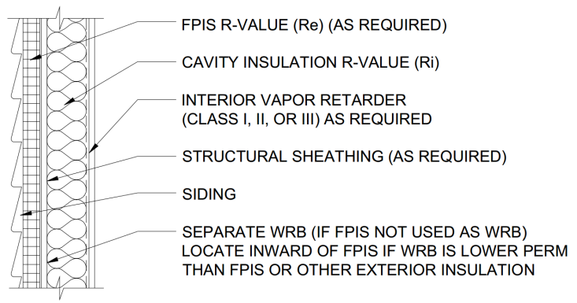
Insulation Ratio (Tabulated Format)
(basis of 2021 IBC and IRC for walls with continuous insulation)
Source: http://www.appliedbuildingtech.com/rr/1701-01

Slide 28
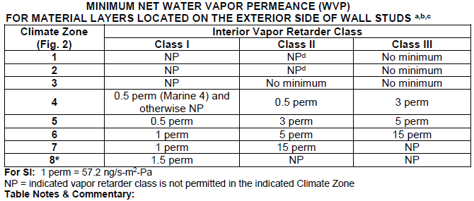
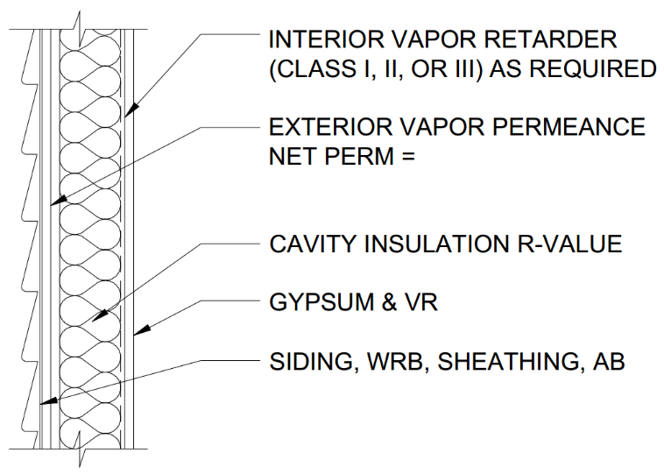
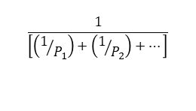
Permeance Ratio
(not included in 2021 IBC and IRC)
$$\frac{1}{\left[\left(1/{P_{1}}\right)+\left(1/{P_{2}}\right)+…\right]}$$
NOTE: For use with cavity insulation only walls, or walls that have continuous insulation but inadequate insulation ratio.
Source: http://www.appliedbuildingtech.com/rr/1701-01

Slide 29
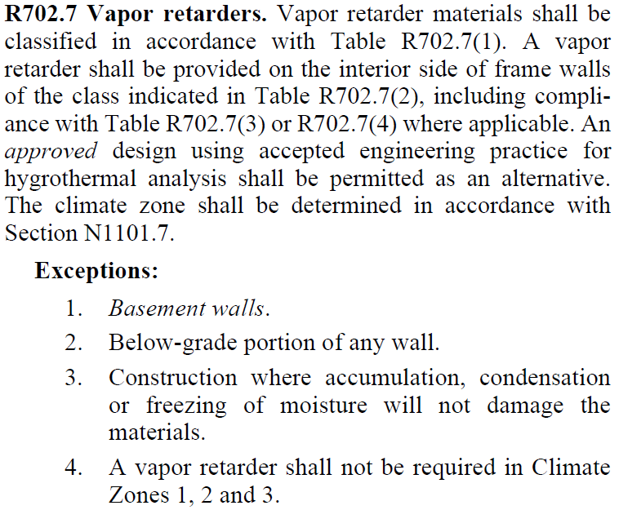
2021 IRC & IBC Vapor Retarder Provisions
IRC and IBC provisions are similar.
  Refer to 2021 IBC errata for Section 1404.3
First, the general requirements:

Slide 30
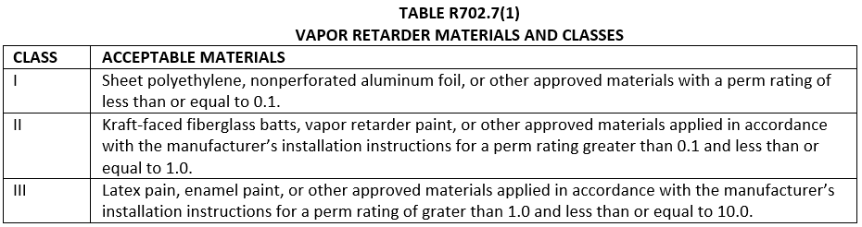
2021 IRC & IBC Vapor Retarder Provisions
Vapor retarder classes are broadly defined.
  Based on static “dry cup” permeance only.
  “Smart” (dynamic or responsive) vapor retarders are addressed separately as an “adder” to these classes.

Slide 31
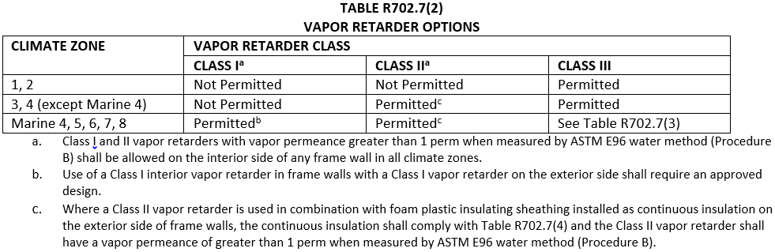
2021 IRC & IBC Vapor Retarder Provisions
Second, VR permitted application by climate zone is tabulated.
Footnotes address additional conditions of use such as “smart” vapor retarders and use of foam sheathing continuous insulation with a Class II “smart” vapor retarder.
Footnote ‘b’ prevents double vapor barrier unless designed – generally meaning use of a Class I smart vapor retarder (see footnote ‘a’)
Footnote ‘c’ and Table R702.7(3) provide requirements when foam sheathing (‘ci’) is used.

Slide 32
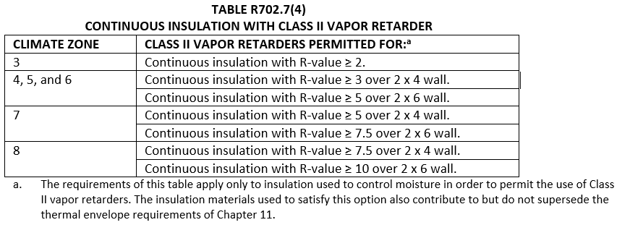
2021 IRC & IBC Vapor Retarder Provisions
Next, where the wall has a Class II VR and foam sheathing ci...
This is the “insulation ratio” in prescriptive form (same format as used in the existing Class III VR table shown in next slide)
As noted in footnote ‘c’ the Class II VR must have a permeance of > 1 perm under “wet cup” ASTM E96 test (e.g., is a smart vapor retarder). Generically, this means a Kraft paper facer on fiberglass batts (or similar).

Slide 33
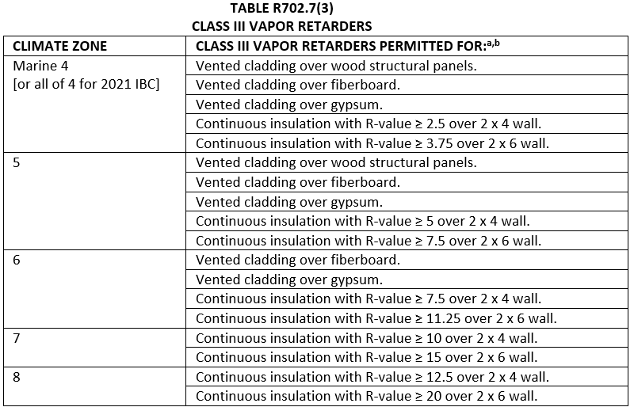
2021 IRC & IBC Vapor Retarder Provisions
Finally, where a Class III VR is used...
As with the Class II VR table, the colder the climate the more ci R-value required (greater insulation ratio) – this is the temperature controlled design approach. In CZ 7 & 8, this is the only solution.
Also, as the climate gets colder a higher exterior sheathing permeance is required if not using ‘ci’ to protect the wall from moisture accumulation (same should apply with use of a Class II VR, but is not currently in the code) – this is the permeance controlled design, but only for Class III VR applications.

Slide 34
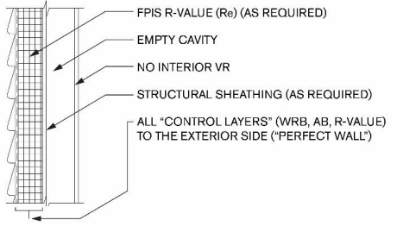
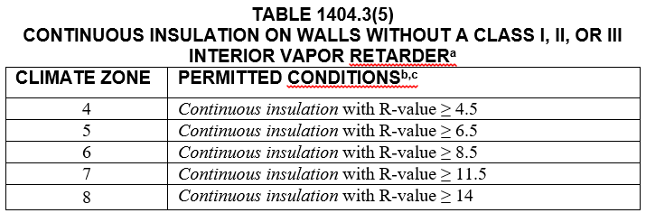
2024 IBC – Ci Only, No Interior Vapor Retarder
The “Perfect Wall” – all control layers on the exterior side of the assembly; maximum protection of structure and maximum mitigation of thermal bridging.
Generally, the energy code will require more insulation than needed for water vapor control when using all exterior continuous insulation.

Slide 35
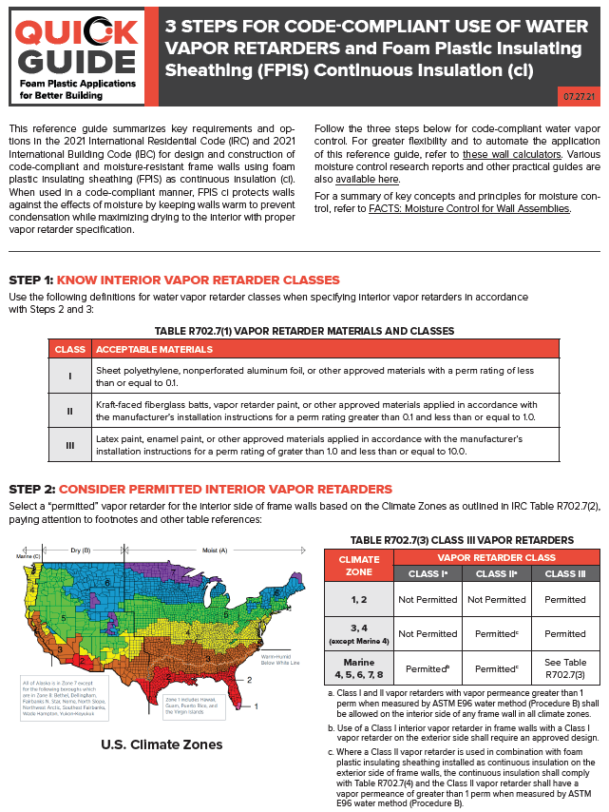
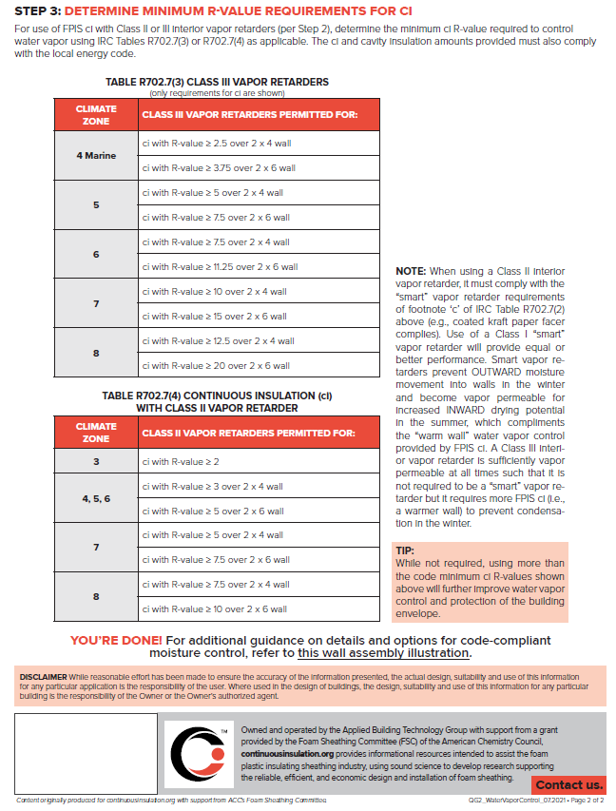
Simplified Code-Compliance Guide
Download resource at continuousinsulation.org/quick-guides

Slide 36
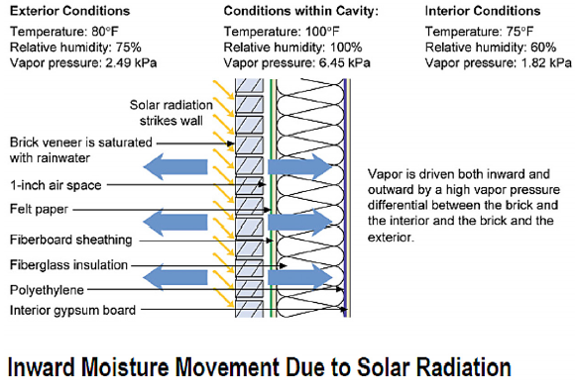
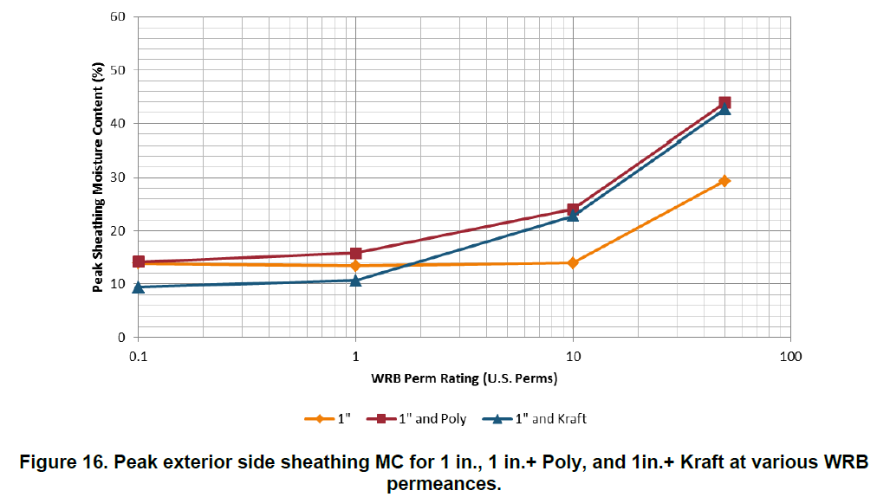
Supplemental Design
Considerations
CAN YOU HAVE TOO MUCH PERMEANCE?
Yes! (in some conditions)
Recommendation:
The Net WVP of exterior layers between the cladding and sheathing (e.g., the WRB or continuous insulation) should not exceed ~10 perm.
This prevents solar-driven inward moisture movement, where direct-applied (unvented) reservoir cladding (adhered veneer, stucco, etc.) is used on air-conditioned buildings.
Can also be addressed by increasing back-ventilation of reservoir cladding (more like brick veneer).
See 2021 IBC and IRC provisions for stucco WRB (required drainage space for “Moist” and “Marine” climates)
High sheathing moisture content
Source: Lepage & Lstiburek (2013). Moisture Durability with Vapor-Permeable Insulating Sheathing. US DOE, Building Technologies Office, Building America Program

Slide 37
Supplemental Design Considerations
CAN YOU HAVE TOO LITTLE PERMEANCE?
Yes! (in some conditions)
For all wall assembly types in climates with severe wind-driven rain hazard (see next slide), avoid use of “double vapor barriers*” (e.g., Class I vapor retarder on interior and << 1 perm net water vapor permeance material layers on exterior).
  Use a Class II VR (preferably a “smart” VR like Kraft paper) or Class III VR to promote drying to interior or high perm materials on the exterior to promote drying to the exterior.
  Use of pan flashings below window sills and door thresholds highly recommended to prevent wetting from rain intrusion in the first place. All flashings and WRB installation should be inspected/verified before concealment.
  * The concern is not with “double vapor retarders.” Many walls are “double vapor retarders” because both sides of typical wall assemblies provide resistance to water vapor diffusion (some more than others).

Slide 38
Supplemental Design Considerations
IMPORTANT NOTES FOR PREVIOUS SLIDE:
  Drying potential (breathability) is not a “cure all” for leaky walls and components. Taken to an extreme, it can lead to “too much permeability” or inattention to the primary concern with preventing leaks or properly specifying insulation location and vapor retarders.
  Class I vapor retarders are not permitted in climate zones 1-4 already (except Marine 4), so this recommendation applies mainly to the Northwest and Northeast seaboards of the US (see next slide).
  Use of a Class I or II “smart” (responsive) vapor retarder is now recognized in the 2024 codes to promote inward drying and restrict outward (winter) vapor movement.
For additional info on double vapor barriers, refer to: “Doubling Down: How Come Double Vapor Barriers Work?” (Dr. Lstiburek, ASHRAE Journal, Jan. 2016).

Slide 39
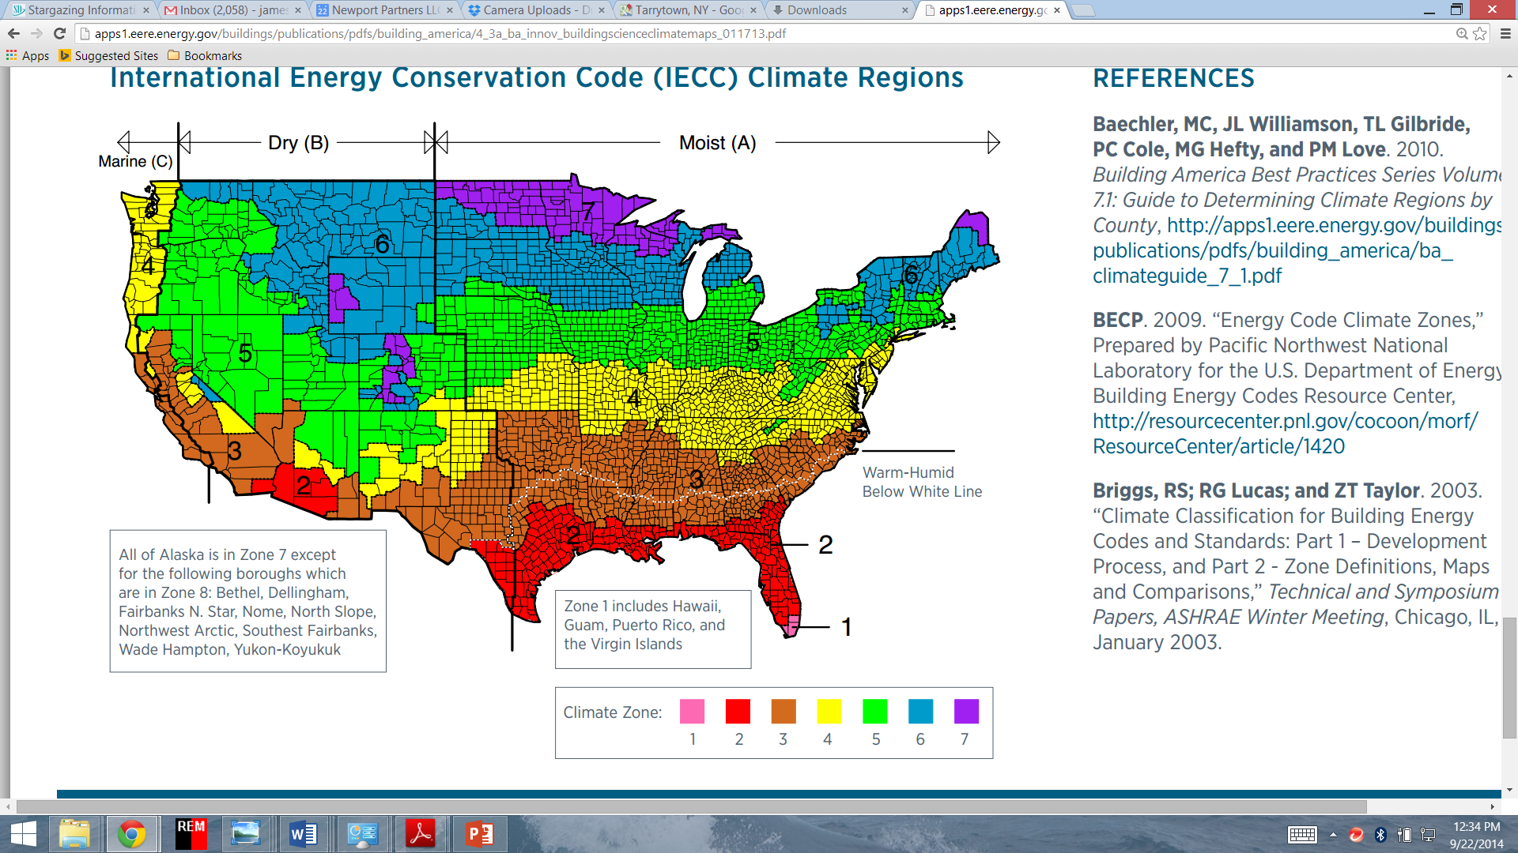
Wind-driven Rain & Climate Zone Maps

Slide 40
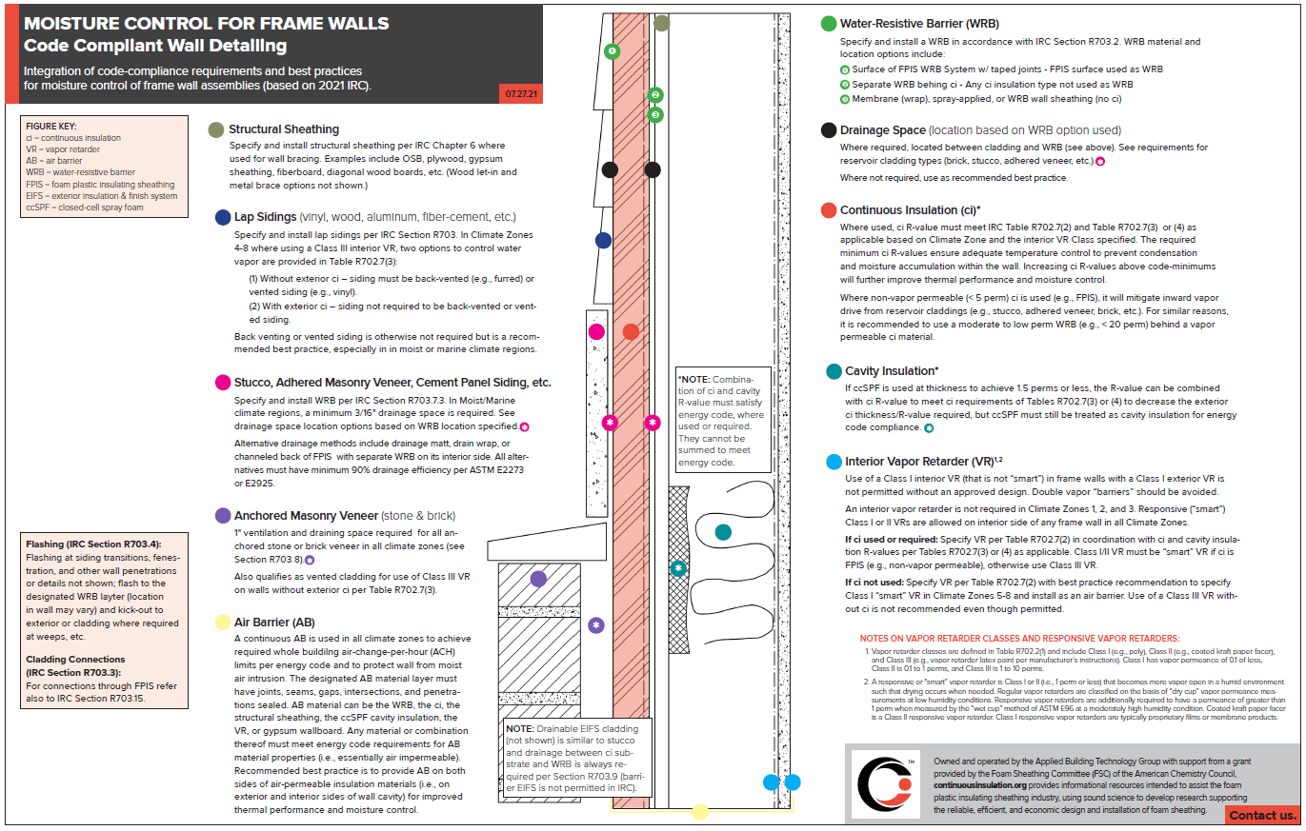
Summary – Graphic for Integrated Moisture Control
Download resource at continuousinsulation.org/water-vapor-control

Slide 41

Wall Calculator
Easy Button to IECC & IBC/IRC Coordinated Compliance
Implements R-value and
U-factor checks per IECC and also a moisture control check (including insulation and permeance ratio checks)
Flexible, More Solutions than Code, More Precise
Access the Steel Wall Calculator at:
continuousinsulation.org/steel-wall-calculator

Slide 42
Design Example
Commercial Building (“All Other” – non-Residential)
Given: In Climate Zone 5 for a non-residential metal-frame building, the 2018 & 2021 IECC provides the following prescriptive R-values:
  R-13+R-7.5ci (2018 IECC)
  R-13+R-10ci (2021 IECC)
Find: Appropriate vapor retarder options in accordance with the building code.

Slide 43
Design Example
In Climate Zone 5:
  All vapor retarders are permitted to meet the code requirement for an interior vapor retarder in CZ 5.
  Footnotes provide additional conditions for use.
Solution 1: Class II VR with
R-13 + R-3ci (minimum) works for moisture control.
  Therefore, 2018 IECC R-13 + R-7.5ci
  will provide better than code minimum moisture control (greater insulation ratio).
  2021 IECC R-13 + R-10ci even better yet.
  Footnote ‘c’ requires use of a “smart” Class II VR (e.g., Kraft paper meets criteria) for inward drying
  Use of a “smart” Class I VR (NOT poly) will actually exceed code minimum intent of Footnote ‘c’ (clarified in future 2024 codes)

Slide 44
Design Example
Solution 2: Class III VR with R-13 + R-5ci (minimum) works for moisture control.
  Therefore, 2021 IECC R-13 + R-7.5ci will provide better than code minimum moisture control (greater insulation ratio).
  2021 IECC R-13 + R-10ci even better yet.
  Class III VR is not required to be “smart” (sufficient drying potential as is)
Use of lower-perm ci (<10 perm) will
also help minimize inward vapor drives
if reservoir claddings used.

Slide 45
Conclusions
Energy Code Advancements
  Significant advancements have been made and are continuing.
  These require improved and coordinated building code moisture control requirements as per 2021 IBC and IRC.
Coordinated Building Code Advancements
  Based on extensive, peer-reviewed research and supported unanimously at code hearings
  Significant expansion and improvement of water vapor retarder provisions
  Still some work needed (e.g., guidance for permeance controlled assemblies)
Design aids are available to assist in efficiently coordinating energy code and building code compliance.
Example design demonstrates simplicity of prescriptive energy code and building code vapor retarder compliance.

Slide 46

QUESTIONS?
Jay Crandell
www.aresconsulting.biz
Please submit any questions through the Continuous Insulation website at continuousinsulation.org/contact.

