Slide 1
Ci by Climate Zone in Commercial Energy & Building Codes
Jay H. Crandell, P.E.
ABTG / ARES Consulting

Slide 3
Outline
The Building Thermal Envelope & Continuous Insulation (Ci)
Commercial Energy Code
Commercial Building Code
Resources to help put it all together

Slide 4
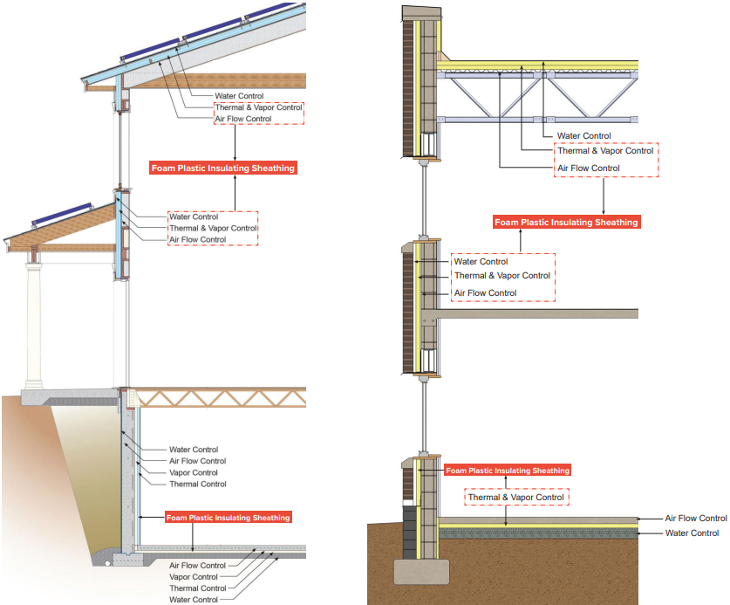
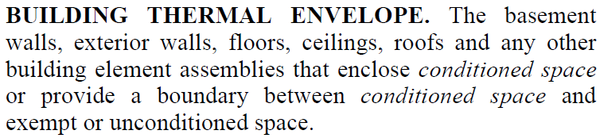
What is the building thermal envelope (BTE)?
The BTE separates the indoor from the outdoor environment.
The BTE is an integrated system which also supports the design and function of other building systems.
IECC Definition:

Slide 5
Why is the BTE important?
Allows indoor environment (conditioned space) to be controlled for comfort, productivity, and health
Major factor in sizing HVAC equipment
Protects the structure and its contents from the outdoor environment (wind, rain, U/V radiation, temperature and humidity cycling, etc.)
Determines the life-cycle operational cost, energy use (heating/cooling), and carbon footprint/handprint for the building.
“Without a good building envelope, …HVAC system and design actions become more difficult and costly, and uncertain in their effectiveness [to control the indoor environment].”
Source: ABTG RR No. 2006-01, p10, https://www.continuousinsulation.org/topical-library/healthy-buildings
RESOURCE: https://www.continuousinsulation.org/sustainability

Slide 6
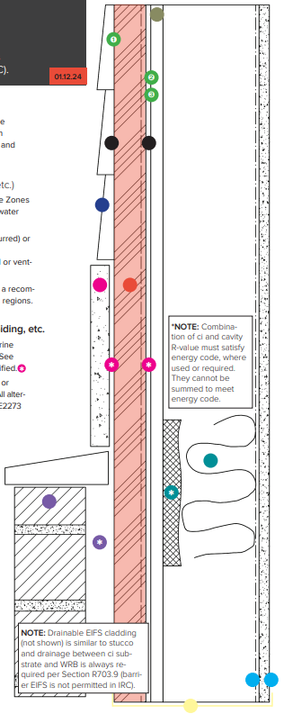
Functions of the BTE
In addition to fire safety, structural safety, sound control,and durability the BTE must address the following control layers (functions):
  Water control layers [cladding + continuous water-resistive barrier (WRB) + flashing to control water intrusion]
  Air control layer [continuous air barrier (AB) to control air leakage]
  Thermal control layer [continuity of thermal insulation to control heat loss/gain and surface temperatures]
  Water vapor control layer [use of vapor retarders (VR) in coordination with insulation strategy and climate]
All functions must be satisfied at least to the minimum extent required by the building and energy code.
Some “layers” or materials can perform multiple functions depending on design approach and material properties

Slide 7
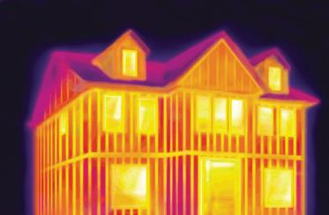
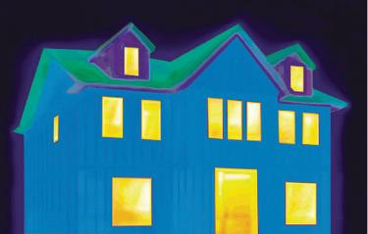
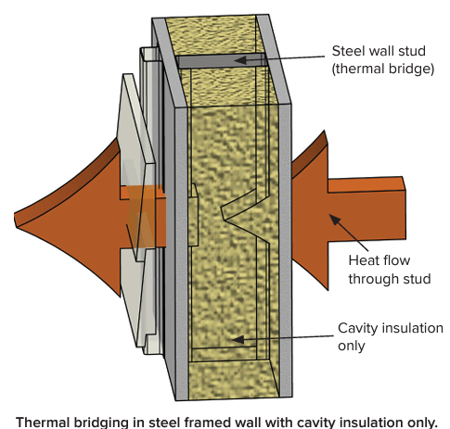
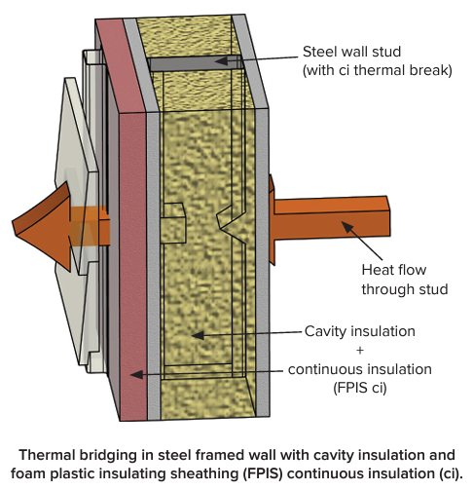
What is Ci?
Without Ci
Cavity insulation only
With Ci
Cavity + Ci insulation (or Ci only)
Two building thermal envelope insulation components are defined in the IECC & ASHRAE 90.1{}:
  CAVITY INSULATION. Insulating material located between framing members.
  CONTINUOUS INSULATION (ci): Insulation that is {uncompressed and} continuous across all structural members without thermal bridges other than fasteners and service openings. It is installed on the interior or exterior or is integral to any opaque surface of the building envelope.
Various insulation material options for each, but with different performance attributes and functional capabilities for energy code and building code compliance.
Source: Dryvit/Dow

Slide 8
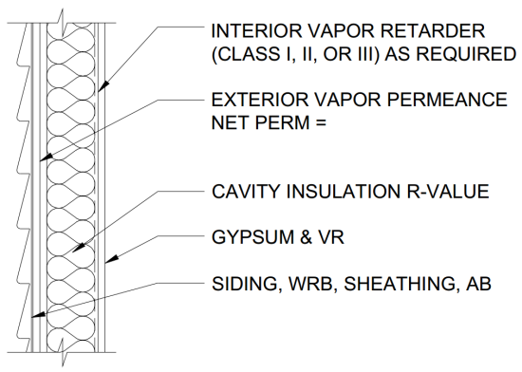
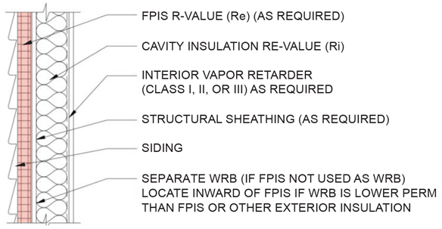
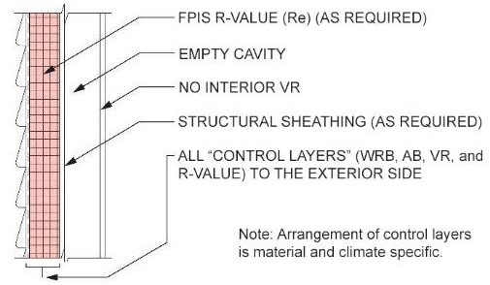
Typical Methods for Insulating Exterior Walls
Cavity insulation only (traditional method)
Cavity insulation + continuous insulation (common choice for modern code-compliant or high-performance walls)
Continuous insulation (ci) only (the “perfect wall” with all control layers to the exterior – maximum protection and thermal performance)

Slide 9
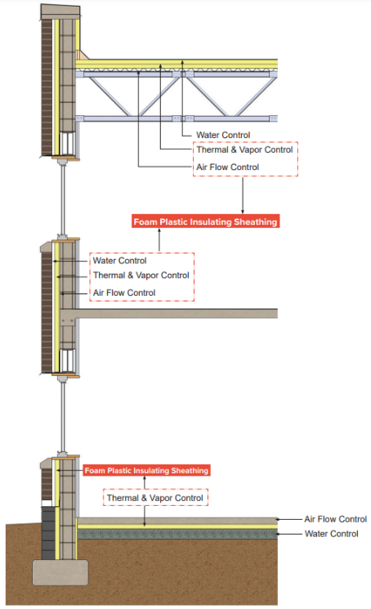
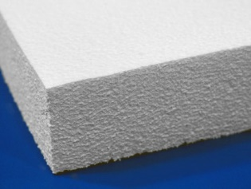
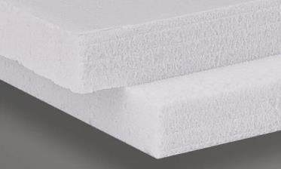
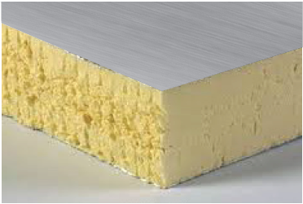
Multi-functional Capabilities of Ci
EXAMPLE: Foam Plastic Insulating Sheathing (FPIS); i.e. “rigid board”
Applications: walls, roofs, floors, and foundations (residential and commercial)
BTE Functional Capabilities of FPIS:
  IECC - Thermal Insulation (Ci)
  IECC - Air barrier (AB)
  IBC/IRC – Water vapor control/retarders (VR)
  IBC/IRC – Water-resistive barrier (WRB) system
  IBC/IRC – Foundation/footing frost protection
More multi-functional capabilities =
➔ satisfy multiple code requirements
➔ simpler assemblies
➔ optimized cost vs. performance

Slide 10


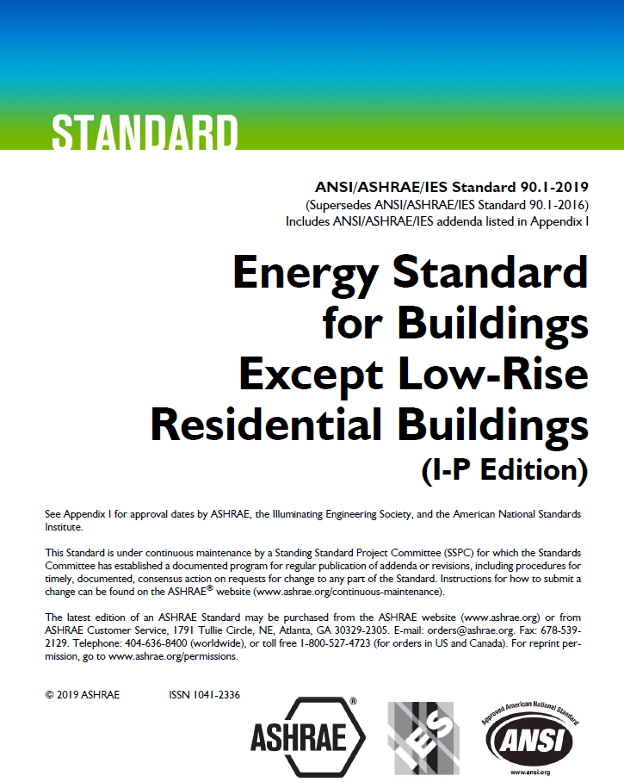
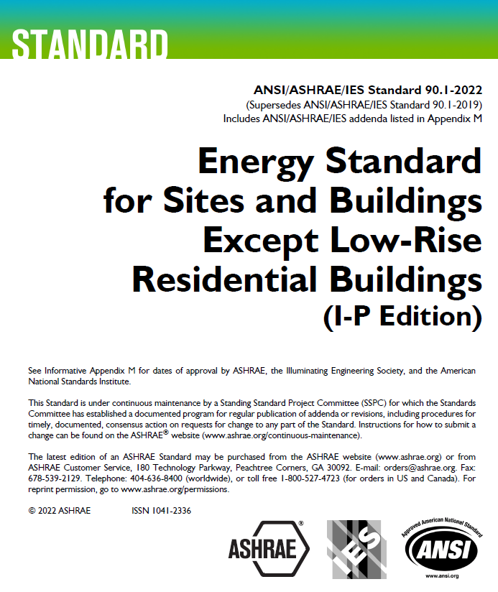
Commercial Energy Codes

Slide 11
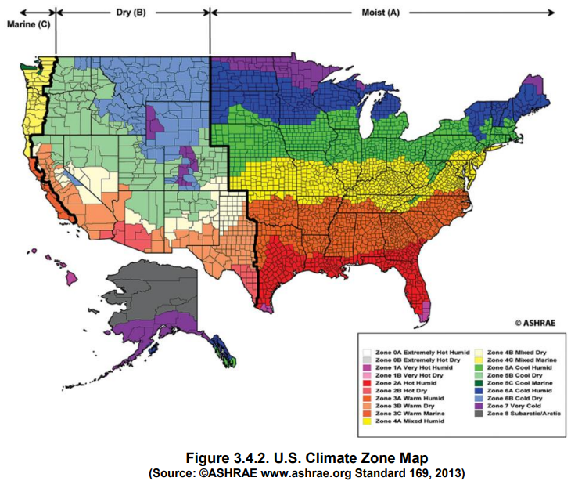
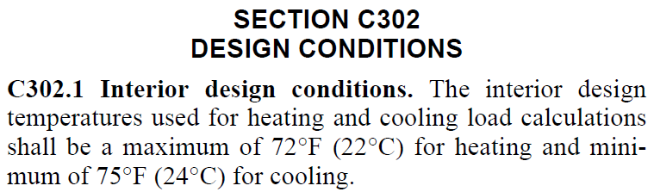
C301 Climate Zone & C302 Design Conditions
6
7
4
6
5
5
4
4
3
3
2
3
2
8
1
1
7
IECC Figure C301.1

Slide 12
Choose your compliance path
C401.2.1 International Energy Conservation Code
  Prescriptive Compliance (Sections C402 – C406 and C408)
    For BTE per C402, the following choices:
      Prescriptive minimum R-value insulation components
      Prescriptive maximum assembly U-factor
      Prescriptive component performance trade-offs (i.e. COMcheck)
      + Additional Efficiency Credits (C408)
      OR
  Total Building Performance (Section C407)
  OR
C401.2.2 ASHRAE 90.1
  Also has prescriptive and performance paths for compliance
IECC Prescriptive?
ASHRAE 90.1 ?
IECC Performance?

Slide 13
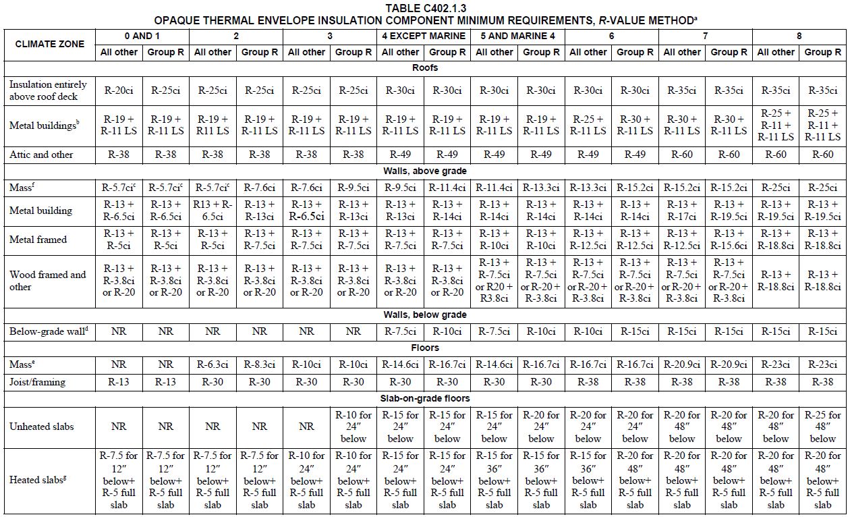
Opaque Envelope – Minimum R-value Method
LOTS OF PRESCRIPTIVE R-VALUES!

Slide 14
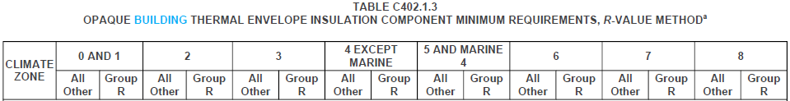
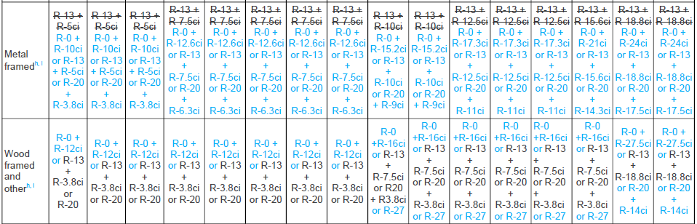
2024 IECC – added equivalent prescriptive R-value options for steel and wood framed walls…
h. The first value is cavity insulation; the second value is continuous insulation. Therefore, “R-0 + R-12ci” means R-12 continuous insulation and no cavity insulation; “R-13 + R-3.8ci” means R-13 cavity insulation and R-3.8 continuous insulation; “R-20” means R-20 cavity insulation and no continuous insulation. R-13, R-20 and R-27 cavity insulation, as used in this table, apply to a nominal 4-inch, 6-inch and 8-inch-deep wood or cold-formed steel stud cavities, respectively.
i. Where the required R-value in Table C402.1.3 is met by using continuous insulation such that cavity insulation is not required, the R-value is applicable to any wall framing spacing.
Also added new Table C402.1.2.1.7 – effective U-factors / R-values for spandrel panels (opaque wall)

Slide 15
Summary of IECC Prescriptive R-value & U-factor Requirements for Walls
2021 IECC - Tables C402.1.3 & C402.1.4; 2024 IECC - Tables C402.1.2 & C402.1.3
Climate Zone | Building Use | Mass | Metal Framed |  |  | Wood Framed
 |  | 2018/2021/2024 IECC | 2018 IECC | 2021 IECC | 2024 IECC | 2018 IECC | 2021 IECC | 2024 IECC
0 and 1 | All other | R-5.7ci (U-0.151) | R13+5ci (U-0.077) | R13+5ci (U-0.077) | R0+10ci or R13+5ci or R20+3.8ci (U-0.077) | R13+3.8ci or R20 (U-0.064) | R13+3.8ci or R20 (U-0.064) | R0+12ci or R13+3.8ci or R20 (U-0.064)
 | Group R
2 | All other
 | Group R | R-7.6ci (U-0.123) | R13+7.5ci (U-0.064) | R13+7.5ci (U-0.064) | R0+12.6ci or R13+7.5ci or R20+6.3ci (U-0.064)
3 | All other
 | Group R | R-9.5ci (U-0.104)
4 Except Marine | All other
 | Group R | R-11.4ci (U-0.090)
5 and Marine 4 | All other |  |  | R13+10ci (U-0.055) | R0+15.2ci or R13+10ci or R20+9ci (U-0.055) |  | R13+7.5ci or R20+3.8ci (U-0.051) | R0+16ci or R13+7.5ci or R20+3.8ci or R27 (U-0.051)
 | Group R | R-13.3ci (U-0.080) |  |  |  | R13+7.5ci or R20+3.8ci (U-0.051)
6 | All other |  |  | R13+12.5ci (U-0.049) | R0+17.3ci or R13+12.5ci or R20+11ci (U-0.049)
 | Group R | R-15.2ci (U-0.071)
7 | All other
 | Group R |  | R13+15.6ci (U-0.052) | R13+15.6ci (U-0.042) | R0+21ci or R13+15.6ci or R20+14.3ci (U-0.042)
8 | All other | R-25ci (U-0.037) | R13+7.5ci (U-0.064) | R13+18.8ci (U-0.037) | R0+24ci or R13+18.8ci or R20+17.5ci (U-0.037) | R13+15.6ci or R20+10ci (U-0.036) | R13+18.8ci (U-0.032) | R0+27.5ci or R13+18.8ci or R20+14ci (U-0.032)
 | Group R |  | R13+17.5ci (U-0.045)

Slide 16
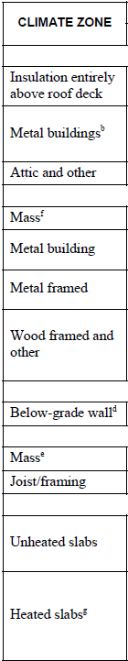
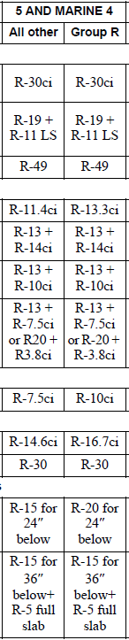
Opaque Envelope – R-value Method
Example application of Table C402.1.3 for Climate Zone 5
  Assume: Office building (use “all other” category, not Group R)
    Roof (“insulation entirely above deck”): R-30
    Above-grade walls: R-13+10ci
    (“metal framed” = cold-formed steel)
    Foundation (below grade walls): R-7.5ci
    Floors (over unconditioned space): R-30 (steel frame)
    R-14.6ci (mass floor)
    Floor (slab on grade): R-15 for 24” below
2024 IECC:
R-0 + 15.2ci
R-13 + 10ci
R-20 + 9ci
F-factor equivalent = R-10 for 36” below

Slide 17
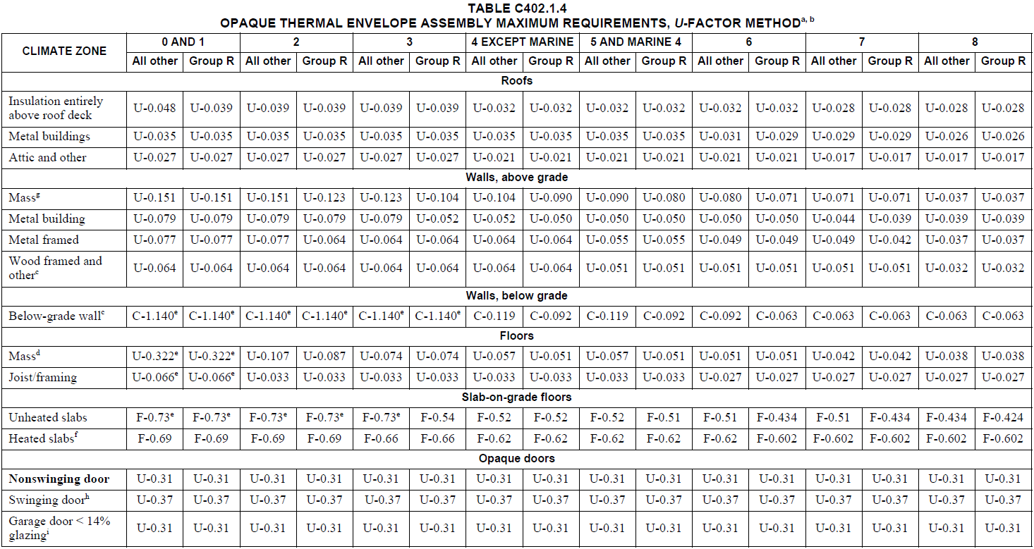
Opaque Envelope – Maximum U-, C-, F-Factor Method
Example use of U-factor next slide

Slide 18
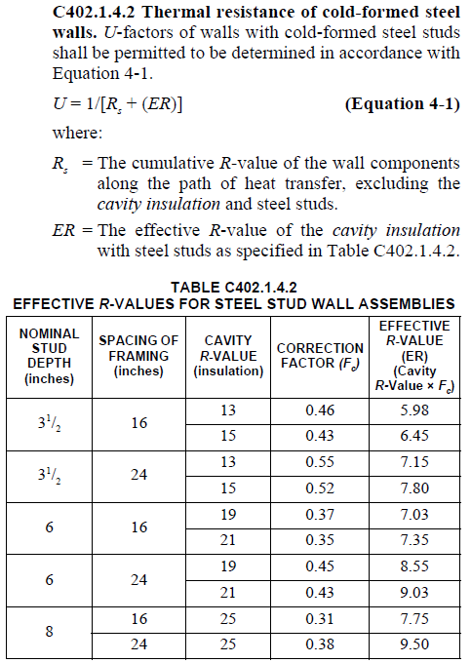
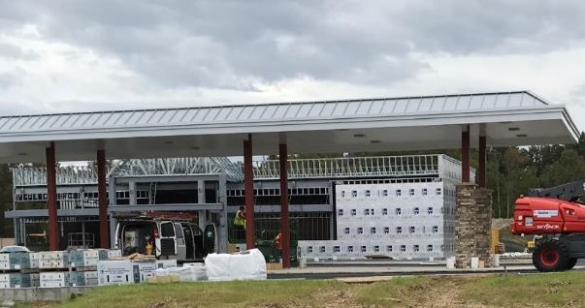
Opaque Envelope – U-, C-, F-Factor Method
Example cold-formed steel frame wall
U-factor calculation (C402.1.4.2, Eq 4-1):
NEW 2024: Deletes Eq 4-1 and references AISI S250 standard. But, standard only addresses studs at layout spacing (omits tracks and headers and built-up studs). Significantly underestimates actual wall U-factor. Suggest retaining Eq 4-1 and limit AISI S250 for use on tall curtain walls without framing other than layout studs.
U-factor per Eq 4-1 ≤ U-factor 0.055 required by Table C402.1.4 (OK)

Slide 19
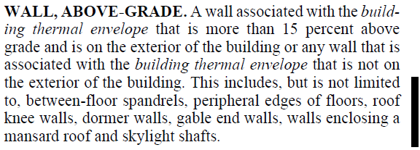
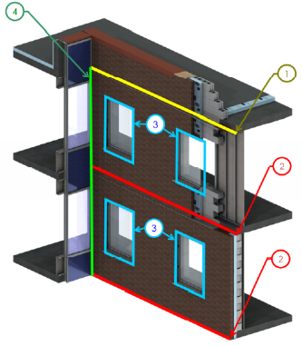
Opaque Envelope – R-value Method
Again, definitions matter…
NOTE: Thermal bridging at assembly intersections (e.g., wall-floor, wall-roof, window-wall, etc.) must be addressed to avoid unaccounted heat flows that can significantly impact performance of the building thermal envelope.
NEW 2024 IECC: Prescriptive and performance-based thermal bridging provisions in C402.7 & C407 enable compliance with this definition; similar requirements in ASHRAE 90.1-2022 Section 5.5.5, Chapter 12 & Appendix G (modeling), and Appendix A.10. [CZ 0-3 exempted]
Source: BC Hydro BETB Guide, Morrison Hershfield LTD

Slide 20
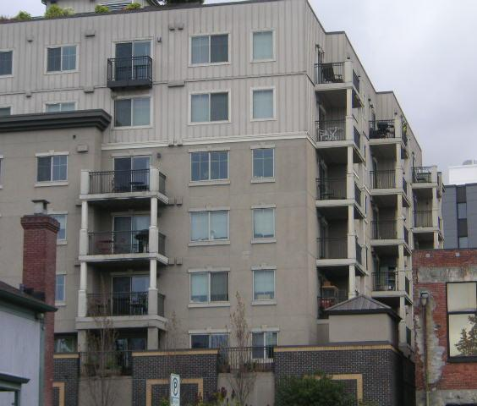
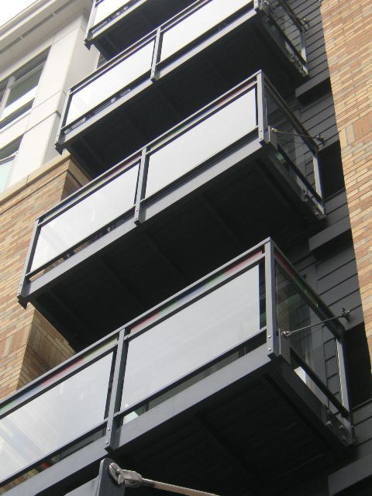
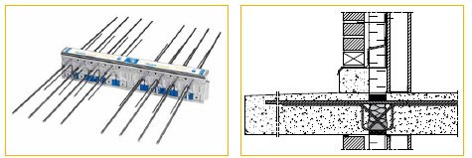
Examples of Mitigated Linear Thermal Bridges (Balconies)
Suspended and separately supported balconies with shear tab or offset shelf-angle point connection to building
OR…
Cantilevered Balcony Structural Thermal Break
Source: Google search
Photos courtesy of John Hogan

Slide 21
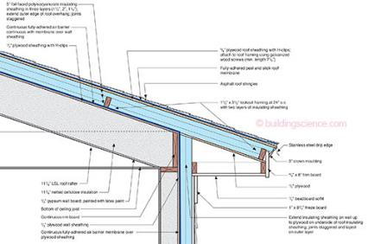
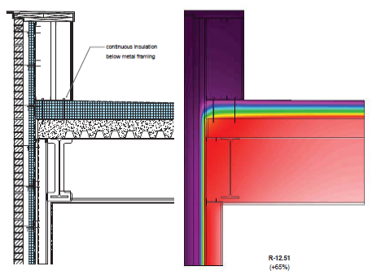
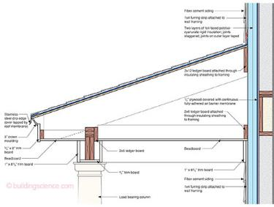
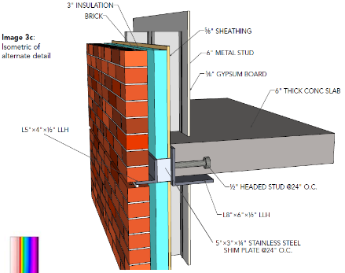
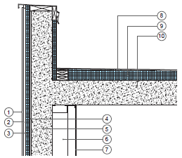
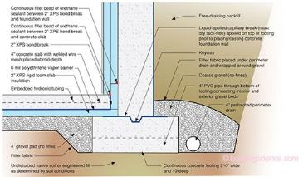
More Examples of Mitigated Linear Thermal Bridges
(non-exhaustive “commodity” details)
INSULATED WINDOW ROUGH OPENING DETAIL
(USACE report)
OFFSET SHELF ANGLE
(AISC/SEI article)
Example Details from BSI-081: Zeroing In (J. Lstiburek, Building Science Corp) as used on NIST NZERTF Project
NOTE: Coordinate detailing at floor-wall and fenestration with NFPA 285 tested assemblies and approved engineering analysis details (applies to Type I-IV buildings, not Type V wood frame).
INSULATED PARAPET DETAILS
(Payette/AIA report)

Slide 22
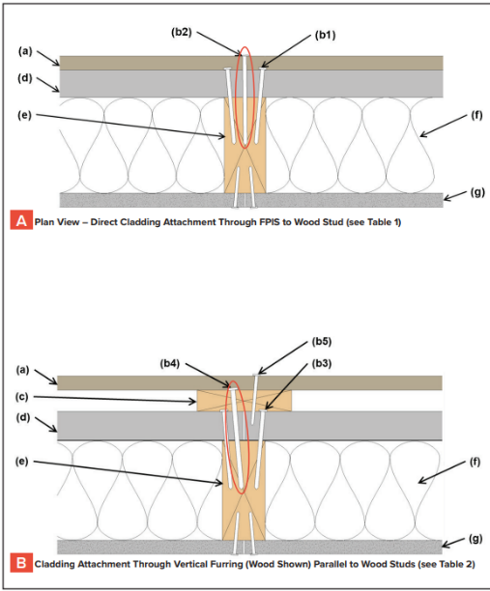
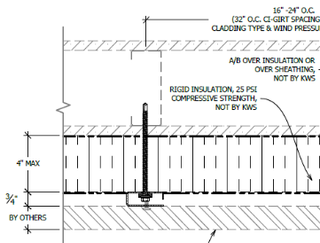
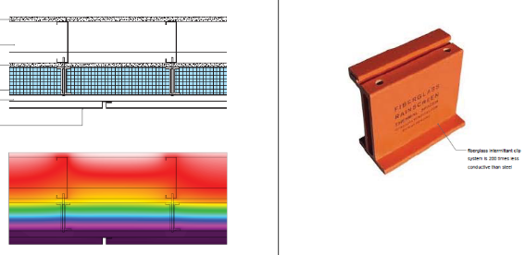
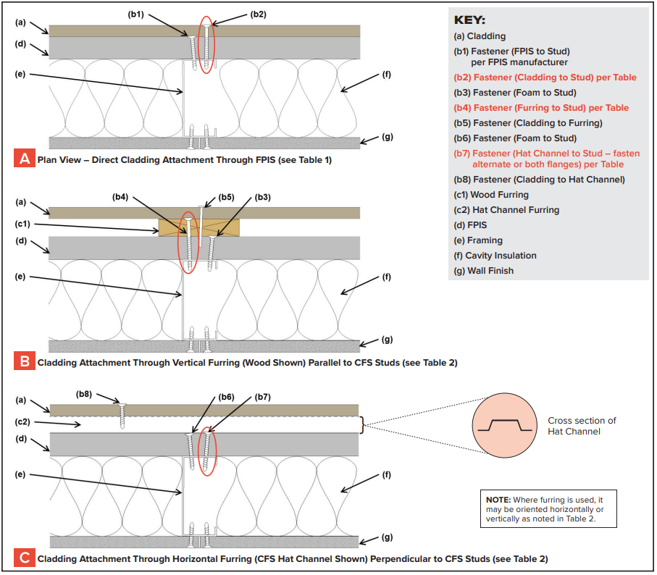
Cladding Connections and Supports
Low thermal conductivity furring/cladding/ledger supports
Sources: Payette/AIA report and product info from Google search
See 2021 IBC Section 2603.12 and .13 ( 2024 IBC Section 1404.5) for fastening cladding or furring through FPIS ci. Z-furring penetrating through exterior insulation is cavity insulation – doesn’t meet continuous insulation definition. See also: https://www.continuousinsulation.org/cladding-connections
GOAL: Avoid continuous linear cladding supports like metal Z-furring penetrating continuous insulation which would not meet building and energy code definition for ci; instead, use “point” connections through continuous insulation to offset furring (or fasten cladding directly through FPIS ci to framing).

Slide 23
2021 IECC C402.5 Air Leakage
NEW for 2024 IECC:
Re-organization of requirements
Testing expanded to cover more buildings
Air leakage rate decreased from 0.40 cfm/ft² to 0.35 cfm/ft² @ 75Pa
Exception for failed test allowing up to 0.60 cfm/ft² is reduced to 0.45 cfm/ft²
For Group R-2 and I-1 buildings, it changed from 0.30 cfm/ft² to 0.27 cfm/ft² @ 50 Pa
C402.5.1 Air barriers
  C402.5.1.1 Air barrier construction
  C402.5.1.2 Air barrier compliance
  C402.5.1.3 Materials
  C402.5.1.4 Assemblies
  C402.5.1.5 Verification
C402.5.2 Dwelling and sleeping unit enclosure testing
C402.5.3 Building thermal envelope testing
C402.5.4 Air leakage of fenestration
Other related requirements (Section C402.5.5 – C402.5.11)

Slide 24
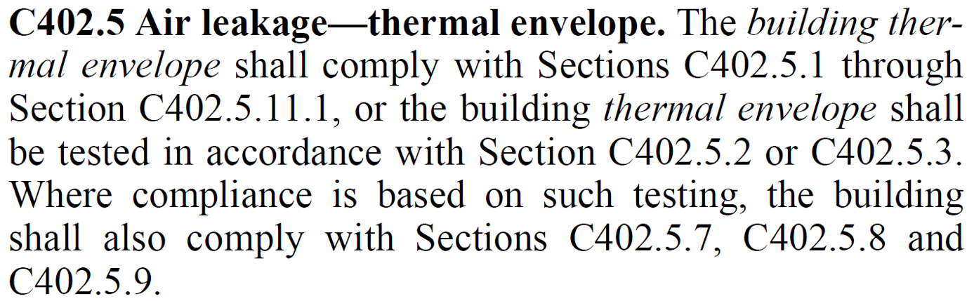
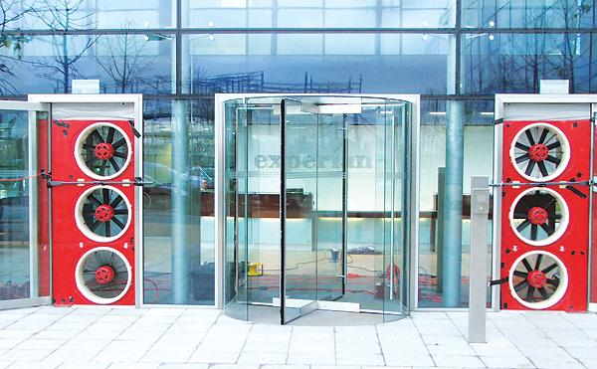
2021 IECC - C402.5 Air Leakage Compliance
PRESCRIPTIVE: Comply with Sections C402.5.1 through C402.5.11.1 (basically the entirety of C402.5)
OR
PERFORMANCE: Tested in accordance with Section C402.5.2 or C402.5.3
  Including requirements of C402.5.7, C402.5.8, and C402.5.9
Testing can always be done, if specified, but it is now required in certain conditions for 2021* and 2024 IECC.
(* subject to interpretation)
Source: https://www.swinter.com/

Slide 25
When is air leakage testing required? (2021 IECC)
  Section C402.5.1.2 - Compliance (testing vs. air barrier install/inspection) varies by building occupancy group with exceptions based on climate zone and building size (FYI - ASHRAE 90.1-2019 has same maximum leakage rate of 0.40 cfm/ft², but requires testing in nearly all cases)
  Table below based on interpretation of C402.5 that testing was not intended to be optional and is required in many cases per specific requirements in C402.5.1.2 with exceptions:
Building Occupancy | Testing Requirements | Exceptions by Building Size and Climate Zone | Climate Zones where testing required
Group R & I | Section C402.5.2 (max ALR=0.30 cfm/ft² @ 50Pa) | Any Size: 2B, 3C, and 5C | 0, 1, 2A, 3A/B, 4, 5A/B, 6, 7, 8
All Other Groups | Section C402.5.3 (max ALR = 0.40 cfm/ft² @ 75 Pa) | SF ≤ 5,000: 2B, 3B, 3C and 5C | 0, 1, 2A, 3A, 4, 5A/B, 6, 7, 8
 |  | 5,000 < SF < 50,000: 0, 1, 2, 3, 4B/C and 5B/C | 4A, 5A, 6, 7, 8
 |  | SF ≥ 50,000: 0B, 1, 2, 3B/C, 4B/C, and 5C | 0A, 3A, 4A, 5A/B, 6, 7, 8
Any building where testing is excepted above and not otherwise specified | Comply with Sections C402.5.1.3, C402.5.1.4, and C402.5.1.5 (materials, assemblies, and inspection/verification) – These are not required when testing, but often done to ensure achieving test requirement.

Slide 26
When is air leakage testing required? (2024 IECC)
Section C402.6.2 – Max air leakage rate reduced to 0.35 cfm/ft² @ 75 Pa with fewer exceptions to compliance by whole building testing:
  Climate Zone 2B exempted from testing or any air barrier installation/inspection requirement for all buildings.
  Buildings (other than Group I and R) > 25,000 sf in CZ 0-4 that comply with periodic field inspection/verification of C402.6.2.3 are exempted from testing
  Group I-1 and R-2 buildings are permitted to do dwelling/sleeping unit testing method (C402.6.2.2) at ALR = 0.27 cfm/ft² @ 50 Pa in lieu of whole building testing (C402.6.2.1)
ASHRAE 90.1-2022, Section 5.4.3.1:
  Only single wythe CMU buildings exempt in CZ 2B
  Buildings < 10,000 sf ➔ whole building test (to same leakage rate as IECC)
  Buildings ≥ 10,000 sf ➔ either test or do periodic field inspection/verification

Slide 27
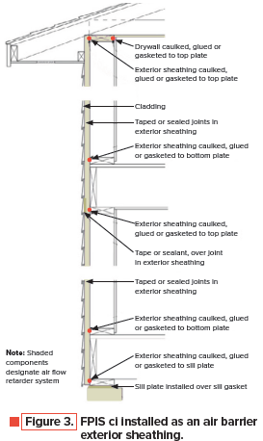
Air Barrier Tips
Key to good air barrier system is sealing of joints, gaps, penetrations, and transitions.
Best practice is dual air barrier to encapsulate air-permeable insulation (if used) – not required by code.
Multi-functional Ci considerations
  Most foam sheathing products meet air barrier material requirements (air permeability test)
    Check manufacturer data/label
    Some are “deemed-to-comply” (e.g., XPS and Polyiso min. ½” thick) per IECC, but not in ASHRAE 90.1
  Tape foam sheathing joints per manufacturer instructions (also required if the FPIS ci is used as the WRB system)
  Integrate with air/water control at fenestration and roof/foundation.

Slide 28

Commercial Building Code
Requirements that vary by energy code climate zones include:
  IBC Section 1404.3 - Vapor control (vapor retarders coupled with insulation strategy)
  IBC Section 1202.3 – Unvented roofs for vapor control
  IBC Section 2510.6 - Drainage of conventional stucco cladding for Moist(A) and Marine(C) climate regimes
    Foam sheathing also helps mitigate severe inward vapor drives that can occur with “reservoir” claddings like stucco.
Other Requirements (fire, WRB, flashing, cladding attachment, wind resistance, etc.) don’t vary by energy code climate zones
  See additional resources at end of presentation for code compliance and design guidance on these topics

Slide 29
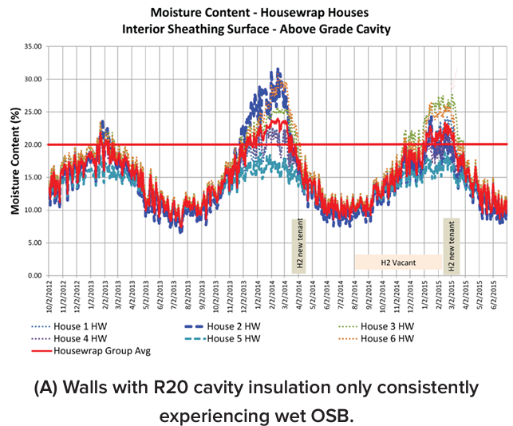
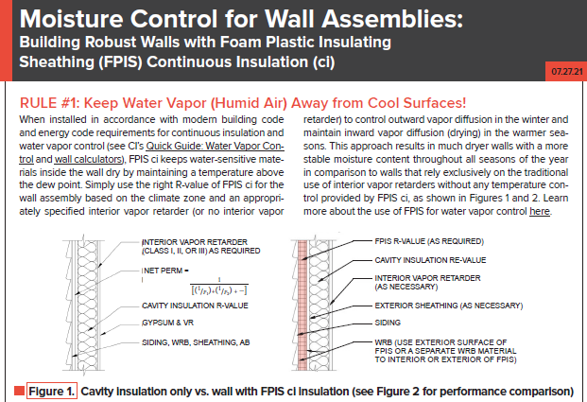
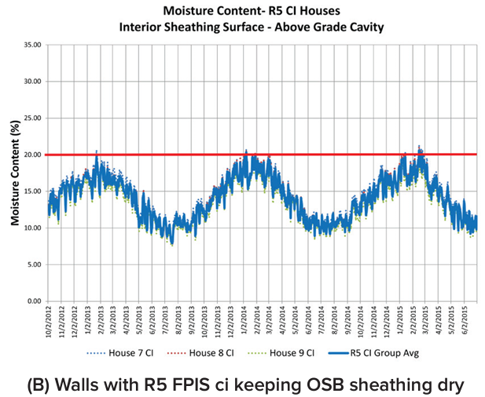
Rule #1 of 3
https://www.continuousinsulation.org/resources/facts-ci

Slide 30
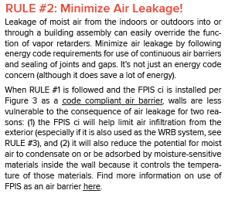
Rule #2 of 3
https://www.continuousinsulation.org/resources/facts-ci

Slide 31
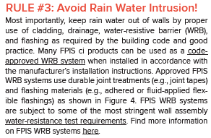
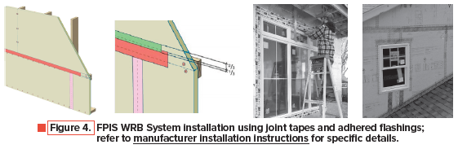
Rule #3 of 3
https://www.continuousinsulation.org/resources/facts-ci

Slide 32
IBC Section 1404.3 Vapor Retarders
2021 IBC includes major improvements for water vapor control with Ci
2024 IBC adds some incremental enhancements/options
  Class I and II “responsive vapor retarders” are defined for Ci applications
  Added provisions for the “perfect wall” (all control layers on exterior)
Water vapor control per building code must be coordinated with energy code insulation requirements

Slide 33

3-Step Guide for Water Vapor Control Code Compliance
(based on 2024 IBC/IRC)
Satisfies Rule #1 of 3 – Keep Water Vapor Away from Cool Surfaces
https://www.continuousinsulation.org/resources/quick-guides

Slide 34

3-Step Guide (cont’d)

Slide 35


3-Step Guide (cont’d)
Example 1: CZ 5 with Class III VR
  IRC Table R702.7(3) or IBC 1404.3(3):
  Use min. R-5ci on a R13 2x4 wood frame wall (e.g., R13+5ci)
    Energy code requires R13+7.5ci (OK, exceeds minimum Ci R-value for vapor control)
  Use min. R-7.5ci on a R20 2x6 wood frame wall
    Exceeds energy code R20+3.8ci which doesn’t work for vapor control (unless flash & batt in cavity, e.g., R13 batt + R7 ccSPF in cavity with R3.8ci on exterior)
    Alternatively consider using Class I or II RVR (Example 2)
Example 2: CZ 5, Class I or II Responsive Vapor Retarder
  IRC Table R702.7(4) or IBC Table 1404.3(4):
  Use min. R-5ci on 2x6 wall with R20 cavity (e.g., R20+5ci wall)
  Exceeds minimum energy code for 2x6 WFW (i.e., R20+3.8ci) and could use R19+5ci to get closer to minimum energy code (by equivalent U-factor compliance)
  Class I or II VR must be “responsive vapor retarders” (RVR) to minimize outward diffusion wetting while promoting inward diffusion drying
    Class II RVR = kraft paper facer
    Class I RVR = proprietary membranes
Generally, steel frame walls require more Ci R-value in energy code and thus usually satisfy these vapor control requirements.

Slide 36

3-Step Guide (cont’d)
Example 3: CZ 5, No interior vapor retarder, exterior Ci only
  Table R702.7(5) or IBC 1404.3(5)
  Generally, the minimum ci R-values for moisture control are less than the energy code requires for exterior Ci-only walls.
  Therefore, if complying with energy code minimums these vapor control requirements are met.
Footnotes are important!
  There still must be a max 1 perm vapor retarder but on the exterior side of the wall and to the interior side of the Ci insulation, unless the Ci insulation or its interior facer is a vapor retarder.

Slide 37

Resources to help put it all together

Slide 38

Simplified Energy & Water Vapor Code Compliance
Implements R-value and U-factor checks per IECC & ASHRAE 90.1
Automates vapor control check per IBC/IRC (including insulation ratio and permeance ratio checks)
Flexible, More Solutions than Code, More Precise
Wood and Steel framing
2-minute wall design and optimization (or compliance check)
https://www.continuousinsulation.org/calculators

Slide 39


Ci Resource Guide

Slide 40

“Cheat Sheet”
Integrated, Code-Compliant Moisture Control
(center-fold of the Ci Resource Guide)
https://www.continuousinsulation.org/resources/quick-guides

Slide 41

ANSI FS200.1 Standard for FPIS Applications
Scope
  Above-grade frame walls
  Labeling & Quality Assurance
  Wind resistance
  WRB (water resistance)
  Vapor Control
  Window installation
  Cladding installation
Addresses
  Performance criteria (design)
  Evaluation/testing criteria by application
  Prescriptive criteria (“cook-book” design and installation)
Exclusions
  Refer to locally applicable code for fire safety requirements
  (e.g., IBC Chapter 14 and 26; IRC Section R316)
  Refer to FPIS manufacturer data to demonstrate compliance (ASTM E84, ASTM E119, NFPA 285, etc. – as applicable)
https://www.appliedbuildingtech.com/standards

Slide 42
THANK YOU!
Questions?
Contact:
Jay Crandell
jcrandell@aresconsulting.biz
www.appliedbuildingtech.com
www.aresconsulting.biz

