Slide 1
Moisture Drive & Code-Compliant Building Envelopes
Jay H. Crandell, P.E.
ABTG / ARES Consulting

Slide 3
OUTLINE
The Building thermal envelope (BTE)
Code-compliant thermal insulation
Code-compliant water/air/vapor control
  Fundamentals of moisture control
  Water Vapor control
  Air leakage control
  RainWater intrusion control
Additional resources & applications
questions

Slide 4
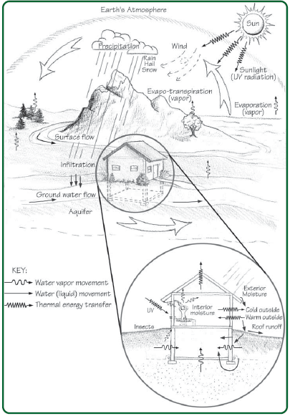
A. The Building Thermal Envelope (BTE)
The primary function of a building envelope is to separate the indoor from the outdoor environment.
“Without a good building envelope, the previous HVAC system and design actions become more difficult and costly, and uncertain in their effectiveness.”
Source: ABTG RR No. 2006-01, p10, https://www.continuousinsulation.org/topical-library/healthy-buildings
The BTE is an integrated system which also supports the design and function of other building systems.
“It is like the skin that protects the internal parts of your body; it is the largest organ of the body.”
Source: HUD, Durability by Design

Slide 5
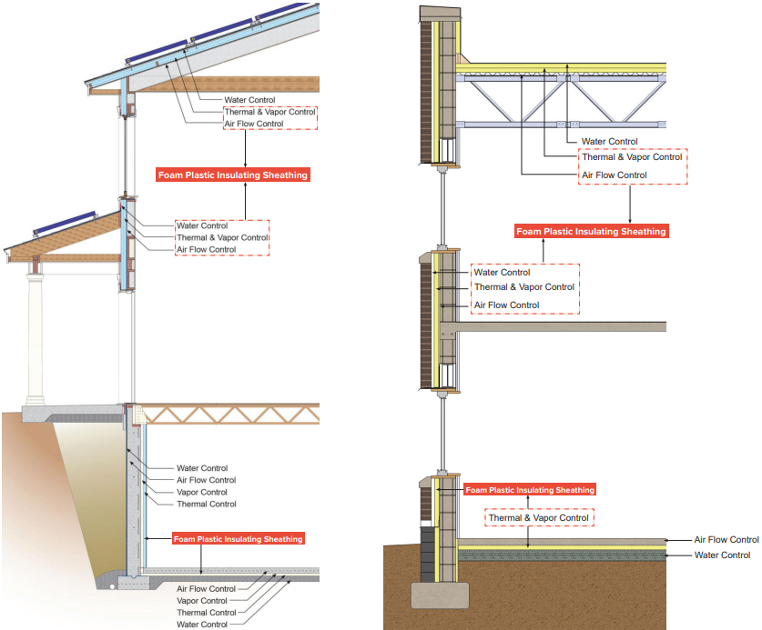
Why is the BTE important?
Allows indoor environment (conditioned space) to be controlled for comfort, productivity, and health
Major factor in sizing HVAC equipment
Protects the structure and its contents from the outdoor environment (wind, rain, U/V radiation, temperature and humidity cycling, etc.)
Determines the life-cycle operational cost, energy use (heating/cooling), and carbon footprint for the building.
  This last point is why building envelope has such a focus in the energy code

Slide 6
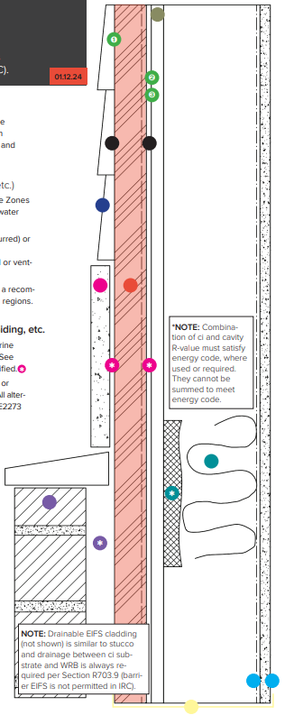
Functions of the Building Thermal Envelope (BTE)
In addition to fire safety, structural safety, and durability the BTE must address the following control layers (functions):
  Water control layers [cladding + continuous water-resistive barrier (WRB) + flashing to control water intrusion]
  Air control layer [continuous air barrier (AB) to control air leakage]
  Thermal control layer [continuity of thermal insulation to control heat loss/gain and surface temperatures]
  Water vapor control layer [use of vapor retarders (VR) in coordination with insulation strategy and climate]
Some “layers” or materials can perform multiple functions depending on design approach and material properties
Vast number of options for Wall configuration:
5 VR x 5 AB x 5 ci x 5 cavity x 6 WRB x 5 str shtg x 9 cladding = 168,750 possibilities
Not all options are equal in performance but all may meet minimum code requirements

Slide 7

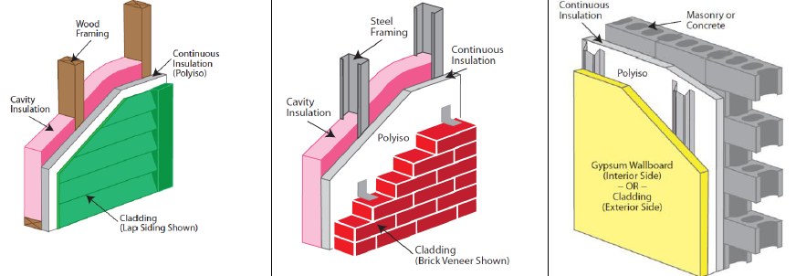
B. Code-compliant Thermal Insulation
Prescriptive R-value & U-factor Requirements
Insulation Methods

Slide 8
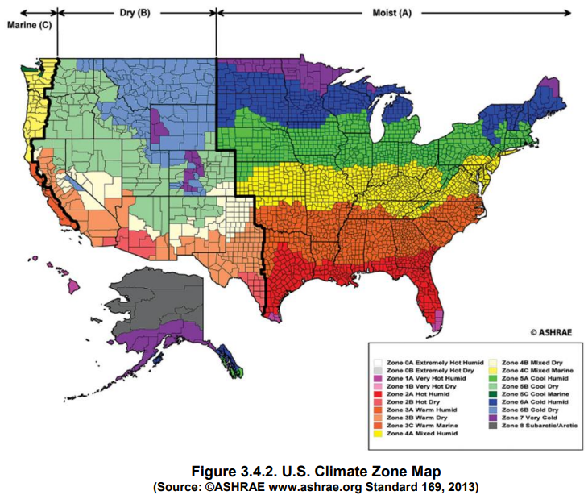
Climate ZoneS
6
7
4
6
5
5
4
4
3
3
2
3
2
8
1
1
7
IECC Figure C301.1 & R301.1

Slide 9
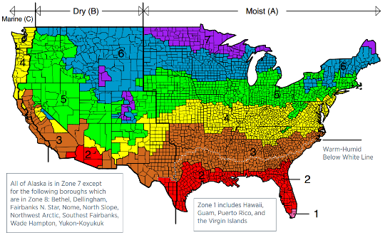
Prescriptive R-value & U-factor Requirements
IECC Commercial
Tables C402.1.3 & C402.1.4
Climate Zone | Building Use | Mass | Metal Framed* |  | Wood Framed
 |  | 2021 IECC | 2018 IECC | 2021 IECC | 2018 IECC | 2021 IECC
0 and 1 | All other | R-5.7ci (U-0.151) | R13+5ci (U-0.077) | R13+5ci (U-0.077) | R13+3.8ci or R20 (U-0.064) | R13+3.8ci or R20 (U-0.064)
 | Group R
2 | All other
 | Group R | R-7.6ci (U-0.123) | R13+7.5ci (U-0.064) | R13+7.5ci (U-0.064)
3 | All other
 | Group R | R-9.5ci (U-0.104)
4 Except Marine | All other
 | Group R | R-11.4ci (U-0.090)
5 and Marine 4 | All other |  |  | R13+10ci (U-0.055) |  | R13+7.5ci or R20+3.8ci (U-0.051)
 | Group R | R-13.3ci (U-0.080) |  |  | R13+7.5ci or R20+3.8ci (U-0.051)
6 | All other |  |  | R13+12.5ci (U-0.049)
 | Group R | R-15.2ci (U-0.071)
7 | All other
 | Group R |  | R13+15.6ci (U-0.052) | R13+15.6ci (U-0.042)
8 | All other | R-25ci (U-0.037) | R13+7.5ci (U-0.064) | R18+18.8ci (U-0.037) | R13+15.6ci or R20+10ci (U-0.036) | R13+18.8ci (U-0.032)
 | Group R |  | R13+17.5ci (U-0.045)
IECC Residential Provisions
Tables R402.1.2 & 402.1.3
Climate Zone | Wood Frame Walls
 | 2018 IECC | 2021 IECC**
0, 1 and 2 | R13 (U-0.084) | R13 or R0+10ci (U-0.084)
3 | R20 or R13+5ci ( U-0.060) | R20 or R13+5ci or R0+15ci (U-0.060)
4 except Marine |  | R30 or R20+5ci or R13+10ci or R20ci (U-0.045)
5 and Marine 4
6 | R20+5ci or R13+10ci (U-0.045)
7 and 8
‘* Cavity insulation is only 40-50% effective on CFS walls, so ci is prescribed for all climate zones.
** Cavity only, Ci only, and Hybrid options available for all climate zones.

Slide 10
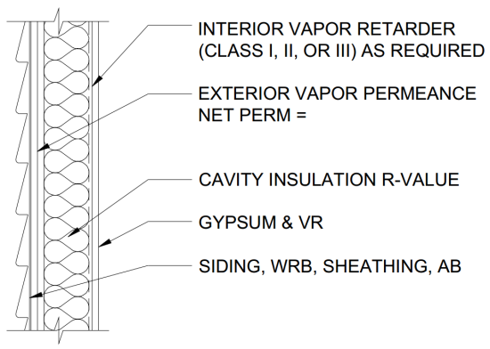
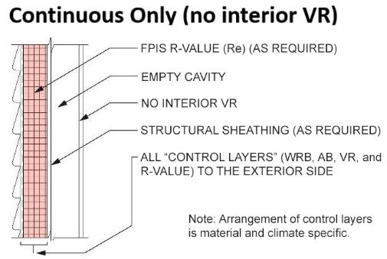
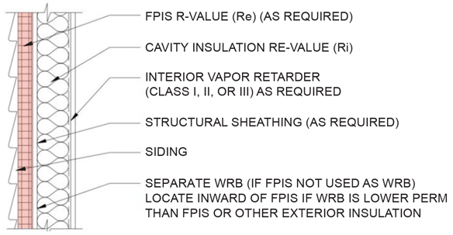
Three Basic Methods for Insulating Light-Frame Exterior Walls
Cavity insulation only (“traditional” method)
Cavity insulation + continuous insulation (“Hybrid” Method)
Continuous insulation (ci) only (“perfect wall” method)

Slide 11
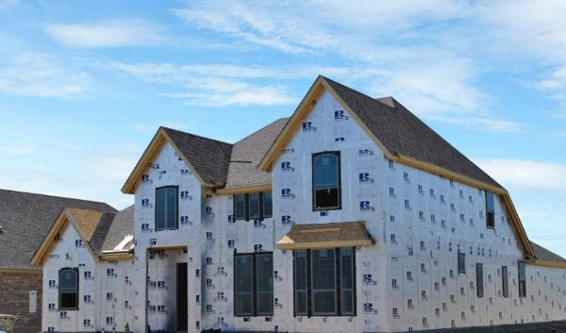
Continuous Insulation (ci):
  Insulation that is uncompressed
  …and continuous across
  all structural members
  …without thermal bridges
    other than fasteners and service openings.
  (IBC, IRC, IECC and ASHRAE 90.1 definition)

Slide 12


C. Code-compliant Water/Air/Vapor Control
Fundamentals of moisture control
Water Vapor Control
Air Leakage Control (AB)
Rain Water Control (WRB & Flashing)

Slide 13
I. Fundamentals of Moisture Control
Successful moisture control requires an integrated approach to 5 key building science concepts:
  Control Rain Water Intrusion (e.g., continuous water-resistive barrier (WRB))
  Control Air Leakage (e.g., continuous air barrier (AB))
  Control Indoor Relative Humidity (e.g., building ventilation & de-humidification)
  Control Water Vapor (e.g., optimized balance of wetting and drying through strategic use of insulation and vapor retarders)
  Control Initial Construction Moisture (e.g., prevent enclosure of wet materials)
All are important, all vary in significance, all have inter-dependencies.
These 5 concepts are captured in the following 3 rules:
  Keep water vapor (humid air) away from cool surfaces
  Minimize air leakage into and through building envelope assemblies
  Avoid rain water intrusion

Slide 14
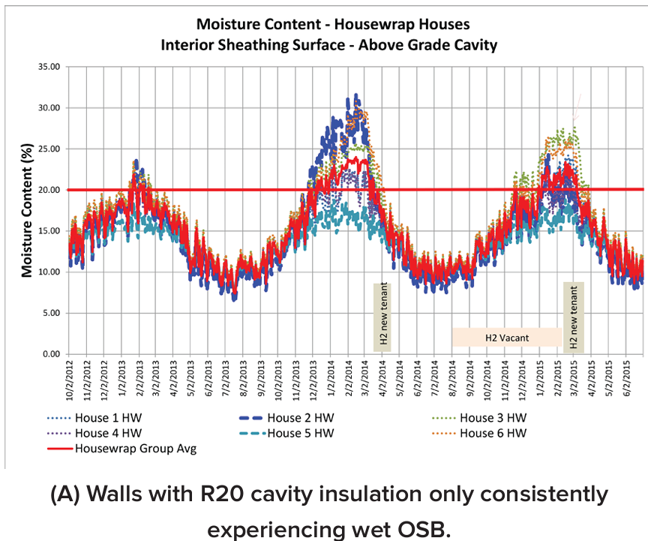
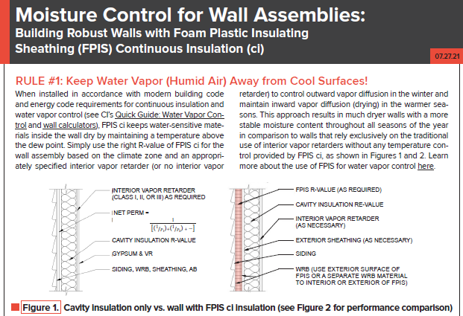
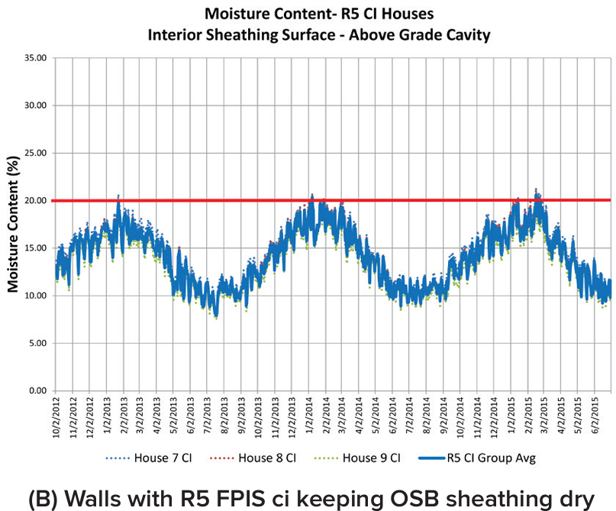
II. Water Vapor control (RULE #1)
https://www.continuousinsulation.org/resources/facts-ci

Slide 15
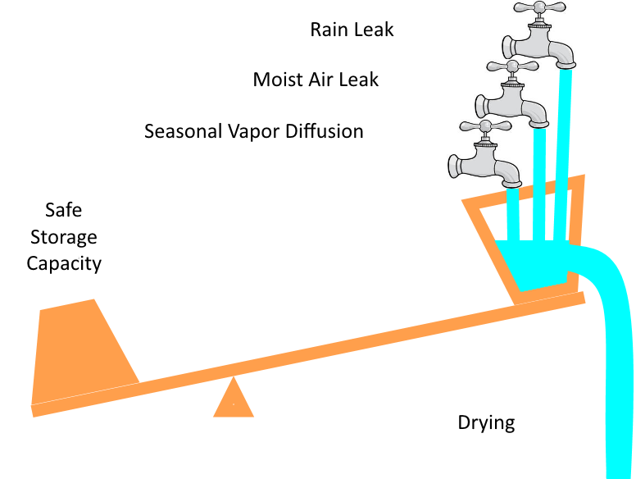
Driver = vapor pressure differential
It is a balancing act!
direction through BTE changes seasonally!
Must balance overall seasonal and annual:
  Risk of rain water wetting
  Risk of air-leakage wetting
  Risk of vapor diffusion wetting vs. drying
R-value and relative WVP of materials and their location within the assembly matters
  Ability of materials to store and tolerate moisture also matters
GOAL: Drying > wetting to control risk of mold or water-sensitive material degradation
http://buildingscience.com/documents/digests/bsd-114-interior-insulation-retrofits-of-load-bearing-masonry-walls-in-cold-climates

Slide 16
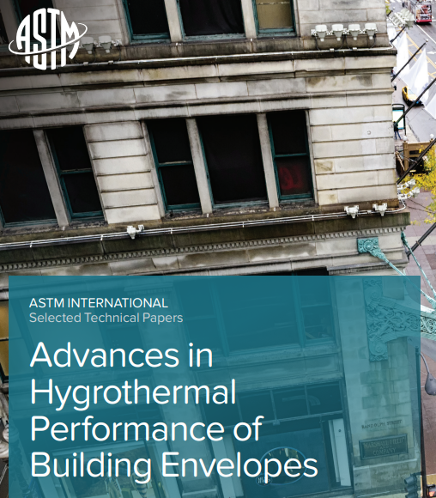
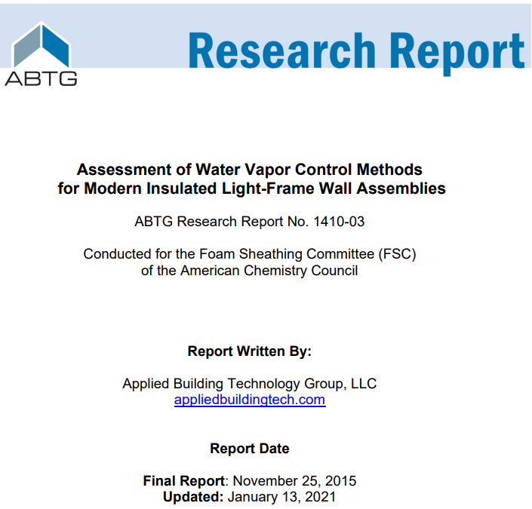
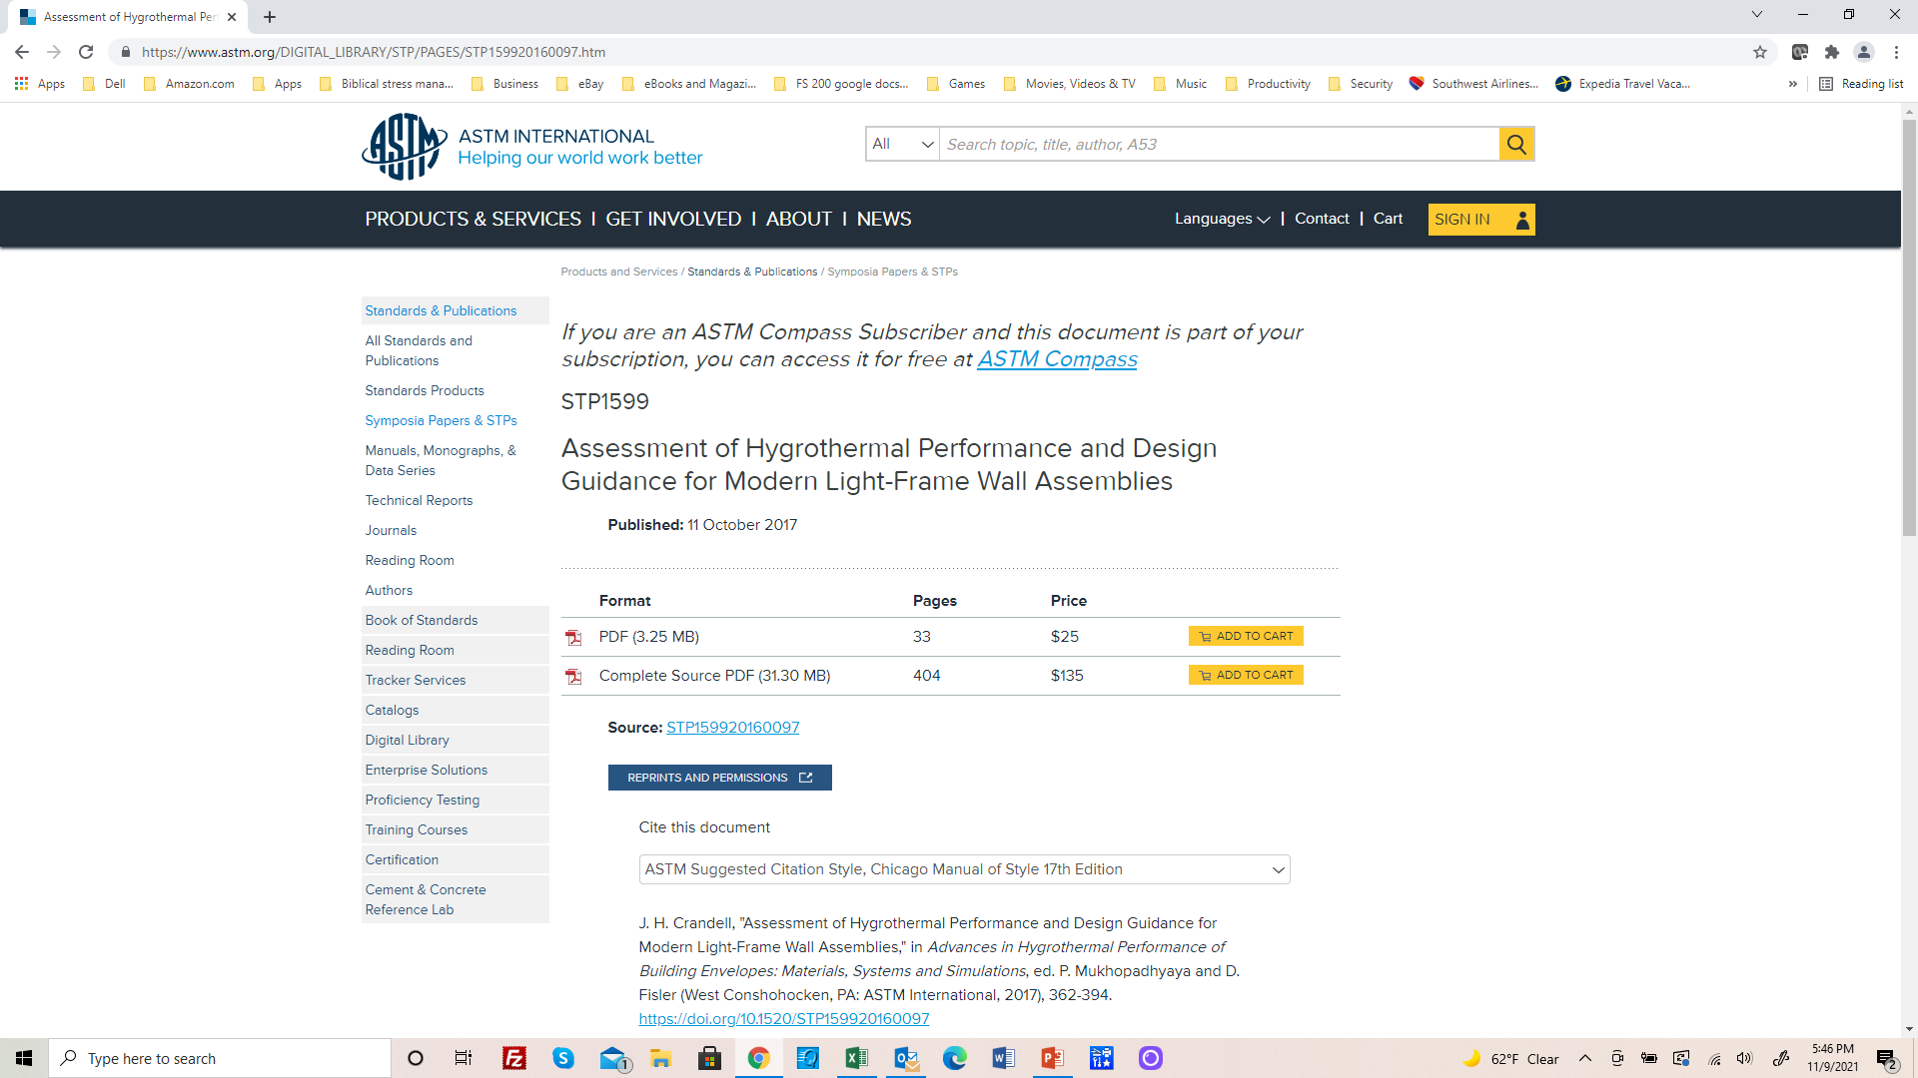
Research Leading to 2021/2024 IRC & IBC Provisions
https://www.appliedbuildingtech.com/rr/1410-03
https://www.astm.org/DIGITAL_LIBRARY/STP/PAGES/STP159920160097.htm

Slide 17
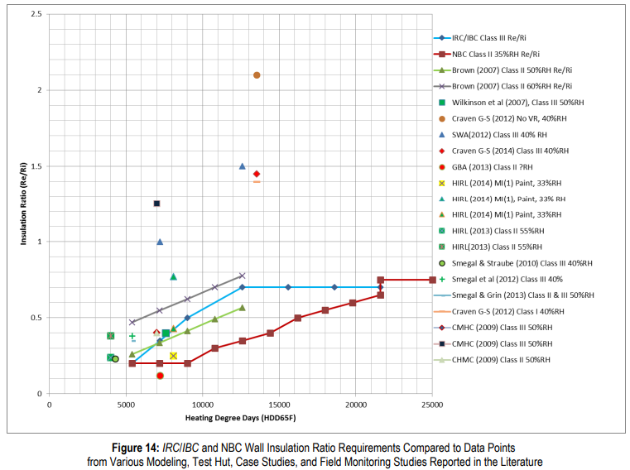

Research Findings
Surveyed multiple field, test hut, and modeling studies
Compared to U.S. and Canadian Code and Practices
Confirmed where practices were working well
Conducted analysis where refinements needed
Peer reviewed
Combined best of U.S. and Canadian practices to result in 2021 IBC/IRC
Assumed worst-case low permeance conditions for ci and/or exterior material layers to ensure robust prescriptive provisions
Unanimous approval at code hearings including major stakeholders

Slide 18
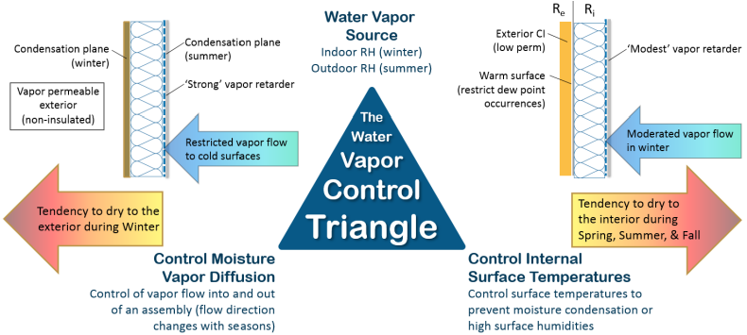
Vapor Control Principles
Two approaches to control water vapor:
  Permeance Controlled Design (permeance ratio)
  Temperature Controlled Design (insulation ratio, IR = Re/Ri)

Slide 19
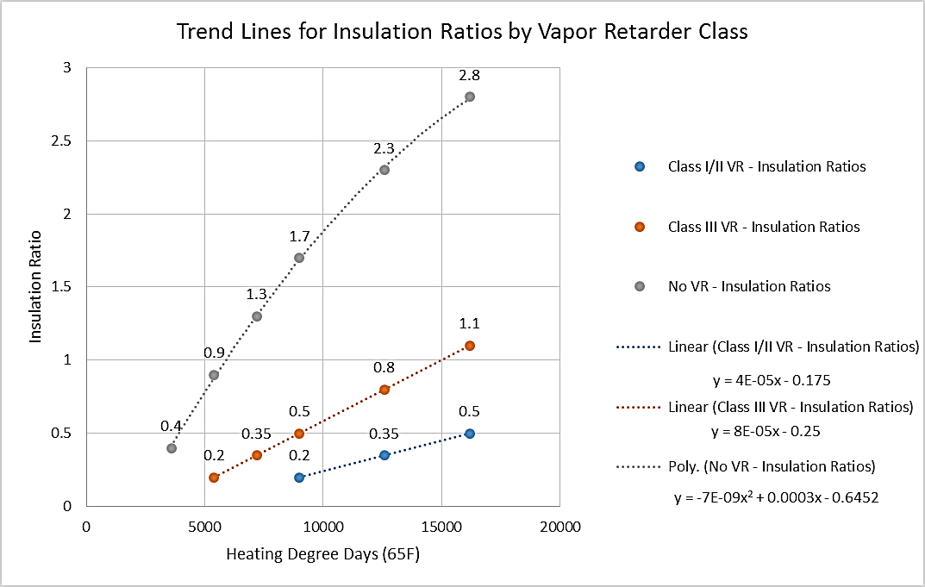
Insulation Ratio (Graphic Format)
(Temperature-controlled Design)
Source: http://www.appliedbuildingtech.com/rr/1410-03

Slide 20
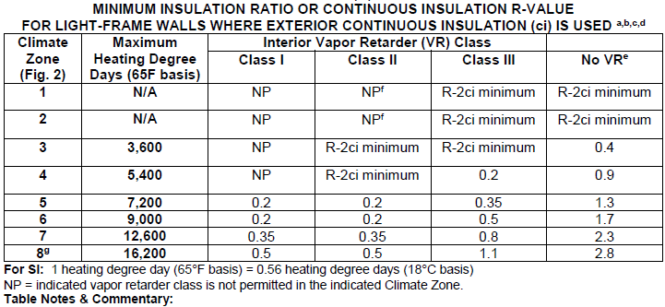
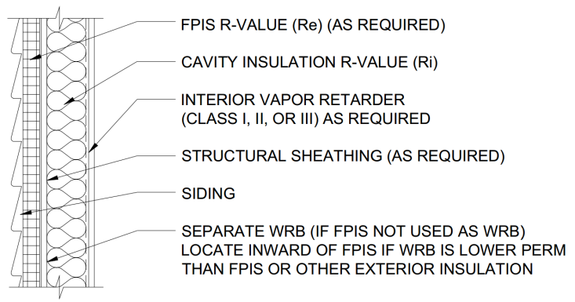
Insulation Ratio (Tabulated Format)
(basis of 2021/2024 IBC and IRC for walls with continuous insulation)
Source: http://www.appliedbuildingtech.com/rr/1701-01

Slide 21
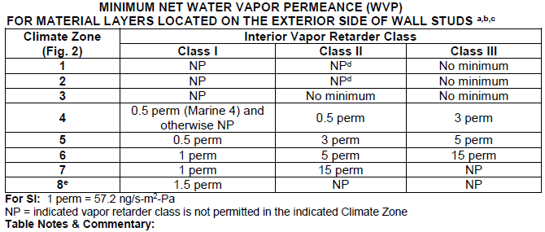
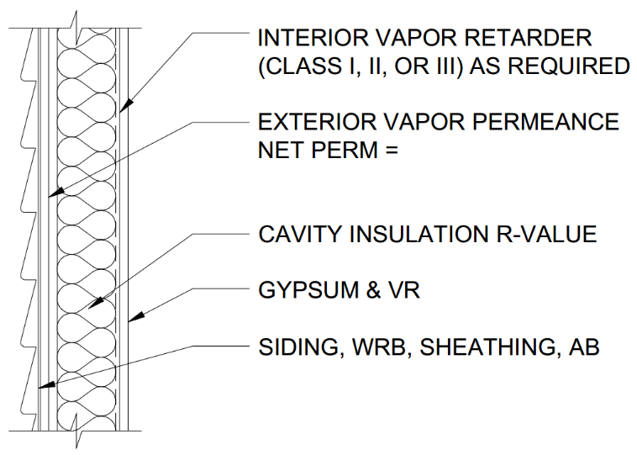
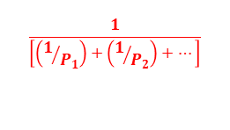
Permeance Ratio
(not included in 2021 or 2024 IBC and IRC)
$$\frac{1}{\left[\left(1/{P_{1}}\right)+\left(1/{P_{2}}\right)+…\right]}$$
Requires determination of net water vapor permeance of all layers on the exterior side of the wall and comparison to minimum required permeance (table) for a given climate zone and interior vapor retarder class.
NOTE: Applies to walls with vapor/air permeable cavity insulation only, or with continuous insulation not meeting minimum insulation ratio (previous table).
Source: http://www.appliedbuildingtech.com/rr/1701-01

Slide 22
CODE-COMPLIANT Water Vapor Control
IBC Section 1404.3 Vapor Retarders
IRC Section R702.7 Vapor Retarders
2021 code includes major improvements
2024 code includes some incremental enhancements/options
Water vapor control per building code must be coordinated with energy code insulation requirements
  Insulation and vapor retarders work together and vary in application by climate
  The code has taken a complicated building science matter and simplified it into prescriptive rules or “look-up” tables
  Use of continuous insulation provides a simple and robust way to address thermal and water vapor control performance

Slide 23
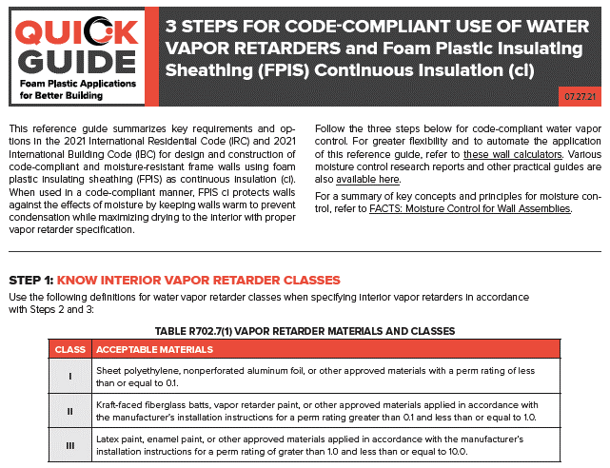
3-Step Guide for Water Vapor Control Code Compliance
(based on 2021 IBC/IRC)
Satisfies Rule #1 – Keep Water Vapor Away from Cool Surfaces
https://www.continuousinsulation.org/resources/quick-guides

Slide 24
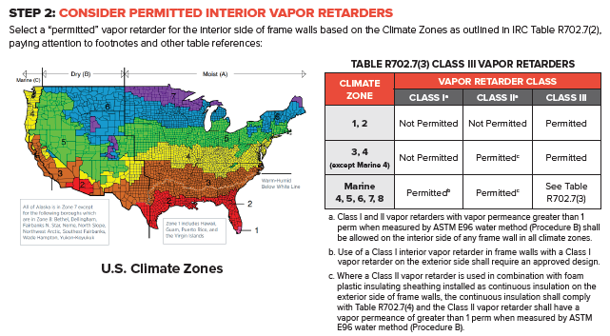
3-Step Guide (cont’d)
TABLE R702.7(2) VAPOR RETARDER OPTIONS

Slide 25
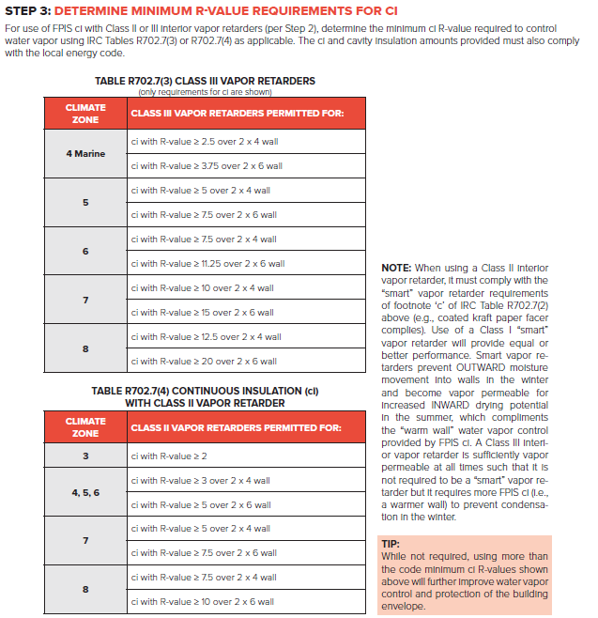
3-Step Guide (cont’d)
Ci Example 1: CZ 5, Class III VR
  Table R702.7(3):
  Use min. R-5ci on a 2x4 wall with R13 cavity – but doesn’t meet energy code (R13+10ci) ☹
  Use min. R-7.5ci on a 2x6 wall with R20 – but this exceeds minimum energy code (R20+5ci) ☺☺
Ci Example 2: CZ 5, Class II VR
  Table R702.7(4):
  Use min. R-5ci on 2x6 wall with R20 cavity
  Matches energy code (R20+5ci) ☺
Class II interior VR must be “smart”
  Promotes Drying to interior
  2024 also includes Class I “smart”
    Called “responsive vapor retarders”
  Allows use of class I or ii ci material on exterior without creating a “double vapor barrier” wall (e.g., avoids low drying potential)

Slide 26
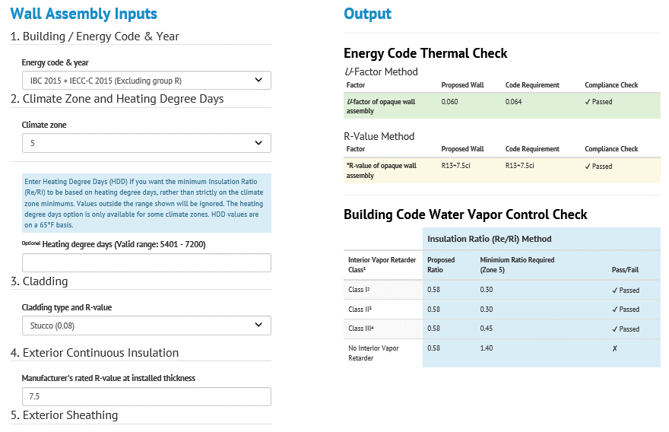
Simplified Energy & Water Vapor Code Compliance
Implements R-value and U-factor checks per IECC & ASHRAE 90.1
Vapor control check per IBC/IRC (including insulation ratio and permeance ratio checks)
Flexible, More Solutions than Code, More Precise
Wood and Steel framing
2-minute wall design and optimization (or compliance check)
LIVE DEMO…(as time allows)
https://www.continuousinsulation.org/calculators

Slide 27
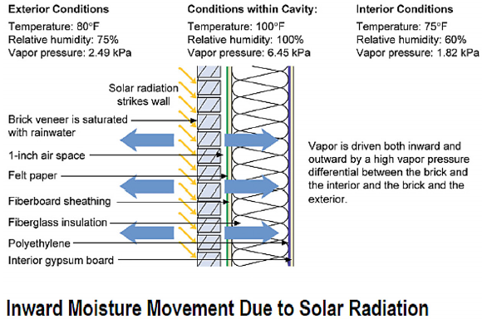
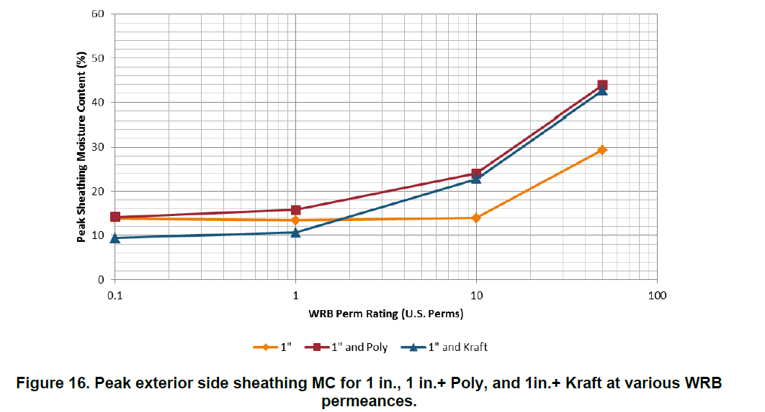
Supplemental Design Considerations
CAN YOU HAVE TOO MUCH PERMEANCE?
Yes! (in some conditions)
Recommendation:
The Net WVP of exterior layers between the cladding and sheathing (e.g., the WRB or continuous insulation) should not exceed ~10 perm
This prevents solar-driven inward moisture movement, where direct-applied (unvented) reservoir cladding (adhered veneer, stucco, etc.) is used.
Alternative: back-ventilate & drain reservoir cladding (like brick veneer) – new stucco wrb requirements in 2021/2024 ibc and IRC for “moist” and “marine” climate regimes.
High sheathing moisture content
Source: Lepage & Lstiburek (2013). Moisture Durability with Vapor-Permeable Insulating Sheathing. US DOE, Building Technologies Office, Building America Program

Slide 28
Supplemental Design Considerations
Can you have too little permeance? - YES!
RECOMMENDATION: AVOID “DOUBLE VAPOR BARRIER” wallS! But…
The issue is not necessarily with a double vapor retarder wall (all materials on interior and exterior of a wall have some level of vapor retardance).
In 2021/2024 IBC and IRC, Class I interior vapor retarders (that are not “smart” or “responsive”) are not permitted in climate zones 1-4, so this recommendation applies mainly to the climate zones 5-8 and particularly the “moist” and “marine” climate regimes.
Use of a Class I or II “smart” (responsive) vapor retarder is now conservatively required in 2021/2024 IBC and IRC for walls with exterior ci
  Promotes inward drying while still restricting outward (winter) vapor movement.
  This effectively resolves the double vapor barrier issue with use of low perm exterior ci.
For additional info on double vapor barriers, refer to: “Doubling Down: How Come Double Vapor Barriers Work? (Dr. Lstiburek, ASHRAE Journal, Jan. 2016)

Slide 29
Supplemental Design Considerations
Drying potential (“breathability”) is not a “cure all” for walls and components that allow water intrusion.
Taken to an extreme, it can lead to:
  a false sense of security in “breathability”
  inattention to the primary concern with preventing water leaks with proper wrb and flashing installation together with pROPER use of insulation and vapor retarders to control water vapor.
Walls with high exterior vapor permeability (outward drying potential) and inadequate interior VR (even though code compliant) will pass water vapor through cold hydrophilic exterior layers (e.g., OSB, Gypsum sheathing, etc.) causing them to:
  Have a high wetting potential! (i.e., adsorb moisture to high levels in the winter, even without presence of condensation and with adequate drying in warmer seasons to avoid visible mold growth).
  This high seasonal moisture cycling can degrade exterior sheathing structural properties, cause expansion/buckling, and also impact durability and appearance of claddings (particularly if unventilated).
Solution: Use a class I Responsive vapor retarder in CZ 5-8 for these walls with high exterior “breathability”.
Inadequate moisture control in a code-compliant “breathable” 2x6 wall in CZ 5 with vapor-permeable cavity insulation only and a Class II (kraft) interior vapor retarder.

Slide 30
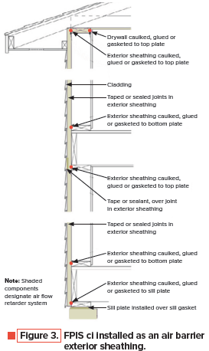
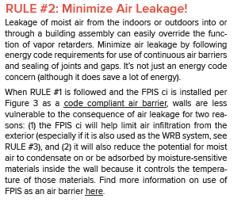
III. Air leakage control (Rule #2)
Drivers = air pressure differential = f(stack effect + wind + unbalanced mechanical ventilation)
https://www.continuousinsulation.org/resources/facts-ci

Slide 31
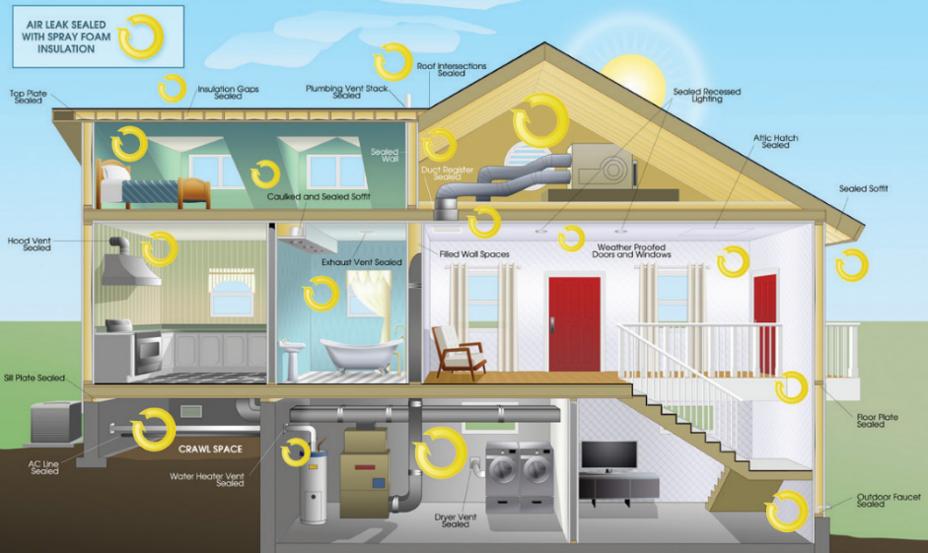
Code-compliant Air Leakage Control
2021 IECC-C Section C402.5 (testing optional, air barrier always)
2021 IECC-R Section R402.4 (testing always, air barrier always)
  See code for details for AB installation, test methods (blower door), and maximum leakage rates (cfm/ft²) or air-changes per hour (ACH)
NOTE: While mainly an energy code compliance concern, air barriers also play an important role in control of water vapor in coordination with IBC/IRC vapor retarder provisions.
https://www.americanchemistry.com/industry-groups/spray-foam-coalition-sfc

Slide 32
FPIS ci & SPF as Air Barriers
Air Barrier (AB)
  Most foam sheathing products meet air barrier material requirements (air permeability test)
    Check manufacturer data/label
  IECC C402.5.1.3 lists “deemed-to-comply” products, e.g.:
    FPIS (XPS and Polyiso of min ½” thick)
    ccSPF of min. 1.5” thick and 1.5 pcf density
    ocSPF of min. 4.5” thick and 1.5 pcf density
  Key to good air barrier system is sealing of joints, penetrations, and transitions.
  Best practice is dual air barrier to encapsulate air-permeable insulation (if used) – code only requires on one side insulation.
  Single component/canister SPF is used as an air sealant for joints & cracks (not insulation)

Slide 33
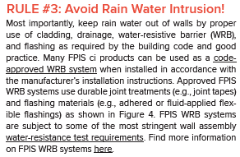
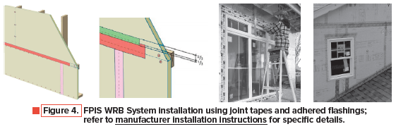
IV. Control rainwater intrusion (Rule #3)
https://www.continuousinsulation.org/resources/facts-ci

Slide 34
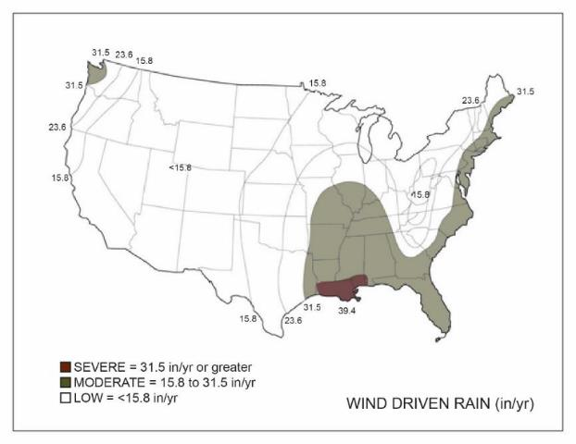
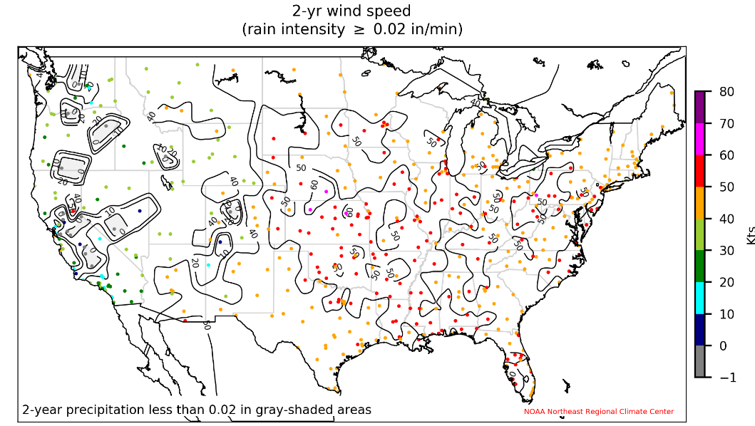
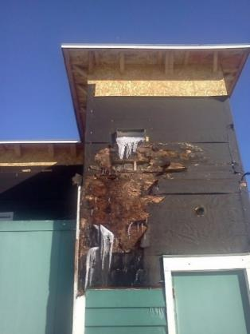
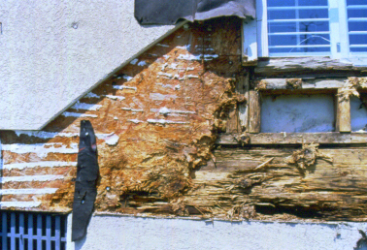
Driver = wind-driven rain
Rain water intrusion is often the primary factor associated with observed failure or success of moisture control
  Wind driven rain (WDR) is the primary hazard (see maps)
If rain water is not adequately controlled, other control measures can be rendered ineffective (air barriers, vapor retarders, drying potential, etc.)
Concept is simple: Keep water out!
Annual Average Wind Driven Rain Receipt (in/yr)
(map based on UofGA research)
(http://www.huduser.gov/portal/publications/reports/Guide-Durability-by-Design.html)
WDR Hazard Map for United States
Source: Cornell University, NOAA Northeast Climate Data Center (DRAFT)

Slide 35
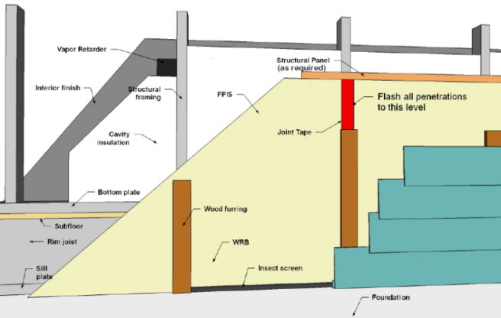
IBC/IRC WRB Code Requirements
  IBC 1403.2 / IRC R703.2 Water-resistive barrier. …continuous…flashed… shall comply with one of the following:
    1. No. 15 felt complying with ASTM D226, Type 1.
    2. ASTM E2556, Type I or II.
    3. Foam plastic insulating sheathing water-resistive barrier systems complying with Section 1402.2 and installed in accordance with manufacturer's installation instructions.
    4. ASTM E331 in accordance with Section 1402.2.
    5. Other approved materials installed in accordance with the manufacturer’s installation instructions.
NEW
2024
FPIS ci can be used as WRB, air barrier, and means to control water vapor (multi-functional):
  For guidance on use of FPIS ci as a WRB, refer to: https://www.continuousinsulation.org/applications/WRB
  For listing of code-compliant FPIS WRB systems refer to: https://www.drjengineering.org/drr/1410-05

Slide 36
Four WRB strategies with FPIS ci
WRB Strategy | Pros | Cons
FPIS-ci used as the WRB | System resistance to water penetration (highest of all WRB criteria) Simple flashing detailing when used with flanged fenestration units (see STEP 3B). Cost-effective (eliminates a separate WRB material layer) Can be used to effectively control water vapor in coordination with vapor retarder selection (STEP 3C) | Only applies to FPIS-ci products that have been tested and approved for WRB application (refer to manufacturer code compliance data - DrJ FSC report). Must use manufacturer specified joint sealing treatments (joint tapes and adhered flashing) Requires proper conditions for application of joint sealing treatments.
Separate WRB layer applied behind FPIS on wall substrate | Separate WRB layer is protected by FPIS-ci. With proper R-value of FPIS-ci, the permeance of the WRB and sheathing is less of a concern when coordinated with interior vapor retarder selection (STEP 3C). With reservoir claddings like stucco or adhered veneers the FPIS-ci layer prevents inward vapor drives through higher perm WRBs. | Additional cost of WRB separate from FPIS-ci Potential for more complex and less reliable flashing details at windows if flanges are flush with FPIS-ci and back of siding as usually detailed while WRB is recessed from the flange (STEP 3B). May need to use more expensive wrap to create small gap for drainage behind FPIS-ci.
Separate WRB layer applied over FPIS and directly behind cladding | Easier to flash windows to WRB if window flanges are placed flush with outside of wall (on plane with FPIS-ci outer surface). Not preferred location for WRB behind stucco and adhered veneers which will prevent drainage unless an additional drainage layer or gap is provided between the WRB and stucco. | Additional cost of WRB separate from FPIS-ci Difficulty attaching WRB layer through FPIS-ci layer. WRB should be higher perm than FPIS-ci layer in cold climates or mixed climates. WRB layer is not protected by FPIS-ci. Added metal penetrations/thermal bridges through FPIS-ci layer.
Dual WRB: FPIS-ci is used as the primary WRB layer with a separate WRB layer applied behind FPIS | Perhaps the most “fail-safe” installation. Otherwise Pros are similar to Strategy #2. | The most costly WRB installation. Otherwise Cons are similar to Strategy #2.
Simplest and most efficient solution uses FPIS ci as WRB System
  Simplifies window flashing for finned fenestration
Other strategies may be necessary depending on window location (inny vs. outty window) and window, cladding, and trim detailing

Slide 37
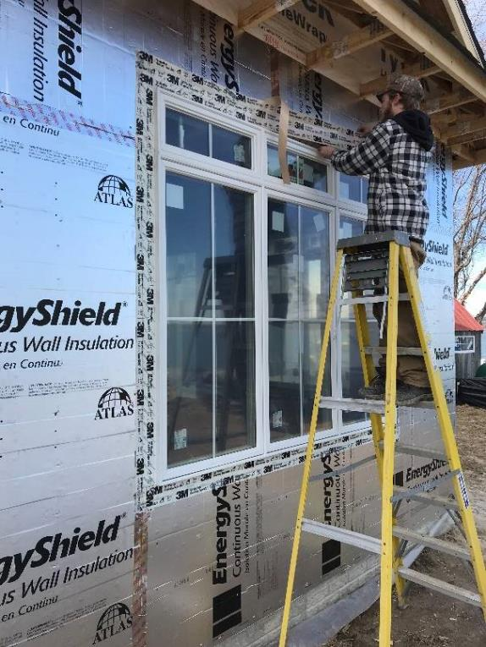
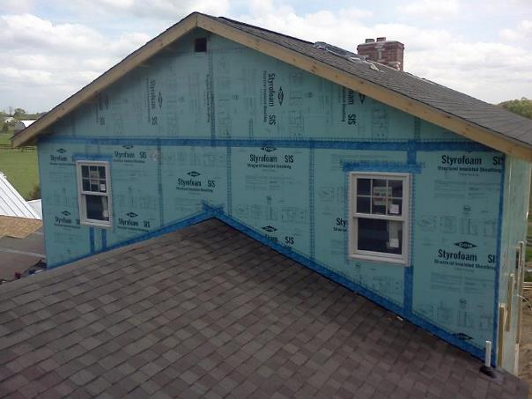
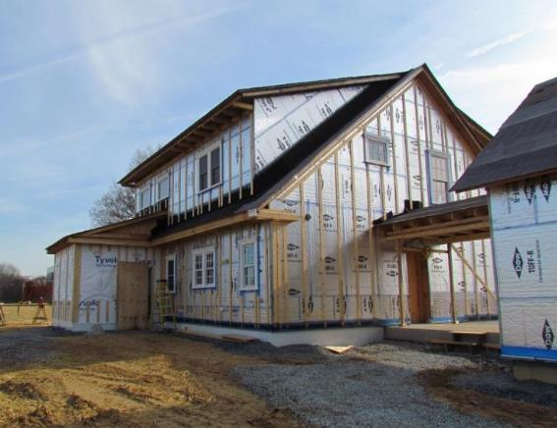

FPIS ci WRB Systems, Joint Tape, & Flashing
Also serves as air barrier.
“Outty window install

Slide 38
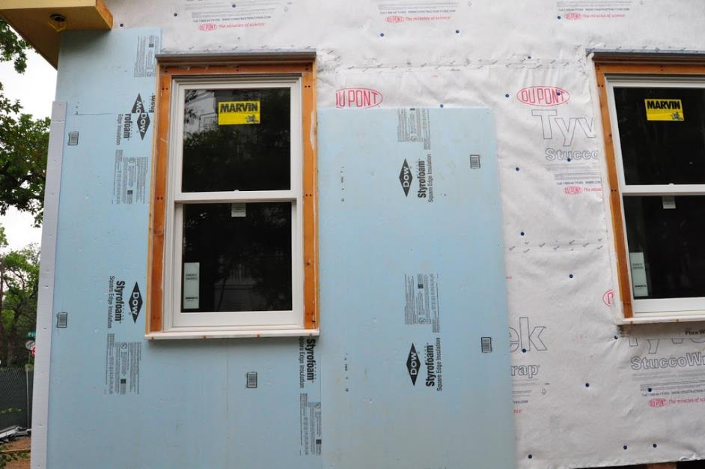
Example of “Inny” Window Install
For any thickness of FPIS
For block frame and finned windows
Can be used for new or retrofit (residing with added ci)
Requires use of separate WRB behind FPIS ci flashed to window trim extension (or window fin)

Slide 39
IBC Flashing Requirements
2024 IBC Flashing provisions (Similar for 2024 irc):
1404.4 Flashing. Flashing shall be installed in such a manner so as to prevent moisture from entering the exterior wall or to redirect that moisture to the surface of the exterior wall covering or to a water-resistive barrier complying with Section 1403.2 and that is part of a means of drainage complying with Section 1402.2.
Flashing shall be installed at the perimeters of exterior door and window assemblies in accordance with Section 1404.4.1, penetrations and terminations of exterior wall assemblies, exterior wall intersections with roofs, … etc.
1404.4.1 Fenestration flashing. Flashing of the fenestration to the wall assembly shall comply with the fenestration manufacturer's instructions or, for conditions not addressed by the fenestration manufacturer's instructions, shall comply with one of the following:
The water-resistive barrier manufacturer's flashing instructions;
The flashing manufacturer's flashing instructions;
A flashing design or method of a registered design professional; or,
Other approved methods.
New in 2024 – to match 2024 IRC

Slide 40
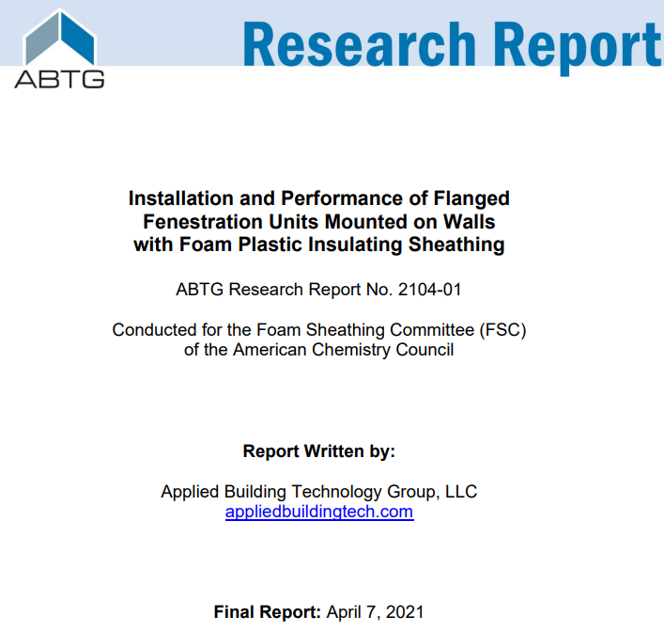
IBC/IRC Fenestration Installation Compliance
Installed Performance Testing
Field Installation Experience
Recommended installation instructions
For more information, refer to: https://www.continuousinsulation.org/window-installation
https://www.appliedbuildingtech.com/rr/2104-01

Slide 41
Installed Performance Testing
~150 tests on ~30 wall assembly specimens by independent sources (HIRL & CBI)
Integrally-flanged window types (SH, DH, C, and HS; vinyl and wood frames; single and mulled; openings up to 6-ft wide; 30 to 400 lb window unit weight)
Three FPIS types (XPS, EPS, and PIR), 1” and 2" thick, and 15 and 25 psi compressive resistance
FPIS WRB systems installed and flashed per manufacturers’ specifications
FGIA/AAMA TIR-504-2020 fenestration installation evaluation method (air leakage, water resistance, thermal cycling, design pressure, repeat water test, structural pressure)

Slide 42
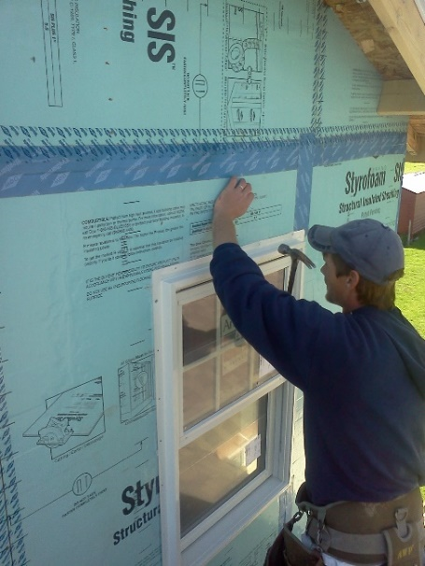
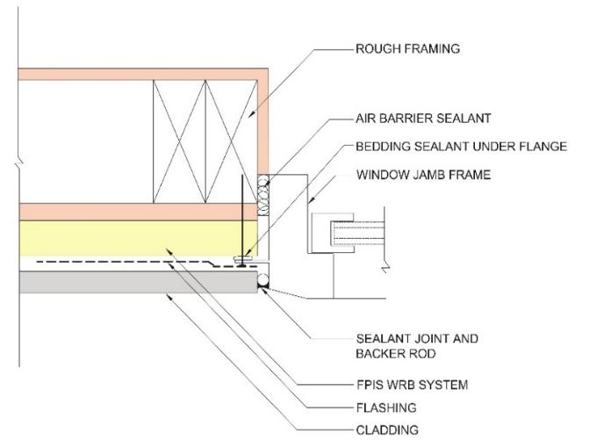
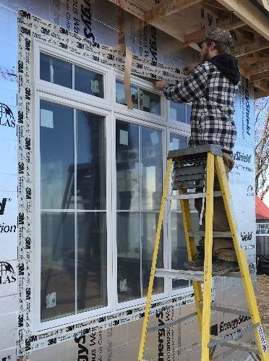
Examples of Historically Accepted Practice
(≤ 1.5" FPIS ci)

Slide 43
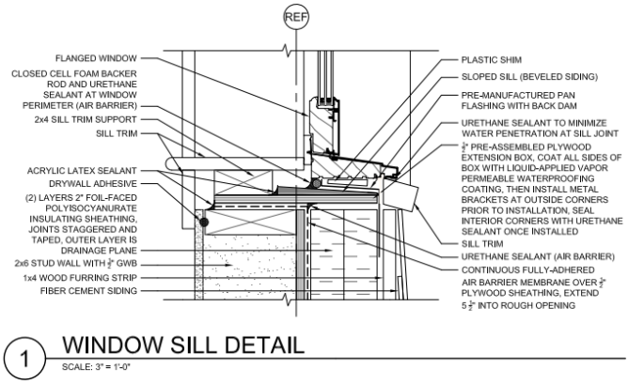

Examples of Historically Accepted Practice
(> 1.5” FPIS ci)
Plywood window buck with 4"-thick FPIS ci
2x wood bucks also used (especially for masonry/concrete construction)
NOTE: For Type I-IV construction (IBC), the window-wall interface also must comply with NFPA 285 tested assembly and engineering analysis.
  Applies regardless of FPIS thickness.
  See examples next two slides.
Source: www.nist.gov/system/files/nzertf-architectural-plans3-june2011.pdf

Slide 44

Recommended Installation Instructions
For FPIS of minimum 15 psi compression resistance and maximum 1.5" thickness:
  Use fenestration manufacturer shim and fastener schedule
    Adjust fastener length to maintain embedment in framing
  Use WRB or window manufacturer flashing instructions
For FPIS > 1.5" thick:
  Use window buck or similar support method
    Some manufacturers offer specialty support brackets
  Otherwise, same as above for remaining installation details
For any type and thickness of FPIS: Option to use an “inny” window install
If window manufacturer instructions address the specific application with FPIS, use those instructions.
NOTE: If NFPA 285 applies (Type I-IV construction), the window-wall interface must comply with the FPIS manufacturer’s tested assembly and engineering analysis, regardless of FPIS thickness.
  Refer to the manufacturer data and standard details
For additional information, refer to:
https://www.continuousinsulation.org/applications/window-installation

Slide 45



Example Details from AWCI/SFIA
Various CAD details for ci on steel frame wall assemblies
Details used for fenestration flashing & support must also comply with NFPA 285 tested assembly or Engineering Analysis for Type I – IV building applications (does not apply to TYPE v construction)
http://www.awcitechnologycenter.org/content/cad-detail-library

Slide 46
D. Additional Resources & Applications

Slide 47

FS200.1 Standard for FPIS ci Applications
Scope
  Above-grade frame walls
  Labeling & Quality Assurance
  Wind resistance
  WRB (water resistance)
  Vapor Control
  Window installation
  Cladding installation
Addresses
  Performance criteria (design)
  Evaluation/testing criteria by application
  Prescriptive criteria (“cook-book” design and installation)
Exclusions
  Refer to locally applicable code for fire safety requirements
  (e.g., IBC Chapter 14 and 26; IRC Section R316)
  Use FPIS manufacturer data to demonstrate compliance (ASTM E84, ASTM E119, NFPA 285, etc. – as applicable)
https://www.appliedbuildingtech.com/standards

Slide 48

“Cheat Sheet”
Integrated, Code-Compliant Moisture Control
https://www.continuousinsulation.org/resources/quick-guides

Slide 49

Quick Guide for FPIS Foundation Applications
https://www.continuousinsulation.org/resources/quick-guides

Slide 50


IBC/IRC – Unvented Crawlspaces
  Allows ductwork in conditioned space; warm floor; no moist air foundation vents; storage space
  Place insulation only at crawlspace perimeter, not between every joist
  Requires conditioned air supply
  Refer to IRC Section R408.3

Slide 51

Applications:
Insulation Entirely Above Roof Deck
FPIS ci commonly used for low-slope roofs as “above deck” continuous insulation
  Under roof membrane (most common)
  Over roof membrane (Protected Membrane Roof System) – New provisions in 2024 IBC
Also, used for steep slope roofs

Slide 52


Raised Floors / Elevated Buildings
Floor over Unconditioned Space (e.g., vented crawlspace or raised coastal foundation, etc.)
  FPIS provide continuous insulation and air-barrier
    Must be approved for interior exposure if no thermal barrier (e.g., gypsum panels)
  Also useful for floor overhangs, particular if adjoining walls have FPIS ci
Can also use SPF for floor cavities and perimeter (band/rim joist insulation and air sealing)
  SPF has R-values as much as R-7 and can achieve high R-values in shall floor cavities (especially useful for retro-fit)
Photo by Shaunna Mozingo

Slide 53

Ci RESOURCE GUIDE

Slide 54
Thank you!
Questions?
Jay Crandell
jcrandell@aresconsulting.biz

