Slide 1
Water, Water Everywhere and
Not a Drop to Drink
Practical Building Science
to Keep Walls Dry
January 10, 2017 • IBS 2017

Slide 3
Introduction
Newer homes, materials and code requirements have changed the way “invisible” water (water vapor) must be managed to avoid it becoming visible in unwanted ways.
Water vapor control is one of the trickiest and riskiest areas of building and energy code compliance.
The old “rules of thumb” are no longer reliable or universal.
This program will provide actionable prescriptive guidelines for integrated insulation and vapor control strategies.

Slide 4
Session Learning Outcomes
Understand 5 key building science concepts
Know current U.S. & Canadian code requirements
Learn simplified method of design to control water vapor
Apply the method to evaluate solutions

Slide 5
Key Building Science Concepts (BSC’s)
Successful moisture control requires an integrated approach to 5 key building science concepts:
  Control Rain Water Intrusion (e.g., continuous water-resistive barrier)
  Control Air Leakage (e.g., continuous air barrier)
  Control Indoor Relative Humidity (e.g., building ventilation & de-humidification)
  Control Initial Construction Moisture (e.g., prevent enclosure of wet materials)
  Control Water Vapor (e.g., optimized balance of wetting and drying through strategic use of insulation and vapor retarders)
All are important, all vary in significance, all have inter-dependencies.

Slide 6
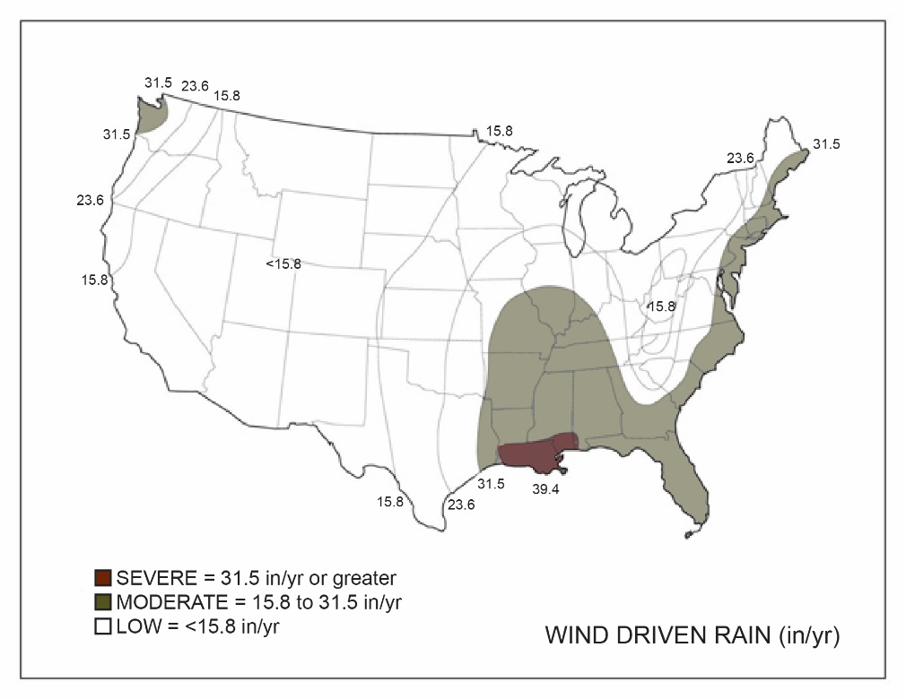
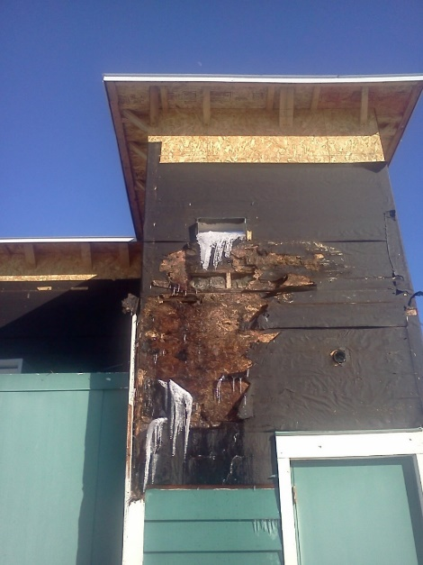
BSC #1 – Rain Water Control
Rain water control is often the primary factor associated with observed failure or success of moisture control.
If rain water is not adequately controlled, other building science measures can be rendered ineffective.
Concept is simple:
Keep water out!
Wind driven rain is the primary hazard
(map based on UofGA research)

Slide 7
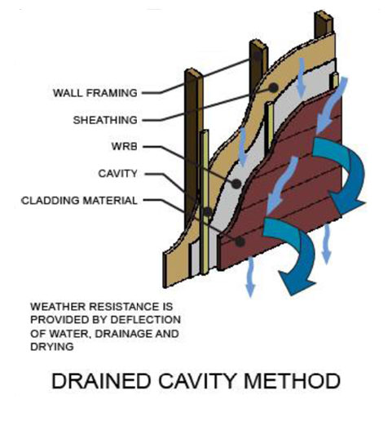

BSC #1 – Rain Water Control
  Select cladding type, windows & doors, and installation methods best suited to the local climate wind-driven rain hazard.
  Durability by Design – 2nd Edition
  Cladding type/method performance not differentiated in the code.

Slide 8
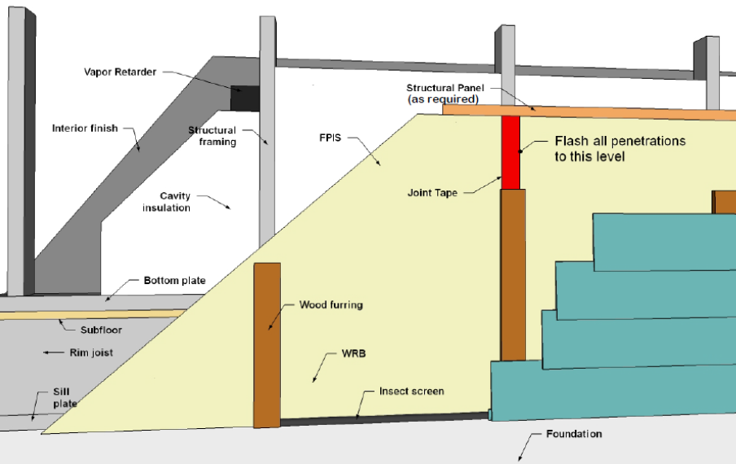
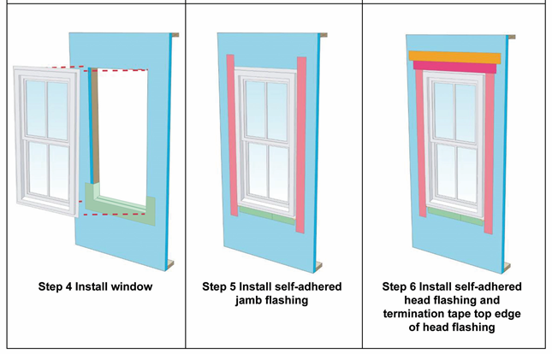
BSC #1 – Rain Water Control
Use a code compliant water-resistive barrier (WRB) and flashing details at all penetrations for a continuous drainage plane behind the cladding
  WHY? Claddings leak!
  Required by code
Pan flashing strongly recommended under
all window sills and door thresholds
  Why? Many windows/doors leak or will leak.
  Code doesn’t require plan flashing in any climate.

Slide 9
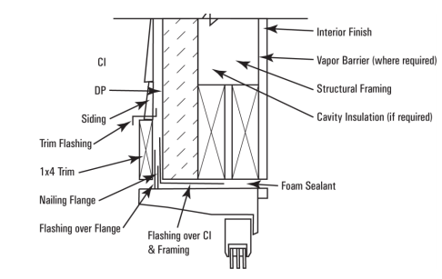
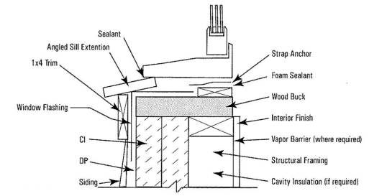
BSC #1 – Rain Water Control
Integrate Window/Door/Flashing/WRB Manufacturer Installation Instructions
  Why? This is not done for all possible combinations of approved materials and components that must be integrated
  For integration examples, refer to continuousinsulation.org/window-installation for window installation recommendations.
Inspect/Verify WRB and flashing prior to concealment by cladding
  Why? Installation quality is important.

Slide 10
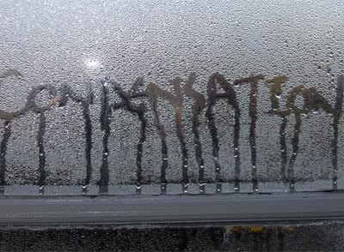
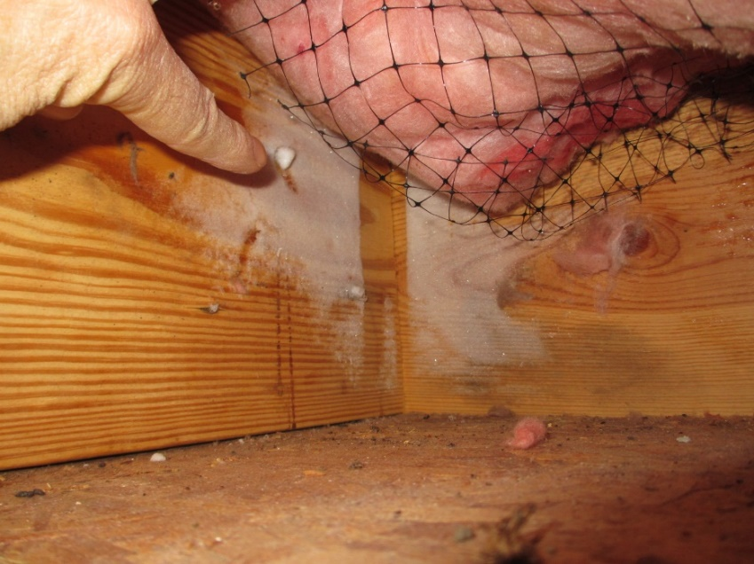
BSC #2 – Air Leakage Control
Lack of air leakage control can allow substantial amounts of moist/humid air
into and through assemblies.
  Air can bypass vapor retarders, rendering them much less effective.
  Increased risk of moisture problems such as condensation and mold
Air can bypass insulation, rendering insulation less effective.
  Increased energy bills

Slide 11
BSC #2 – Air Leakage Control
A continuous air-barrier (AB) is required by the International Energy Conservation Code (IECC). The IECC does not specify where the air barrier must be located
  Can be located on the interior, inside, or to the exterior side of walls
EPA Energy Star* requires AB on both sides of assemblies in cold climates (best practice and highly recommended).
For additional guidance refer to:
  Durability by Design: A Professional’s Guide to Durable Home Design
  Air Leakage Guide, US DOE, Building Technologies Program

Slide 12
BSC #2 – Air Leakage Control
Many materials and methods of AB installation are available:
  Exterior sheathing with sealed joints
  Sealed drywall installation
  Mechanically attached wraps with sealed joints
  Adhered membranes
  Spray-applied coatings
  Closed-cell spray foam

Slide 13
BSC #2 – Air Leakage Control
It’s not just a material; it’s a system!
  As with the WRB and flashing, the AB must be properly sealed at all joints and penetrations and discontinuities.
  Inspection and air-leakage testing are important for quality installations.
With proper design and location in an assembly, some air barrier materials may perform multiple roles (e.g., sheathing, insulation, vapor retarder, and air barrier all in one).

Slide 14
BSC #3 – Control Indoor Relative Humidity
  Excessive indoor relative humidity (RH) can also overwhelm any reasonable code-compliant building envelope design.
  Acceptable indoor RH levels are not specified the code (or coordinated with vapor retarder and insulation requirements).
  Include a relative humidity meter in the home for homeowner use and to guide proper operation of the home (avoid excessive indoor RH >> 40%).
  Building ventilation requirements in the code for indoor air quality purposes can help control indoor RH in the winter.
  Whole building ventilation methods are better than spot ventilation.
  Must be reasonably balanced to avoid increased air-leakage due to indoor-outdoor pressure imbalances.
  Proper sizing and specification of AC equipment can help control indoor RH in the summer.
  Dehumidification should be considered and used as needed.

Slide 15
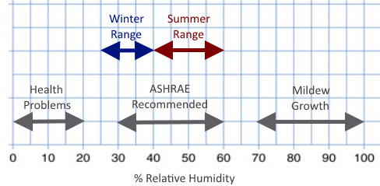
BSC #3 – Control Indoor Relative Humidity
  In general, summertime indoor RH
  should not exceed 60%.
  In the winter, max recommended RH
  varies by climate (25% to 40%).
  Lower indoor RH needed in colder
  climates for water vapor control.
  Preferred indoor RH levels for building
  durability and occupant comfort can be in conflict.
  Must control indoor RH or adjust water vapor control strategy accordingly.
  Special conditions require special solutions (e.g., pool rooms, saunas,
  hot tubs, etc.).

Slide 16
BSC #4 – Control Initial Construction Moisture
Wet framing materials and wet-applied insulation materials can overwhelm the tolerance of materials and assemblies to withstand prolonged exposure to moisture and high water vapor drives.
This issue mainly affects the initial year of building operation.
  The solution varies based on the time of year a wall is enclosed with wet materials, which will determine the primary direction of vapor flow for drying.
Can result in mold or moisture-related damage to materials such as moisture-sensitive sheathings and interior finishes, if not dried out in a timely manner.

Slide 17
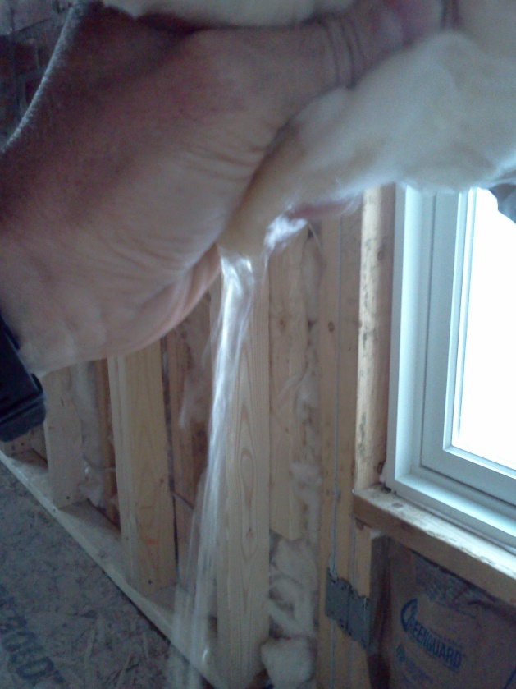
BSC #4 – Control Initial Construction Moisture
Solutions are simple:
  Don’t use wet materials and when they are wet, don’t close-in the assembly until they are dry.
  Don’t install cavity insulation, vapor retarder, and interior finishes until the wall is dried-in (e.g., water-resistive barrier and all flashings completed).
Storm water expelled from FG batt insulation installed prior to completion of the WRB and flashing

Slide 18
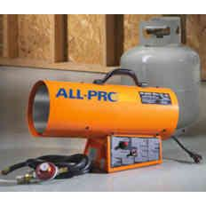
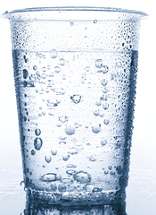

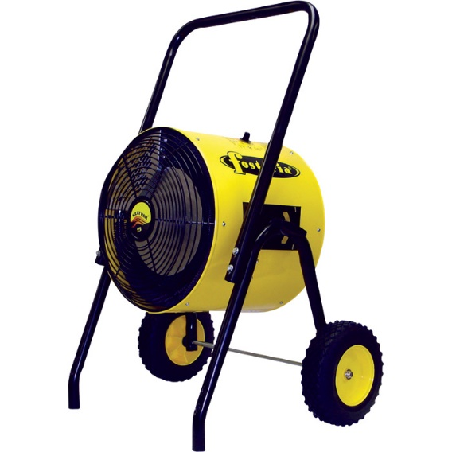
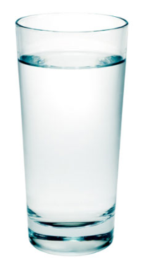
BSC #4 – Control Initial Construction Moisture
TIP: Don’t dry buildings using gas/fuel fired heaters – water vapor is a primary combustion by-product!
  Hot/humid air creates huge vapor drives and can slow drying rather than help it.
  Use hot/dry air instead (electric heaters, dry air ventilation, etc.).

Slide 19

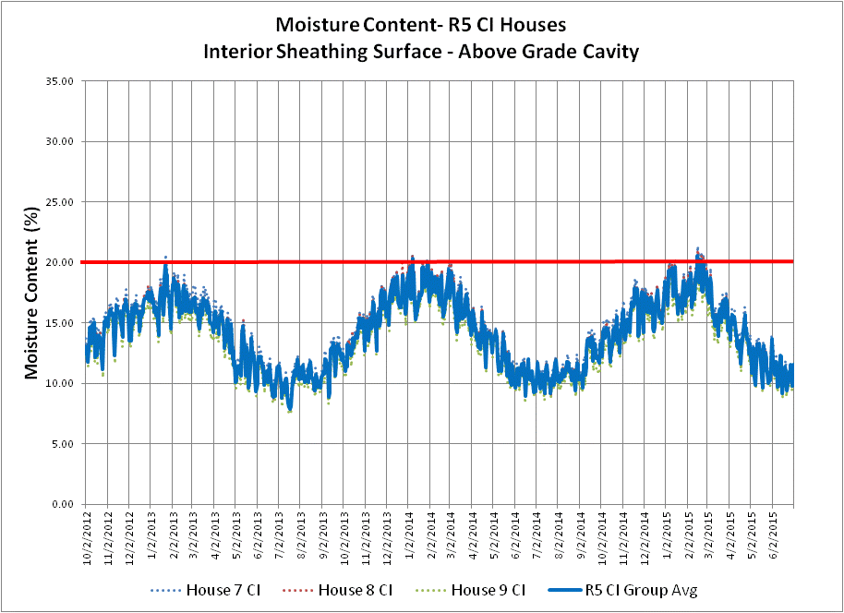
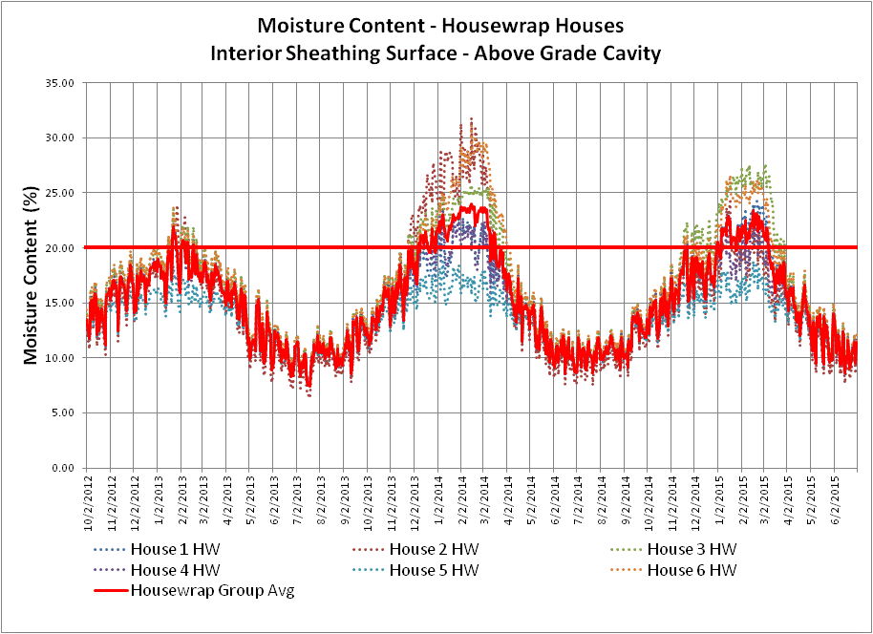
BSC #5 – Control Water Vapor
Water vapor control involves two simple concepts:
  Minimize the risk of the assembly getting wet due to water vapor diffusion (adsorption or condensation).
  Optimize the ability of the assembly to dry in relation to its risk of getting wet.
Two “Code-Compliant” Walls:
Left – moisture cycling below 20% MC
Right – moisture cycling above 20% MC

Slide 20
BSC #5 – Control Water Vapor
While simple in concept, this practice involves consideration
of several factors (not all addressed in code):
  Climate and Indoor RH (boundary conditions)
  Water vapor permeance (WVP) of exterior materials
    Sheathing, WRB, etc.
  WVP of interior materials
    Interior vapor retarders in cold climates, or interior finishes in warm climates
  Location and properties of insulation:
    Cavity insulation R-value and its WVP
    Exterior insulation R-value (continuous insulation) and its WVP

Slide 21
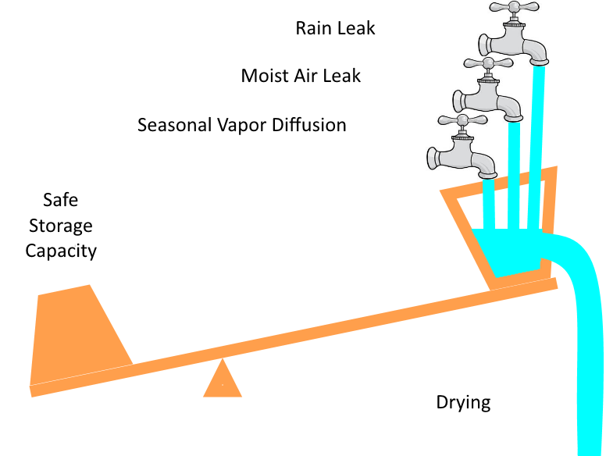
BSC #5 – Control Water Vapor
It is truly a balancing act!
  Risk of rain water wetting
  Risk of air-leakage wetting
  Wetting and drying by water vapor diffusion
R-value and relative WVP of materials and their location within the assembly matters
  Ability of materials to store and tolerate moisture also matters
GOAL: Drying > wetting (in annual, not monthly/seasonal basis) to control risk of mold
or water-sensitive material degradation

Slide 22
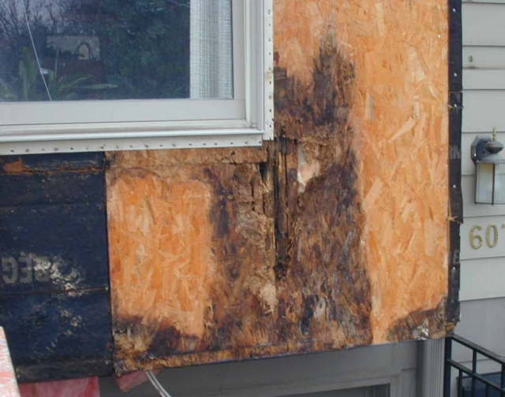
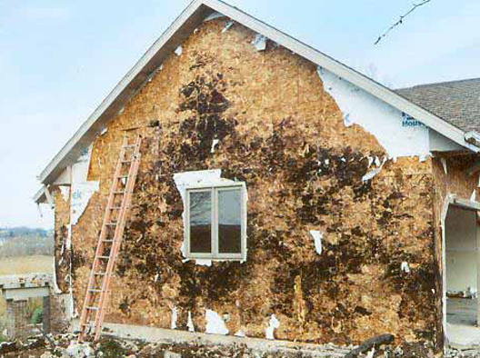
BSC#5 – Control Water Vapor
(Addressing a common misconception)
Also, there are different consequences for
different types of wetting:
  The first photo (above right) illustrates localized
  wetting from a leak and affirms the need for good
  WRB and flashing practices (e.g., pan flashing)
  The second photo (lower left) deals with wetting over large areas that can occur due to inward water drives
  (too vapor permeable on the exterior) or inadequate wintertime condensation control (sheathing too cold,
  poor VR, poor AB, etc.).
Neither consequence is good.
  But, there is a way to avoid both of these consequences...
More on wall rot at: http://www.greenbuildingadvisor.com/blogs/dept/musings/all-about-wall-rot

Slide 23
Water Vapor Control: Putting BSC’s to Practice
The remainder of this presentation addresses the following
water vapor control topics:
  Terms to know (see handout))
  Assessment of US and Canada building code requirements
  Two unifying design methods for water vapor control
  Framework for simplified design and example applications
  Supplemental Design Considerations

Slide 24
Terms to Know
Vapor Retarder (VR): A material in an assembly designated for purpose of serving as means to limit water vapor flow into or through the assembly.
  Also known as a “vapour barrier” in Canada (material used as a vapor retarder having permeance of 1 perm or less).
  In the U.S., the term “vapor barrier” is reserved for Class I vapor retarders (very low perm, 0.1 perm or less).
This definition does not mean that the vapor permeance and location of other materials in an assembly is not important!

Slide 25
Terms to Know
[2015 IBC/IRC] VAPOR RETARDER CLASS. A measure of the ability of a material or assembly to limit the amount of moisture that passes through that material or assembly. Vapor retarder class shall be defined using the desiccant method with Procedure A of ASTM E 96 as follows:
  Class I: 0.1 perm or less (e.g., polyethylene, foil facing, etc.)
  Class II: 0.1 < perm <= 1.0 perm (e.g., Kraft paper, VR paints)
  Class III: 1.0 < perm <= 10 perm (e.g., latex paint)
Vapor retarder classes in the codes are not precise (e.g., a factor of 10 difference within a given class) but they help to generally communicate solutions and material selections.

Slide 26
Terms to Know
Water vapor permeance (WVP): The property of a building material related to the ability of water vapor to diffuse through it; measured in “perms.”
  This property may vary depending on moisture content of the material as related to its surrounding conditions (e.g., relative humidity) – “smart vapor retarders” fall into this category (usually organic materials like Kraft paper, wood structural panels, or proprietary vapor retarder membranes).
Low perm = relatively high resistance to water vapor flow
High perm = relatively low resistance to water vapor flow

Slide 27
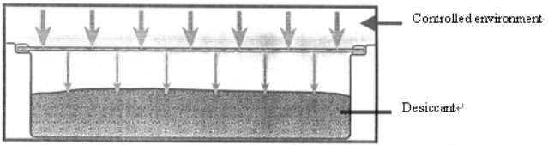
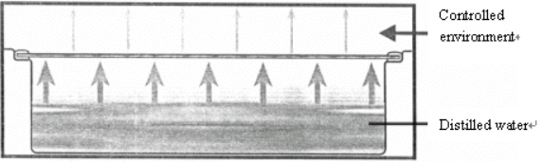
Terms to Know
50% RH
Water vapor permeance
  WVP is usually measured by ASTM E96 (dry cup) method which relates to 25% average relative humidity at room temperature.
  ASTM E96 (wet cup) method relates to 75% average relative humidity condition and may be more relevant to some applications (e.g., materials on the exterior)
0% RH
Dry Cup Method
50% RH
100% RH
Wet Cup Method
http://www.labthink.com/en-us/literatures/an-outline-of-standard-for-cup-method-water-vapor-permeability-testing.html

Slide 28
Terms to Know
Water Vapor Permeance
  Materials that are hygrophyllic (organic) tend to have WVP that changes significantly with the ambient relative humidity (A)
  Materials that are not hygrophyllic (non-organic) tend to have WVP that changes little with the ambient humidity (B)
Thus, wet-cup and dry-cup WVP
per ASTM E96 can better inform material selection and design for water vapor control
(A)
Y perm
(B)
X perm
25%
75%
Avg. Relative Humidity (ASTM E96)

Slide 29
Terms to Know
[2015 IBC/IRC] VAPOR PERMEABLE. The property of having a moisture vapor permeance rating of 5 perms (2.9 x 10-10 kg/Pa · s · m2) or greater, where tested in accordance with the desiccant method using Procedure A of ASTM E 96. A vapor permeable material permits the passage of moisture vapor.
Other classifications: semi-permeable, semi-impermeable, impermeable (varying degrees of vapor retardance)

Slide 30
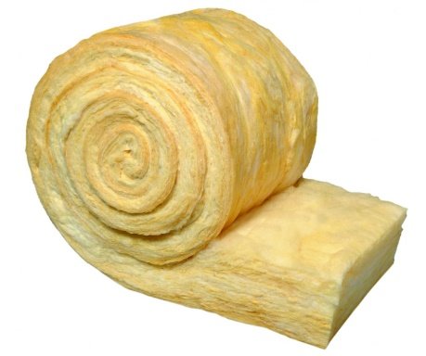
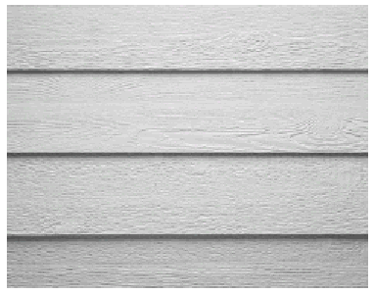
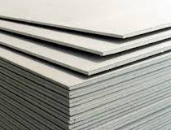
Ballpark Examples of Water Vapor Permeance
All materials, regardless of what they are called, have some measure of resistance to water vapor flow...
Air film = 120+ perm
  (Still air, 1” thick – most air is
  “moving”, so effective permeance
  is much higher)
Fiberglass/mineral fiber =
116 perms
Batt insulation (without facer),
1” thick
Drywall = 50 perm
(unpainted)
  Lap siding = 10 perm
  (wood/painted) to 40 perm
  (vinyl/vented)

Slide 31
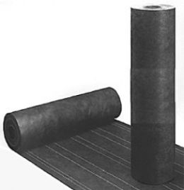
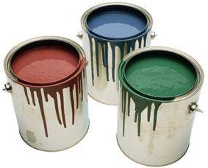
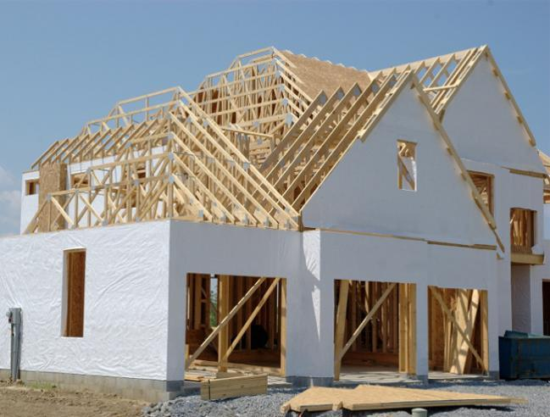
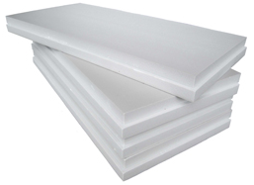
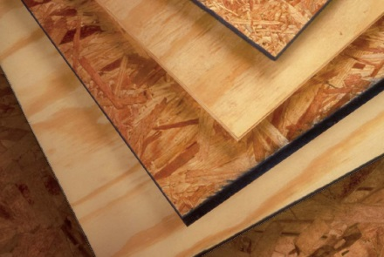
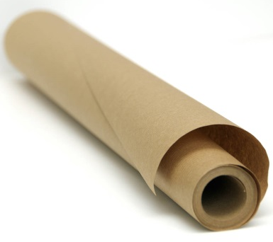
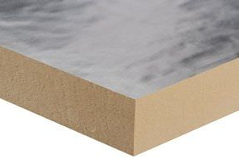
More examples...
Latex paint film = 3 to 30 perm
(primer + 1-2 coats)
House wraps = 5 to 50 perm
(depending on type)
No.15 asphalt felt paper =
1 perm (dry cup) to
5 perm (wet cup)
1” thick polystyrene insulation =
~1 perm to 5 perm
No facer. Depending on type/density. Decreases with increased thickness or added facers.
OSB or plywood = 0.7 to 1 perm (dry cup)
or 1.5 to 10 perm (wet cup)
OSB is lower perm than plywood
Kraft paper = 0.3 perm (dry cup) or
1.8 perm (wet cup)
Foil faced plyiso insulation < 0.1 perm

Slide 32
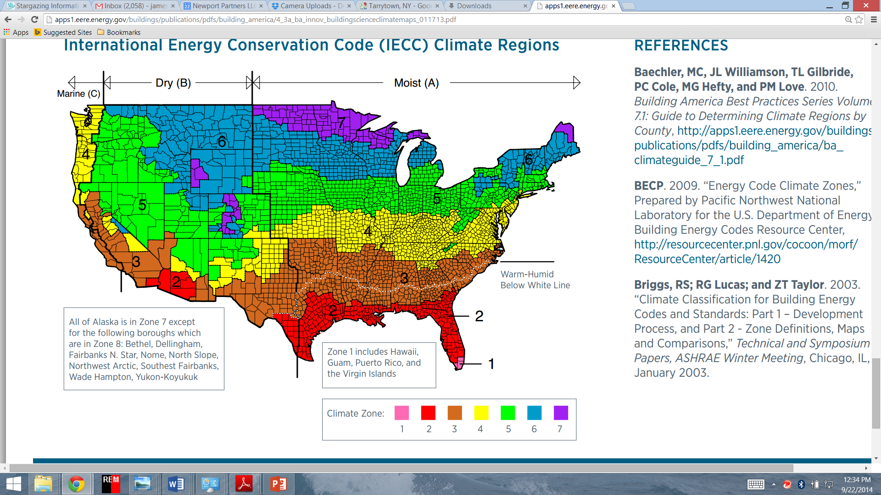
Current U.S. Building
Code Requirements
2015 IBC and IRC provisions
are similar
2015 IRC (one and two family dwellings):
  R702.7 doesn’t say not to put a Class I or II VR on the interior side in CZ 1-3!
  Silent on exterior permeance limits with Class I or II VR
  Silent on minimum insulation ratio with Class I or II VR

Slide 33
Current U.S. Building
Code Requirements
Class III vapor retarder is permitted
as an alternative to Class I or II VR
for two cases:
  Vented Cladding: In this case, exterior permeance is controlled prescriptively by requiring use of vented cladding with limitations on types of sheathing by climate zone (permeance controlled design).
  Continuous Insulation: In this case, insulation ratio is controlled for applications of continuous insulation (temperature controlled design)

Slide 34
Current U.S. Building
Code Requirements
BUT, now this reveals some gaps in
the code!
  How much continuous insulation is needed if a Class I or II vapor retarder is used?
  Under what condition should vented cladding or a higher perm exterior sheathing be required for use of a Class II vapor retarder?
  What about “double vapor barriers”?

Slide 35
Current Canadian Building Code (NBC 2010)
Only recognizes use of 1 perm or less vapor retarder on inside
(warm-in-winter side) of assembly.
  Same as Class I or Class II vapor retarder in U.S. codes
  Polyethylene VR and AB commonly used
  Does NOT recognize use of a Class III vapor retarder
Recognizes special design needed for buildings with high internal moisture loads (e.g., high indoor RH).

Slide 36
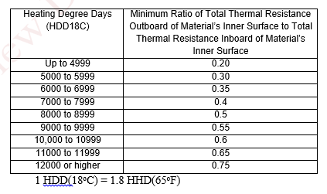
Current Canadian Building Code (NBC)
NBC Part 9 (housing and light-commercial) includes requirements for use of low perm (less than 1 perm) material layers on the exterior side (Section 9.25.5.2)
  Requires use of exterior insulation meeting minimum insulation ratio
  (ci R-value / Cavity R-value)
  First introduced in the 1995 edition
  of NBC

Slide 37
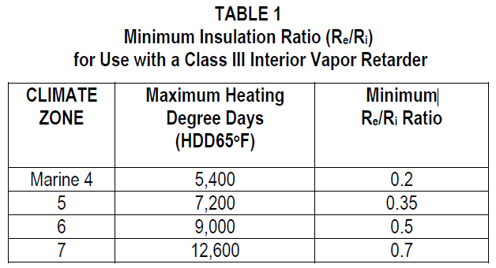
The Insulation Ratio Concept
Same principle as insulation ratios (exterior ci R-value) used for Class III VR in U.S. codes
  See adjacent table as basis for IRC Table R702.7.1.
Same principle used for above-deck roof insulation in millions of square feet of low-slope commercial building roofs.

Slide 38
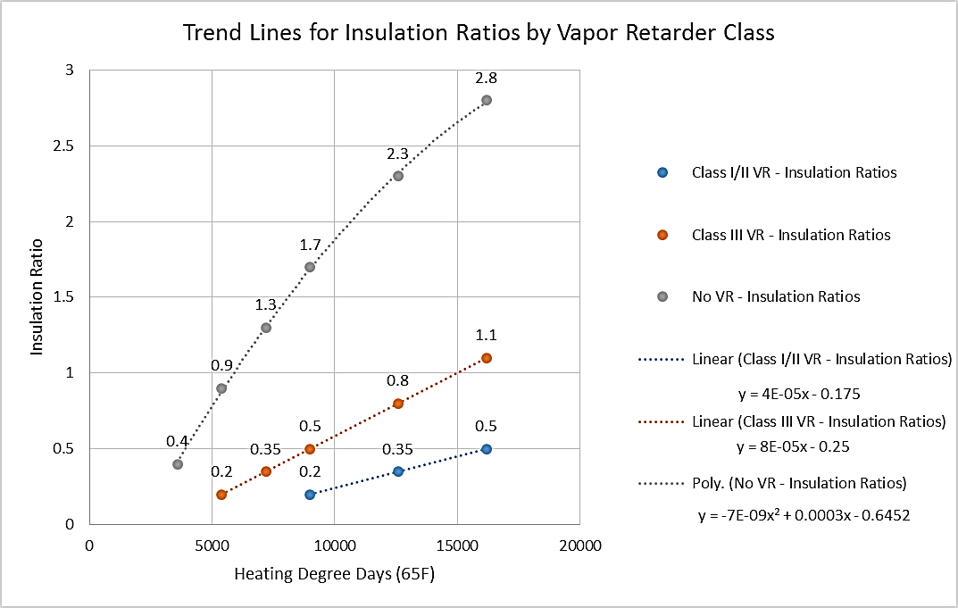
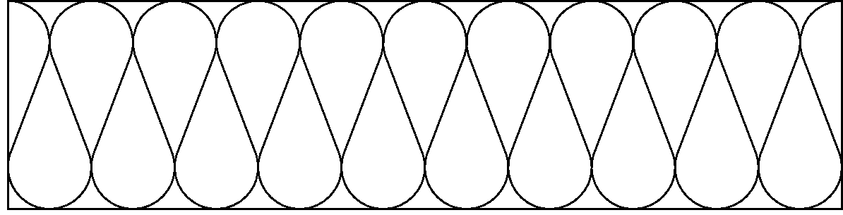
The Insulation Ratio Concept
Keep the inside of the wall warm in the winter!
This is the key concept
of the “temperature controlled” design approach to manage water vapor.
Simple to determine:
  Insulation ratio = R_{e}/R_{i}
R_{e}
R_{i}
Exterior CI
(low perm)
Interior Cavity Insulation
Vapor Retarder
(Class I, II, or III depending on R_{e}/R_{i} and climate)

Slide 39

SUMMARY:
US Code + Canadian Code = Complete Approach
U.S. codes give incomplete guidance.
Canadian code gives incomplete guidance.
Both taken together are reasonably complete.
  SOLUTION: Unify North American codes and experience and investigate need for any incremental improvements.

Slide 40
Two Unifying Design Approaches – Same Objective
R_{e}
R_{i}
Water Vapor Source
Indoor RH (winter)
Outdoor RH (summer)
Condensation
plane (winter)
Vapor permeable exterior
(non-insulated)
Condensation plane
(summer)
‘Strong’ vapor retarder
Exterior CI
(low perm)
Warm surface
(restrict dew point occurrences)
‘Modest’ vapor retarder
The
Water
Vapor
Control
Triangle
Restricted vapor
flow to cold surfaces
Moderated vapor flow in winter
Tendency to dry to the exterior during Winter
Tendency to dry to
the interior during
Spring, Summer, & Fall
Control Moisture Vapor Diffusion
Control of vapor flow into and
out of an assembly (flow direction changes with seasons)
Control Internal
Surface Temperatures
Control surface temperatures to prevent moisture condensation or high surface humidity

Slide 41
Two Unifying Design Approaches – Different Emphasis
Permeance controlled design
Applies to walls:
  Without exterior insulation
  Or, with vapor-permeable exterior insulation
Relies on permeance of all
interior and exterior layers
  Interior & exterior must be checked
  and balanced!
  Permeance of exterior materials not always known or reliably reported/controlled
  Not required to be checked by US code (except HUD Code has permeance ratio)
Temperature controlled design
Applies to walls:
  With exterior insulation of any permeance
  Including very low perm
Only requires control of insulation ratio (R_{e}/R_{i})
  Insulation ratio varies by climate and in relation to selected interior vapor retarder

Slide 42
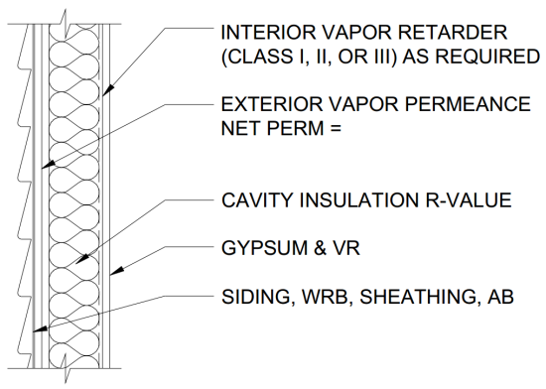
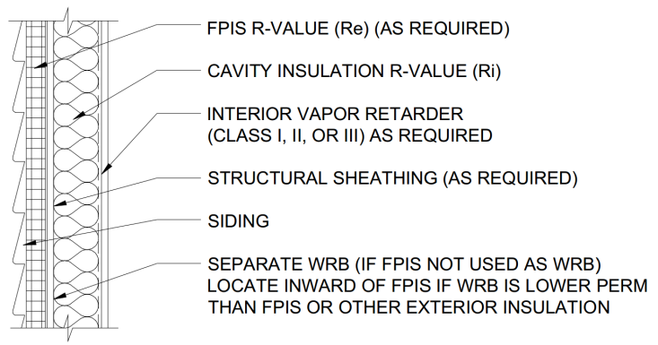
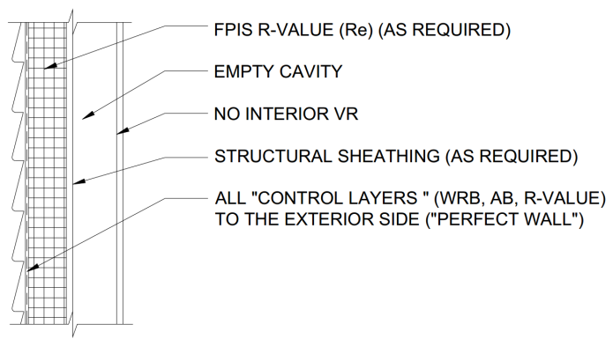
Two Unifying Design Approaches – Many Applications
Non-material specific and impartial
Covers a wide range of wall designs:
CAVITY INSULATION ONLY ➔CAVITY + CONTINUOUS HYBRID ➔CONTINUOUS ONLY

Slide 43
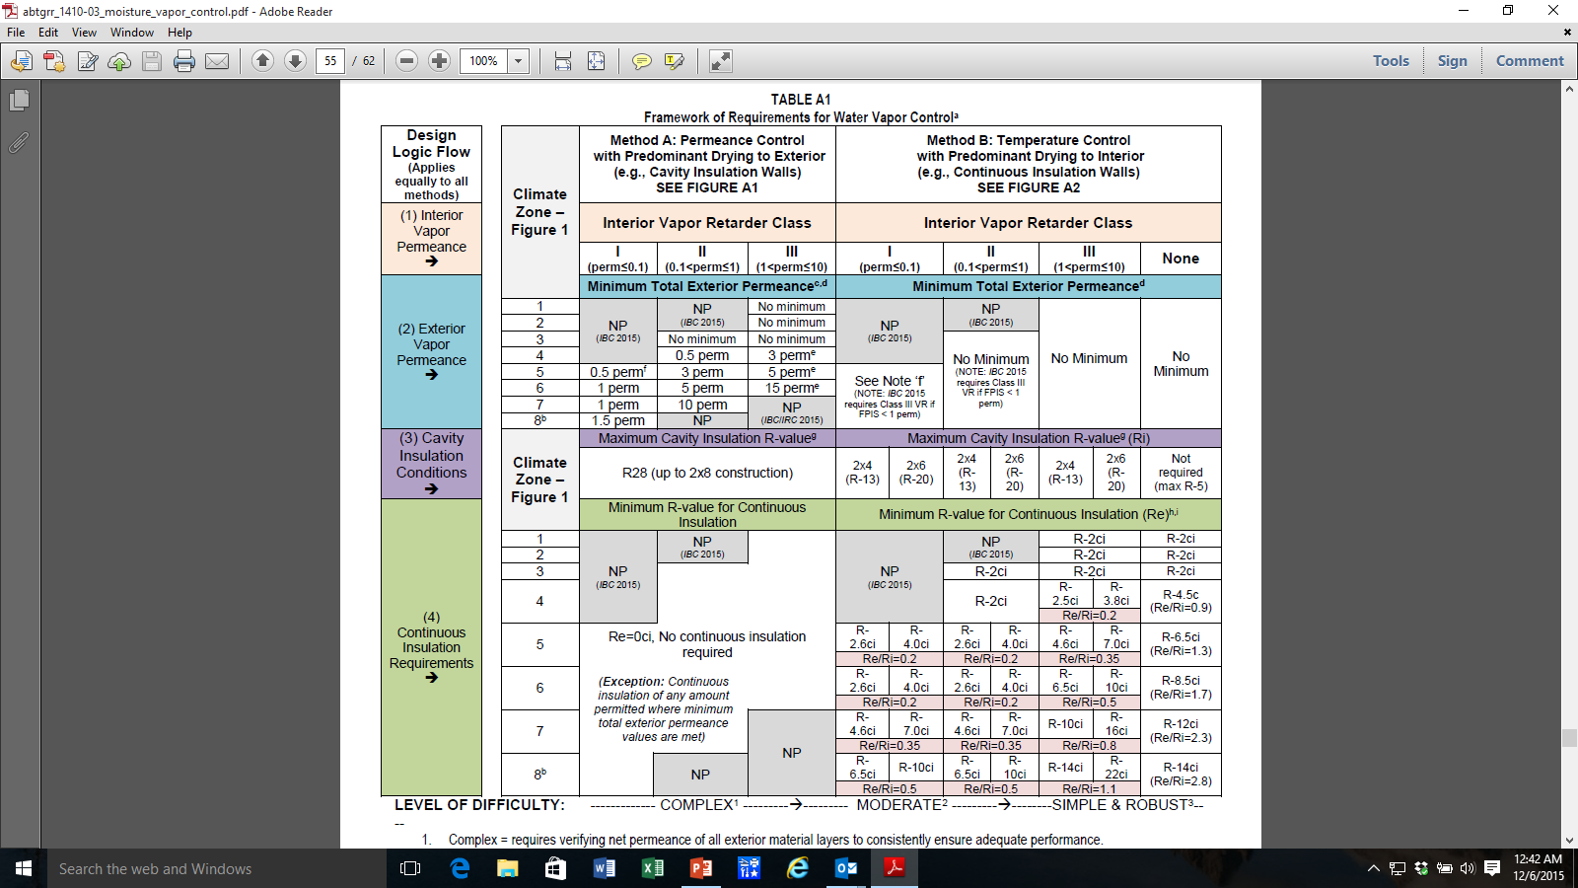
Framework for
Water Vapor Control
(using prescriptive “cook book” designs)
Based on compilation of US and Canadian building codes and practices plus extensive review of research and analysis of actual field data.
Source: Assessment of Water Vapor Control Methods for Modern Light-frame Wall Assemblies, ABTG Research Report 1410-03, 2015

Slide 44
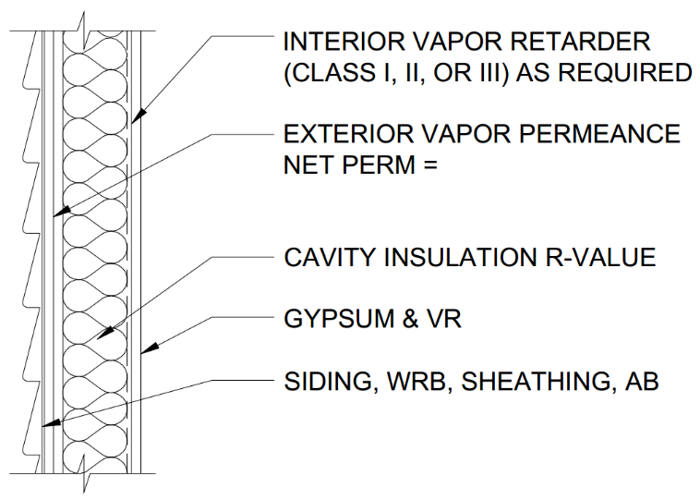
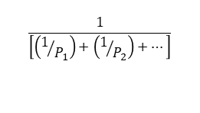
Simplified Permeance-
Controlled Design
Cavity Insulation Only*
$$\frac{1}{\left[\left(1/{P_{1}}\right)+\left(1/{P_{2}}\right)+…\right]}$$
* Can also include any amount of continuous insulation complying with exterior permeance limits

Slide 45
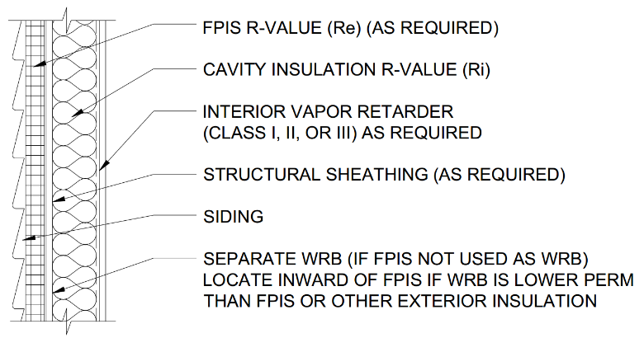
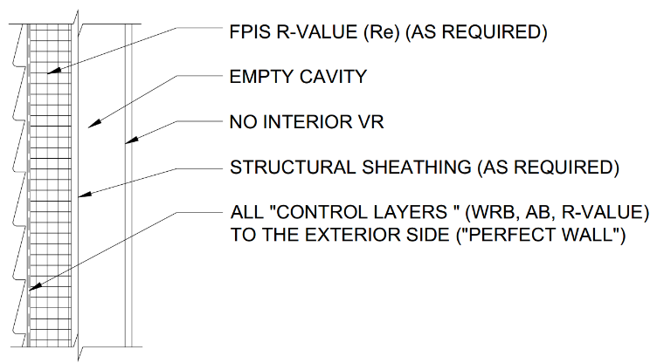
Simplified Temperature-
Controlled Design
Cavity* + Continuous + Interior VR
Continuous Only (No VR)
* Also applies where ccSPF is used in cavity

Slide 46
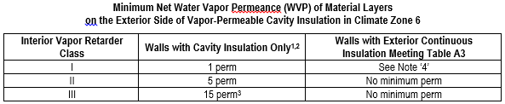
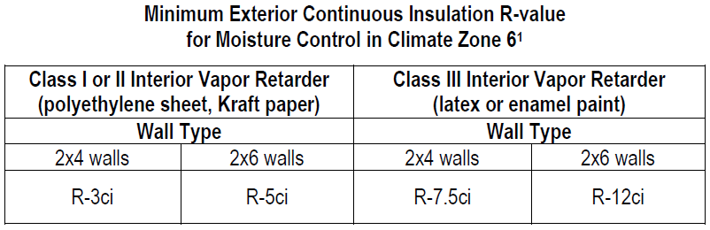
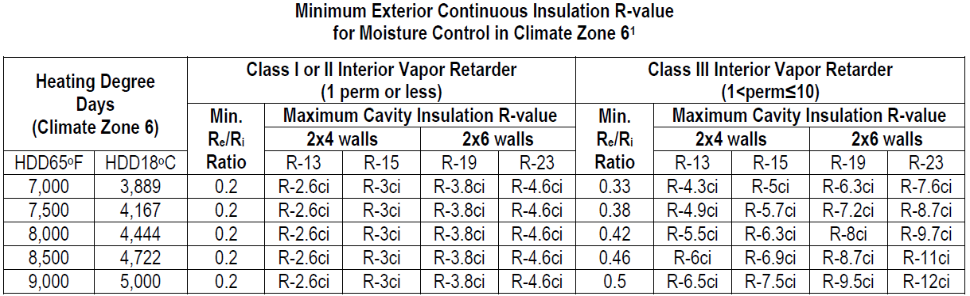
Many ways to use design method to format prescriptive solutions...
Can be very simple...
Permeance Controlled Solutions (CZ 6 only):
Or allow more options/precision...
Temperature Controlled Solutions (CZ 6 only):

Slide 47
Example 1
Using insulation ratios to check energy code solutions and alternative wall insulation strategies for adequate moisture durability.
  Given: Assume the energy code requires R20+5ci (2x6 wall with R20 cavity insulation and R5 continuous insulation). This is a “temperature-controlled wall” wall in accordance with Table 2.
  Find: What is the maximum (coldest) permissible climate zone for this wall when using a Class I, II or Class III interior vapor retarder?

Slide 48
Example 1
Solution: First, determine the insulation ratio, R_{e}/R_{i} = 5/20 = 0.25.
Per Table 2, the maximum/coldest climate zone is 6 with a Class I or II interior vapor retarder and Climate Zone 4 with a Class III interior vapor retarder.
Using Footnote ‘b’ to interpolate with HDD, this wall could be used into the lower third of the next colder climate zone (0.25 falls between 0.2 and 0.35).

Slide 49
Example 2
Verify compliance of a conventional 2x6 (cavity insulation only) wall assembly in Climate Zone 5 with exterior permeance requirements for water vapor control.
  Given: Assume the energy code requires minimum R-20 cavity insulation and the product used is vapor permeable (e.g., fiberglass, cellulose, etc.). This is a “permeance-controlled” wall assembly in accordance with Table 1. Also assume that 7/16" OSB sheathing is used (typical wet cup vapor permeance ~ 3.8 perm – verify with manufacturer) together with a 10 perm building wrap and a vented cladding (e.g., anchored brick veneer).
  Find: What Class of interior vapor retarder is permitted for use with this assembly in Climate Zone 5?

Slide 50
Example 2
Solution: First, determine the net vapor permeance of the exterior material layers (excluding the vented cladding) in accordance with Note ‘c’ of Table 1. Thus, net permeance = 1 / [(1/3.8) + (1/10)] = 1 / 0.36 = 2.75 perm.
This is just under the minimum 3 perm required by Table 1 for use with a Class II (e.g., Kraft paper) vapor retarder. Thus, a Class I vapor retarder is required.

Slide 51
Example 2
However, there are alternative solutions:
  For example, one could use a sheathing product with a minimum permeance of 4.3 perm (e.g., ½" plywood sheathing, fiberboard, etc) which would result in a net vapor permeance of 3.0 perms or greater, allowing use of a Class II vapor retarder.
  Alternatively, the OSB sheathing can be used (assuming it has a wet cup vapor permeance of 3.8 perm or greater) with a building wrap or other water resistive barrier having a permeance of at least 15 perms.
    Thus, the net permeance = 1 / [(1/3.8) + (1/15)] = 1 / 0.33 = 3.03 perm which would also allow use of a Class II interior vapor retarder instead of a Class I.
    Using a non-vented cladding material of low water vapor permeance will require similar adjustments (or conversion to a vented cladding using furring) to achieve a similarly suitable design.

Slide 52
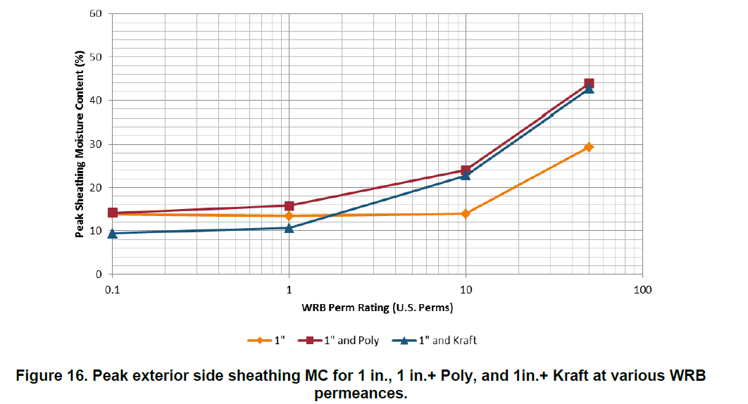
Supplemental Design Considerations
High sheathing moisture content
CAN YOU HAVE TOO MUCH PERMEANCE?
Yes! (in some conditions)
Recommendation:
The Net WVP of exterior layers between the cladding
and sheathing (e.g., the WRB or continuous insulation) should not exceed ~10 perm
This prevents solar-driven inward moisture movement, where direct-applied (unvented)
reservoir cladding (adhered veneer, stucco, etc.)
is used on air-conditioned buildings.
This is primarily a concern in warmer and more humid climates but can extend up into Climate Zone 5.
Can also be addressed by increasing back-ventilation of reservoir cladding.
Peak moisture content (wetting) of exterior sheathing increases as the permeance of the exterior insulation and/or WRB approaches and exceeds ~ 10 perm
Source: Lepage & Lstiburek (2013). Moisture Durability with Vapor-Permeable Insulating Sheathing. US DOE, Building Technologies Office, Building America Program

Slide 53
Supplemental Design Considerations
CAN YOU HAVE TOO LITTLE PERMEANCE?
Yes! (in some conditions)
For all wall assembly types in climates with severe wind-driven rain hazard (see next slide), avoid use of “double vapor barriers*” (e.g., Class I vapor retarder on interior and << 1 perm net water vapor permeance material layers on exterior).
  Use a Class II VR (preferably a “smart” VR like Kraft paper) or Class III VR to promote drying to interior or high perm materials on the exterior to promote drying to the exterior.
  Use of pan flashings below window sills and door thresholds highly recommended to prevent wetting from rain intrusion in the first place. All flashings and WRB installation should be inspected/verified before concealment.
  * The concern is not with “double vapor retarders.” Many walls are “double vapor retarders” because both sides of typical wall assemblies provide resistance to water vapor diffusion (some more than others).

Slide 54
Supplemental Design Considerations
IMPORTANT NOTES FOR PREVIOUS SLIDE:
  Drying potential (breathability) is not a “cure all” for leaky walls and components. Taken to an extreme, it can lead to “too much permeability” or inattention to the primary concern with preventing leaks or properly specifying insulation location and vapor retarders.
  Class I vapor retarders are not permitted in climate zones 1-4 already (except Marine 4), so this recommendation applies mainly to the Northwest and Northeast seaboards of the US (see next slide).
  Use of a Class I or II “smart” (responsive) vapor retarder is now recognized in the 2024 codes to promote inward drying and restrict outward (winter) vapor movement.
For additional info on double vapor barriers, refer to: “Doubling Down: How Come Double Vapor Barriers Work?” (Dr. Lstiburek, ASHRAE Journal, Jan. 2016).

Slide 55
Wind-driven Rain & Climate Zone Maps

Slide 56
Alternative Designs by Analysis
Insulation ratios and permeance requirements discussed earlier are “simplified” solutions to give reasonable and reliable answers for many common conditions.
Where alternate or more precise solutions are desired or necessary, various means of hygrothermal analysis are available to help.
  These design tools generally require some degree of expertise to properly use and interpret results
  A professional should be consulted.
  Results may be precise, but are never more accurate than the inputs and assumptions (GIGO).

Slide 57
Conclusion
Summary:
  5 Key Building Science Concepts for moisture-resistant & energy efficient construction
  Terms important to the “trade”
  Current US and Canadian building code provisions
  Two Unified Design Approaches
  Example Applications (prescriptive and design)
  Supplemental Design Considerations

Slide 58

QUESTIONS?
Jay Crandell
www.aresconsulting.biz
Please submit any questions through the Continuous Insulation website at continuousinsulation.org/contact.

