Slide 1
The Energy Code Myths That Haunt Us
Jay Crandell, ABTG / ARES Consulting
Amy Schmidt, Dow Building Solutions
Presented at RESNET Building Performance Conference
Orlando, FL : February 26-28, 2018

Slide 3
Haunting Myths
20+5 = 25
The Energy Code is not a life safety code
Any material can be used to meet the insulation R-value requirements
Any air-space can help achieve the assembly’s thermal performance requirements
All above code programs are code compliant
Moisture management isn’t an energy issue
Compliance requirements are straightforward
An envelope backstop is not needed in the ERI option

Slide 4

Myth: 20 + 5 = 25 ?
Isn’t 20 +5 always equal to 25?
SIMPLE ANSWER: No. They are not equal when the 20 and the 5 are really two different things. This is the classic “apples and oranges” fallacy.
  “Apples” = Cavity insulation in cavities which includes framing of lower R-value
  “Oranges” = Continuous insulation without framing thermal bridges
In the real wall assembly, these two insulation components contribute differently to the effective or total R-value of the assembly.
They can’t be simply added to get the right answer
  “20 + 5” is really just a symbol for communicating how to insulate an assembly (like “4 x 4” is used to signify a 4-wheel drive truck).
  It was never meant to be a math equation for determining the actual R-value or alternative insulation strategies for wall assemblies.

Slide 5
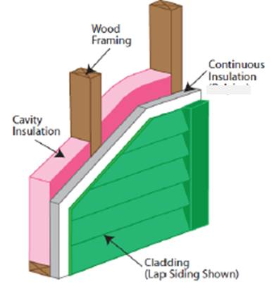
“20 + 5” = 22.4 and “25” = 18.6
Why does “20 + 5” equal 22.4 ? Why does “25” = 18.6? This is very strange math, or is it?
KEY: The math must properly account for the way heat actually flows through the assembly.
There are two paths for heat flow:
  Framing path
  Cavity path
    Note that continuous insulation insulates both paths, but the cavity insulation only insulates the cavity path

Slide 6
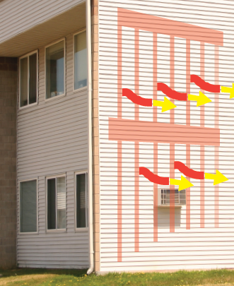
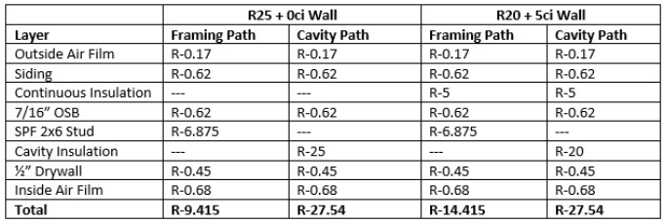
Myth Solved – Parallel Path Math
First, add up the R-value for each heat flow path through the R25 and R20+5ci wall assemblies:
Note: Multiple cavity insulation layers can be added to get a total cavity R-value and multiple continuous insulation layers can be added to get a total continuous insulation R-value. This is the ONLY case where R-values can be added.

Slide 7
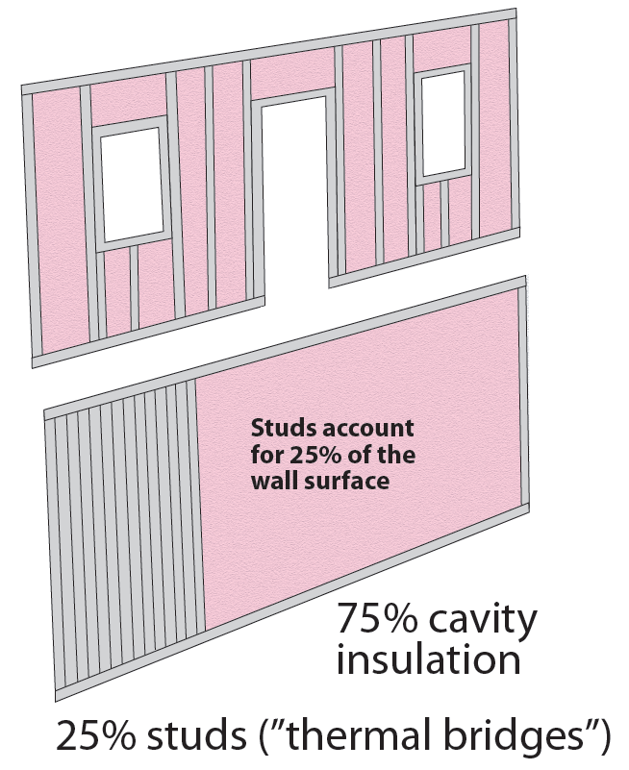
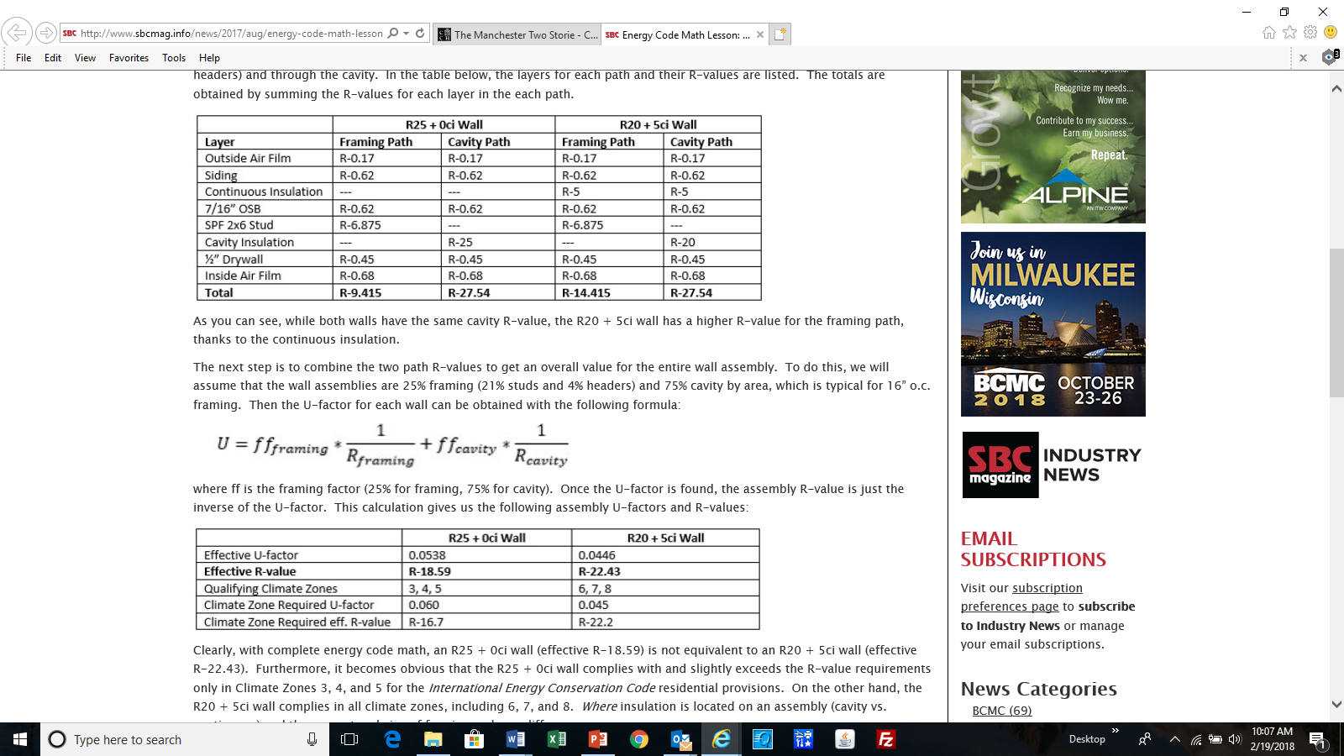
Myth Solved – Parallel Path Math
Second, weight the heat flow or conductance (1/R) of each path by the percentage area of each path as follows:
CONCLUSION: An “R25” wall has an effective R-value of R-18.6 (U = 0.054). An “R20 + 5ci” wall has a much greater effective R-value of R-22.4 (U = 0.045) because the continuous insulation insulates both paths while the cavity insulation insulates only the cavity.
So, “20 + 5” does not equal “25” when the R-value math is done properly for each heat flow path in an assembly.

Slide 8


Myth: The Energy Code is not a Life Safety Code
Me:
Preventing moisture issues, comfortably withstanding power outages, savings on energy bills for the entire life of the house. Yes, that’s nice to have.
Skeptic:
The energy code is a “nice to have.”

Slide 9
Myth Busted: The Energy Code IS a Life Safety Code
Skeptic:
“You all think that it’s the energy code that keeps buildings from falling down.”
Me:
“Yes indeed.”

Slide 10
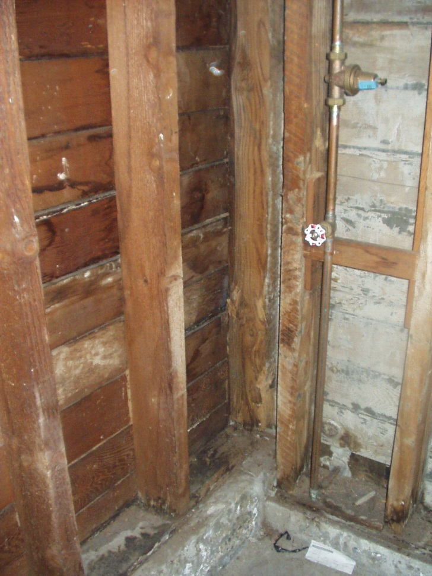
The Energy Code IS a Life Safety Code
ENERGY CODE PROVISIONS CONTROLLING MOISTURE:
AIR BARRIERS
SLAB-ON-GRADE INSULATION
RIM JOISTS
WINDOW CONDENSATION
ICE DAMMING
For the best results:
Carefully consider the best insulation and fenestration strategy for the job
Select the appropriate vapor retarder and location
Install properly!!!

Slide 11
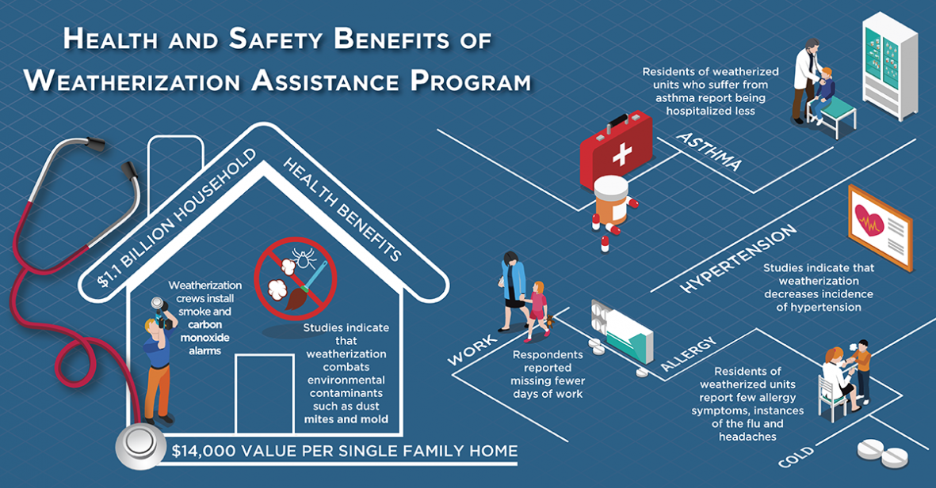
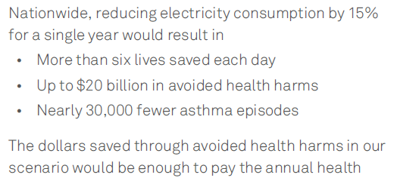
The Energy Code IS a Life Safety Code
http://aceee.org/sites/default/files/publications/researchreports/h1801.pdf
https://energy.gov/eere/articles/3-health-benefits-weatherizing-your-home

Slide 12
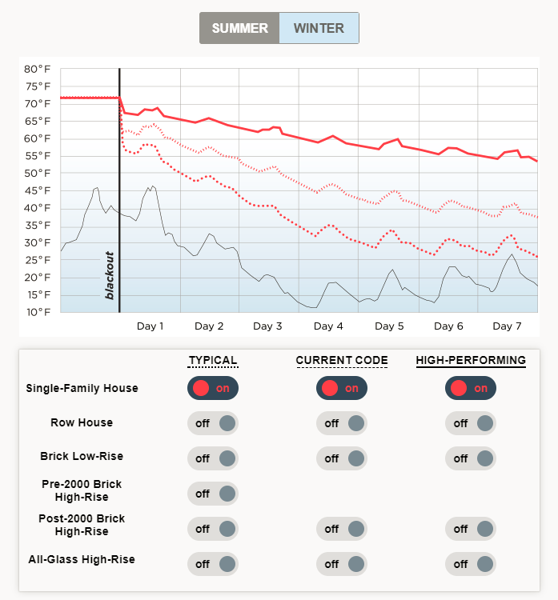


The Energy Code IS a Life Safety Code
Baby It’s Cold Inside, 2014 report by Urban Green a Chapter of USGBC, modeling by Atelier Ten

Slide 13
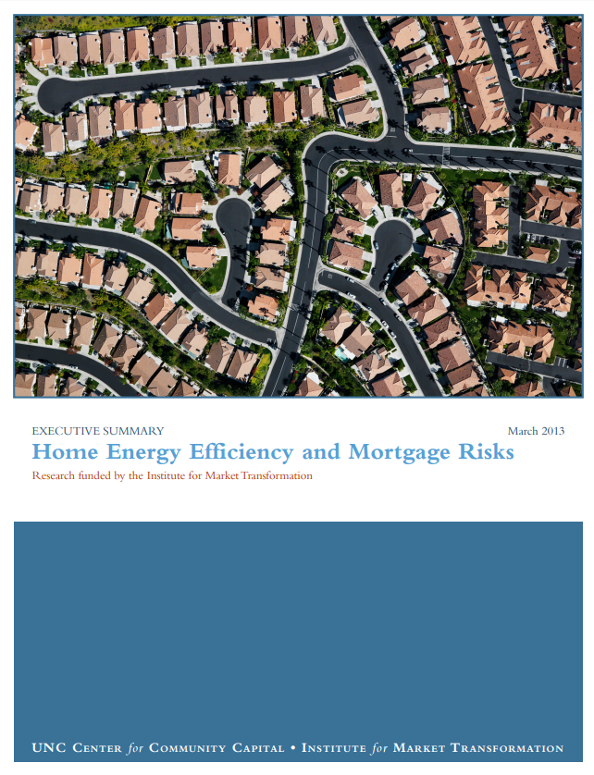
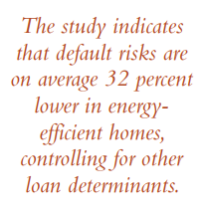
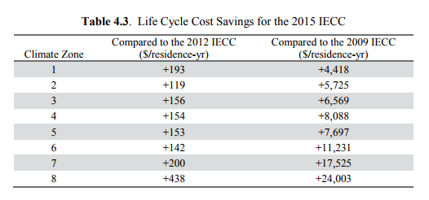
Beyond Life Safety
The Energy Code is the ONLY code that reduces energy bills and overall cost of ownership.
Based on 30 Year Life Cycle: https://www.pnnl.gov/main/publications/external/technical_reports/PNNL-24948Rev1.pdf

Slide 14
Myth: Any material can be used to meet insulation R-value requirements
SIMPLE ANSWER: Yes and No. It depends.
The R-values for insulation components in the R-value compliance path assume certain building materials are present and contribute a baseline R-value to the assembly.
A parallel path calculation must be done and U-factors used to demonstrate assembly performance (as shown in prior slides).
Example 1: Siding Building Material
  Siding = R-0.62 assumed in R-value tables.
  Implication: Using a siding with a lower R-value will increase the insulation R-value required or reduce performance; Using a siding with a higher R-value than 0.62 can be used to reduce insulation required (or improve performance).
  Insulated siding cannot be fully added to continuous insulation to get a net R-value for continuous insulation without first reducing the R-value of the insulated siding by R-0.6 to avoid double counting the R-0.62 already assumed to be present for siding when using the prescriptive R-value path.

Slide 15
Myth: Any material can be used to meet insulation R-value requirements
Example 2: Structural Sheathing Building Material
  Structural sheathing with R-0.62 (e.g., 7/16” OSB) is assumed present in the tabulated insulation R-value requirements
  Using thinner or thicker structural sheathing may slightly increase or decrease performance, but can only be counted through the parallel path calculations (U-factor compliance)
  This building material is not continuous insulation and does not have “rated” R-values for FTC R-value rule. Thus, it cannot be added to ci R-value to get a net ci R-value.
    Structural insulated panels are an exception if tested and rated for R-value per FTC R-value Rule as a composite panel.

Slide 16
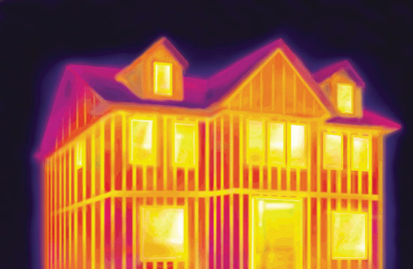
Myth: Any material can be used to meet insulation R-value requirements
Example 3: Framing Materials
  Advanced framing can be used as a means to reduce prescribed insulation R-value requirements or improve the performance of an assembly.
  True, but..
    The benefit is found in having a lower “framing factor” than assumed as a baseline in the code (i.e., less than 25% framing factor)
    When framing practices are used as a means for thermal performance, those practices become as important to inspect for energy code compliance as the insulation materials.

Slide 17
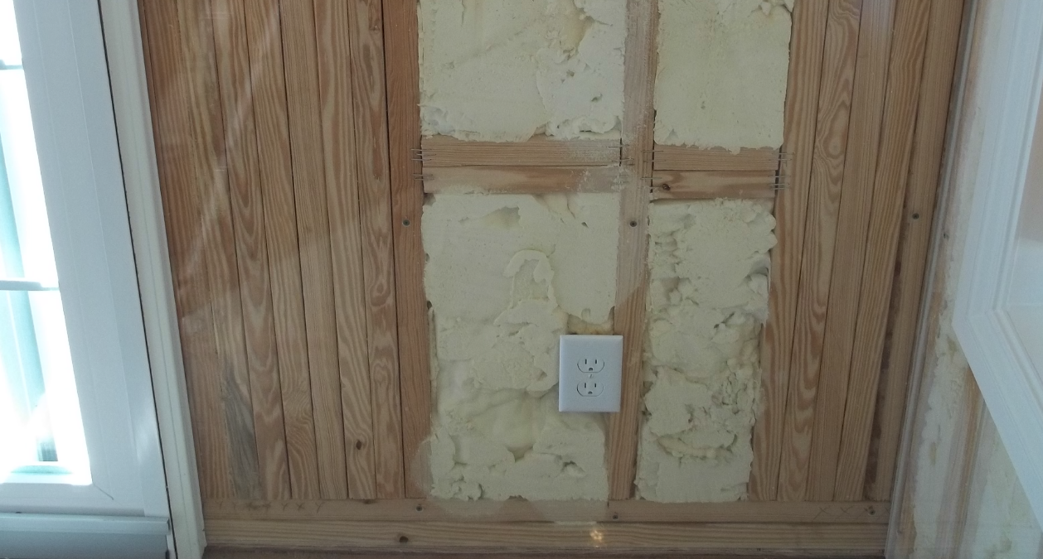
Myth: Any material can be used to meet insulation R-value requirements
  How are lower framing factors confirmed through plan review and field inspection/rating ? How do they vary with fenestration amounts and structural framing conditions? Are shop drawings available for each wall assembly to guide framers and inspectors?
  Simply relying on a specified lay-out stud spacing (e.g., 24”oc instead of 16”oc) does not capture or control the true framing factor that may result in the field.
What is the framing factor of this wall segment?

Slide 18
The Air Space R-value Enigma
Can air space R-values can be determined using ASHRAE Handbook of Fundamentals or ASHRAE 90.1 Appendix A (Section A9.4.2)?
SIMPLE ANSWER: Yes and No. It depends on the air space.
ASHRAE HOF Ch26, Table 3, footnote ‘b’ (6 font):
  “b. …Values apply for ideal conditions (i.e., air spaces of uniform thickness bounded by plane, smooth, parallel surfaces with no air leakage to or from the space).”
  Read the above footnote carefully:
  “…Values apply for ideal conditions (i.e., air spaces of uniform thickness bounded by plane, smooth, parallel surfaces with no air leakage to or from the space).”

Slide 19
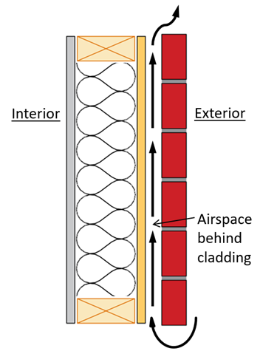
The Air Space R-value Enigma
What is the impact of airflow into and out of a non-ideal air space?
  Air changes per hour can approach 400 ACH for vented or ventilated air spaces behind cladding (typical 90 – 150 ACH)
    Ventilation of cladding for moisture control and drying competes with the ability to use those same air spaces for R-value.
    ACH varies widely and depends on cladding type, arrangement of vents, vent screens, air-flow pathways, wind speed (point-in-time or annualized), etc.
  This airflow can help lower solar heat gain through southerly-facing facades in the summer, but the same effect reduces apparent R-value of the air-space in the winter for all façade orientations.
  ASTM C1363 tests with and without induced ventilation air-flow behind cladding indicate assumed ideal R-values for air spaces (no air leakage) should be significantly reduced.
    For example, a tabulated R-value of R-2.96 for foil-backed vinyl siding may actually be only R-0.62 due to impact of air exchange rate (see ASHRAE HOF Ch26, Table 1). Similar impacts expected for vented brick veneer.
    The performance of reflective air spaces is especially affected by leakiness of the air space because the R-value is larger and more sensitive to departure from assumed ideal air space conditions.
    The same impact occurs to non-reflective air spaces and is only less significant because the ideal R-values are generally less than R-1.0.
For additional information, refer to: https://www.appliedbuildingtech.com/system/files/abtgrr_1601_02_air_space_r_value_0.pdf
Note: Applies to any vented or air-permeable siding, not just brick.

Slide 20
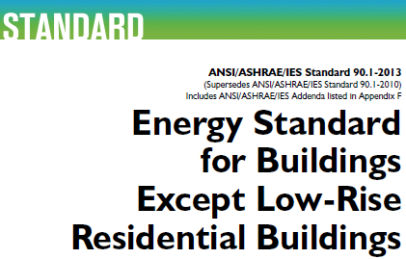
Myth Solved: Air Space R-value
ASHRAE 90.1-2016 Section A9.4.2 Air Spaces:
  “The air space shall be an enclosed and unventilated cavity designed to minimize airflow into and out of the enclosed air space.”
    This effectively requires a sealed air space which is consistent with the basis of the ideal air space R-values provided in ASHRAE 90.1 and ASHRAE HOF
  Limited practical exception provided:
    “Airflow shall be deemed minimized when the enclosed air space is located on the interior of the continuous air barrier and bounded on all sides by building components.”
  Air spaces behind claddings do not meet this criteria and have R-values less than those commonly used in the past.
ASHRAE Research Project is funded to provide guidance for determination of appropriate R-values for “non-ideal” air spaces.

Slide 21
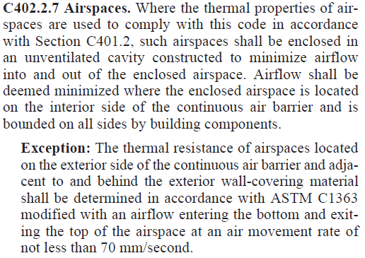

Myth Solved: Air Space R-value
2018 IECC takes a similar approach, but adds an exception to allow R-values to be tested for “non-ideal” air spaces (i.e., vented or unsealed or unenclosed).

Slide 22
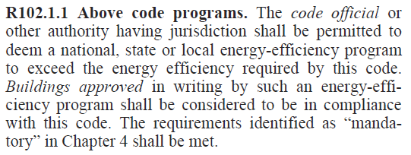
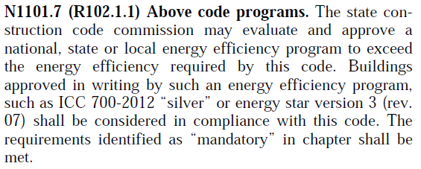
Myth: All“Above Code” programs are code compliant
Many states and jurisdictions allow above code programs as an alternate to code compliance
Based on 2015 IECC
State modified IECC
Based on 2015

Slide 23

Myth: All“Above Code” programs are code compliant
Definitely not all. It depends . . .
Important considerations for evaluating code compliant alternatives:
  What version of the model code is the local code based on?
  Is the base code amended? Stronger? Weaker?
  What version of the above code program is being used?
  Is there analysis/modeling available showing equivalence?

Slide 24

Let’s Compare: Energy Star
EASY: Analysis done for you
The proper version must be used
Version for home rule states with local adoptions are not so clear
Applicable Energy Star checklist must be used
https://www.energystar.gov/newhomes/homes_prog_reqs/national_page

Slide 25

Let’s Compare: Environments for Living
Performance based program
EFL Certified Green = 20% energy savings (baseline not specified)
EFL Gold = 12% above 2009 IECC
EFL Platinum = 18% above 2009 IECC
EFL Diamond = 30% above 2009 IECC
MUST ensure mandatory code requirements are met for code compliance
Check to see if plan review service for code compliance is included
http://ww.environmentsforliving.com/EFLPublicSite/index.jsp?action=bd_testing

Slide 26
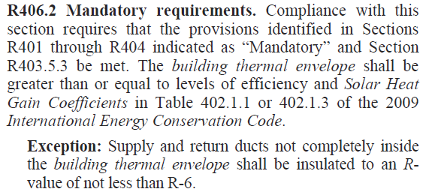
Let’s Compare: RESNET HERS/ERI
Performance based program
Benefit of having specific ERI path in the 2015 & 2018 IECC, Section R406
Compliance for earlier versions of the code more fuzzy
The code includes mandatory requirements beyond HERS/ERI
Must have a rating at or below that which is specified in the code

Slide 27
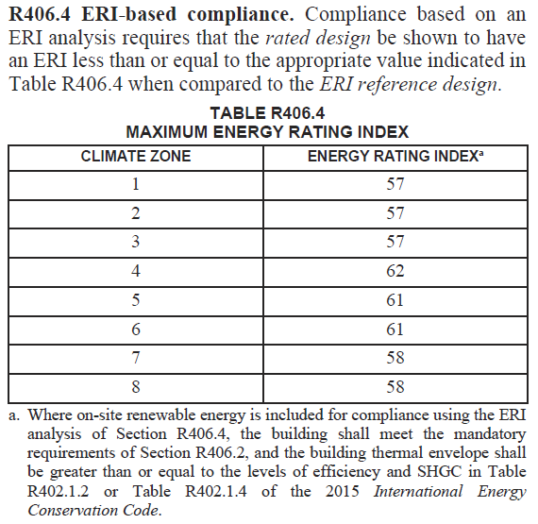
Let’s Compare: RESNET HERS/ERI
Solar can be included in the modeling for code compliance with mandatory 2015 IECC envelope (2018 IECC)
Approved software for modeling is required per RESNET/ICC 301
Some states have amended ERI targets

Slide 28
Myth: Moisture Control is NOT an Energy Code Issue
Myth: Are all of these wall insulation assembly options equivalent?
  R13 + 10ci (2x4, std. 16”oc framing w/ ff=25%) – R-value for CZ 6-8 in IECC
  R15 + 8.4ci (2x4)
  R19 + 5.6ci (2x6)
  R20 + 5ci (2x6) - R-value for CZ 6-8 in IECC
  R23 + 3.4ci (2x6)
  R29 cavity (2x6, adv. Framing w/ ff=18%)
  R29 cavity (2x8, std. 16”oc framing w/ ff=25%)
SIMPLE ANSWER: Yes and maybe. It depends.
  Yes. From a thermal performance standpoint, they are all approximately equivalent (U-factor ~ 0.045) {see earlier slides on parallel path math}
  Maybe. From a moisture control standpoint, they may not be equivalent depending on climate, interior vapor retarder selection, vapor permeance of exterior material layers, etc.
  Energy code compliance must be coordinated with somewhat incomplete building code requirements for vapor retarders and moisture control.
  Thus, moisture control is an energy code and a building code coordination issue.
  The location and type of insulation and climate affect decisions regarding the optimal moisture control approach for the assembly.

Slide 29
Myth: Moisture Control is NOT an Energy Code Issue
All high performance walls are faced with a challenge to coordinate energy code requirements with adequate moisture control
This can be achieved in different ways depending on the insulation methodology used and other factors.
For walls with all cavity insulation:
  Can use an adequate amount of low-perm (e.g., ccSPF) cavity insulation.
  Can use vapor permeable insulation (e.g., FG batts, ocSPF, cellulose, etc.) with proper selection of interior vapor retarder and vapor permeance of exterior material layers (which side should have higher or lower vapor permeance depends on climate)
  These walls rely on control of vapor flow into and out of the assembly to avoid high moisture accumulation and balance seasonal changes in vapor flow direction.
For walls with cavity + continuous insulation (or all continuous insulation)
  The key here is having the right ci R-value relative to the R-value of cavity insulation, climate, and interior vapor retarder
  These walls rely more heavily on controlling temperature of material surfaces inside the assembly to prevent condensation and moisture accumulation.

Slide 30
Myth: Moisture Control is NOT an Energy Code Issue
Code Coordination Problem:
  The energy code specifies insulation amounts only from a thermal perspective.
  IRC residential building code specifies minimum continuous insulation for moisture control only when optionally using a Class III (latex paint) interior vapor retarder.
  IRC is silent regarding the same when a Class I (poly) or II (kraft paper) vapor retarder is used.
  The National Building Code of Canada is the opposite: it specifies only what to do with continuous insulation amount when a Class I or II vapor retarder is used and does not recognize Class III vapor retarders.
SOLUTIONS:
  Must consider both the IRC and NBC and combine the best of both to allow the full spectrum of moisture control solutions to be coordinated with energy code insulation requirements.
  Alternatively, conduct a project specific hygrothermal analysis, but beware of data inputs and assumptions. It is a design tool and, like a hammer, it’s quality of work is dependent on what the user does.

Slide 31
Myth: Moisture Control is NOT an Energy Code Issue
Example:
  How to coordinate continuous insulation and cavity insulation for energy code compliance and moisture control (insulation ratio method):
MINIMUM INSULATION RATIO OR CONTINUOUS INSULATION R-VALUE
FOR LIGHT-FRAME WALLS WHERE EXTERIOR CONTINUOUS INSULATION (ci) IS USED ^{a,b,c,d}
Climate Zone (Fig. 7.3.1) | Maximum Heating Degree Days (65F basis) | Interior Vapor Retarder (VR) Class
 |  | Class I | Class II | Class III | No VR^{e}
1 | N/A | NP | NP^{f} | R-2ci minimum | R-2ci minimum
2 | N/A | NP | NP^{f} | R-2ci minimum | R-2ci minimum
3 | 3,600 | NP | R-2ci minimum | R-2ci minimum | 0.4
4 | 5,400 | NP | R-2ci minimum | 0.2 | 0.9
5 | 7,200 | 0.2 | 0.2 | 0.35 | 1.3
6 | 9,000 | 0.2 | 0.2 | 0.5 | 1.7
7 | 12,600 | 0.35 | 0.35 | 0.8 | 2.3
8^{g} | 16,200 | 0.5 | 0.5 | 1.1 | 2.8
Insulation Ratio = Re / Ri
Example: An R20+5ci wall has
an insulation ratio of 5/20 = 0.25

Slide 32

Myth: Moisture Control is NOT an Energy Code Issue
MINIMUM INSULATION RATIO OR CONTINUOUS INSULATION R-VALUE
FOR LIGHT-FRAME WALLS WHERE EXTERIOR CONTINUOUS INSULATION (ci) IS USED ^{a,b,c,d}
Prescriptive Method
  This “look-up” table is based on the insulation ratios (previous slide)
  No insulation ratio calculations required
These requirements can be compared with energy code compliant assemblies to select the optimal insulation strategy and moisture control approach.
These can also be used together with ERI analysis to evaluate appropriateness of wall insulation methods for moisture control.
Additional considerations are important for all walls…(see next slide)

Slide 33
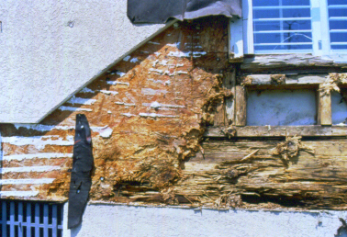
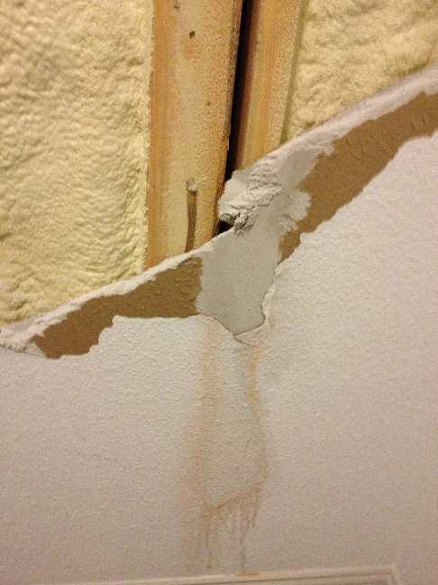
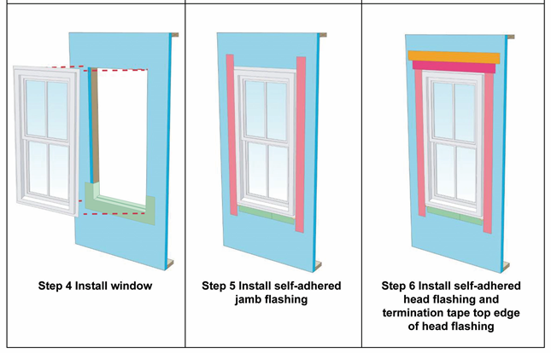
Myth: Moisture Control is NOT an Energy Code Issue
All wall types and insulation strategies must consider the following to ensure good and reliable moisture performance:
  Control of indoor relative humidity (HVAC design and operation)
  Control of rain-water leakage (WRB, flashing details, drainage, etc.)
  Air sealing to prevent moist air intrusion.
For more information and guidance:
  Wall Calculator Tool (https://www.appliedbuildingtech.com/fsc/calculator)
  Model Moisture Control Guidelines (https://www.appliedbuildingtech.com/rr/1701-01 )
  Moisture Control Methods Research Report (https://www.appliedbuildingtech.com/rr/1410-03)
  ASHRAE STP 1599 Paper (https://www.astm.org/DIGITAL_LIBRARY/STP/PAGES/STP159920160097.htm)
Visit https://www.continuousinsulation.org/ for these and many other resources.

Slide 34
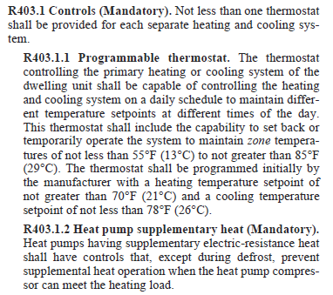
Myth: Compliance Options are Straightforward
Example 1
Section R403.1 Controls (Mandatory)
Section R403.1.1 Programmable thermostat ???
Section R403.1.2 Heat pump supplementary heat (Mandatory)
Where does that leave programmable thermostats?
Can we assume they are Mandatory?

Slide 35
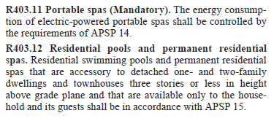
Myth: Compliance Options are Straightforward
Example 2
Section R403.9 Snow and ice melt systems (Mandatory)
Section R403.10 Pools and permanent spa energy consumption (Mandatory)
Section R403.11 Portable spas (Mandatory)
Section R403.12 Residential pools and spas ???
Where does that leave residential pools and spas?
Can we assume they are Mandatory?

Slide 36

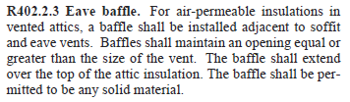
Myth: Compliance Options are Straightforward
Example 3
Per Section R402.2 Specific insulation requirements are (Prescriptive)
Section R402.2.3 Eave baffle, falls under this prescriptive grouping
If using the performance or ERI compliance option are baffles required (Mandatory)when air-permeable insulations is installed in that location?

Slide 37

Myth: Compliance Options are Straightforward
ICC’s SEHPCAC is working on fixing the issue identified by the first two examples
Others will have to try and address the third example
It will likely take YEARS and a lot of grey hair and wrinkles before it is straightened out!

Slide 38
Myth: An Envelope “Backstop” is Not Needed in the ERI Path
This myth is founded on several subtle ideas that can be tested:
  Trade-offs are “energy neutral”
  The same energy amount of energy is used in the end
  A “Btu is a Btu”
Why an envelope “backstop” is needed:
  Performance-based design for energy conservation is not just a “Btu for Btu” issue and is not actually energy neutral.
  It does matter to what degree the performance of one building assembly or component is traded-off for improvements in another.
    ANALOGY: Would you weaken the brakes on a car because air-bags have been improved? You could do this in such a way that it is “safety neutral”. But, does it make sense?
    Similarly, there are consequences if trade-offs occur in building energy conservation designs without reasonable constraints that maintain overall system reliability, performance, and cost-effectiveness.
  Just as a building structural system is only as strong and reliable as its weakest link, the long-term energy savings performance of building’s energy code compliance strategy are subject to the weakest link theory.

Slide 39
Myth: An Envelope “Backstop” is Not Needed in the ERI Path
Trading off envelope performance has the following implications:
  DURABILITY: The envelop provides the most durable and lasting form of energy efficiency. It works 24-7 for 365 days a year over the life of a building. It is the most permanent and reliable energy efficiency practice and requires the least maintenance and replacement. When done well, it also protects the durability of the structure and its contents.
  COST-EFFECTIVENESS: The most cost-effective time to maximize efficiency of the building is when it is constructed. It is very expensive to make improvements to the envelope after construction.
  AFFORDABILITY: There is no free lunch! This is a matter of pay now or pay later. The new energy efficient homes of today are the energy efficient affordable existing homes of tomorrow. Affordability is primarily a matter of land and development costs; for those on the margin of new housing ownership, it is primarily a matter of controlling land costs, house size, and cost of amenities. ERI should be modified to properly account for house size in the rating methodology such that smaller homes are rewarded and larger homes that use more energy are held to a higher standard to offset greater energy use in a balanced approach.
  COMFORT: Well insulated and air-sealed envelopes with mitigated thermal bridges provide a more comfortable and easier to control indoor environment. Occupants tend to offset uncomfortable conditions by increasing or lowering set point temperature, resulting in more energy use and also potentially increased risk of moisture problems.

Slide 40
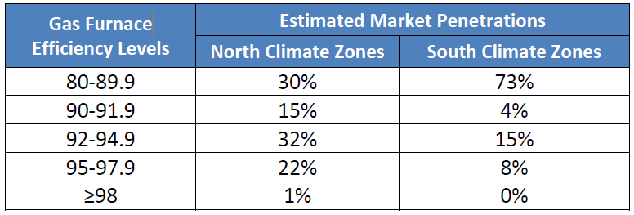
Myth: An Envelope “Backstop” is Not Needed in the ERI Path
  EQUIPMENT TRADE-OFF: When this method is used, it is a “fake” trade. It is not based on typical equipment efficiencies but rather outdated federally mandated minimums. Thus, for nothing more than common equipment, the home envelope is weakened in a subsidized trading scheme. Plus, the equipment must be sized larger (and all future replacement equipment). The consumer get’s the short end of the stick on using envelope weakening to subsidize equipment sales as a kick-back behind the scenes.
  SOLAR TRADE-OFF: This is like the HVAC equipment subsidy described above. Except, the inclusion of on-site solar power generation is used to weaken the envelope such that there is no net decrease in use of power from the grid which is sourced primarily from non-renewable fuels. So the net energy used is increased by decreasing insulation of the envelope and adding solar. This is a classic “shell game”. [IECC 2018 has implemented a backstop for renewables]
In northern climates, 70% of gas furnaces sold have an efficiency of 90% or greater. Why then is 80% efficiency used as the baseline for trade-offs to weaken the envelope?

Slide 41
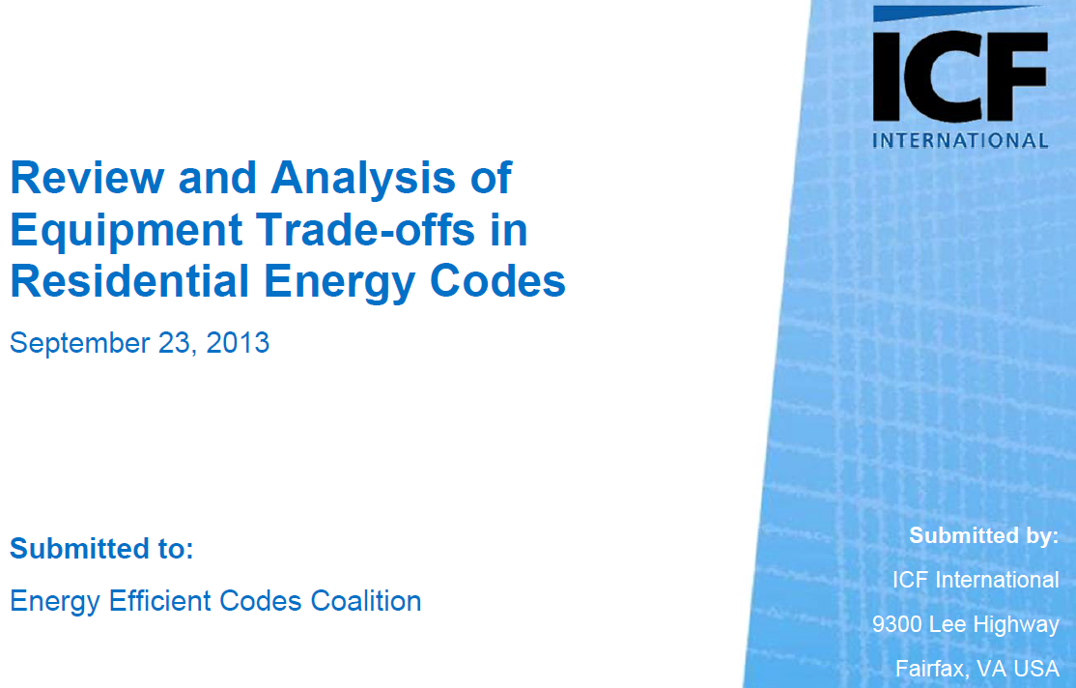
Myth: An Envelope “Backstop” is Not Needed in the ERI Path
So, what is the evidence to support need for a backstop?
  Refer to ICF study (http://energyefficientcodes.com/wp-content/uploads/2013/08/2013-9-23-FIN-Review-Analysis-of-Equipment-Trade-offs-in-Residential-IECC.FIN_.pdf )
Trade-off using common 90% AFUE gas equipment has a $400,000,000 net present value of increased energy bills for each year’s housing starts using the trade-off scheme with gas furnaces.
The trade-off is not “energy neutral” and is likely worse since this study made conservative assumptions.

Slide 42
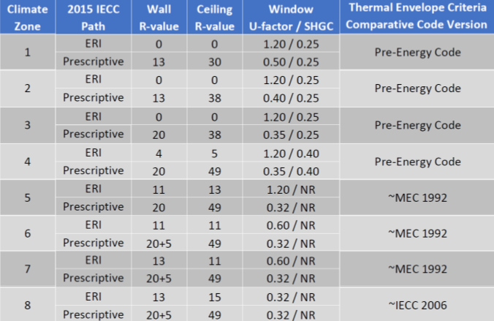
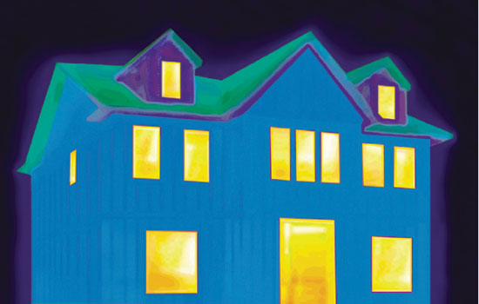
Myth: An Envelope “Backstop” is Not Needed in the ERI Path
Example reduction in envelope requirements where 5kW PV system used in ERI path to trade-off:
VS.

Slide 43
Myth: An Envelope “Backstop” is Not Needed in the ERI Path
Some possible solutions:
  Create a separate backstop table to limit trade-off of envelope components (minimum R-values for insulation, maximum U-factors & SHGC for windows, etc.)
  Allow a maximum percentage reduction in performance of envelope when trading off by improving other assemblies or systems.
  Limit envelop trades to not be less than prior code values (like 2009 or later editions of IECC)
Better yet, remove the subsidy schemes:
  Don’t allow equipment trades (as the IECC doesn’t allow) or fix federal mandates to allow equipment efficiency for trade-offs to be set at median/typical equipment efficiency values in the market.
  Don’t allow or limit solar PV or on-site renewable trade offs. These systems should be evaluated on the basis of their own economic and energy producing merits, including installation, maintenance and replacement costs.

Slide 44
Have we missed any of your haunting myths?
Questions?

Slide 45
Jay Crandell, ARES Consulting
Jcrandell@aresconsulting.biz
Amy Schmidt, Dow Building Solutions
ASchmidt4@dow.com

