Slide 1
Continuous Insulation:
Research, Applications, and Resources for
Walls, Roofs, and Foundations
Jay H. Crandell, P.E.
ABTG / ARES Consulting

Slide 3
OUTLINE
Introduction
Background
CI Applications and Functions
Coordination with Other Building Code Requirements
Conclusion & Questions

Slide 4
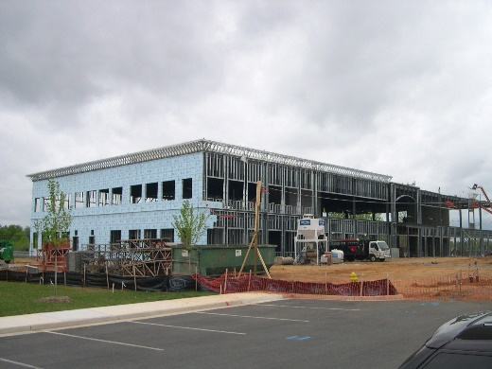
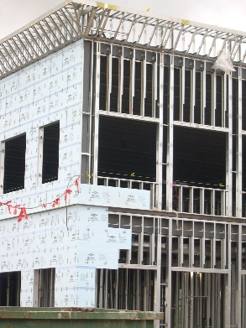
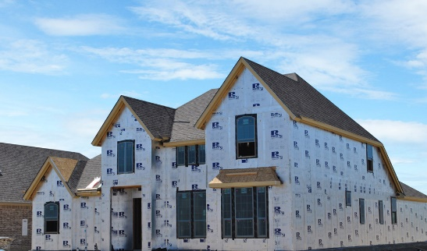
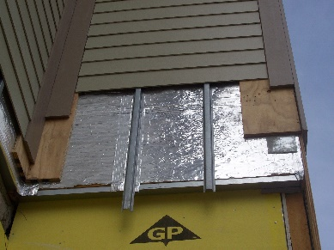
INTRODUCTION
Continuous insulation (ci) has many building applications:
  Walls
  Roofs
  Foundations
  Floors

Slide 5
INTRODUCTION
Definition (IECC, ASHRAE 90.1):
  Continuous insulation (c.i.): insulation that is uncompressed and continuous across all structural members without thermal bridges other than fasteners and service openings. It is installed on the interior or exterior or is integral to any opaque surface of the building envelope.

Slide 6
INTRODUCTION
Relevant Codes and Standards include:
  ASTM C578 (polystyrene EPS or XPS foam board) ~ R4 to R5/in
  ASTM C1289 (polyisocyanurate foam board) ~ R6/in
  IECC/IRC Chapter 11 – Model energy conservation code
  ASHRAE 90.1 – Model energy conservation standard (commercial)
  IBC – Model commercial building code
  IRC – Model residential building code

Slide 7
INTRODUCTION
Additional Resources: www.continuousinsulation.org
  Design guides
  On-line calculator tools (U-factor/R-value + moisture control)
  Construction details
  Installation guidance
  Code compliance resources & evaluation reports
  Research reports

Slide 8
BACKGROUND
CI is not a new concept:
  Wood board sheathing was recognized for ~R-1 insulating value in the early 1900s
  Wood fiberboard (~R2.6/in) was invented in the late 1800s (based on paper-making technology) and used for insulating sheathing by early 1900s

Slide 9
BACKGROUND
CI technology in recent decades:
  1940s-1950s, “appearance of plastic foam created a huge revolution”
  1970’s oil crisis helped draw attention to foam plastic insulating sheathing used as continuous insulation
  Modern energy codes include continuous insulation on the basis of energy savings and economic cost-benefits
    Environment (e.g., GWP reduction), durability, and comfort also are an important drivers for improved building envelopes

Slide 10
BACKGROUND
Three envelop insulation approaches:
  Cavity Insulation Only (traditional)
  Cavity + Continuous Insulation (hybrid)
  Continuous Insulation Only (high performance)
We will focus primarily on the latter two approaches for building walls, roofs, foundations, and floors
We will also focus primarily on use of Foam Plastic Insulating Sheathing (FPIS)

Slide 11
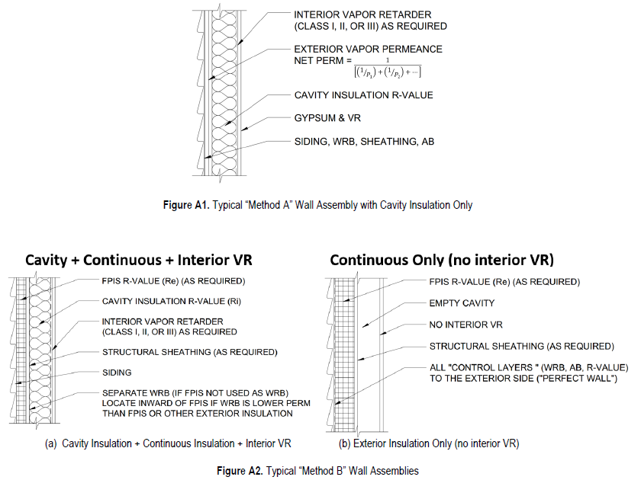
BACKGROUND

Slide 12
CI APPLICATIONS & FUNCTIONS
Thermal Control
Water Vapor Control
Water-Resistive Barrier (WRB)
Air Barrier (AB)
Foundation Moisture & Frost Protection
Roof Above Deck Insulation

Slide 13
1. Thermal Control
Wearing your sweater is better than eating it !!
  same applies to buildings
The primary thermal benefit of CI is that it is placed continuously on the exterior of the building
  Mitigates thermal bridges within and at interfaces of building envelope assemblies (see Table 1 next slide)
  Provides effective means of compliance with energy codes and standards

Slide 14
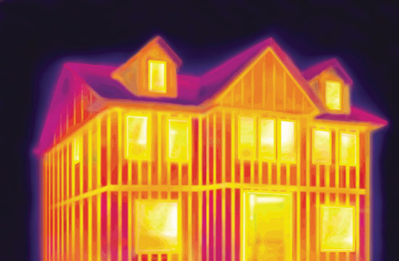

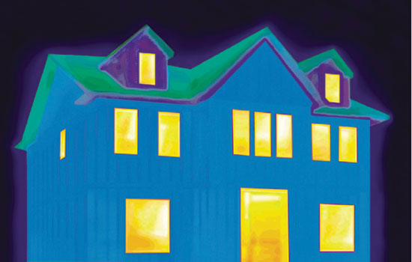

1. Thermal Control
How the “sweater” works
R-13 cavity insulation
CONCLUSION:
Uh Oh, baby ate sweater…
      Source: FreeImages.com/Hector Landaeta
½” rigid foam CI added
CONCLUSION:
Warm baby, happy baby…
Source: Dryvit/DOW
http://continuingeducation.construction.com/article.php?L=38&C=1147&P=3
Source: http://www.flickr.com/photos/vatobob
(Wikimedia commons – well-clothed baby)

Slide 15
1. Thermal Control
TABLE 1 (abbreviated*)
Wall Construction & Insulation Strategy: | 2x6@16”oc Wood Frame Wall |  | Cold-Formed Steel Stud Wall
 | “R25” (cavity only) | “R20+5” (cavity + ci) | “R19” (cavity only) | “R13+6” (cavity + ci)
Total Nominal R-value of Insulation: | R25 | R25 | R19 | R19
U-factor | 0.0573 | 0.0464 | 0.0905 | 0.0639
Effective R-value | 17.5 | 21.6 | 11.1 | 15.7
*See Table 1 in paper for detailed calculations

Slide 16
1. Thermal Control
Observations from Table 1:
  Wood Frame: R20+5ci wall has 20% better U-factor / Effective R than R25 cavity insulation only wall
  Steel Frame: R13+6ci wall has 40% better U-factor / Effective R than R19 cavity insulation only wall
  These comparisons each have the same total nominal R-value of insulation components, but very different performance.

Slide 17

1. Thermal Control
“R20+5” and “R13+6” symbolizes an insulation strategy (hybrid) with cavity and continuous insulation components
  It is not a math equation: “R20+5” ≠ “R25” and “R13+6” ≠ “R19”
  Similarly, a “4x4” truck is not a “16” truck.

Slide 18
1. Thermal Control
Insulation location matters because continuous insulation mitigates framing thermal bridges; cavity insulation does not.
Adding cavity and continuous insulation R-values is like adding apples and oranges and is prohibited by the energy code as a means of compliance.
  You can add cavity insulation R-values where multiple materials are in the cavity (apples + apples).
  You can add continuous insulation R-values where multiple layers are used (oranges + oranges).

Slide 19
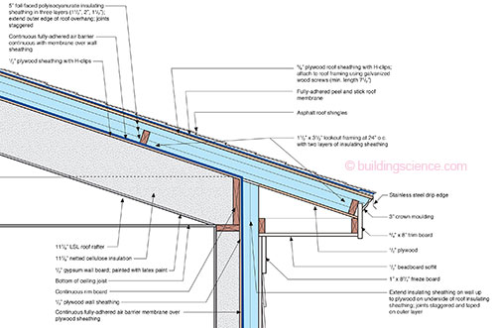
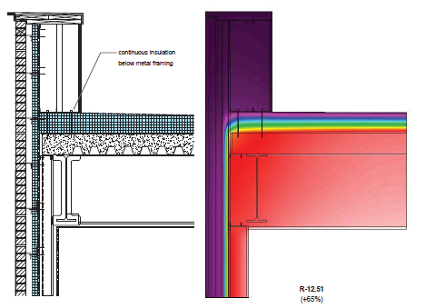
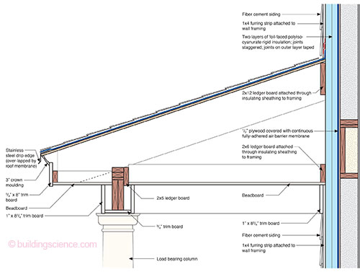
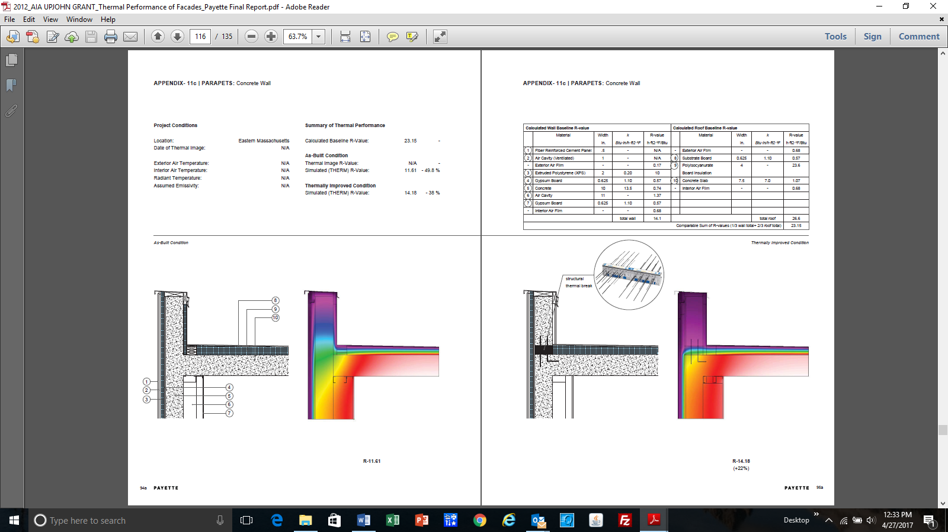
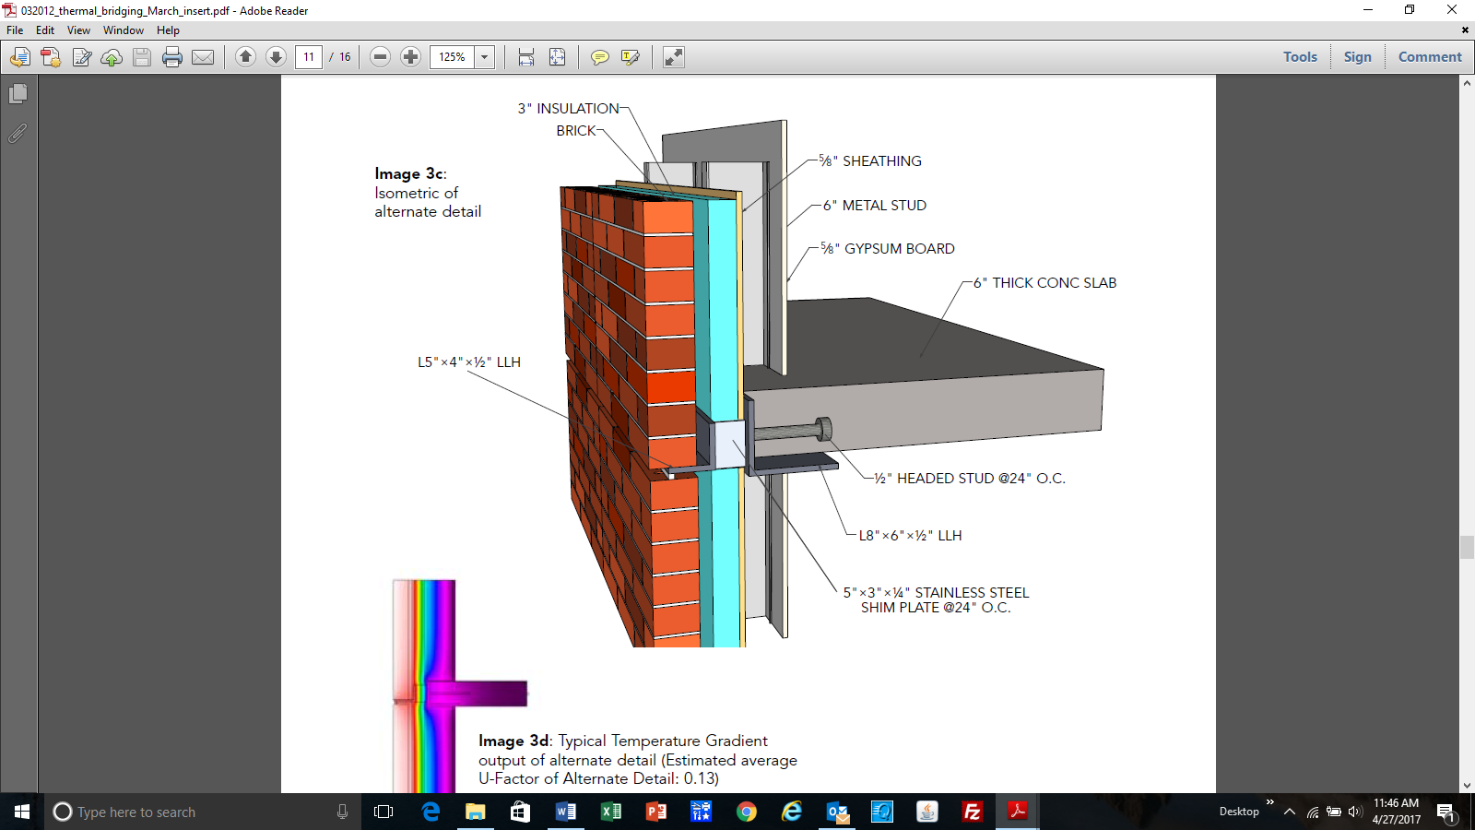
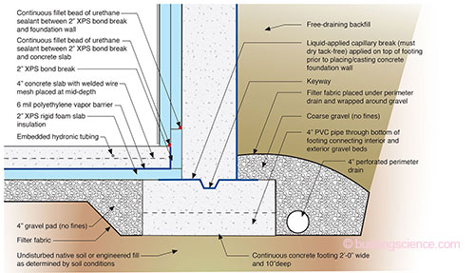
1. Thermal Control – Using CI to mitigate thermal bridges:
INSULATED WINDOW ROUGH OPENING DETAIL
(USACE report)
INSULATED PARAPET DETAILS
(Payette/AIA report)
Example Details from BSI-081: Zeroing In (J. Lstiburek, Building Science Corp) as used on NIST NZERTF Project
OFFSET SHELF ANGLE
(AISC/SEI article)

Slide 20
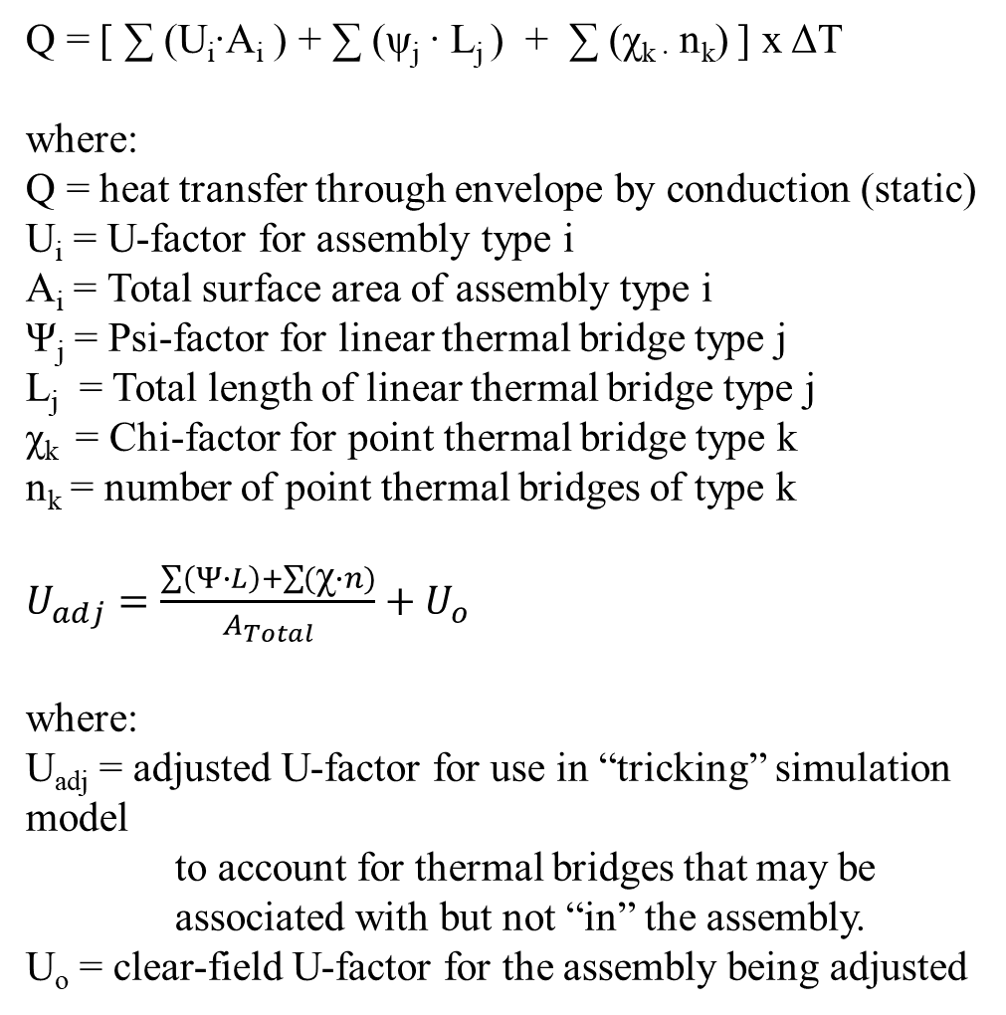
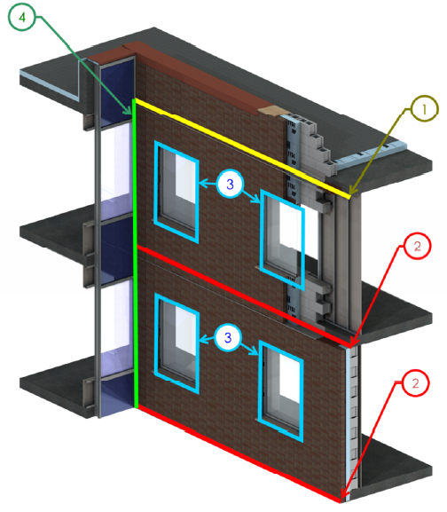
1. Thermal Control
– Using CI to mitigate thermal bridges:
Source: BC Hydro BETB Guide / Morrison Hershfield LTD

Slide 21
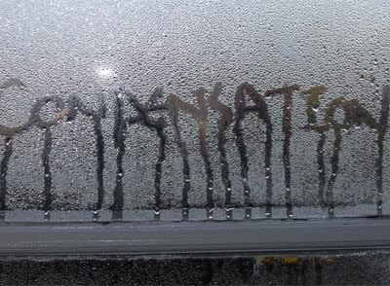
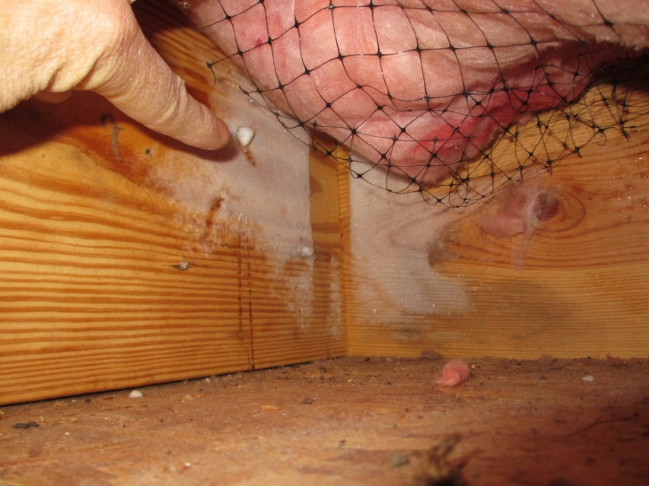
2. Water Vapor Control
Where properly used, CI helps to lower risk of:
  Condensation
  Moisture accumulation and cycling in building materials
  Material damage (rot, corrosion, etc.)
  Expansion and contraction of materials
  Mold

Slide 22
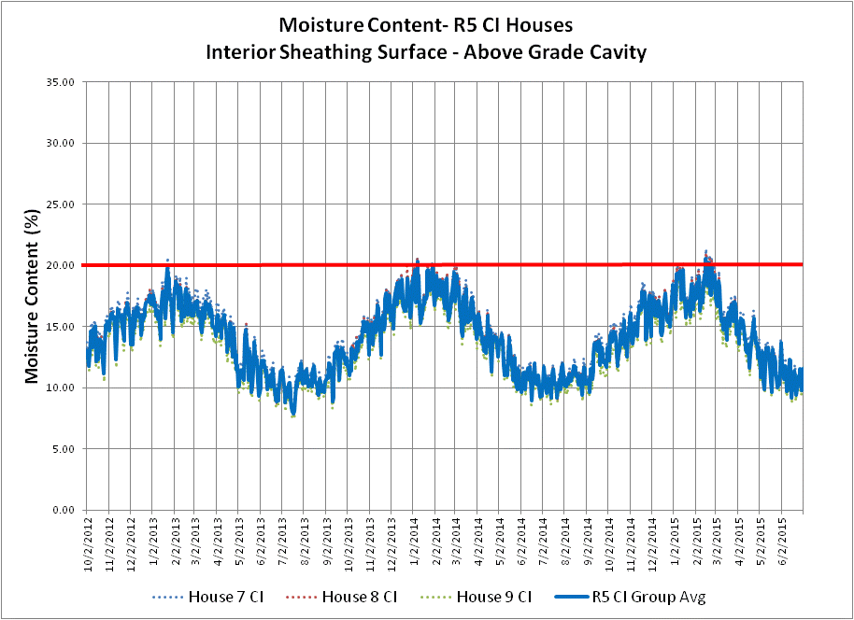
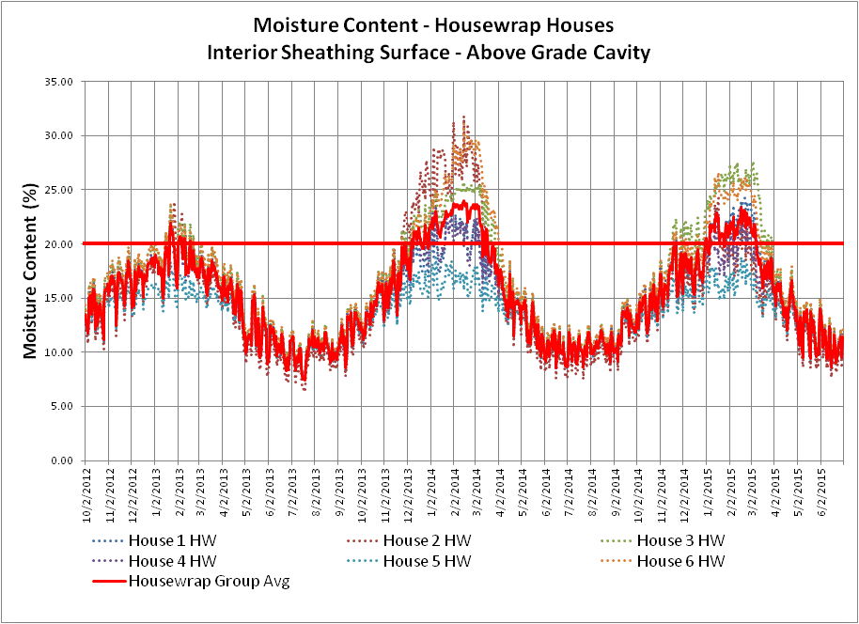
2. Water Vapor Control
Water vapor control involves two simple concepts:
  Minimize the risk of the assembly getting wet due to water vapor diffusion (condensation or adsorption)
  Optimize the ability of the assembly to dry in relation to its risk of getting wet
Two “Code-Compliant” Walls:
Left – moisture cycling below 20% MC
Right – moisture cycling above 20% MC

Slide 23
2. Water Vapor Control
Two design approaches:
  Vapor Permeance Controlled Design (Traditional)
    Relies on interior vapor retarders; ignores vapor permeance of exterior layers and amount of insulation which makes materials cold
    Prone to condensation or high humidity inside the assembly leading to moisture accumulation & seasonal cycling
  Temperature Controlled Design (Contemporary)
    Relies on a combination of continuous insulation and vapor retarders to control temperature of protected materials within the assembly
    Reduces risk of condensation and high internal humidity levels
    Stable & dry conditions for the structure year-round.

Slide 24
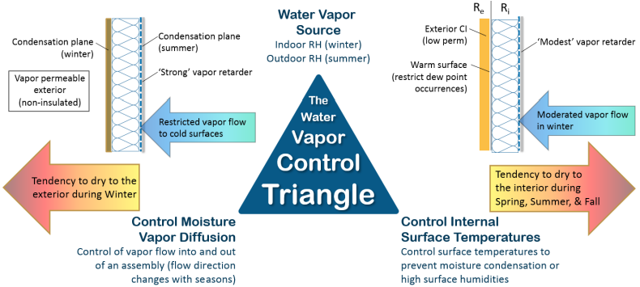
2. Water Vapor Control

Slide 25
2. Water Vapor Control
How do you design for water vapor control with CI?
  You use a temperature controlled design approach
Simple:
  Determine Climate Zone (Figure 2)
  Select appropriate interior vapor retarder and insulation ratio (Table 2)

Slide 26
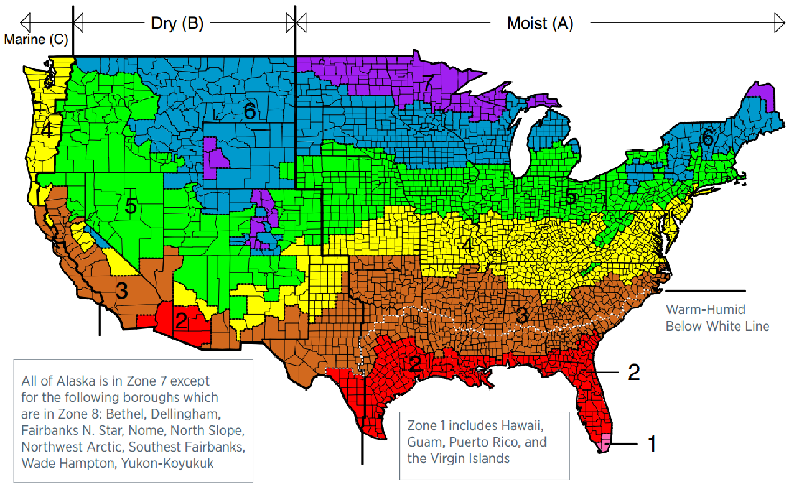
2. Water Vapor Control
Figure 2. U.S. Climate Zone Map

Slide 27
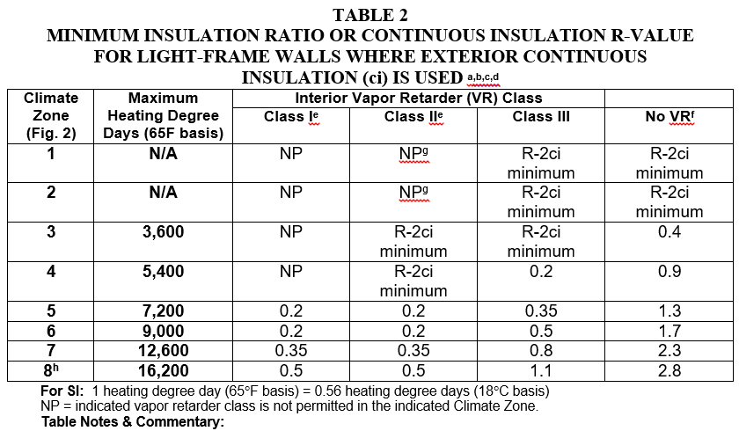
2. Water Vapor Control
See Table 2 in report for important table notes & commentary!

Slide 28
2. Water Vapor Control
Example Design:
  “R20+5ci” 2x6 wall
  Insulation Ratio (IR) = Re/Ri = 5/20 = 0.25
    With Class III VR, Table 2 shows it works in CZ 1-4+
    With Class I or II VR, Table 2 shows it works in CZ 1-6+
  For colder climates, just use required insulation ratio for specified vapor retarder.

Slide 29
2. Water Vapor Control
Example (cont’d)
  Table 2, Note ‘e’: Where Class I or II VR is used with low-perm FPIS, the VR must have a “wet cup” (ASTM E96 Procedure B) vapor permeance of 1 perm or greater.
    Why? To promote drying to the interior of incidental or unintended water intrusion! – safety factor.
    This means a “smart” (responsive) vapor retarder, like Kraft paper or other proprietary alternatives.
  Data from numerous field studies shows walls with appropriate use of FPIS are consistently dry and stable (ASTM STP 1599).

Slide 30
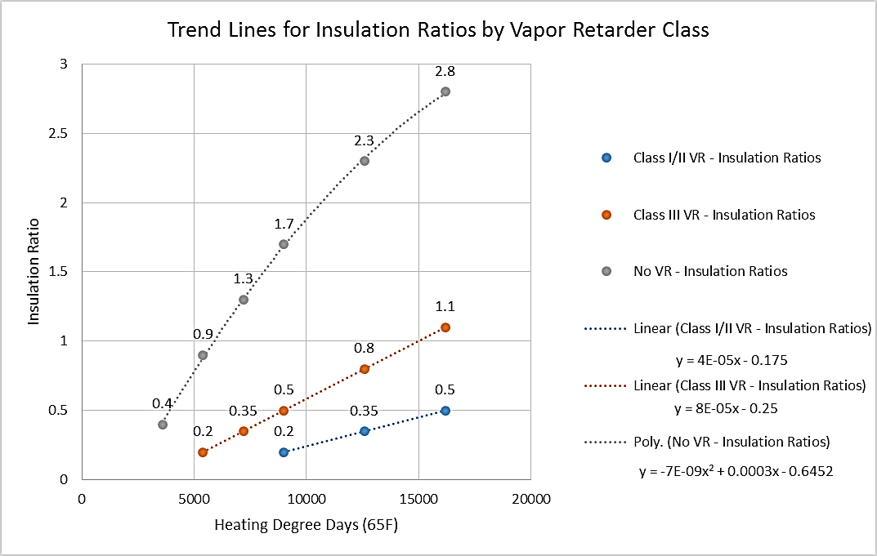
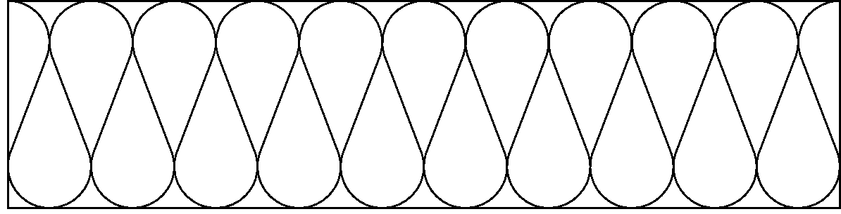
2. Water Vapor Control
Another way to show insulation ratios:
R_{e}
R_{i}
Exterior CI
(low perm)
Interior Cavity Insulation
Vapor Retarder
(Class I, II, or III depending on Re/Ri and climate)

Slide 31
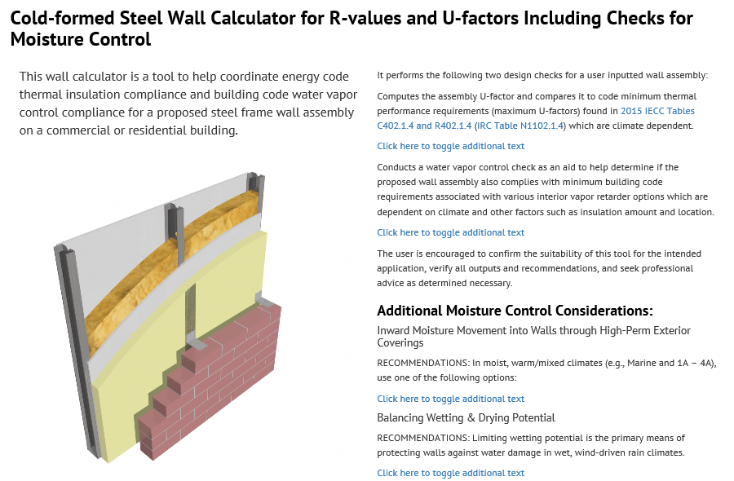
2. Water Vapor Control
Wall Calculator for Energy Code (U-factor) and Building Code Vapor Control Compliance Check: www.continuousinsulation.org

Slide 32
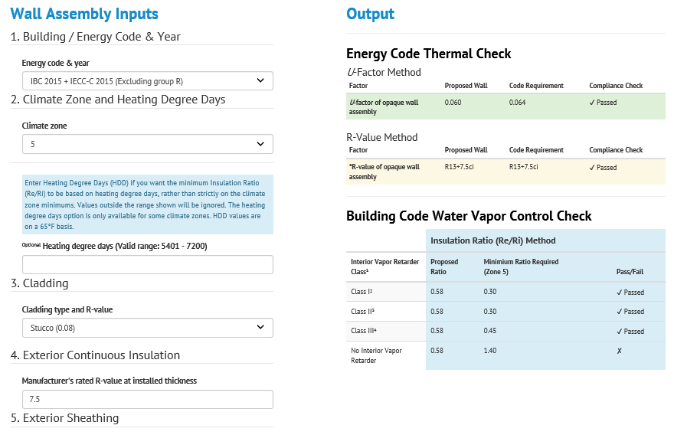
2. Water Vapor Control

Slide 33
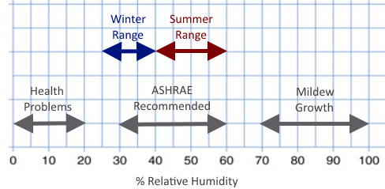
2. Water Vapor Control
Caveats (for all design approaches and assemblies):
  Assumes “normal” indoor RH conditions
    Where high indoor RH (e.g., pools, saunas, etc.) additional consideration required (e.g., increased IR, lower permeance VR, better building ventilation and dehumidification, or combination )

Slide 34
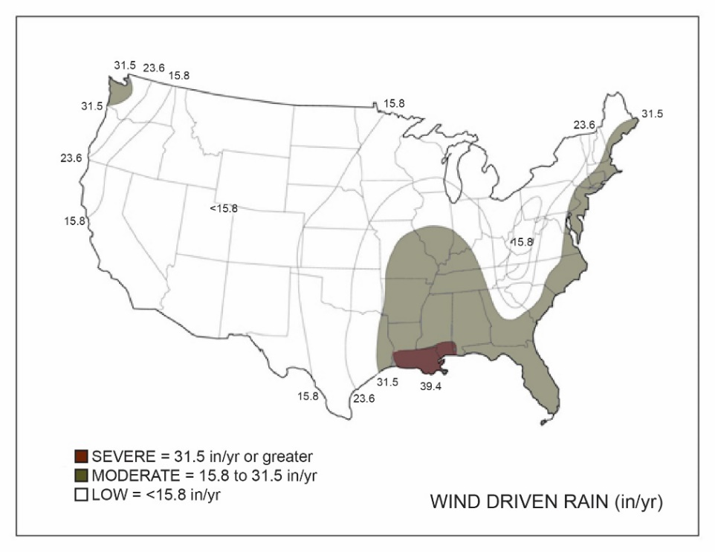
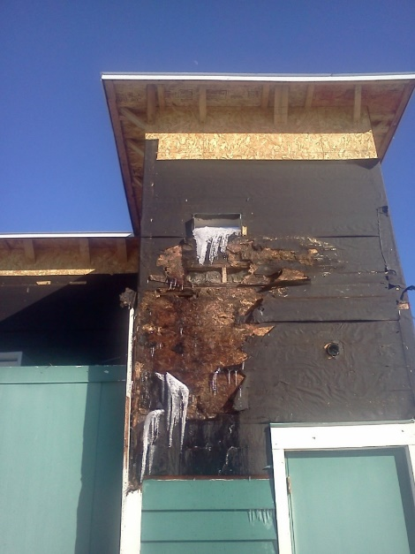
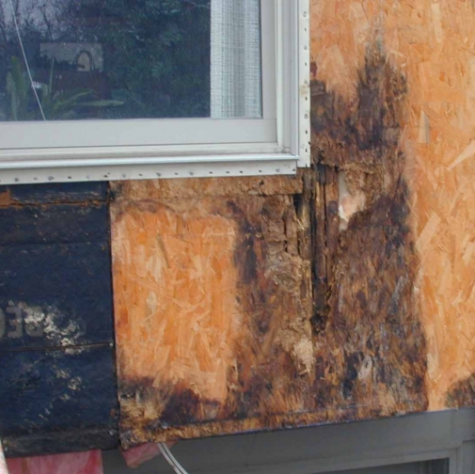
2. Water Vapor Control
Caveats (for all design approaches and assemblies):
  Adequate (code-compliant or better) air leakage control to avoid “flanking” of VR
    Walls with adequate CI tend to reduce moisture control threat of air leakage
  Adequate (code-compliant or better) rain water control
    Appropriate use and installation of WRB and flashings
    Poor control of rain water will cause any wall assembly to fail.

Slide 35
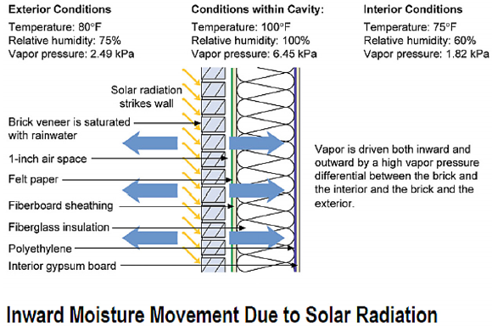
2. Water Vapor Control
Inward Vapor Drive & Reservoir Claddings
  Modern experience and codes now are beginning to recognize that reservoir claddings (like stucco or adhered veneers) absorb rainwater (wow!).
  After rain, then the sun drives that water inward in the form of water vapor (stucco dries inward and outward).

Slide 36
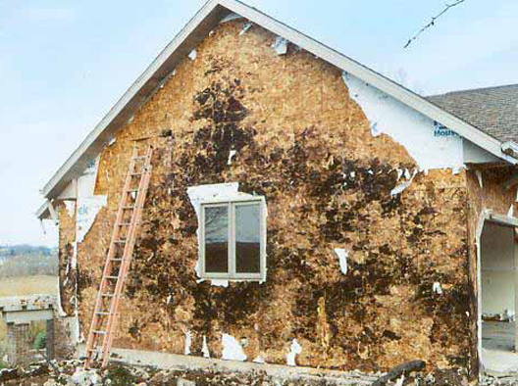
2. Water Vapor Control
Inward vapor drives can exceed the worst outward vapor drives during winter
This is why anchored veneers (like brick) have used a vented airspace for ages
Particularly problematic in Moist (A) and Marine (C) Climate Regions and especially the “warm-humid” region (Figure 2).
http://www.greenbuildingadvisor.com/blogs/dept/musings/all-about-wall-rot

Slide 37
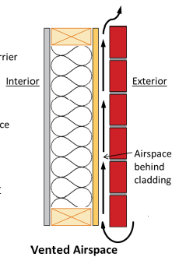
2. Water Vapor Control
Solutions for inward water vapor drives in moist climates:
  Back ventilation of reservoir cladding
  Use of low-perm (<~5 perm) FPIS continuous insulation to block inward vapor drive
    Means of drainage still required as always important

Slide 38
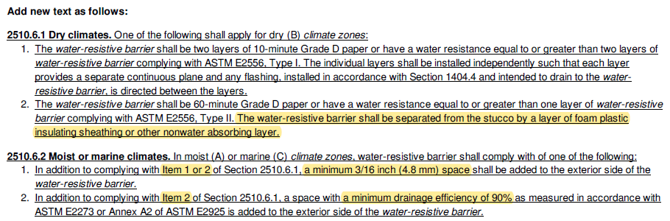
2. Water Vapor Control
New code proposal related to ci application with stucco
to mitigate inward vapor drive:

Slide 39
2. Water Vapor Control
Additional Resources:
  ABTG Research Report No. 1701-01 (2017), Model Moisture Control Guidelines for Light-Frame Walls: A Building Code Supplement for Builders, Designers, and Building Officials
  ASTM STP 1599 (2017), Assessment of Hygrothermal Performance and Design Guidance for Modern Light-Frame Wall Assemblies
  ABTG Research Report No. 1401-03 (2015), Assessment of Water Vapor Control Methods for Modern Insulated Light-frame Wall Assemblies
  Durability by Design, 2nd Edition: A Professional’s Guide to Durable Home Design (2015), U.S. HUD
Most are available for free download at www.continuousinsulation.org

Slide 40
3. Water-Resistive Barrier (WRB)
When properly qualified, FPIS continuous insulation can also be used as the WRB system (see next slide)
Test requirements are some of the most stringent in the industry (e.g., ASTM E331 wall spray test with 6.24psf pressure difference)
Joint sealing components also individually tested for weatherization/durability and water-resistance
Use FPIS manufacturer’s approved materials and installation instructions; don’t substitute

Slide 41
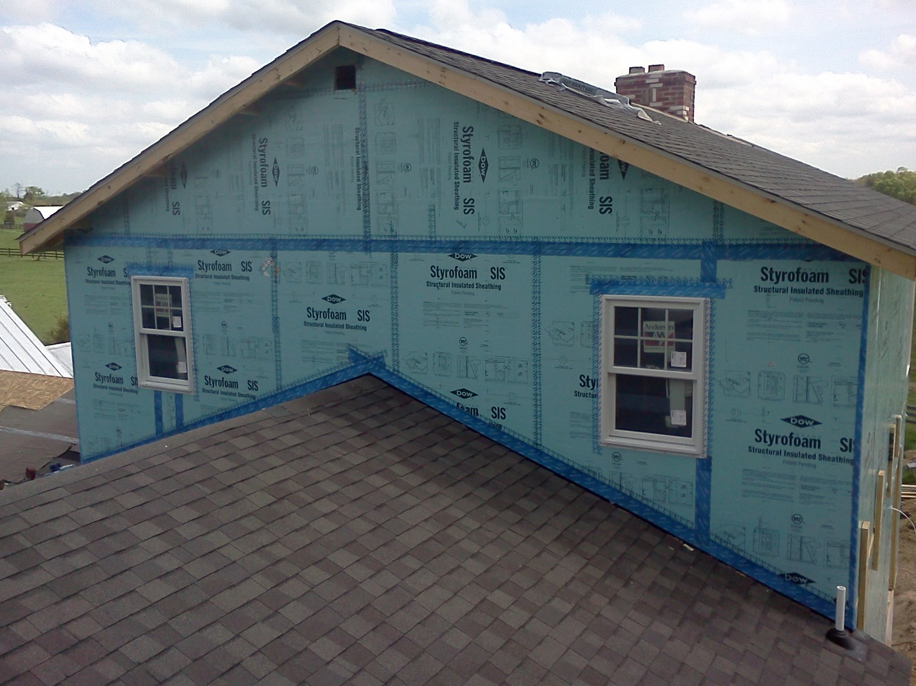
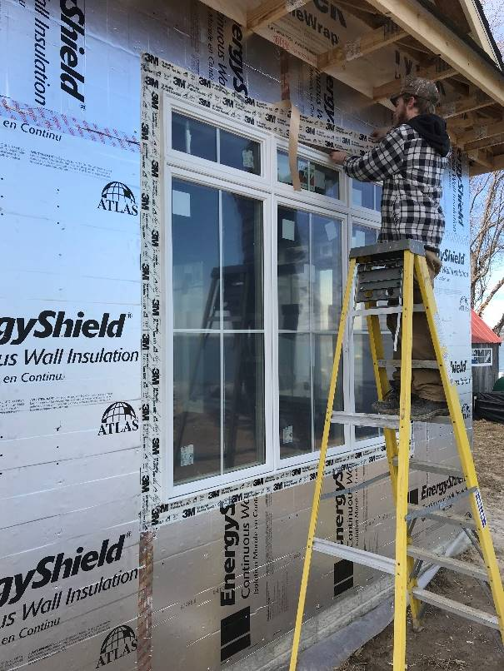
3. Water-Resistive Barrier (WRB)

Slide 42
4. Air Barrier (AB)
FPIS continuous insulation can also be used as an air barrier
Deemed to comply in IECC and ASHRAE 90.1 (i.e., XPS and Polyiso, min ½” thick)
Alternatively, can comply with material air permeability limits per ASTM testing.
If using FPIS WRB system per building code, then taped/sealed joints also serve as means to create a continuous air barrier system as required by the energy code.

Slide 43
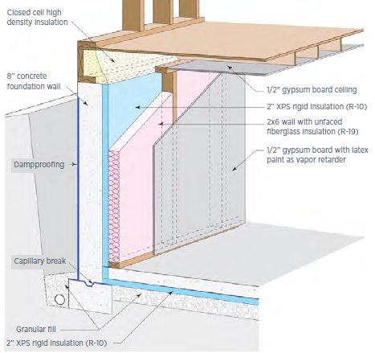
5. Foundations
FPIS continuous insulation is considered a “hall of fame” insulation method for basement walls by DOE Building America Program
  Improved energy efficiency and moisture resistance

Slide 44
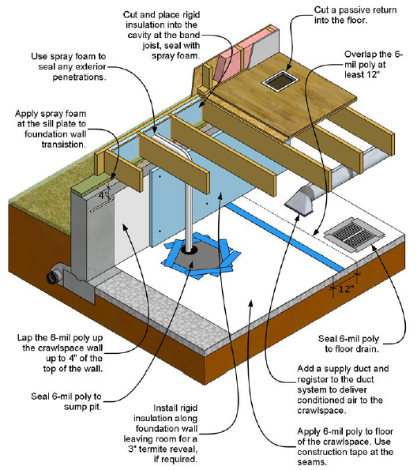
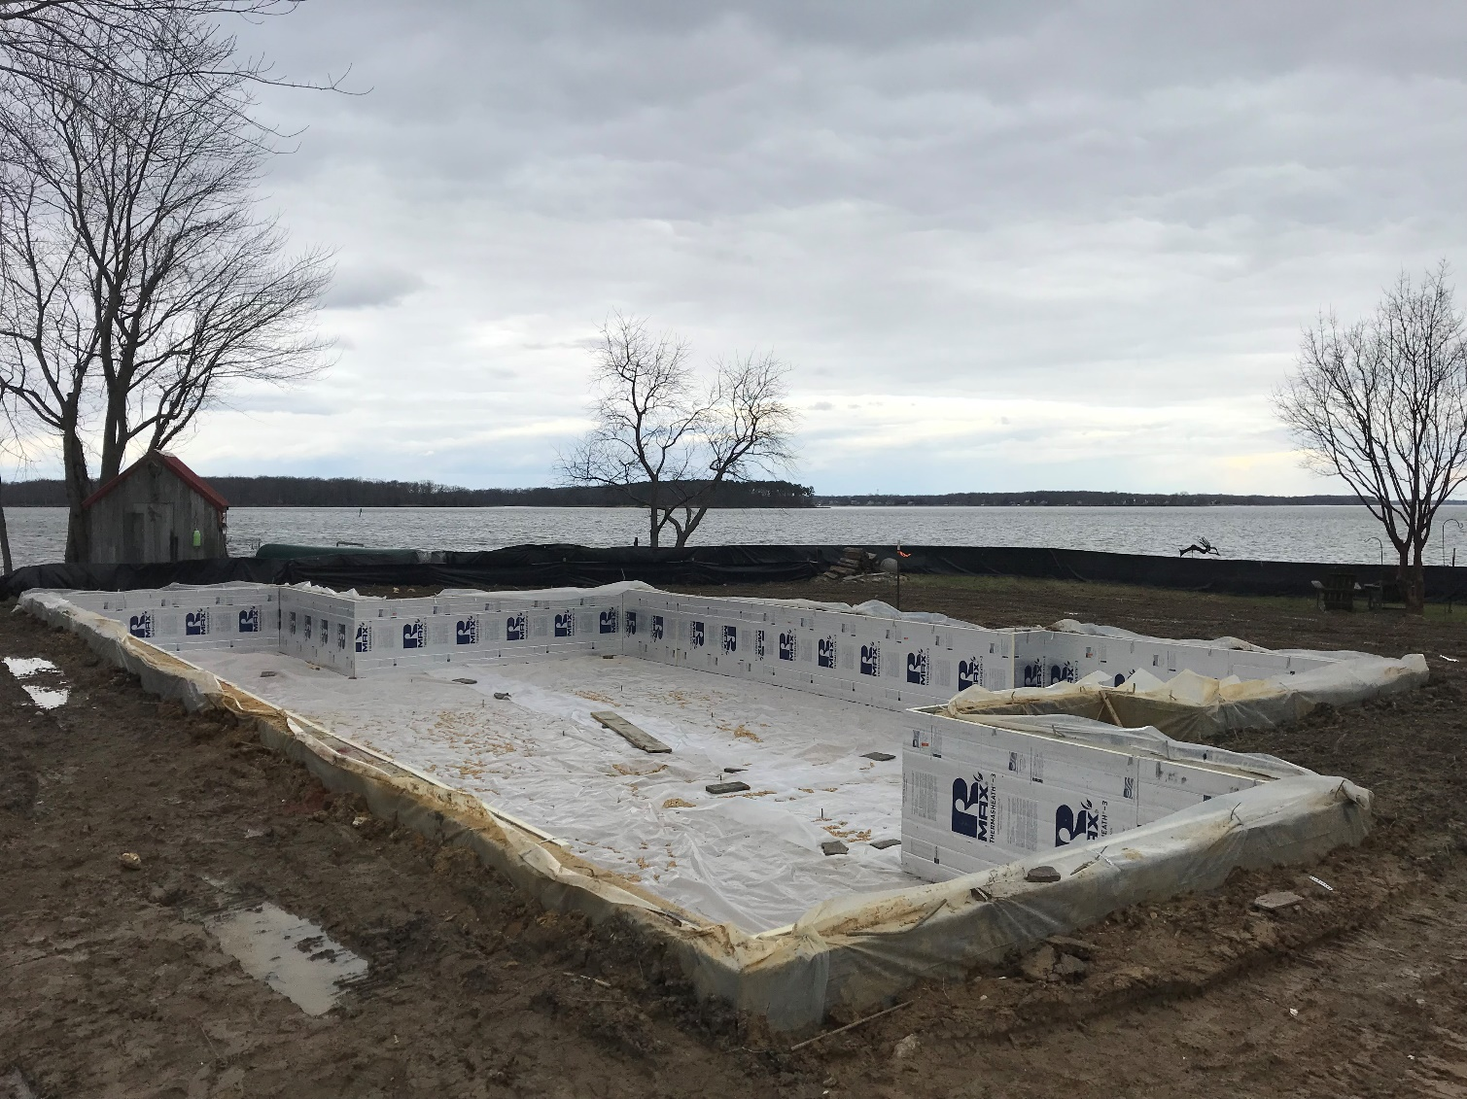
5. Foundations
Also, works great for unvented (conditioned) crawlspaces
  Allows ductwork in conditioned space; warm floor; no moist air foundation vents; storage
  Place insulation only at crawlspace perimeter, not between every joist

Slide 45
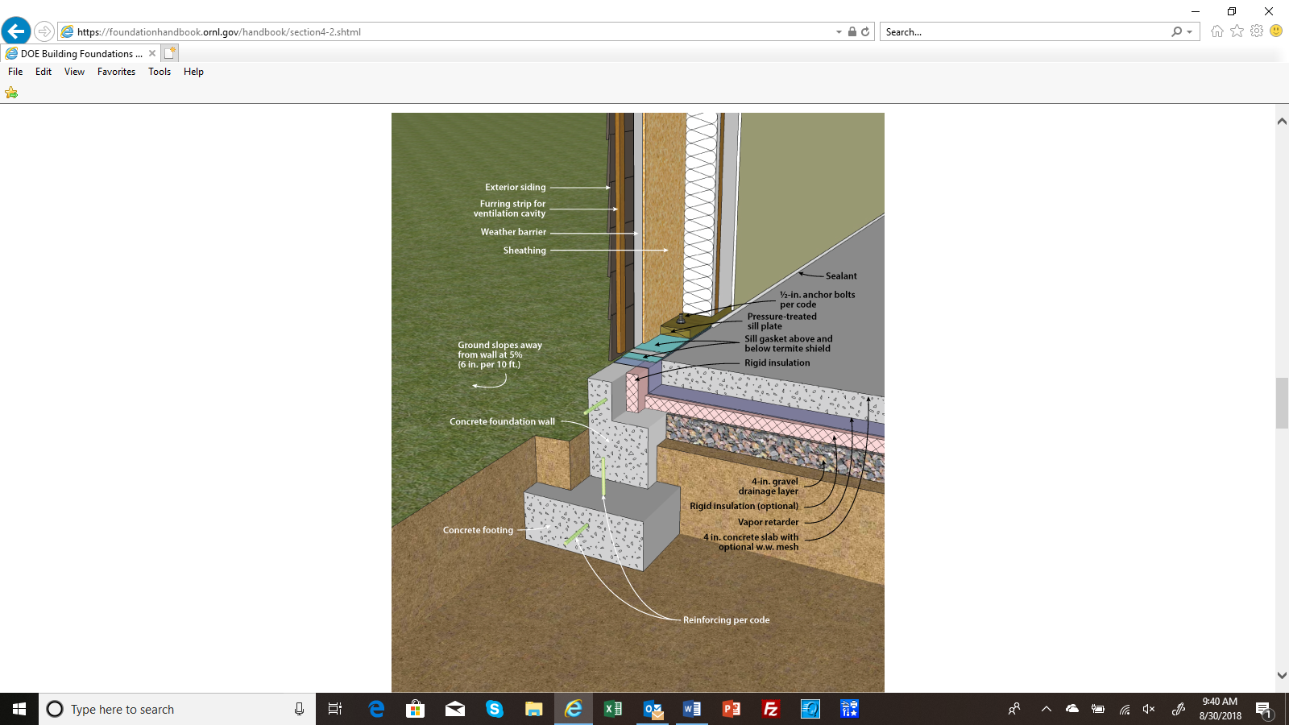
5. Foundations
Heated and Unheated Slabs
  Improved energy savings, comfort, condensation control

Slide 46
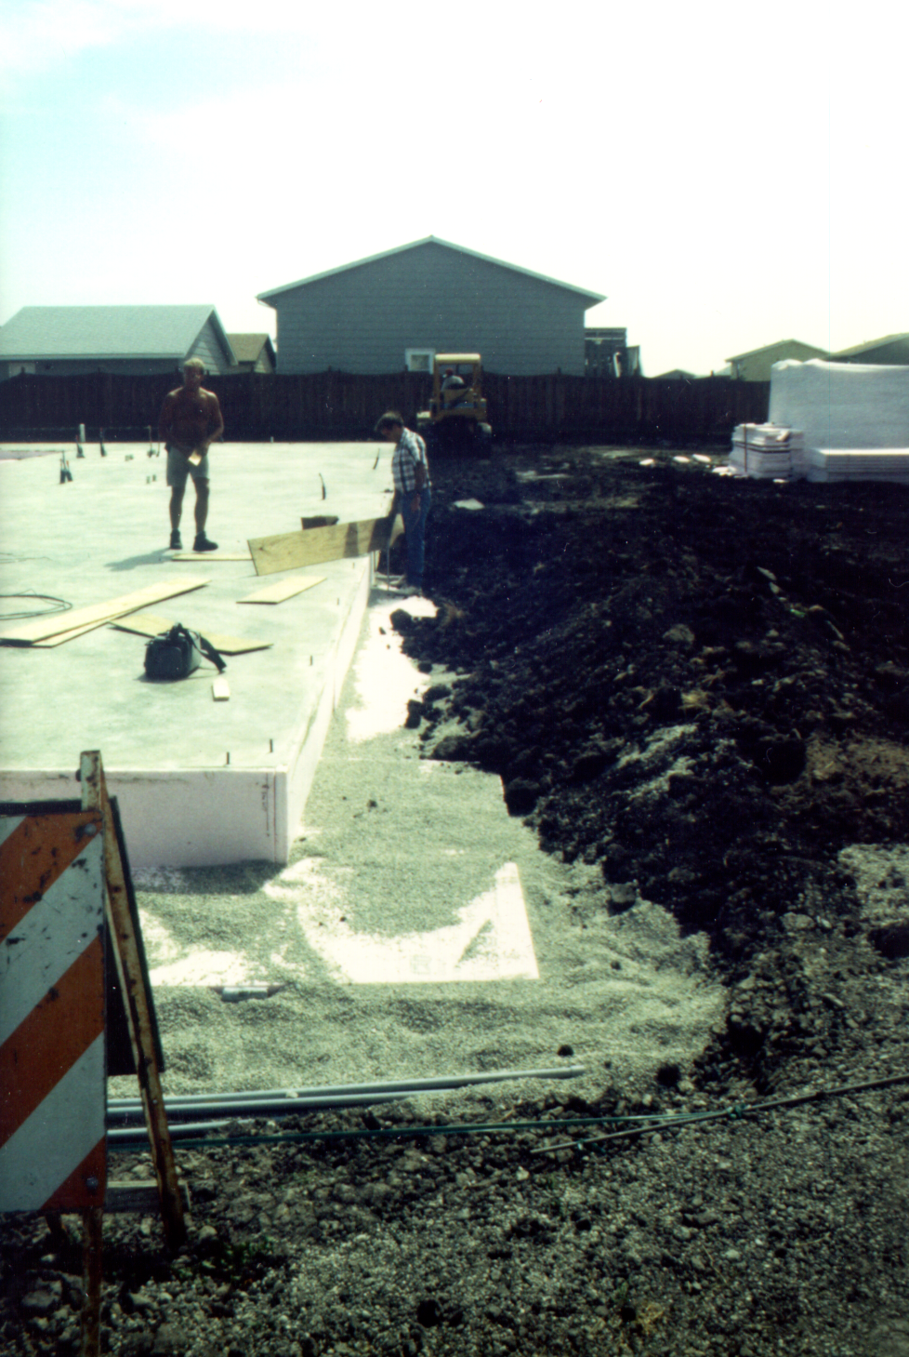
5. Foundations
Frost-Protected Shallow Foundations
  Energy Savings and Construction Cost Savings ($$$)
  ASCE 32 standard, IRC, and IBC

Slide 47
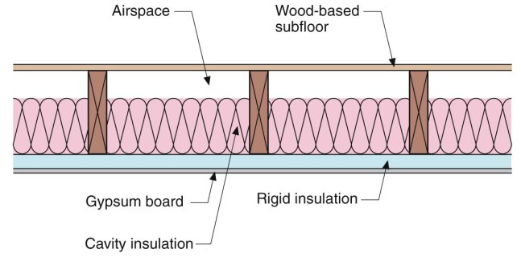
5. Foundations
Floor over Unconditioned Space (e.g., vented crawlspace or raised coastal foundation, etc.)
  Improved comfort, energy savings, and moisture control
  Same as sideways wall or upside-down roof.

Slide 48
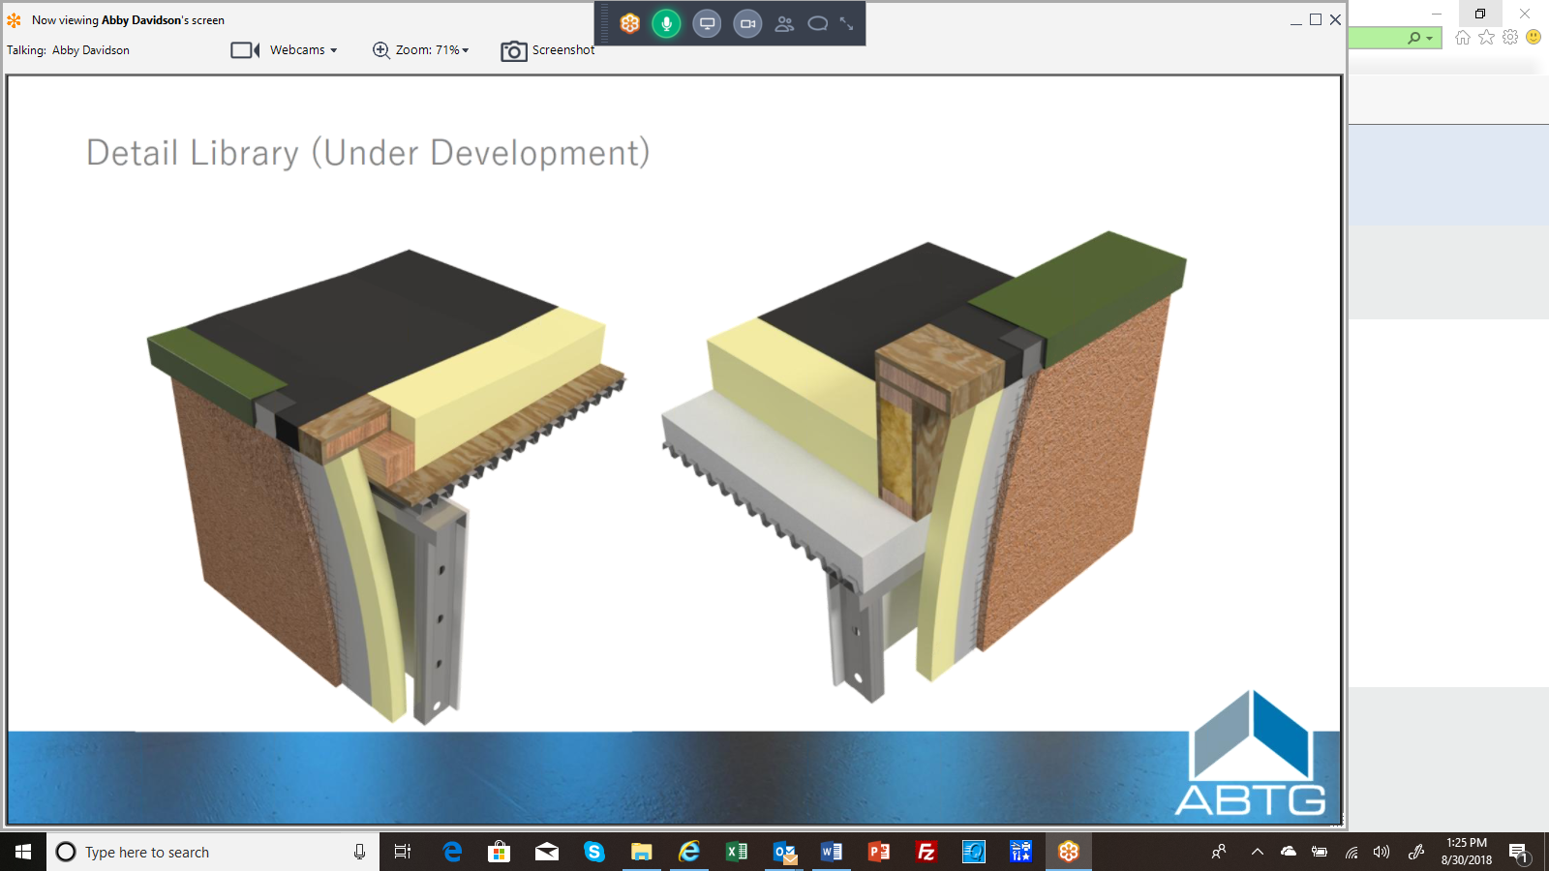
6. Roofs
Commonly used for low-slope roofs as “above deck” continuous insulation
  Under roof membrane (most common)
  Over roof membrane (Protected Membrane Roof System)

Slide 49
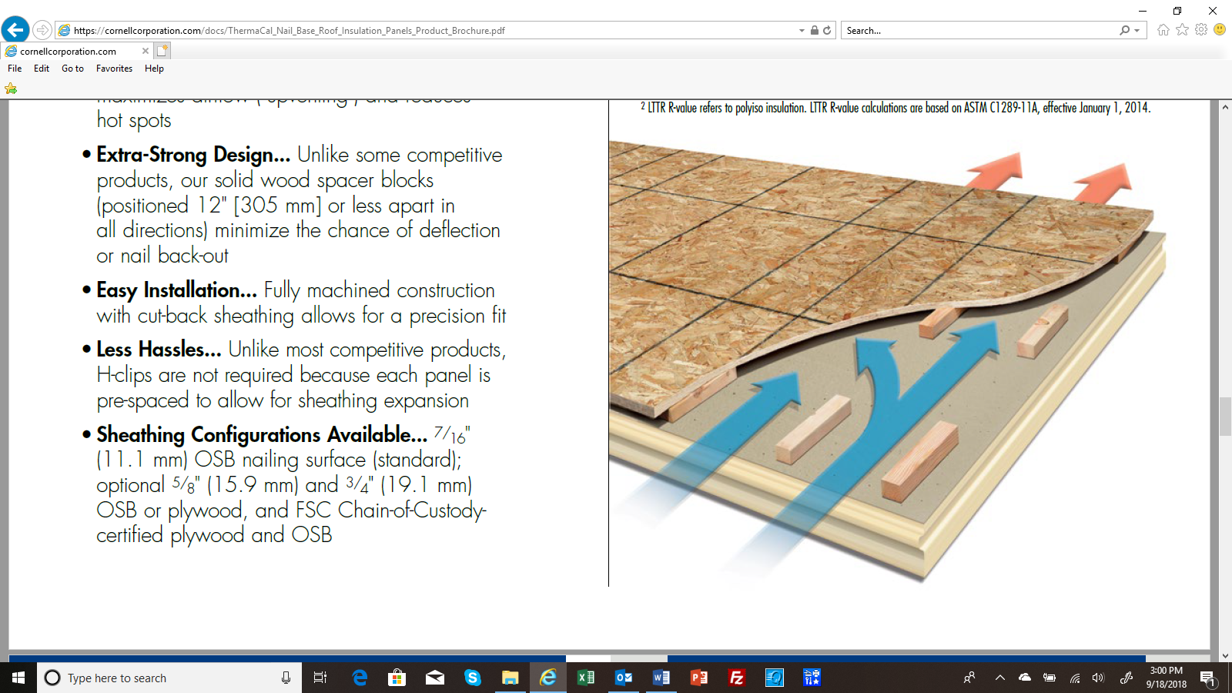
6. Roofs
Also, used for steep slope roofs
  Cathedral roofs
  Attic roofs (puts ducts in
  condition space)
  Improved energy efficiency
  Converts vented attic into storage or living space
Vented nail-base roof deck panel (image courtesy GAF)

Slide 50
COORDINATION WITH OTHER BUILDING CODE REQUIREMENTS
Cladding Attachment
Window/Door Installation
Wall Bracing
Wind Resistance
Fire Safety and Use of FPIS

Slide 51
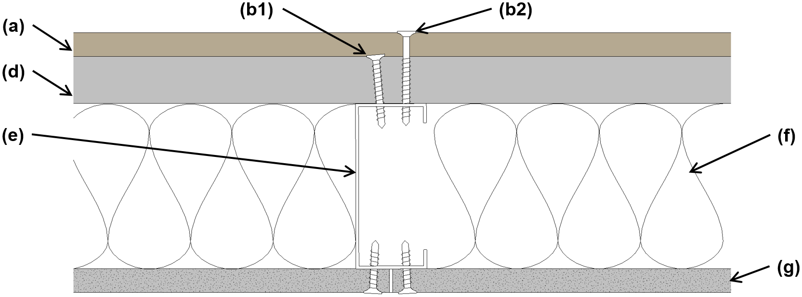
1. Cladding Attachment
Prescriptive provisions for attachment of cladding and furring through FPIS to wood and steel framing:
  Commercial: IBC Chapter 26
  Residential: IRC Section R703
Proprietary fasteners & brackets
Additional resources at www.continuousinsulation.org
NOTE: Design procedure can be used to also design structural connections (e.g., roof or deck ledgers) through FPIS

Slide 52
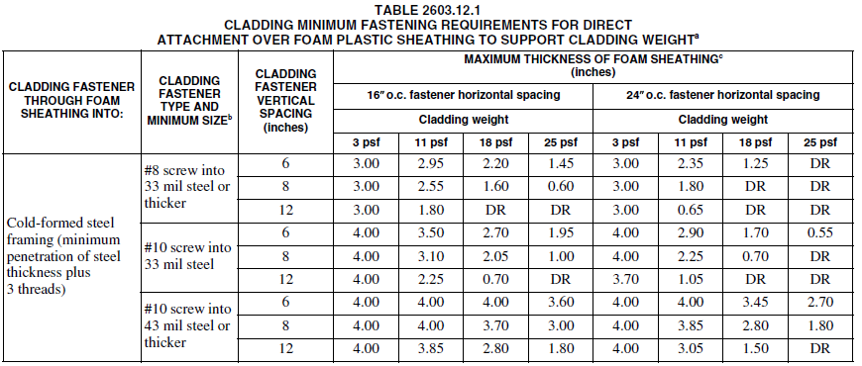
1. Cladding Attachment
2018 IBC – similar tables also for wood framing and furring connections

Slide 53
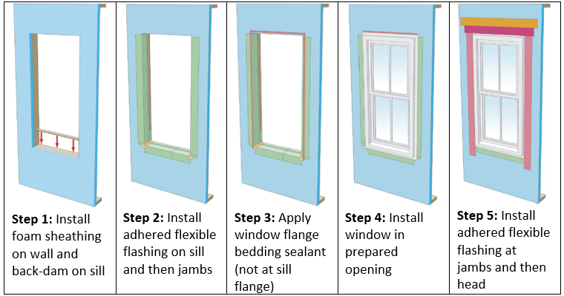
2. Window/Door Installation
Standard installation detail

Slide 54
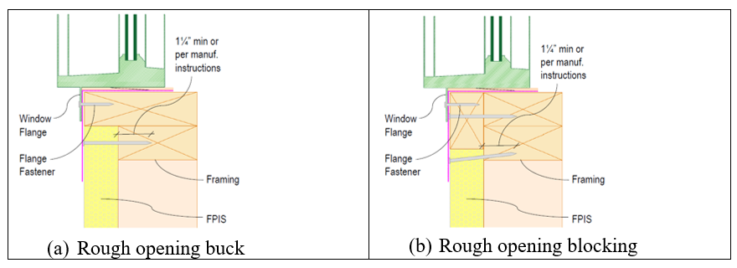
2. Window/Door Installation
Window Buck / Picture Frame (blocking) Detail

Slide 55
2. Window/Door Installation
Consult with window/door manufacturer
  May have relevant installation procedure for warranty
Consult with design professional for unique conditions
AAMA 540 – provides test method to evaluate fenestration installation procedures
FPIS WRB system manufacturers test with specific flashing details & materials for windows/doors/penetrations
  Consult FPIS manufacturer’s installation instructions

Slide 56
3. Wall Bracing / 4. Wind Resistance
FPIS is NOT wall bracing – must use as oversheathing or with diagonal braces (e.g., wood let-in or metal X bracing)
  Can also use as undersheathing (e.g., Extended Plate Wall or Huber Zip-R, etc.) with adjusted framing/fastening to maintain bracing strength
  Some FPIS materials are laminated to structural sheathing materials/facers for bracing; refer to specific manufacturer code compliance data.
FPIS and installation/fastening is typically intended only for temporary exposure to wind during construction
  For wind pressure rating of FPIS where installed over open cavities and fastened to resist 100% of design wind load, refer to manufacturer data per ANSI/SBCA FS100 standard.

Slide 57
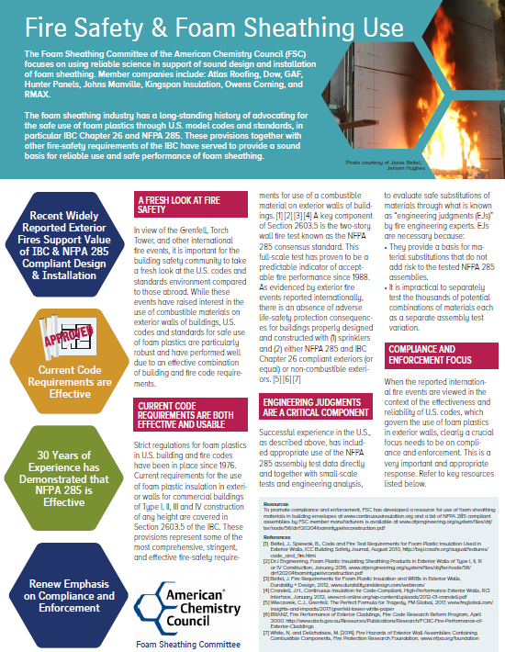
5. Fire Safety and Use of FPIS
Some of the most stringent fire safety requirements for any material.
Decades of successful experience with code compliant construction.
Recent international fires (e.g., Grenfell) result of non-compliant construction.
Solution: compliance and enforcement

Slide 58
5. Fire Safety and Use of FPIS
Example Code Requirements (IBC 2603, IRC R316):
  Flame Spread & Smoke Development Index (max 75/450 or 25/450, depending on application)
  Thermal barrier to separate from interior (e.g. ½” GWB)
  Ignition barriers (attic and crawlspace applications)
  NFPA 285 testing for Type I, II, III, and IV commercial buildings
    Full-scale two-story fire test with compartment fire exiting window in lower story – addresses all failure modes and most common source for exterior fires
  Special full scale testing per code may allow certain applications without ignition or thermal barrier, etc. (check with manufacturer)
Afternoon session: “Foam Plastic Insulation: Fire Safety for Exterior Walls” (Koscher and Ross)
Additional Resources: www.continuousinsulation.org/fire-performance

Slide 59
CONCLUSION
There are many applications for FPIS in walls, foundations, floors, and roofs.
Benefits include improved thermal, moisture, durability, and comfort performance.
Significant experience and technical information is available for appropriate and code-compliant use
  Refer to www.continuousinsulation.org

Slide 60
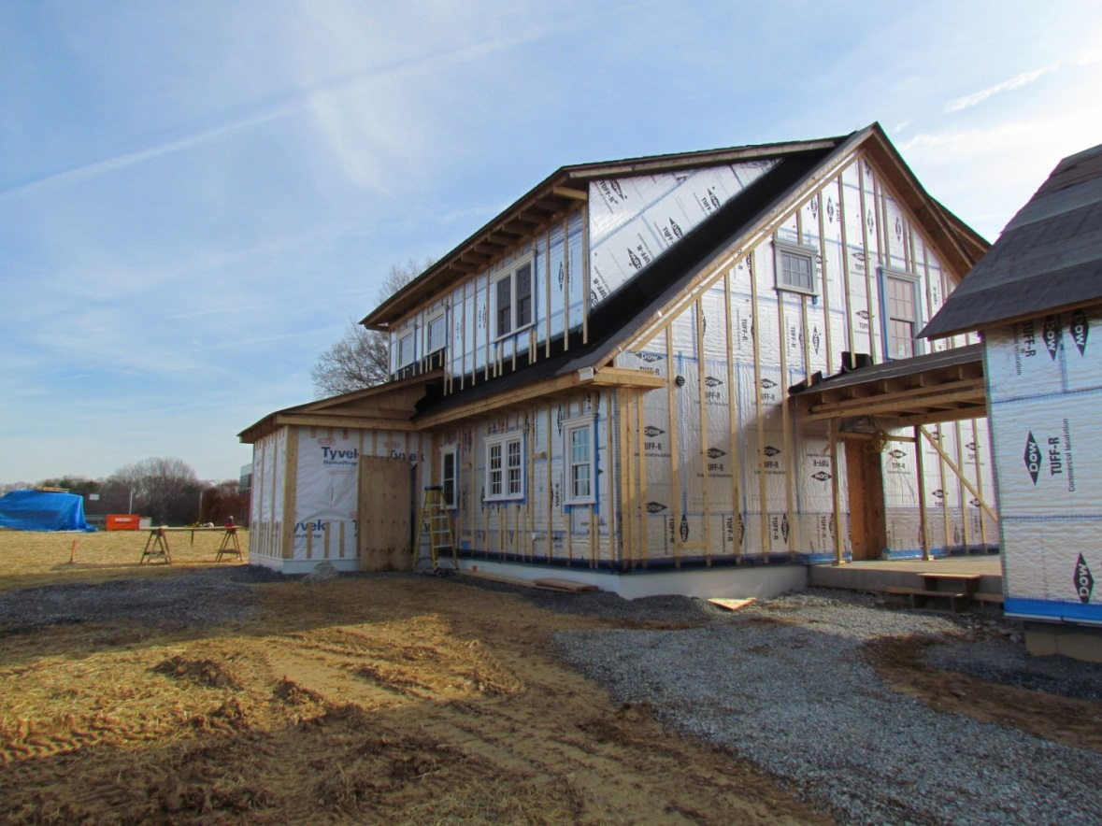
CONCLUSION
THANK YOU –
ANY QUESTIONS?
Zero Energy
WRB
AB
WVC

