Slide 1
Moisture Control Guidelines for
Light-Frame Walls
Educational Overview
Revised March 17, 2020

Slide 3
Introduction
This Research Report provides actionable guidelines to effectively consider, evaluate, and manage the balance of wetting and drying potential in common above-grade, light-frame wall assemblies in a broad range of climate conditions.
This objective involves the appropriate use and integration of a wide variety of light-frame wall construction methods and materials including various cladding types, water-resistive barrier types, insulation types, and vapor retarder types or classes.

Slide 4
Scope
Therefore, the approach taken herein applies to a multitude of light-frame wall assemblies and material choices, including walls:
  with claddings that may or may not store water (e.g., reservoir claddings like Portland cement stucco or adhered masonry veneers) and which may or may not be back-ventilated,
  with water-resistive barriers having a wide range of water vapor permeance properties,
  with exterior sheathing materials having a wide range of water vapor permeance properties,
  with or without exterior continuous insulation and with varying amounts cavity insulation, both of high or low water vapor permeance,
  with a variety of interior vapor retarder choices suitable to a given climate or wall assembly condition, and
  with various combinations of the above materials in climates with different moisture control implications or challenges (e.g., wind-driven rain).

Slide 5
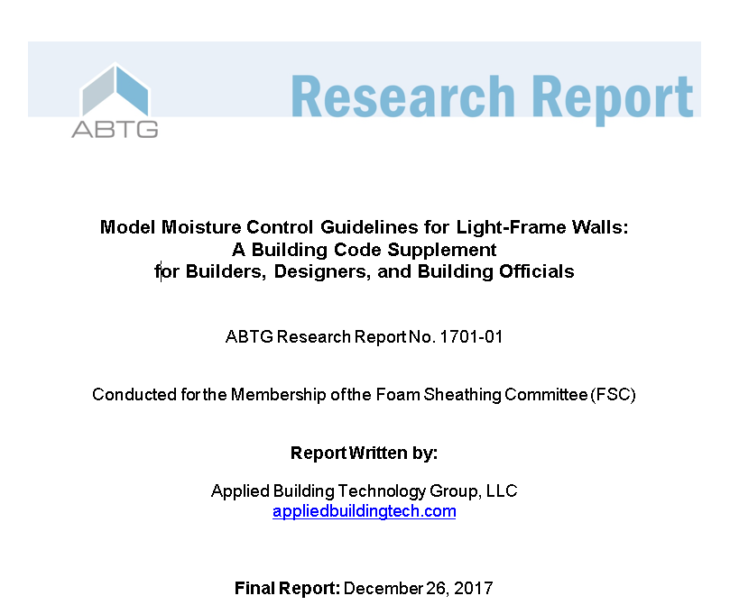
Technical Basis
This presentation is based on a research report (ABTG Research Report No. 1701-01) which:
  Digests relevant building science knowledge to support risk-consistent and performance-based prescriptive guidelines
  Provides a step-by-step worksheet to aid in implementing the guidelines

Slide 6
Performance Based Approach
A performance-based approach provides for flexibility and inclusiveness in making component material selections as governed by their method of integration into a variety of plausible and climate-appropriate wall assembly configurations.
For example, a relatively high permeance water-resistive barrier may be used with a reservoir cladding like Portland cement stucco in moist climates when properly coupled with the practice of providing back-ventilation of the cladding to avoid high inward wetting potential that is inextricably linked with attempts to achieve high outward drying potential in this case.
Similarly, low permeance materials can be used on the exterior side of assemblies with proper selection of interior vapor retarders in coordination with cavity and exterior insulation amounts that vary appropriately with climate to maintain proper balance of wetting and drying potential.
Further, wetting and drying potential cannot be managed effectively by focusing only on properties of one or two materials or components forming only part of a wall system.
These examples speak to the need for an integrated, inclusive, and performance-based approach as the model guidelines included herein strive to provide.
These also speak to the importance of avoiding overly broad (too generalized) or, conversely, narrowly interpreted (taken out of context or exclusive) applications of otherwise useful building science concepts and principles.

Slide 7
Performance Based Approach
The benefits of the above-described guideline approach are manifold:
  promotes risk-consistent performance across various conditions of use;
  makes key variables affecting moisture control performance more transparent such that they are not inadvertently overlooked, misunderstood, or misused in an attempts to achieve acceptable performance or improve performance;
  helps expose potentially harmful misapplications of building science concepts such as “drying potential”, “vapor permeable”, or “double vapor barriers” and brings them into proper balance with a system-based approach to moisture control;
  encourages intelligent decision-making, competition, and innovation founded on a level playing field with a more complete and consistent treatment of key interactions between various related design decisions making up a final wall assembly design and component material specifications; and,
  Provides actionable prescriptive guidelines that are accessible to a variety of end users including designers, builders, and code officials without requiring specialized knowledge or skill except as needed to implement guidance in a simple “look-up” fashion (e.g., figures, tables) and verify material properties and installation practices for compliance.

Slide 8
Performance Based Approach
Because current model and state/local building codes address some and not all matters of integrated moisture control for building wall assemblies, solely relying on compliance with minimum code requirements is no guarantee of successful performance. In short, there are hidden risks that can be avoided or better managed with an integrated prescriptive approach that considers all of the key variables affecting performance. This realization forms one of the main reasons for development of the supplemental model guidelines included in this report. However, these model guidelines are not intended to be used as a replacement for locally applicable building and energy code requirements; they are intended to be a supplement to ensure that the intent of the code is satisfied with a greater degree of reliability than may be achieved by merely following somewhat incomplete minimum code requirements. While written in a “mandatory language” style to ensure compatibility of use with the style used in model building codes and standards, these model guidelines are presented “as is” and should not be taken as a definitive or exhaustive representation of standardized or accepted practices. Therefore, the user must assume full responsibility for code compliance and for assessing the suitability of any information in this document for any purpose. The assistance of a properly qualified professional should be sought as needed.

Slide 9
Qualifiers
These provisions are predicated on two important qualifiers. First, they are intended for “normal” use, occupancy, and operating conditions for typical light-frame commercial and residential buildings.
Indoor relative humidity conditions should not exceed approximately 60% in the summer and, for the winter season, should not exceed approximately 45% in the warmer climates or 30% in the colder climates.
Building occupants responsible for building operation should monitor and control interior relative humidity by way of minimizing interior moisture loads or managing them by use of properly designed ventilation systems and/or dehumidification.
For buildings with occupancy and use conditions that result in significant indoor moisture generation, additional actions should be taken in the design of building envelope assemblies and HVAC equipment; a design professional should be consulted.
Such conditions may include high occupancy buildings, sauna rooms, pool rooms, and other conditions that produce significant indoor moisture loads.

Slide 10
Qualifiers
Second, these provisions assume a reasonable level of construction quality control. Significant defects in any one of the moisture control practices addressed herein may erode or negate the benefits of some or all of them.
For example, major defects in flashing resulting in rain water penetration can easily overwhelm any reasonable attempt to control other wetting mechanisms, even when significant drying potential is provided.
Similarly, a major defect in complying with water vapor and air-leakage control can negate the benefits of even a perfect execution of measures to prevent rain water intrusion.
In summary, a building system is only as strong and durable as its weakest link.

Slide 11
MODEL GUIDELINES
1.0 General. Light-frame, above-grade exterior wall assemblies shall comply with the locally applicable building and energy conservation codes, and the supplemental requirements of Sections 2.0, 3.0, 4.0, 5.0, and 6.0. Alternative solutions shall be permitted in accordance with provisions for alternative means and methods of design and construction in the locally applicable building code.

Slide 12
2.0 Control of Rain Water Intrusion to Reduce Wetting Potential
2.1 General. Exterior wall coverings, water-resistive barriers, fenestration, flashings, and other exterior wall components shall be designed, specified, and installed to resist rain water intrusion in accordance with the locally applicable building code and the corresponding product manufacturers’ installation instructions. The water-resistance of water-resistive barriers and fenestration products and their installation methods shall comply with Section 2.2 or the locally applicable building code, whichever is more stringent. The additional requirements of Sections 2.3 and 2.4 shall be provided as applicable and, where not required, shall be permitted.

Slide 13
2.0 Control of Rain Water Intrusion to Reduce Wetting Potential
2.2 Wall System Water Resistance. In addition to other criteria necessary for code-compliance and in-service performance, water-resistive barrier assemblies including accessories, installation methods, and flashing or interfacing details for continuity of water resistance shall be qualified and specified in accordance with Section 2.2.1. Fenestration products shall comply with and be specified in accordance with Section 2.2.2.

Slide 14
2.0 Control of Rain Water Intrusion to Reduce Wetting Potential
2.2.1 The water-resistive barrier assembly shall be tested in accordance with ASTM E331 [4] using the following qualification and specification criteria:
  The minimum test pressure differential shall be 15% of the allowable stress design wind load for a building wall determined in accordance with ASCE 7 [5], the locally applicable building code, or Table 1 and Figure 1 for the intended design conditions.
  The minimum water-spray test duration at the qualifying test pressure shall not be less than 15 minutes with a minimum total test duration of 1 hour at a test pressure differential of not less than 3 psf.
  At the qualifying test pressure differential, no water leakage shall pass through the water-resistive barrier or related installation details and onto wall framing materials concealed behind the water-resistive barrier.
  Where the water-resistive barrier is tested together with and concealed by a cladding material (not tested exposed without cladding), the test result shall be applicable for use only with the particular cladding and installation method.

Slide 15
2.0 Control of Rain Water Intrusion to Reduce Wetting Potential
2.2.2 Fenestration products shall comply with and be specified in accordance with the locally applicable building code and NAFS [6]. The fenestration product’s structural design wind pressure rating shall be equal to or greater than the allowable stress design wind load determined in accordance with Table 1 and Figure 1, ASCE 7, or the locally applicable building code for the building site and fenestration location on the building configuration.
User Note: For Canada, water resistance test pressures and ratings for fenestration must comply with wind-driven rain design pressures as required by A440S1-09 [7].

Slide 16
2.0 Control of Rain Water Intrusion to Reduce Wetting Potential
2.3 Fenestration Pan Flashing and Rough Opening Air-Leakage Sealing. Where the annual wind-driven rain receipt is greater than 16 inches per year in accordance with Figure 2, all rough openings for unprotected exterior windows and doors shall have sill or threshold pan flashing installed that is capable of draining intruded water outward onto the surface of the concealed water-resistive barrier or directly to the exterior of the cladding. The interior edge of the pan flashing and the rough opening gap around the window or door frame interior perimeter shall be sealed to prevent air-leakage and promote pressure equalization of the rough opening gap.

Slide 17
2.0 Control of Rain Water Intrusion to Reduce Wetting Potential
2.4 Drainage Space. Where the annual wind-driven rain hazard is greater than 32 inches per year in accordance with Figure 2, a means of drainage shall be provided in accordance with one of the following:
A drained and unobstructed air space not less than 3/16-inch-thick located between the water-resistive barrier and the cladding;
An open drainage material, not less than ¼-inch thick and with a cross-section area that is not less than 80 percent open, installed between the cladding and backing;
Hollow-backed metal or vinyl siding loosely fastened to the backing substrate; or,
An alternative drainage design with drainage performance at least equivalent to Items 1, 2, or 3, or not less than 90% drainage efficiency as measured in accordance Annex A.2 of ASTM E2925 [14] or ASTM E2273 [15].

Slide 18
2.0 Control of Rain Water Intrusion to Reduce Wetting Potential
TABLE 1
WATER-RESISTANCE TEST PRESSURES FOR FENESTRATION PRODUCTS AND WATER-RESISTIVE BARRIERS IN COORDINATION WITH REQUIRED ALLOWABLE STRESS STRUCTURAL DESIGN WIND LOADS
Mapped Wind Speed (Fig 1) (mph) | Allowable Stress Structural Design Wind Loads (psf)¹ | Minimum Required Fenestration Structural Design Pressure Rating (psf)² |  |  | Minimum Required Wall System and Fenestration Water-Resistance Test Pressure (psf)³ |  |  | Minimum WRB Water-Resistance Test Pressure for Exposed WRB Test Condition (psf)⁴
 |  | Wind Exposure¹ |  |  | Wind Exposure¹ |  |  | Wind Exposure¹
 |  | B | C | D | B | C | D | B | C | D
≤110 | -17.0 / +13.1 | 17.0 | 23.8 | 28.9 | 3.0 | 3.6 | 4.4 | 3.0 | 3.0 | 3.1
115 | -19.0 / +14.3 | 19.0 | 26.6 | 32.3 | 3.0 | 4.1 | 4.9 | 3.0 | 3.0 | 3.4
120 | -20.0 / +15.5 | 20.0 | 28.0 | 34.0 | 3.0 | 4.2 | 5.1 | 3.0 | 3.0 | 3.6
130 | -24.0 / +18.2 | 24.0 | 33.6 | 40.8 | 3.6 | 5.0 | 6.1 | 3.0 | 3.5 | 4.3
140 | -28.0 / +21.2 | 28.0 | 39.2 | 47.6 | 4.2 | 5.9 | 7.1 | 3.0 | 4.1 | 5.0
150 | -32.0 / +24.3 | 32.0 | 44.8 | 54.4 | 4.8 | 6.7 | 8.2 | 3.4 | 4.7 | 5.7
160 | -37.0 / +27.7 | 37.0 | 51.8 | 62.9 | 5.6 | 7.8 | 9.5 | 3.9 | 5.5 | 6.7
170 | -41.0 / +31.2 | 41.0 | 57.4 | 69.7 | 6.2 | 8.7 | 10.5 | 4.3 | 6.1 | 7.4
180 | -46.8 / +35.0 | 46.8 | 65.6 | 79.6 | 7.0 | 9.8 | 11.9 | 4.9 | 6.9 | 8.3

Slide 19
2.0 Control of Rain Water Intrusion to Reduce Wetting Potential

Slide 20
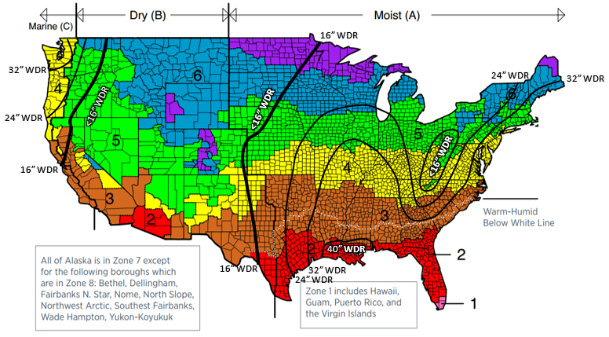
2.0 Control of Rain Water Intrusion to Reduce Wetting Potential

Slide 21
3.0 Control of Water Vapor Diffusion to Manage Wetting and Drying Potential
3.1 General. The location and properties of insulation components, vapor retarders, and other material layers on light frame, above-grade exterior wall assemblies as illustrated in Figure 3 shall comply with Table 2(A) or Table 2(B). The requirements of Sections 3.2, 3.3, and 3.4 shall be additionally satisfied as applicable. Where insulation is used as a means to control water vapor in accordance with Table 2(B), insulation solutions also shall comply with the locally applicable energy conservation code.
Exception: Table 2(B) shall be used where the net water vapor permeance of material layers on the exterior side of wall studs is unquantified or does not comply with the minimum net water vapor permeance values in Table 2(A) for the climate and specified interior vapor retarder class.

Slide 22
3.0 Control of Water Vapor Diffusion to Manage Wetting and Drying Potential
User Note: A means of determining net water vapor permeance is provided in footnote ‘b’ of Table 2(A). Use of Table 2(A) and other provisions in this section require the availability and use of the water vapor permeance properties of specified material layers. These properties should be obtained from manufacturer data for the specified materials using test methods as indicated herein. Preferably, this data should be based on testing by an approved agency or approved source (e.g., certified independent, third-party laboratory).

Slide 23
3.0 Control of Water Vapor Diffusion to Manage Wetting and Drying Potential
3.2 Drying Potential for Moist Climates with Severe Wind-Driven Rain. In climates with an annual wind-driven rain receipt exceeding 32 inches in accordance with Figure 2, inward or outward drying potential of the wall assembly shall be provided by one of the following practices in addition to maintaining compliance with Section 3.1:
  Drying to the exterior – The minimum net permeance of exterior material layers, including the exterior sheathing, water-resistive barrier, and any unvented air-impermeable cladding, shall be 1.5 perms or greater as measured by ASTM E96 [23] Procedure B (wet cup), or
  Drying to the interior – The minimum net permeance of interior material layers, including the interior vapor retarder and interior finishes, shall be 1.5 perms or greater as measured by ASTM E96 Procedure B (wet cup).

Slide 24
3.0 Control of Water Vapor Diffusion to Manage Wetting and Drying Potential
User Note: Where using Item 1 above with Table 2(A) in areas with greater than 32 in/yr wind-driven rain per Figure 2, the minimum net water vapor permeance of 1.5 perms for exterior material layers may over-ride the minimum values for the same provided in Table 2(A) to ensure adequate drying potential to the exterior. Similarly, where using Item 2 above with Table 2(B) in areas with greater than 32 in/yr wind-driven rain per Figure 2, the selection of interior vapor retarder becomes limited to a Class II (Kraft paper) or Class III vapor retarder to ensure adequate drying potential to the interior. In either case, increasing net water vapor permeance to the exterior or interior, respectively, will improve drying potential of the assembly, but must be done in coordination with Section 3.1.

Slide 25
3.0 Control of Water Vapor Diffusion to Manage Wetting and Drying Potential
3.3 Reservoir Claddings (Solar-Driven Inward Water Vapor Drive). Reservoir claddings include Portland cement stucco, adhered masonry veneers, anchored masonry veneer, cement siding panels, and other claddings that have water absorption greater than 3% (volumetric moisture content) as measured in accordance with ASTM C209 [25] 2-hour soak test. For reservoir claddings used in Moist (A) and Marine (C) regions of Figure 2 where the wind-driven rain is greater than 16 in/yr and where installed over moisture sensitive wall materials such as wood-based or gypsum-based sheathing, one of the following practices shall be used in addition to maintaining compliance with Section 3.1:
  A drained and ventilated air space, complying with or exceeding the minimum requirements of Items 1, 2, or 4 of Section 2.4, located behind the reservoir cladding to the exterior side of the water-resistive barrier with ventilation air outlets and inlets at the top and bottom of each air space.
  An alternative drainage and ventilation design with drainage complying with Item 4 of Section 2.4 and with ventilation performance at least equivalent to Items 1 or 2 of Section 2.4 with ventilation air outlets and inlets included. Ventilation performance shall be measured in accordance with Annex A1 of ASTM E2925 [14].

Slide 26
3.0 Control of Water Vapor Diffusion to Manage Wetting and Drying Potential
Exceptions: An air space for ventilation shall not be required for any of the following conditions:
  Foam plastic insulating sheathing complying with ASTM C578 or ASTM C1289 located between the reservoir cladding and underlying moisture sensitive wall materials. A drainage space shall be provided in accordance with Section 2.4 as applicable and compliance with Section 3.1 shall be maintained.
  A water-resistive barrier, a substantially nonwater-absorbing layer, a bond-break layer, or combination of these materials between the reservoir cladding and underlying moisture sensitive wall materials provide a net water vapor permeance not exceeding 10 perms where each material’s water vapor permeance is measured by ASTM E96, Procedure B. A drainage space shall be provided in accordance with Section 2.4 as applicable and compliance with Section 3.1 shall be maintained.

Slide 27
3.0 Control of Water Vapor Diffusion to Manage Wetting and Drying Potential
User Note: Where Exception 1 is used, the application of foam plastic insulating sheathing must comply with Section 3.1 and Table 2(B), particularly in the colder climate zones. Where Exception 2 is used, the permeance of the exterior material layers must comply with Section 3.1 and Table 2(A) or, otherwise, be insulated in accordance with Table 2(B), particularly in the colder climate zones and where the net water vapor permeance on the exterior side of the assembly is substantially less than 10 perms. The selection of an interior vapor retarder will also be affected by these design decisions to maintain compliance with Section 3.1 and also Section 3.2 where applicable.

Slide 28
3.0 Control of Water Vapor Diffusion to Manage Wetting and Drying Potential
3.4 Walls with Non-reservoir Claddings in Warm-Humid Climates (Inward Vapor Drive). In the “warm-humid” climate region of Figure 2, the net water vapor permeance of material layers located on the exterior side of wall studs shall not exceed a net water vapor permeance of 20 perms where the permeance of each material layer is based on ASTM E96 Procedure B (wet cup).
  Exception: The net water vapor permeance of materials to the exterior side of wall studs shall be permitted to exceed 20 perms where spray foam is applied in the wall cavity at an installed thickness as necessary to be non-vapor permeable and air impermeable.

Slide 29
3.0 Control of Water Vapor Diffusion to Manage Wetting and Drying Potential
User Note: While Section 3.3 focused on material layers (and air space) between a reservoir cladding and water sensitive wall materials such as wood-based and gypsum-based sheathing, Section 3.4 focuses on all material layers to the exterior side of the assembly (including the exterior sheathing layer). In this case, it is the net water vapor permeance of all the exterior layers (sheathing, WRB, and unvented claddings) that are required to comply with the 20 perm maximum for net water vapor permeance. Thus, some layers could substantially exceed the 20 perm limit if there is at least one layer that complies with the 20 perm limit. For example, typical wood sheathing materials (e.g., OSB or plywood) have a wet cup water vapor permeance well below 20 perms. Thus, a water-resistive barrier with unlimited water vapor permeance can be used. A means to determine net water vapor permeance of multiple layers is addressed in note ‘b’ of Table 2(A).

Slide 30
3.0 Control of Water Vapor Diffusion to Manage Wetting and Drying Potential
TABLE 2(A)
MINIMUM NET WATER VAPOR PERMEANCE (WVP) FOR MATERIAL LAYERS LOCATED ON THE EXTERIOR SIDE OF WALL STUDS ^{a, b, c}
Climate Zone (Fig. 2) | Interior Vapor Retarder Class
 | Class I | Class II | Class III
1 | NP | NP^{d} | No minimum
2 | NP | NP^{d} | No minimum
3 | NP | No minimum | No minimum
4 | 0.5 perm (Marine 4) and otherwise NP | 0.5 perm | 3 perm
5 | 0.5 perm | 3 perm | 5 perm
6 | 1 perm | 5 perm | 15 perm
7 | 1 perm | 15 perm | NP
8e | 1.5 perm | NP | NP

Slide 31
3.0 Control of Water Vapor Diffusion to Manage Wetting and Drying Potential
TABLE 2(B)
MINIMUM INSULATION RATIO OR CONTINUOUS INSULATION R-VALUE FOR LIGHT-FRAME WALLS WHERE EXTERIOR CONTINUOUS INSULATION (ci) IS USED ^{a, b, c, d}
Climate Zone (Fig. 2) | Maximum Heating Degree Days (65F basis) | Interior Vapor Retarder (VR) Class
 |  | Class I | Class II | Class III | No VR^{e}
1 | N/A | NP | NP^{f} | R-2ci minimum | R-2ci minimum
2 | N/A | NP | NP^{f} | R-2ci minimum | R-2ci minimum
3 | 3,600 | NP | R-2ci minimum | R-2ci minimum | 0.4
4 | 5,400 | NP | R-2ci minimum | 0.2 | 0.9
5 | 7,200 | 0.2 | 0.2 | 0.35 | 1.3
6 | 9,000 | 0.2 | 0.2 | 0.5 | 1.7
7 | 12,600 | 0.35 | 0.35 | 0.8 | 2.3
8^{g} | 16,200 | 0.5 | 0.5 | 1.1 | 2.8

Slide 32
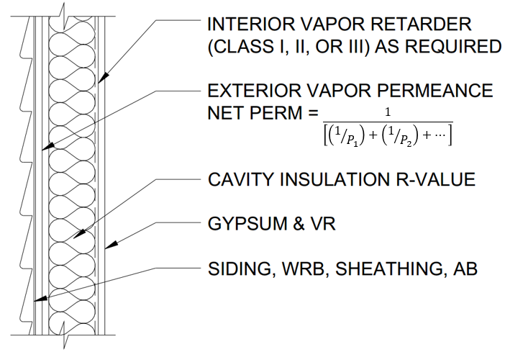
Typical Wall Assembly with Vapor Permeable Cavity Insulation Only for Use with Table 2(A)

Slide 33
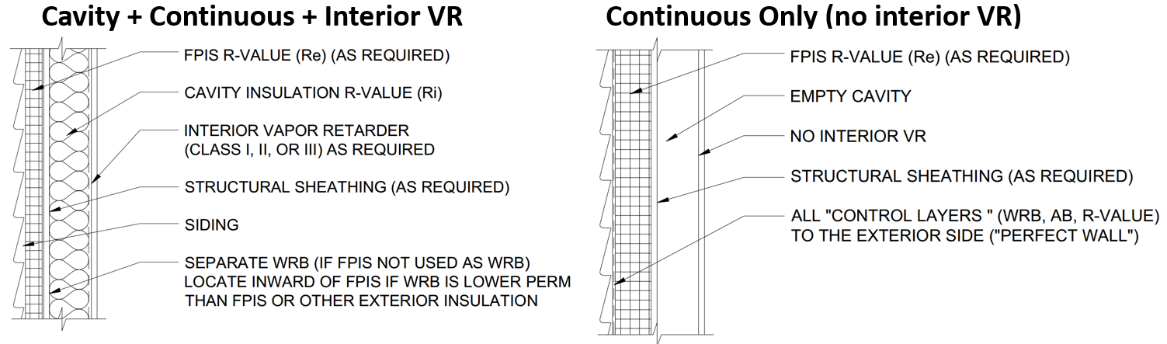
Typical Hybrid Wall Assembly and Exterior Continuous Insulation Only Assembly for Use with Table 2(B)
Note: Arrangement of control layers is material and climate specific.

Slide 34
4.0 Control of Moist Air Movement
4.1 General. Air movement into and through building envelope assemblies shall be controlled in accordance with air barrier material and assembly requirements of the locally applicable energy conservation code. The air-barrier location requirements of Section 4.2 shall be permitted as optional practices where not already required by the locally applicable energy conservation code. Air barrier materials and components shall be installed in accordance with the manufacturer’s installation instructions and integrated with other building components and sealed at transitions to maintain a continuous barrier to air leakage.

Slide 35
4.0 Control of Moist Air Movement
4.2 Air barrier location. The air-barrier control layer in a wall assembly shall be permitted to be located in accordance with this section unless otherwise required by the locally applicable energy conservation code.
  4.2.1 Climate Zones 1 and 2. Locate the air barrier control layer on the exterior side of the wall assembly. Alternatively, use spray-applied cavity insulation of a thickness necessary to qualify as an air barrier material.
  4.2.2 Climate Zones 3 and 4. The location of the air barrier control layer shall not be limited.
  4.2.3 Climate Zones 5 through 8. Locate the air barrier control layer on the interior and exterior sides of the wall assembly. Alternatively, use spray-applied cavity insulation of a thickness necessary to qualify as an air barrier material.

Slide 36
5.0 Control of Initial Construction Moisture
5.1 General. The moisture content of materials at the time of enclosure within exterior wall assemblies shall be controlled to a sufficiently low level to minimize the risk of mold growth or moisture accumulation in sensitive materials as the enclosed materials dry inward or outward by vapor diffusion through the wall enclosure layers (e.g., vapor retarders, interior finishes, exterior sheathing, water-resistive barrier, air-barrier). The control of initial construction moisture shall comply with Sections 5.2 and 5.3 as applicable.

Slide 37
5.0 Control of Initial Construction Moisture
5.2 Wet-applied insulation materials. Insulation materials that are wet-applied shall be dried to a moisture content of less than 20% (dry mass basis) prior to their enclosure within a wall assembly. Where more stringent, the wet-applied insulation manufacturer’s installation instructions shall be followed.
5.3 Wood-based framing and sheathing materials. Prior to enclosure of a wall assembly, wood framing and sheathing materials shall be dried to a moisture content of 16% or less (dry mass basis). Where more stringent, the wood-based framing material producer’s installation instructions shall be followed.

Slide 38
6.0 Corrosion Resistance
6.1 General. Fasteners, connectors, stucco lath, metal flashing, and other metal materials that are exposed to the exterior side of the cladding or the water-resistive barrier material shall be corrosion resistant in accordance with the locally applicable building code and the additional requirements of Sections 6.2 or 6.3 as applicable. Contact of dissimilar metals shall be avoided.
6.2 Moderate Corrosion Exposures. Where the annual wind-driven rain receipt in accordance with Figure 2 is greater than 32 inches, corrosion resistance at least equivalent to hot-dipped galvanized carbon steel shall be provided.
6.3 Severe Corrosion Exposures. In areas within 3 miles of coastal salt water bodies, corrosion resistance at least equivalent to stainless steel, copper, anodized aluminum, or other coated or uncoated metals or materials of at least equivalent corrosion resistance shall be used.

Slide 39
References
Refer to:
http://www.appliedbuildingtech.com/rr/1701-01
Model Moisture Control Guidelines for Light-Frame Walls: A Building Code Supplement for Builders, Designers, and Building Officials
ABTG Research Report No. 1701-01
December 26, 2017

