Slide 1
Frost Protected Shallow Foundations
Jay H. Crandell, P.E.
ARES Consulting/ABTG

Slide 3
Overview
History & Code Acceptance
Principles
Cost Savings
Technology Verification
Applications
Construction Method
IRC 2006 Requirements
Plan Review & Inspection Checklist
Beyond the IRC: ASCE Standard 32-01
Resources & References
Conclusions

Slide 4
History of FPSFs
1930s – Frank Loyd Wright designed and built the first FPSFs in the Chicago area
1950s – 1970s In rebuilding after WWII, Scandinavian countries studied U.S. construction and then became leaders in FPSF technology
1980s – U.S. Plastics Industry and NAHB/RC begin technology transfer back to U.S.
1992 -1994 U.S. HUD sponsors a 5-home verification study in the northern U.S. climates; Air-freezing Index map is created; U.S. design guide developed
1995 CABO OTFDC – first model code recognition of FPSF in U.S.
2001 – ASCE standard 32 is completed
(based on HUD guides for FPSFs)

Slide 5
Code Acceptance
2000/2003/2006 – IRC includes simplified FPSF provisions for homes
2003/2006 – ASCE standard 32-01 referenced in IRC and IBC for residential and commercial building applications
Market Acceptance:
>1,000,000 in Scandinavia (and continuing)
1,000s in U.S. (and growing)

Slide 6
Cost & Energy Savings
Construction cost savings: $1,000 to $4,000
(depends on size and complexity of foundation and severity of local frost depth/climate)
Compared to basement construction, the cost savings more than double.
Annual energy savings: ~$75 per year
(typical 6,000 HDD heating climate)
FPSF insulation amount can be sized to also meet or exceed Energy Code
FSPF insulation can be increased to improve slab comfort; works great with in-slab heating systems
Aren’t these
numbers exciting!
TIP: Not necessarily cost-effective for unheated building foundations

Slide 7
Principles
Frost Depth in Ground
Heat Transfer & Storage
Heat Loss at Corners
Two Approaches, Same Principles
The “Frost-Heave Triangle”

Slide 8
Frost Depth in Ground

Slide 9
Heat Transfer & Storage

Slide 10
Heat Loss at Corners (3D)
3D heat transfer at outside corners is greater than 2D heat transfer along wall

Slide 11
Two Approaches, Same Principles
Heated Buildings
(living spaces
conditioned ≥ 64o F):

Slide 12
Two Approaches, Same Principles
Unheated Buildings (unconditioned <41oF)

Slide 13
The Frost-Heave Triangle
All of the following must occur for frost heave to happen:
Freezing Temperatures
Moving Into Soil
Frost-Susceptible Soil Type (e.g., silt)
Wet Soil Condition
(e.g., >75% saturation)

Slide 14
FPSF Technology Verification
Sponsored by U.S. Dept. of Housing and Urban Development (1992-1995)
Built and monitored 5 homes in VT, IA, ND, and AK
Used dataloggers and 90 +/- thermocouples in foundation and ground to monitor temperatures and frost line at building and “far-field”.
Monitored for 2 complete years and winter events
Some foundation portions designed for only average winter freezing temperatures to simulate the 100-year event

Slide 15
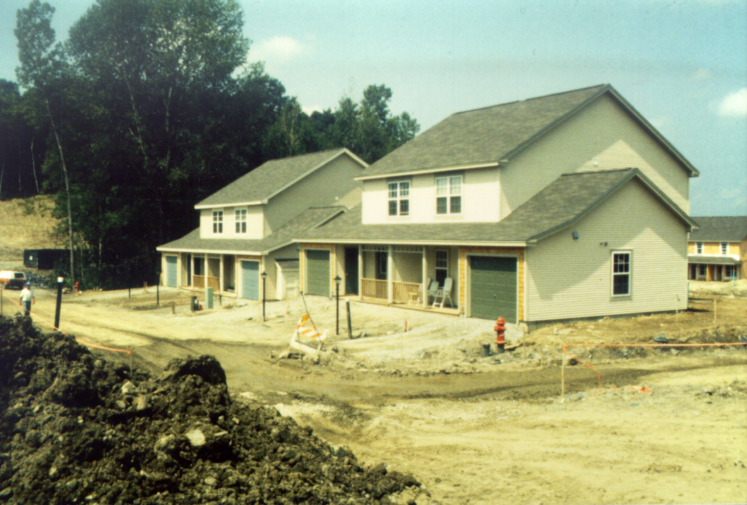
Test Site #1 – Williston, VT

Slide 16
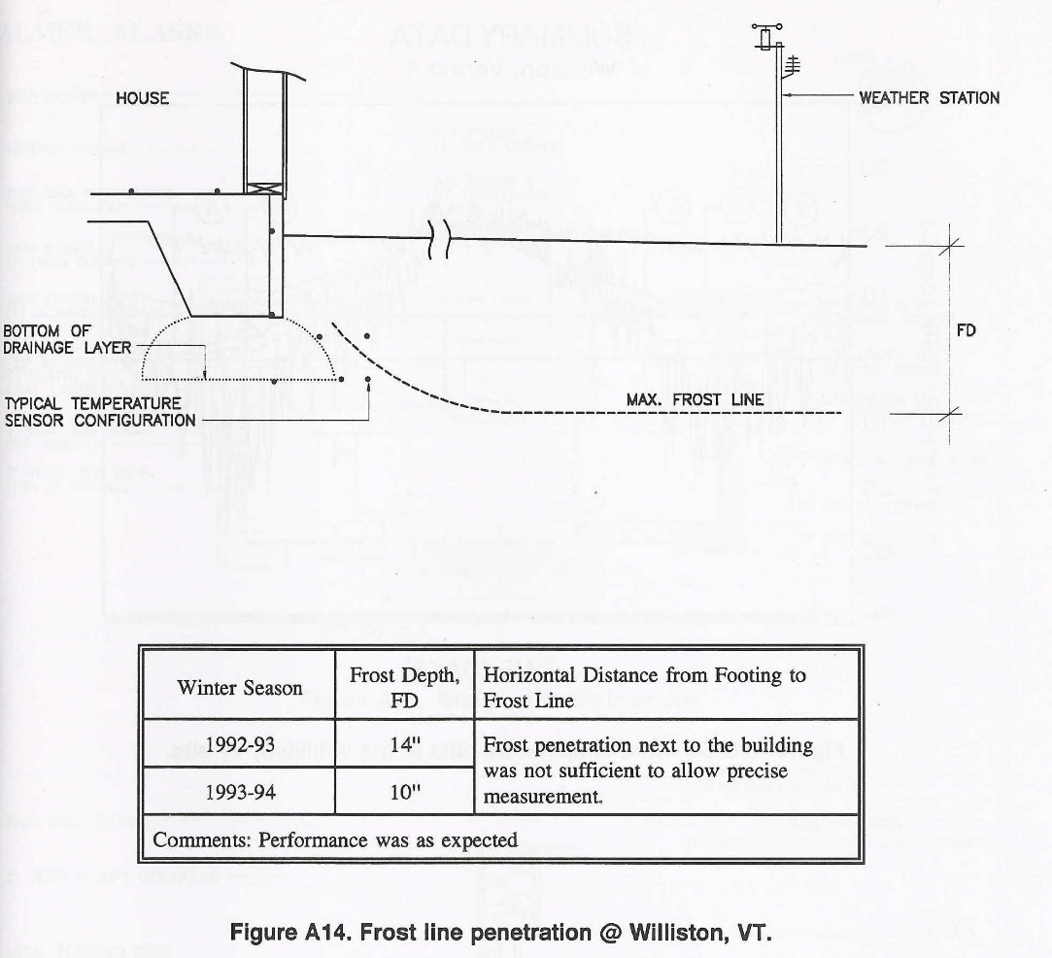
Test Site #1 - Results

Slide 17
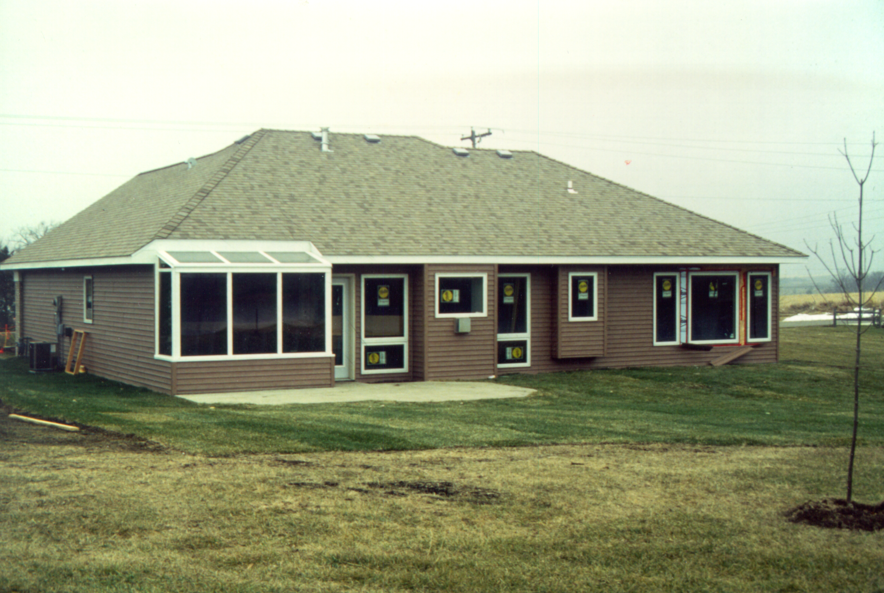
Test Site #2 – Spirit Lake, IA

Slide 18
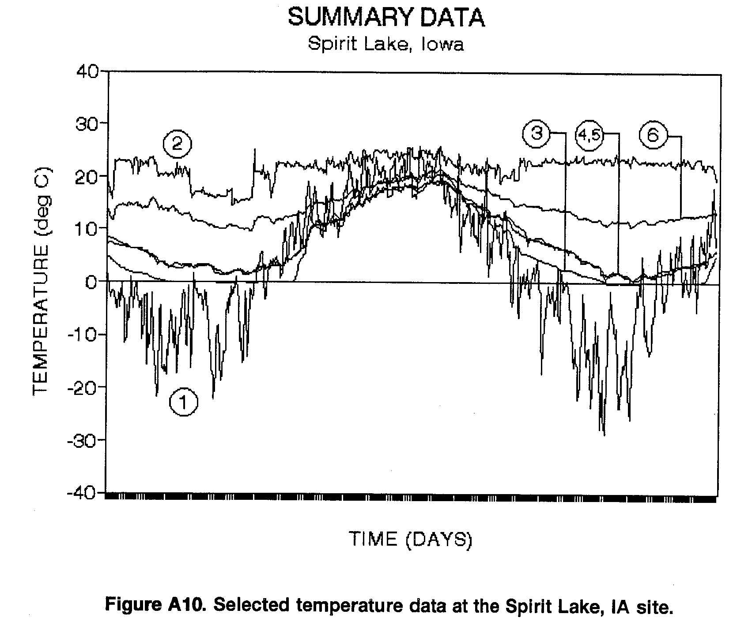
Test Site #2 - Results
Key:
Outdoor
Indoor
Ground @ 21” depth
Subgrade at corner
Subgrade at garage corner
Slab surface, 3’ from edge
Period of Record:
11/20/92 to 4/20/94

Slide 19
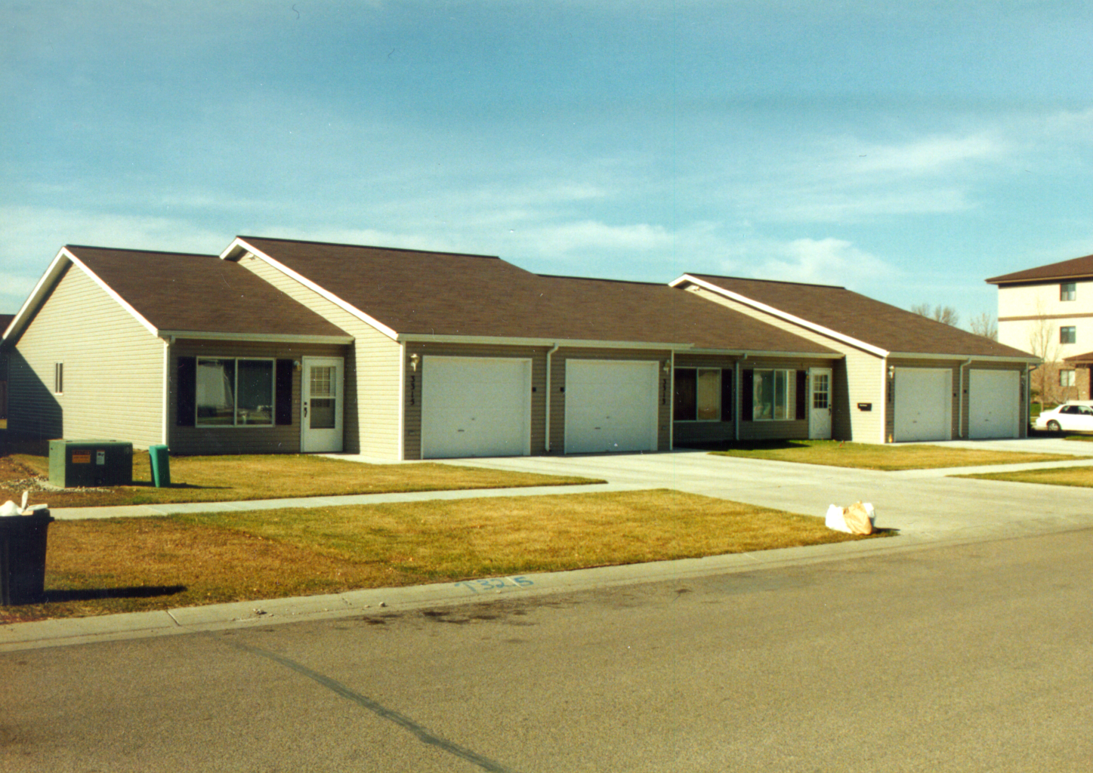
Test Site #3 – Fargo, ND

Slide 20
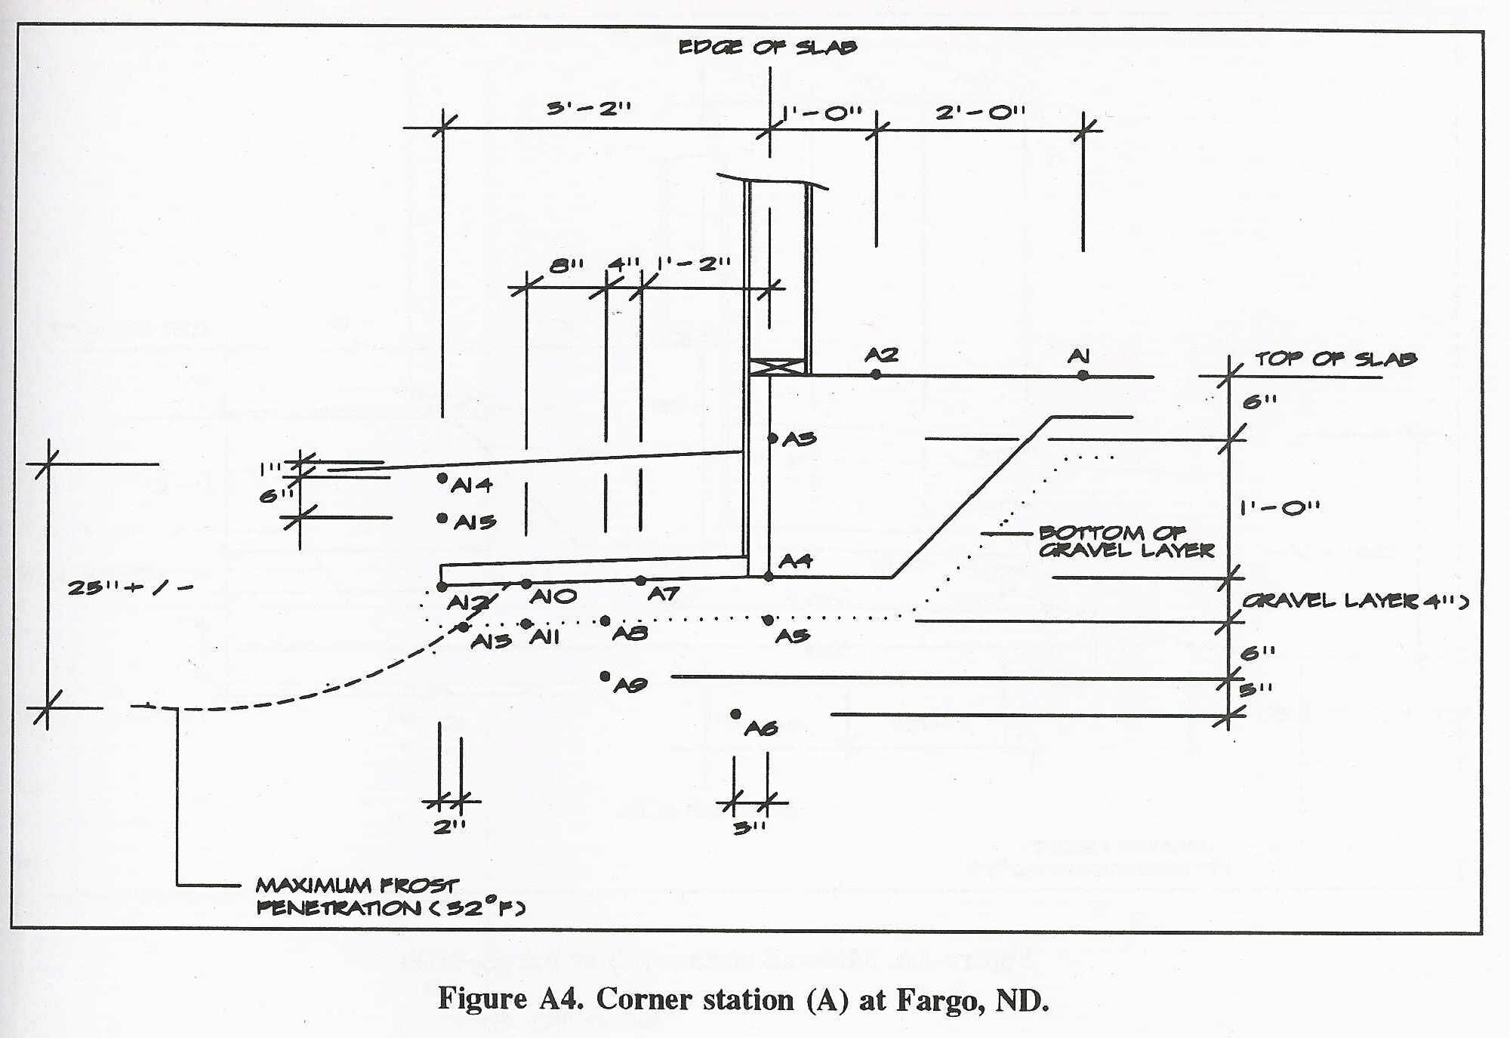
Test Site #3 - Results

Slide 21
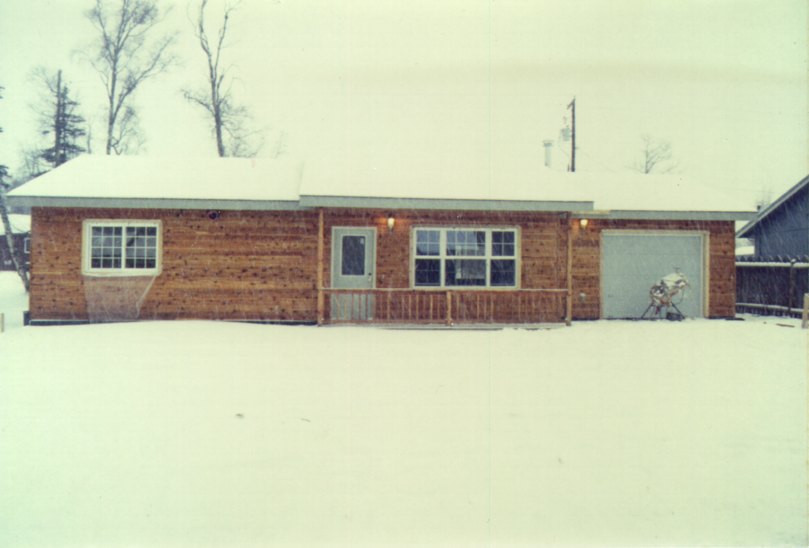
Test Site #4 – Palmer, AK

Slide 22
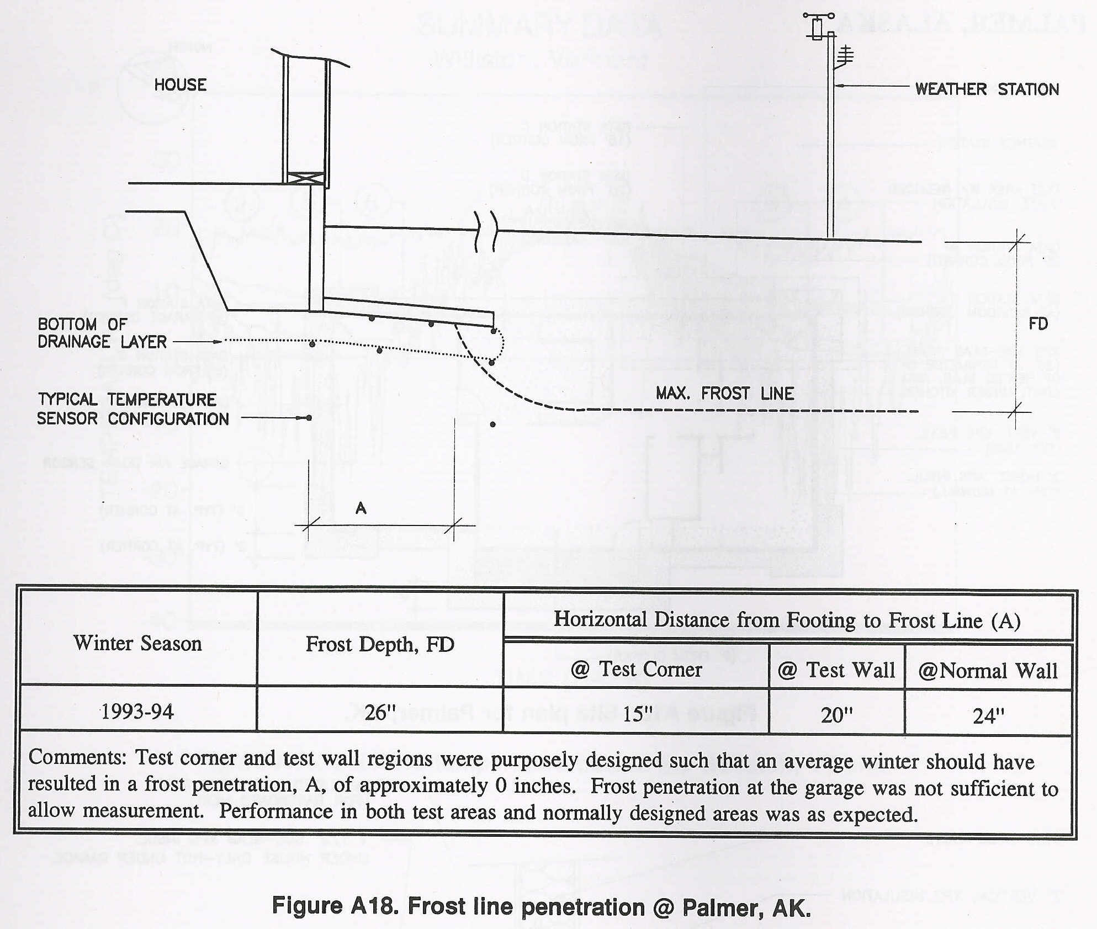
Test Site #4 - Results

Slide 23
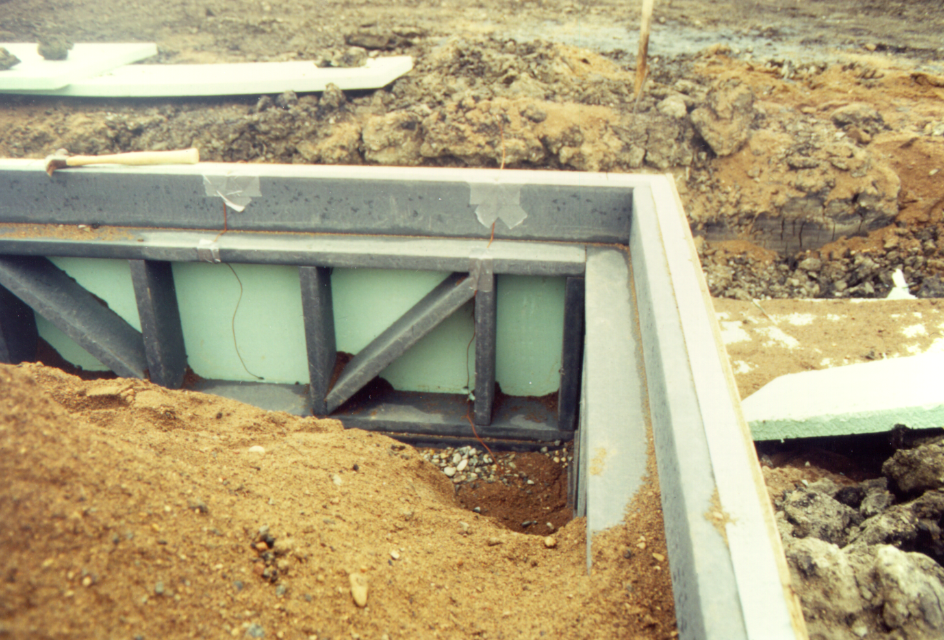
Test Site #5 – Fargo, ND

Slide 24
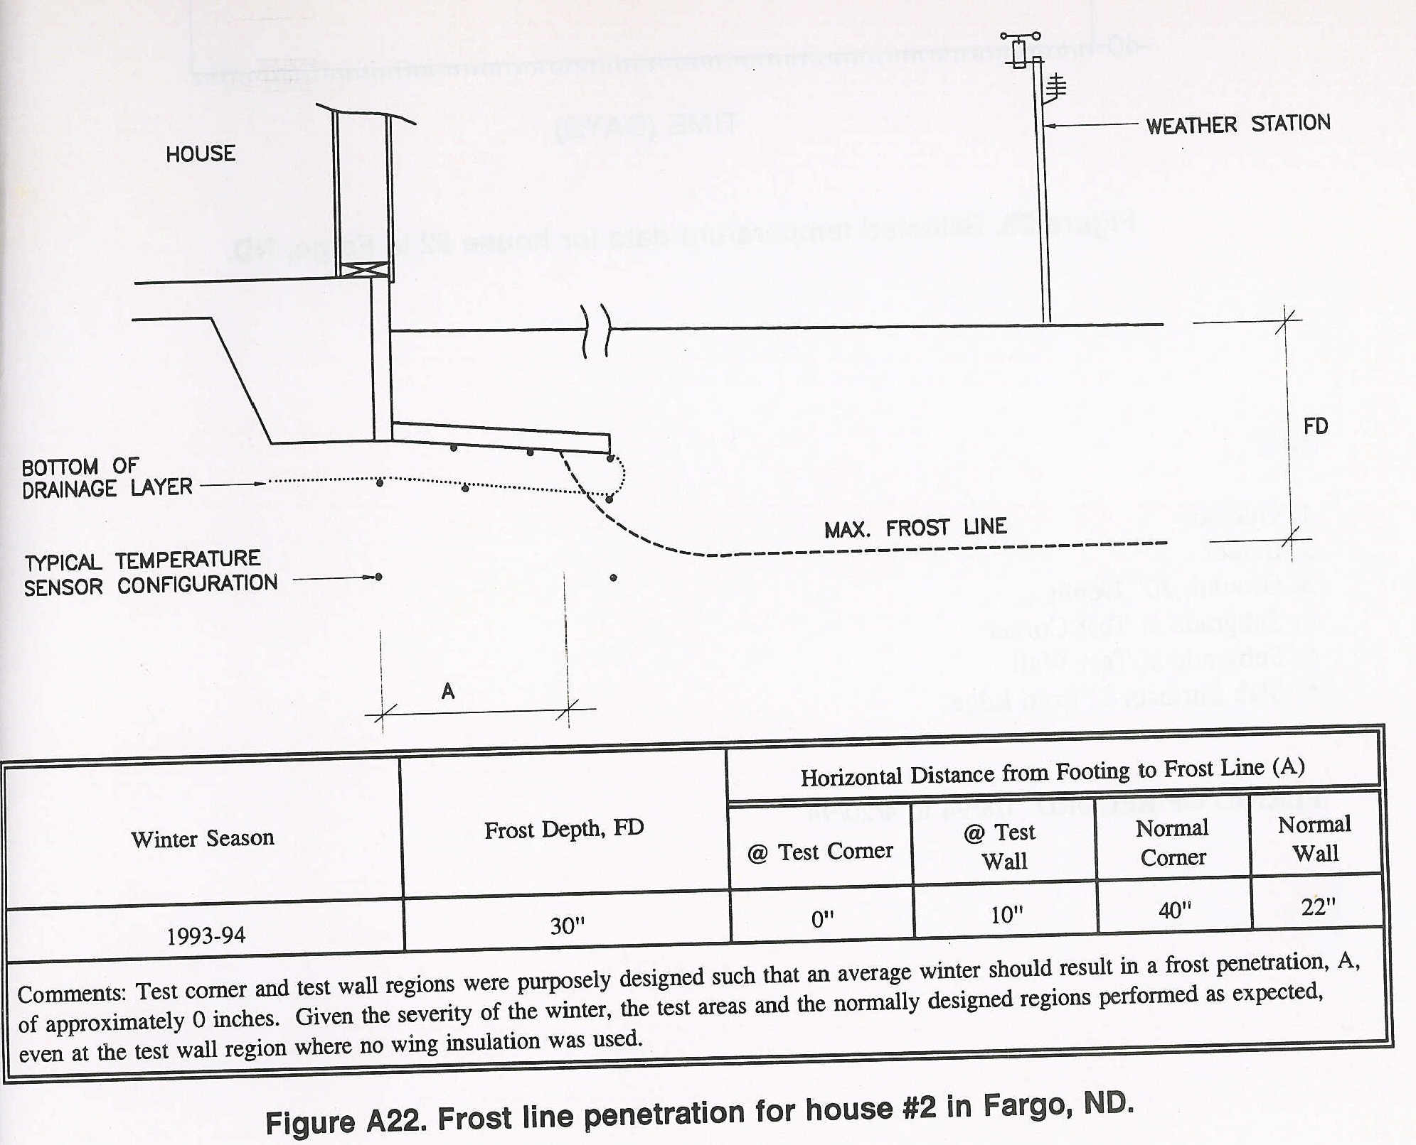
Test Site #5 - Results

Slide 25
Demonstration Projects
DOE / NREL (House in Colorado)
DOE Build America (various)
HUD/PATH Demonstrations (various)
Others?

Slide 26
FPSF Applications
Residential Buildings & Additions
Commercial Buildings
Infrastructure (U/G utilities, roads, dams, retaining walls, etc.)

Slide 27
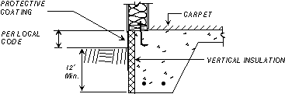
Applications: Slab on Ground (Heated Building)*
Monolithic thickened edge
Concrete stem wall
Permanent wood stem wall
CMU stem wall
* Recognized in IRC 2000/2003/2006

Slide 28
Applications:
Unvented Crawlspaces (Heated Building)*
* Unvented crawlspaces recognized in 2006 IRC Section R408.3. But, FPSF insulation must be determined in accordance with ASCE 32-01 (referenced in IRC and IBC)

Slide 29
Applications:
Walk-out Basement (Heated Building)*
Apply FPSF insulation to exterior of basement wall, or
Use Permanent wood walls (insulation in wall)
* Not addressed in IRC; must refer to ASCE 32

Slide 30
Applications:
Unheated Buildings*
* Must refer to ASCE 32 to size insulation and selection insulation type to support light structural loads
Ground insulation must “blanket” entire footprint of foundation
Also used for unheated
portions of heated buildings

Slide 31
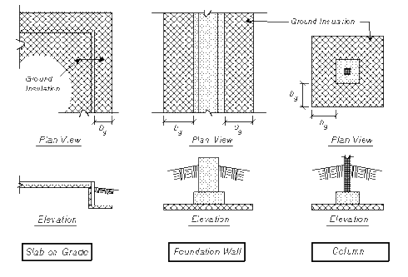
Applications:
Unheated “Cold” Foundations*
* Refer to ASCE 32
(not addressed in IRC)

Slide 32
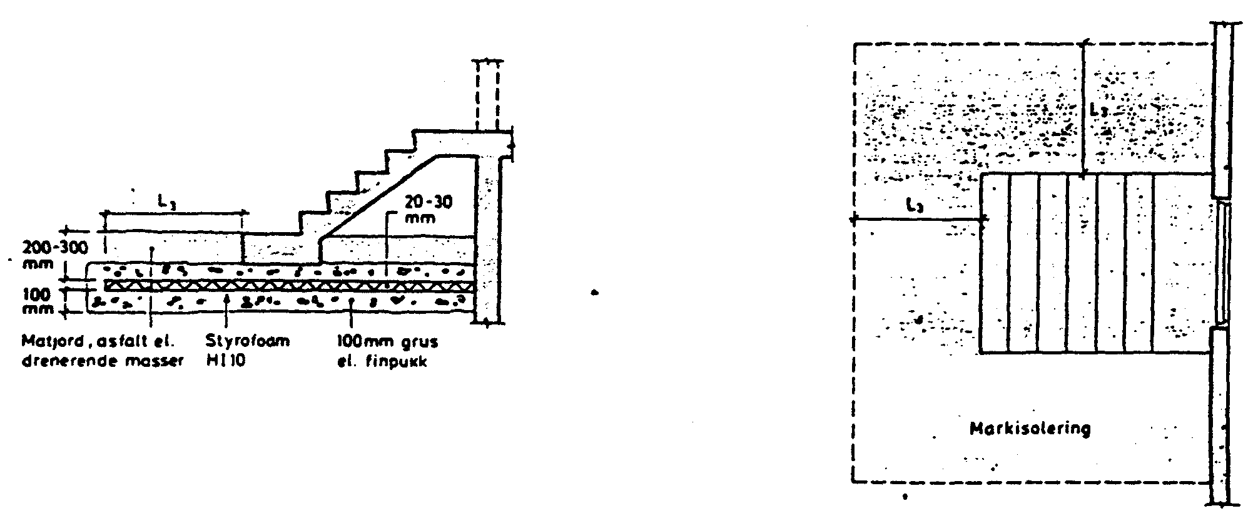
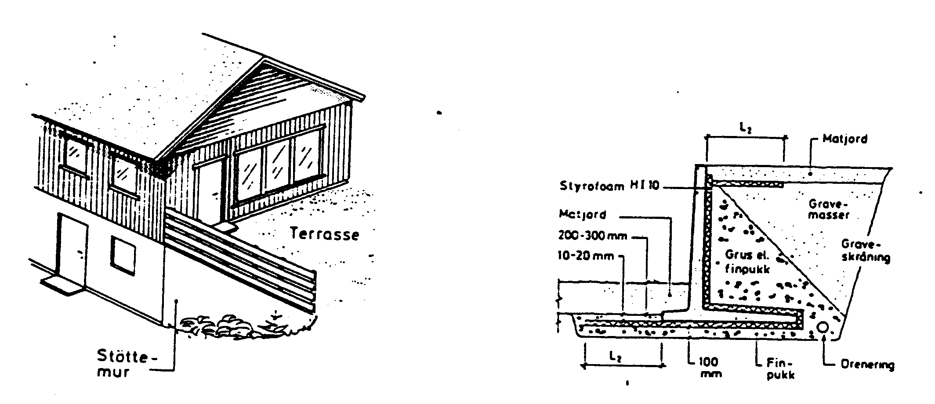
Applications:
Exterior Slabs/Stairs, Retaining Walls, U/G Wet Utilities*
*Not addressed in IRC or ASCE 32 – refer to Norwegian guidelines
Exterior Stairway
Retaining Wall
Utility Trench

Slide 33
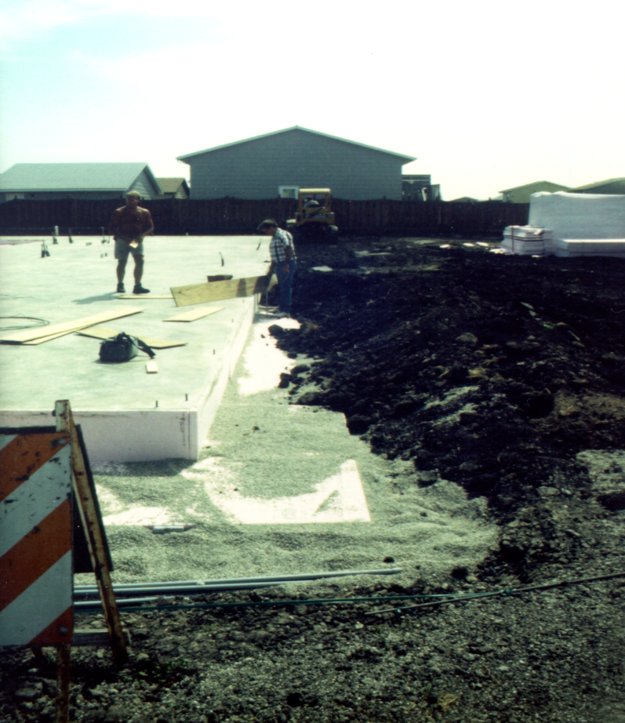
Construction Method (Monolithic SOG)
Form slab using vertical foam and cast slab
Place drain pipe (if horizontal insulation used)
Use concrete truck to place pea-gravel aggregate around foundation
Place horizontal insulation on smooth gravel surface
Protect vertical insulation (to 6” below grade)
Protect horizontal insulation if required and extends more than 24” from face of foundation
Backfill with loader

Slide 34
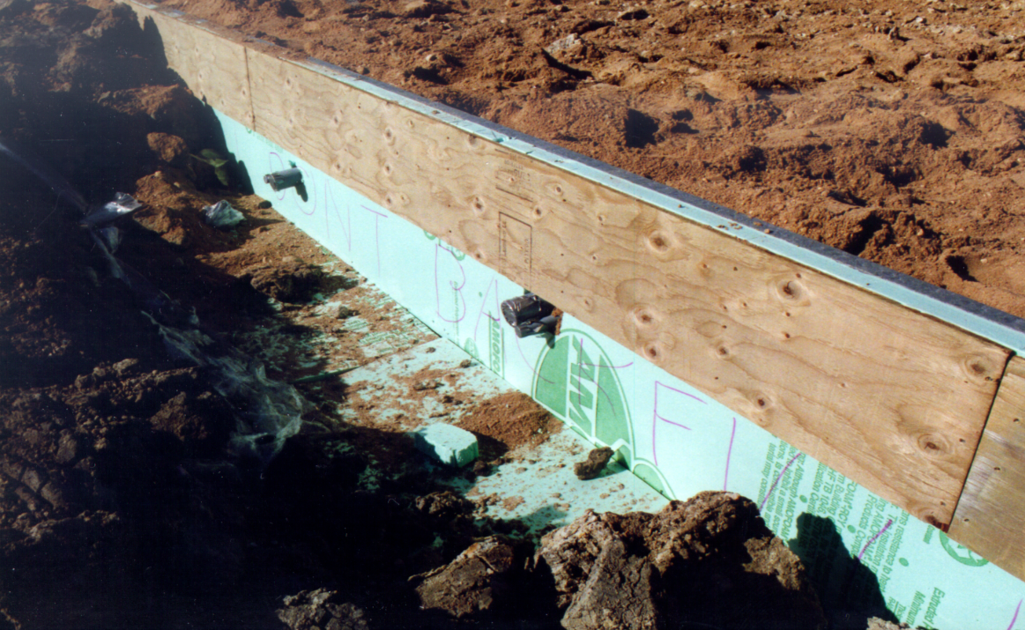
Construction Method (Plastic Lumber Stem Wall & SOG)
Insulation Protection
Electric Utility Rough-in

Slide 35
2006 IRC Requirements for FPSFs
SCOPE: heated building slab-on-grade foundations only–for other applications refer to ASCE 32.
STEP 1: Determine AFI per Figure R403.3(2)
STEP 2: Specify and size FPSF insulation per Figure R403.3(1) and Table R403.3*
STEP 3: Details
  Joining to heated or unheated foundations (R403.3.1)
  Protection of insulation (R403.3.2)
  Drainage (R403.3.3)
  Termite protection (R403.3.4)
*Only XPS and EPS insulation materials listed in Table R403.3(2) and complying with ASTM C578
are permitted for FPSF construction

Slide 36
Example Problem: Lincoln, NE
STEP 1: 100-yr AFI = ~1,500 ºF-days
For AFI by local weather stations, refer to http://lwf.ncdc.noaa.gov/oa/fpsf
Figure R403.3(2) Air-Freezing Index
Estimate of the 100-Year Return Period

Slide 37
Example Problem: Lincoln, NE
STEP 2: To determine insulation thickness, divide required R-value by effective R-per-inch values (for below ground service) in footnote ‘c’ of Table R403.2
R-req’d = 4.5
Eff. R/in = 3.2
(Type IX EPS)
Thickness =
4.5R / 3.2R/in
= 1.4” (use 1.5”)
Or
Eff.R/in = 4.5
(Type IV XPS)
Thickness =
4.5R / 4.5R/in
= 1.0”
Table R403.3
Minimum Insulation Requirements for Frost-Protected Footings in Heated Buildings

Slide 38
Example Problem: Lincoln, NE
STEP 3: Details (Foundation wall cross section)
Figure R403.3(1)
Insulation Placement for
Frost-Protected Footings in Heated Buildings

Slide 39
Example Problem: Lincoln, NE
STEP 3: Details (Foundation Insulation Plan)
(NOT REQUIRED)
Figure R403.3(1)
Insulation Placement for
Frost-Protected Footings in Heated Buildings

Slide 40
Special Conditions
IRC 403.3.1.1 – Unheated building conventional foundation (e.g., garage) adjoining an FPSF foundation (e.g., house); shows insulation at interface of foundations
IRC 403.3.1.2 – FPSF foundation (e.g., addition) adjoining a conventional heated building foundation (e.g., existing house)

Slide 41
Additional Requirements
Figure R403.3(1) – Vertical insulation must be protected against physical damage and U/V radiation from top of foundation to 6” below grade (various options such as trt’d plywood, elastomeric coatings, stucco, etc.)
Section R403.3.2 – Horizontal insulation must be protected if less than 12” below grade or when extending outward more than 24”

Slide 42
Additional Requirements
R403.3.3 – Drainage layer and drain to daylight required under horizontal insulation; slope finish grade to drain away from building
R403.3.4 – provide termite protection per R320.5*
*Per Section R320.5, foundation wall insulation must be terminated above ground to allow a minimum 6” inspection strip in areas with “heavy” termite infestation probability. This inspection strip is not permitted with FPSF (creates a thermal short circuit). Therefore, recommend using foam impregnated with termiticide in “heavy” areas.

Slide 43
Verify FPSF Insulation Meets Energy Code
2006 IRC Chapter 11, Table N1102.1 requires R10 slab edge insulation, 2’ wide (Climate Zone 5)
FPSF design for Lincoln, NE requires 1.0” of nominal 5 R/in XPS which gives 1.0” x 5 R/in = 5.0R (or 1.5” EPS x 4.2 R/in = R6.3, nominal) << R10
Now What?
(1) increase FPSF thickness to meet energy code (or use IECC energy code trade-off), or
(2) Use DOE Building Foundation Design Handbook (Table 4-1) to show that using 2’ of R5 insulation on the exterior face of the foundation (FPSF design) saves more energy than using 2’ or R10 insulation placed horizontally under the slab as permitted by the energy code.

Slide 44
Plan Review and Inspection Checklist
✓ Insulation type (per ASTM C578)
✓ Insulation dimensions and continuity
✓ Foundation depths
✓ Distance from top of slab to grade
✓ Protection of insulation
✓ Termite precautions
✓ Drainage

Slide 45
Overview of ASCE 32
Provides for three different building use conditions (heated, semi-heated, and unheated)
Provides insulation requirements for slab on grade, crawlspace, and basement foundations.
Provides insulation requirements for isolated footings or small unheated areas of otherwise heated buildings
Allows horizontal (wing) insulation to be reduced in size in trade-off with increasing minimum foundation depth
Provides guidance for use of non-frost susceptible fills
Future edition may include a risk-consistent frost depth map for conventional foundations correlated to the AFI map in the IRC and ASCE 32 based on work by Cornell University and NOAA. For example, Lincoln, NE (AFI = 1,500 ºF-days) would have a design frost depth of 32” – not very different than current practice of 36” – southern U.S. and seaboard states will be affected more by this change.
…..ASCE 32 is a reference standard in the 2003/2006 IRC and IBC and is applicable to foundation and building types addressed in the IRC and IBC.

Slide 46
Resources and References
IRC 2006 (www.iccsafe.org)
IBC 2006 (www.iccsafe.org)
Revised Builder’s Guide to FPSFs
(www.toolbase.org or www.nahb.org)
Various FPSF research reports and older design guides (www.huduser.org)
ASCE Standard 32-10 (www.asce.org)

Slide 47
Conclusions
$1,000-$4,000 cost savings per home/business
$75/yr energy savings
Long history of successful performance
Easy to design
Easy to build
Easy to inspect
Any questions?

