Slide 1
Building Envelopes for Healthy & Resilient Buildings in a Post-COVID-19 Pandemic World
Amy Schmidt DuPont Performance Building Solutions
Jay Crandell, P.E. ABTG/ARES Consulting

Slide 3
Outline
Introduction
History Repeats Itself
What can we do?
The Role of Building Science for Healthy Buildings
HVAC Actions
Building Envelope Actions
Conclusions
Questions

Slide 4
COVID-19 Has Us Concerned About Protecting Ourselves and Others

Slide 5
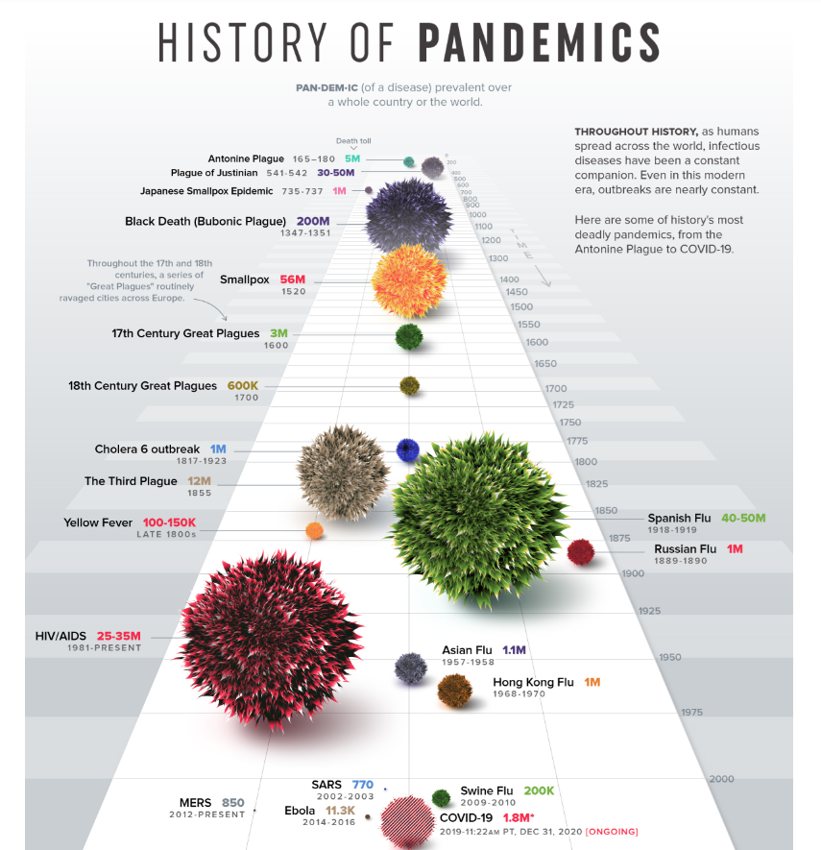
Pandemics are nothing new
Source: https://www.visualcapitalist.com/history-of-pandemics-deadliest/

Slide 6
We’ve Been Here Before

Slide 7
And we will be here again

Slide 8
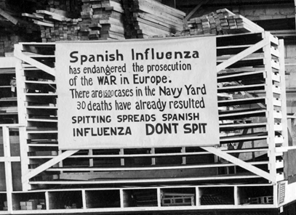
History repeats itself

Slide 9
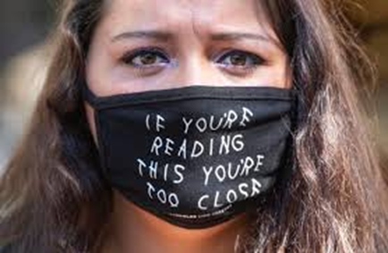
The similarities are striking

Slide 10
The pandemics will come but our preparation can be different. We can be more resilient.

Slide 11
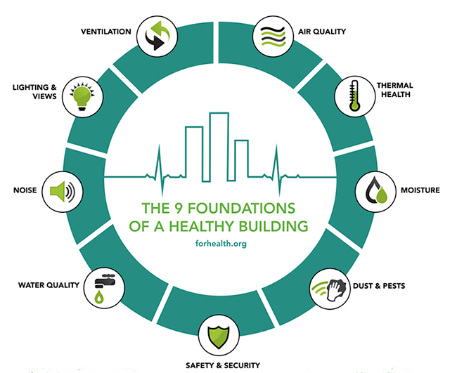
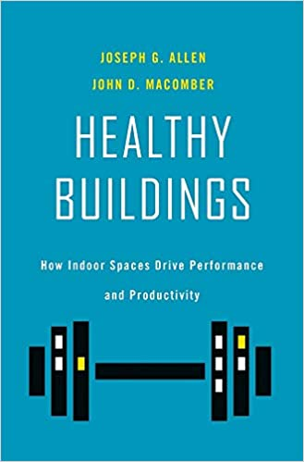
Building design needs to play a role
Building envelopes play a direct and indirect role in all of these foundations of healthy buildings.
Source: https://hbswk.hbs.edu/item/why-covid-19-raises-the-stakes-for-building-health

Slide 12
Buildings also Play an Important Role in Protecting Ourselves and Others
“Think of the building envelope as the protective skin or PPE of the building and the HVAC system as the internal lymphatic system to maintain internal health and help suppress pathogen propagation and survival within the buildings body.”
Source: ABTG RR No 2006-01, p.8, https://www.continuousinsulation.org/topical-library/healthy-buildings

Slide 13
The Role of Building Science
Building Science – the application of science as it relates to the physical behavior of buildings as systems with many interactions
Source: https://www.wbdg.org/resources/building-science-concepts

Slide 14
Relevant Science for Healthy Buildings
Sociology – the study of human behavior
Biology – the study of life and living organisms
Economics – the study of how society uses its limited resources

Slide 15
Sociology
People in the U.S. spend about 87% of their time indoors.
Over 2,000 COVID-19 superspreader events (SSEs) worldwide
Nearly all SSEs occurred indoors
Most involved confinement for extended time
Higher frequency during flu season
Indoor environment is important to health and safety.

Slide 16
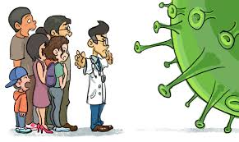
Biology
People and other organisms need the following things to live:
Oxygen (O₂)
Water (H₂O)
Food (energy and nutrition)
Protection (extreme temperature, solar UV radiation, pathogens, natural and man-made hazards, etc.)

Slide 17
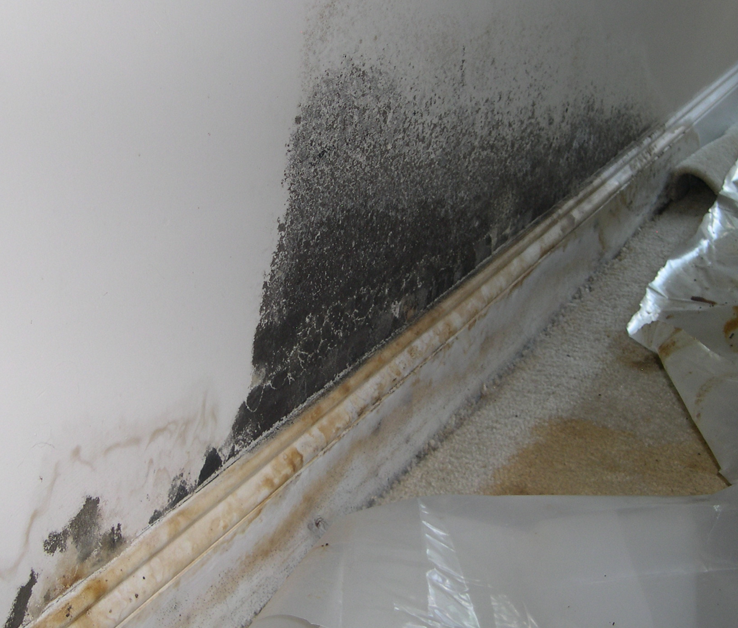
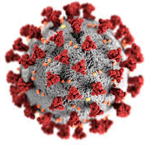
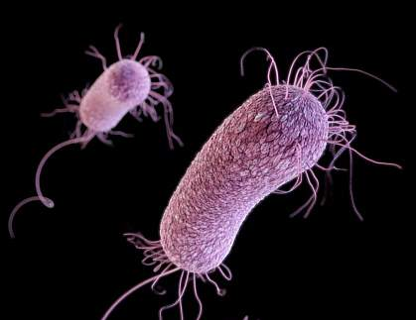
Biology
Pathogens
Molds
Bacteria
Viruses

Slide 18
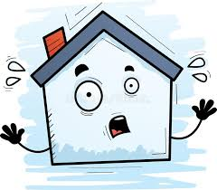
Biology
Molds and bacteria are prolific and thrive in buildings when conditions are conducive.
Temperature
Humidity/water
Food source
Molds and bacteria tend to have optimal temperature and moisture conditions for survivability.

Slide 19
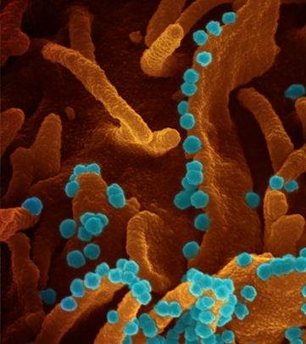
Biology / Virology
Viruses require a host to replicate and propagate.
Example: just one infected kidney cell can shed thousands of SARS Cov2 virions that then infect other cells of the host (see electron microscope image)
Source: https://directorsblog.nih.gov/2020/04/28/capturing-viral-shedding-in-action/

Slide 20
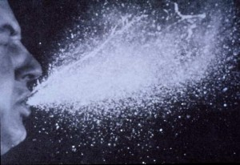
Biology / Virology
Viruses become part of the building biome by “shedding” of body fluids from a host
Coughing
Talking & Breathing & Touching
Urine and Feces

Slide 21
Biology / Virology
Viruses exist and are transferred to others in the building environment by:
Infectious droplets on building surfaces (fomite transmission)
Infectious aerosols suspended in the air (air-borne transmission)
Dose/Exposure and vulnerability are important factors determining risk
When exposed to the building environment (i.e., shed from a host), virions tend to have optimal conditions for survivability.
Guangzhou restaurant superspreader event
Source: Jay C. Butler, MD, Center for Disease Control, “Importance of Understanding the Role of Airborne Transmission in COVID-19” (image attributed to Li Y, et al. MedRxIV preprint) https://doi.org/10.1101/2020.04.16.20067728

Slide 22
The “Health Window” for Indoor Humidity
40% to 60% indoor relative humidity favors human respiratory defenses against air-borne disease (REDUCED VULNERABILITY)
It also tends to disfavor survival of many types of pathogens (REDUCED HAZARD, VIRAL BURDEN)
These trends are representative and have much variation (e.g., SARS Cov-2 survivability considered to be mildly influenced by RH).
Why does this chart show a “Healthy Zone” of 30% to 60% RH if the optimal “Health Window” is 40% to 60% RH?
ANSWER: Building envelopes must be designed more robustly to withstand 40% RH during winter in cold climates.

Slide 23
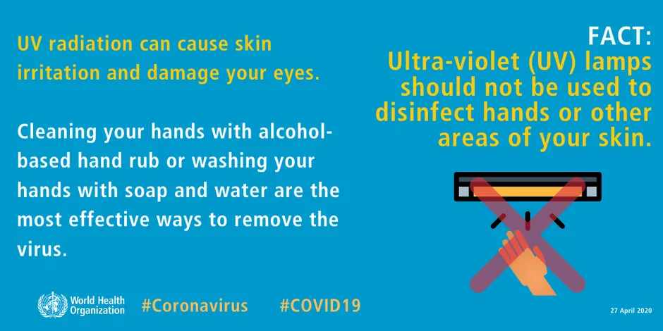
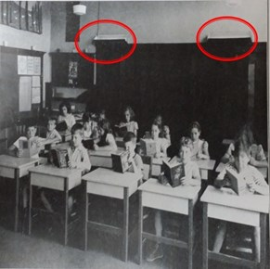
UVGI – Ultra-Violet Germicidal Irradiation (aka, killing germs with UV light)
Not healthy for humans (sunburn, skin cancer, eye damage, etc.)
But, also not healthy for pathogens
~260 nm most effective U/V wavelength to disable many types of pathogens
Dose is important
Effectiveness known since 1800s
Measles outbreak in 1930s during U/V upper room air treatment experiment:
50% measles transmission in school rooms without U/V treatment
Only 15% in rooms with U/V treatment
Source: http://www.uvresources.com/blog/uv-c-lamps-a-short-wave-history/

Slide 24
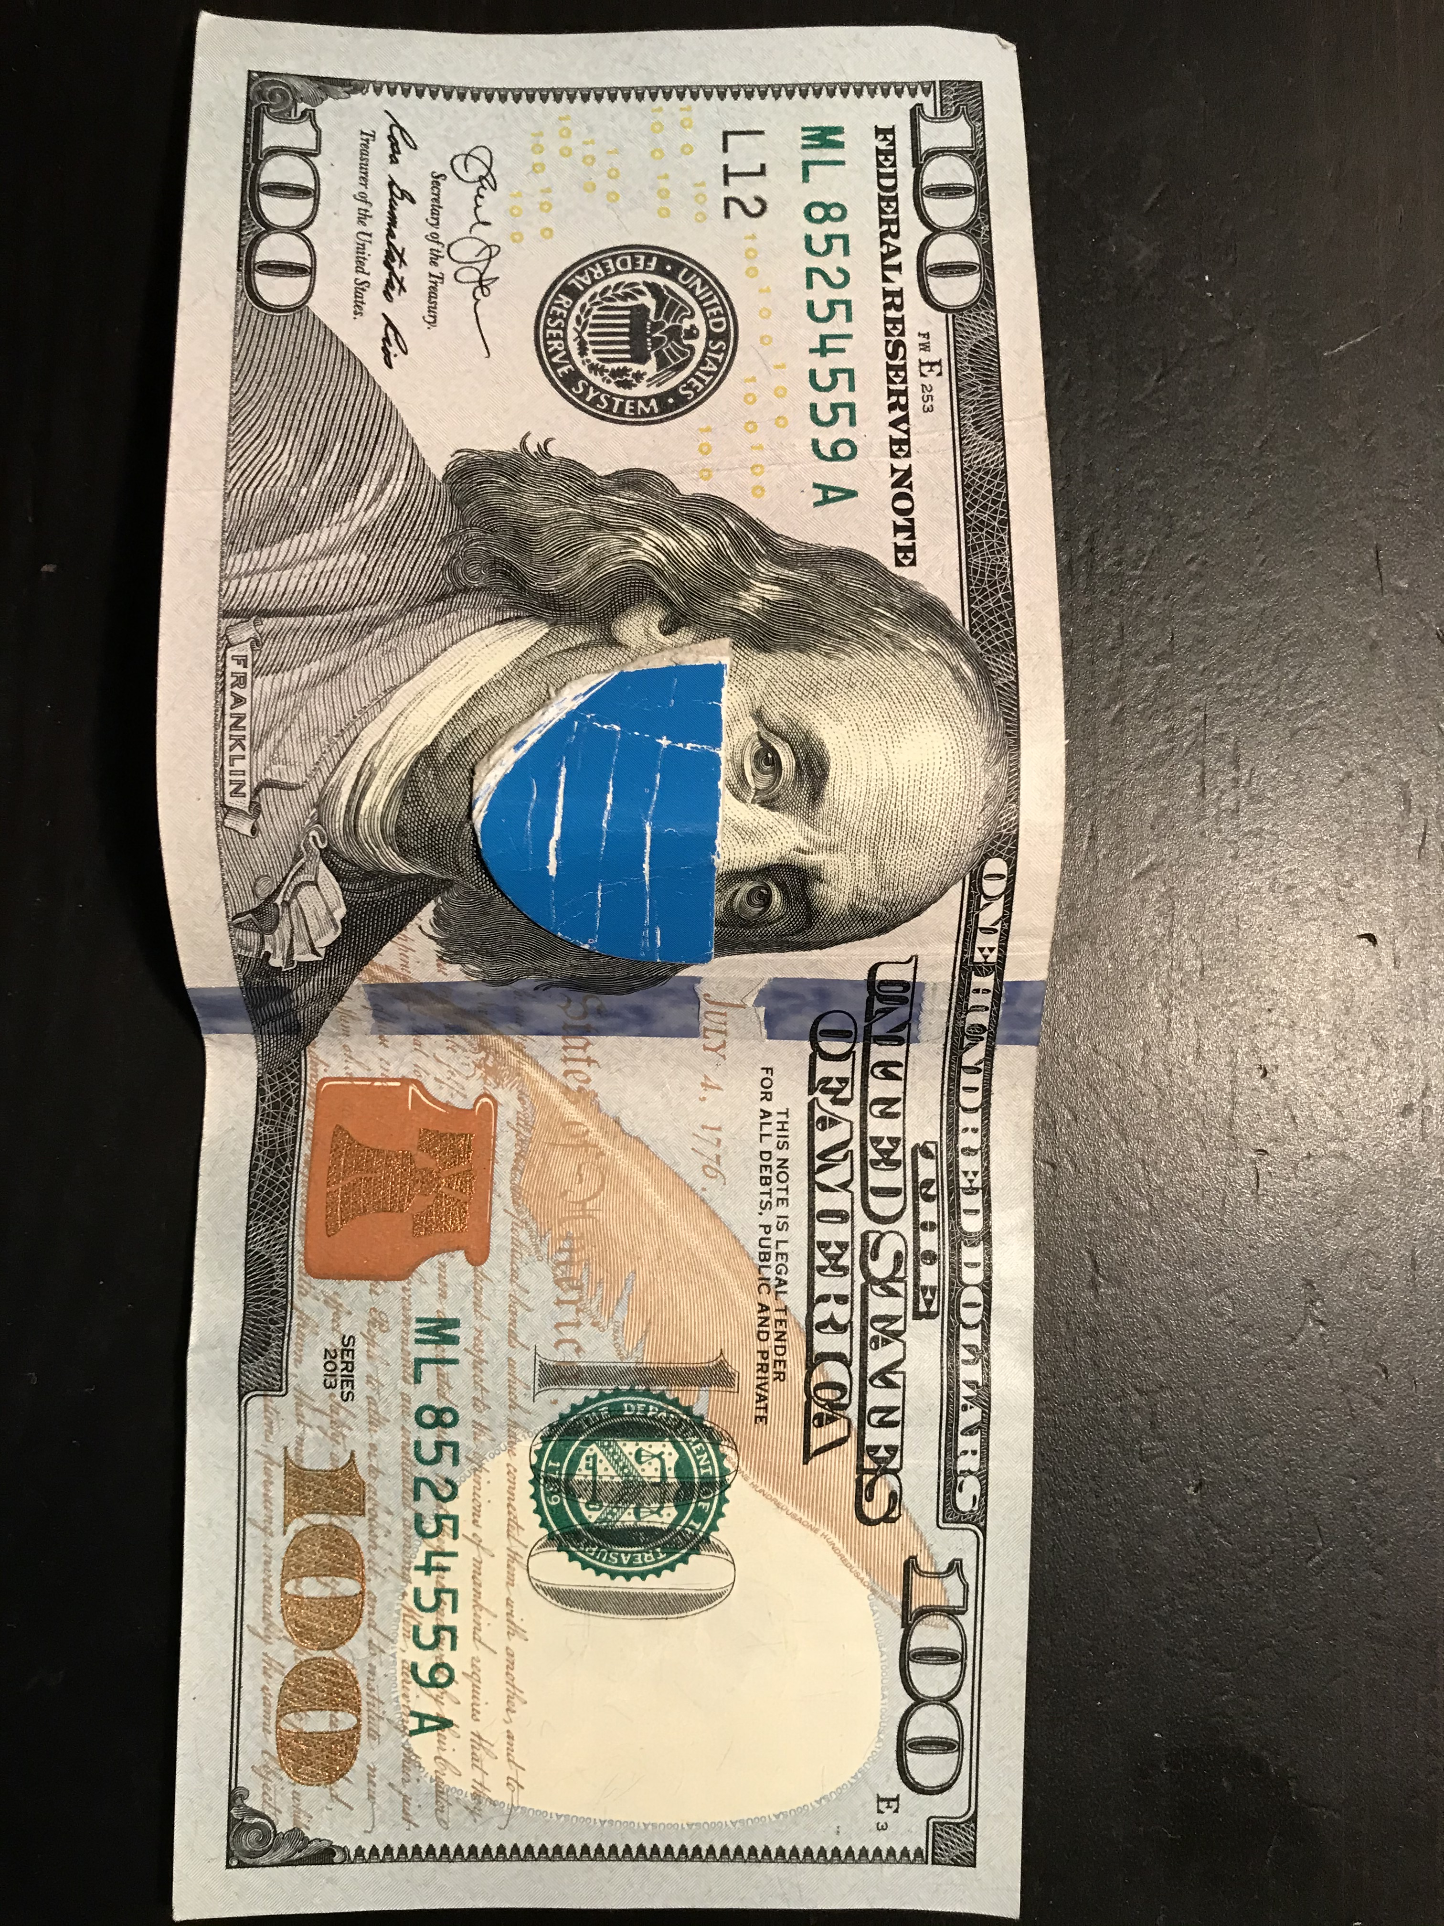
Economics
Cost of COVID-19: $3,000,000,000,000+
~$9,000+ per capita every ~100 years
Annual Cost of Colds/Flu: $130,000,000,000
~$400 per capita every year!
Value of healthy building improvements estimated to be $25 to $150 billion per year
Doesn’t include energy savings benefits

Slide 25
Economics
Retrofitting/weatherizing 200,000 homes could save an estimated $600 million over 10 years in consideration of several health benefits.
Generally, estimated $3 dollar benefit for every $1 invested.
Source: ACEEE

Slide 26
Economics
Difficult to precisely quantify and monetize these benefits, but a clear potential for health and economic benefits exists.
Health risks must be balanced with cost-effective measures to implement in new and existing buildings

Slide 27
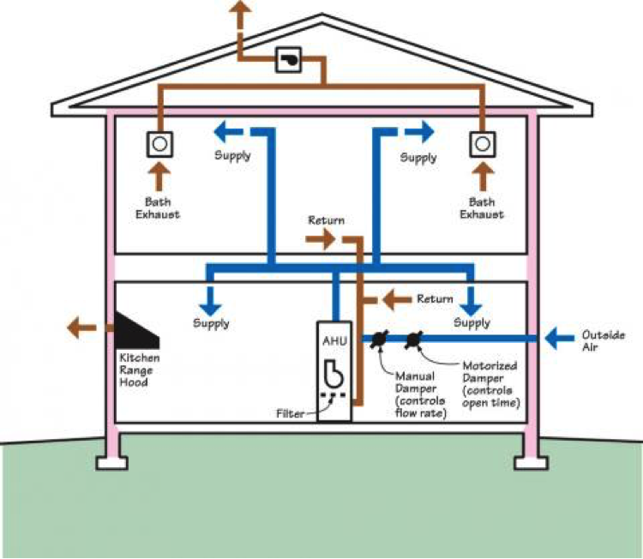
Building Science Applications – The Role of HVAC Systems
Objective: Control the indoor air quality
Air Quality Measures:
Temperature (set points)
Heating – 68ºF
Cooling – 75ºF
Mechanical ventilation (Outdoor air + indoor air recirculation)
Indoor air hygiene (particulate burden)
Indoor air humidity
Controlling these measures is not a substitute for other interventions during periods of high risk (PPE, social distancing, disinfecting surfaces, etc.)
Source: https://basc.pnnl.gov/resource-guides/outdoor-air-intake-damper-controlled

Slide 28
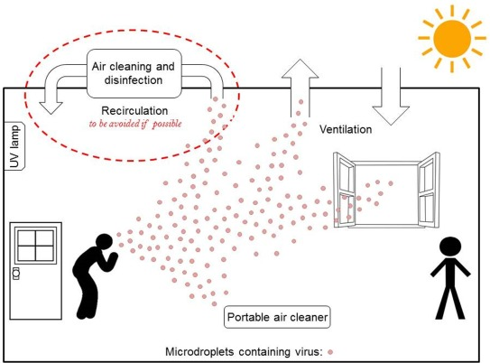
Outdoor Air Ventilation
Dilution with outdoor air
Mechanical Ventilation (HVAC System)
Natural Ventilation (operable windows)
Must consider trade-off in control of indoor air humidity, temperature, and energy penalty
Many recommend code-minimum ventilation is sufficient with good filtration
Consider higher outdoor air ventilation rate during high occupancy and for “flushing” before and after events (weather permitting)

Slide 29
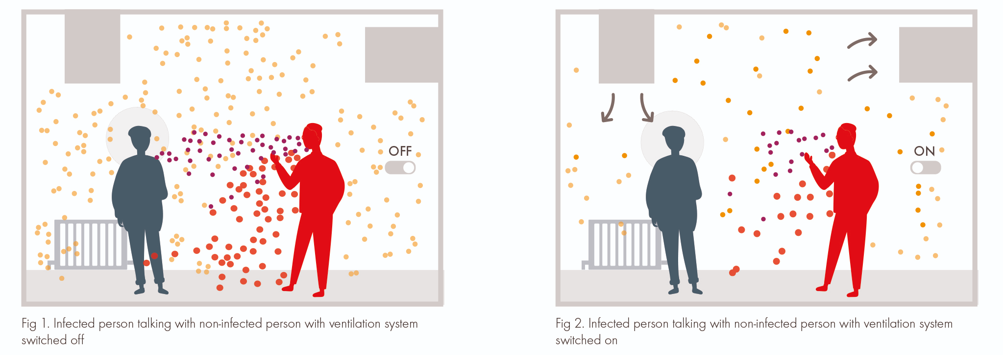
Filtration
The HVAC filter is like your mask
If the ventilation fan is not running, it will not filter/clean the indoor air
Run fan “on” (instead of auto) during high occupancy
Avoid high velocity room airflows from supply registers

Slide 30
Filtration Efficiency Ratings
Use the most efficient filter that your HVAC system and budget will allow:
MERV 13 (~FPR 10) often recommended
MERV 11 (~FPR 7) is better than MERV 8 (~FPR 5)
Generally, less than MERV 8 is not recommend (very low capture efficiency for “viral-sized” particles < 1 micron or 0.00004”)
Filter “blow-by” (poor fitting) will decrease filtration effectiveness
Source: Zhang, et al., Study of Viral Filtration Performance of Residential HVAC Filters, ASHRAE Journal, August 2020

Slide 31
Filtration Pressure Drop
Getting the “best” filter is not always the best for the HVAC system
Filter resistance to air flow (pressure drop) also is important
Must match the capability of the HVAC system and fan, including energy penalty for higher pressure drop
Not all filters are equal
Significantly higher or lower pressure drops for different filter brands with the same MERV rating
Source: CEC, Staff Supplement to Case Report #2019-RES-IAQ-F

Slide 32
Room Filtration
When all else fails?
Consider a portable room air cleaner
The only option where the HVAC system does not use forced air
Also useful in “quarantine rooms”
Source: https://www.consumerreports.org/cro/air-purifiers/buying-guide/index.htm

Slide 33
UV Treatment of Indoor Air
In-duct systems
Room upper air systems
Portable treatment systems
Must be designed to get the desired treatment level
Generally considered for uses where risk and consequences of disease transmission are high
Source: https://peerj.com/articles/10196/

Slide 34
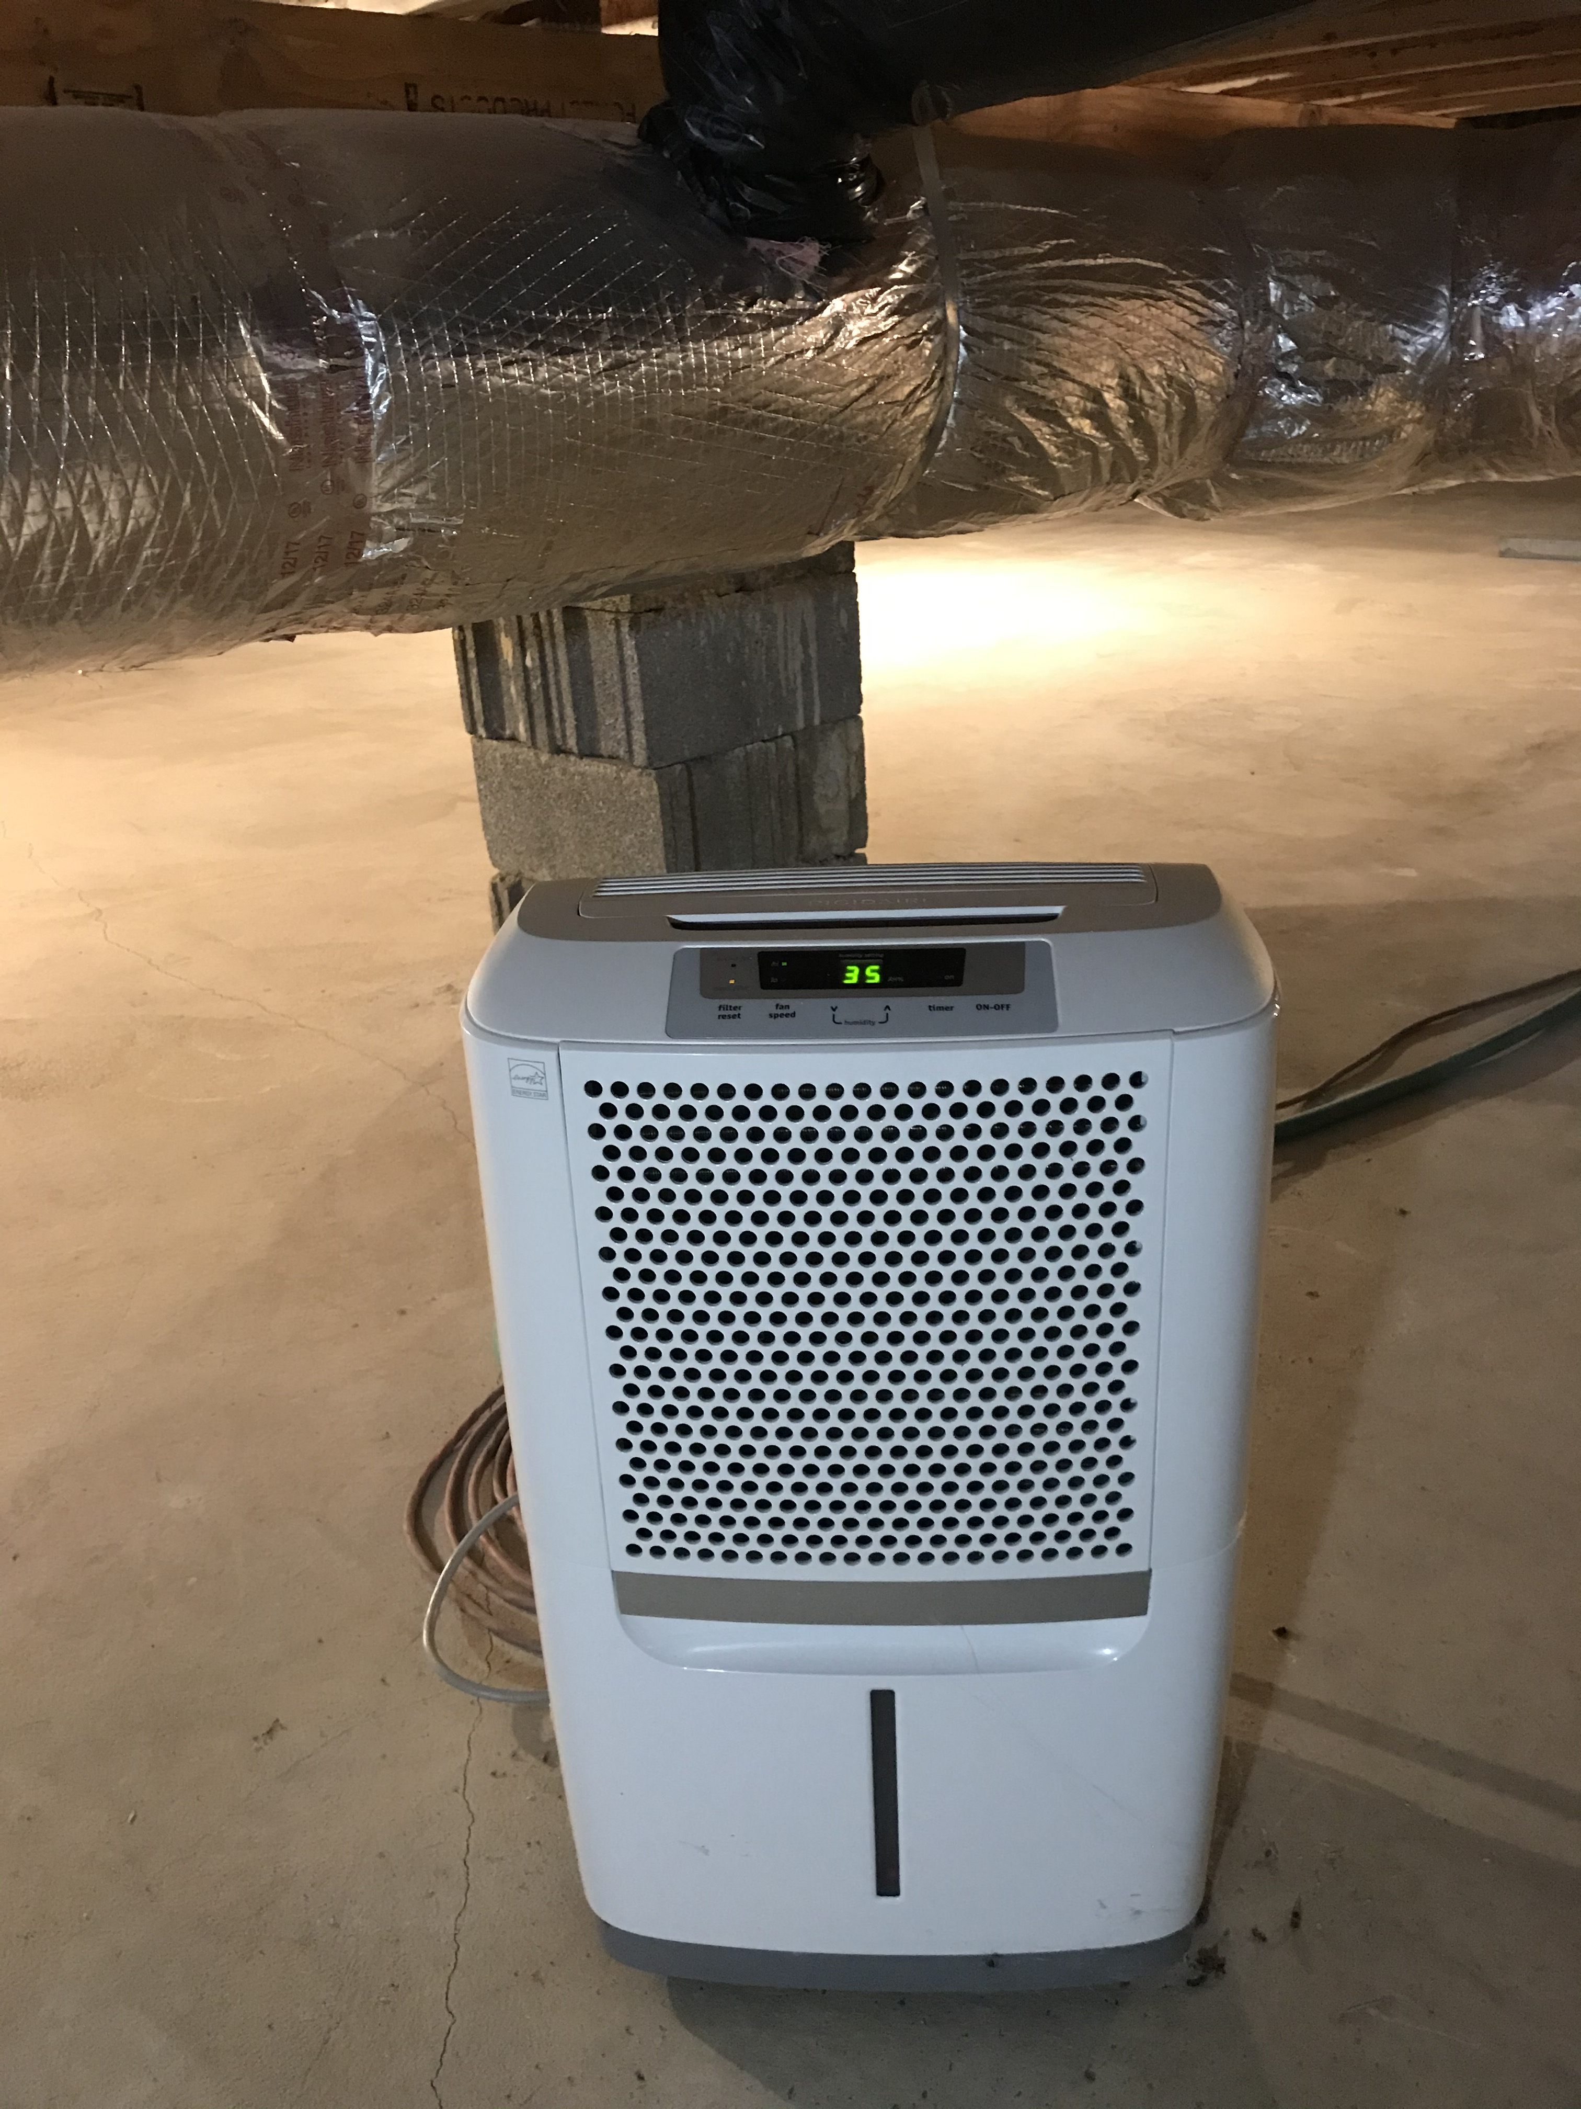
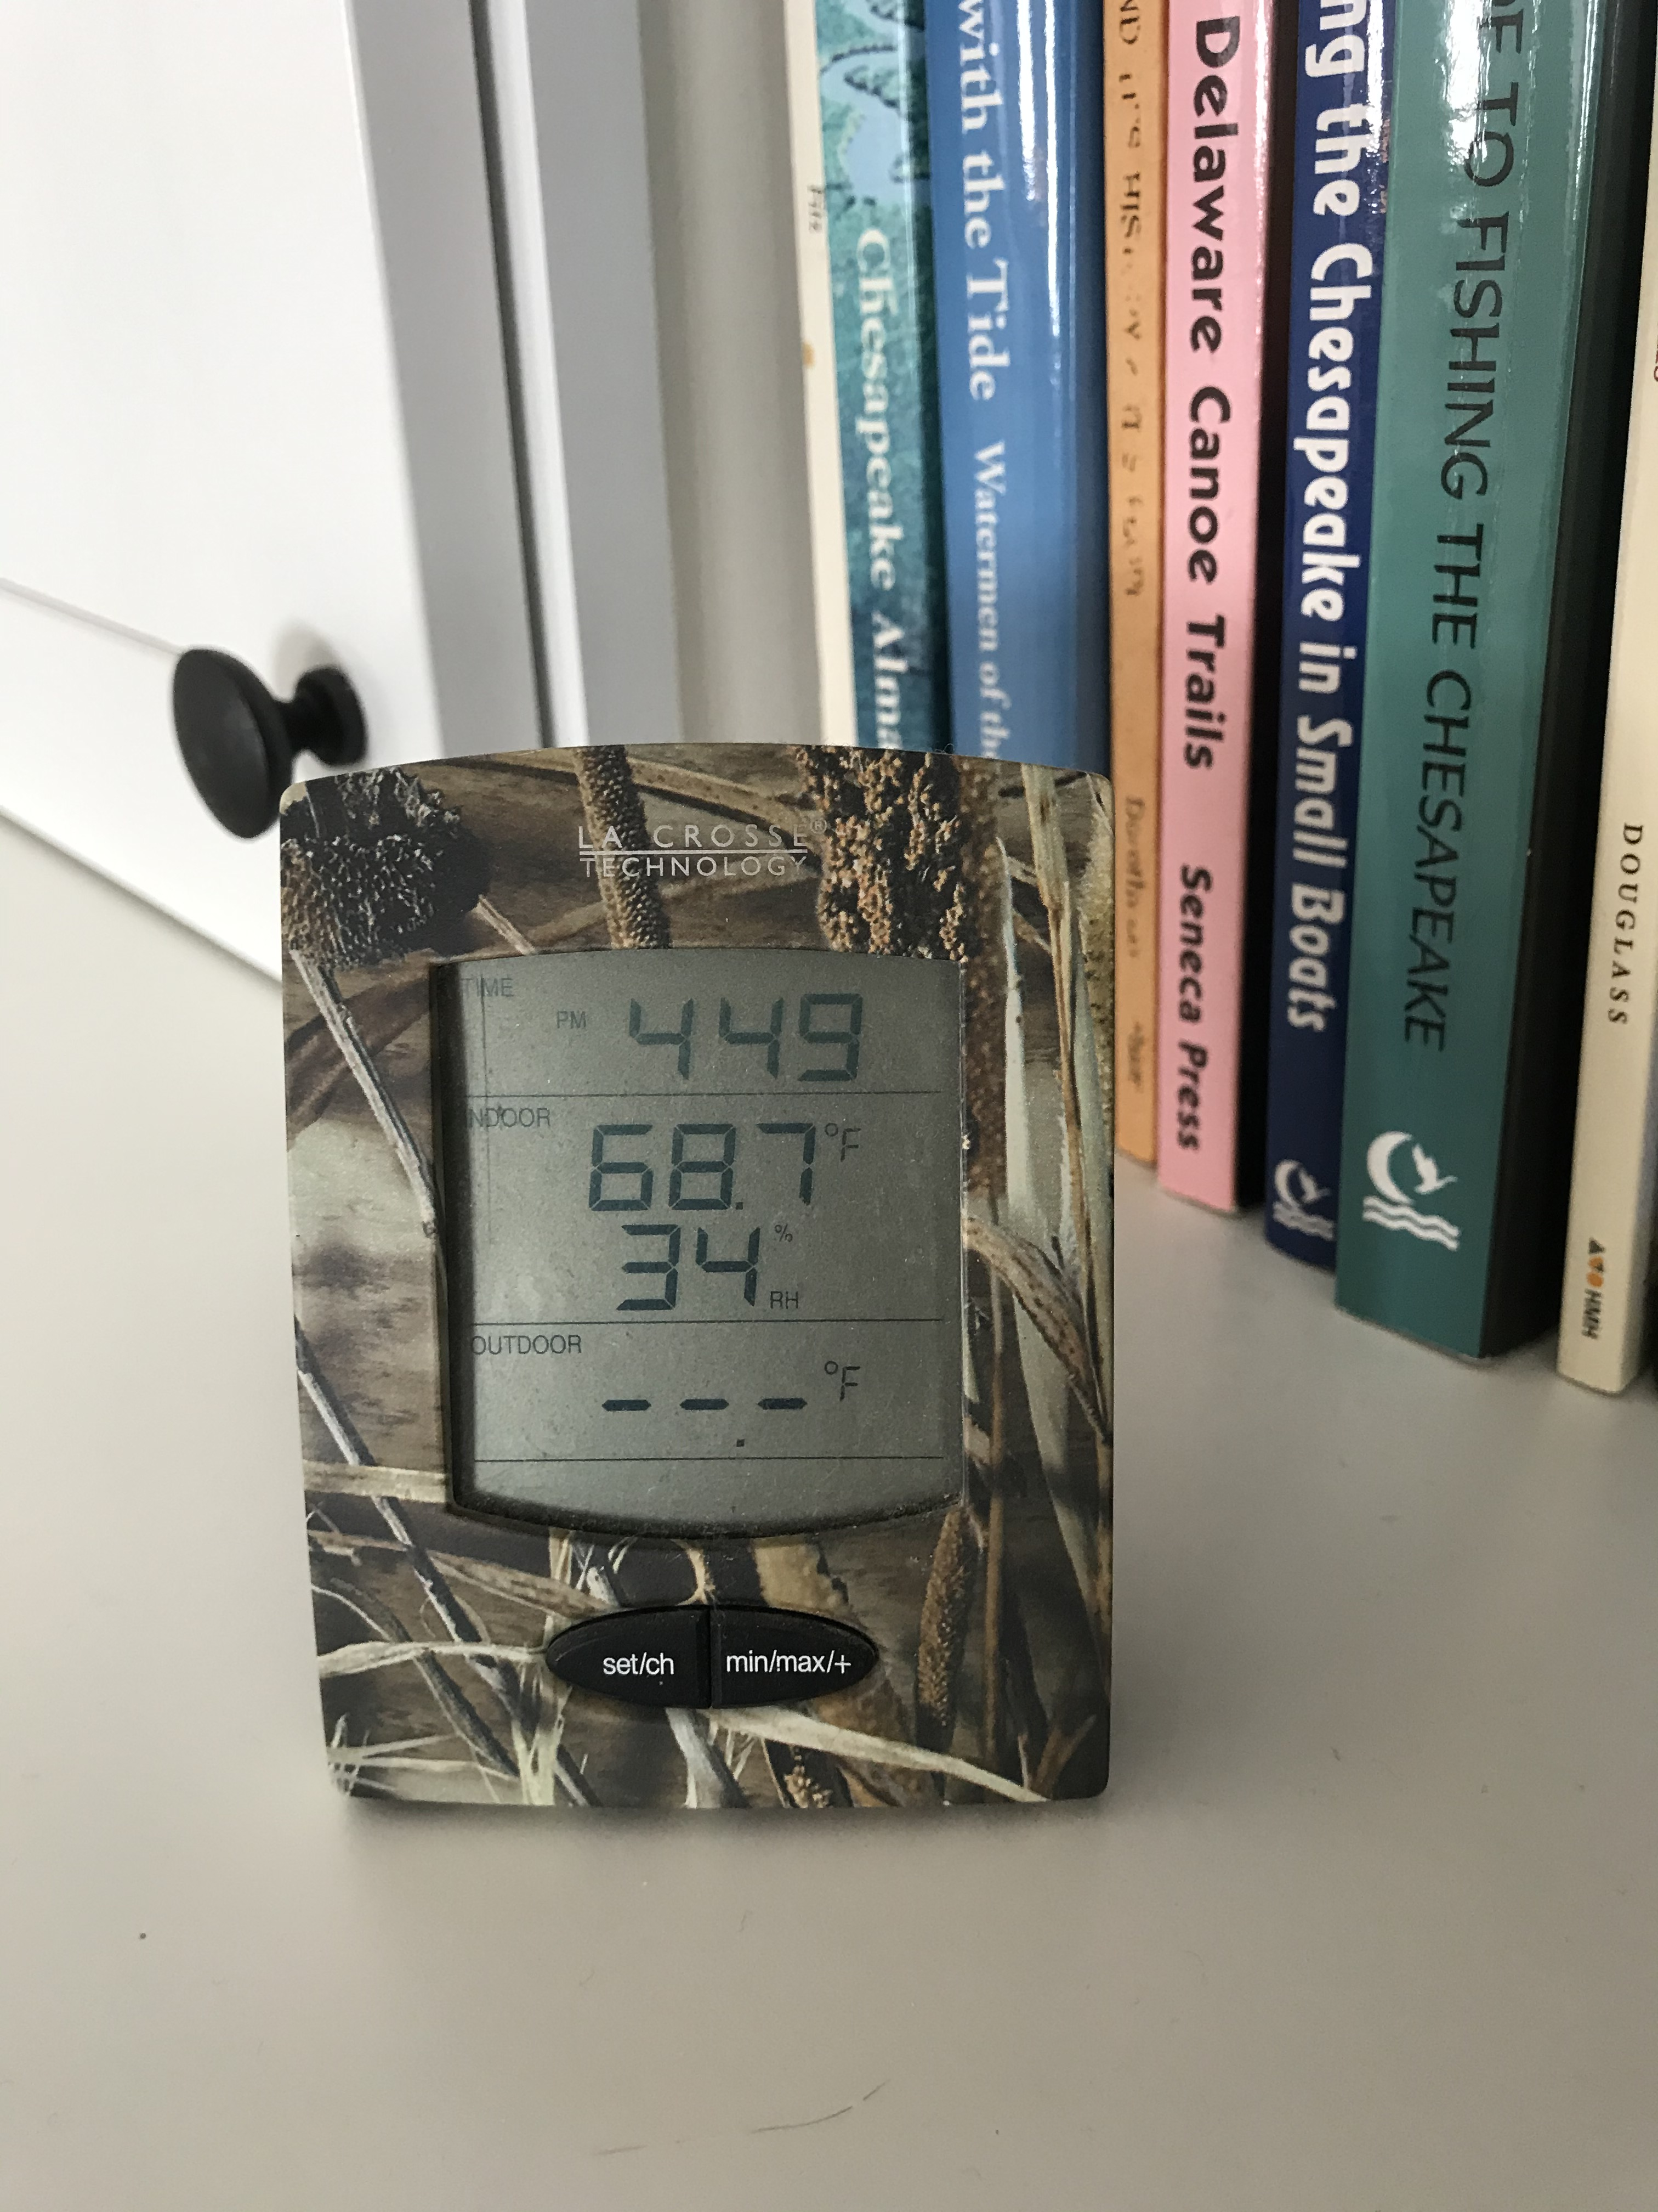
Indoor Relative Humidity
Health Window (target): 40% to 60% RH
Difficult to maintain 100% of the time.
Summer: max 65% for short periods probably OK
Winter: min 35% for short periods probably OK
Ability to control RH also depends on:
Occupancy conditions (moisture load)
Tightness of building envelope
Outdoor air ventilation rate
Control methods:
Manually controlled equipment/sensors (retrofit)
Automated equipment/sensors (built-in)
Maintenance is important

Slide 35
ASHRAE Indoor Air Quality Guide
EXAMPLE: Unless designed for it, many building envelopes meeting minimum code compliance are unable to endure a prolonged exposure to 40% indoor RH during the winter in cold climates.

Slide 36
Building Science Applications – The Role of the Building Envelope
The primary function of a building envelope is to separate the indoor from the outdoor environment.
“Without a good building envelope, the previous HVAC system and design actions become more difficult and costly, and uncertain in their effectiveness.”
Source: ABTG RR No. 2006-01, p10, https://www.continuousinsulation.org/topical-library/healthy-buildings
Source: HUD, Durability by Design

Slide 37
Applications – Building Envelope
Benefits of a Good Building Envelope:
Better energy efficiency, less costly to operate as a healthy building
Better moderate indoor temperature and humidity
Better moderate temperature and humidity within the envelope assembly itself
Minimize thermal bridging to avoid “cold” or “hot-spots” with can promote condensation, mold-growth, corrosion, etc.
Provide sustained protection to occupants during power outages.
Control layers in a building envelope support all of these benefits
Source: https://www.continuousinsulation.org/content/2021-ibc-irc-adopt-improved-vapor-retarder-requirements

Slide 38
Applications – Building Envelope
Building Envelope Control Layers:
Water control layers (cladding + continuous water-resistive barrier to prevent water intrusion)
Air control layer (continuous air barrier to prevent air leakage)
Thermal control layer (continuity of thermal insulation to prevent heat loss/gain and control surface temperatures)
Water vapor control layer (use of vapor retarders in coordination with insulation strategy)
Example Wall Assembly for Maximal Compatibility with and Support of a Healthy Indoor Environment in Any Climate Zone

Slide 39
Applications – Building Envelope
Water vapor control is perhaps the most tricky due to many inter-dependencies
Resources:
Wood Wall Calculator
Water Vapor Control
Basis of newer vapor retarder provisions in 2021 IRC and IBC

Slide 40
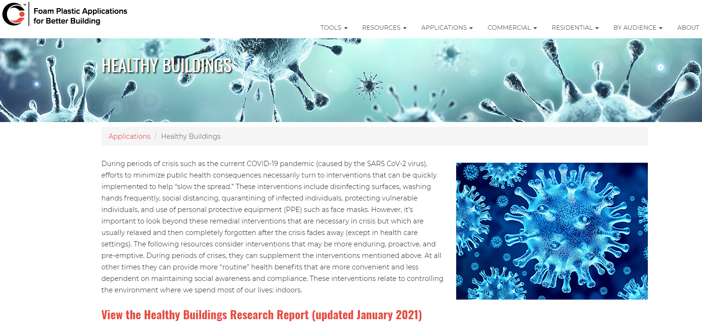
Find Helpful Resources at Ci.org
continuousinsulation.org/healthybuildings

Slide 41
Conclusions
History repeats itself:
Pandemics will come again
Routine health threats will persist
We can be more prepared and resilient if we design buildings to better mitigate these threats
Various branches of science intersect to build a strong case for reasonable actions
Building science integrates related science to guide optimal design for occupant health and protection, energy efficiency, and durability through coordinated:
HVAC System Design and Operational Practices
Building Envelope Design and Construction Practices

Slide 42
Questions?
Thank you!
Please submit any questions through the Continuous Insulation website at continuousinsulation.org/contact.

