Slide 1
Thermal Bridging:
Small Details with a Large Impact
& Getting Ready for New Codes
Jay H. Crandell, P.E.
ABTG / ARES Consulting

Slide 3
Outline
Types of Thermal Bridges & Implications
Energy Code Requirements for Thermal Bridges
Design and Mitigation Concepts
Examples of Thermal Bridge Mitigation Strategies & Details
Calculation Methods and Design Data
Design Example
Conclusions
Bibliography (design resources)

Slide 4
Learning Objectives
Learn the types of thermal bridges and their impacts
Learn new energy code requirements for thermal bridges
Learn how to account for thermal bridges prescriptively and by design
Learn how to mitigate thermal bridges using improved details with continuous insulation

Slide 5
Course Description
The International Energy Conservation Code (IECC) will become a new consensus standard available for adoption in 2024. It and ASHRAE 90.1-2022 contain a number of significant changes affecting building enclosure design, especially for thermal bridging. This presentation reviews the new thermal bridging requirements in the IECC (similar for ASHRAE 90.1) and focuses on detailing and design requirements for mitigating thermal bridging in building enclosures. The code text as well as illustrated solutions will be presented to provide a practical understanding for code compliance.

Slide 6
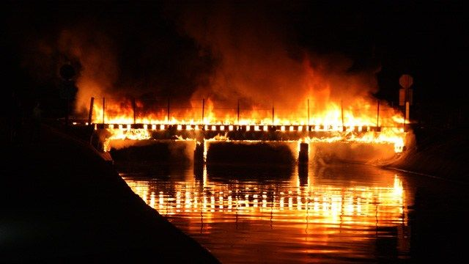
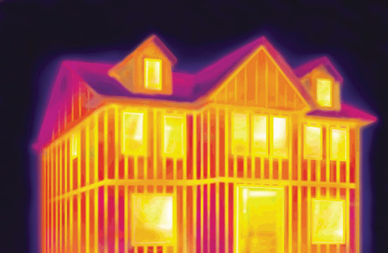
What is a thermal bridge?
A thermal bridge is not a burning bridge, although both have something to do with an increased rate of heat transfer or energy loss.
Burning bridge releasing the embodied (stored) energy.
Source: Steve Dadds; as published in azfamily.com by 3TV/CBS 5, posted Aug. 17, 2015.
Thermal imaging illustration of unmitigated framing thermal bridges releasing heating energy (no continuous insulation).

Slide 7
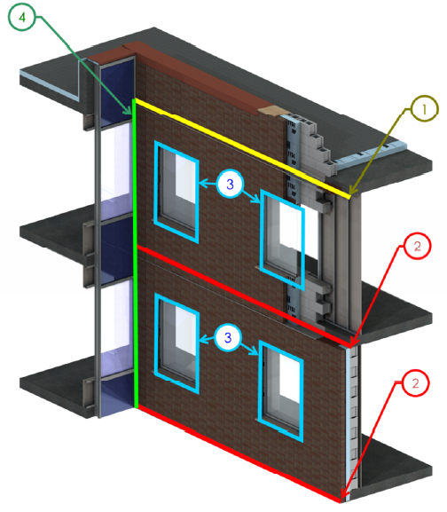
Types of Thermal Bridges
Clear-field thermal bridge
Linear thermal bridge
Point thermal bridge
Source: BC Hydro BETB Guide / Morrison Hershfield LTD

Slide 8
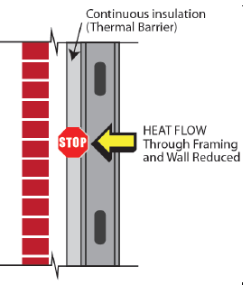
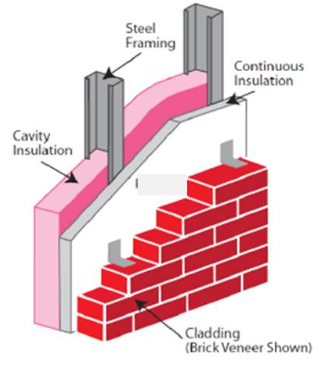

Clear-Field Thermal Bridge
Clear-Field Thermal Bridge
  Thermal pathways inherent to a building assembly
  and its surface area
  Generally accounted for in U-factor calculations,
  R-value prescriptions, and assembly thermal test
  methods for energy code compliance
    Examples: Wood and steel studs and plates
    (framing), webs of concrete masonry units, etc.
  Impact:
    For example, cavity insulation in steel framing is only ~35-50% effective
      Wall with R-21 cavity insulation has effective R-7.4 to R-9.0 for 16”oc and 24”oc stud (with no added framing for wall openings)
      More than 50% loss in insulation R-value
    For example, cavity insulation in wood framing is about 83% effective
      Wall with R-21 cavity insulation has an effective R-17.2 to R-17.5 (including plates and headers and jamb studs for wall openings)
      More than 15% loss in insulation R-value

Slide 9
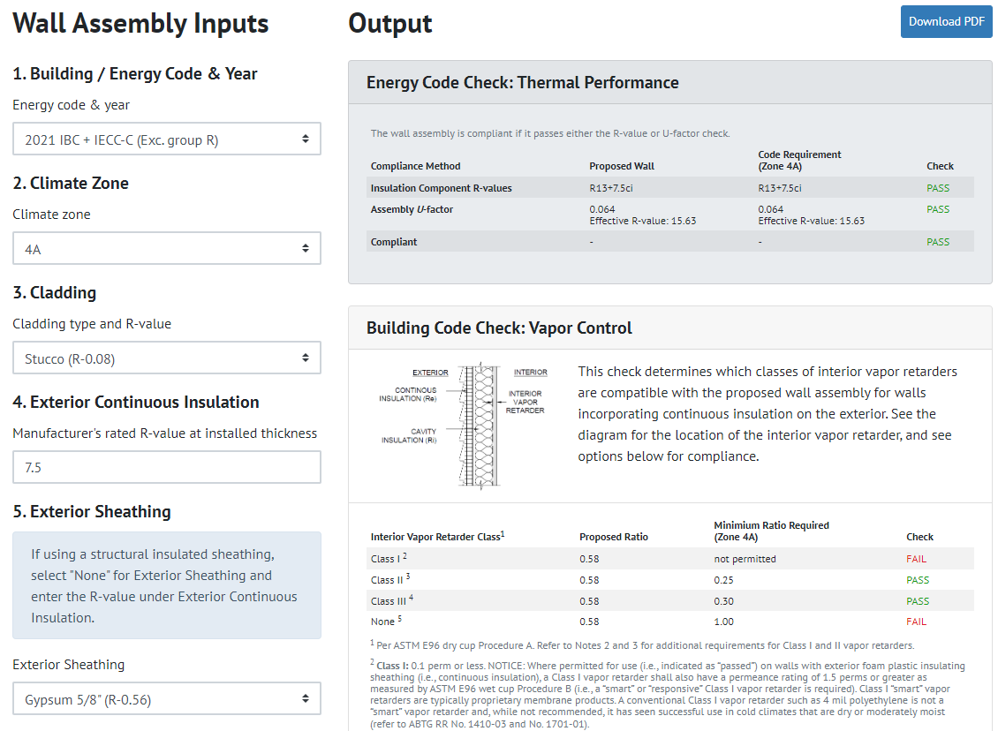
Clear-Field Thermal Bridge - Resources
Design Tool: Steel Wall & Wood Wall Calculators
  Performs U-factor and water vapor control design checks for coordinated energy code and building code compliance
Free on-line tool available!
  https://www.continuousinsulation.org/calculators
YouTube tutorial also provided. Simple!

Slide 10
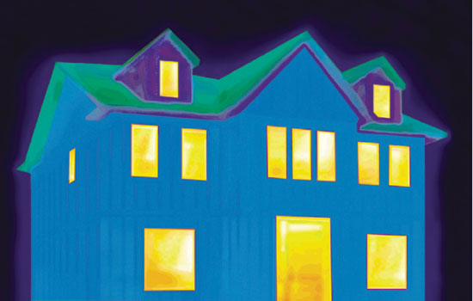
Clear-Field Thermal Bridge – ci mitigation
R25 ≠ R20 + 5ci
The R20+5ci wall is 15% more efficient than the R-25 wall.
This demonstrates that R-value of cavity and continuous insulation cannot be added (and this is prohibited as a means of compliance).

Slide 11
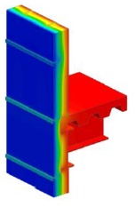
Linear Thermal Bridge
Linear Thermal Bridge:
  Additional heat flow caused by details that can be defined by a length along the building surface.
    Units for “Psi-factor” (Ψ) – linear thermal transmittance:
    [IP] Btu / hr-ft-ºF
    [SI] W / m-K
  Usually associated with the intersection of different building thermal envelope assemblies and components.
  These are not accounted for in the clear-field U-factors
  used for purposes of “compliance” with 90.1 or IECC building thermal envelope assembly requirements:
    Exception:
    1) F-factors for insulation of slab-on-grade foundation edges for insulation configurations consistent with the F-factor selected.
Linear Thermal Transmittance
Source: Morrison Hershfield LTD /
ASHRAE RP 1365

Slide 12
Linear Thermal Bridge
Examples: Slab floor edges, balconies, shelf-angles, corners, parapets, window-wall interface, int/ext wall interface, floor-wall interface, foundation-slab interface, furring penetrating through insulation, columns or beams in the plane of an assembly, etc.
Impact: Depending on quantity and detailing used, these heat flows can account for 20-70% of total opaque envelope heat flow!
  And they are not accounted for in the energy codes’ assembly U-factors and R-values!
Source: USACE report

Slide 13
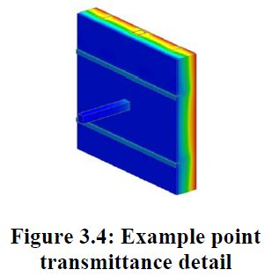
Point Thermal Bridge
Point Thermal Bridge:
  Heat flow caused by a thermal bridge that occurs at single element or discrete “point”
    Units for “Chi-factor” (χ) – point thermal transmittance:
    [IP] Btu / hr-ºF
    [SI] W / K
  Generally not accounted for in U.S. energy codes and standards, but not as severe as linear thermal bridges in “normal” quantities.
  Examples: Pipes, beams, and column penetrations through building envelope
    Fasteners, brackets, ties, etc. also can be treated as point thermal bridges, but are best addressed as part of the assembly U-factor calculation if distributed uniformly and repetitively over area of assembly
    Code definition for continuous insulation permits fastener penetrations (point thermal bridges) but not linear thermal brides (e.g., framing or Z-furring through ci layer)
  Impact: Assembly U-factor increased by 1% to 40% depending on amount of insulation penetrated, size and spacing of penetrations, type of structure (e.g., wood, steel, concrete), penetrating material conductivity, 3-D geometry, etc.
Point Thermal Transmittance
Source: Morrison Hershfield LTD /
ASHRAE RP 1365

Slide 14
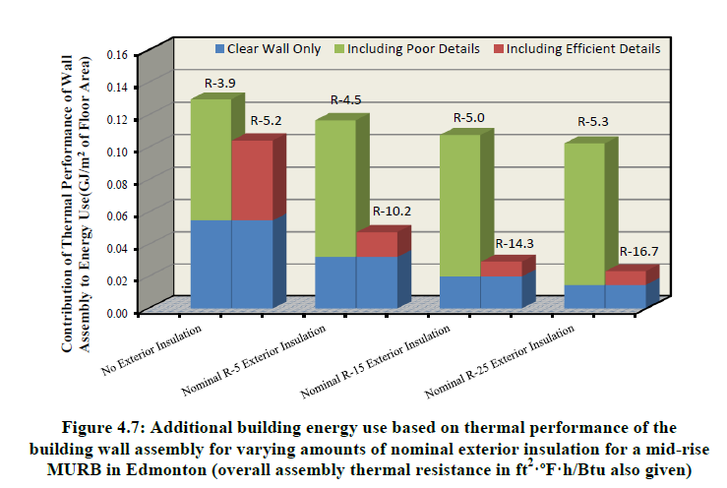
What are the implications of unaccounted thermal bridges?
Unaccounted thermal bridges
can result in significantly over-estimated building performance (under-estimated energy use).
Inaccurate heating and cooling loads for HVAC equipment sizing
Moisture problems (condensation, corrosion, mold, rot).
Diminishes the effective R-value of insulation materials (devalues insulation to extent bridged)
Use of continuous insulation with good thermal bridge detailing is key to meeting intended performance.
Source: Morrison Hershfield Ltd

Slide 15
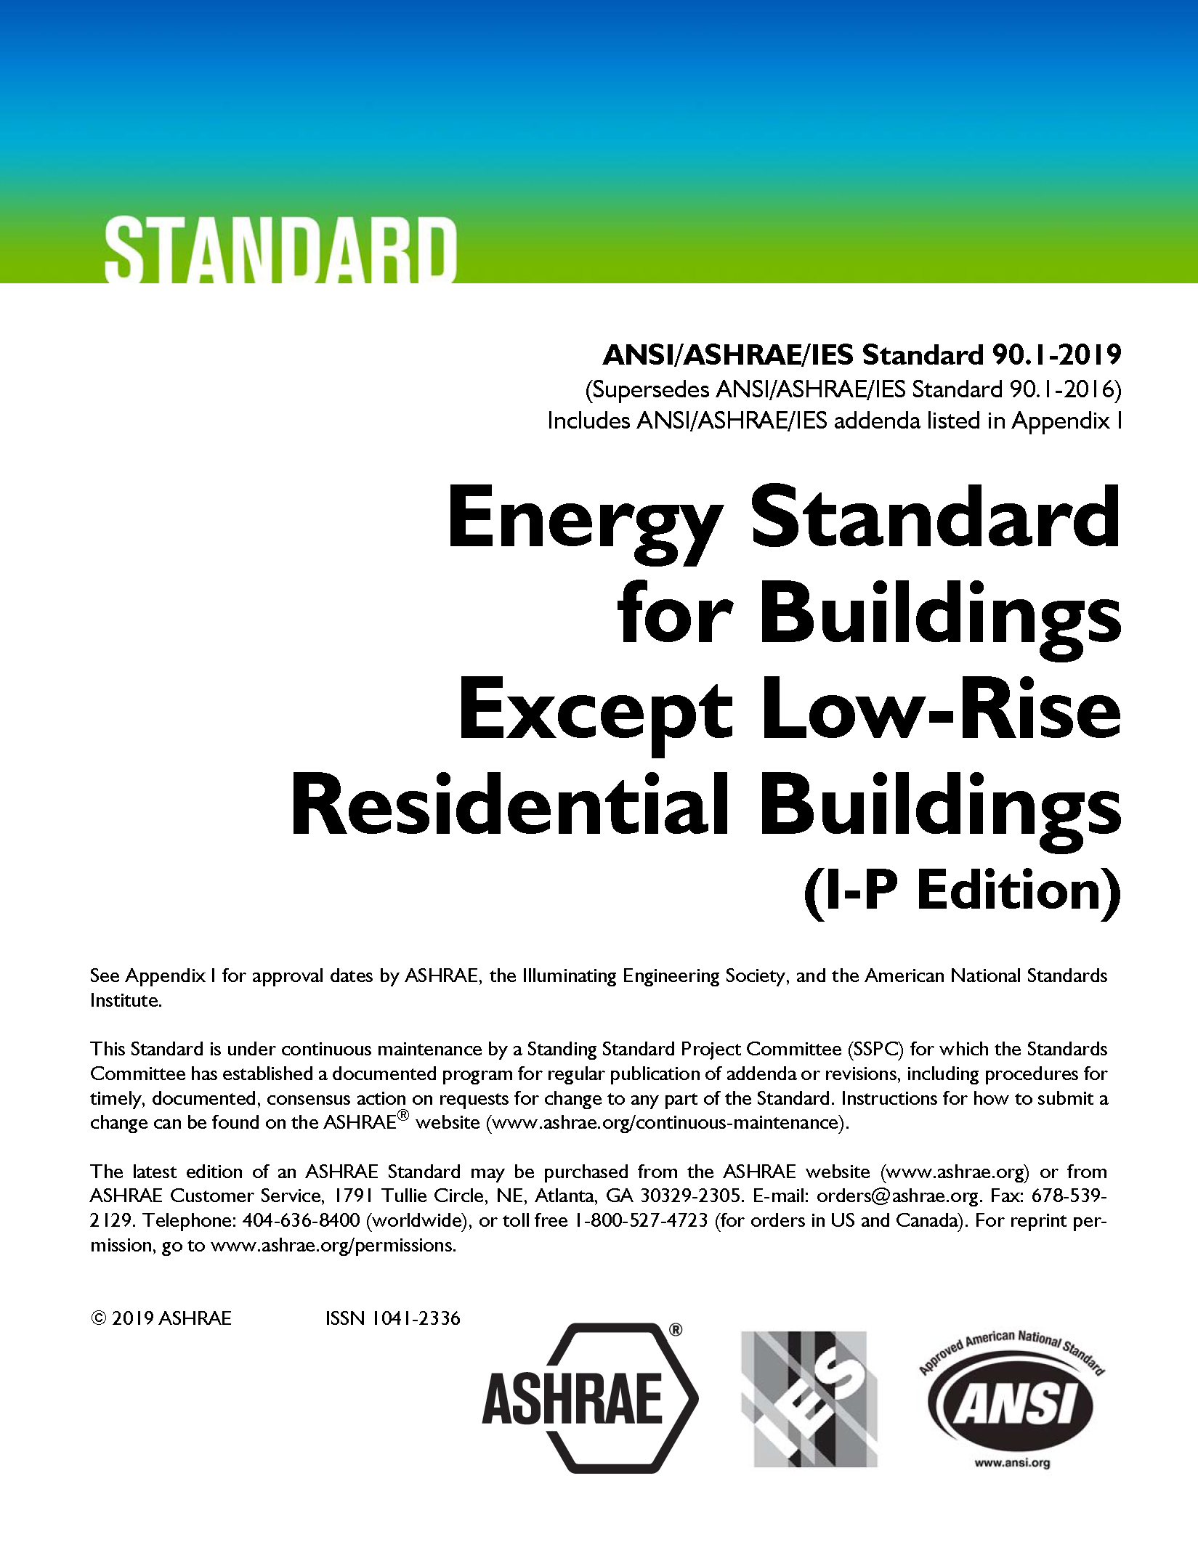

What have past codes required?
Repetitive framing thermal bridges (studs, tracks, headers, joists, rafters, etc.) are accounted for in the prescriptive R-values and U-factor calculations for individual assemblies (walls, roofs, floors, etc.)
Thermal bridges that occur at intersection of assemblies and components have not been accounted for or clearly addressed in past codes.
  ASHRAE 90.1-2019 and earlier - Performance path has required them to be considered as “uninsulated assemblies”, but this is inaccurate and often not enforced or applied.
  IECC 2018 and earlier – thermal bridges beyond assembly U-factors are all ignored.
  IECC 2021 - “above-grade wall” definition revised to include thermal bridges at assembly and component intersections with wall (but not enabled by requirements and data in the code).
  Prescriptive R-value path in the IECC and ASHRAE 90.1 (baseline for the performance path) was built on the assumption of no unaccounted thermal bridges.

Slide 16
What will the newer codes require?
2024 IECC – New provisions added to account for thermal bridges at assembly and component intersections.
  Prescriptive (R-value path) minimum requirements for insulation/structure details.
  Thermal bridging included in component performance trade-off (i.e., prescriptive UA trade-off method)
  Requirements for reference design and proposed design in performance modeling (simulation) path.
ASHRAE 90.1-2022 – New thermal bridging provisions also added
  Similar to IECC provisions (similar sources considered by both)
  Few more options but different approach (i.e., more complicated prescriptive requirements)
Both focus only on the “big” thermal bridges and either are silent on or provide allowances for other less significant thermal bridges.
Does not achieve “ideal” mitigation of thermal bridges (but significantly improves on current practice).
Both will allow alternative solutions with at least equivalent performance (e.g., proprietary thermal bridge mitigation devices).

Slide 17
2024 IECC Definitions
THERMAL BRIDGE. An element or interface of elements that has a higher thermal conductivity than the surrounding building thermal envelope, which creates a path of least resistance for heat transfer.
CHI-FACTOR (χ-FACTOR). The heat loss factor for a single thermal bridge characterized as a point element of a building thermal envelope (Btu/h x °F)[W/K].
PSI-FACTOR (ψ-FACTOR). The heat loss factor per unit length of a thermal bridge characterized as a linear element of a building thermal envelope (Btu/h × ft × °F)[W/(m × K)].

Slide 18
2024 IECC Construction Documents
C105.2 Information on construction documents.
  1. Energy compliance path.
  2. Insulation materials and their R-values.
  3. Fenestration U-factors and solar heat gain coefficients (SHGCs).
  4. Area-weighted U-factor and solar heat gain coefficient (SHGC) calculations.
  5. Air barrier and air sealing details, including the location of the air barrier .
  6. Thermal bridges as identified in Section C402.6.
  Etc.

Slide 19
2024 IECC – Prescriptive Thermal Bridging Rules
C402.7 Thermal bridges in above-grade walls Thermal bridges in above-grade walls shall comply with this section or an approved design.
Exceptions:
  1. Buildings and structures located in Climate Zones 0 through 3.
  2. Any thermal bridge with a material thermal conductivity not greater than 3.0 Btu/h-ft-°F. ⬅ EXCLUDES WOOD AND OTHER “LOW-CONDUCTIVITY” MATERIALS PENETRATING BTE
  3. Blocking, coping, flashing, and other similar materials for attachment of roof coverings.
  4. Thermal bridges accounted for in the U-factor or C-factor for a building thermal envelope. ⬅ AVOIDS DOUBLE-COUNTING (I.E., FRAMING)

Slide 20
2024 IECC - Prescriptive
C402.7.1 Balconies and floor decks Balconies and concrete floor decks shall not penetrate the building thermal envelope. Such assemblies shall be separately supported or shall be supported by structural attachments or elements that minimize thermal bridging through the building thermal envelope.
Exceptions: Balconies and concrete floor decks shall be permitted to penetrate the building thermal envelope where:
  1. an area-weighted U-factor is used for above-grade wall compliance which that includes a U-factor of 0.8 Btu/h-F-ft² for the area of the above-grade wall penetrated by the concrete floor deck in accordance with Section C402.1.2.1.5;
  2. an approved thermal break device of with not less than R-10 insulation material is installed in accordance with the manufacturer's instructions ; or,
  3. an approved design where the above-grade wall U-factor used for compliance accounts for all balcony and concrete floor deck thermal bridges.

Slide 21
2024 IECC - Prescriptive
C402.7.2 Cladding supports Linear elements supporting opaque cladding shall be off-set from the structure with attachments that allow the continuous insulation, where present, to pass behind the cladding support element except at the point of attachment.
  Exceptions:
  1. An approved design where the above-grade wall U-factor used for compliance accounts for the cladding support element thermal bridge.
  2. Anchoring for curtain wall and window wall systems where curtain wall and window wall systems comply with C402.7.4.
Examples: Offset shelf angle, offset furring with shear tab attachments, cladding direct fastening through ci, etc.

Slide 22
2024 IECC - Prescriptive
C402.7.3 Structural beams and columns Structural steel and concrete beams and columns that project through the building thermal envelope shall be covered with not less than R-5 insulation for not less than 2 feet (610 mm) beyond the interior or exterior surface of an insulation component within the building thermal envelope.
  Exceptions:
  1. Where an approved thermal break device is installed in accordance with the manufacturer's instructions.
  2. An approved design where the above-grade wall U-factor used to demonstrate compliance accounts for the beam or column thermal bridge.

Slide 23
2024 IECC - Prescriptive
C402.7.4 Vertical fenestration Vertical fenestration intersections with above grade walls shall comply with one or more of the following:
  1. Where above-grade walls include continuous insulation, the plane of the exterior glazing layer or, for metal frame fenestration , a non-metal thermal break in the frame shall be positioned within 2 inches (610 mm) of the interior or exterior surface of the continuous insulation.
  2. Where above-grade walls do not include continuous insulation, the plane of the exterior glazing layer or, for metal frame fenestration , a non-metal thermal break in the frame shall be positioned within the thickness of the integral or cavity insulation .
  3. The surface of the rough opening, not covered by the fenestration frame, shall be insulated with insulation of not less than R-3 material or covered with a wood buck that is not less than 1.5 inches (457 mm) thick.
  4. For the intersection between vertical fenestration and opaque spandrel in a shared framing system, manufacturer's data for the spandrel U-factor shall account for thermal bridges.
  Exceptions:
  1. Where an approved design for the above-grade wall U-factor used for compliance accounts for thermal bridges at the intersection with the vertical fenestration.
  2. Doors.

Slide 24
2024 IECC - Prescriptive
C402.7.5 Parapets Parapets shall comply with one or more of the following as applicable:
  1. Where continuous insulation is installed on the exterior side of the above-grade wall and the roof is insulated with insulation entirely above deck, the continuous insulation shall extend up both sides of the parapet not less than 2 feet (610 mm) above the roof covering or to the top of the parapet, whichever is less. Parapets that are an integral part of a fire-resistance rated wall, and the exterior continuous insulation applied to the parapet, shall comply with the fire resistance ratings of the building code.
  2. Where continuous insulation is installed on the exterior side of the above-grade wall and the roof insulation is below the roof deck, the continuous insulation shall extend up the exterior side of the parapet to not less than the height of the top surface of the roof assembly .
  3. Where continuous insulation is not installed on the exterior side of the above-grade wall and the roof is insulated with insulation entirely above deck, the wall cavity or integral insulation shall extend into the parapet up to the exterior face of the roof insulation or equivalent R-value insulation shall be installed not less than 2 feet (610 mm) horizontally inward on the underside of the roof deck.
  4. Where continuous insulation is not installed on the exterior side of the above-grade wall and the roof insulation is below the roof deck, the wall and roof insulation components shall be adjacent to each other at the roof-ceiling-wall intersection.
  5. Where a thermal break device with not less than R-10 insulation material aligned with the above-grade wall and roof insulation is installed in accordance with the manufacturer's instructions.
Exception: An approved design where the above-grade wall U-factor used for compliance accounts for the parapet thermal bridge.

Slide 25
2024 IECC - Prescriptive
C402.1.2.1.8 Mechanical equipment penetrations. Where the total area of through penetrations of mechanical equipment is greater than 1 percent of the opaque above grade wall area, such area shall be calculated as a separate wall assembly , in accordance with either Section C402.1.2.1.5 or Section C402.1.4 using a published and approved U-factor for that equipment or a default U-factor of 0.5.

Slide 26
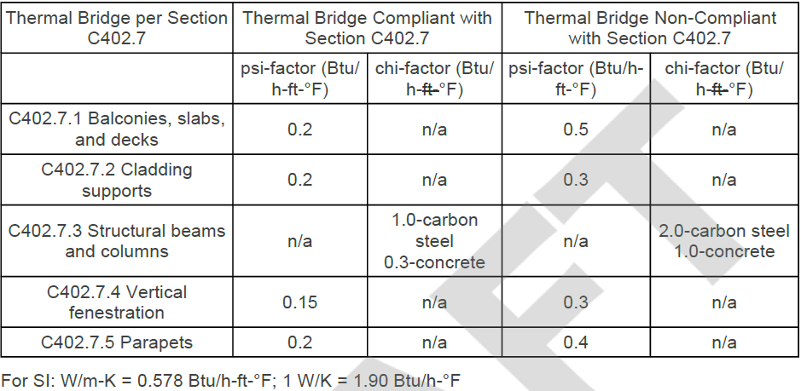
2024 IECC – Prescriptive (UA trade-off method)
TABLE C402.1.4 - PSI- and CHI-FACTORS TO DETERMINE THERMAL BRIDGES
FOR THE COMPONENT PERFORMANCE METHOD

Slide 27
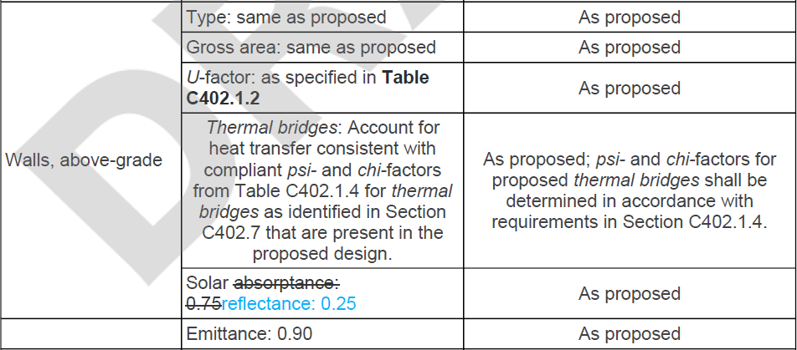
2024 IECC – Performance (Simulation) Path
TABLE C407.4.1(1) - SPECIFICATIONS FOR THE STANDARD REFERENCE
AND PROPOSED DESIGNS

Slide 28
Design Concepts for Clear-Field Thermal Bridges
Clear-field thermal bridges generally are required to be accounted for in U-factor calculations or tests for assemblies:
  Refer to ASHRAE 90.1 Appendix A and Handbook of Fundamentals
    Light-frame construction and metal building systems account for thermal bridging caused by framing members within the assemblies
    Steel framing calculation methods (and the new AISI S250 standard) excludes impact of additional framing for wall openings; correction may be necessary.
  Some U-factor calculation methods are empirical and include some amount of fastener point thermal bridges; some may include brick ties; some don’t address impact of fasteners at all (cladding, interior finish, exterior sheathing, etc.).
  Can model or test assemblies, but all relevant thermal bridges in the
  “as-constructed” assembly must be included where required by code.
  Also, see 2024 IECC (residential) new APPENDIX RF for U-factor and F-factor data
    Also includes “effective” U-factors for below grade walls which must be used in prescriptive UA trade-off approaches.

Slide 29
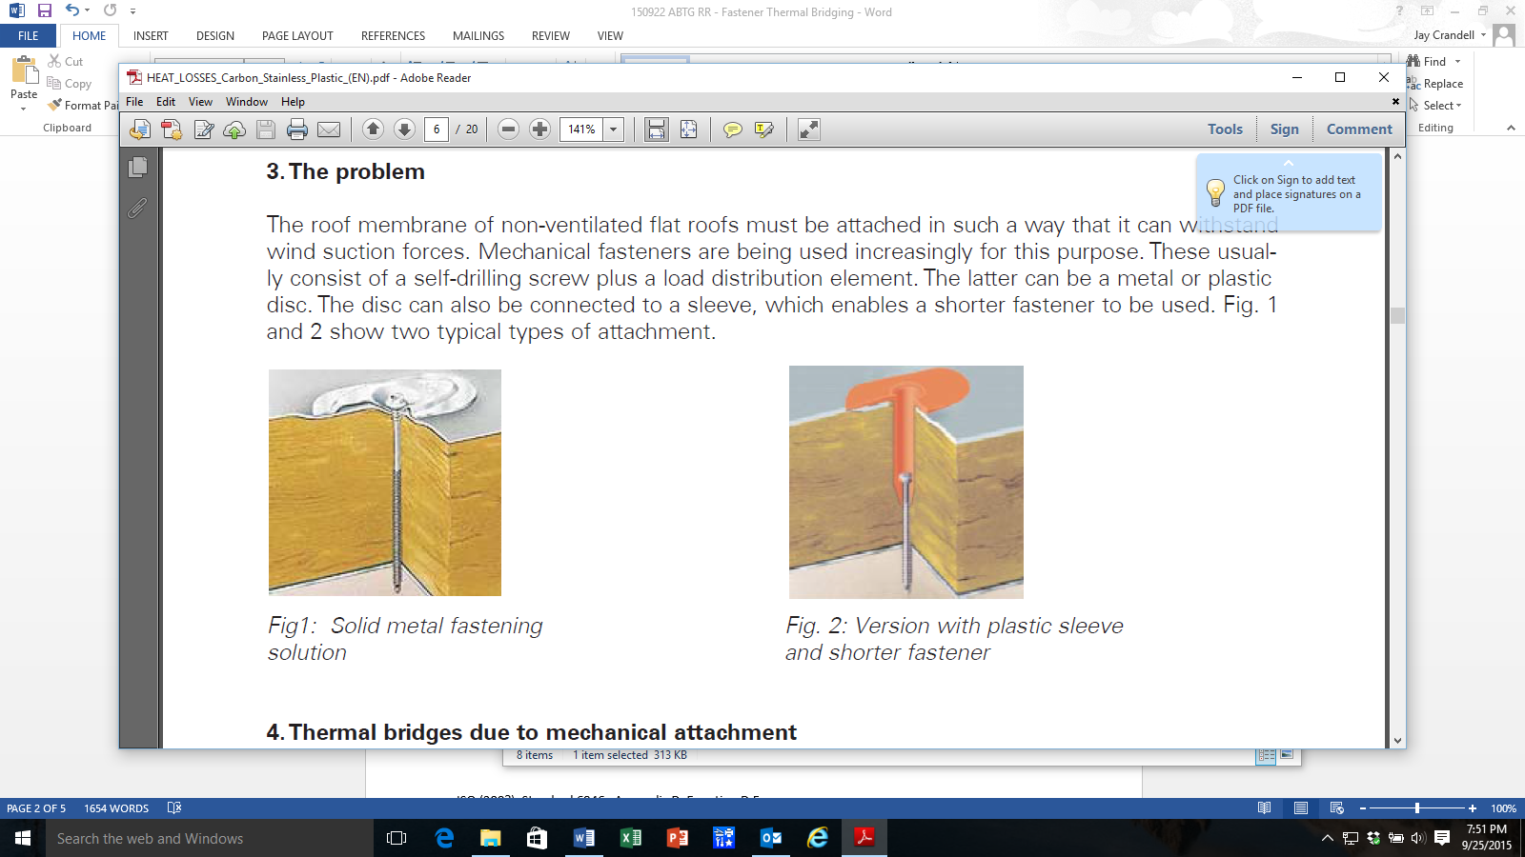
Mitigation Concepts for Clear-Field Thermal Bridges
Some ways to mitigate clear field thermal bridges include:
  Reduce “framing factor” where structurally feasible (wider frame spacing, double stud framing, etc.)
  Use low conductivity structural materials
  Apply continuous insulation over structure/framing members (minimize discontinuity at floor/wall/roof intersections)
  Mount metal or wood furring over (not through) continuous insulation layer (RESOURCE: https://www.continuousinsulation.org/cladding-connections )
  Use low conductivity fasteners or devices to attach cladding, furring, etc. to framing (e.g., stainless steel, carbon fiber, etc.)
Before
R-13 batts in cavity between studs
After
R13 + ½” rigid foam continuous insulation over studs
Source: Dryvit/Dow

Slide 30
Mitigation Concepts for Point Thermal Bridges
Some ways to mitigate point thermal bridges include:
  Minimize penetrations of high thermal conductivity materials through the building envelope.
  Encapsulate the penetrating element with insulation for at least 2 feet inward or outward from the envelope.
  Use lower conductivity materials
    Stainless steel
      3x lower thermal conductivity than carbon steel
      5x lower thermal conductivity than aluminum
      More durable (benefit for cladding attachments)
    Various proprietary thermal break materials and devices (carbon fiber, fiberglass, brick ties with thermal-break joints, etc.)

Slide 31
Mitigation Concepts for Linear Thermal Bridges
Some ways to mitigate linear thermal bridges include:
  Convert a linear thermal bridge to a series of point thermal bridges to disrupt and minimize heat flow pathway
  Examples:
    Offset brick shelf angle and continuous insulation
    Offset furring (on surface of continuous insulation and fastened through at points)
    Thermally broken or self-supported balconies
    Fenestration interface (alignment with insulation and insulation of exposed rough opening)
    Floor edges (continuous insulation)
    Foundation edges (continuous insulation) – F-factors don’t account for all the options to maximize placement and value of insulation to minimize slab edge heat loss
    Various proprietary structural thermal break devices

Slide 32
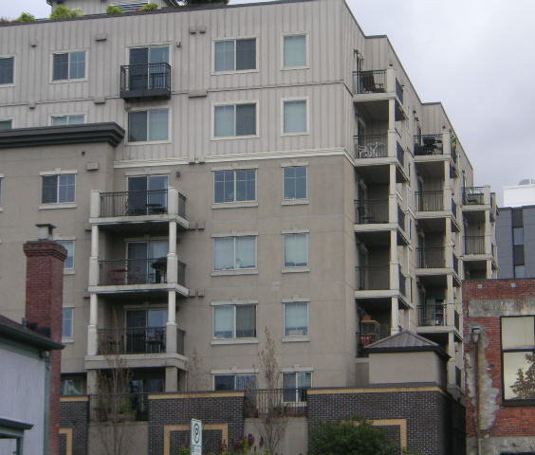
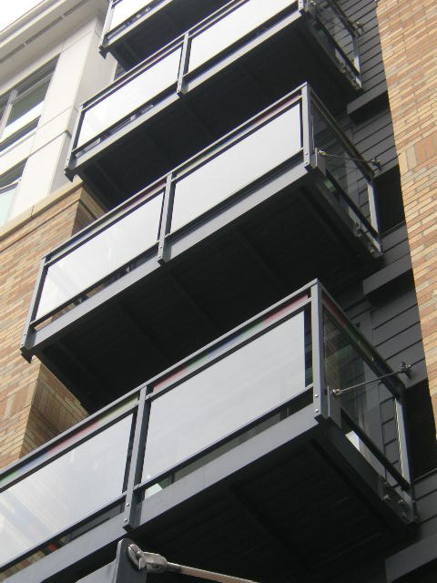
Examples of Mitigated Linear Thermal Bridges (Balconies)
Suspended and separately supported balconies with shear tab or offset shelf-angle point connection to building
Photos courtesy of John Hogan

Slide 33
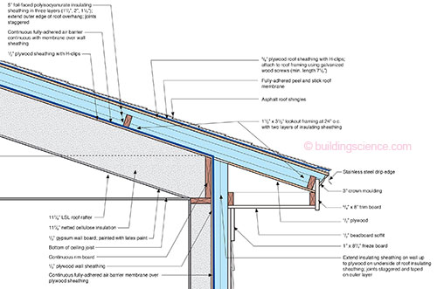
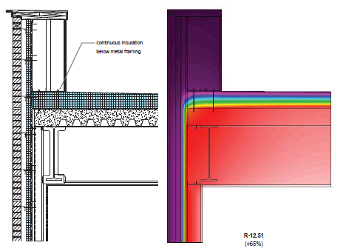
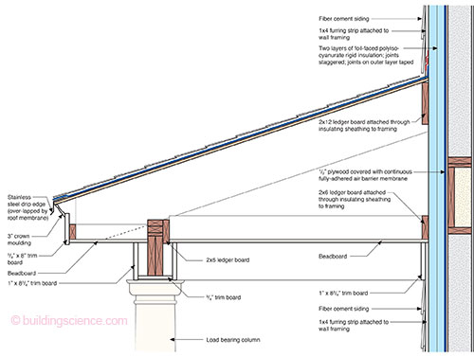
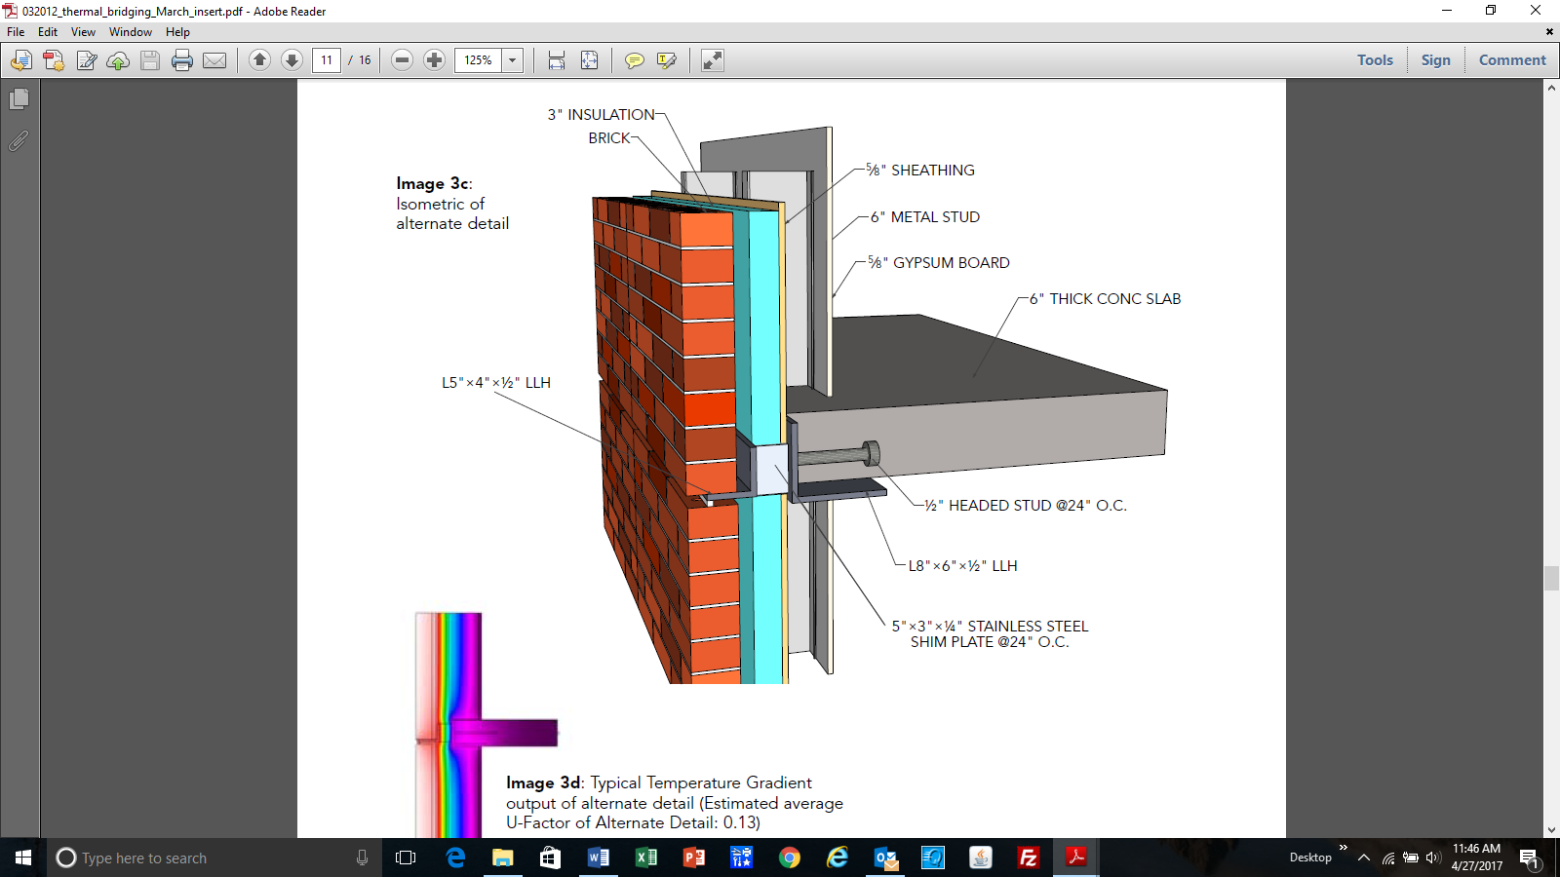
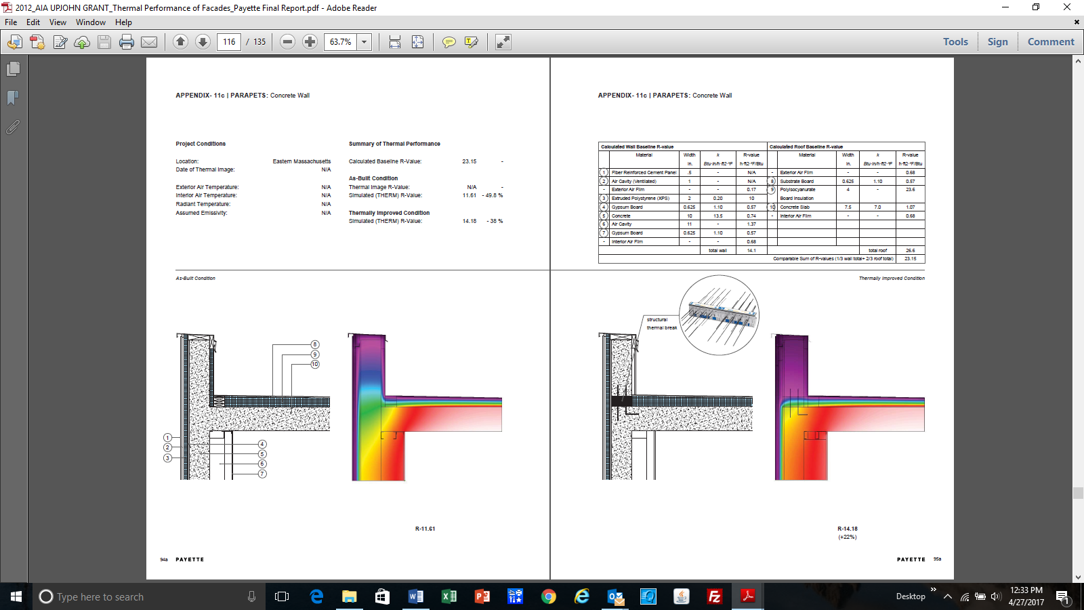
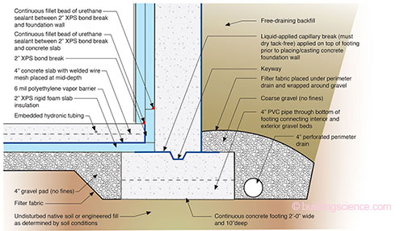
More Examples of Mitigated Linear Thermal Bridges (non-exhaustive “commodity” details)
INSULATED WINDOW ROUGH OPENING DETAIL
(USACE report)
OFFSET SHELF ANGLE
(AISC/SEI article)
Example Details from BSI-081: Zeroing In (J. Lstiburek, Building Science Corp) as used on NIST NZERTF Project
NOTE: Coordinate detailing at floor-wall and fenestration with NFPA 285 tested assemblies and approved engineering analysis details (applies to Type I-IV buildings, not Type V wood frame).
INSULATED PARAPET DETAILS
(Payette/AIA report)

Slide 34
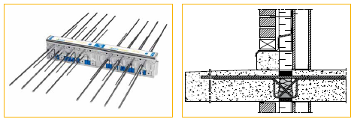
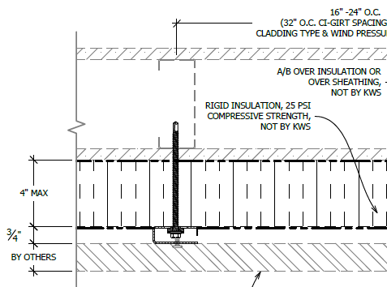
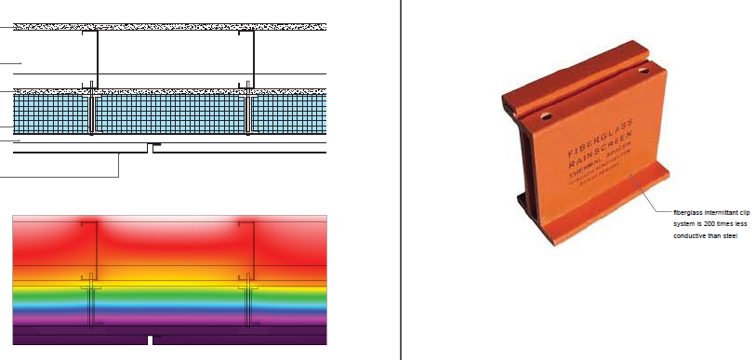

Examples of Proprietary Thermal Bridging Devices (non-exhaustive “google” search)
Cantilevered Balcony Structural Thermal Break
Source: Google search
Low thermal conductivity furring/cladding/ledger supports
Sources: Payette/AIA report and product info from Google search
Structural thermal block for steel beam projections through building envelope
Source: Google search

Slide 35
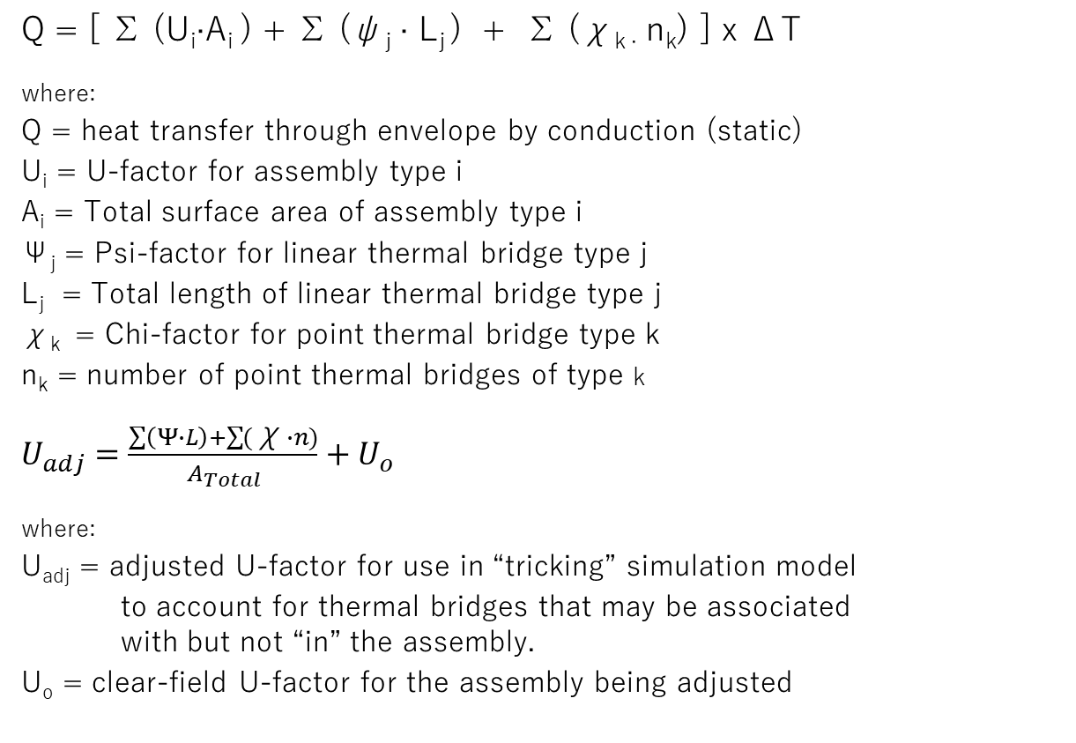
Calculations to Account for Point & Linear
Thermal Bridges
Q = [ ∑ (U_{i}∙A_{i} ) + ∑ (ψ_{j} ∙ L_{j} ) + ∑ (χ_{k ∙} n_{k}) ] x ΔT
where:
Q = heat transfer through envelope by conduction (static)
U_{i} = U-factor for assembly type i
A_{i} = Total surface area of assembly type i
Ψ_{j} = Psi-factor for linear thermal bridge type j
L_{j} = Total length of linear thermal bridge type j
χ_{k} = Chi-factor for point thermal bridge type k
n_{k} = number of point thermal bridges of type k
$U_{adj}=\frac{\sum{\left(Ψ∙L\right)+\sum{(\text{χ}∙n)}}}{A_{Total}}+U_{o}$
where:
U_{adj} = adjusted U-factor for use in “tricking” simulation model
to account for thermal bridges that may be associated
with but not “in” the assembly.
U_{o} = clear-field U-factor for the assembly being adjusted
Source: BC Hydro BETB Guide / Morrison Hershfield LTD

Slide 36
Example Design Data (Psi-factors for floor edges)
Source: BC Hydro BETB Guide / Morrison Hershfield LTD

Slide 37
Example Design Data
(Psi-factors for fenestration-wall interface)
Source: BC Hydro BETB Guide / Morrison Hershfield LTD

Slide 38
Example Design Data
(Psi-factors for parapet roof-wall intersection)
Source: BC Hydro BETB Guide / Morrison Hershfield LTD

Slide 39
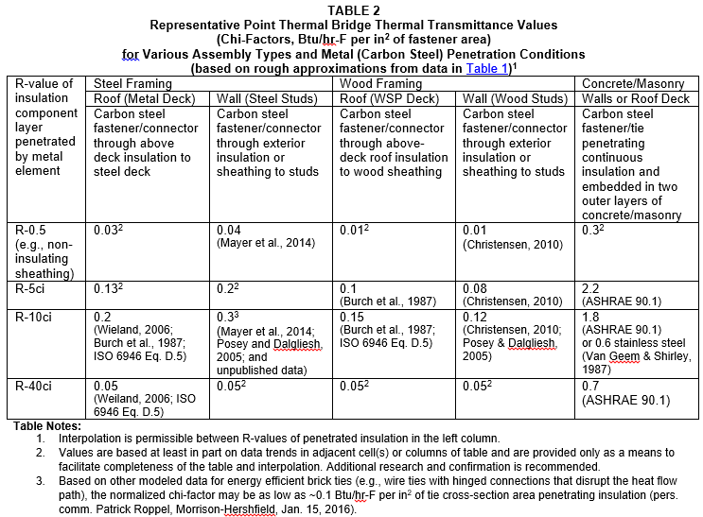
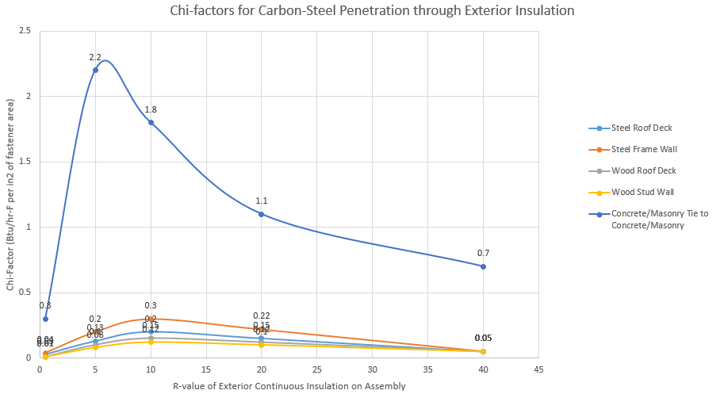
Example Design Data
(Chi-factors for metal/fastener penetrations)
Source: ABTG RR No. 1510-03
Available at: https://www.continuousinsulation.org/thermal-bridging-prevention

Slide 40
Clear-field U-factor Analysis –
CFS steel frame wall with and without ci
Source: ABTG RR No. 1510-03

Slide 41
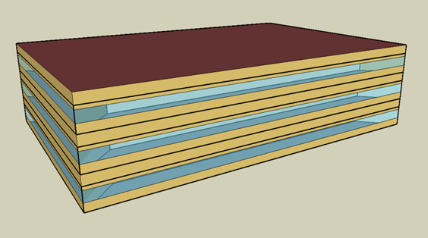
Design Example
(3-story office building)
Structure: Steel Frame Walls with Concrete Slab Floors
NOTE: All cases include metal stud clear field thermal bridges within U-factor for assembly
CASE 1: No Thermal Bridges (ideal or ignored) w/ R13 cavity insulation only
Overall Opaque Wall Thermal Performance
Opaque U-Value (BTU/hr ft^{2 o}F) | 0.124
Effective R-Value (hr ft^{2 o}F/BTU) | 8.1
Transmittance Type | Transmittance Description | Area, Length or Amount Takeoff | Units | Transmittance Value | Units | Heat Flow (BTU/ hrºF) | %Total Heat Flow
Clear Field | Opaque Wall Area (R13 cavity insulation only) | 14267.00 | ft² | 0.124 | BTU/ hr ft² ºF | 1769.1 | 100%
CASE 2: No thermal bridges (ideal or ignored) w/ R13+10ci insulation per 90.1
Overall Opaque Wall Thermal Performance
Opaque U-Value (BTU/hr ft^{2 o}F) | 0.055
Effective R-Value (hr ft^{2 o}F/BTU) | 18.2
Transmittance Type | Transmittance Description | Area, Length or Amount Takeoff | Units | Transmittance Value | Units | Heat Flow (BTU/ hrºF) | %Total Heat Flow
Clear Field | Opaque Wall Area (R13+10 per ASHRAE 90.1) | 14267.00 | ft² | 0.055 | BTU/ hr ft² ºF | 784.7 | 100%
Case 2 mitigates the clear-field framing thermal bridges within the assembly.

Slide 42
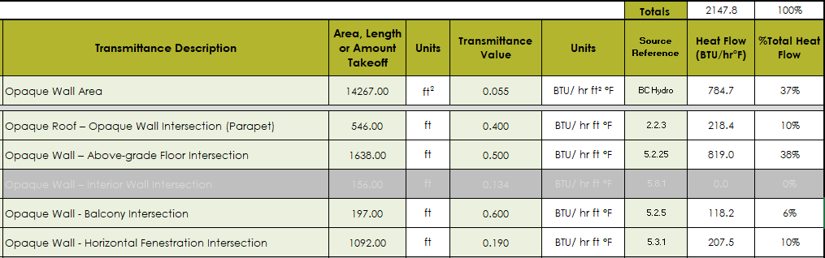
Design Example
(3-story office building)
CASE 3: R13+10 with Poor Thermal Bridging Details Included in Analysis (64% of opaque wall heat flow)
Overall Opaque Wall Thermal Performance*
Opaque U-Value (BTU/hr ft^{2 o}F) | 0.151
Effective R-Value (hr ft^{2 o}F/BTU) | 6.6
* U-factor and effective R-value of opaque wall area is adjusted to include effect of various unmitigated linear thermal bridges at wall-to-floor, -fenestration, and -roof assembly intersections

Slide 43
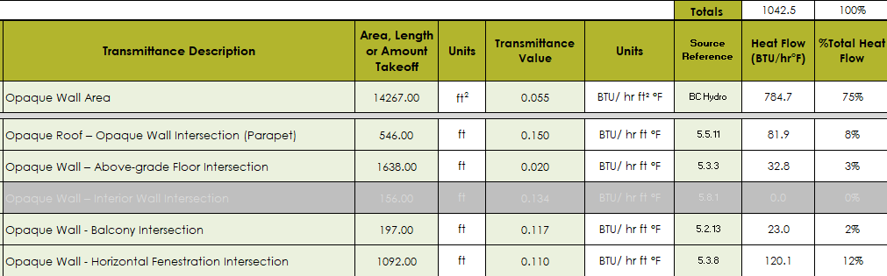
Design Example
(3-story office building)
CASE 4: R13+10 with Efficient (Mitigated) Thermal Bridging Details (now only 25% of wall heat flow)
Overall Opaque Wall Thermal Performance*
Opaque U-Value (BTU/hr ft^{2 o}F) | 0.073
Effective R-Value (hr ft^{2 o}F/BTU) | 13.7
* U-factor and effective R-value of opaque wall area is adjusted to include effect of various mitigated linear thermal bridges at wall-to-floor, -fenestration, and -roof assembly intersections

Slide 44
Conclusions
Thermal bridging has generally been ignored and unregulated, except as they occur due to framing members within assemblies.
Unaccounted thermal bridging can account for 20-70% of heat flow through the building’s opaque envelope.
Reasonable efforts to use improved details to mitigate point and linear thermal bridges with continuous insulation can significantly improve (e.g., double) building thermal envelope performance.
For buildings with significant types or quantities of thermal bridges, it is beneficial to mitigate thermal bridges, especially when considering increased insulation amounts above minimum code levels (i.e., “a thicker bucket with holes will still leak water at nearly the same rate”).
Several sources of data and design guidance are available to support appropriate consideration and mitigation of thermal bridges (see Bibliography).
New energy codes and standards have changed to better address thermal bridging effects.

Slide 45
Bibliography
Morrison Hershfield Ltd. 2016. Building Envelope Thermal Bridging Guide, Version 1.1, Prepared for BC Hydro Power Smart, Canadian Wood Council, Fortis BC, FPInnovations, Homeowner Protection Office of BC Housing.
Morrison Hershfield Ltd. 2012. “Thermal Performance of Building Envelope Details for Mid- and High-Rise Buildings.” ASHRAE Research Project RP-1365. Atlanta, GA: American Society of Heating, Refrigerating, and Air-Conditioning Engineers (ASHRAE).
ISO Standard 10211: 2007, Thermal Bridges in Building Construction – heat flows and surface temperature – Detailed calculations.
ISO Standard 14683: 2007, Thermal Bridges in Building Construction – Linear thermal transmittance (simplified methods and default Chi-factors).
AISC/SEI, Thermal Bridging Solutions: Minimizing Structural Steel’s Impact on Building Envelope Energy Transfer, A Supplement to Modern Steel Construction, March 2012, American Institute for Steel Construction (AISC) & Structural Engineering Institute (SEI).
USACE, “Development of Thermal Bridging Factors for Use in Energy Models,” ERDC/CERL TR-15-10, June 2015, U.S. Army Corp of Engineers, Engineer Research and Development Center, Construction Engineering Research Laboratory.
Thermal Performance of Facades, 2012 AIA Upjohn Grant Research Initiative, Payette, Boston, MA, November 2014.
Repetitive Metal Penetrations in Building Thermal Envelope Assemblies, ABTG Research Report No. 1510-03, Applied Building Technology Group LLC, 2016
Attachment of Exterior Wall Coverings Through Foam Plastic Insulating Sheathing (FPIS) to Wood or Steel Wall Framing, ABTG Research Report No. 1503-02, Applied Building Technology Group LLC, 2019.

Slide 46

Questions?
Jay Crandell, P.E.
www.aresconsulting.biz
www.appliedbuildingtech.com
Be sure to visit the www.continuousinsulation.org website for more information and related technical support continuousinsulation.org/contact.

