Slide 1
Window Installation Methods for Frame Walls with Foam Sheathing
Revised 6/30/2021
Notes:
Change title and presenter info to suit purpose.

Slide 2
Applied Building Technology Group (ABTG) is committed to using sound science and generally accepted engineering practice to develop research supporting the reliable design and installation of foam sheathing. ABTG’s educational program work with respect to foam sheathing is supported by the Foam Sheathing Committee (FSC) of the American Chemistry Council.
ABTG is a professional engineering firm, an approved source as defined in Chapter 2 and independent as defined in Chapter 17 of the IBC.
DISCLAIMER: While reasonable effort has been made to ensure the accuracy of the information presented, the actual design, suitability and use of this information for any particular application is the responsibility of the user. Where used in the design of buildings, the design, suitability and use of this information for any particular building is the responsibility of the Owner or the Owner’s authorized agent.
Foam sheathing research reports, code compliance documents, educational programs and best practices can be found at www.continuousinsulation.org.
Copyright © 2021 Applied Building Technology Group

Slide 3
Outline
Background
Key Principles
Scope
Applicability
Installation Details
Installation Steps

Slide 4
Background
There are many acceptable ways to mount and detail windows for support and weather resistance.
This presentation covers representative solutions for integrating windows with Foam Plastic Insulating Sheathing (FPIS).
It is the responsibility of the user to verify the appropriateness of any specific detail for their specific conditions.

Slide 5
Key Principles
The intent of any acceptable detail for integrating windows with FPIS is:
To provide adequate structural support to the window unit.
To prevent water penetration at the window-wall interface by flashing to direct water onto the exterior surface of the WRB layer and/or cladding and away from the window opening.
Ensure the detail is consistent with or meets the intent of window, flashing, and WRB manufacturers’ installation instructions.

Slide 6
Scope
Four installation methods are featured in this presentation
Other wall components not shown include:
Cladding (various types)
Structural sheathing (if required for bracing)
Interior finish (e.g., gypsum wallboard)
Vapor retarder (various types or “classes” as required by code)
Standard
Picture Frame
Window Buck
Rainscreen (furred siding)

Slide 7
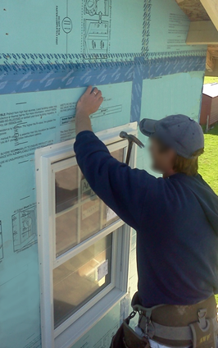
Applicability
The “standard” method is traditionally used for FPIS up to 1-1/2” thick and windows not more than 6’ wide
The “picture frame” method is used where additional window support is needed and with FPIS of ¾” to 1-1/2” thick to match typical 1x or 2x lumber thickness
The “window buck“ method also is used where additional window support is needed and usually when the FPIS is over 1-1/2” thick.
The “rainscreen” method is used with rainscreen (furred) cladding installation.

Slide 8
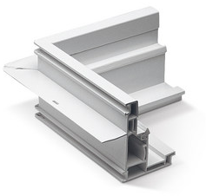
Applicability
The installation methods featured in the presentation assume use of windows with integral mounting flanges (i.e., nail fin).
Although, some methods (like the window buck and picture frame methods) are relevant to “block frame” windows without a flange
Fasteners are installed through the pre-punched holes in the flange and flashing and sealants are applied to the flange during installation
Be sure that the flange fastener length is increased to accommodate the thickness of FPIS when using the “standard” installation method.

Slide 9
Applicability
Similar installation methods can be used for flanged door installations
Thresholds should always have full support (e.g., blocking equal to thickness of FPIS – similar to that used for the “picture frame” method)
Where frame/hinge anchors are required into rough opening framing, in-swing exterior doors generally allow for FPIS thickness of up to 1-1/2 inches. Beyond that, use of a “window buck” is recommended.
Outswing exterior doors generally require use of a “window buck” where FPIS thickness exceeds 1”

Slide 10
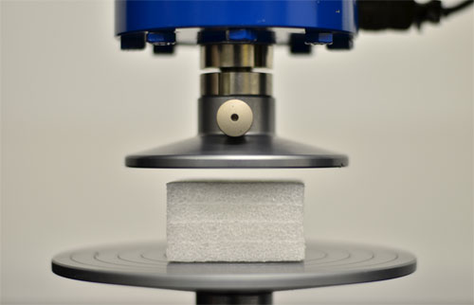
Applicability
FPIS materials comply with the following standards:
Expanded Polystyrene (EPS) - ASTM C578,
Extruded Polystyrene (XPS) - ASTM C578, or
Polyisocyanurate (Polyiso) - ASTM C1289
Where the window flange bears directly on FPIS, the FPIS must have a minimum compressive strength of 15 psi per the above standards (equivalent to 2,160 PSF bearing capacity).

Slide 11
Applicability
The installation methods featured in this presentation assume use of FPIS as a water-resistive-barrier (WRB) system.
Refer to DrJ DRR 1410-05 for a listing of FPIS manufacturers with code-approved FPIS WRB systems and installation instructions.
Use of a separate WRB material layer is also common and acceptable with appropriate installation and detailing.

Slide 12
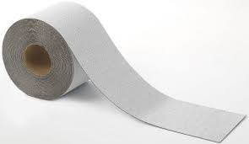
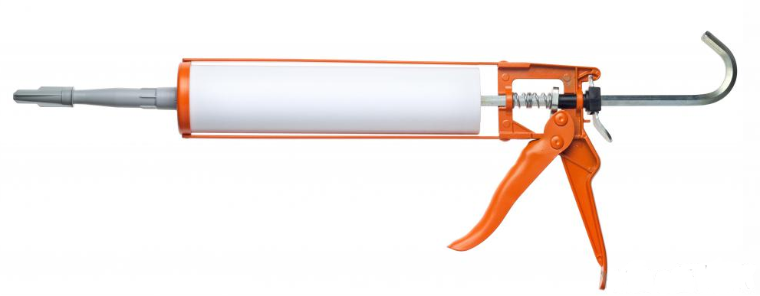
Applicability
Use flashing materials and sealants recommended by the window, FPIS, and/or WRB manufacturers.
Flexible adhered flashing is featured in this presentation, but fluid-applied flashings also may be used in similar fashion.
Follow sealant and flashing manufacturer’s instructions to ensure adhesion and durability.

Slide 13
Installation Details
Ordered by installation method:
Sill details
Jamb details
Head details

Slide 14
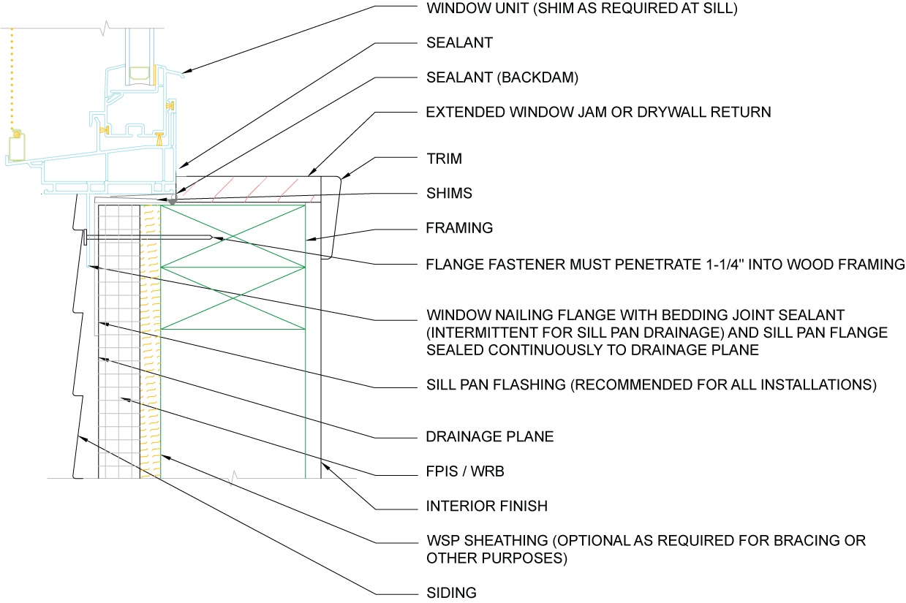
Standard Method – Sill Detail

Slide 15
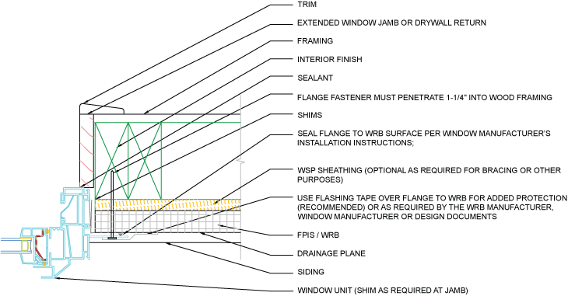
Standard Method – Jamb Detail

Slide 16
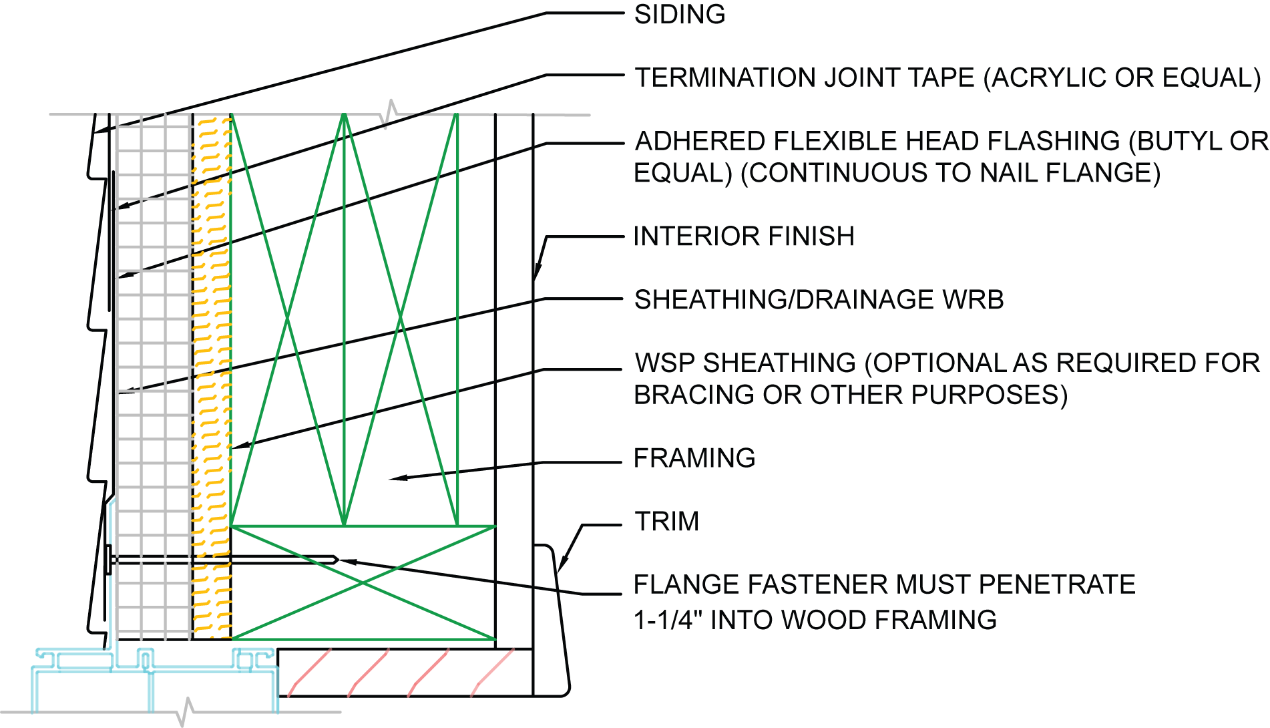
Standard Method – Head Detail

Slide 17
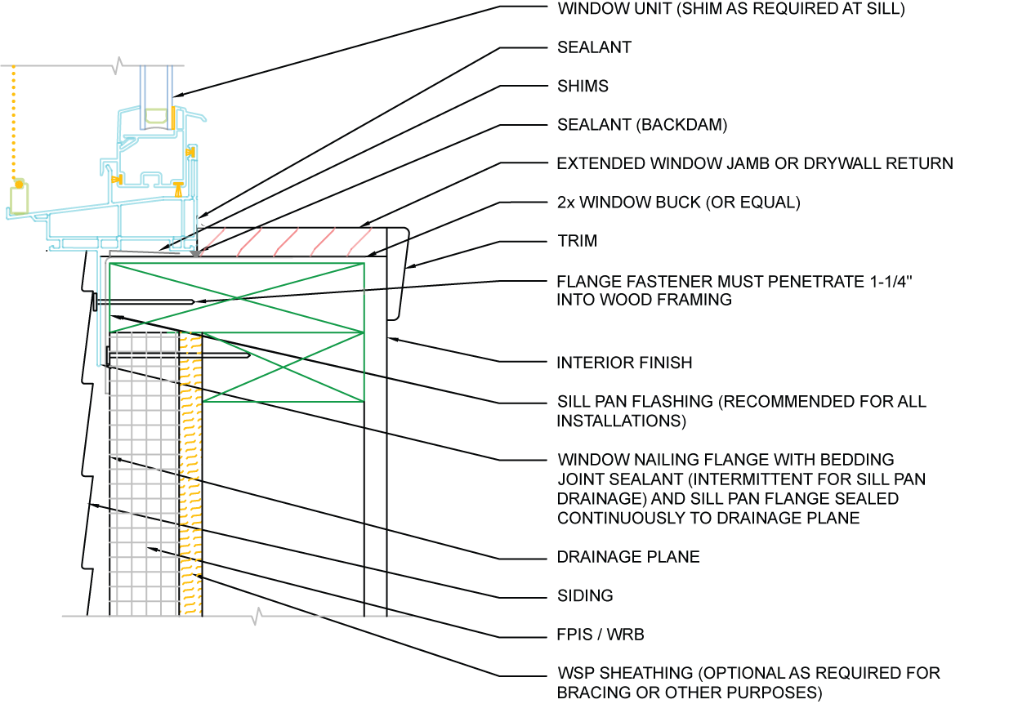
Window Buck – Sill Detail

Slide 18
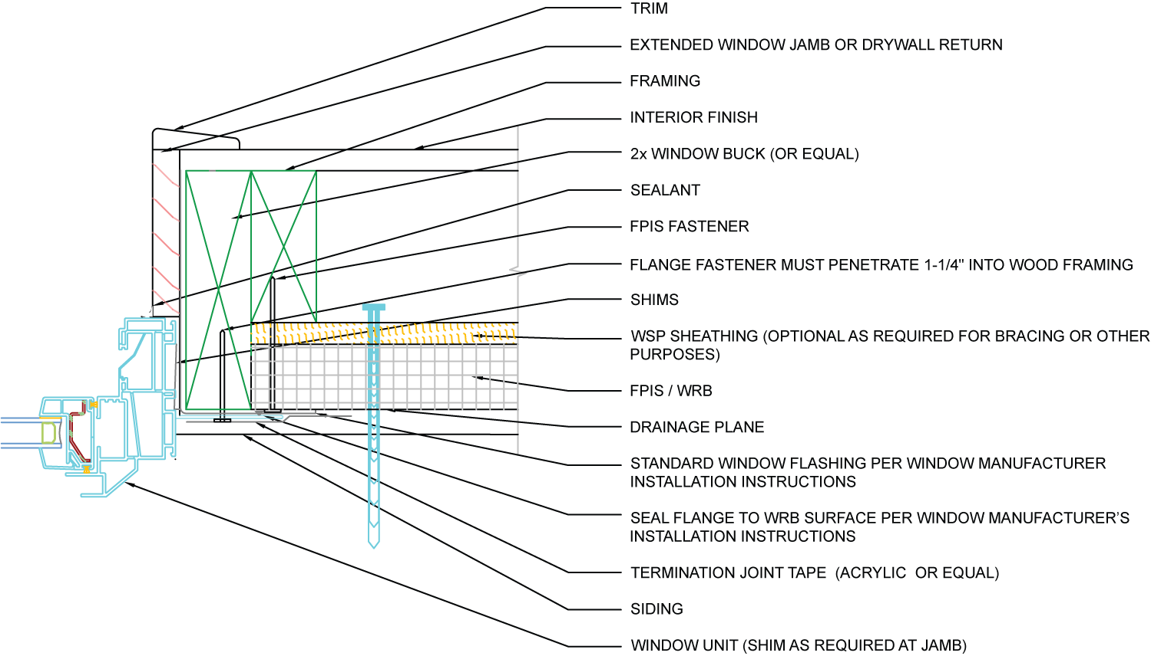
Window Buck – Jamb Detail

Slide 19
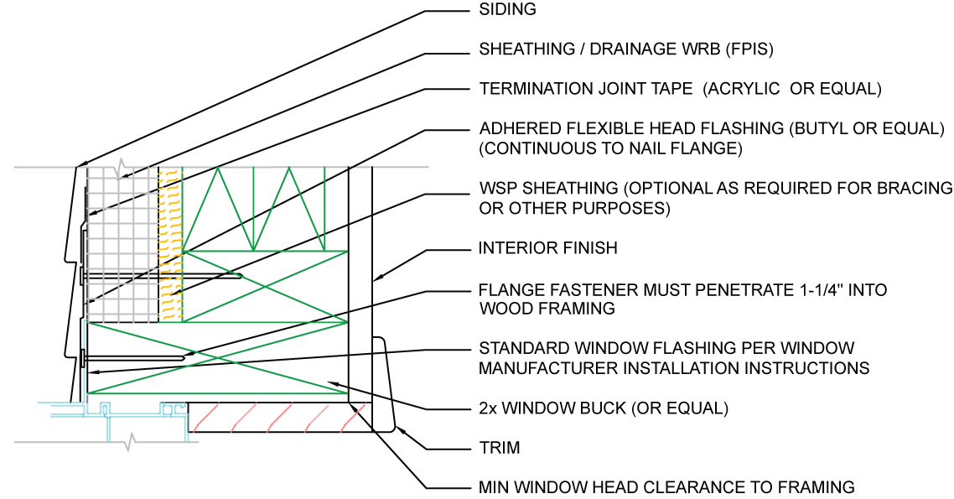
Window Buck – Head Detail

Slide 20
Window Buck – Plywood Buck (alternative to 2x lumber buck)
https://www.nist.gov/system/files/nzertf-architectural-plans3-june2011.pdf
https://www1.eere.energy.gov/buildings/publications/pdfs/building_america/incorporating-thick-layers-exterior-insulation.pdf

Slide 21
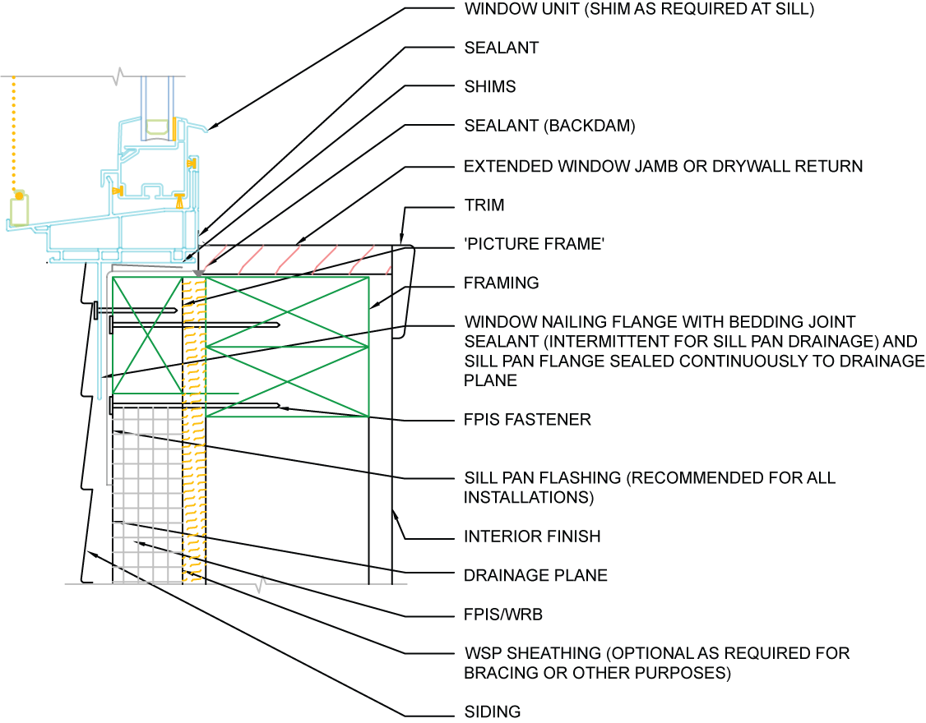
Picture Frame – Sill Detail

Slide 22
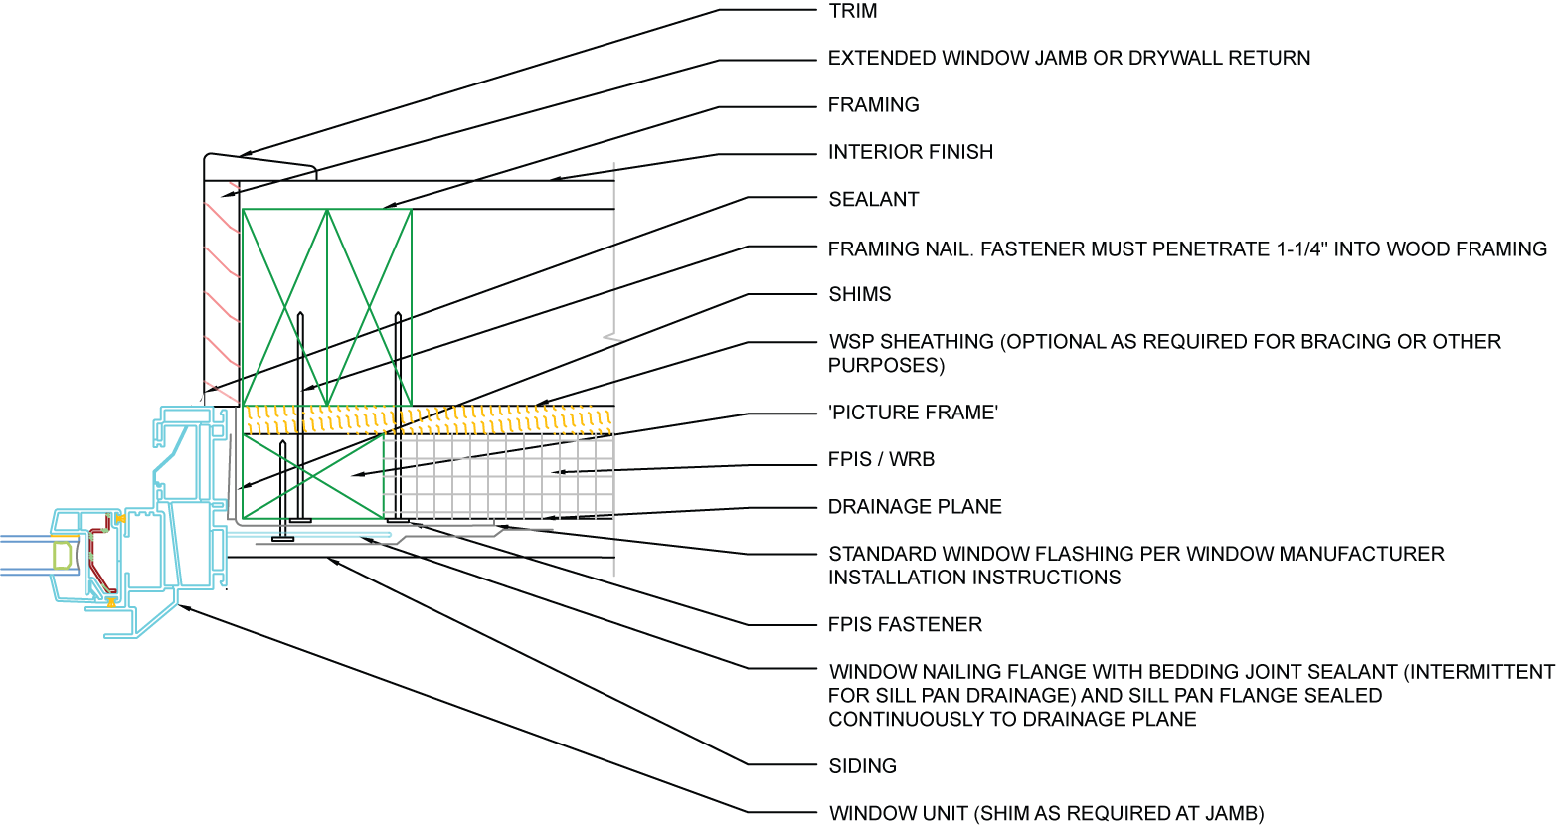
Picture Frame – Jamb Detail

Slide 23
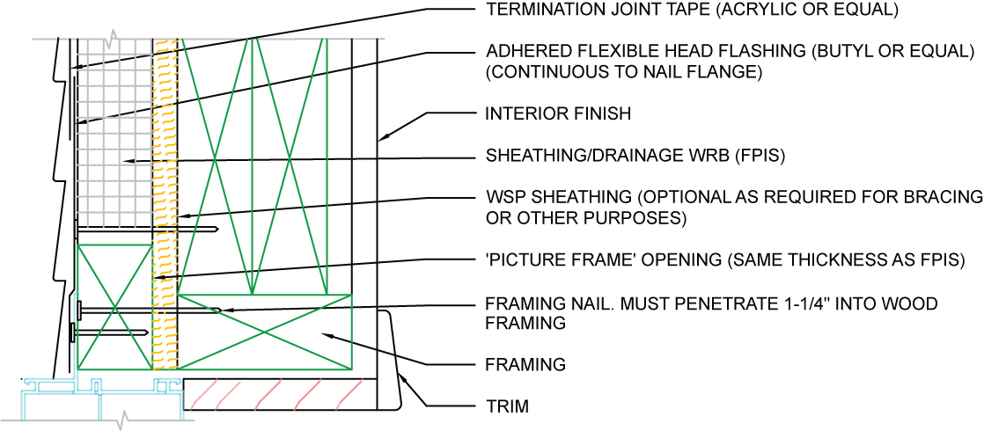
Picture Frame – Head Detail

Slide 24
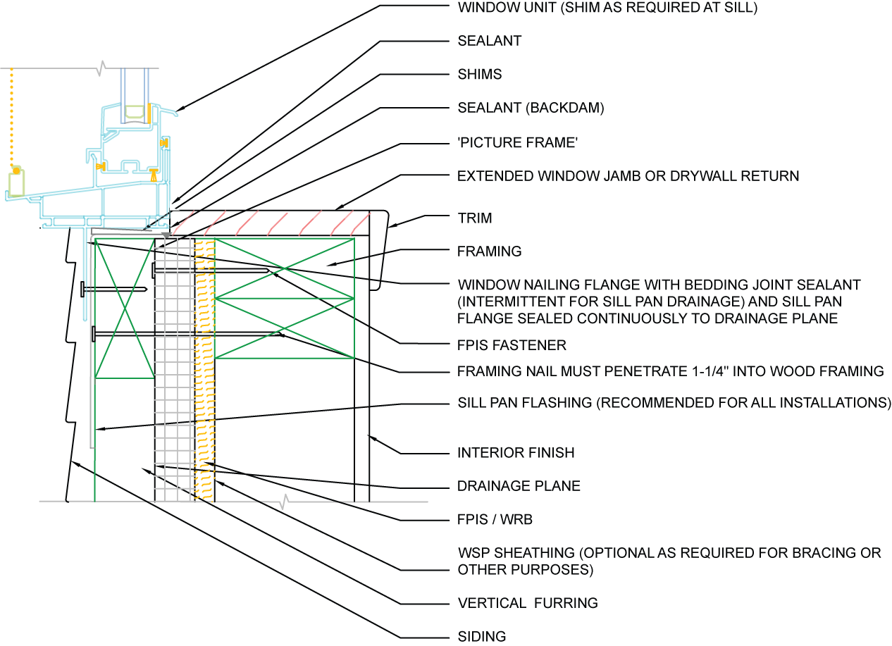
Rainscreen Method – Sill Detail

Slide 25
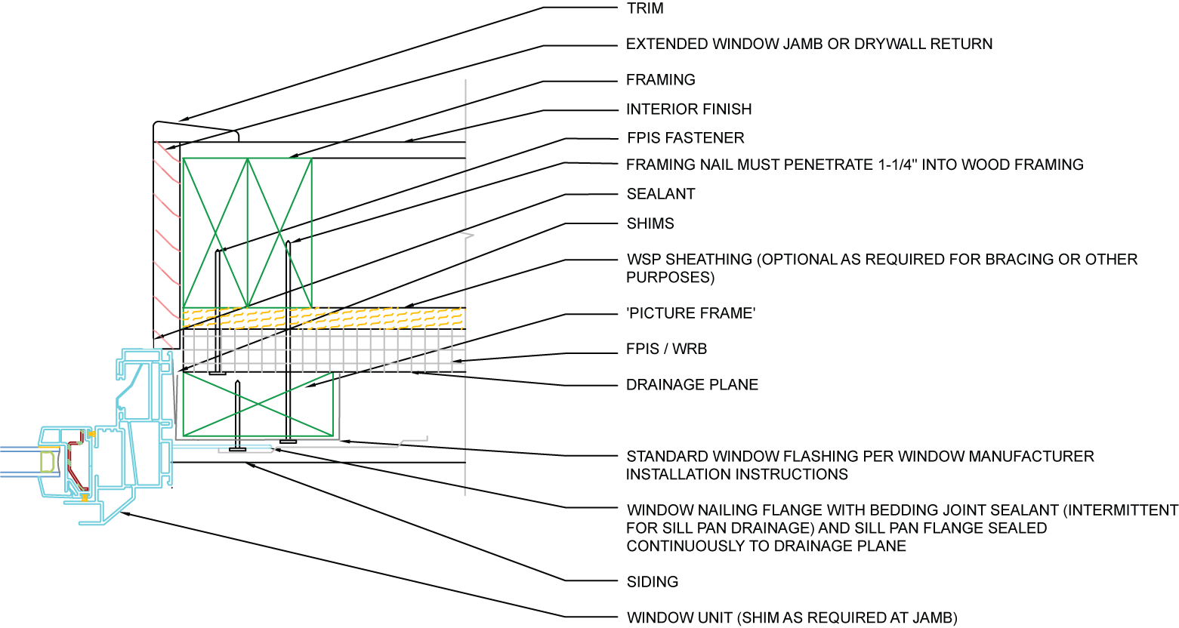
Rainscreen Method – Jamb Detail

Slide 26
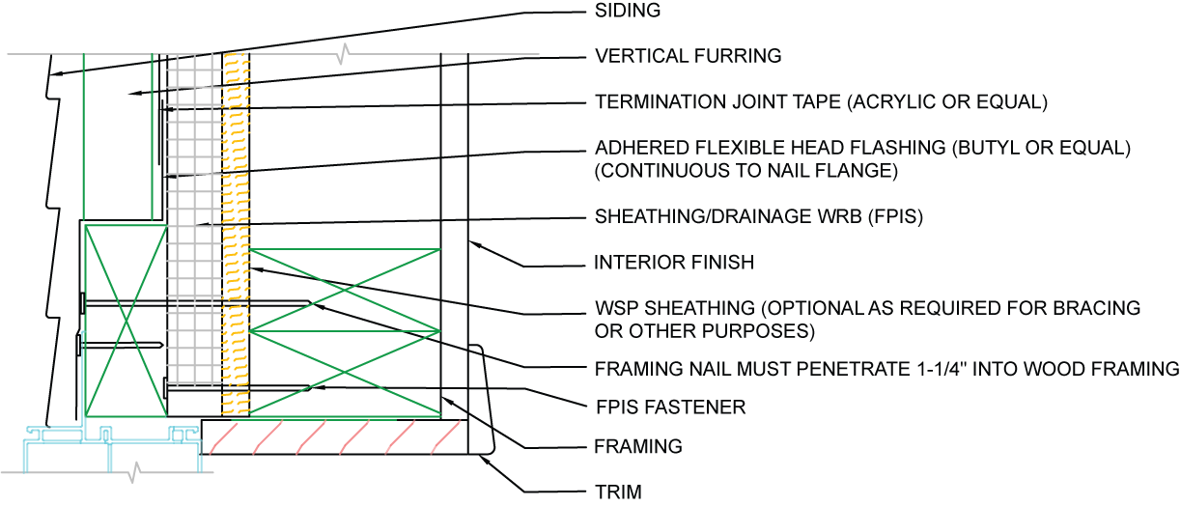
Rainscreen Method – Head Detail

Slide 27
Basic Installation Steps
The following installation steps are based on the “standard” method
Similar steps apply to the other installation methods (see previous detail differences).
For a printable installation instructions refer to CI’s Quick Guide on Window Installation.

Slide 28
STEP 1: Frame Window Opening
Frame walls with wood or steel as required by the applicable code.
Ensure window rough opening is square and plumb and of the size required for the window.
If using the “window buck” method, frame the buck into the rough opening or be sure to leave extra clearance for the buck to be installed after framing to accommodate the required window rough opening size.
Top plate
Header
Sill plate
Wall stud
Cripple stud
Bottom plate

Slide 29
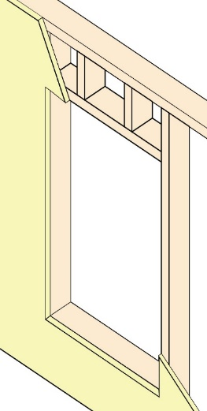
STEP 2: Install FPIS
Follow FPIS manufacturer’s installation instructions
If an FPIS WRB system, install flashing and joint sealing materials per manufacturer’s instructions
Where a separate WRB is used, following the WRB manufacturer’s installation instructions

Slide 30
STEP 3: Install Sill Pan Flashing
Pan flashing is a recommended best practice and is required by some manufacturer’s instructions.
Apply flashing or sill pan component in accordance with manufacturer’s instructions.
Sloped sill is recommended, especially if sealant to window frame is used as the backdam (see STEP 8).

Slide 31
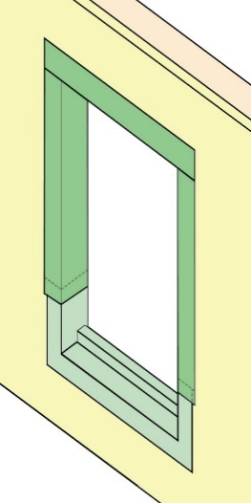
STEP 4: Install Rough Opening Jamb and Head Flashings
Recommended best practice for continuous air-barrier between wall and window.
Sometimes required or recommended by manufacturer’s instructions.
Shingle lap jamb flashing over sill flashing and head flashing over jamb flashing

Slide 32
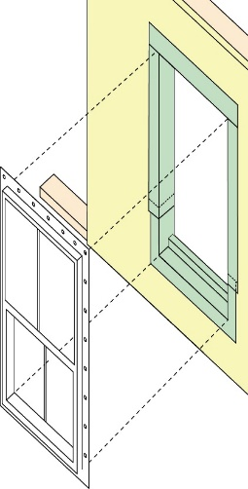
STEP 5: Install Window
Follow window manufacturer’s instructions for flange fastening, support (e.g., shims), and additional anchorage if required (e.g., frame fasteners or brackets).
Use flange fasteners of sufficient length to penetrate FPIS and framing
Apply bedding sealant under flange per manufacturer’s instructions
Omit at sill flange for drainage if using a sill pan

Slide 33
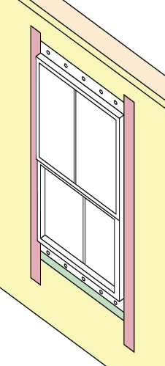
STEP 6: Install External Jamb Flashings
Follow flashing manufacturer’s instructions for proper application

Slide 34
STEP 7: Install External Head Flashing
Follow flashing manufacturer’s instructions for proper application
Where flexible adhered flashing is used, a best practice is to apply “termination tape” over the top edge of the adhered flashing for extra protection
FPIS WRB joint tape is often used for this purpose

Slide 35
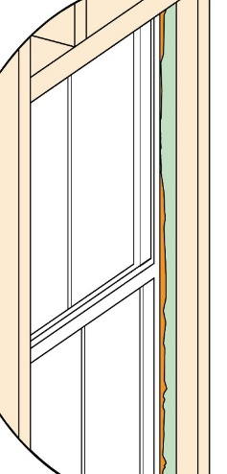
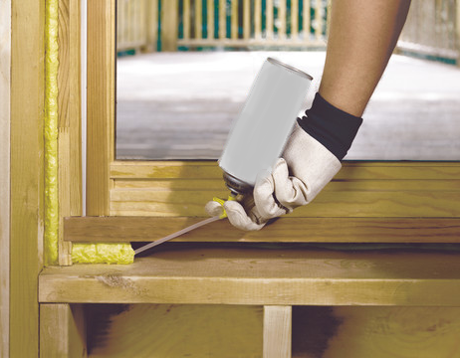
Step 8: Apply Sealant
Air seal window around entire perimeter on the interior with sealant or low-expanding foam made for this purpose.

Slide 36
Additional Resources
For additional window installation resources refer to:
Window Installation Application page
CI’s Quick Guide on Window Installation
ABTG Research Report 2104-01 – Installation & Performance of Flanged Fenestration Units Mounted on Walls with FPIS
Window Installation Details for Effective Sealing Practice (from the National Research Council of Canada)
Window Sill Details for Effective Drainage of Water (from the National Research Council of Canada)
Always use product manufacturer’s installation instructions as the primary resource!
Notes:
Additional reading
36

