Slide 1
Cladding & Building Enclosure
Component Connections Through
Foam Plastic Continuous Insulation
Design & Prescriptive
Code Compliance
September 19, 2021

Slide 3
Overview
Cladding and building envelope component connections are important to the overall performance and integrity of a building envelope.
Continuous insulation (ci) is a means of:
  improving energy efficiency and energy code compliance.
  providing moisture control (with appropriate use of other control layers).
CI and connections through it must be properly optimized to achieve structural objectives and minimize impact to thermal objectives.
Newer model codes provide prescriptive solutions.
Design methods also are available to evaluate alternatives.

Slide 4
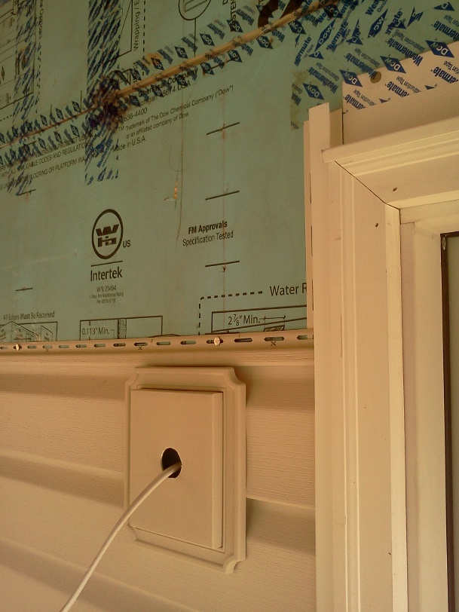
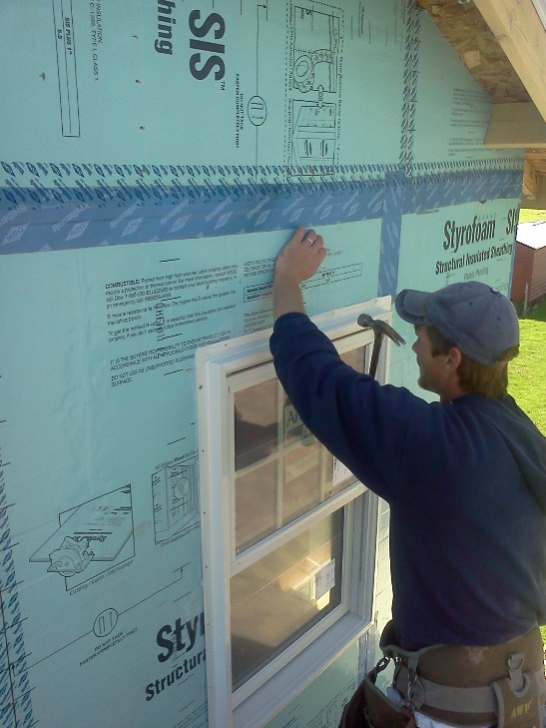
Outline
Define continuous insulation
Practical Challenges
Foam Plastic Insulating Sheathing (FPIS)
  Material Properties
  Common Wall Assembly Applications
Connections through FPIS
  Prescriptive solutions for cladding/furring attachment
  Design procedures and applications
Conclusions

Slide 5
Ci Definition
IECC and ASHRAE 90.1:
  Continuous Insulation (ci): Insulation that is uncompressed and continuous across all structural members without thermal bridges other than fasteners and service openings. It is installed on the interior or exterior or is integral to any opaque surface of the building envelope.
Uncompressed
Continuous
No thermal bridges except fasteners and service openings
  Intent to avoid large thermal bridges (floor edge discontinuities, etc.) but allow for necessary service penetrations (vents, piping, electrical conduit, etc.)
  Fasteners are small but cumulative thermal bridges. While permitted, their impact should be minimized without sacrificing structural purpose.
  This requires optimization of thermal performance and structural performance.

Slide 6
Practical Challenges
Fastening of cladding and other components through continuous insulation is not without challenges:
  Insulation material must not compress due to fastener draw-down forces and
  shear-transfer reaction forces.
  Insulation material and fastener must control creep (long term movement).
If insulation material compresses, it doesn’t comply with ci definition.
  Example: Metal building insulation compressed between metal cladding and purlins
  or girts.

Slide 7
Practical Challenges
If compressible insulation is used without compression, then other cladding attachment and support methods become necessary.
  Examples: metal shear tabs supporting offset furring, Z-furring through the insulation, or specialty thermal break devices or brackets.
  These attachment/support methods do not comply with the ci definition.
  Must use U-factor method and account for cladding support thermal bridging to determine energy code compliance.

Slide 8
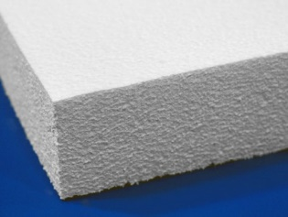
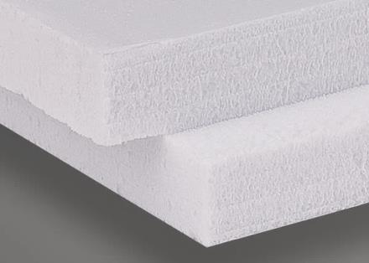
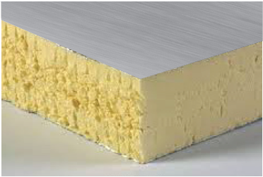
Foam Plastic Insulating Sheathing (FPIS)
FPIS Material Types:
  ASTM C578 – Standard specification for rigid, cellular polystyrene thermal insulation
    Extruded polystyrene (XPS)
    Expanded polystyrene (EPS)
  ASTM C1289 – Standard specification for faced rigid cellular polyisocyanurate thermal insulation board
    Polyisocyanurate (Polyiso, PIC, etc)
All FPIS types are applicable to building envelope applications; however, foundation and other ground contact applications generally use polystyrenes
(e.g., ASCE 32 standard)

Slide 9
FPIS (cont’d)
FPIS Compressive Strength
  Range from 10 psi to 100 psi or more
  15 psi or greater typically used for wall applications (XPS, EPS, and Polyiso)
  Higher compressive strengths used to support foundation loads (footing loads, structural slab loads, highway/infrastructure loads, etc.)
    For example, FPIS can support foundation loads of 3,000 psf or more (with a typical safety factor of 3 to 5 applied to the ASTM rated compressive strength)
  Compressive strength and rigidity makes through fastening more practical

Slide 10
FPIS (cont’d)
FPIS R-values range from 4 to 6 R per inch (e.g., 2"ci = R8 to R12).
  High R-value/inch allows thinner ci to meet required R-value.
  Thinner ci makes through-fastening easier (places less stress on fasteners
  supporting cladding and component loads).

Slide 11
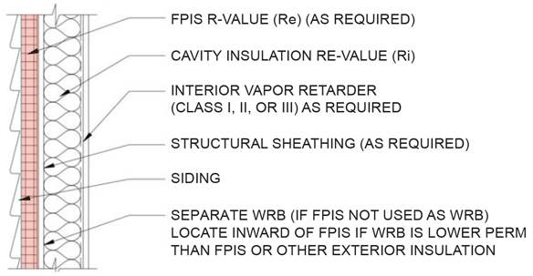
FPIS (cont’d)
Building Envelope Functions of FPIS:
  Continuous insulation
  (thermal control layer)
  Water-resistive barrier
  (water control layer)
  Water vapor control
  (vapor control layer)
  Air barrier
  (air control layer)
Primary function is
thermal control layer

Slide 12
FPIS (cont’d)
Other functions are based on design preference and product properties/qualification (e.g., many FPIS products are approved for WRB applications, but some not).
Ci should always be applied in a manner that integrates with the water-vapor control strategy for the overall wall assembly (e.g., insulation ratio based on climate and interior vapor retarder specified).
Other code requirements must be satisfied (fire safety, wind load, etc.) as with any material or assembly. (See IBC Chapter 26 for many requirements related to code-compliant use of foam plastics.)

Slide 13
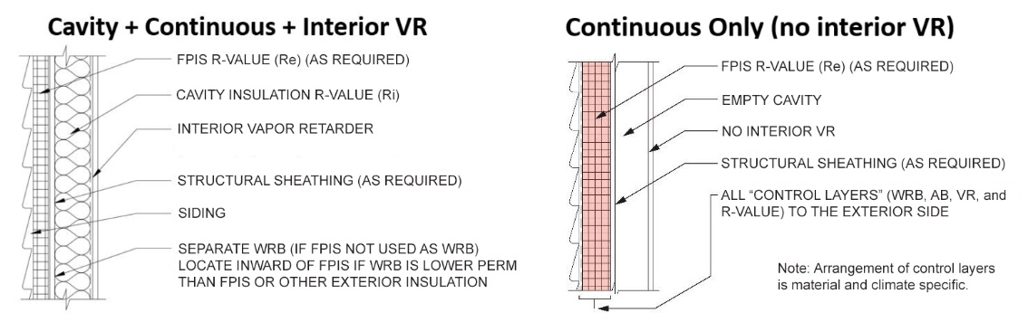
Common Wall Assembly Applications
Two Examples:
  “Hybrid wall” (cavity + ci)
  “Perfect wall” (ci only; all control layers on exterior)

Slide 14
Research: Connections through FPIS ci
ABTG (2015). Attachment of Exterior Wall Coverings Through Foam Plastic Insulating Sheathing
Basis for prescriptive requirements in:
  Section 2603, International Building Code (IBC) – 2012 through 2021 editions
  Section R703, International Residential Code (IRC) – 2012 through 2021 editions
Basis for engineering design procedure supporting the above code provisions

Slide 15
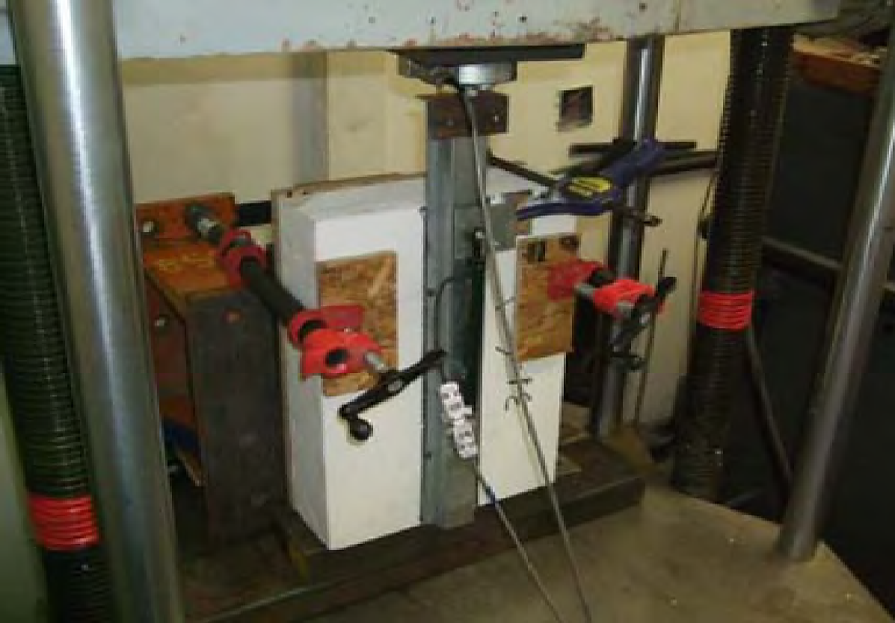
Research (cont’d)
Based on many tests conducted for NYSERDA, FSC, AISI/SFA, and DOE projects, each by independent sources/labs.
Evaluated both short term load resistance and stiffness of connections through FPIS (15 psi min.) up to 4-inches thick as well as long term creep behavior and stabilization (1 month to 1 year duration).
Limit short-term deflection to 0.015" maximum and stabilized creep
Short-term load-deflection test
Long-term (sustained)
load-deflection test

Slide 16
Prescriptive Solutions
General Requirements
  FPIS minimum 15 psi compressive strength
  FPIS complies with ASTM C578 or ASTM C1289
  Solutions address fastener shear capacity and stiffness to support cladding weight
  Must also check cladding attachment requirements for wind load, etc.
  (the more stringent fastening schedule will control)
  Fastener length must be long enough to accommodate FPIS thickness and maintain required fastener embedment in wood/steel
  Fastener tightened to draw connected materials together but not distort
  Fastening schedule will depend on FPIS thickness and cladding weight supported
  Only connections to wood framing or cold-formed steel framing are addressed; connections to masonry/concrete must be approved by alternate means
  (often proprietary fasteners are used)

Slide 17
Prescriptive Solutions
Tabulated requirements addressed 4 cladding weight classes:
  3psf or less – vinyl siding, wood lap siding, most fiber cement siding…
  11 psf – 3-coat Portland cement stucco
  18 psf – medium weight adhered masonry veneer
  25 psf – heavy adhered masonry veneer
Weight should include weight of all materials outbound of FPIS surface
Other material layers in addition to FPIS, such as gypsum sheathing and drainage matts (up to 3/8" thick), should be counted in the allowable FPIS thickness when applying tabulated requirements.

Slide 18
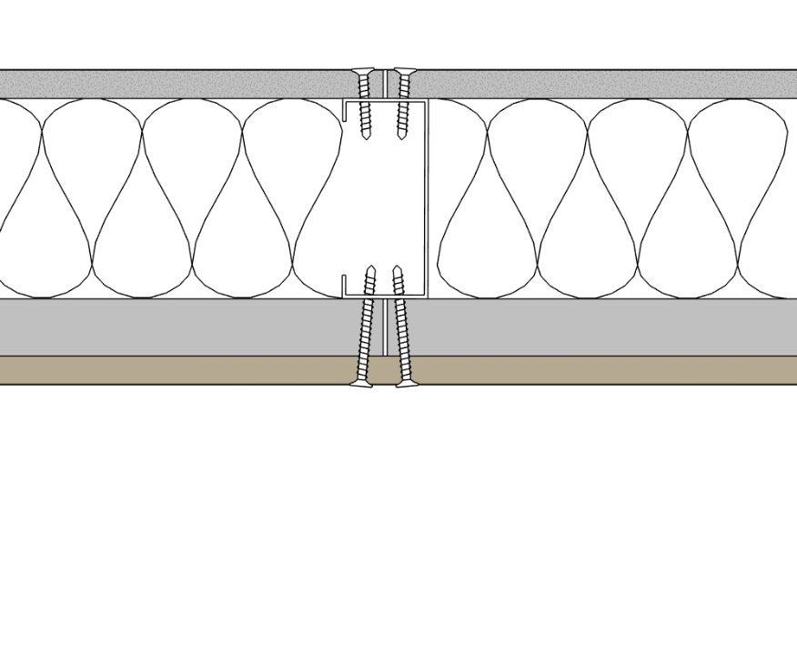
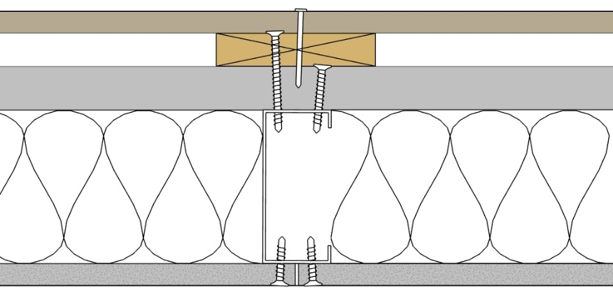
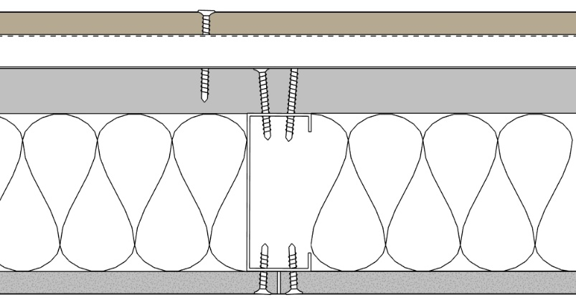
Prescriptive Solutions
Cladding Connections to Cold-Formed Steel Framing
  Direct cladding attachment
  Furring attached (wood or steel furring)
Direct Cladding Attachment
Vertical Furring Attachment
Horizontal Furring Attachment
FPIS
FPIS
FPIS

Slide 19
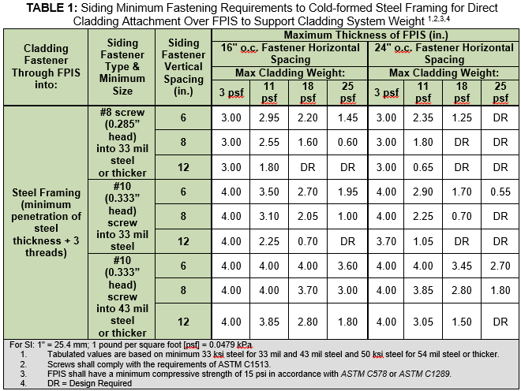
Prescriptive Solutions

Slide 20
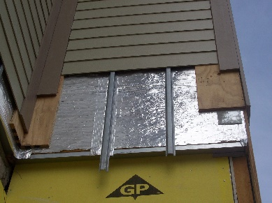
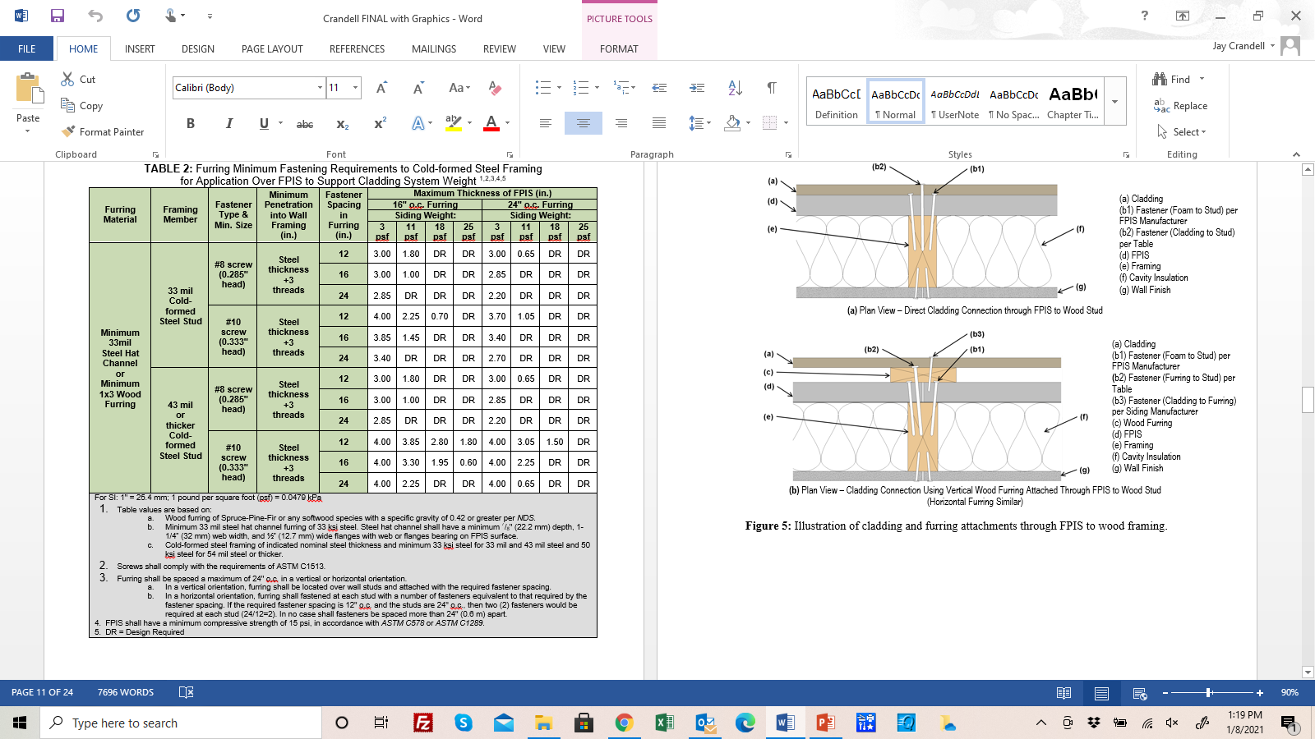
Prescriptive Solutions
TABLE 2 NOTES

Slide 21
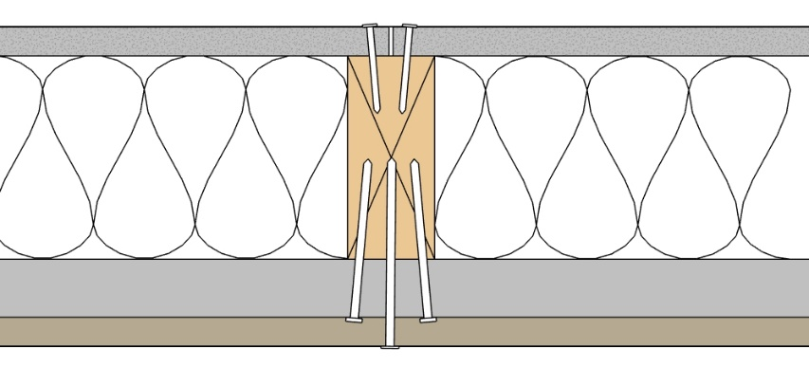
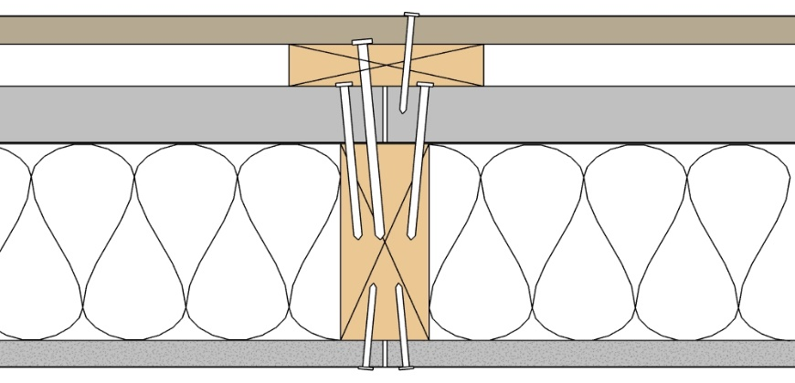
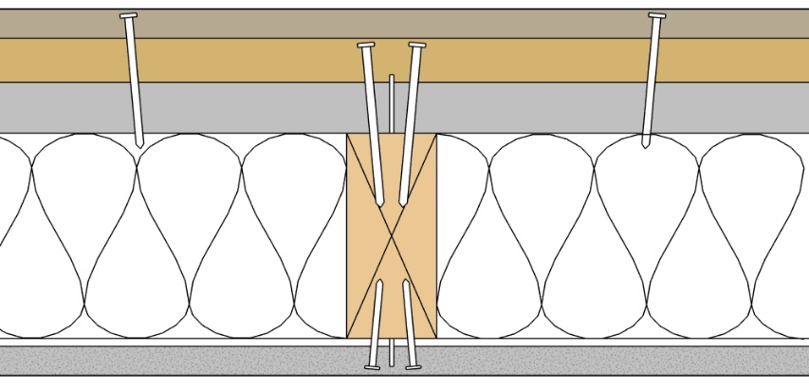
Prescriptive Solutions
Cladding Connections to Wood Framing
  Direct cladding attachment
  Furring attachment (wood furring)
Direct Cladding Attachment
Vertical Furring Attachment
Horizontal Furring Attachment
FPIS
FPIS
FPIS

Slide 22
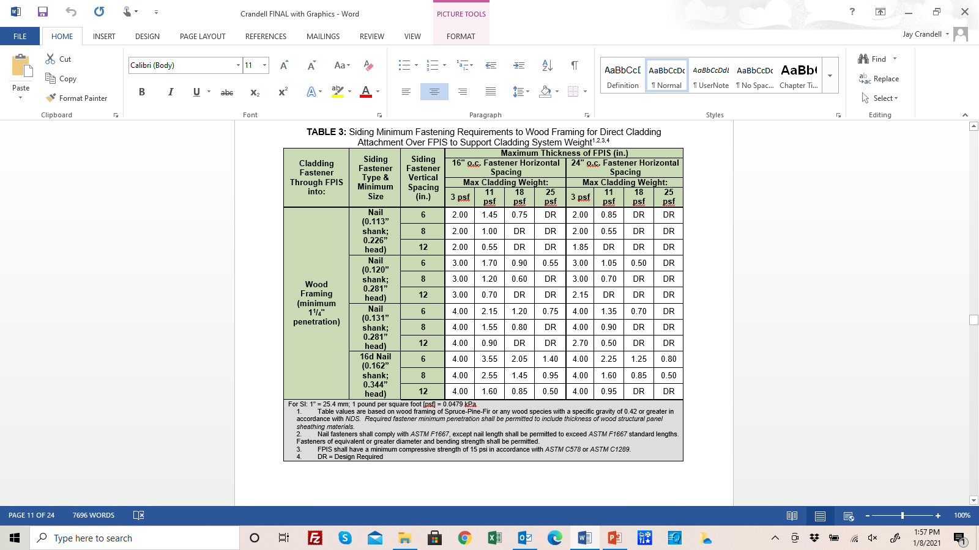
Prescriptive Solutions

Slide 23
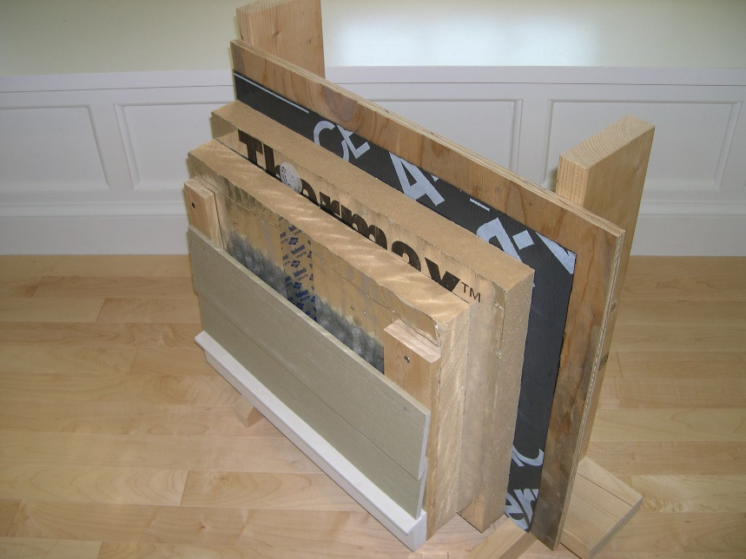
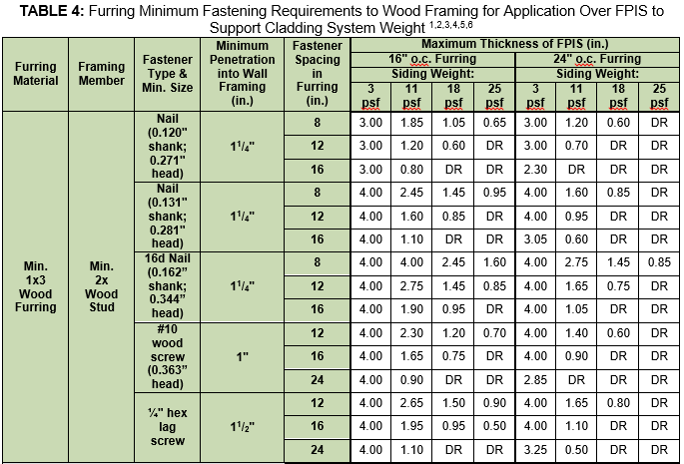
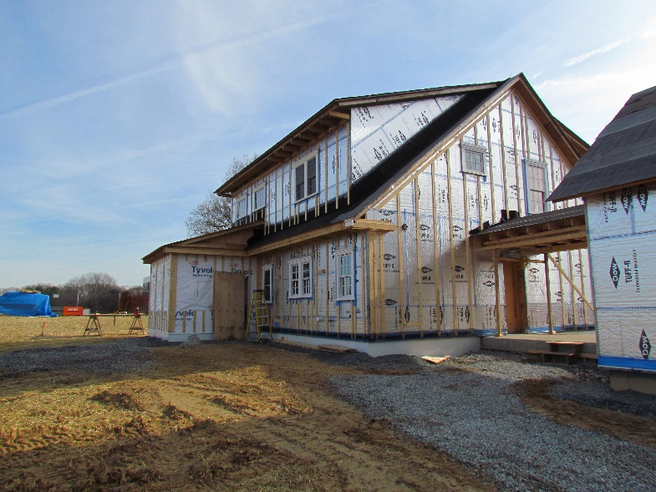
Prescriptive Solutions

Slide 24
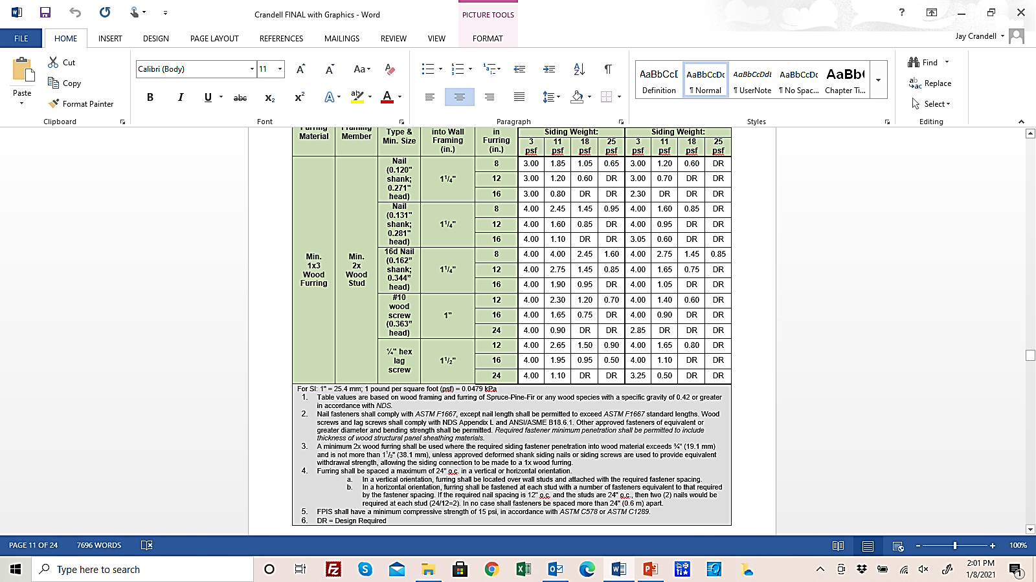
Prescriptive Solutions
Table 4 Notes:

Slide 25
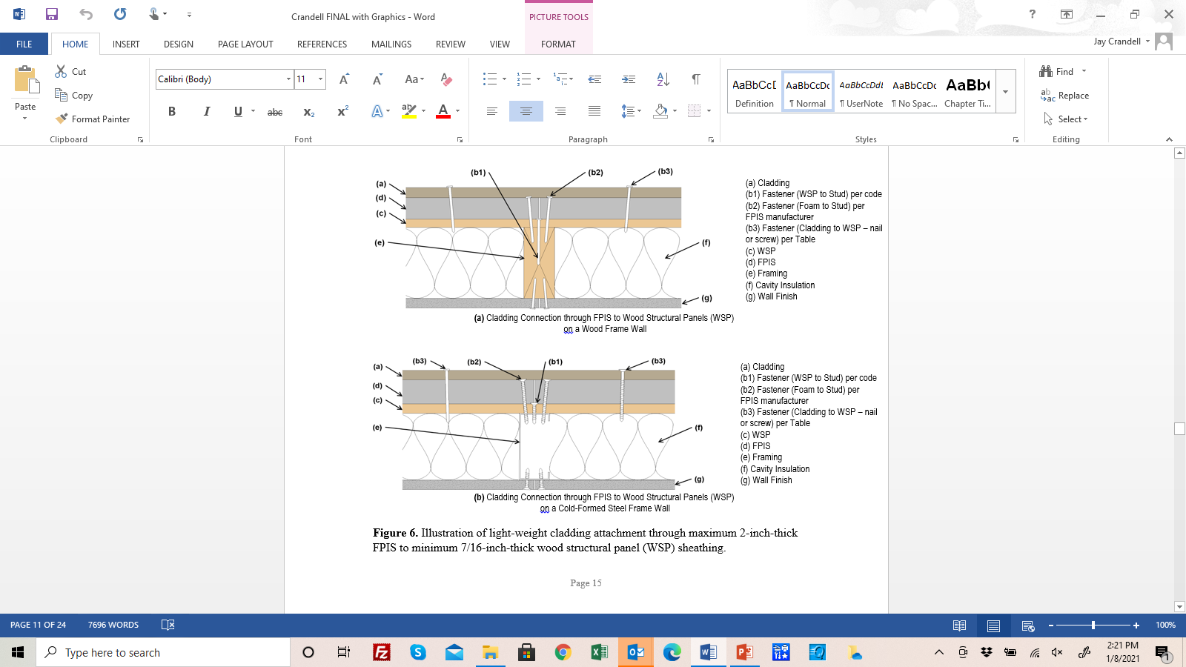
Prescriptive Solutions
Cladding connection through FPIS directly
to wood structural panel (2018 & 2021 IRC Section R703.3.3).
  Min. 7/16" WSP
  Max. 2" FPIS
  Min. 15psi FPIS
  Max. 30 psf wind load
  Fastener spacing of 12" oc to 16" oc depending on fastener type/size
  Max. 3 psf cladding weight

Slide 26
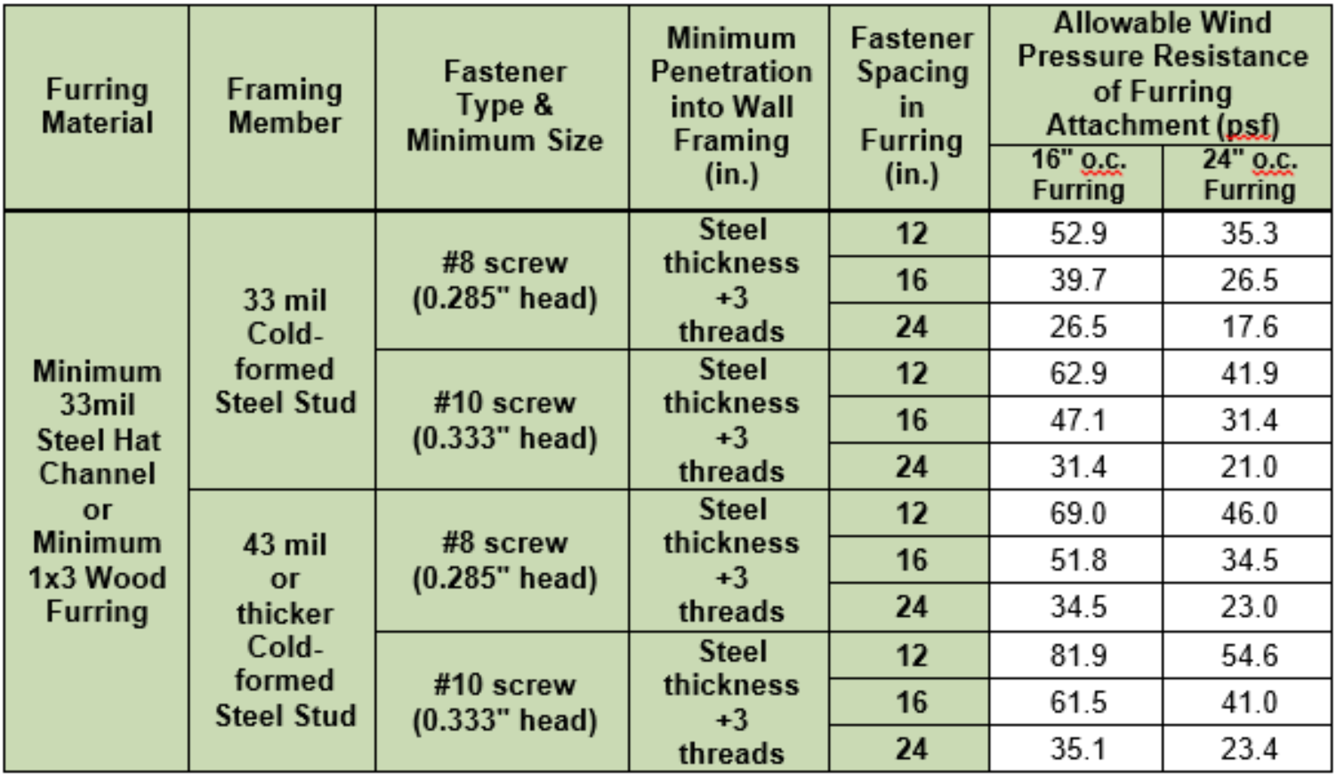
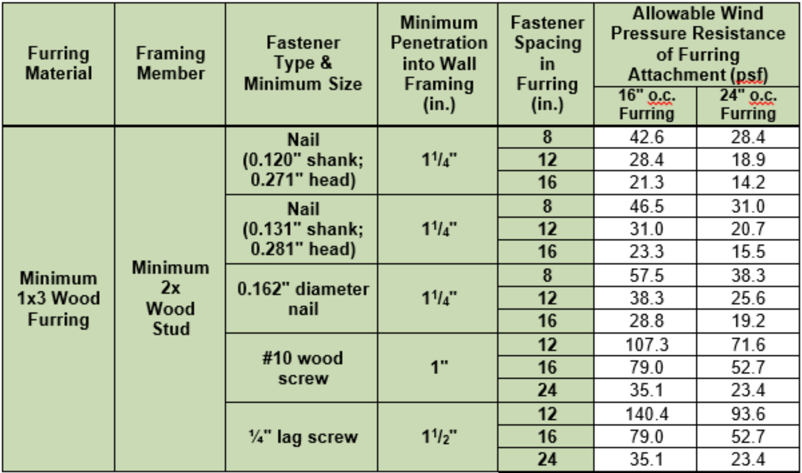
Prescriptive Solutions
Wind load resistance of furring (separate design check, not in prescriptive codes for claddings, except wood shingles and shakes)

Slide 27
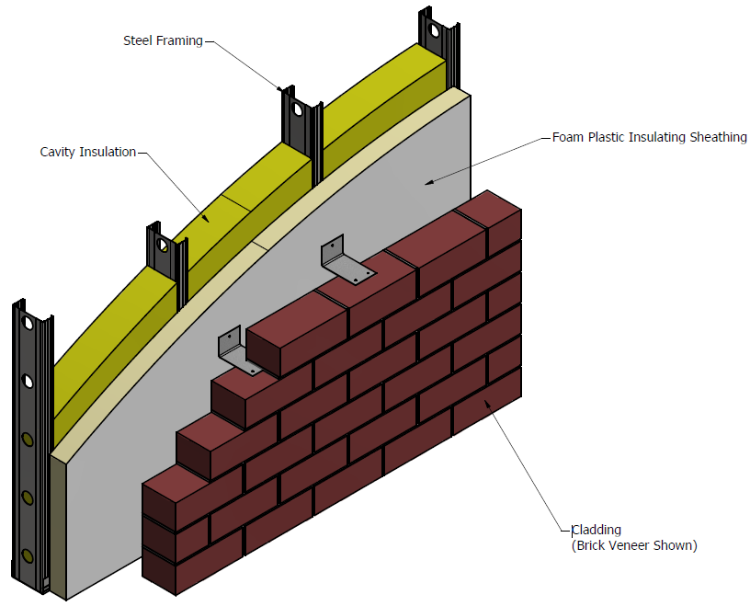
Prescriptive Solutions
Brick ties attached over foam sheathing to wood
framing or sheathing with only the tie fastener
penetrating foam sheathing (IRC Section R703.8.4)
Proprietary brick ties also are available that are
“stand-off” ties with pedestals for fasteners
penetrating foam sheathing.
Both of these solutions comply with the code definition of ci.
Finally, using stainless steel cladding, furring, and brick tie fasteners
will result in more durable installation and also reduce thermal bridging.
  Carbon steel is three times more thermally conductive than stainless.
  But smooth stainless-steel nails have less withdrawal strength than galvanized or plain, smooth shank carbon steel nails in wood. May need to use deformed shank stainless steel nails.

Slide 28
Design Procedure – Engineered Solutions
Same general requirements apply
Can design connections for cladding, furring, and building component attachments (including structural elements like ledgers)
  Not just limited to cladding and furring attachments

Slide 29
Design Procedures
Design of Connections through FPIS to Cold-formed Steel
  Tension allowable design values: Follows same procedure in AISI S100 for screw withdrawal capacity (just use longer screws)
  Shear allowable design values: Follows the same procedure in AISI S100, Section J4.3.1, but modifies Eq. J4.3.1.-1 by a gap reduction factor, Gr, as follows:
    For #10 screw in 54mil and 50 ksi steel: Gr = 0.17 – 0.0048 r
    For #10 screw in 43mil and 33 ksi steel: Gr = 0.19 – 0.0066 r
    For #8 or #10 screw in 33mil and 33 ksi steel: Gr = 0.16 – 0.0064 r
    Where,
      r = d_sep/d
      d_sep = thickness of FPIS separate connected steel parts
      d = nominal screw diameter (0.164” for #8, 0.190” for #10)
    Value of r shall not exceed 21.
    For 0<r<2, Gr need not be less than (1 – r/2)
    Material against screw head shall be minimum 33mil and 33ksi steel or minimum 3/8” thick wood or wood-based material with specific gravity of 0.42 or greater.

Slide 30
Design Procedures
Design of Connections through FPIS to Wood Framing
  Allowable withdrawal design values: Follows same procedure as NDS Section 12.2 (just use longer fasteners to accommodate FPIS thickness)
  Reference lateral (shear) resistance design values: Follows same procedure as NDS Section 12.3, but includes gap parameter per AWC TR No. 12.
    Modifies to require reduction term, Rd, to be not less than 3.0
    Minimum fastener penetration into wood not less than 1-inch for screws and 1-1/4 inches for nails.
    Minimum specific gravity of wood materials of 0.42.

Slide 31
Design Procedures
Example Applications:
  Cladding and furring connections using alternative fasteners
  Load bearing structural component connections through FPIS (e.g., deck and roof ledgers attached to wall surface)
  Architectural component connections through FPIS (e.g., awning frames, shading devices, etc.)
  Structural sheathing connections through FPIS (placed under sheathing rather than over sheathing)
  Window and door frame anchorages where passing through a rough opening gap or through a layer of foam sheathing (e.g., conditions not addressed in fenestration manufacturer instructions)

Slide 32
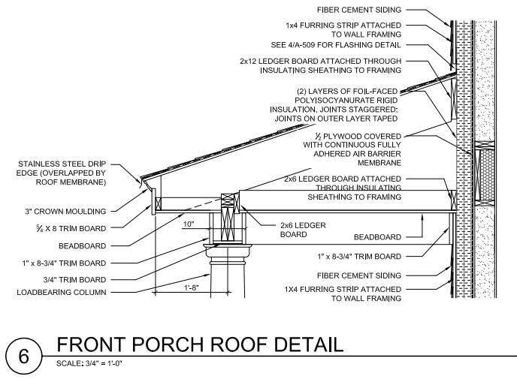
Design Procedures
Example Application:

Slide 33
Conclusions
Goal of the prescriptive solutions and design procedures is
to provide a means to optimize structural integrity, thermal efficiency, and construction efficiency for building envelopes using FPIS continuous insulation.
Major “take-aways” include:
  Many options for code-compliant and efficient solutions for attaching cladding and building components through FPIS
  Provides a means to comply with code definition and performance intent for continuous insulation
  Consistent with IBC and IRC provisions
  Applicable to cladding, furring, structural and architectural components attached to building envelope through FPIS
  Supports use of FPIS for multiple building envelope functions (WRB, vapor control, etc.)
  for environmentally stable, dry, and thermally efficient building envelopes.

Slide 34
Suggested Resources
Cladding Connections – continuousinsulation.org

