Slide 1
Explanation of footnote h

Slide 2
R2ci ≠ R5ci – “Footnote h”
The application of an earlier version of a footnote to the R-value table was stretched beyond its original intent.
The intent was to provide for a uniform wall thickness when partial structural sheathing is used (not fully structurally sheathed buildings):
Table R402.1.1, footnote h:
First value is cavity insulation, second is continuous insulation or insulated siding, so "13+5” means R-13 cavity insulation plus R-5 continuous insulation or insulated siding. If structural sheathing covers 40 percent or less of the exterior, continuous insulation R-value shall be permitted to be reduced by no more than R-3 in the locations where structural sheathing is used – to maintain a consistent total sheathing thickness.

Slide 3
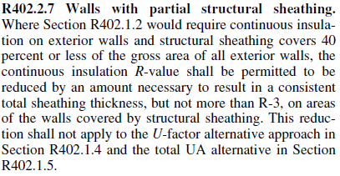
R2ci ≠ R5ci (cont’d)
In the 2015 IECC-R, this has been corrected by new text limiting its application to walls only with partial structural sheathing as originally intended

Slide 4
R2ci ≠ R5ci (cont’d)
To claim an R-value as a reflective air-space, it must meet the requirement of “no air-leakage” in the area behind the siding
This is basically impossible for most residential siding materials
Recent ASHRAE 90.1 changes clarify the issue:
  Air-spaces must be enclosed within a building assembly
  Air-spaces must be located to the interior of an air-barrier
  Thus, because siding ≠ air-barrier, reflective air-spaces cannot be included in the wall or CI R-value
For more details, see 2012 IECC and IRC Energy Chapter Code Development Footnote “h”- The Energy Code Loophole

Slide 5
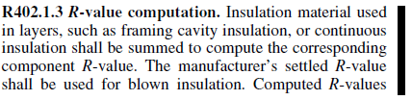

R2ci ≠ R5ci (cont’d)
The 2015 IECC requires a R0.6 reduction for insulated claddings or exterior wall covering
  IECC Table R402.1.1 (prescriptive) assumes R0.6 for generic siding, including the air-space behind the siding
  A R0.6 reduction brings a wall assembly complying with Table R402.1.2 (performance) in line with the prescriptive table assumptions
Thus, the R2 must be reduced to R1.4 to avoid the R-value of the air being double-counted to get to the R2 loophole in the older footnote h.

Slide 6

R2ci ≠ R5ci (cont’d)
The improper use of footnote h can erode continuous insulation R-value from R-5 to R-2 or less for the whole structure.
It is the code official’s job to disapprove this
Refer local code officials to this presentation available on the FSC website for more information.

