Slide 1
Fire

Slide 2
Fire - IBC Commercial Buildings
What are Types I-V construction? (IBC Section 602)
Type I-II construction:
Exterior and interior building elements must be noncombustible materials
Type III construction
Exterior must be noncombustible
Interior may be any permitted by code
Type IV construction (Heavy Timber)
Exterior must be noncombustible
Interior must be solid or laminated wood without concealed spaces
Type V construction
Exterior and interior building elements may be any permitted by code
Notes:
Why should we learn about continuous insulation?
Continuous insulation has been around for a long time. First used as fiberboard insulation, continuous insulation has been used in the construction market since the early 1900s. In more modern times, continuous insulation has commonly been used in low-slope commercial roofs since at least the 1940s source: http://building.dow.com/about/history.htm
The scope of this presentation will cover wall applications only. Images show polyiso used in a wall application.
Image source:
polyiso.org
2

Slide 3
Fire Requirements - IBC
Fire safety requirements for foam sheathing
IBC Chapter 26
2603.5.1 – Fire resistance rated walls (e.g. hourly rated walls)
ASTM E119 or UL 263 - Standard Test Methods for Fire Tests of Building Construction and Materials
2603.5.2 – Thermal barrier (e.g. 15 minute barrier)
Foam needs to be covered by a thermal barrier unless tested in accordance with NFPA 286 (Exception: one story buildings)
2603.5.3 – Potential heat
NFPA 259 - Standard Test Method for Potential Heat of Building Materials.
Notes:
Chapter 26 of the IBC is almost entirely devoted to fire safety requirements for foam sheathing materials and assemblies, including foam sheathing.
Section R316 of the IRC is similarly devoted to fire safety requirements for foam plastics.
These fire requirements for foam sheathing are comprehensive and effective.

Slide 4
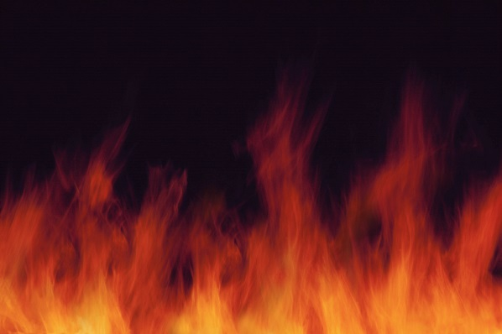
Fire Requirements - IBC
Fire safety requirements for foam sheathing
IBC Chapter 26
2603.5.4 - Flame spread index, smoke developed index
ASTM E84 or UL 723 - Standard Test Method for Surface Burning Characteristics of Building Materials
2603.5.5 – Vertical and lateral fire propogation.
NFPA 285 - Standard Fire Test Method for Evaluation of Fire Propagation Characteristics of Exterior Non-Load-Bearing Wall Assemblies Containing Combustible Components

Slide 5
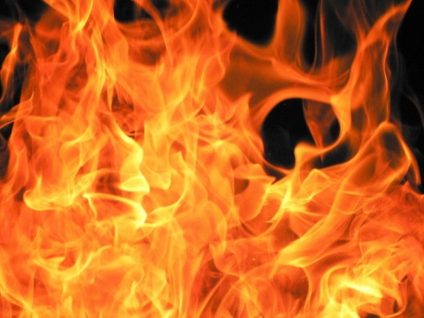
Fire Requirements - IBC
Fire safety requirements for foam sheathing
IBC Chapter 26
2603.5.6 – Label required
Must be labeled by an approved agency
2603.5.7 – Ignition
NFPA 268 - Standard Test Method for Determining Ignitability of Exterior Wall Assemblies Using a Radiant Heat Energy Source

Slide 6
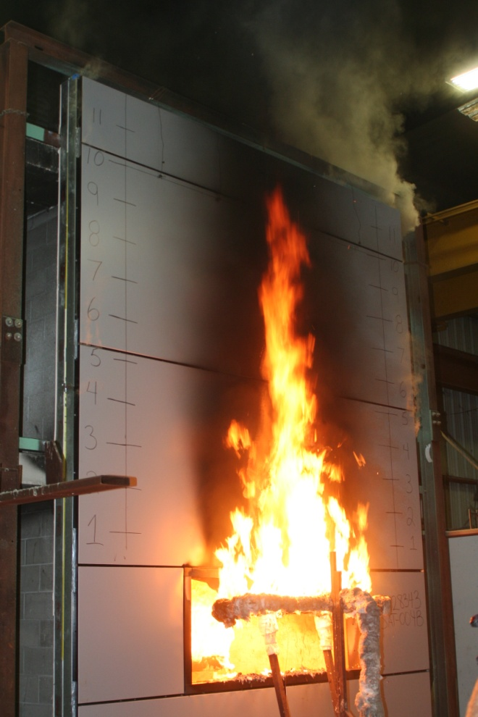
Exterior Flame Spread
NFPA 285 assembly testing is required for Type I-IV construction (IBC 2603.5)
Not required for Type V construction (IBC) and some cases of 1-story construction of other types (IBC 2603.4.1.4)
Not required for IRC (dwelling) construction.
Jesse Beitel, Hughes Associates, Inc.
Notes:
6

Slide 7
NFPA 285 Assembly Listing
Refer to TER No. 1202-01 for information on a variety of foam sheathing manufacturers with code-compliant NFPA 285 tested assemblies.
Various foam sheathing manufacturers have multiple assemblies that meet this requirement
Notes:
7

Slide 8
Fire Requirements - IRC
Fire safety requirements for foam sheathing
IRC Section R316
R316.3 – Surface burning characteristics
ASTM E84 or UL 723 - Standard Test Method for Surface Burning Characteristics of Building Materials
R316.4 – Thermal barrier
Foam needs to be covered by ½” gypsum or other approved material
R316.6 – Special approval
NFPA 286, FM 4880, UL 1040, UL 1715, or other
fire tests related to end use configurations
Notes:
Section R316 of the IRC is almost entirely devoted to fire safety requirements for foam sheathing materials and assemblies, including foam sheathing.
Chapter 26 of the IBC is similarly devoted to fire safety requirements for foam plastics.
These fire requirements for foam sheathing are comprehensive and effective.

Slide 9
Comparison of Two Common Types of Combustible Sheathing
Notes:
From ACC-FSC Tech Matters
9

Slide 10
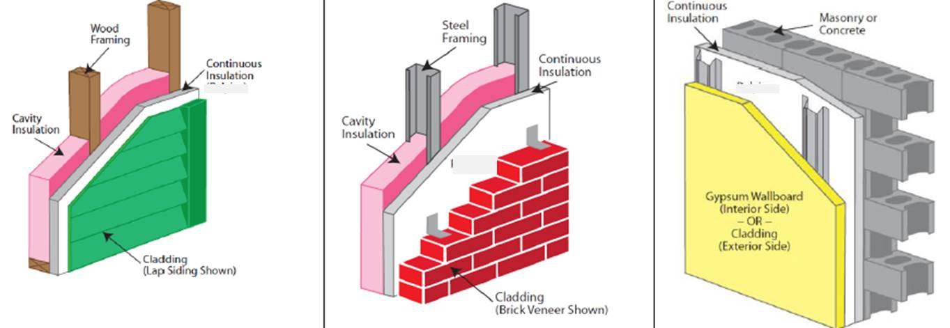
Gypsum board typically added to provide interior and exterior fire rating
*
* Gypsum board typically added between wood or steel stud and FPIS where exterior fire resistance properties are needed (usually for building sites with short fire separation distances between buildings
Notes:
With proper detailing, continuous insulation can be used in any wall assembly. This graphic shows three common assemblies using continuous insulation.
10

Slide 11
Fire Resources for FPIS
TER No. 1202-04 Type I-IV Construction
TER No. 1202-03 Type V Construction
TER No. 1202-01 NFPA 285 Tested Assemblies

