Slide 1
Cladding attachment

Slide 2
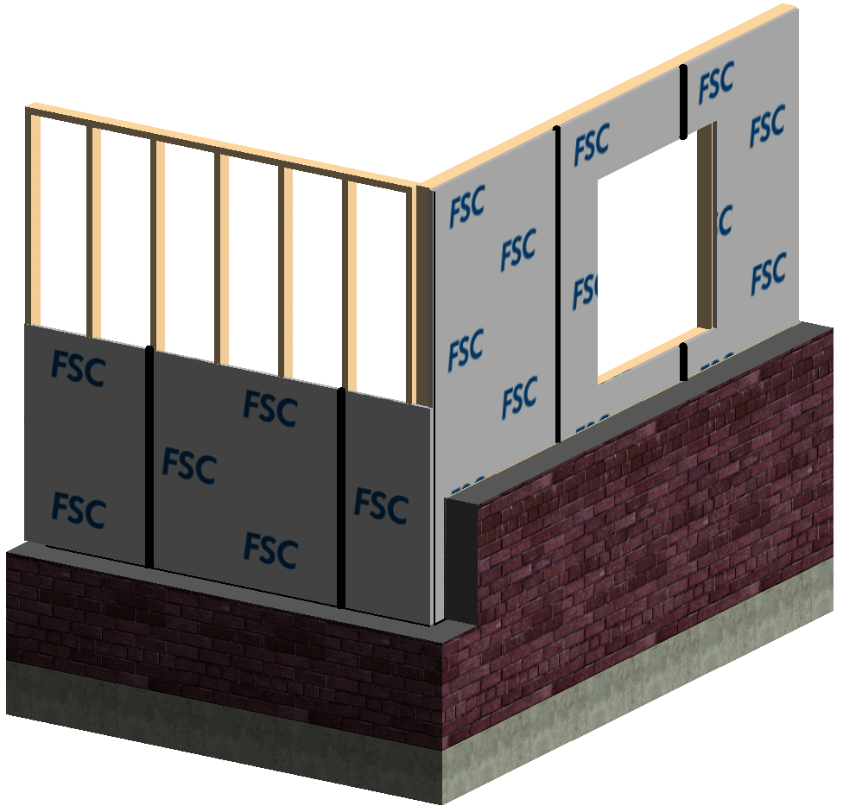
Foam Plastic Insulating Sheathing (FPIS) Products:
Exterior wall coverings are attached directly through the FPIS into the framing or to furring attached through the FPIS to framing.
Shall be installed in
accordance with:
  Code compliance requirements per
  TER 1303-04
  How to Install FPIS
  Installation Guide
  Manufacturer’s installation
  instructions
  The following general
  installation guidelines

Slide 3
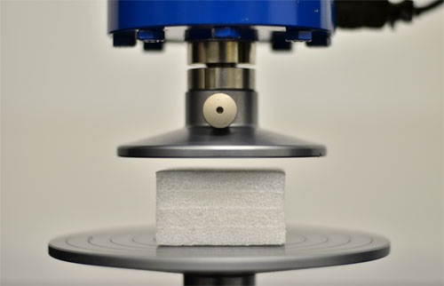
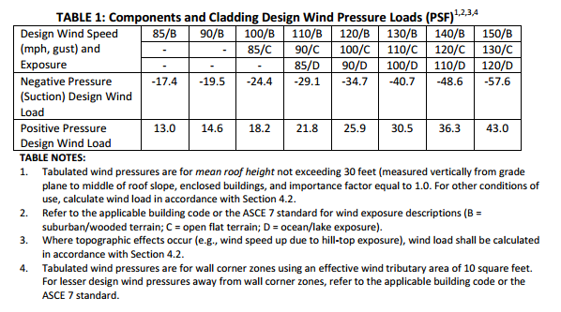
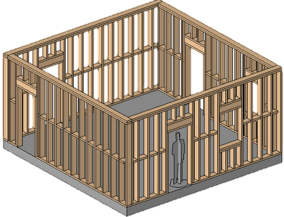
Step 1: Verify FPIS and Framing
FPIS must have min compressive strength of 15 psi
Must comply with ANSI/SBCA FS100 where wind pressure resistance is required
ASTM D 1621
Note: Wind speeds shown in Table 1 are V_{ASD.} Where V_{ULT} is used, multiply wind speeds by a factor of 1.26
_
+
_

Slide 4
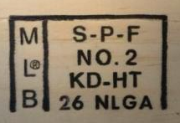

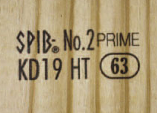
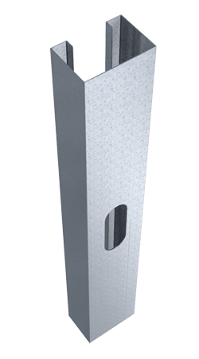
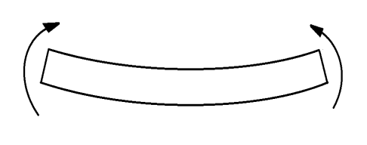
Step 1: Verify FPIS and Framing
Wood framing may be any softwood species with specific gravity 0.42 or higher
Steel framing must be:
Thickness | Minimum F_{b}
33 mil, 43 mil | 33 ksi
54 mil | 50 ksi
F_{b}

Slide 5
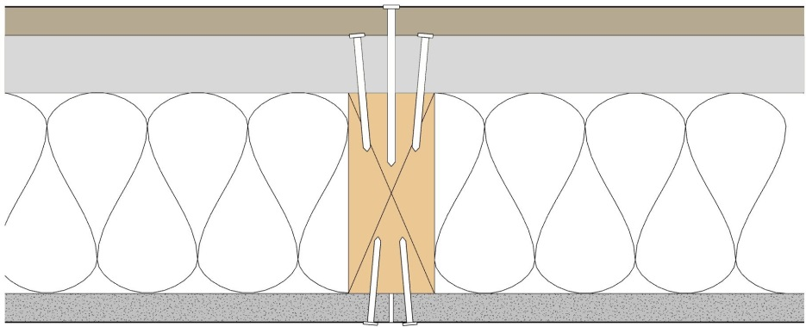
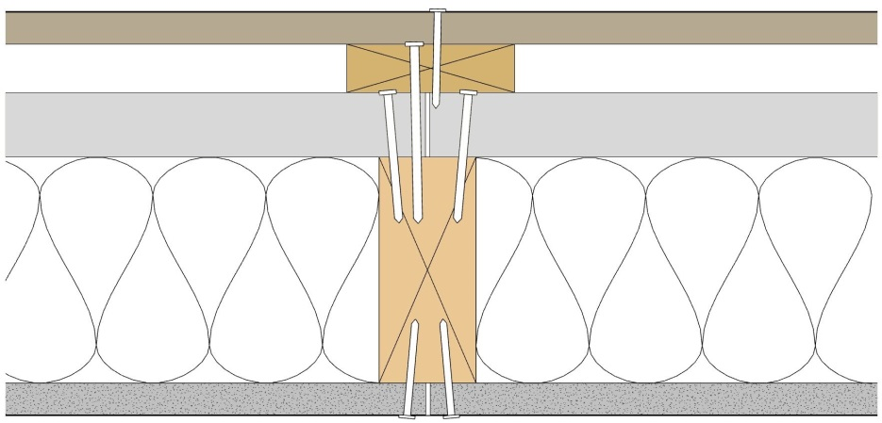
Step 2: Verify Fasteners
Exterior coverings may be attached by the following methods:
(b)
(a)
(d)
Cladding
Fasteners
Furring
FPIS
Framing
Cavity Insulation
Interior wall finish
(e)
(f)
(g)
Direct Attachment
(b)
(a)
(c)
(d)
(e)
(f)
(g)
Attachment through Furring

Slide 6
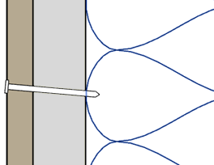
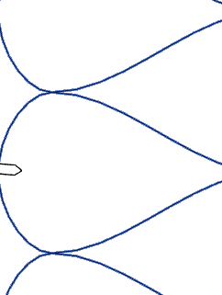
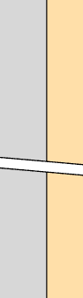

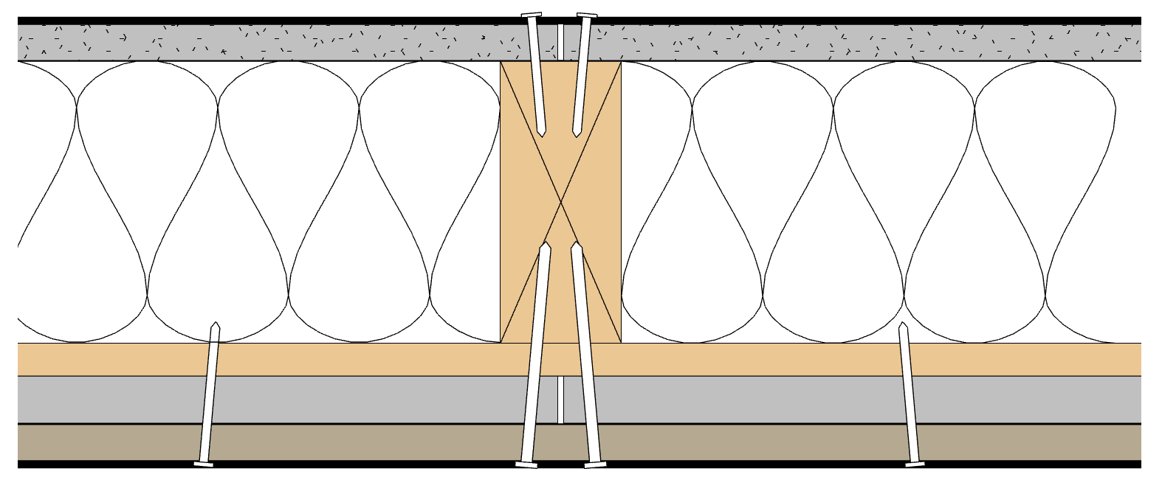
Step 2: Verify Fasteners
1¼” min
or per manuf.
instructions
Fasteners must meet penetration requirements per IRC Table R703.3(1) into:
  Studs
  Framing members
Where penetration into framing is not required, fasteners must extend ¼” beyond the opposite face of the sheathing per IRC Table R703.3.2
1/4” min

Slide 7
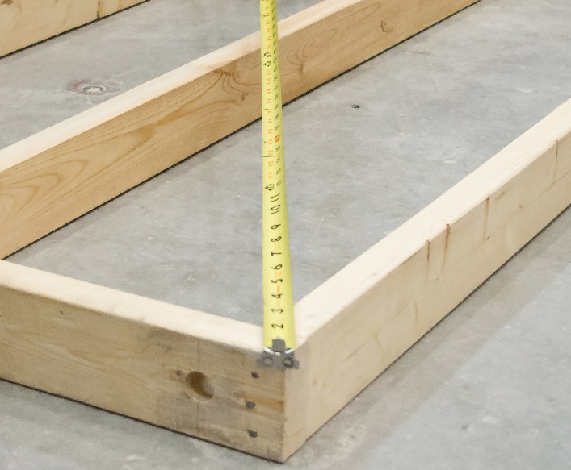
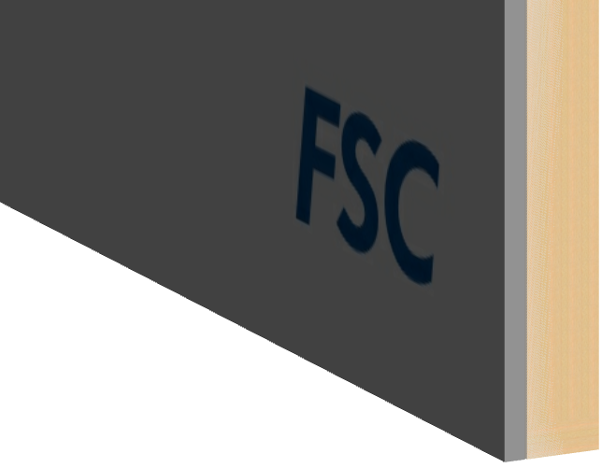
Step 3: Place Insulation Boards
Ensure wall is square and true
Align boards with bottom edge of wall

Slide 8
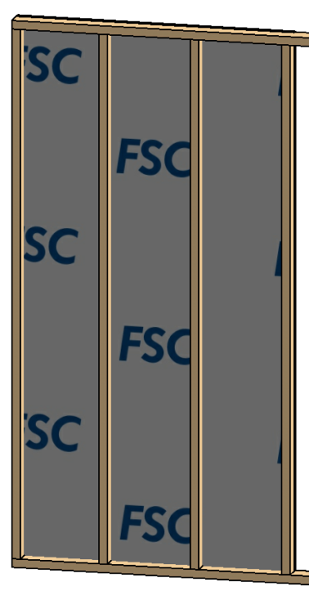
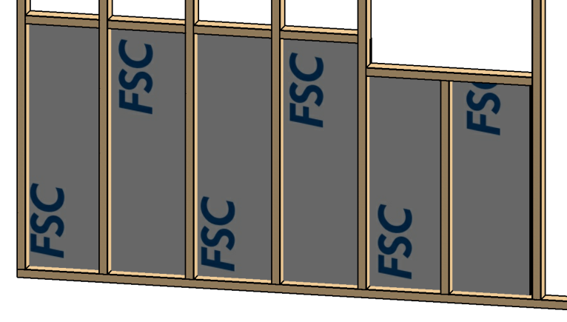
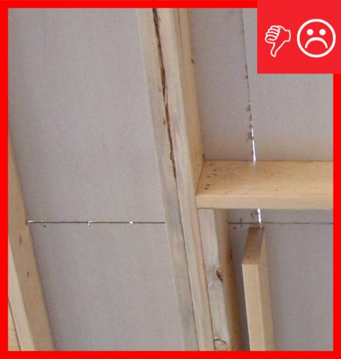


Step 3: Place Insulation Boards
Verify stud spacing, blocking, and bracing requirements with manufacturer.
Provide framing or blocking for attachment of siding and trim at transitions
  Seams should not be visible from interior unless allowed by manufacturer.
16” o.c.
(or per
manuf.)

Slide 9
Step 4: Attach Insulation Boards
Space fasteners per manufacturer’s instructions
  Around edges of panel
  Through panels and into interior members
Interior Spacing
Edge Spacing

Slide 10
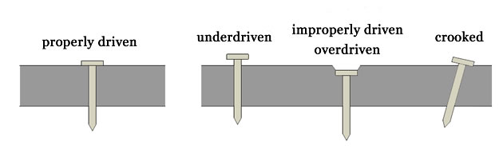
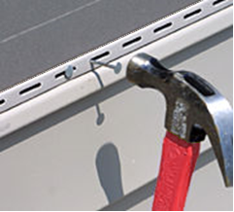
Step 4: Attach Insulation Boards
Drive nails flush and snug
Do not over drive nails
Do not under drive nails
  Exception: Leave 1/32” gap (or as required by manufacturer) to allow for lengthwise thermal expansion of vinyl or aluminum siding

Slide 11
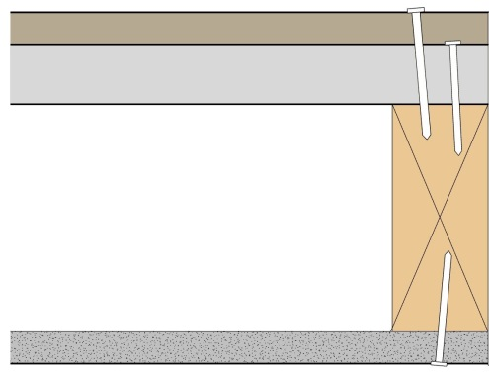

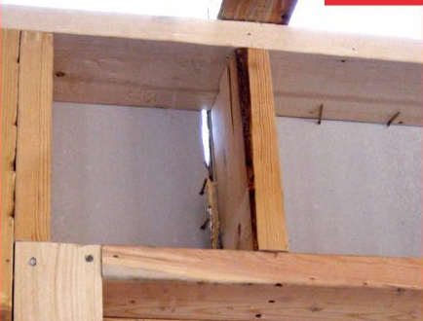
Step 5: Trim Boards at Openings
Trim boards at all window and door openings
Cover all framing with FPIS
Fit joints tightly
FPIS Continuous Insulation

Slide 12
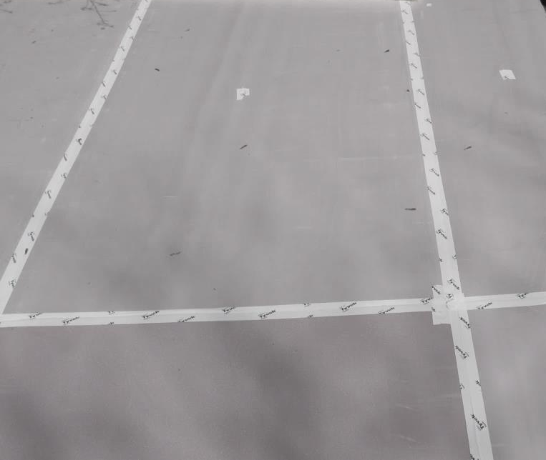
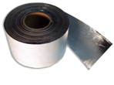
Step 6: WRB and Flashing
Ensure that a code-compliant water resistive barrier (WRB) and required flashing is provided
If using FPIS as a WRB:
  Seal all joints and openings and penetrations per manufacturer’s installation instructions

Slide 13
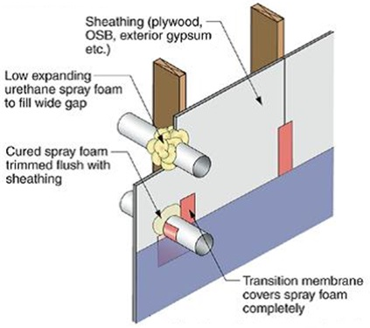
Step 6: WRB and Flashing
At pipe and other small penetrations, seal gaps with silicone or expanding spray foam sealant
Seal joints and openings with joint tape per manufacturer’s instructions
  FPIS
  Continuous Insulation

Slide 14
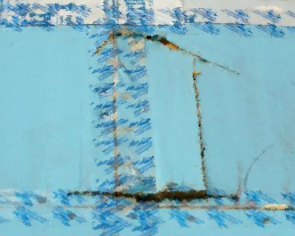
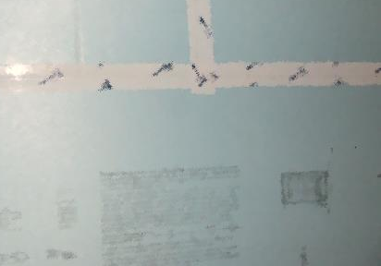
Step 6: WRB and Flashing
Repair damaged areas per manufacturer’s instructions

