Slide 1
Continuous Insulation (ci) &
Water Vapor Control
Educational Overview
Revised March 18, 2020

Slide 3
Learning Objectives
Review key building science concepts
Recall current U.S. & Canadian code requirements
Explain accepted methods of design to control water vapor
Apply prescriptive design solutions:
  Framework of prescriptive solutions for all climate zones
  Example solutions for walls with Continuous Insulation
  Example solutions for walls without Continuous Insulation

Slide 4
Key Building Science Concepts
Successful moisture control requires an integrated approach to 5 key building science concepts:
  Control Rain Water Intrusion (e.g., continuous water-resistive barrier)
  Control Air Leakage (e.g., continuous air barrier)
  Control Indoor Relative Humidity (e.g., building ventilation & de-humidification)
  Control Initial Construction Moisture (e.g., prevent enclosure of wet materials)
  Control Water Vapor (e.g., optimized balance of wetting and drying through strategic use of insulation and vapor retarders)
All are important, all vary in importance, all have inter-dependencies.

Slide 5
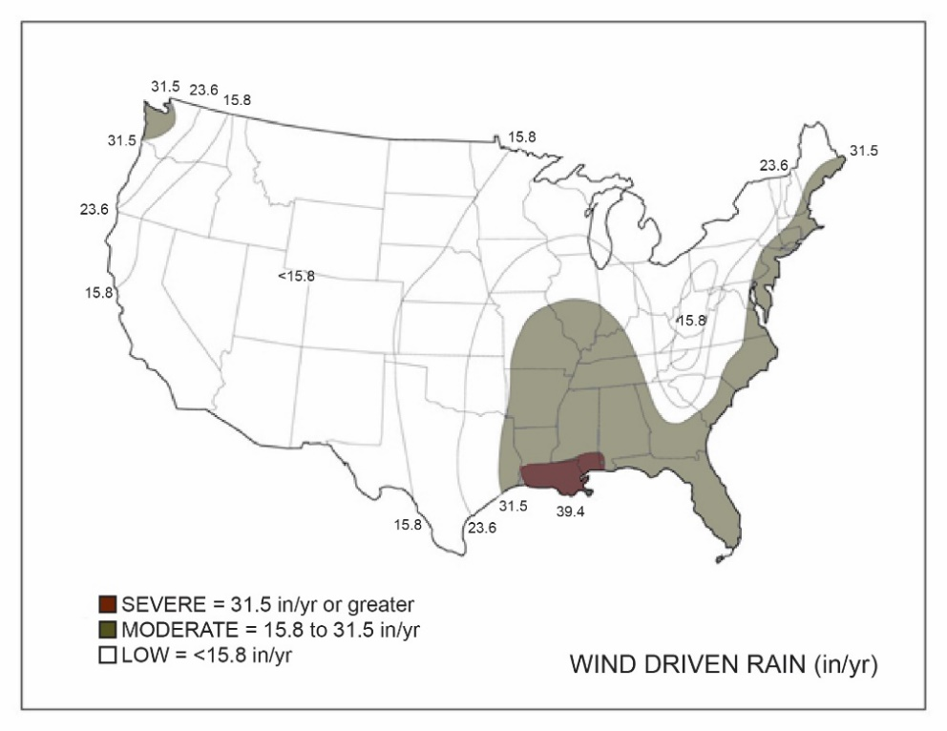
Building Science Concept #1 – Rain Water Control
Rain water control is often the primary factor associated with observed failure or success of moisture control
Concept is simple: Keep water out!
Wind driven rain is the primary environmental hazard (see map)

Slide 6
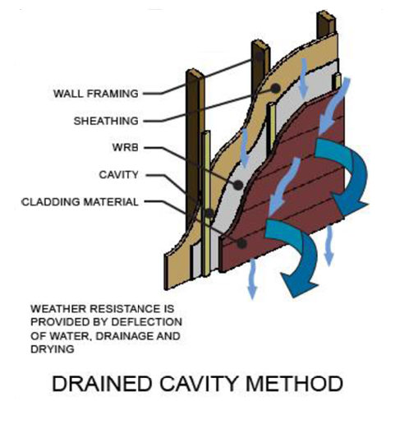
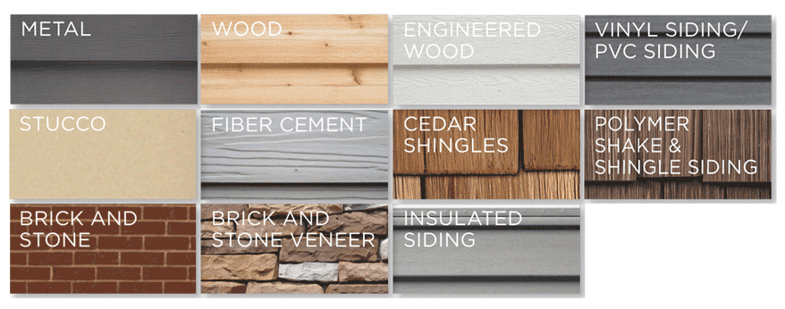
Building Science Concept #1 – Rain Water Control
How to control or mitigate rain water hazard?
Two main ways:
  Select materials and methods appropriate to local environment
  Ensure a continuous drainage plane behind the cladding

Slide 7
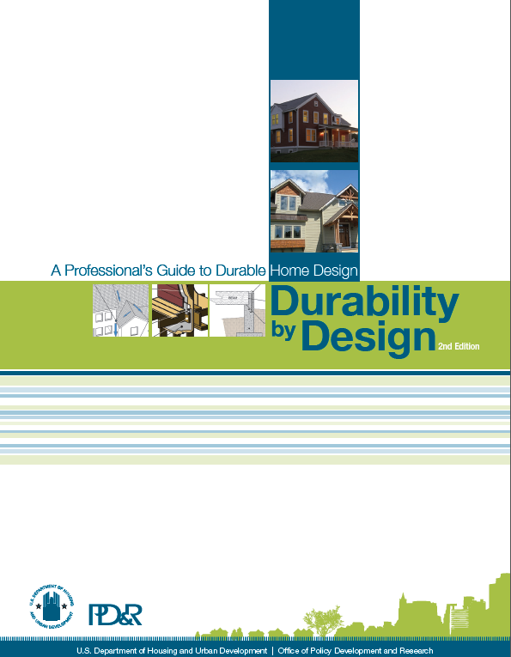
Building Science Concept #1 – Rain Water Control
Select cladding type, windows & doors, and installation methods best suited to the local climate wind-driven rain hazard
  Durability by Design Guide – A Professional’s Guide to Durable Home Design, U.S. HUD, Office of Policy Development & Research

Slide 8
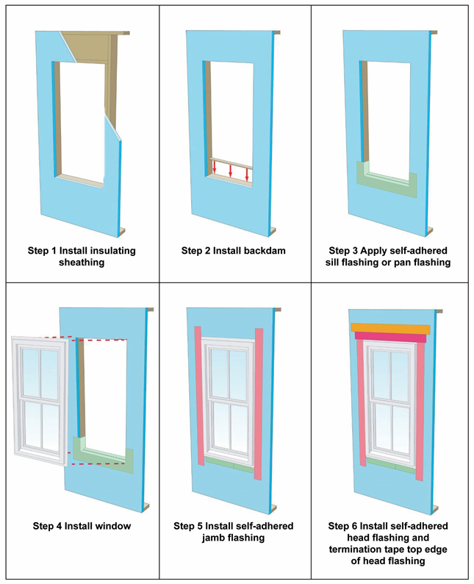
Building Science Concept #1 – Rain Water Control
Use a code compliant water-resistive barrier (WRB) and flashing details at all penetrations for a continuous drainage plane behind the cladding
  WHY? All claddings leak! Also, codes generally require a WRB behind all cladding types.

Slide 9
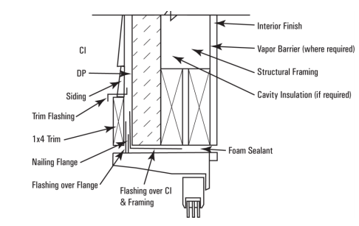
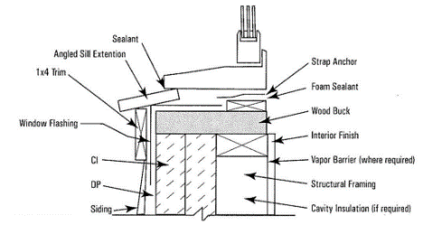
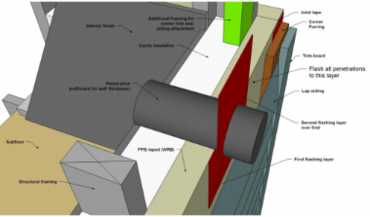
Building Science Concept #1 – Rain Water Control
Refer to DRR 1410-05 (Using FPIS as a WRB) and DRR 1205-05 (Construction Details) for information on appropriate use of Foam Plastic Insulating Sheathing (FPIS)
Refer to Window Installation Guides for applications with FPIS

Slide 10
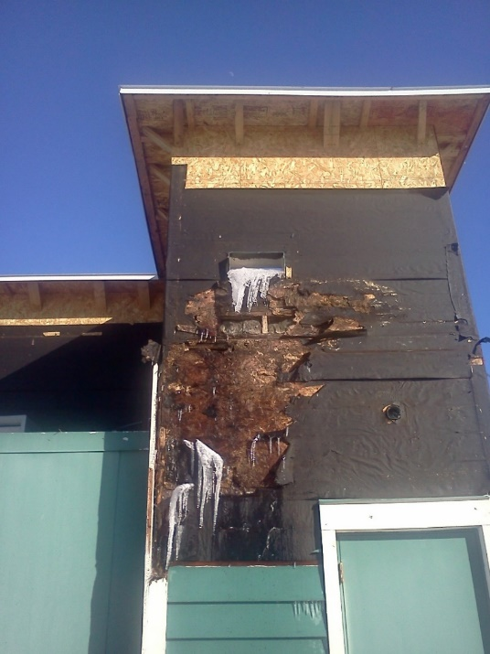
Building Science Concept #1 – Rain Water Control
Variations in wind-driven rain hazard and performance of cladding types and installation methods are not addressed in the building code.
If rain water intrusion is not adequately controlled, other building science control measures may be unable to compensate or rendered ineffective.

Slide 11
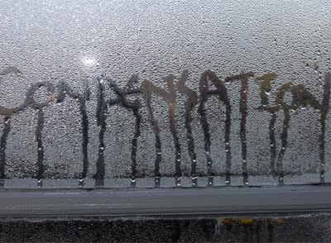
Building Science Concept #2 – Air Leakage Control
Lack of air leakage control can allow substantial amounts of moist/humid air into and through assemblies.
  Air can bypass vapor retarders, rendering them much less effective
  Increased risk of moisture problems such as condensation and mold

Slide 12
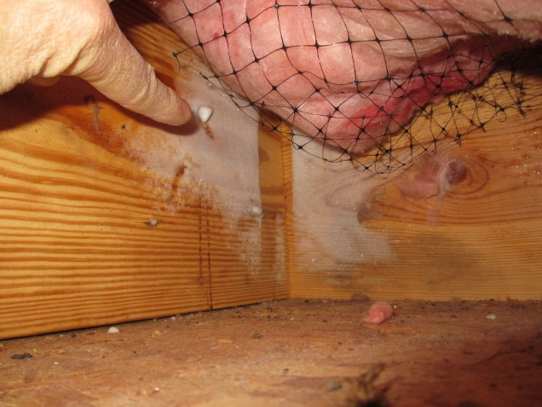
Building Science Concept #2 – Air Leakage Control
Air can bypass insulation, rendering insulation less effective
Increased energy bills

Slide 13
Building Science Concept #2 – Air Leakage Control
A continuous air-barrier (AB) is required by the International Energy Conservation Code (IECC)
The IECC does not specify where the air barrier must be located
  Can be located on the interior, inside, or to the exterior side of walls
EPA Energy Star* requires AB on both sides of assemblies in cold climates (best practice and highly recommended).
Refer to:
  Durability by Design: A Professional’s Guide to Durable Home Design
  Air Leakage Guide, US DOE, Building Technologies Program

Slide 14
Building Science Concept #2 – Air Leakage Control
Many materials and methods of AB installation are available
  For FPIS, refer to DRR 1410-06, FPIS Used as an Air Barrier Material in an Air Barrier Assembly.
  Other methods include:
    Sealed drywall installation
    Mechanically attached wraps with sealed joints
    Adhered membranes
    Spray-applied coatings
    Exterior sheathing with sealed joints
    Closed-cell spray foam

Slide 15
Building Science Concept #2 – Air Leakage Control
As with the WRB, the AB must be properly sealed at all joints and penetrations and discontinuities in framing assemblies.
In general, rigid air-barrier materials including FPIS provide better control than flexible, mechanically attached varieties (when not restrained by other material layers).
With proper design and location in an assembly, some air barrier materials may perform multiple roles.
  For example, FPIS can serve as insulation, an air-barrier, and a vapor retarder.

Slide 16
Building Science Concept #3 – Control Indoor Relative Humidity
Like rain water intrusion (BSC #1), excessive indoor relative humidity (RH) can overwhelm any reasonable water vapor control strategy
BEWARE! Vapor retarder and insulation provisions in the building and energy code are not explicitly related to limits on indoor RH

Slide 17
Building Science Concept #3 – Control Indoor Relative Humidity
Building ventilation requirements in the code for indoor air quality purposes can help control indoor RH in the winter
  Whole building ventilation methods are better than spot ventilation
Proper sizing of AC equipment can help control indoor RH in the summer
  Dehumidifiers should be considered and used as needed

Slide 18
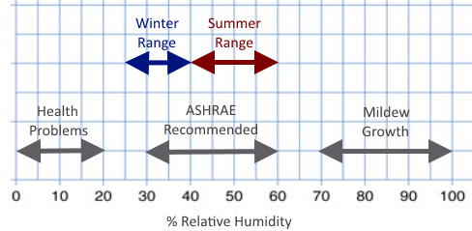
Building Science Concept #3 – Control Indoor Relative Humidity
Summertime indoor RH should not exceed 60%.
Winter max recommended indoor RH varies by climate (25% to 40%).
  In colder climates, a lower indoor RH is needed for water vapor control

Slide 19
Building Science Concept #3 – Control Indoor Relative Humidity
Preferred indoor RH levels for
building durability and occupant
comfort can be in conflict
  Must control indoor RH or adjust
  water vapor control strategy accordingly
Special conditions require special solutions (e.g., pool rooms, saunas, hot tubs)

Slide 20
Building Science Concept #4 – Control Initial Construction Moisture
Initial construction moisture mainly affects the initial year of building operation
  Wet framing materials and wet-applied insulation materials can overwhelm the tolerance of materials and assemblies to withstand prolonged exposure to moisture and high water vapor drives.
  This can result in mold or moisture-related damage to materials such as moisture-sensitive sheathings and interior finishes, if not dried out in a timely manner
The solution varies based on the time of year a wall is enclosed with wet materials, which will determine the primary direction of vapor flow for drying.

Slide 21
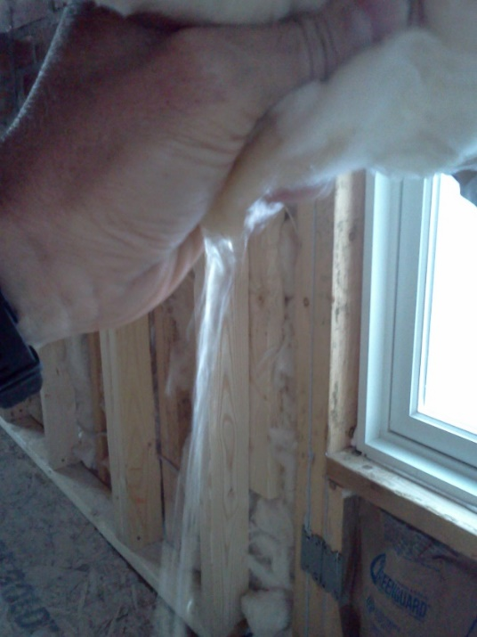
Building Science Concept #4 – Control Initial Construction Moisture
Solutions are simple:
  Don’t use wet materials and when they are wet, don’t close-in the assembly until they are dry.
  Don’t install cavity insulation, vapor retarder, and interior finishes until the wall is dried-in (e.g., water-resistive barrier and all flashings completed).
Storm water expelled from FG batt insulation installed prior to completion of the WRB and flashing

Slide 22
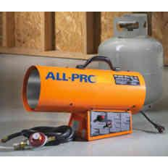
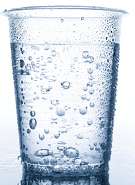

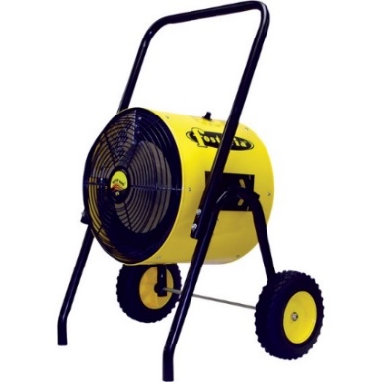
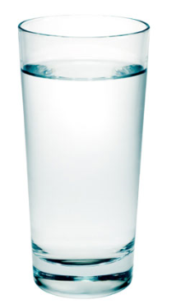
Building Science Concept #4 – Control Initial Construction Moisture
TIP: Don’t dry buildings using gas/fuel fired heaters – water vapor is a primary combustion by-product!
  Hot/humid air creates huge vapor drives and can slow drying rather than help it.
  Use hot/dry air instead (electric heaters, dry air ventilation, etc.)

Slide 23
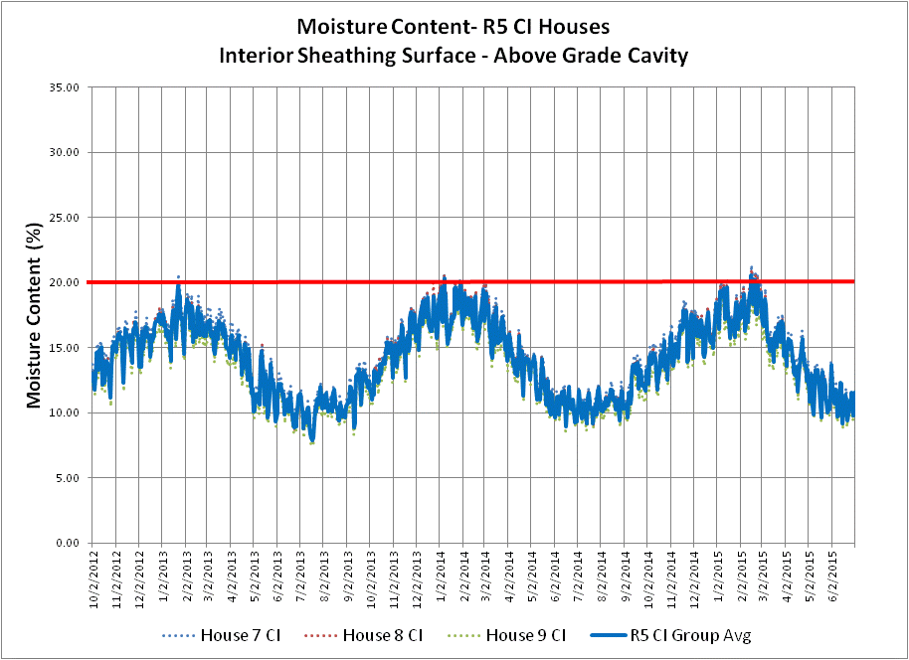
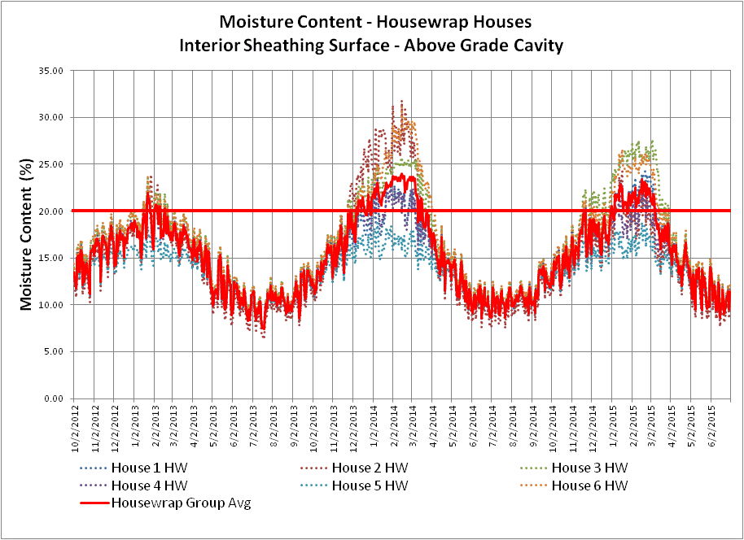

Building Science Concept #5 – Control Water Vapor
Water vapor control involves two simple concepts:
  Minimize the risk of the assembly getting wet due to moisture vapor diffusion (or condensation)
  Optimize the ability of the assembly to dry in relation to its risk of getting wet
Two “Code-Compliant” Walls:
Left – moisture cycling below 20% MC
Right – moisture cycling above 20% MC

Slide 24
Building Science Concept #5 – Control Water Vapor
While simple in concept, this practice involves many design considerations depending on the method used to control water vapor:
  Climate and Indoor RH (boundary conditions)
  Water vapor permeance (WVP) of exterior materials (sheathing, WRB, etc.)
  WVP of interior materials (Interior vapor retarders in cold climates, or interior finishes in warm climates)
  Cavity insulation R-value and its WVP
  Exterior insulation R-value (continuous insulation) and its WVP

Slide 25
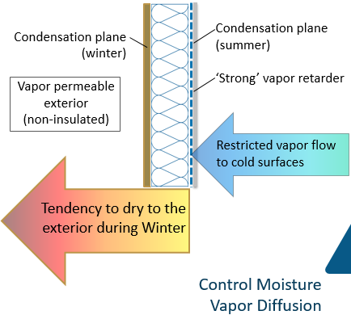

Building Science Concept #5 – Control Water Vapor
Ability to dry in at least one direction (inward or outward) is recommended in most conditions
  “Safety factor“ for incidental non-diffusion moisture sources (e.g., rain intrusion or moist air exfiltration)
  FPIS walls can help reduce effect of moist air leakage (the more CI the better)
  Double vapor barrier assemblies should be avoided in areas with severe wind driven rain hazard

Slide 26
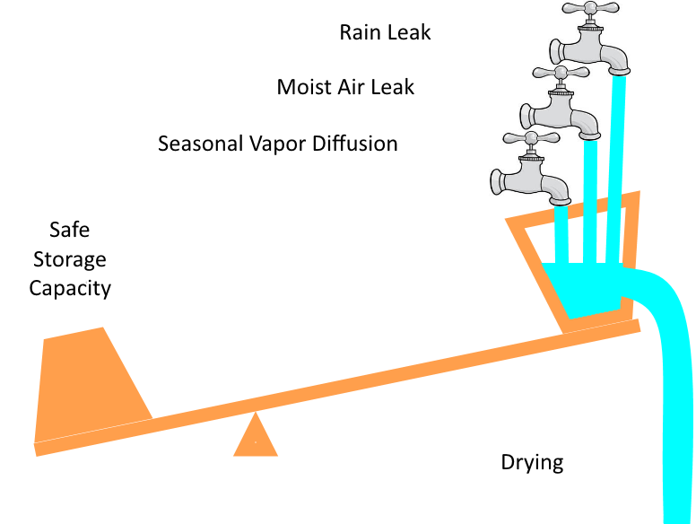
Building Science Concept #5 – Control Water Vapor
It is truly a balancing act!
  Risk of rain water wetting
  Risk of air-leakage wetting
  Wetting and drying by water vapor diffusion
R-value and relative WVP of materials and their location within the assembly matters
  The ability of materials to store and tolerate moisture also matters
GOAL: Drying > wetting to control risk of mold or water-sensitive material degradation
BSD-114: Interior Insulation Retrofits of Load-Bearing Masonry Walls In Cold Climates

Slide 27
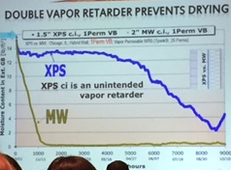
Building Science Concept #5 – Control Water Vapor
(Addressing Common Misconceptions)
The key to water vapor control is balancing drying potential and wetting potential.
  It’s a matter of optimization, more is not always better (and neither is less always better)
For example, it is often said that more vapor permeance is needed on the exterior to promote increased drying rates (see chart)
But, this is not a balanced or complete design recommendation…it is only part of the story…(next slide)
Slide shown at Green Build AIA/CEU presentation indicating a lower permeance insulation material (XPS) on the exterior has a slower drying rate than a higher permeance material (MW) with a high perm building wrap underneath.

Slide 28
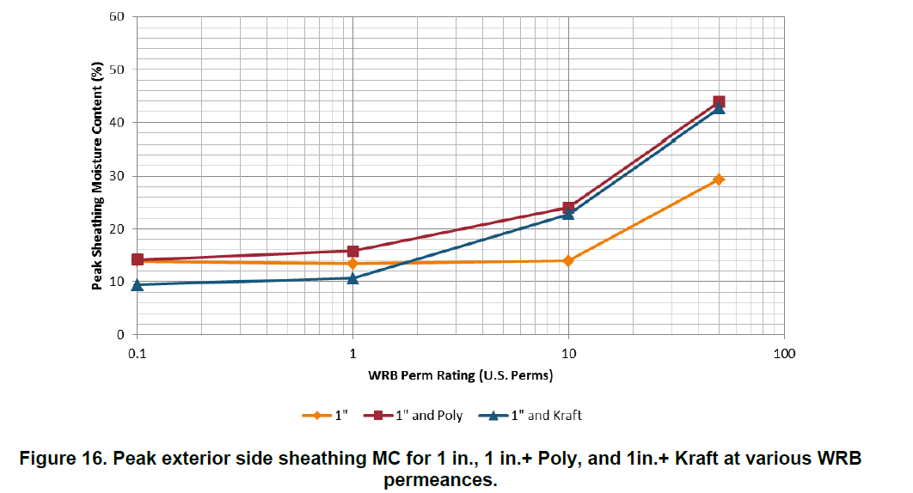
Building Science Concept #5 – Control Water Vapor
(Addressing Common Misconceptions)
High sheathing moisture content
When conditions change seasonally to reverse vapor drives, the wall that dries fast at one time of the year can become saturated at another time of the year (see chart)
Clearly, optimizing the insulation strategy and vapor retarder and WRB properties is important!
Peak moisture content (wetting) of exterior sheathing increases as the permeance of the exterior insulation and/or WRB approaches and exceeds ~ 10 perm
(Source: Lepage & Lstiburek (2013). Moisture Durability with Vapor-Permeable Insulating Sheathing. US DOE, Building Technologies Office, Building America Program)

Slide 29
Building Science Concept #5 – Control Water Vapor
(Addressing Common Misconceptions)
Also, there are differences in consequences for the two types of the wetting:
  The first chart (drying rate) deals with localized wetting from a leak and affirms the need for good flashing practices
  The second deals with wetting over large areas that can occur due to inward moisture drives (too vapor permeable on the exterior) or inadequate wintertime condensation control (sheathing too cold, poor VR, poor AB, etc.).

Slide 30
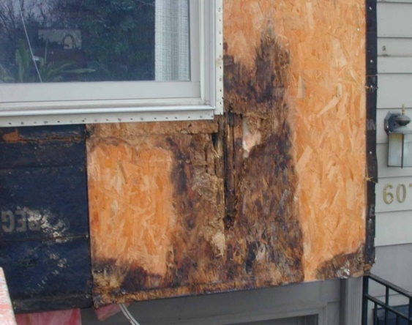
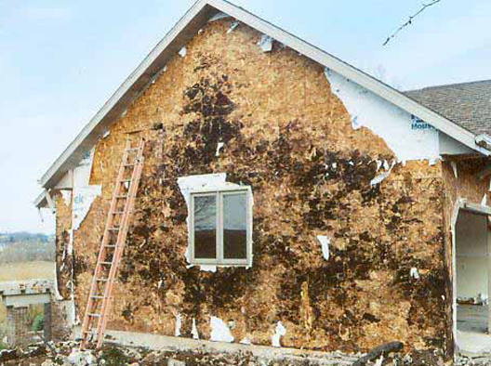
Building Science Concept #5 – Control Water Vapor
(Addressing Common Misconceptions)
Neither consequence is good.
  FPIS when properly installed can help prevent both localized wetting and wetting over large areas
Green Building Advisor: All About Wall Rot

Slide 31
Water Vapor Control: Putting Building Science Concepts to Practice
The remainder of this presentation addresses the following water vapor control topics:
  Terms to know
  Current building code requirements (e.g., use of vapor retarders)
  Appropriate design methods and tools
  Appropriate use of vapor retarders (with and without CI)
  Additional resources

Slide 32
Terms to Know
Water vapor permeance (WVP): The property of a building material related to the ability of water vapor to diffuse through it; measured in “perms”.
    This property may vary depending on moisture content of the material as related to its surrounding conditions (e.g., relative humidity) – “smart vapor retarders” fall into this category (usually organic materials like Kraft paper, wood structural panels, or proprietary vapor retarder membranes).
Low perm = relatively high resistance to water vapor flow
High perm = relatively low resistance to water vapor flow

Slide 33
Terms to Know
Don’t confuse water vapor permeance with water vapor permeability
Water vapor permeability is a measure of WVP for a unit thickness of homogenous material
  Permeability/thickness = WVP
  But, this math only applies to homogenous materials – not composites, not materials with surface films, etc.!
Water vapor permeability (more scientific definition):
The water vapor permeability is the time rate of water vapor transmission through unit area of flat material of unit thickness induced by unit vapor pressure difference between two specific surfaces, under specified temperature and humidity conditions

Slide 34
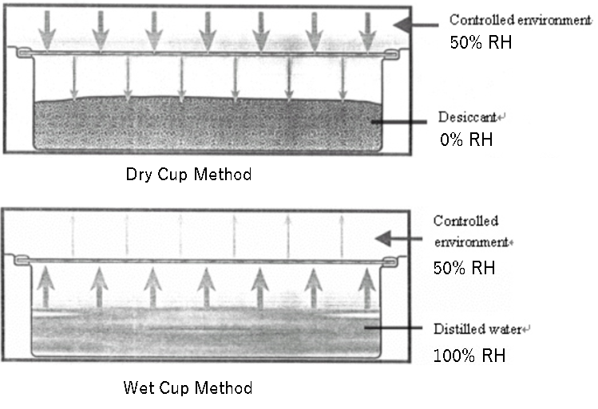
Terms to Know
Water vapor permeance
  WVP is usually measured by ASTM E96 (dry cup) method which relates to 25% average relative humidity at room temperature.
  ASTM E96 (wet cup) method relates to 75% average relative humidity condition and may be more relevant to some applications (e.g., materials on the exterior)
An Outline of Standard ASTM E96 for Cup Method Water Vapor Permeability Testing

Slide 35
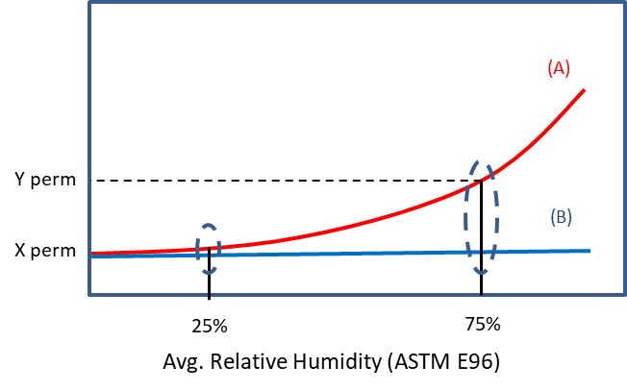
Terms to Know
Water Vapor Permeance
  Materials that are not hygrophyllic (non-organic) tend to have WVP that changes little with the ambient humidity (A)
  Materials that are hygrophyllic (organic) tend to have WVP that changes significantly with the ambient relative humidity (B)
Thus, wet-cup and dry-cup WVP per ASTM E96 can better inform material selection and design for water vapor control

Slide 36
Terms to Know
[2018 IBC/IRC] VAPOR PERMEABLE. The property of having a moisture vapor permeance rating of 5 perms (2.9 x 10-10 kg/Pa · s · m2) or greater, where tested in accordance with the desiccant method using Procedure A of ASTM E 96. A vapor permeable material permits the passage of moisture vapor.
Other classifications: semi-permeable, semi-impermeable, impermeable (varying degrees of vapor retardance)

Slide 37
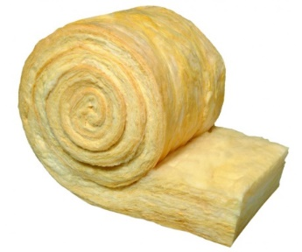
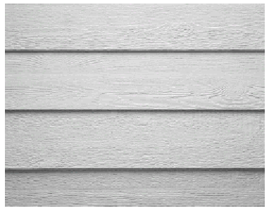
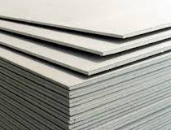
Terms to Know
All materials, regardless of what they are called, have some measure of resistance to water vapor flow.
Some “generic” examples of perm rated materials:
Air film = 120+ perm
  (Still air, 1” thick – most air is “moving”, so effective permeance is much higher)
Fiberglass/mineral fiber = 116 perms
Batt insulation (without facer), 1” thick
Drywall = 50 perm
(unpainted)
  Lap siding = 10 perm (wood/pained) to 40 perm (vinyl/vented)

Slide 38
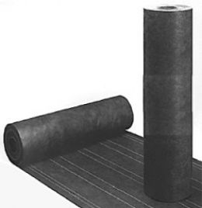
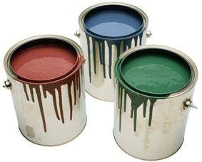
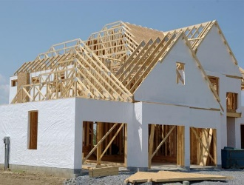
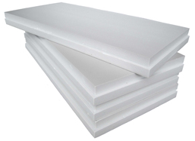
Terms to Know
Some more “generic” examples of perm rated materials:
Latex paint film = 3 to 30 perm
(primer + 1-2 coats)
House wraps = 5 to 50 perm
(depending on type)
No.15 asphalt felt paper = 1 perm (dry cup) to
5 perm (wet cup)
1” thick polystyrene insulation ≈ 1 perm to 5 perm
No facer. Depending on type/density. Decreases with increased thickness or added facers

Slide 39
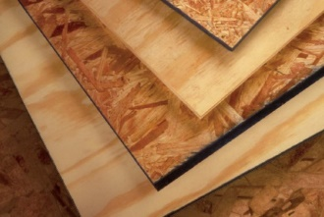
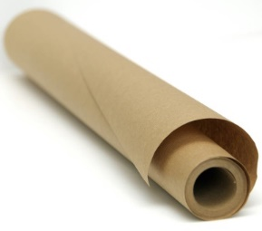
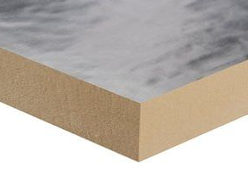
Terms to Know
Even more “generic” examples of perm rated materials:
OSB or plywood = 0.7 to 1 perm (dry cup)
or 1.5 to 10 perm (wet cup)
OSB is lower perm than plywood
Kraft paper = 0.3 perm (dry cup) or 1.8 perm (wet cup)
Foil faced polyiso insulation < 0.1 perm

Slide 40
Terms to Know
Vapor Retarder (VR): A material in an assembly designated for purpose of serving as means to limit water vapor flow into or through the assembly
  Also known as a “vapour barrier” in Canada (material used as a vapor retarder having permeance of 1 perm or less)
  In the U.S., the term “vapor barrier” is reserved for Class I vapor retarders (very low perm, 0.1 perm or less)
This definition does not mean that the vapor permeance and location of other materials in an assembly is not important!

Slide 41
Terms to Know
[2018 IBC/IRC] VAPOR RETARDER CLASS. A measure of the ability of a material or assembly to limit the amount of moisture that passes through that material or assembly. Vapor retarder class shall be defined using the desiccant method with Procedure A of ASTM E 96 as follows:
    Class I: 0.1 perm or less (e.g., polyethylene, foil facing)
    Class II: 0.1 < perm <= 1.0 perm (e.g., Kraft paper, VR paints)
    Class III: 1.0 < perm <= 10 perm (e.g., latex paint)

Slide 42
Terms to Know
Vapor retarder classes in the codes are fairly crude (e.g., a factor of 10 difference within a given class).
But, they serve a purpose in communicating broad recommendations or generic building code requirements.
Specific analyses using specific material properties (rather than classes) will give more precise answers.

Slide 43

Building Codes: Out with the old... in with the new?
Building codes and construction practice often tend to rely on old conventions…Should this be ignored?
No! (short answer). Keep the old and bring in the new to make the old more complete and up to date with the 21st century!
In proper context, conventional wisdom has generally worked, but now is incomplete.

Slide 44
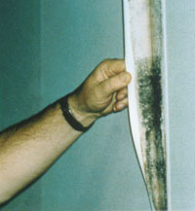
Building Codes: Out with the old... in with the new?
Conventional wisdom: VR is placed on the “warm-in-winter” side of assembly in colder climates
  Conventional wisdom still holds true in cold climates
  Don’t do this in hot/humid climates! -- better to have lower permeance (vapor retarder materials) on the exterior, not the interior (see photo)
The simplicity of conventional wisdom worked with “old” buildings, old materials, etc. Doesn’t always work so well or reliably today!
Low perm interior finish on interior (warm-in-winter) side of wall in hot/humid climate – perfect for culturing mold colonies!

Slide 45

Caution
Use of outdated, incomplete, or over-simplified conventions (rules-of-thumb) can result in unexpected moisture problems.
  When taken out of context, they also can be misused to give perception of advantage of one option or material over another.

Slide 46
Why must “new” be added to the “old”?
Conventional wisdom only applies to a “permeance controlled” design approach (more on this later) and it is incomplete in view of newer construction materials and practices
U.S. building codes don’t include the conventional wisdom of having a permeance ratio (i.e. higher perm on outside than inside in cold climates; reverse in hot/humid climates)
Vapor permeance of materials on the exterior side of the assembly is generally ignored (but is nearly as important as the VR) – REMEMBER: water vapor control is a balance of letting water in and letting it out

Slide 47
Why must “new” be added to the “old”?
Absence of exterior permeance control and design property control of these materials which are not “designated” vapor retarders creates uncertainties in performance outcome.
More cavity insulation creates colder exterior sheathing/siding/membrane surfaces which are more prone to condensation and moisture accumulation and some may be less durable or tolerant.

Slide 48

Why must “new” be added to the “old”?
Newer energy codes and insulation requirements have created a need for a “temperature controlled” design approach using exterior continuous insulation (more on this later)
  Some requirements are in the 2009 through 2018 IRC and IBC. But, these are not complete
  Some requirements are in the 1995 through 2015 NBCC (Canada). But, these are not complete
  Both together provide a more complete set of solutions. There is a need to unify the knowledge and experience in U.S. and Canada!

Slide 49
Current U.S. Building Code Requirements
2018 IBC and IRC provisions are similar (IBC a bit more precise)
2018 IRC (one and two family dwellings):
  R702.7 doesn’t say not to put a Class I or II VR on the interior side in CZ 1-3!

Slide 50
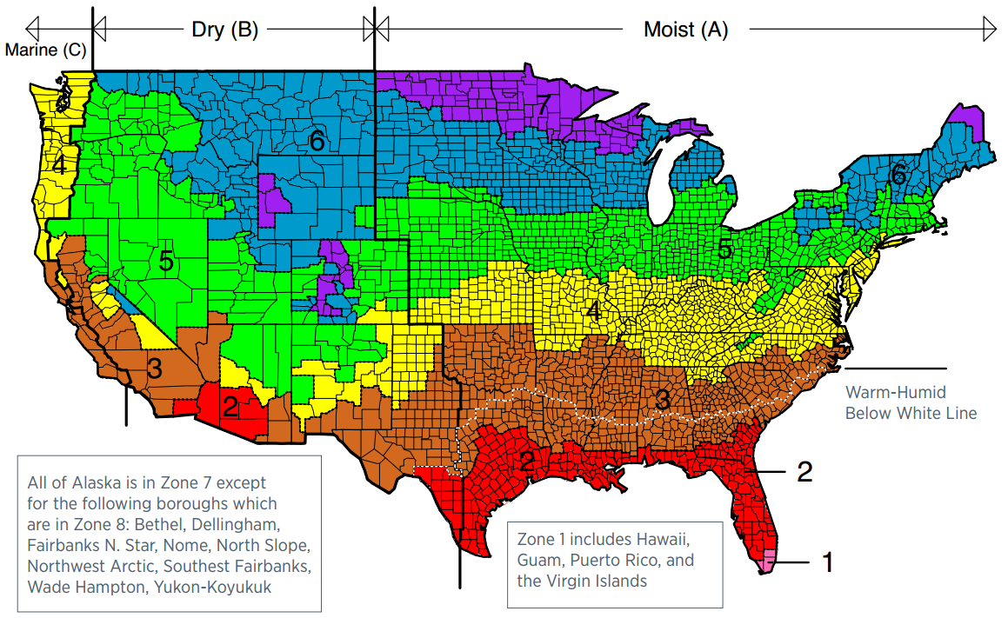
Climate Zones

Slide 51
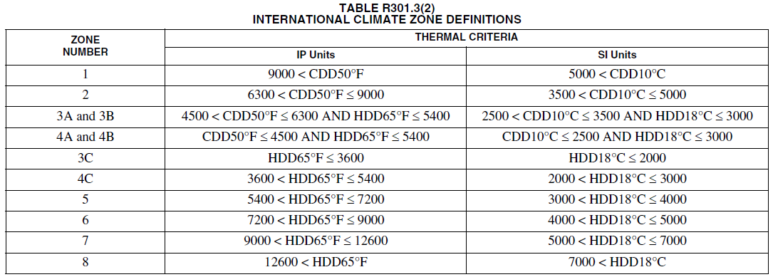
Climate Zone Definitions (2018 IECC)

Slide 52
Current U.S. Building Code Requirements
IBC and IRC allow for use of a Class III vapor retarder as an alternative to use of a Class I or II vapor retarder.
Provides requirements for use with vented cladding and some sheathing materials (permeance controlled design)
Provides requirements for use with exterior continuous insulation (temperature controlled design)

Slide 53
Current U.S. Building Code Requirements
BUT, now this reveals some gaps in the code!
  How much continuous insulation is needed if a Class I or II vapor retarder is used?
  Under what condition should vented cladding or a higher perm exterior sheathing be required for use of a Class II vapor retarder?
  What about “double vapor barriers”?

Slide 54
Current Canadian Building Code (2015 NBC)
Only recognizes use of 1 perm or less vapor retarder on inside (warm-in-winter side) of assembly.
  Same as Class I or Class II vapor retarder in U.S. codes
  Polyethylene VR and AB commonly used
Recognizes special design needed for buildings with high internal moisture loads (e.g., high indoor RH)

Slide 55
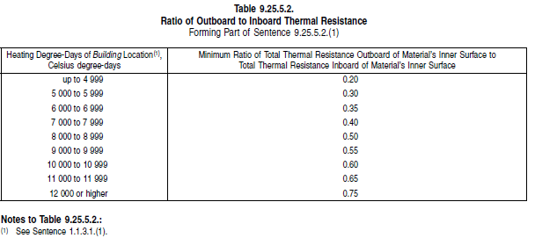
Current Canadian Building Code (2015 NBC)
NBC Part 9 (housing and light-commercial) includes requirements for use of low perm (less than 1 perm) material layers on the exterior side (Section 9.25.5.2)
  Requires use of exterior insulation meeting minimum insulation ratio (ci R-value / Cavity R-value)

Slide 56
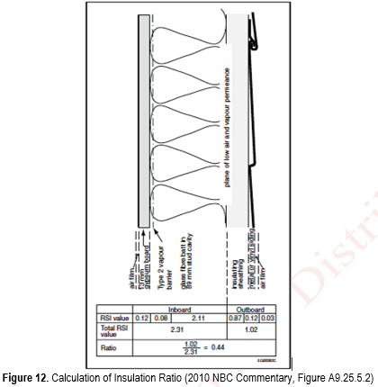
The Insulation Ratio Concept
Keep the inside of the wall warm in the winter!
This is the key concept of the “temperature controlled” design approach to manage water vapor.
The insulation ratio keeps the inside of the exterior sheathing warm enough to control condensation/diffusion wetting when used together with <1 perm vapour barrier (Canada).

Slide 57
The Insulation Ratio Concept
Can be applied to use with Class I or II interior vapor retarder in US codes.
Insulation ratio = Re/Ri, where:
  Re = exterior ci R-value
  Ri = cavity insulation R-value

Slide 58
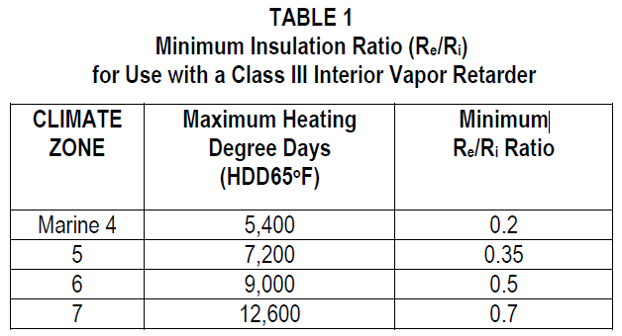
The Insulation Ratio Concept
Same principle as insulation ratios (exterior ci R-value) used for Class III VR in U.S. codes (see adjacent table as basis for IRC Table R702.7.1).
Same principle used for above-deck roof insulation in millions of square feet of low-slope commercial building roofs.

Slide 59
The Insulation Ratio Concept
Successful performance for nearly 20 years in Canada, even with use of a Class I vapor retarder/barrier on the interior side (e.g., double vapor barrier assembly)
For the purpose of this presentation, however, double vapor barriers are not recommended in coastal climates with severe wind-driven rain hazard (high potential of non-diffusion sources of moisture entering wall).

Slide 60

Two Design Approaches for Cold Climates
Water Vapor
Source
Indoor RH (winter)
Outdoor RH (summer)
R_{e}
R_{i}
Condensation plane (winter)
Vapor permeable exterior
(non-insulated)
Condensation plane
(summer)
‘Strong’ vapor retarder
Exterior CI
(low perm)
Warm surface
(restrict dew point occurrences)
‘Modest’ vapor retarder
The
Water
Vapor
Control
Triangle
Restricted vapor flow to cold surfaces
Moderated vapor flow in winter
Tendency to dry to the exterior during Winter
Tendency to dry to
the interior during
Spring, Summer, & Fall
Control Moisture Vapor Diffusion
Control of vapor flow into and out of an assembly (flow direction changes with seasons)
Control Internal Surface Temperatures
Control surface temperatures to prevent moisture condensation or high surface humidities

Slide 61
Two Design Approaches
Permeance controlled design applies to walls:
  Without exterior insulation
  Or, with vapor-permeable exterior insulation
Relies on permeance of all interior and exterior layers
  Both must be checked!
Temperature controlled design applies to walls:
  With exterior insulation of any permeance, (including very low perm)
Only requires control of water vapor permeance of interior layers (e.g., vapor retarder)

Slide 62
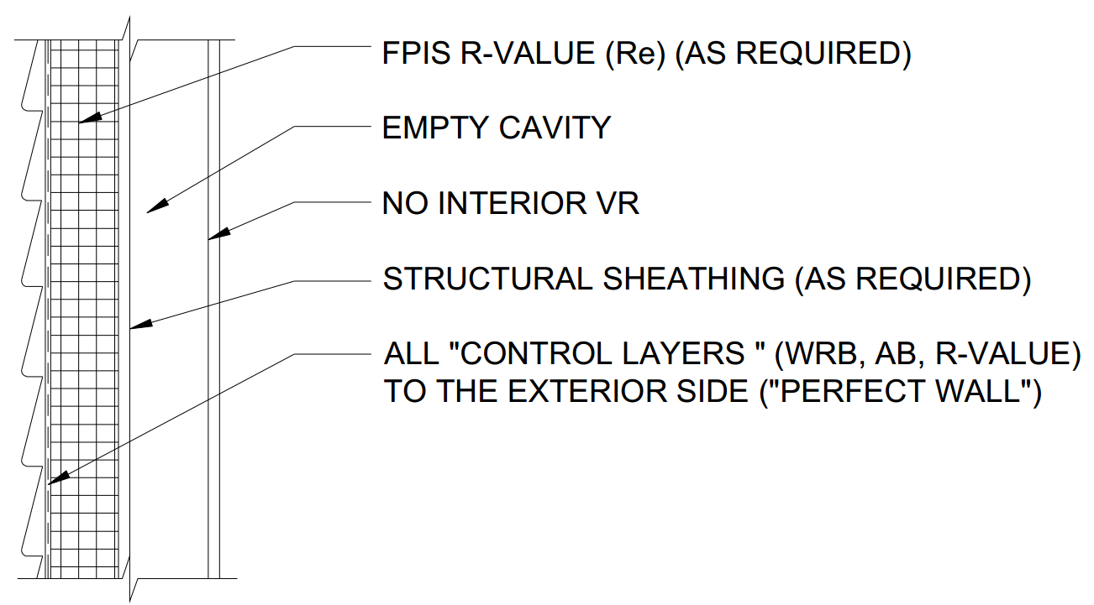
Two Approaches – Many Applications
The two approaches define a continuum of solutions, combining more or less of one or the other design methodology
  For example, a wall with all exterior insulation of a very low to moderately low permeance and no interior vapor retarder would be the extreme “perfect wall” under the temperature controlled design approach.
  In this case, more exterior insulation is always better for moisture and thermal control!

Slide 63
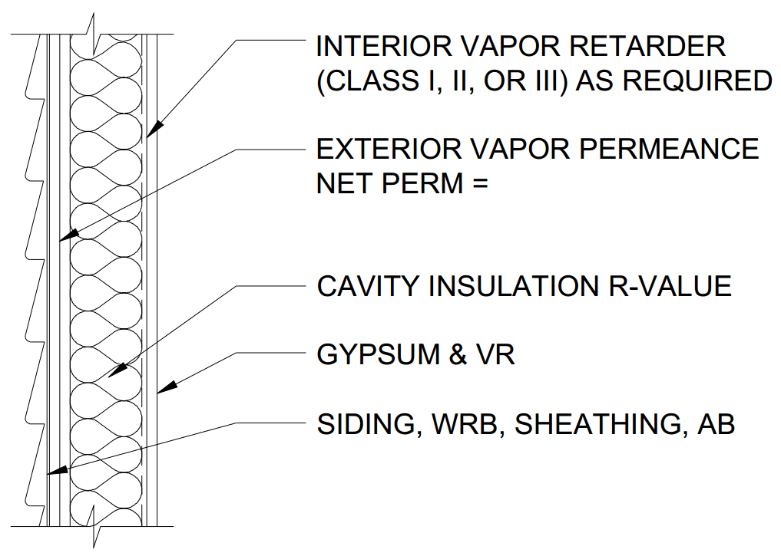
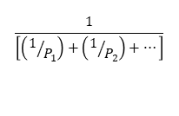
Two Approaches – Many Applications
On the other hand, a wall with cavity only insulation and a Class I vapor barrier on the interior and 100% vapor open on the exterior would be the extreme permeance controlled wall for a cold climate
  Can pose problems during summer AC operation due to high inward water vapor movement.
In this case, more exterior permeance is not always better!
$$\frac{1}{\left[\left(1/{P_{1}}\right)+\left(1/{P_{2}}\right)+…\right]}$$

Slide 64

Two Approaches – Many Applications
Thus, a temperature controlled wall can work in any climate with success and is improved with increasing amount of exterior insulation relative to cavity insulation.
The permeance control approach can be a bit trickier to strike the right balance.

Slide 65
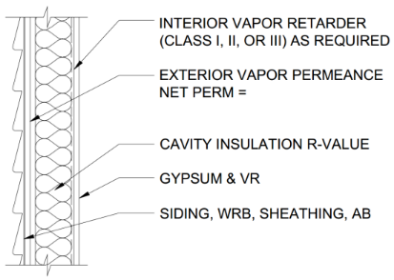
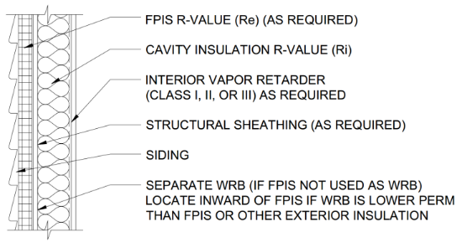
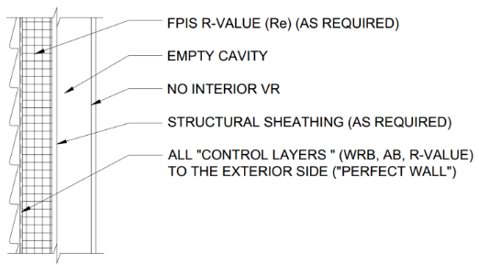

Two Approaches – Many Applications
Either design method or a blended design with features of both methods (e.g., cavity insulation + continuous insulation + interior vapor retarder) can be used successfully.
This is what building sciences is all about – providing options for acceptable solutions.
$$\frac{1}{\left[\left(1/{P_{1}}\right)+\left(1/{P_{2}}\right)+…\right]}$$

Slide 66
Analytical Design Tools
Insulation ratios and vapor retarder requirements discussed earlier are “prescriptive” (pre-determined) solutions; they either require no math or very basic math (+ - x / ).
Where alternate solutions are desired or necessary, various means of hygrothermal analysis are available to help.
  These tools generally require some degree of expertise to properly use the tool and interpret results
  A professional should be consulted

Slide 67
Analytical Design Tools
“Static” Analysis Methods
  Dew point check is simple & conservative
  Glaser, Kieper, etc. – traditional methods (moderately complexity)
    Can be done on spreadsheet with available climate data
    Doesn’t address transient conditions (e.g., moisture storage in materials, solar radiation effects)
    Can be used to look at monthly and annual trends in wetting and drying by diffusion
    Moisture surcharge can be applied to account for non-diffusion moisture sources (e.g., incidental rain intrusion or moist air leakage)
“Transient” Analysis Methods
  Computer finite element models, often including material databases, technical support, etc.
    WUFI, hygRIC, etc.
  Various levels of geometric complexity in modeling heat and moisture transport
    1D, 2D, and 3D
  Various levels of applied physics
    Moisture storage,
    Redistribution
    Water leakage
    Air leakage flows

Slide 68
Analytical Design Tools
All analysis methods require judgment and interpretation due to assumptions and uncertainties in knowing:
  Actual boundary conditions (e.g., indoor relative humidity, air-leakage pathways and orifices)
  Actual material properties (e.g., actual water vapor permeance of a given product/material)
Design is much more than just crunching numbers!

Slide 69
Analytical Design Tools
Additional resources:
  Moisture Control in Buildings, 2nd Edition, Chapter 10, www.astm.org
  Assessment of Water Vapor Control Methods for Modern Light-frame Wall Assemblies, ABTG LLC, 2015, www.appliedbuildingtech.com
  Lstiburek, Ueno, and Musunuru (2015). Modeling Enclosure Design in Above Grade Walls, US DOE, Building Technologies Office

Slide 70
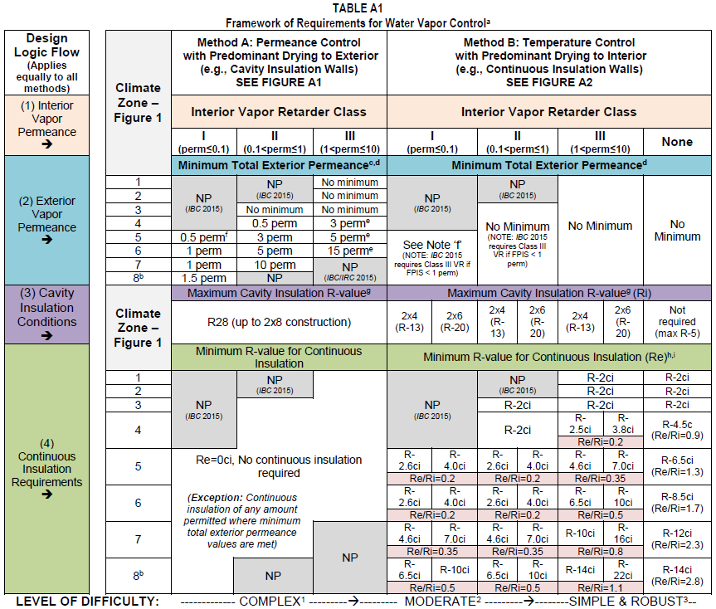
Framework for Water Vapor Control
(using prescriptive “cook book” designs)
Based on compilation of US and Canadian building codes and practices plus extensive review of literature and analysis of field data to “fill the gaps”
  Source: Assessment of Water Vapor Control Methods for Modern Light-frame Wall Assemblies, ABTG LLC, 2015 (ABTG website) Appendix A

Slide 71

Typical “Method A” Wall Assembly
Cavity Insulation Only (assumed to be vapor permeable cavity insulation)*
*SUPPLEMENTAL GUIDANCE:
For cavities with non-vapor permeable (closed-cell spray foam) insulation, use the Method B approach (see footnote on later slide for Table A3);
Method A also applies to walls with continuous insulation of any amount provided the net exterior WVP meets or exceeds Table A1 values.
Net exterior WVP of the exterior layers (particularly the WRB) should not exceed 10 perm to control solar-driven inward moisture movement, where direct-applied (unvented) reservoir cladding (adhered veneer, stucco, etc.) is used on buildings with AC during summer.
$$\frac{1}{\left[\left(1/{P_{1}}\right)+\left(1/{P_{2}}\right)+…\right]}$$

Slide 72


Typical “Method B” Wall Assemblies
Cavity + Continuous + Interior VR
Continuous Only (No Interior VR)
Note: Arrangement of control layers is material and climate specific.
SUPPLEMENTAL GUIDANCE:
The net exterior WVP of the WRB and/or exterior insulation should not exceed 10 perm to control solar-driven inward moisture movement, where direct-applied (unvented) reservoir cladding (adhered veneer, stucco, etc.) is used on buildings with AC during summer.
See also Note 4 on Table A2 next slide to avoid conditions where “double vapor barrier” walls (low permeance on both sides) is considered unacceptable (even more important for walls without exterior insulation in cold or wet climates).

Slide 73

Simplified Framework for Climate Zone 6
Method A: Permeance Controlled Wall (no exterior insulation)
  TABLE NOTES 1 & 4 ARE IMPORTANT!
  Must evaluate permeance of exterior layers to ensure performance

Slide 74

Simplified Framework for Climate Zone 6
Method B: Temperature Controlled Wall (cavity + continuous insulation)
  SOLUTION AND VERIFICATION IS VERY SIMPLE: Check insulation R-values (easy) and check vapor retarder used (easy).

Slide 75

Climate Zone 6 – More Options for CI Amounts
Lose some table size simplicity, but gain much flexibility and accuracy (still a “cook-book” look up the answer approach)

Slide 76

Similarly for Other Climate Zones...

Slide 77

Similarly for Other Climate Zones...

Slide 78
Design Example 1
Example 1: Using insulation ratios to check energy code solutions and alternative wall insulation strategies for adequate moisture durability
  Given: Assume the energy code requires R20+5ci (2x6 wall with R20 cavity insulation and R5 continuous insulation). This is a “Method B” wall in accordance with Table A1 of Appendix A.
  Find: What is the maximum (coldest) permissible climate zone for this wall when using a Class I, II or Class III interior vapor retarder?

Slide 79

Design Example 1
Solution: First, determine the insulation ratio, R_{e}/R_{i} = 5/20 = 0.25.
  In accordance with Table A1 or A3 (Appendix A), the maximum/coldest climate zone is 6 with a Class I or II interior vapor retarder and Climate Zone 4 with a Class III interior vapor retarder.

Slide 80

Design Example 1
Alternatively, a more precise use of insulation ratios as shown in Table A5 (Comprehensive) indicates that an R20+5ci wall with a Class I or II vapor retarder works within Climate Zone 7 for up to 9,900 heating degree days (HDD65F).

Slide 81
Design Example 1
While this example assembly may be permitted as a prescriptive solution in the energy code, the insulation ratio should be checked as demonstrated in this example as moisture control considerations may “override” the energy code.
Consequently, the insulation locations and amounts may need to be adjusted to achieve moisture control while also still complying with the required energy code thermal performance in a given climate zone.
For example, changing to a R13+R10ci insulation strategy using a 2x4 wall which is thermally equivalent will increase the insulation ratio to 10/13 = 0.77, providing much improved water vapor control or the ability to tolerate higher indoor RH conditions and/or much colder climate zones.

Slide 82
Design Example 2
Example 2: Getting More Creative with Insulation Ratios
  Given: Consider a wall assembly comprised of R15 high density batt insulation in a 2x4 wall, the use of exterior continuous insulation, and R2 insulating (foam backed) vinyl siding. This is a “Method B” wall assembly in accordance with Table A1 of Appendix A.
  Find: What would be the required R-value (and thickness) of the exterior continuous insulation to use this assembly in Climate Zone 6 with a Class III interior vapor retarder (e.g., latex paint on drywall)?

Slide 83

Design Example 2
Solution: In accordance with Table A1 a minimum R_{e}/R_{i} ratio of 0.5 is required (which more precisely applies to the extreme northern boundary of Climate Zone 6). Thus, the exterior continuous insulation amount must be at least R15 x 0.5 = R7.5ci.

Slide 84
Design Example 2
Because the insulating siding provides at least R2 of this exterior continuous insulation, the insulated sheathing only needs to make up the difference of 7.5R – R2 = R5.5.
Thus, the following insulated sheathing options are possible:
  1.5 inches of EPS foam sheathing (~R6),
  1’' of XPS (R5) plus an insulated vinyl siding of R2.5 instead of R2, or
  1” of foil-faced polyisocyanurate foam sheathing(~R6)

Slide 85
Design Example 2
While the above wall meets the moisture control objective, energy code compliance must also be checked.
In this case, a U-factor for the assembly should be determined following procedures in the energy code and the ASHRAE Handbook of Fundamentals or an approved method.
For example, if the R15+7.5ci objective is exactly satisfied with a combination of insulating sheathing and insulating siding as discussed above (e.g., R5.5 sheathing and R2 siding), the calculated U-factor of the wood-frame wall assembly is approximately 0.049 with an effective R-value of 20.4.

Slide 86
Design Example 3
Example 3: Verify compliance of a conventional 2x6 (cavity insulation only) wall assembly in Climate Zone 5 with exterior permeance requirements for water vapor control
  Given: Assume the energy code requires minimum R-20 cavity insulation and the product used is vapor permeable (e.g., fiberglass, cellulose). This is a “Method A” wall assembly in accordance with Table A1 of Appendix A. Also assume that 7/16” OSB sheathing is used (typical wet cup vapor permeance ~ 3.8 perm – verify with manufacturer) together with a 10 perm building wrap (verify with manufacturer) and a vented cladding (e.g., anchored brick veneer, vinyl siding, furred lap siding).
  Find: What Class of interior vapor retarder is permitted for use with this assembly in Climate Zone 5?

Slide 87

Example 3
Solution: First, determine the net vapor permeance of the exterior material layers (excluding the vented cladding) in accordance with Note ‘c’ of Table A1. Thus, net permeance = 1 / [(1/3.8) + (1/10)] = 1 / 0.36 = 2.75 perm.
  This is just under the minimum 3 perm required by Table A1 for use with a Class II (e.g., Kraft paper) vapor retarder. Thus, a Class I vapor retarder is required.

Slide 88
Example 3
However, there are alternatives.
  For example, one could use a sheathing product with a minimum permeance of 4.3 perm (e.g., ½” plywood sheathing, fiberboard) which would result in a net vapor permeance of 3.0 perms or greater, allowing use of a Class II vapor retarder.
  Alternatively, the OSB sheathing can be used (assuming it has a wet cup vapor permeance of 3.8 perm or greater) with a building wrap or other water resistive barrier having a permeance of at least 15 perms.
    Thus, the net permeance = 1 / [(1/3.8) + (1/15)] = 1 / 0.33 = 3.03 perm which would also allow use of a Class II interior vapor retarder instead of a Class I.
    Using a non-vented cladding material of low water vapor permeance will require similar adjustments (or conversion to a vented cladding using furring) to achieve a similarly suitable design.

Slide 89
Summary
5 Building Science Concepts important to moisture-resistant & energy efficient construction
Terms important to the “trade”
Current US and Canadian building code provisions for water vapor control, including “gaps” and limits to conventional “rules-of-thumb”
Appropriate design tools for hygrothermal analysis of assemblies
Two design approaches to control water vapor – with many applications
A framework for prescriptive design to control water vapor
How to apply the framework to wall design examples

Slide 90
Suggested Resources
Water Vapor Control – ContinuousInsulation.org

