Slide 1
Water-Resistive Barriers: Assuring Consistent Assembly Water Penetration Resistance
Educational Overview
Revised August 31, 2018

Slide 3

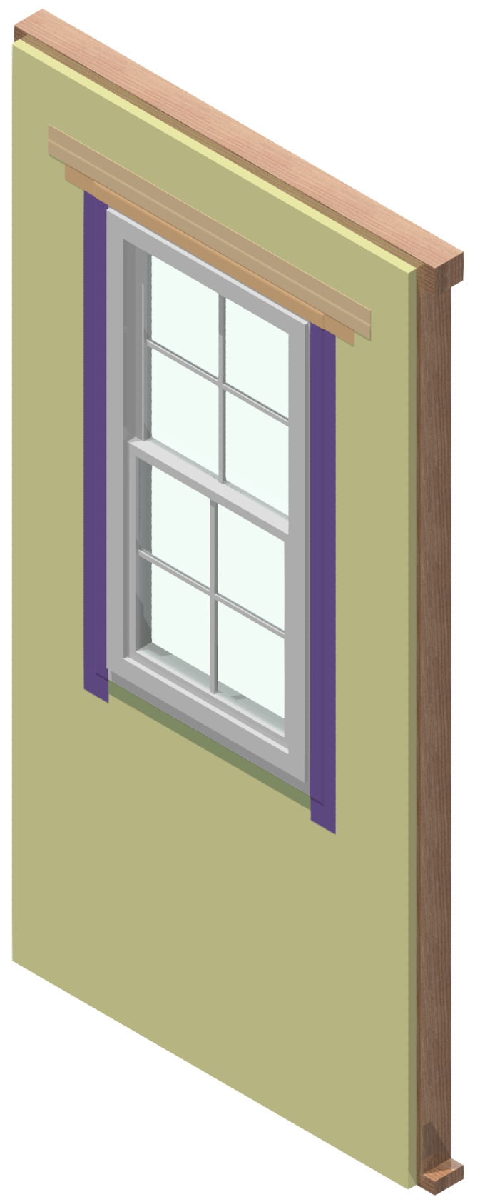
Introduction
Water Resistive Barriers (WRBs) help protect building materials from exterior liquid water penetration, such as rain
Why are WRBs necessary?
  Improve building durability
  Decrease maintenance costs
  Reduce risk of moisture-related problems
WRBs have been required by building codes for many decades

Slide 4
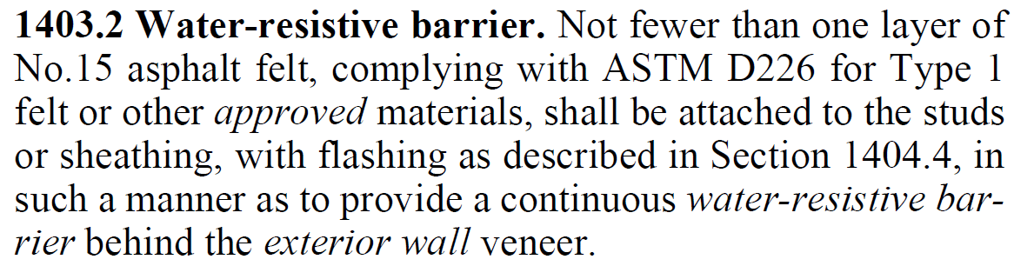
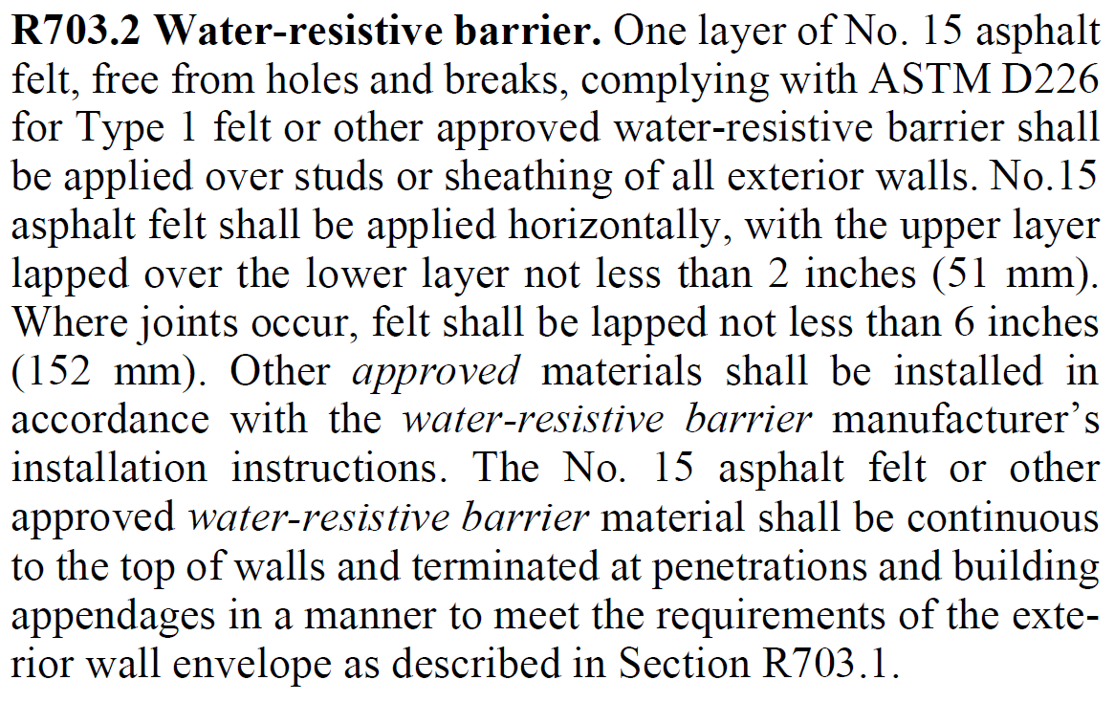
Introduction
WRBs are currently (2015) defined in the codes by the following benchmark:
  IBC Section 1404.2
  IRC Section R703.2

Slide 5
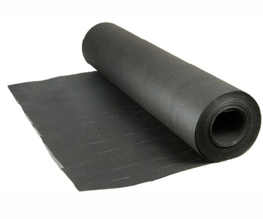
Introduction
What is meant by “other approved WRBs”?
  In order to approve FPIS or any other material as a WRB, the performance of FPIS must equal or exceed that of No.15 asphalt felt
  For this, a uniform basis for assembly water penetration performance is needed

Slide 6
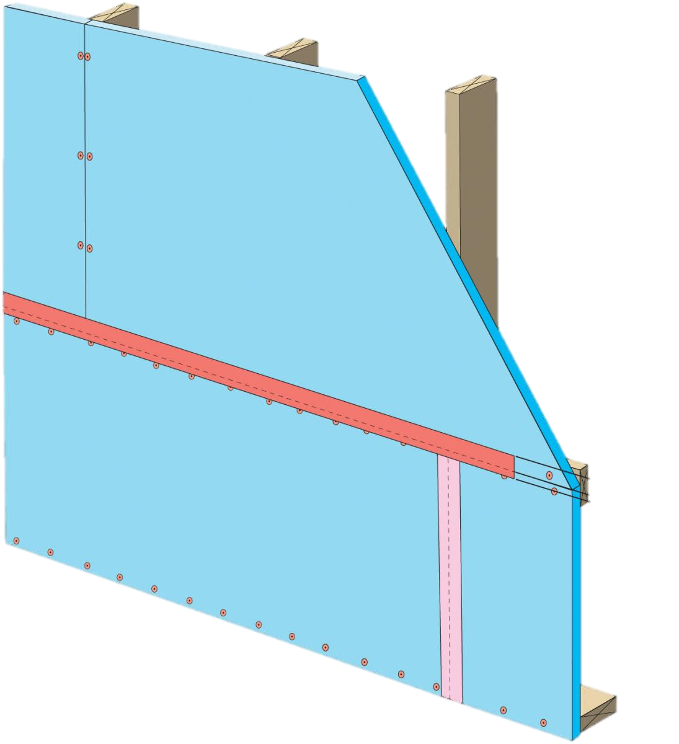
Background
In order to identify “other approved WRBs”, a number of consensus standards and evaluation agency criteria have been developed.
Unfortunately, the criteria found in these sources vary significantly and do not provide a level playing field with regard to code minimum performance.

Slide 7
Background
Foam sheathing has the highest assembly water-resistance test criteria of any product
Evaluation Reference | Water-Penetration Assembly Test Requirements
ASTM E331 | “6.2.4 Water-Spray System – The water-spray system shall deliver water uniformly against the exterior surface of the test specimen at a minimum rate of 3.4 L/m2 (5.0 U.S. gal/ft²-h).” “10.1 The test-pressure difference or differences at which water penetration is to be determined, unless otherwise specified, shall be 137 Pa (2.86 lbf/ft²).” “11.5 Apply the air-pressure difference…along with the specified rate of water spray, for 15 min.”
ASTM E2570 | “8.5.4 ASTM E331…at a minimum pressure difference of 137 kPa (2.86 psf) for a period of 15 minutes” NOTE: The ASTM E331 test occurs after durability testing by applying transverse load (8.5.1), racking displacement (8.5.2), and water/radiant heat cycling (8.5.3)
ASTM E547 | “10.1 The test pressure difference or differences at which water penetration is to be determined, unless otherwise specified, shall be 137 Pa (2.86 lbf/ft²).” “10.3.2 In no case shall the total time of pressure application be less than 15 min.” “6.2.4.1 the water-spray…at a minimum rate of 3.4 L/m² (5.0 U.S. gal/ft²-h)”
AAMA/WDMA/CSA 101/I.S.2/A440 | Minimum water penetration test pressure = 2.9 psf NOTE: Unlike WRB systems, windows are not covered by cladding in end use.
AAMA 504 | “8.4 The completed mockup shall next be tested for water penetration resistance in accordance with ASTM E331 at a minimum test pressure of 150 Pa (3.0 psf) for 60 minutes.”
ICC-ES AC 71 (Foam Sheathing) | “3.4.1.3 The test assemblies shall be tested at a minimum differential pressure of 6.24 psf (0.297 kN/m²).” “3.4.1.4 The test assemblies shall be subjected to a minimum test exposure duration of 2 hours.”
ICC-ES AC 38 (Wraps) | No water penetration assembly test. (0 psf, 0 minutes)
ASTM E2556 (Wraps) | No water penetration assembly test. (0 psf, 0 minutes) “1.2 This specification is limited to the evaluation of materials and does not address installed performance. Although the fastening practices…may affect the installed function of these materials, they are not included in this specification.”

Slide 8
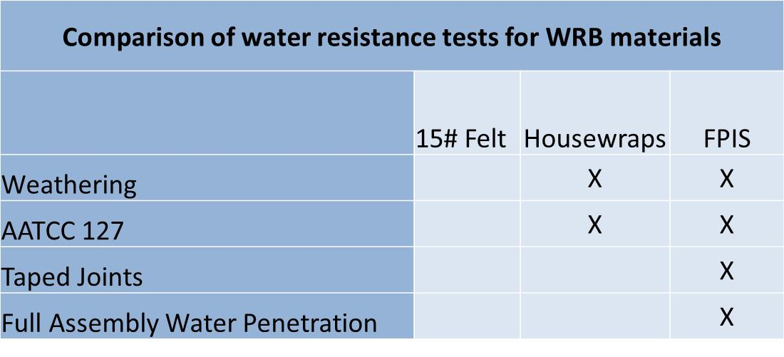
Background
Foam sheathing is tested to a full assembly water penetration test. Other common products such as wraps and 15# felt are not. Taped joints and foam sheathing are also subjected to accelerated weathering and then water resistance.

Slide 9
Background
A study by Hall and Hoigard (2005) investigated the issue of assembly water penetration performance standards.
The study:
  Evaluated current code requirements, acceptance criteria, and field experience
  Reported comparative test data under installed water exposure conditions
  Found varied performance among polymeric building wrap materials including some that were capable of performing equivalently to asphalt-saturated felt materials

Slide 10
Background
The authors concluded:
  "Current building code provisions offer no rational means of assessing the equivalency of alternative WRB products to ASTM D-226 type I asphalt saturated felt ...“
  "The [material only water resistance tests] fail to address several important moisture transport mechanisms that affect the in-service performance of WRBs."

Slide 11
Findings
Product | Test Condition | Performance | Reference
No. 15 Asphalt Felt (ASTM D4869, Type I) installed over wood structural panels, 2 reps | ASTM E331, 2.86psf with 5gal/hr/ft² water spray | No water penetration at 15 min. | PEI, 2013
No. 15 Asphalt Felt (ASTM D226) installed over wood structural panels, 3 reps | ASTM E331, 2.86psf with 5gal/hr/ft² water spray | Water penetration at 5 – 8 min. | RADCO, 2014
No. 15 Asphalt Felt (ASTM D226, Type I) installed over wood structural panels, 1 rep | ASTM E331, 2.86psf with 5gal/hr/ft² water spray | Water penetration at 7 min. | NTA, 2012
No. 15 Asphalt Felt (ASTM D226, Type I) installed over open stud cavity | ASTM E331, 2.86psf with 5gal/hr/ft² water spray | Water penetration at 0.05 min. (3 sec) | NTA, 2013a
House Wrap installed over open stud cavity with shingle lapped joints | ASTM E331, 2.86psf with 5gal/hr/ft² water spray | Water penetration at 0.1 min. (6 sec) | NTA, 2013b
Benchmark WRB test data from multiple approved agencies (test labs) have been gathered to determine an appropriate level of performance for WRBs
Results provide the basis for a unified performance standard for alternative WRB systems

Slide 12
Findings
Product | Test Condition | Performance | Reference
No. 15 Asphalt Felt (ASTM D4869, Type I) installed over wood structural panels, 2 reps | ASTM E331, 2.86psf with 5gal/hr/ft² water spray | No water penetration at 15 min. | PEI, 2013
No. 15 Asphalt Felt (ASTM D226) installed over wood structural panels, 3 reps | ASTM E331, 2.86psf with 5gal/hr/ft² water spray | Water penetration at 5 – 8 min. | RADCO, 2014
No. 15 Asphalt Felt (ASTM D226, Type I) installed over wood structural panels, 1 rep | ASTM E331, 2.86psf with 5gal/hr/ft² water spray | Water penetration at 7 min. | NTA, 2012
No. 15 Asphalt Felt (ASTM D226, Type I) installed over open stud cavity | ASTM E331, 2.86psf with 5gal/hr/ft² water spray | Water penetration at 0.05 min. (3 sec) | NTA, 2013a
House Wrap installed over open stud cavity with shingle lapped joints | ASTM E331, 2.86psf with 5gal/hr/ft² water spray | Water penetration at 0.1 min. (6 sec) | NTA, 2013b
From the table, it can be concluded that the performance of 15 # asphalt felt and wraps varies
  Current code approved applications are insufficient – failed in as low as 3 sec.
  When installed over panels, 2 of 6 tests met the ASTM E331 15-minute threshold
  None of the tests over open stud cavities were even close to meeting the minimum ASTM E331 15-minute threshold

Slide 13
Recommendations
Use one of the following two test conditions for the purpose of qualifying WRB materials:
  Unprotected WRB (no cladding installed)
    Allows the WRB to be generally qualified for use with any code compliant cladding material
  Protected WRB (specific cladding installed)
    Provides option to test WRB and a specific cladding material and installation method as an exterior wall covering assembly

Slide 14
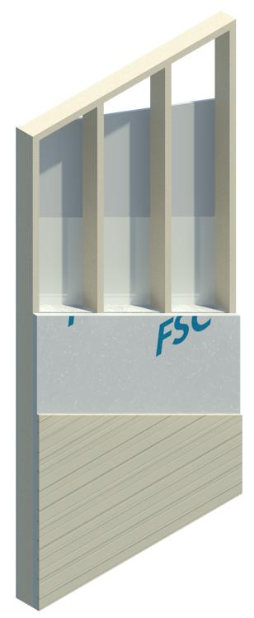
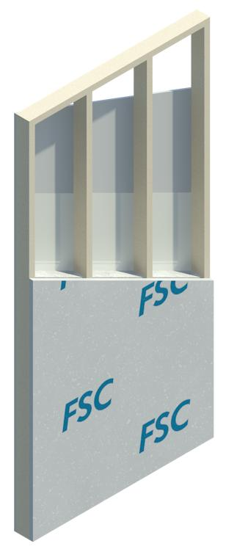
Recommendations
Using the same test (ASTM E331), but adjusting test conditions allows WRB assemblies to qualify in two ways:
  As part of a complete exterior wall envelope system, including the protection of a particular exterior wall finish material per Section 1403.2
  Without the protection of a particular exterior wall finish material,
  under conditions suitable to an exposed WRB test (2.86 psf and 15-min duration with no water penetration)

Slide 15
Recommendations
The reasoning behind the unprotected test criteria is consistent with:
  ASTM E331 (2.86 psf and 15-minute duration with no water penetration)
  Code referenced standard used for evaluating unprotected WRB for use with EIFS (IBC Section 1407.4.1.1)
  Benchmarked performance testing of asphalt felt
    Meets the equivalency intent of IBC Section 104.11

Slide 16
Recommendations
ASTM D226, Type 1 asphalt felt shall be recognized as a deemed-to-comply solution (testing not required)
Water-resistive barriers shall be installed in accordance with the manufacturer's installation instructions to assist in proper use and enforcement and ensure the intended performance level is met.

Slide 17

Conclusion
These recommendations are consistent with the intent of equivalency between code recognized materials and methods (asphalt felt) and alternative WRB materials and assemblies.
The recommendations will help to ensure acceptable and consistent performance of various types of alternative WRB materials and assemblies in a non-exclusionary and effective manner.

Slide 18
Suggested Resources
Water Resistive Barrier Applications - ContinuousInsulation.org
Water Resistive Barrier - ContinuousInsulation.org
“The Importance of Integrating Flashing and the Water Resistive Barrier in the Exterior Wall Systems of Residential Buildings” Dorin (2006)
“Leaks and Holes” Lstiburek (2012)
“Water-Resistive Barriers: How do they compare?” Hall and Hoigard (2005)

