Slide 1
Windows, Cladding, and Continuous Insulation for Steel Frame Walls
Jay H. Crandell, P.E.
ABTG / ARES Consulting

Slide 3
Outline
What is ci?
Why use ci?
Building Science Fundamentals
Water-Resistive Barrier & Flashing – Code Requirements
Fenestration Installation & Performance on Walls with ci
Cladding Installation & Performance on Walls with ci
Conclusions
Q & A

Slide 4
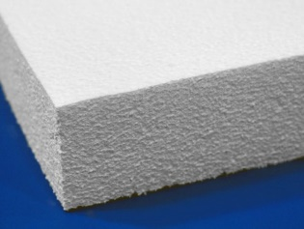
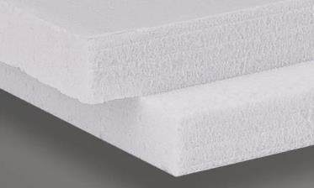
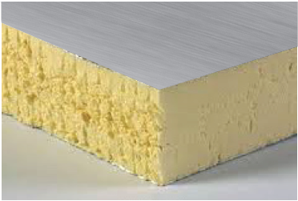
What is ci?
IECC, ASHRAE 90.1, IBC, and IRC Definition:
  Continuous Insulation (ci): Insulation that is uncompressed and continuous across all structural members without thermal bridges other than fasteners and service openings. It is installed on the interior or exterior or is integral to any opaque surface of the building envelope.
  IMPORTANT OR ENERGY CODE COMPLIANCE AND BUILDING CODE COMPLIANCE FOR CLADDING AND WINDOW INSTALLATIONS
CI MATERIAL TYPES:
  Foam Plastic Insulating Sheathing (FPIS)
    10-100 psi compressive resistance; R4-R6 per inch
    ASTM C578 – Standard specification for rigid, cellular polystyrene thermal insulation (XPS – extruded polystyrene; EPS – expanded polystyrene)
    ASTM C1289 – Standard specification for faced rigid cellular polyisocyanurate thermal insulation board (Polyiso or PIR)
  Others ci materials include Phenolic foam (R7+ per in.), mineral/glass fiber, wood fiber, spray foam, structural composite insulating sheathing, etc.

Slide 5
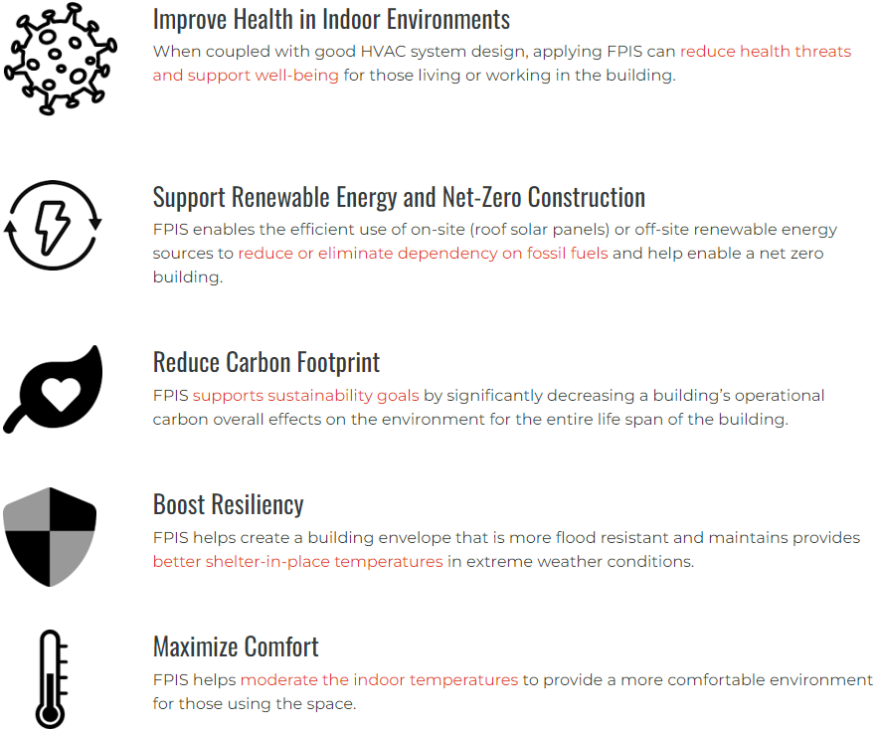
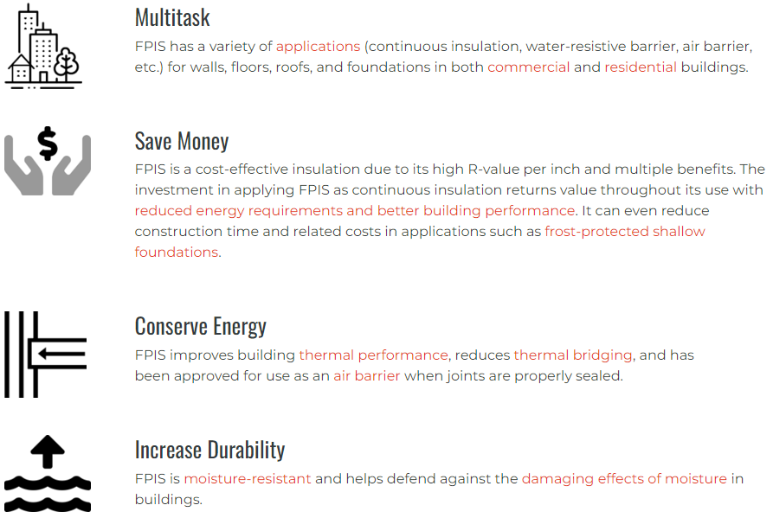
Why use ci?
For code compliance, plus…
https://www.continuousinsulation.org/resources/benefits

Slide 6
Building Science Fundamentals
5 Concepts for Moisture Control
3 Rules to Never Break
Practical Resources
Wind-driven Rain Hazard

Slide 7
5 Building Science Concepts for Moisture Control
Regardless of what materials you specify for a wall assembly, certain building science fundamentals are always necessary to address.
Successful moisture control requires an integrated approach to 5 key building science concepts:
  Control Rain Water Intrusion (e.g., continuous water-resistive barrier)
  Control Air Leakage (e.g., continuous air barrier)
  Control Indoor Relative Humidity (e.g., building ventilation & de-humidification)
  Control Initial Construction Moisture (e.g., prevent enclosure of wet materials)
  Control Water Vapor (e.g., optimized balance of wetting and drying through strategic use of insulation and vapor retarders)
All are important, all vary in significance, all have inter-dependencies.
These 5 concepts are captured in the following 3 rules...

Slide 8
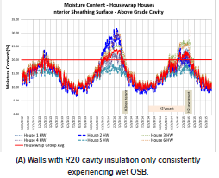
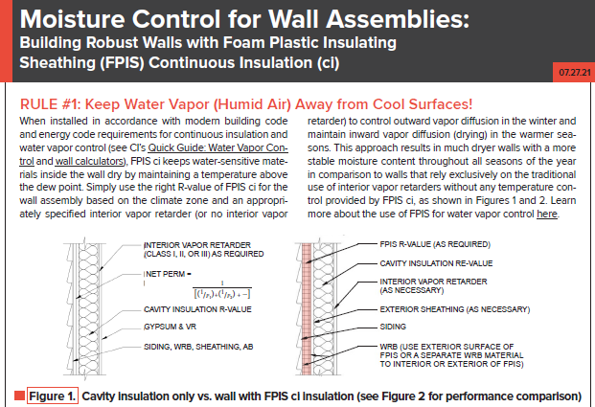
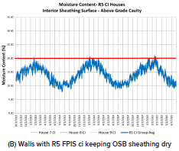
RULE #1 of 3
https://www.continuousinsulation.org/resources/facts-ci

Slide 9

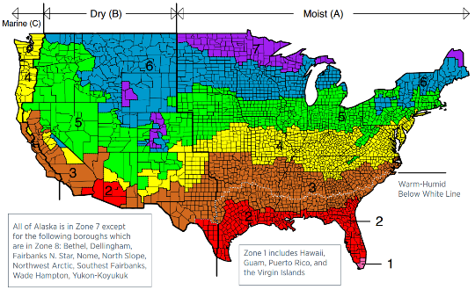
Rule #1 requires coordination with the Energy Code...
IECC Commercial Provisions
Climate Zone | Building Use | Metal Framed |  | Wood Framed
 |  | 2018 IECC | 2021 IECC | 2018 IECC | 2021 IECC
0 and 1 | All other | R13+5ci (U-0.077) | R13+5ci (U-0.077) | R13+3.8ci or R20 (U-0.064) | R13+3.8ci or R20 (U-0.064)
 | Group R
2 | All other
 | Group R | R13+7.5ci (U-0.064) | R13+7.5ci (U-0.064)
3 | All other
 | Group R
4 Except Marine | All other
 | Group R
5 and Marine 4 | All other |  | R13+10ci (U-0.055) |  | R13+7.5ci or R20+3.8ci (U-0.051)
 | Group R |  |  | R13+7.5ci or R20+3.8ci (U-0.051)
6 | All other |  | R13+12.5ci (U-0.049)
 | Group R
7 | All other
 | Group R | R13+15.6ci (U-0.052) | R13+15.6ci (U-0.042)
8 | All other | R13+7.5ci (U-0.064) | R18+18.8ci (U-0.037) | R13+15.6ci or R20+10ci (U-0.036) | R13+18.8ci (U-0.032)
 | Group R | R13+17.5ci (U-0.045)
IECC Residential Provisions
Climate Zone | Wood Frame Walls
 | 2018 IECC | 2021 IECC
0, 1 and 2 | R13 (U-0.084) | R13 or R0+10ci (U-0.084)
3 | R20 or R13+5ci ( U-0.060) | R20 or R13+5ci or R0+15ci (U-0.060)
4 except Marine |  | R30 or R20+5ci or R13+10ci or R20ci (U-0.045)
5 and Marine 4
6 | R20+5ci or R13+10ci (U-0.045)
7 and 8
Note: Cavity insulation is only 40-50% effective on CFS walls, so ci is prescribed for all climate zones.

Slide 10
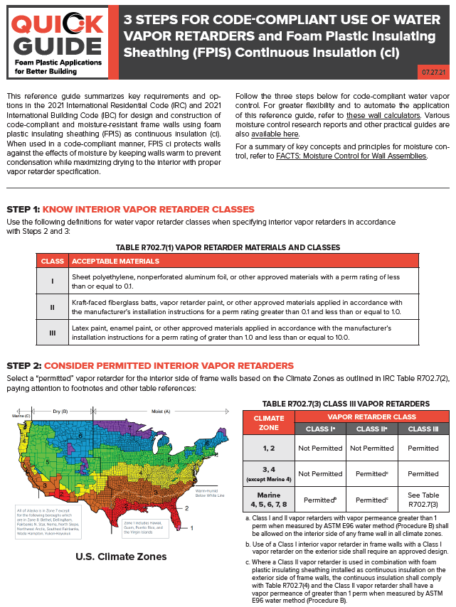
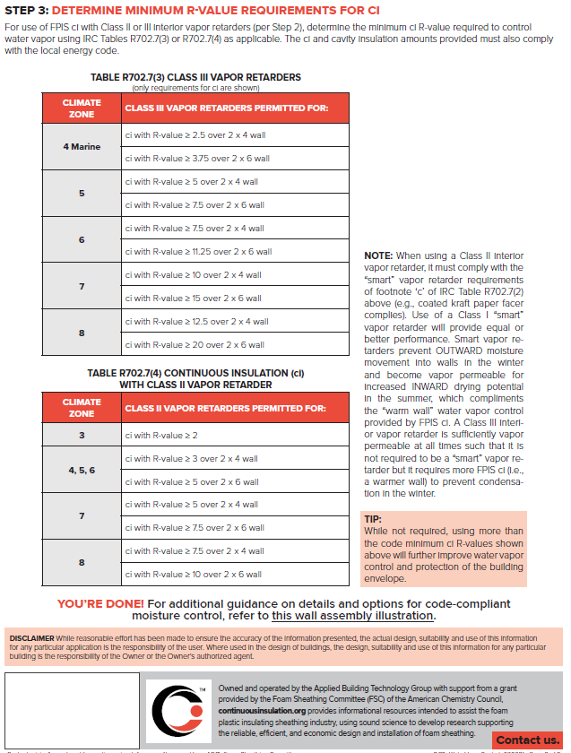
Rule #1 requires coordination with the Building Code...
https://www.continuousinsulation.org/resources/quick-guides

Slide 11
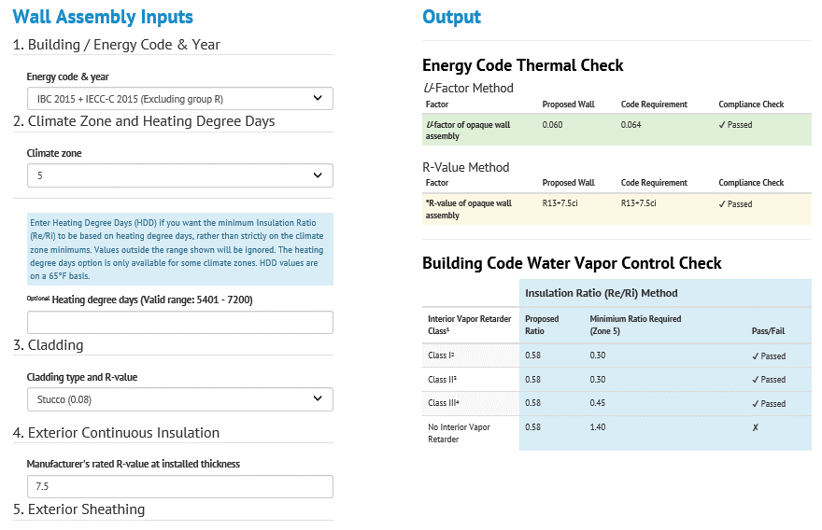
Rule #1 – Wall Calculator to Simplify Energy and Building Code Compliance, Coordination, and Optimization...
Implements R-value and U-factor checks per IECC & ASHRAE 90.1
Moisture control check per IBC/IRC (including insulation and permeance ratio checks)
Flexible, More Solutions than Code, More Precise
Wood and Steel framing
https://www.continuousinsulation.org/calculators

Slide 12
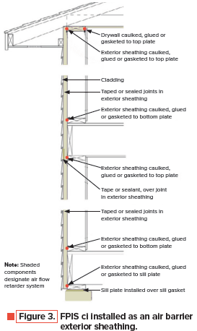
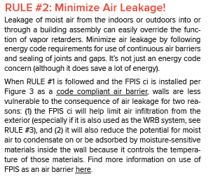
Rule #2 of 3
https://www.continuousinsulation.org/resources/facts-ci

Slide 13
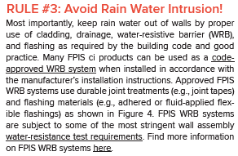
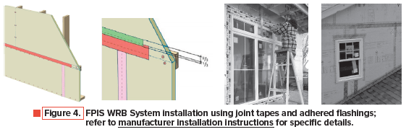
Rule #3 of 3
https://www.continuousinsulation.org/resources/facts-ci

Slide 14
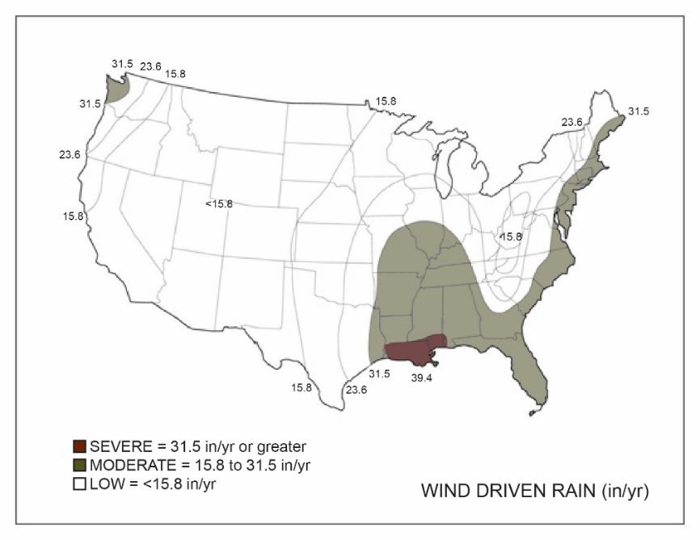
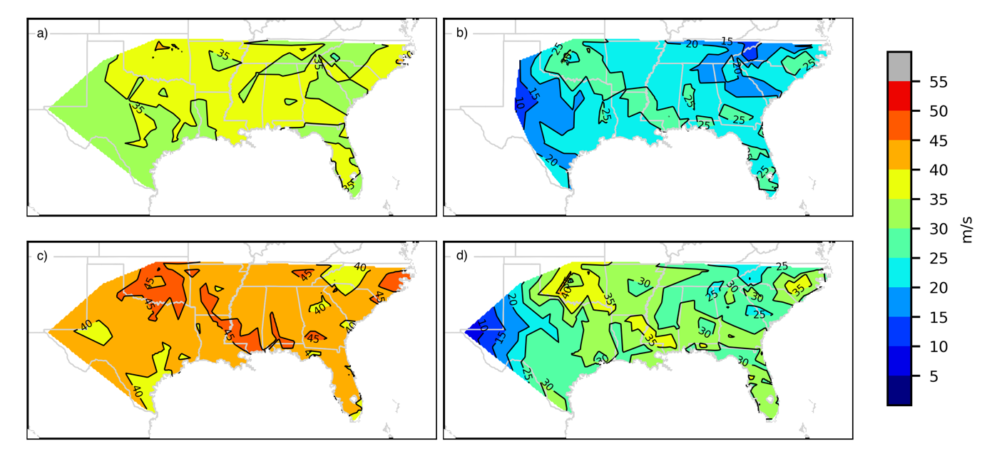
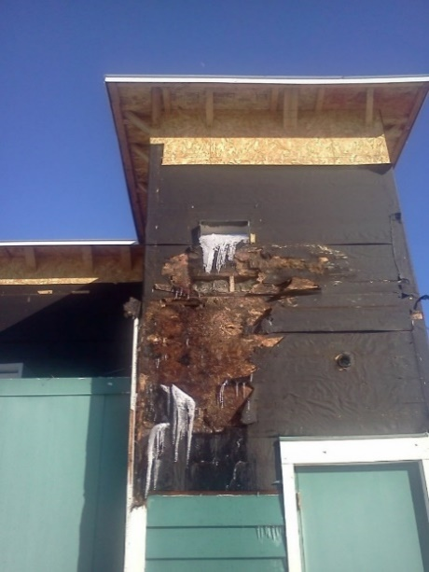
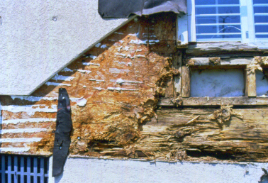
Control of Water Intrusion
Rain water intrusion is often the primary factor associated with observed failure or success of moisture control
  Wind driven rain (WDR) is the primary hazard
If rain water is not adequately controlled, other building science measures can be rendered ineffective (air barriers, vapor retarders, drying potential, etc.)
Concept is simple:
Keep water out!
Annual Average Wind Driven Rain Receipt (in/yr)
(map based on UofGA research)
(http://www.huduser.gov/portal/publications/reports/Guide-Durability-by-Design.html)
WDR Hazard Maps for SE United States
Source: https://journals.ametsoc.org/view/journals/apme/62/7/JAMC-D-22-0156.1.xml

Slide 15
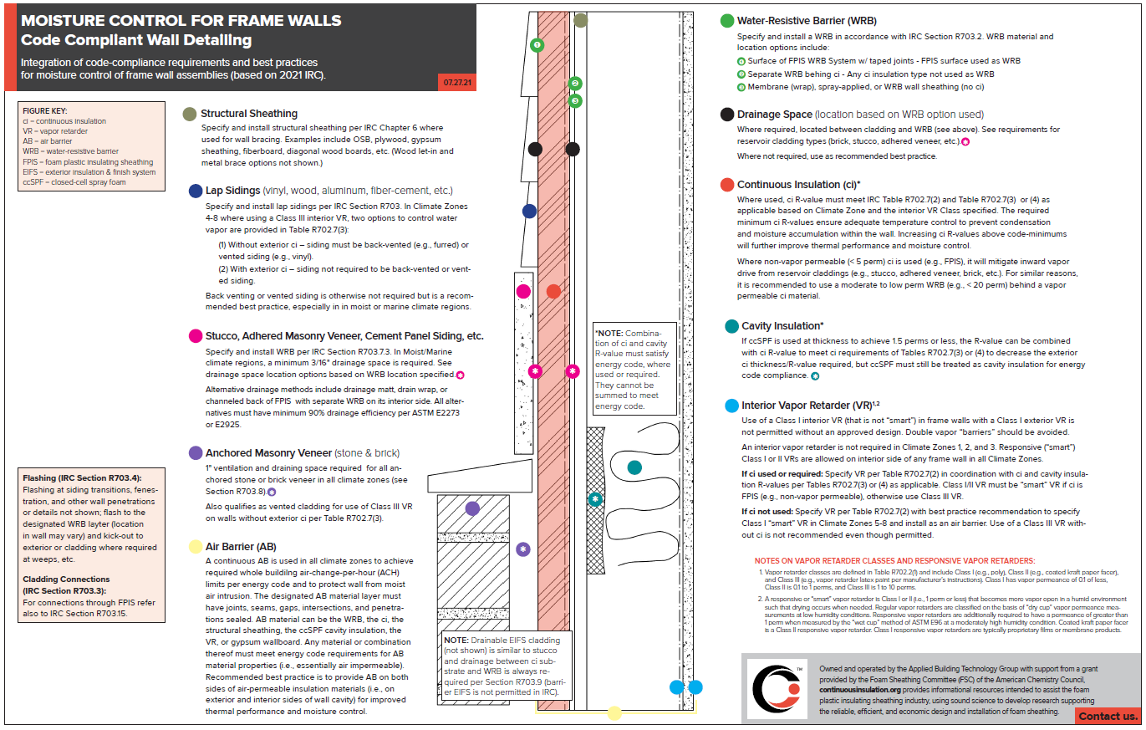
“Cheat Sheet”
Integrated, Code-Compliant Moisture Control
https://www.continuousinsulation.org/moisture-control-frame-walls

Slide 16
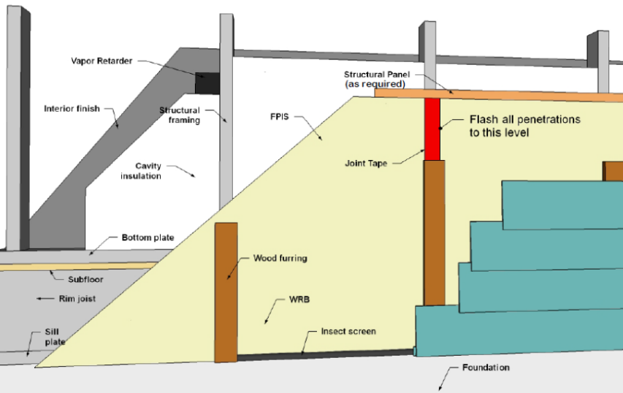
WRB & Flashing Code Requirements
Use of a code-compliant water-resistive barrier (WRB) and flashing details are required by code (since the 2006 IBC/IRC) because we learned that claddings and windows leak.
FPIS WRB systems are now code-recognized; refer to FPIS manufacturer for code compliance data and installation instructions.
For guidance on use of FPIS ci as a WRB, refer to: https://www.continuousinsulation.org/applications/WRB
For listing of code-compliant FPIS WRB systems refer to: https://www.drjengineering.org/drr/1410-05

Slide 17
WRB & Flashing Code Requirements
2024 IBC WRB provisions:
  1403.2 Water-resistive barrier. Not fewer than one layer of water-resistive barrier material shall be attached to the studs or sheathing, with flashing as described in Section 1404.4, in such a manner as to provide a continuous water-resistive barrier behind the exterior wall veneer. The intersection between the water-resistive barrier materials and fenestration openings shall be flashed and assembled in accordance with the fenestration manufacturer’s installation instructions, or other approved methods for applications not addressed by the fenestration manufacturer’s instructions. The water-resistive barrier material shall be continuous to the top of walls and terminated at penetrations and building appendages in a manner to meet the requirements of the exterior wall envelope as described in Section 1402.2.
  Water-resistive barriers shall comply with one of the following:
    1. No. 15 felt complying with ASTM D226, Type 1.
    2. ASTM E2556, Type I or II.
    3. Foam plastic insulating sheathing water-resistive barrier systems complying with Section 1402.2 and installed in accordance with manufacturer's installation instructions.
    4. ASTM E331 in accordance with Section 1402.2.
    5. Other approved materials installed in accordance with the manufacturer’s installation instructions.
  No.15 asphalt felt and water-resistive barriers complying with ASTM E2556 shall be applied horizontally, with the upper layer lapped over the lower layer not less than 2 inches (51 mm), and where joints occur, shall be lapped not less than 6 inches (152 mm).

Slide 18
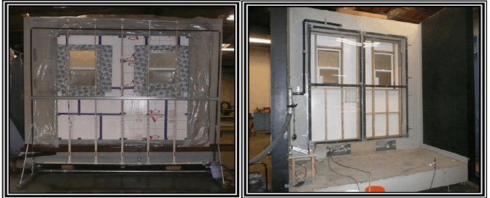
WRB & Flashing Code Requirements
WRB performance criteria vary widely from no installed performance test (material water resistance test only) to full installation system testing (e.g., FPIS WRB systems)
For information on WRB performance testing requirements refer to: https://www.appliedbuildingtech.com/rr/1504-03

Slide 19
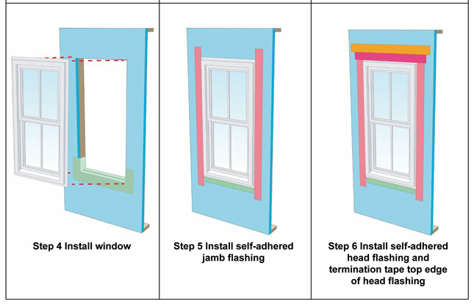
WRB & Flashing Code Requirements
2024 IBC Flashing provisions:
1404.4 Flashing. Flashing shall be installed in such a manner so as to prevent moisture from entering the exterior wall or to redirect that moisture to the surface of the exterior wall covering or to a water-resistive barrier complying with Section 1403.2 and that is part of a means of drainage complying with Section 1402.2.
Flashing shall be installed at the perimeters of exterior door and window assemblies in accordance with Section 1404.4.1, penetrations and terminations of exterior wall assemblies, exterior wall intersections with roofs, … etc.
1404.4.1 Fenestration flashing. Flashing of the fenestration to the wall assembly shall comply with the fenestration manufacturer's instructions or, for conditions not addressed by the fenestration manufacturer's instructions, shall comply with one of the following:
The water-resistive barrier manufacturer's flashing instructions;
The flashing manufacturer's flashing instructions;
A flashing design or method of a registered design professional; or,
Other approved methods.
Window flashing with pan flashing is a recommended best practice (but not required by code)
Flashing instructions may vary from one source to another in scope of materials and methods addressed, limitations, conditions of use, and performance basis.

Slide 20
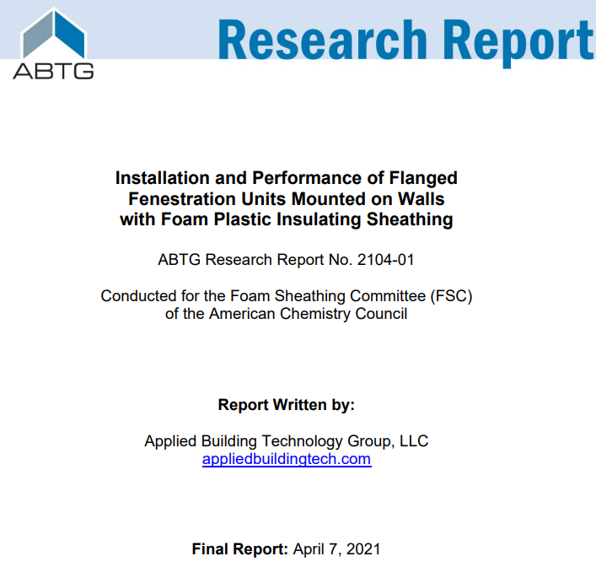
Fenestration Installation & Performance on Walls with ci
FPIS ci Timeline
Field Installation Experience
Installed Performance Testing
Recommended installation instructions
For more information, refer to: https://www.continuousinsulation.org/window-installation
https://www.appliedbuildingtech.com/rr/2104-01

Slide 21
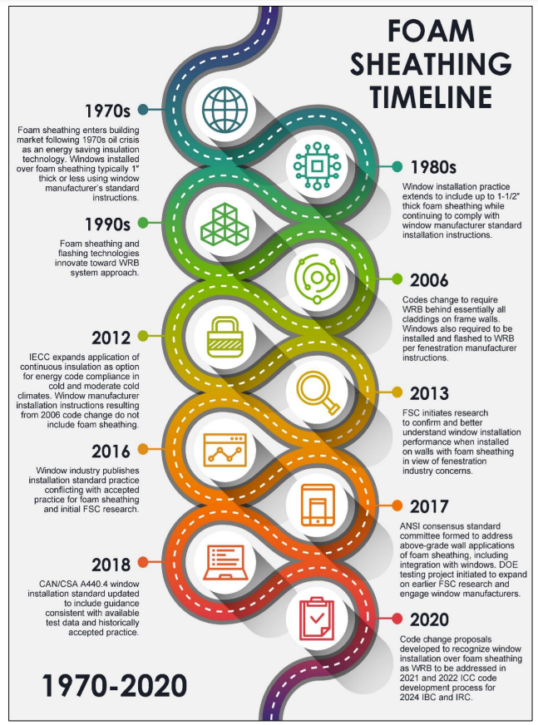
FPIS ci Timeline
1970s – FPIS ci introduced
1980s –flanged window install over FPIS progresses
from 1" to 1½" (window buck used for thicker foam)
1990s –FPIS ci WRB systems evolve
2006 – IRC & IBC codes change to require WRBs and fenestration manufacturer instructions
2012 – IECC expands use of ci for R-value compliance use of ci
2013 – Present – Increased use of FPIS ci, but differing opinions and experience with how to integrate with windows, conflicting requirements, conflicting instructions, conflicting standards, conflicting opinions, etc.
  ➔ Research and testing to resolve confusion
  ➔ Code improvements initiated

Slide 22
Field Installation Experience
Historically accepted practice (survey actual experience)
Typical builder experienced with FPIS ci:
  “We have been installing vinyl double pane windows over 1½" XPS foam with no OSB for over six years and before that over 1" foam for almost 30 years and have seen no issues with window movement.”
Other sources indicate similar experience
Experience from Canada also imported to U.S.

Slide 23
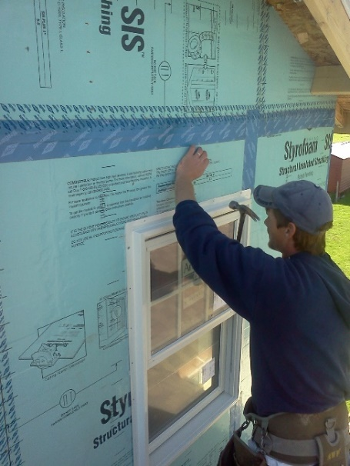
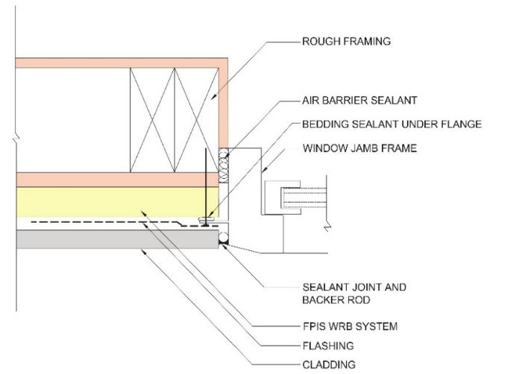
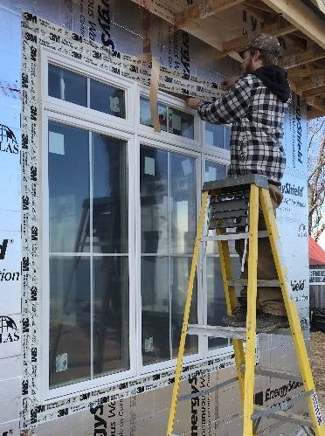
Examples of Historically Accepted Practice
(≤ 1.5" FPIS ci)

Slide 24
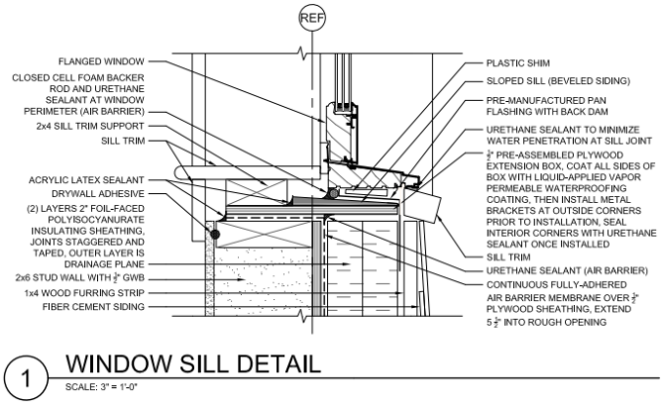
Examples of Historically Accepted Practice
(> 1.5” FPIS ci)
Plywood window buck with 4"-thick FPIS ci
2x wood bucks also used (especially for masonry/concrete construction)
NOTE: For Type I-IV construction (IBC), the window-wall interface also must comply with NFPA 285 tested assembly and engineering analysis.
  Applies regardless of
  FPIS thickness.
  See examples next two slides.
Source: www.nist.gov/system/files/nzertf-architectural-plans3-june2011.pdf

Slide 25
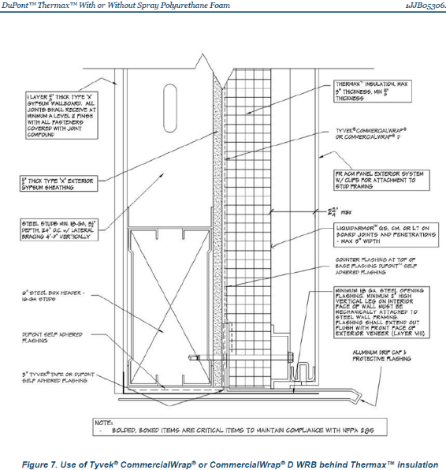
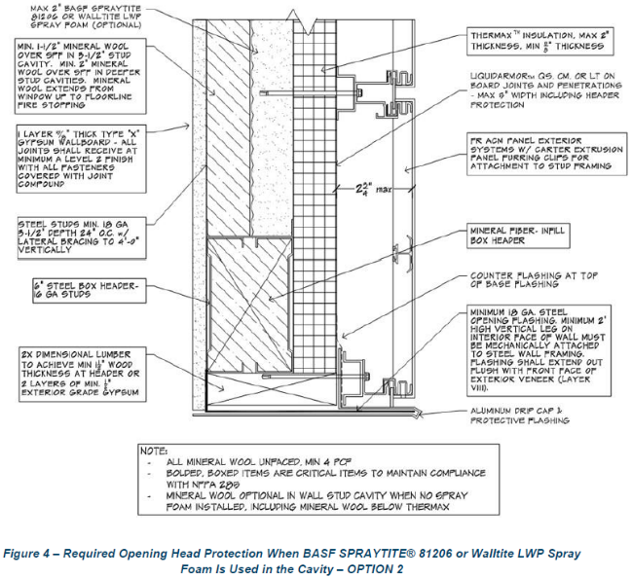
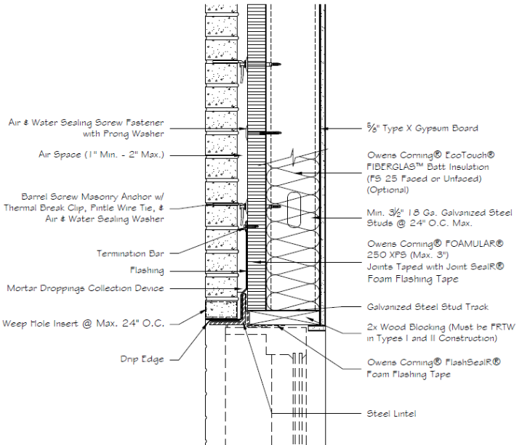
Example NFPA 285 Fenestration Rough Opening Details
Source: DuPont Building Performance Solutions, Jensen Hughes Engineering Analysis, February 4, 2022
Source: Owens Corning, Enclosure Solutions NFPA 285 Guide, May 2019

Slide 26

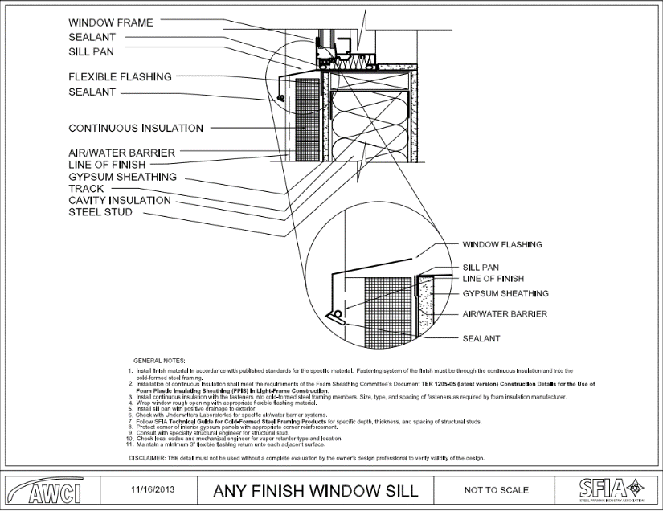
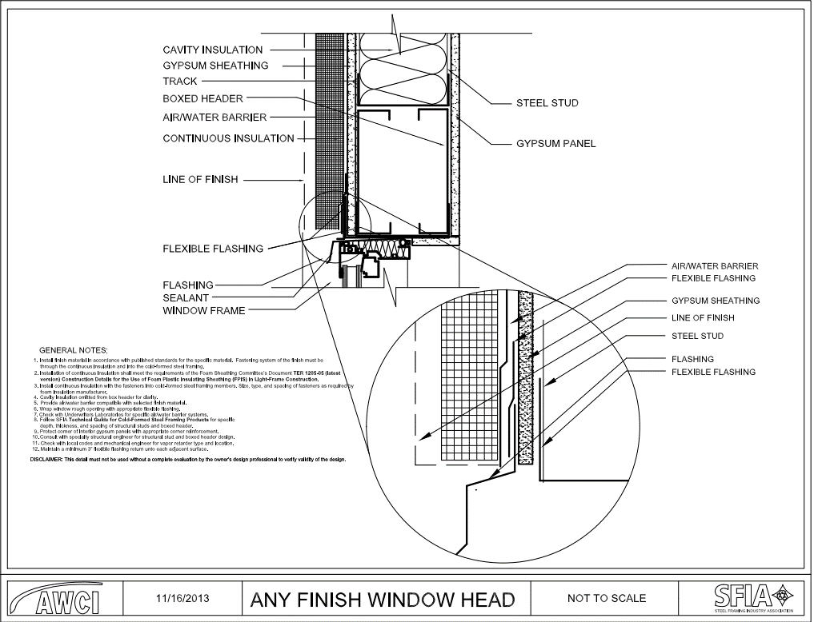
Example Details from AWCI/SFIA
Various CAD details for ci on steel frame wall assemblies
http://www.awcitechnologycenter.org/content/cad-detail-library

Slide 27
Installed Performance Testing
~150 tests on ~30 wall assembly specimens by independent sources
Four integrally-flanged window types (SH, DH, C, and HS)
Two frame material types (vinyl and wood)
Two installation configurations (single 1-wide, mulled 2-wide)
Range of fenestration unit weights (~30 lbs to ~400 lbs)
Rough opening sizes up to 6-feet wide
Wall configurations with and without FPIS ci of three material types (XPS, EPS, and PIR), up to 2" thick, and 15 or 25 psi compressive resistance per ASTM C578 or ASTM C1289
FPIS detailed to serve as WRB system and flashed per WRB manufacturers’ specifications

Slide 28
Installed Performance Testing
Test method generally followed FGIA/AAMA TIR-504-2020:
  Initial air leakage resistance per ASTM E283
  Initial water resistance per ASTM E331
  Thermal cycling per ASTM E2264 Method A (level 1)
  Repeat air and water resistance testing (steps 1 and 2)
  Design pressure (DP) load test per ASTM E330
  Repeat water penetration test (step 2)
  Structural test pressure (STP) = 1.5 x DP load test per ASTM E330

Slide 29
Installed Performance Testing
Performance criteria:
  Report air leakage (Steps 1 and 4)
  No water penetration (Steps 1, 4, and 6)
  Design pressure (DP) – no damage that prevents normal operation
  Structural test pressure (STP) – no damage that results in failure to sustain load; any operability impact reported.
Several later tests were focused only on DP and STP testing as allowed by FGIA/AAMA TIR-504-2020 to address specific questions regarding structural support and anchorage.
Other tests to evaluate special loading conditions also conducted (shear load tests and long term creep/movement tests)

Slide 30
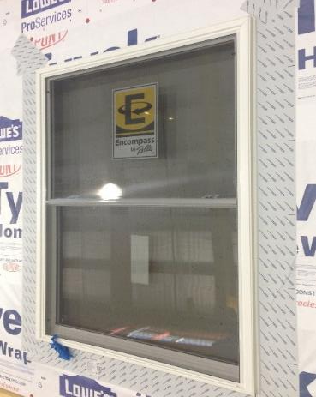
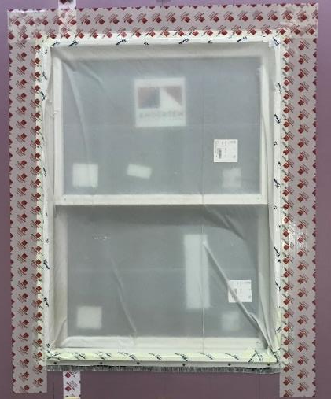
Installed Performance Testing
Water Penetration Resistance Tests
  Tested per ASTM E331 using a 5.4psf pressure differential (just above 15% of the max 35 psf DP rated window unit used in testing)
  Window units “masked” because not re-testing window unit rating itself
  All used joint tapes and adhered flashing specified per the WRB manufacturer’s instructions
  None of the flanges used bedding sealant to the WRB surface (removed redundancy)
  Sill pan flashing used (but without air sealing)
  RESULTS: No water-penetration of assemblies with and without FPIS ci
    As expected, some water movement onto sill pan behind unsealed bottom flange
    Consequence of E331 testing without air sealing rough opening gap and flange providing only 1” lap down from surface of pan flashing

Slide 31
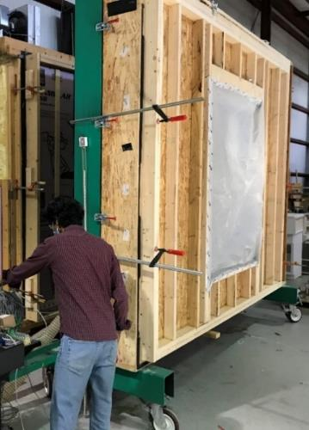
Installed Performance Testing
Uniform Pressure (Wind Load) Resistance
  Tested per ASTM E330 at DP and STP = 1.5 x DP loading
    Most tested to 1.58 x DP (conservatively above STP target)
  Positive pressure then negative pressure tested
  Two specimens ramped to failure (>> STP load)
  Many window installations included weakening variances:
    Flange bedding sealant omitted in all cases
    Some flange fastener groups omitted
    Air sealing of rough opening omitted
    Some shims omitted (e.g., at head of HS window)
  Tests also repeated without weakening variances

Slide 32
Installed Performance Testing
Uniform Pressure (Wind Load) Resistance
  RESULTS: No structural failures related to installation over foam sheathing when adhering to window manufacturer anchorage and support instructions (1” and 2” FPIS thickness, 15psi and 25 psi)
    Some operability impacts observed with missing fastener groups (e.g., sash pin dislodge from brake/balance mechanism discovered after STP test level)
    One structural failure related to missing shims (resulting in premature dislodging of sash from frame)
    One structural failure caused by wood sash cross rail split out at end notch for sash bracket
  As with any window installation with or without FPIS, following manufacturer shimming and flange fastener patterns (i.e., fastener groups) is important
    Casement windows appeared most robust, double hung and horizontal slider appeared most sensitive to non-compliant (weakening) installation variances

Slide 33
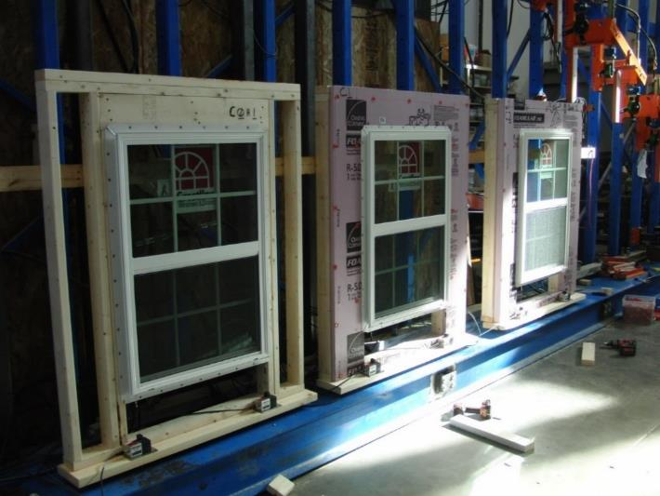
Installed Performance Testing
Sustained Dead Load & Creep Resistance
  Evaluated movement of fenestration under sustained dead load (weight of fenestration unit)
  Monitoring periods of 1 month to 6 months
  Up to 2” thick foam (15 psi minimum)
  Fenestration weights from 27 lbs to 384 lbs
  Included same installation weakening variances mentioned previously
  RESULTS: Recorded movement of 0.000” to -0.032” (~1/32nd inch). Periods of upward movement also observed. No relationship to installation conditions discerned. All movement considered negligible or typical due to environmental changes (not creep).

Slide 34
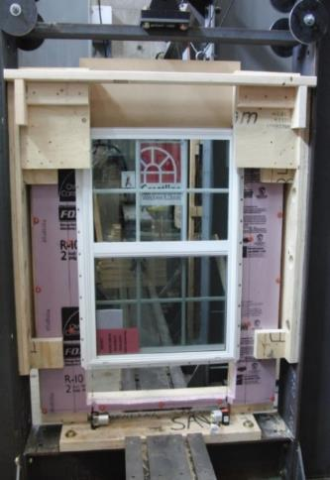
Installed Performance Testing
Flange Fastener Shear Resistance
  Test shear capacity and stiffness of flange fasteners through 1” and 2” thick FPIS (15 psi)
  Windows installed with no shims and no bedding sealant so flange fasteners resist all shear load
  RESULTS: Ultimate shear capacity changed
  little (~3,300 to 3,600 lbs); stiffness was
  affected very predictably; foam sheathing
  added ductility while providing adequate
  stiffness for support of fenestration weight.
    Consistent with fastener shear testing and
    design methodology developed for cladding
    and furring attachments through FPIS

Slide 35
Installed Performance Testing
Fenestration Size Effect on Installed Performance
  Window size effect on DP rating permitted by code to be evaluated per AAMA 2502, Comparative Analysis Procedure
  Comparative analysis by ASTM E330 testing of SH integral flange vinyl window as installed (positive pressure only) – see Table below.
  RESULTS: Even with significant installation non-compliances (e.g., no shims and larger r.o. gap) and up to 2” of FPIS ci, a moderate-size fenestration unit can have more than 3 times the wind pressure rating of the largest (“gateway”) size used for fenestration rating and labeling
Size | STP | DP | Safety Factor | Adjusted DP (min 1.5 safety factor) | Installation Notes*
42x66 (gateway) | 37.5 psf | 25 psf | 1.5 | n/a | Wood substrate + shims + ¼” r.o. gap
30x42 | 151 psf | 25 psf | 6.0 | 80 psf | Wood or up to 2” foam (15 psi) substrate, no shims, and 3/8” r.o. gap
30x42 | 118 psf | 25 psf | 4.7
*Fasteners installed in every flange hole for all cases per manufacturer instructions

Slide 36
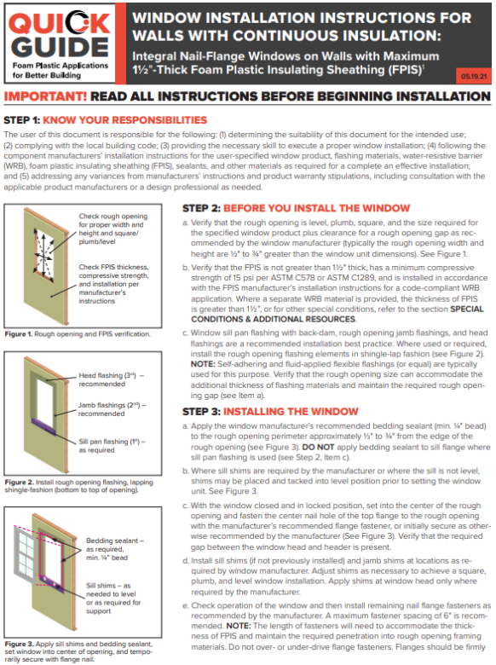
Recommended Installation Instructions
For FPIS of minimum 15 psi compression resistance and maximum 1.5" thickness:
  Use fenestration manufacturer shim and fastener schedule
    Adjust fastener length to maintain embedment in framing
  Use WRB or window manufacturer flashing instructions
For FPIS > 1.5" thick:
  Use window buck or similar support method
    Some manufacturers offer specialty support brackets
  Otherwise, same as above for remaining installation details
If window manufacturer instructions address the specific application with FPIS, use those instructions.
NOTE: If NFPA 285 applies (Type I-IV construction), the window-wall interface must comply with the FPIS manufacturer’s tested assembly and engineering analysis, regardless of FPIS thickness.
  Refer to the manufacturer data and standard details
For additional information, refer to:
https://www.continuousinsulation.org/applications/window-installation

Slide 37
Cladding Installation & Performance on Walls with ci
Performance Research & Testing
Prescriptive Solutions
Design Procedure

Slide 38
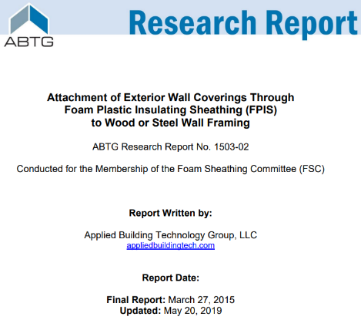
Performance Research & Testing
Basis for prescriptive requirements in:
  Section 2603, International Building Code (IBC) – 2012 through 2024 editions
    Moved into Chapter 14 in 2024 IBC
  Section R703, International Residential Code (IRC) – 2012 through 2024 editions
Basis for engineering design procedure supporting the above code provisions

Slide 39
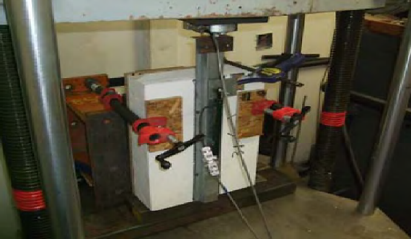
Performance Research & Testing
Based on test program conducted for NYSERDA, FSC, AISI/SFA, and DOE projects, each by independent sources/labs.
Evaluated both short term load resistance and stiffness of connections through FPIS (15 psi min.) up to 4-inches thick as well as long term creep behavior and stabilization (1 month to 1 year duration).
Limit short-term deflection to 0.015" maximum and stabilized creep
Short-term load-deflection test
Long-term (sustained)
load-deflection test

Slide 40
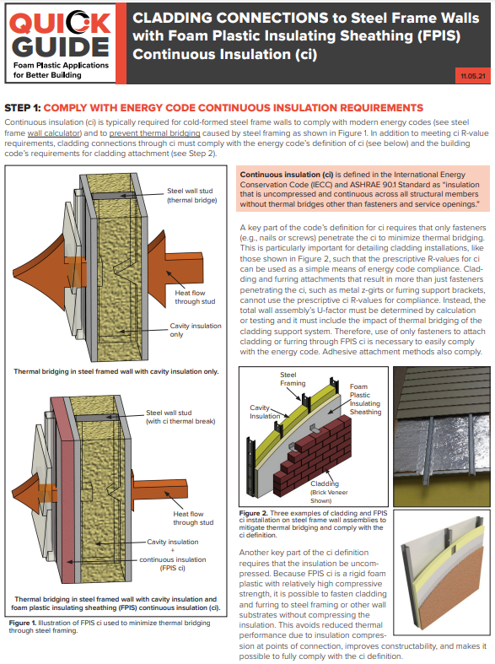
Code Prescriptive Solutions
Prescriptive “Quick Guide” for code compliance
Available at:
https://www.continuousinsulation.org/cladding-connections
Applications:
  Direct Cladding Attachment through FPIS ci
  Furring Attachment through FPIS ci
  Cladding Attachment through FPIS ci to a Wood Structural Panel Substrate
Not required for separately supported cladding
(e.g., anchored masonry veneer); use thermally efficient brick ties

Slide 41
Prescriptive Solutions
General Requirements
  FPIS minimum 15 psi compressive strength; compliant with ASTM C578 or C1289
  Must also check cladding attachment requirements for wind load, etc.
  (the more stringent fastening schedule will control)
  Fastener length must be long enough to accommodate FPIS thickness and maintain required fastener embedment in wood/steel
  Fastener tightened to draw connected materials together but not distort
  Fastening schedule will depend on FPIS thickness and cladding weight supported
  Connections to masonry/concrete must use an approved design
  (often proprietary fasteners are used)

Slide 42
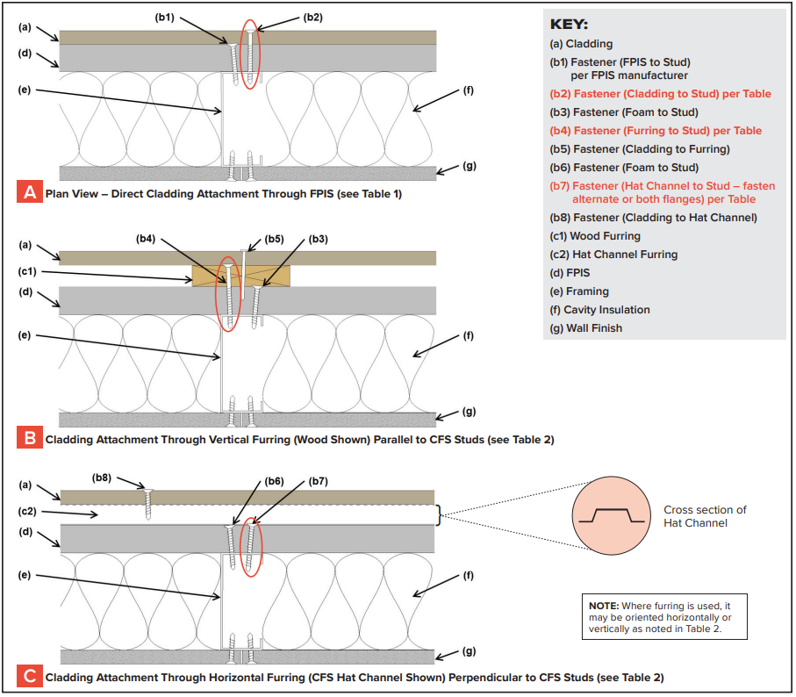
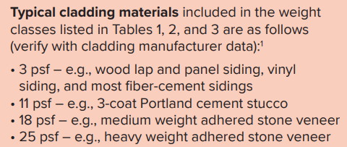
Prescriptive Solutions
(CFS wall framing)
Applications 1 and 2:
  Direct cladding attachment
  Wood or steel furring attachment
Requirements vary by cladding weight:

Slide 43
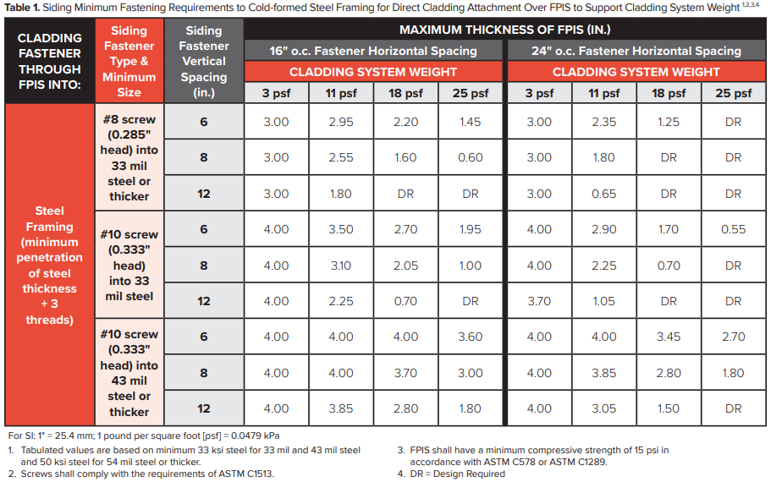
Prescriptive Solutions
Application 1 – Direct Cladding Attachment
Foam sheathing thickness limit based on:
  Framing thickness
  Screw size
  Screw spacing
  Cladding weight

Slide 44
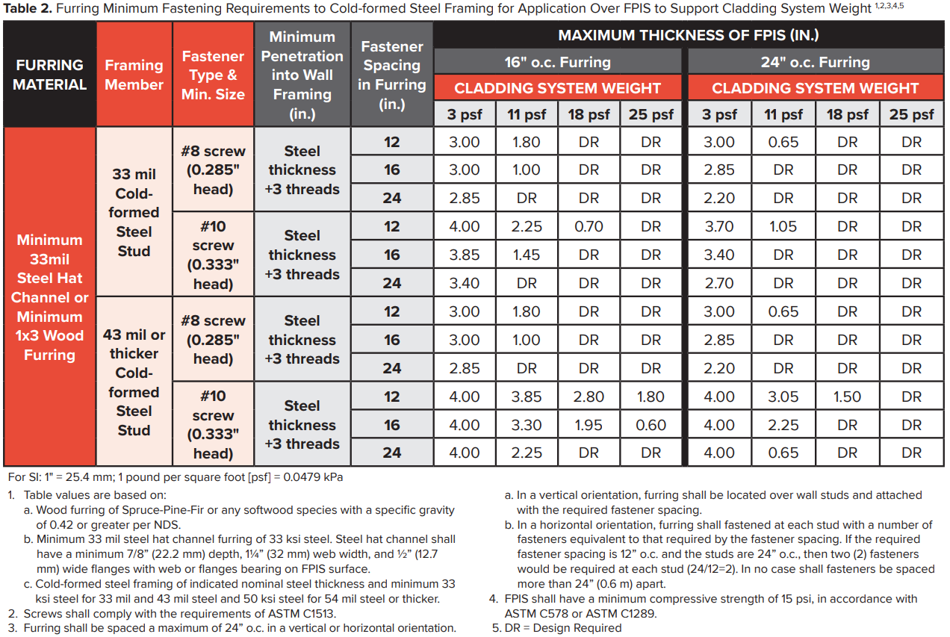
Prescriptive Solutions
Application 2 – Wood or steel furring attachment

Slide 45
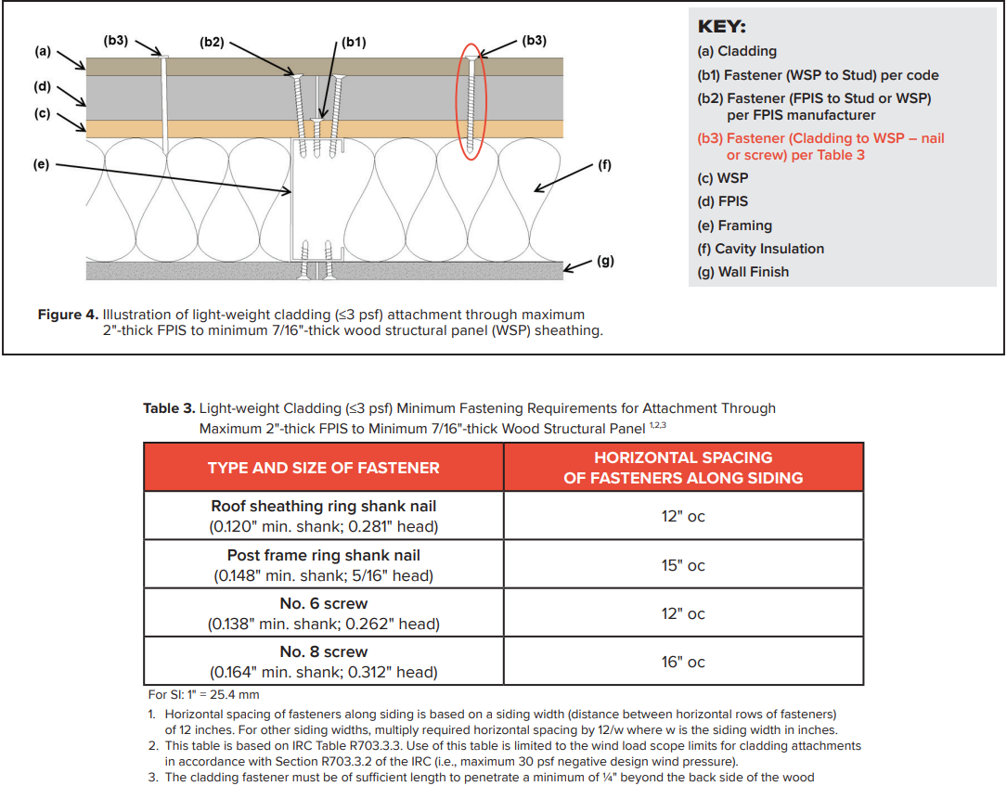
Prescriptive Solutions
Application 3 – Attachment to wood structural panel sheathing (not to studs)
  Limited to light-weight cladding (3psf or less)
  Limited to max. 2" thick FPIS (min. 15 psi)
  Limited to max -30 psf wind load (per scope of IRC)

Slide 46
Design Procedure (CFS wall framing)
Design of Connections through FPIS to Cold-formed Steel
  Tension allowable design values: Follows same procedure in AISI S100 for screw withdrawal capacity (just use longer screws)
  Shear allowable design values: Follows the same procedure in AISI S100, Section J4.3.1, but modifies Eq. J4.3.1.-1 by a gap reduction factor, Gr, as follows:
    For #10 screw in 54mil and 50 ksi steel: Gr = 0.17 – 0.0048 r
    For #10 screw in 43mil and 33 ksi steel: Gr = 0.19 – 0.0066 r
    For #8 or #10 screw in 33mil and 33 ksi steel: Gr = 0.16 – 0.0064 r
    Where,
      r = d_sep/d
      d_sep = thickness of FPIS separating connected steel parts
      d = nominal screw diameter (0.164” for #8, 0.190” for #10)
    Value of r shall not exceed 21.
    For 0<r<2, Gr need not be less than (1 – r/2)
    Material against screw head shall be minimum 33mil and 33ksi steel or minimum 3/8” thick wood or wood-based material with specific gravity of 0.42 or greater.

Slide 47
Design Procedure
Example Applications:
  Cladding and furring connections using alternative fasteners
  Load bearing structural component connections through FPIS (e.g., deck and roof ledgers attached to wall surface)
  Architectural component connections through FPIS (e.g., awning frames, shading devices, etc.)
  Structural sheathing connections through FPIS (placed under sheathing rather than over sheathing)
  Window and door frame anchorages where passing through a rough opening gap or through a layer of foam sheathing (e.g., conditions not addressed in fenestration manufacturer instructions)

Slide 48
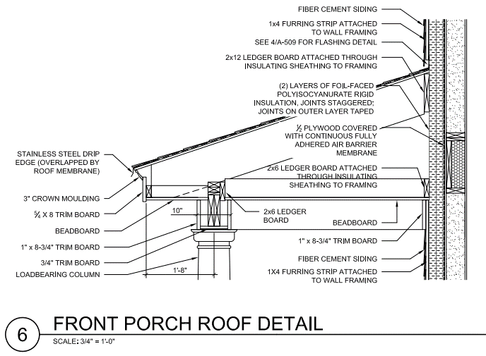
Design Procedure
Example structural connection application:

Slide 49

Other Designed or Manufacturer-Provided Details
Clip and rail systems for rainscreen cladding and ci
  Much better thermal performance than metal furring thermal bridge completely through ci
  But, still does not comply with ci definition
  Must account for thermal bridge effect of furring and clip
Source: http://www.sustainableminds.com/files/transparency/pgds/Part_B_Product_Group_Definition_Cladding_Support_Components_and_Systems_10312022.pdf

Slide 50

ANSI Standard for Continuous Insulation Applications
Scope
  Above-grade frame walls
  Labeling & Quality Assurance
  Wind resistance
  WRB (water resistance)
  Vapor Control
  Window installation
  Cladding installation
Addresses
  Performance criteria (design)
  Evaluation/testing criteria by application
  Prescriptive criteria (“cook-book” design and installation)
Exclusions
  Refer to locally applicable code for fire safety requirements
  (e.g., IBC Chapter 14 and 26; IRC Section R316)
  Use FPIS manufacturer data to demonstrate compliance (ASTM E84, ASTM E119, NFPA 285, etc. – as applicable)
https://www.appliedbuildingtech.com/standards

Slide 51
Conclusions
Building science fundamentals are important, are now addressed in newer model building codes, and are facilitated by various resources and on-line tools.
Fenestration installation practices have been evaluated & confirmed for use with FPIS ci (with appropriate limitations) and enabled in U.S. model codes.
  Provides means to minimize thermal bridging around fenestration openings.
  Fenestration interface with wall and ci must comply with NFPA 285 test data and engineering analysis for Type I – IV buildings.
Cladding connection design and fastening requirements have been extensively researched, design methods developed, and prescriptive solutions enabled in U.S. model codes.
New ANSI/ABTG FS200.1 standard available to provide comprehensive design and installation guidance in code-enforceable language for FPIS above-grade wall applications.
For more information on FPIS ci applications, guidance, and design tools for code compliance refer to www.continuousinsulation.org.

Slide 52
Thank you!
Questions?
Jay Crandell
jcrandell@aresconsulting.biz

